Slide 1


Operation Performance of the SIS100 Series Magnets Produced and Tested at the JINR for FAIR
ЭКСПЛУАТАЦИОННЫЕ ХАРАКТЕРИСТИКИ МАГНИТОВ СЕРИИ SIS100, ПРОИЗВЕДЁННЫХ И ИСПЫТАННЫХ В ОИЯИ ДЛЯ FAIR
E. Fischer, H. Khodzhibagiyan, Y. Bespalov, V. Borisov, E. Iskornev, D. Khramov, B. Kondratiev,
D. Nikiforov, T. Parfylo, M. Petrov, A. Shemchuk, D. Zolotykh
JINR, Dubna, Russia
http://sarantsev22.jinr.ru
2022 September 20-25
Alushta, Crimea

Slide 2
Outline
Introduction
Nuclotron Magnets as Starting Point
      R & D for the fast ramped sc Magnets
      Prototypes for the SIS100 Main Magnets
Series Production and Testing for SIS100 at JINR
      Design of the Quadrupole Units
      Production Status
      Test Results and Operation Performance
Summary

Slide 3

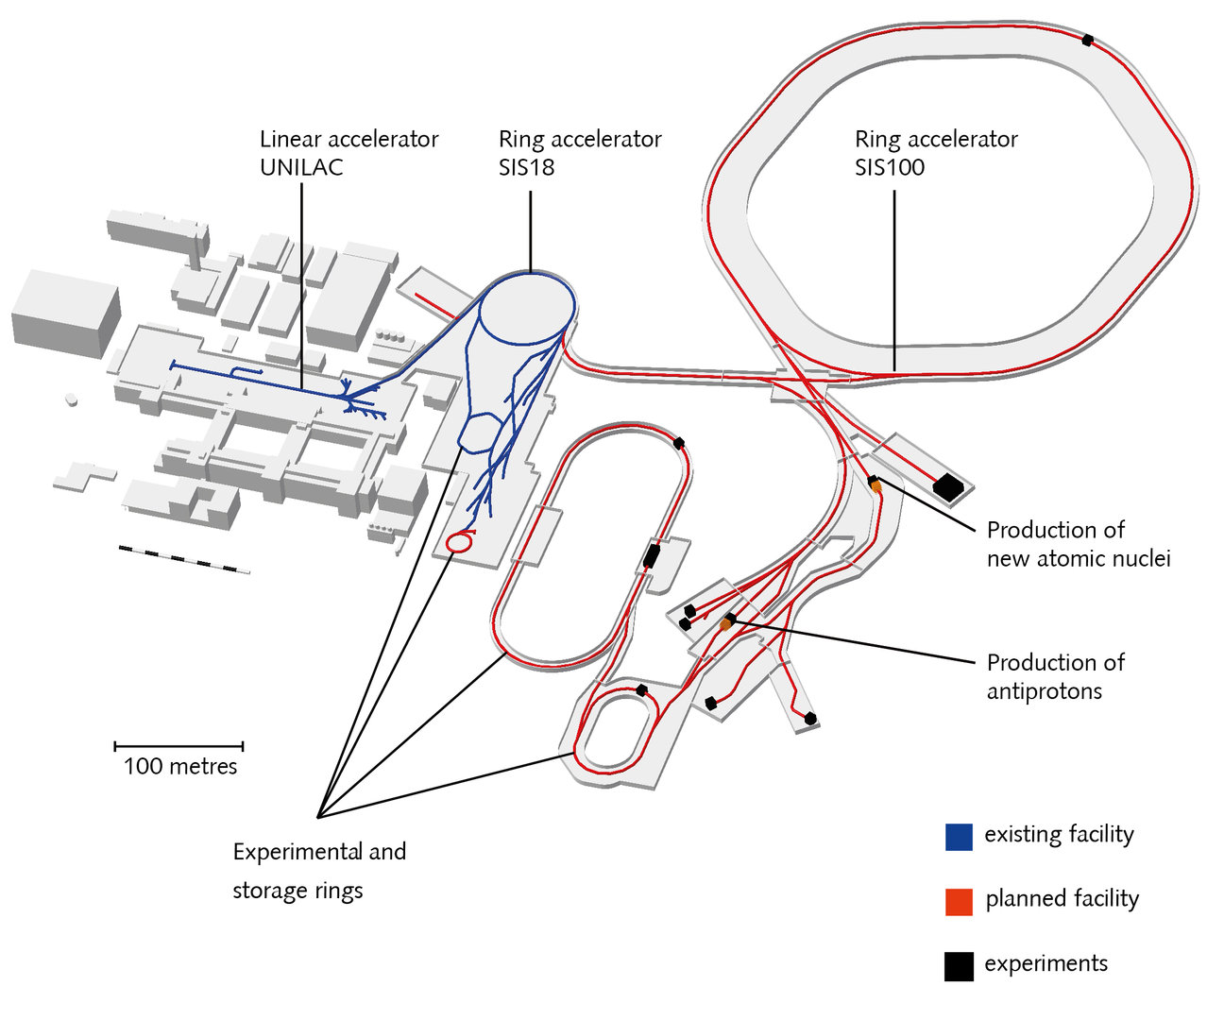
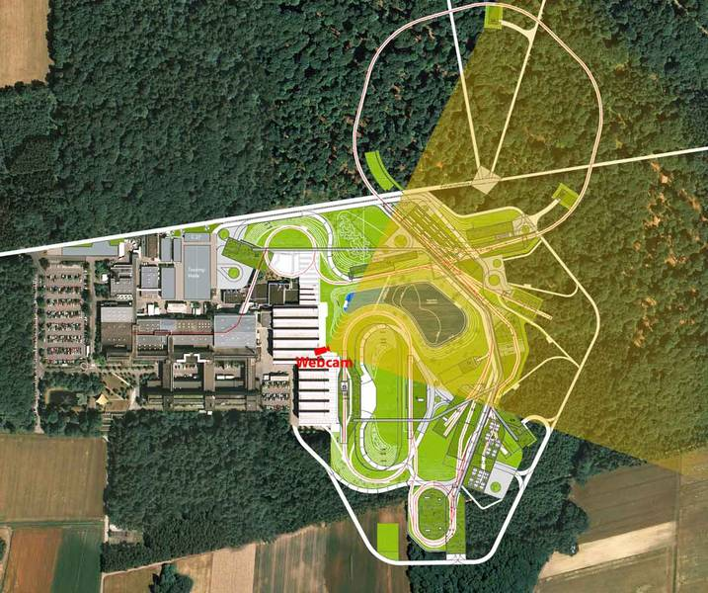
Introduction: SIS100 – the core component
Heavy Ion Synchrotron with superconducting magnets
100 Tm rigidity
B_{max} = 1,9 T, ^{dB}/_{dt} = 4 T/s, f_{cycle} = 1 Hz
1100 m circumference
sc dipoles
sc quadrupoles
sc correctors
cold beam pipe:
vacuum quality critical for
beam lifetime: < 10⁻¹² mbar
www.fair-center.eu

Slide 4
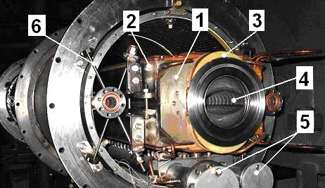
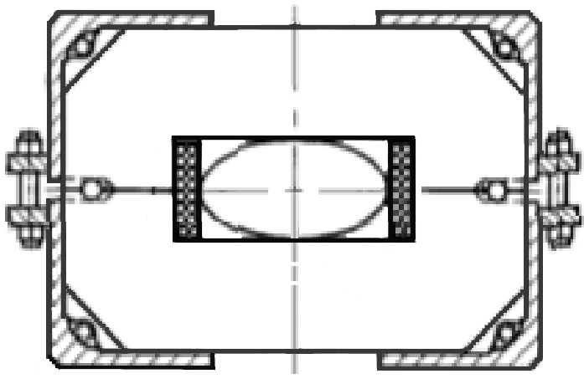
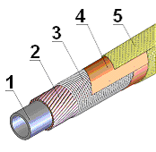
Nuclotron Magnets as Starting Point
Basic Design: Nuclotron Type Magnet
for SIS100 Dipole development
super-ferric, window-frame
sc coil (Nuclotron type cable)
coil and yoke cooled by forced flow of two-phase He @ 4.5 K
B_{max} = 1.9 T
dB/dt = 4 T/s
fast ramping ~ 1 Hz
field homogeneity ± 6·10⁻⁴
200
55
110
Nuclotron cable:
292
1 - сooling tube CuNi
2 - sc wire NbTi
3 - CrNi wire
4 - rapton tape
5 - glasfiber tape
Nuclotron Dipole
1 - yoke end plate, 2 – brackets,
3 - coil end loop, 4 - beam pipe,
5 - helium headers, 6 – suspension.

Slide 5
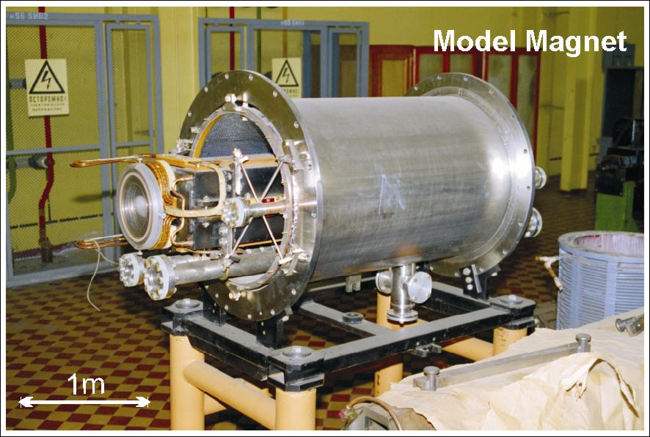
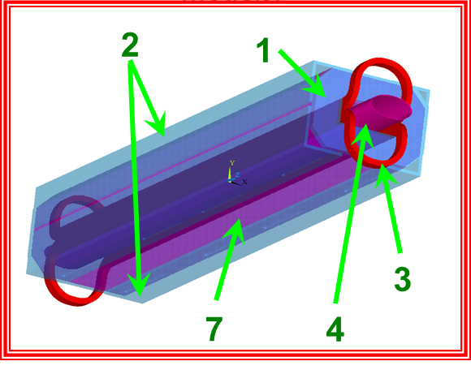
      R & D for the fast ramped sc Magnets
The magic triangle
Reduce effects due to the high ramp rate:
  lower loss at 4 K in
  wire, cable, iron and beam pipe
Improve magnetic field quality
by modification of the iron yoke
Improve mechanics
to guarantee
≥ 5⋅10⁸ cycles for
20 years lifetime at 1 Hz
Test measurements on magnet modifications
FEM calculations on detailed 3D-models
Main reasons for superconducting SIS100:
- Capital and operating costs
- High current Uranium beam modes with intermediate charge states, require ultra low vacuum pressures which can be achieved in long term operation only by cold beam pipes acting as a cryopump with stable temperatures well below 15 K for all operating cycles
Cold mass of the Nuclotron dipole:
1 - yoke end plate
2 - brackets
3 - coil end loop
4 - beam pipe
5 - helium headers
6 - suspension
7 - laminated yoke

Slide 6
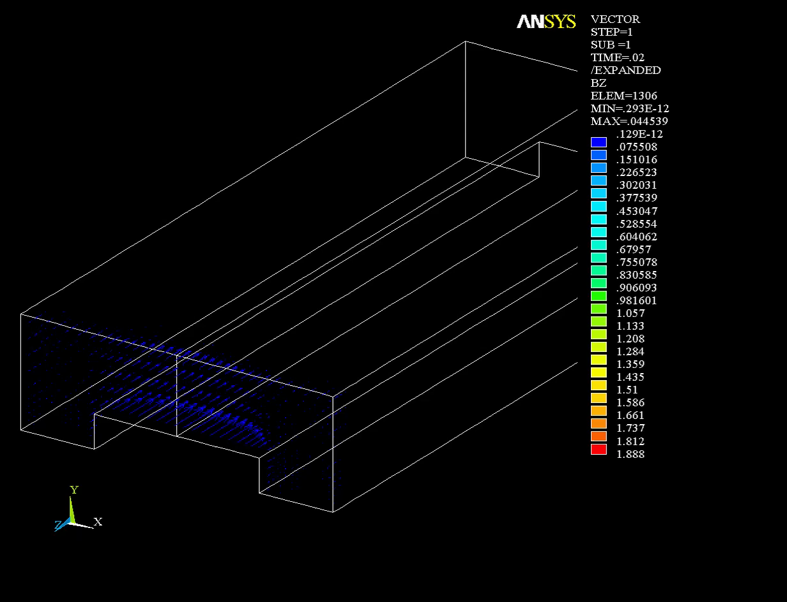
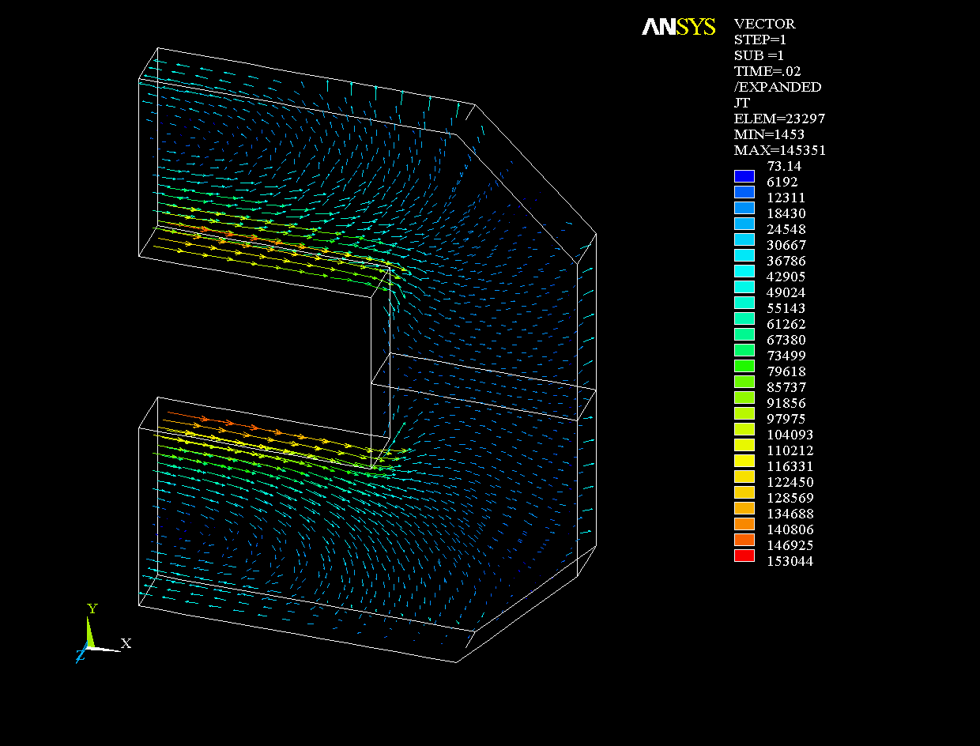
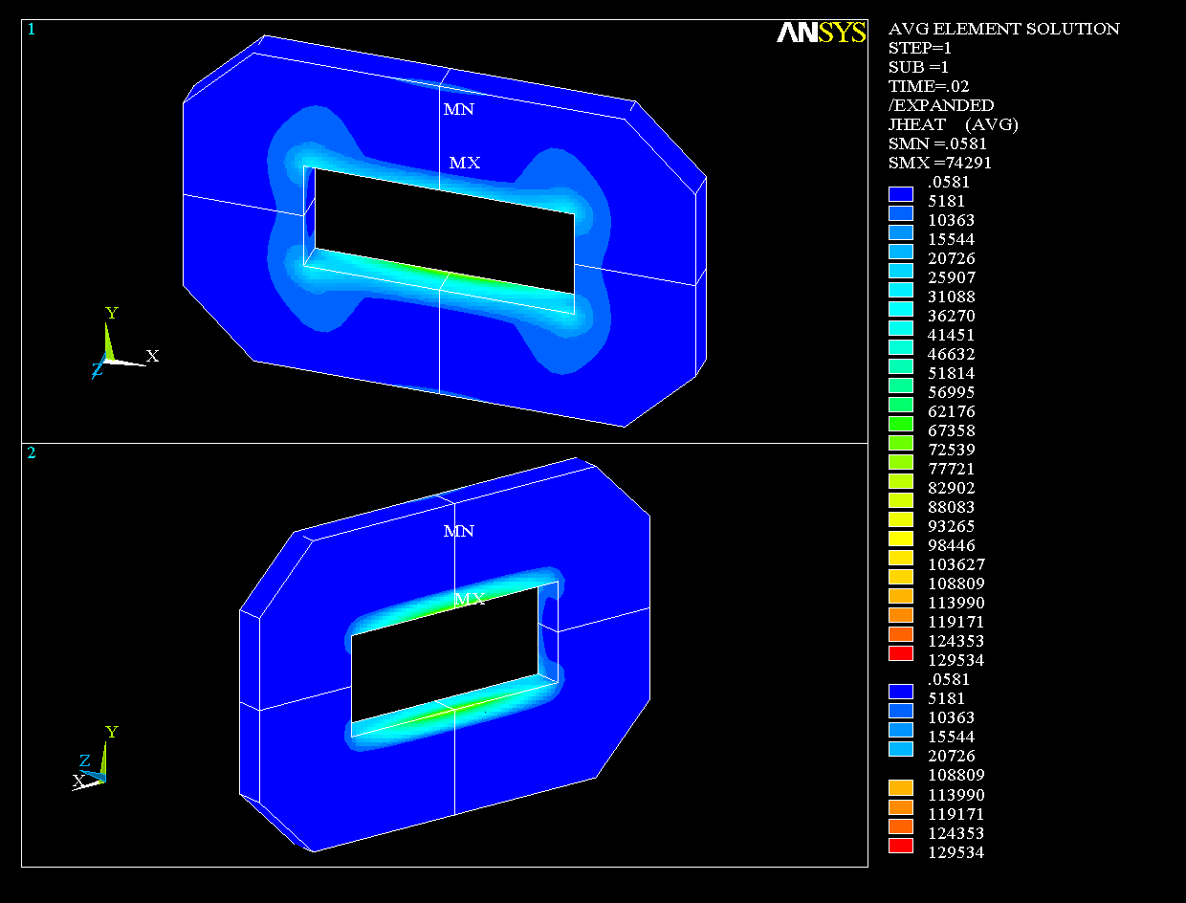
      R & D for the fast ramped sc Magnets
  AC loss reduction: FEM Calculations
Loss density in the end plate:
Replace by nonmagnetic, high resitive material
Vectors of the longitudinal induction B_{Z}(t) in the yoke

Slide 7
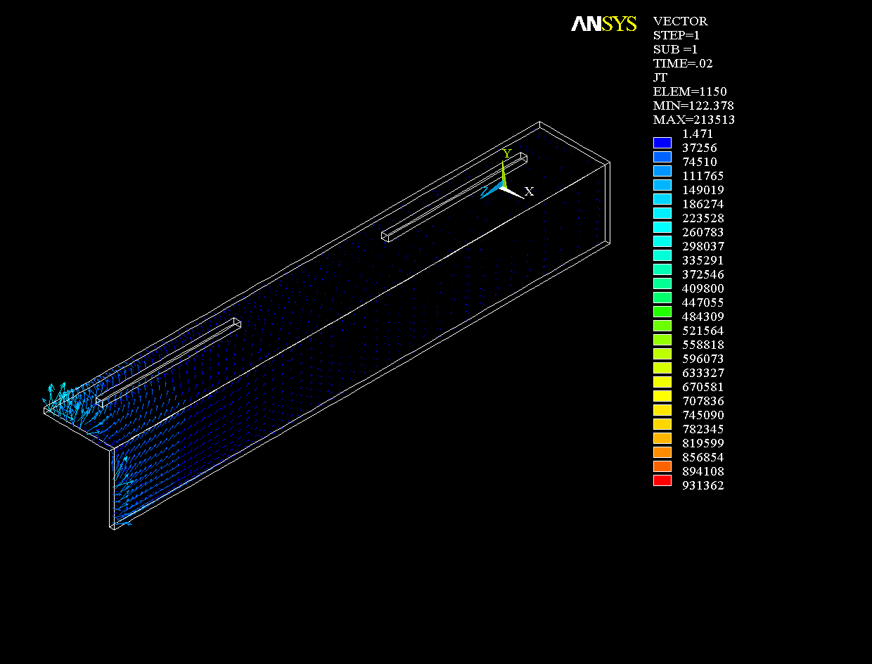
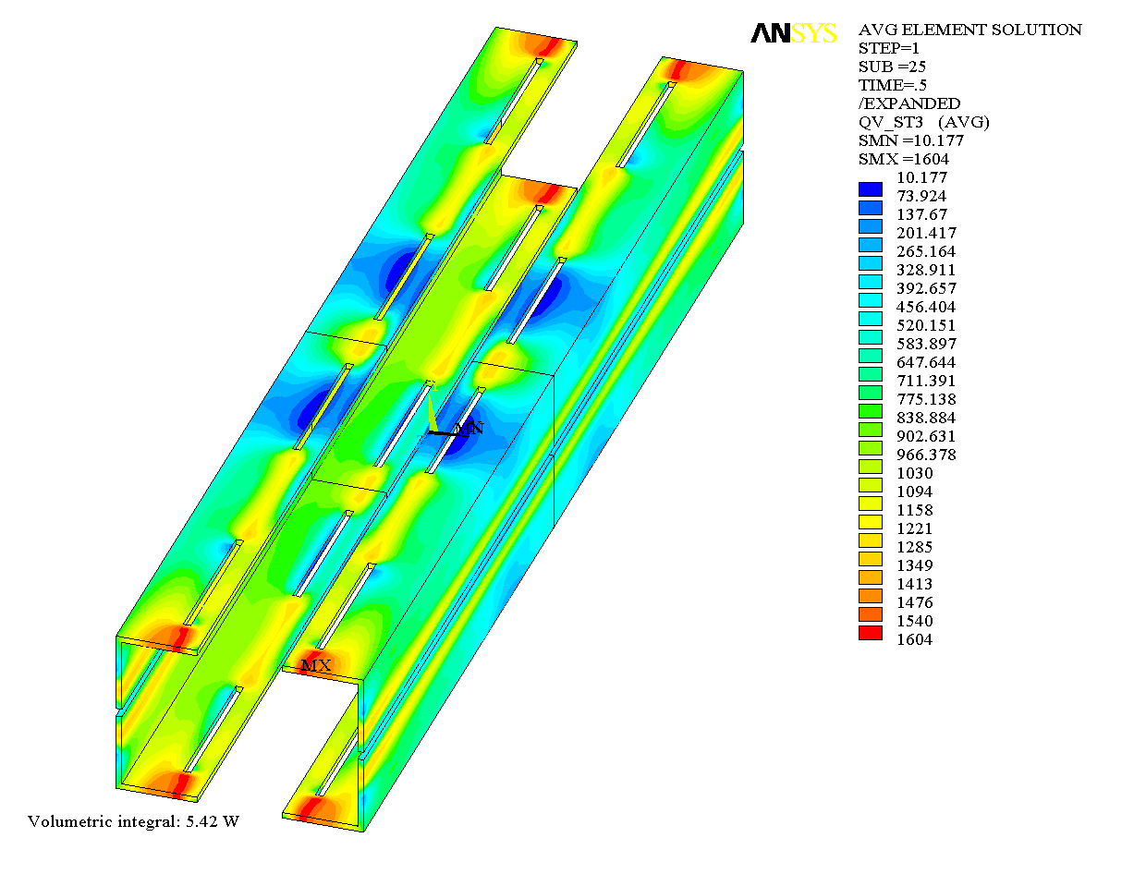
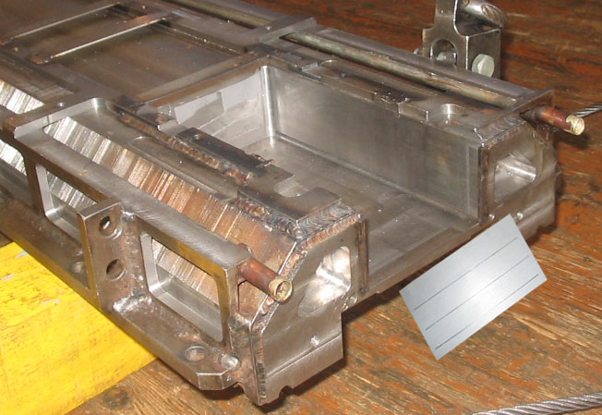
      R & D for the fast ramped sc Magnets
      R & D for the fast ramped sc Magnets
  AC loss reduction: FEM Calculations
Hysteresis loss in the brackets
Vectors of eddy current density in brackets during triangular current cycle
=> AC loss in the yoke restraint

Slide 8
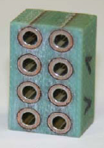
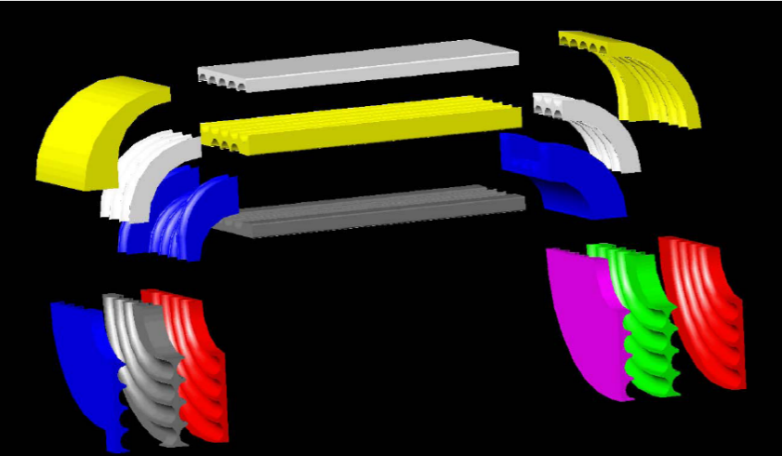
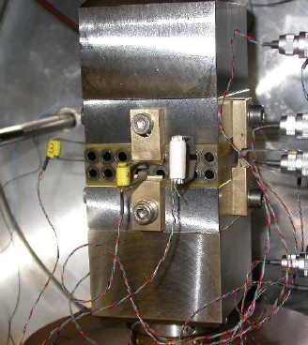
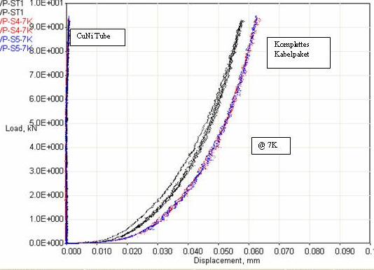
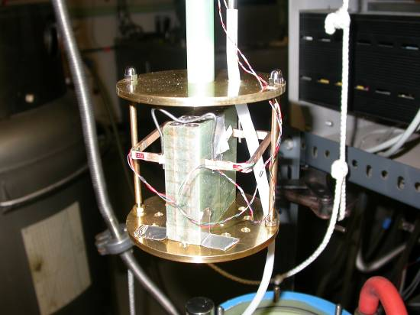
      R & D for the fast ramped sc Magnets
Coil Mechanics
Analysis of:
Wire and cable design
Insulation concept
Winding scheme
Technological optimization
ANSYS Models
Substrate: comb or block
Model coils production
Mechanical tests
stress strain load tests on the
complete coil winding pack:

Slide 9
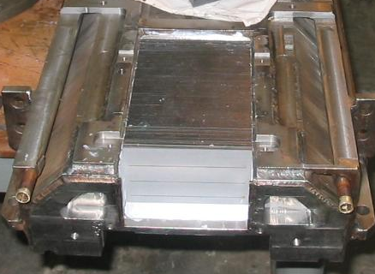
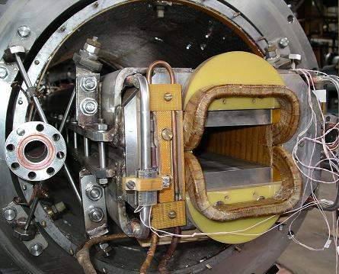
      Prototypes for the SIS100 Main Magnets
  AC loss reduction: Test Models
1
4
2
1
3
0.1mm laser cut
Modificated Nuclotron dipoles with:
1▲ partly removed brackets and end plates
2▲ and laser cut lamination slits
3▲ stainless steel brackets and end plates
4▲ reduced coil end shape

Slide 10
      Prototypes for the SIS100 Main Magnets
AC Loss Reduction for the Nuclotron DP
original
wire
new wire
1. Removed brackets (of made from SS)
2. Laser cut lamination slits
3. Minimized coil ends
4. New sc wire design !
5. Next change: to laminated isotropic 1.0 mm thick M600-100A silicon steel

Slide 11
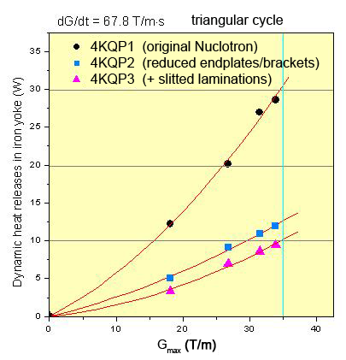
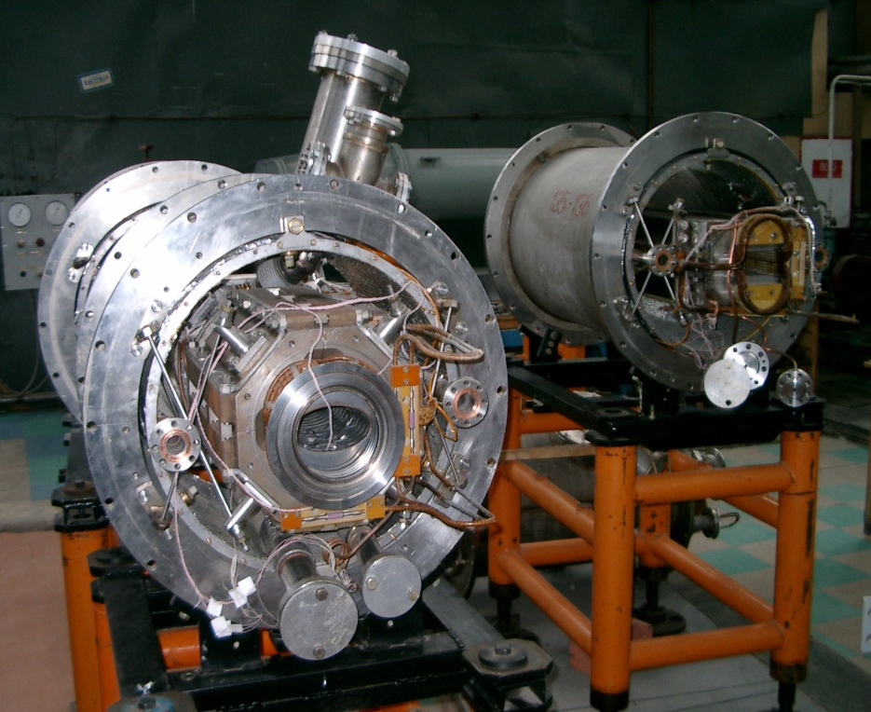
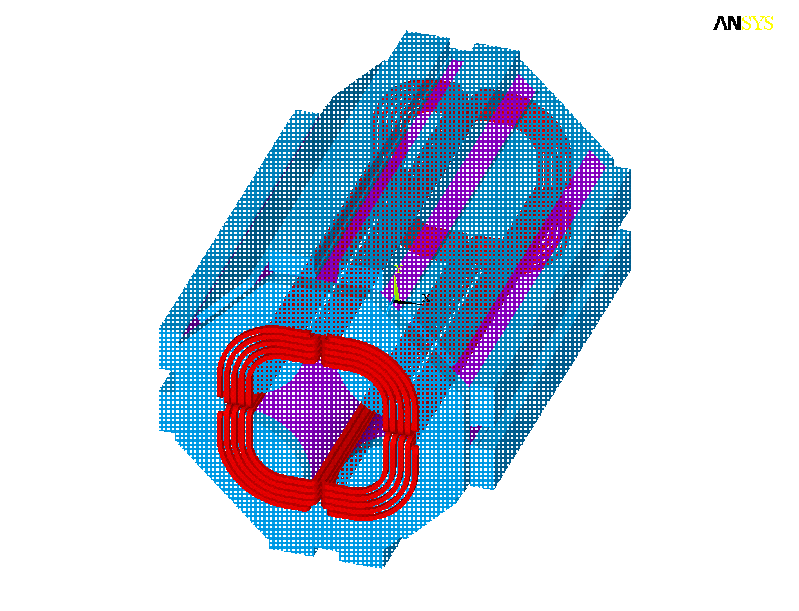
      Prototypes for the SIS100 Main Magnets
  AC loss reduction:
  Test on Quadrupole
▲Test measurements on quadrupole modifications
◄ FEM calculations on detailed 3D-models
Nuclotron Quadrupole :
Nominal gradient: 34 T/m
Ramp rate: 68 T/m⋅s

Slide 12
      Prototypes for the SIS100 Main Magnets
  New Generation of Superferric Magnets: SIS100 Dipole Design
Significant differences between Nuclotron-type Model Dipole and the SIS100 First of Series Magnet:
2-layer straight magnet → 1-layer curved magnet
Main Advantages:
Reducing the size of the cross section of the magnet, and consequently reducing losses and hydraulic resistance
Reduction of peak field to 1.9 T
→ reduction of field errors due to reduced iron saturation
Low loss sc wire (CuMn matrix)
New challenges in manufacturing:
winding of curved coil and stacking of curved yoke
increased cable diameter reduced available space for electrical insulation and structural components in the coil
Parameter | N-type | FoS
Effective length | 2.756 m | 3.062 m
Bending angle | 0 deg | 3.33 deg
B_{max} | 2.1 T | 1.9 T
Max. ramp rate | 4 T/s | 4 T/s
Layers*turns | 2*8 | 1*8
Operating current | 7 kA | 13 kA
Outer diameter of the cooling tube | 5 mm | 5.7 mm
Number of strands | 31 | 23
Strand diameter | 0.5 mm | 0.8 mm
Cable diameter | 7.36 mm | 8.29 mm

Slide 13
      Prototypes for the SIS100 Main Magnets
  New Generation of Nuclotron-Type Dipoles
 | GSI | NICA | NICA
 | SIS100 | Booster | Collider
cable
tube inner diameter | 4.7 | 3 | 3 | mm
number of strands | 21 | 18 | 16
critical current (at 2.5 T and 4.5 K) | 19.8 | 14.2 | 16.8 | kA
dipole
ﬁeld strength | 1.9 | 1.8 | 1.8 | T
ﬁeld ramp rate | 4 | 1.2 | ≤ 0.5 | T/s
pole gap height | 68 | 64 | 70 | mm
magnet length | 3.1 | 2.2 | 1.94 | m
curvature radius | 52.625 | 14.090 |  | m
operation current | 13.1 | 9.68 | 10.4 | kA
inductance | 0.55 | 0.63 | 0.45 | mH
maximum AC loss | 100 | 8.4 | 8 | W
→
→
→

Slide 14
Series Production and Testing at JINR
All SIS100 lattice quadrupole and corrector magnets have to be made in JINR, Dubna. The 108 main dipoles are in the responsibility of GSI, Darmstadt.
Characteristics of the magnets
Characteristic | Lattice Quadrupole | Corrector magnet
 |  | Multipole (Q/S/O) | Steerer | Chrom. Sextupole
Number of magnets | 166 | 12 | 84 | 42
Max. field strength, T/m^{n-1} | 27.77 | 0.75/25/333,3 | 0.37 | 232
Effective magnetic length, m | 1.264 | 0.75 | 0.403/0.41 | 0.383
Aperture diameter, mm | 100 | 150 | 135 | 120
Operation current | 10512 | 250/246/240 | 245/241 | 252
Magnet weight, kg | 850 | 200 | 120 | 145

Slide 15
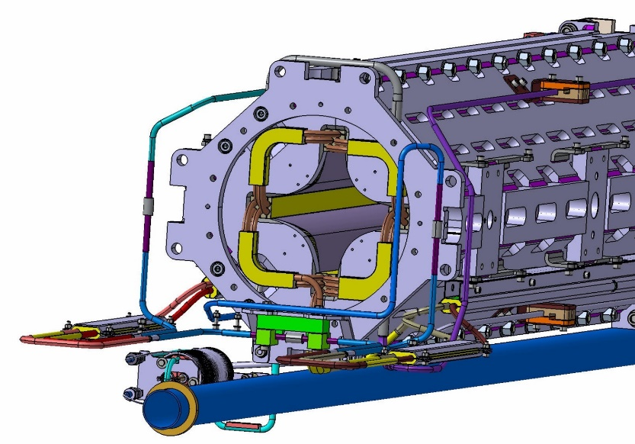
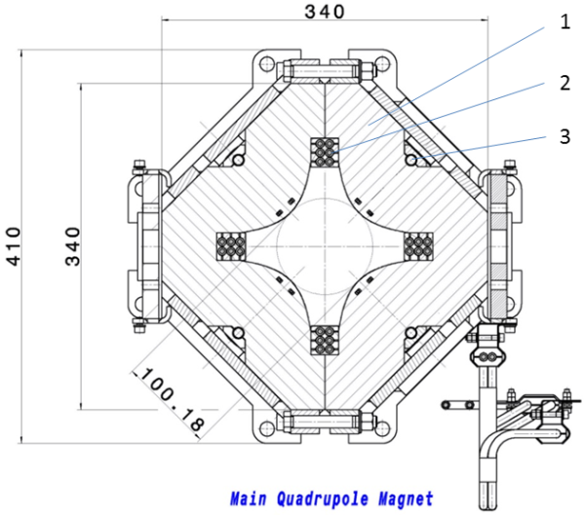
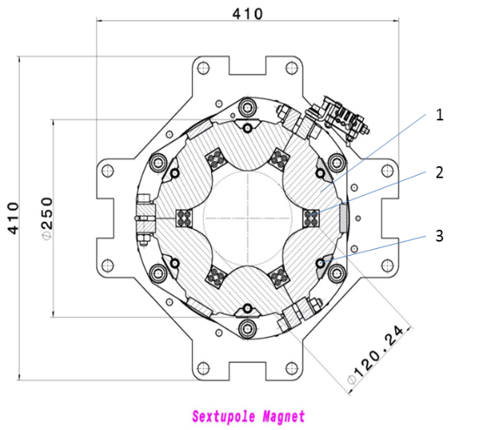
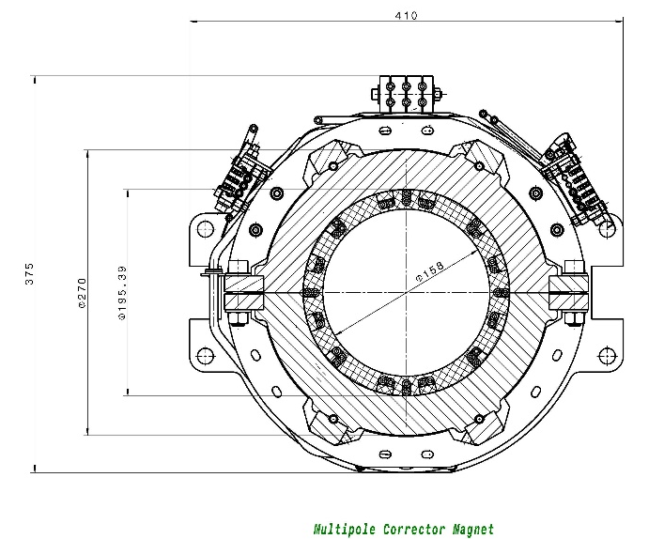
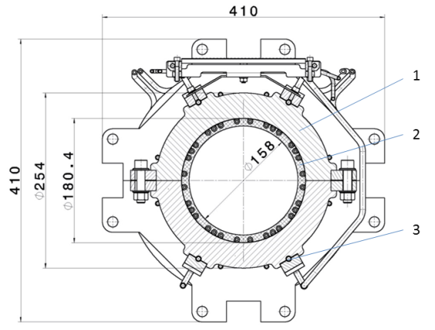
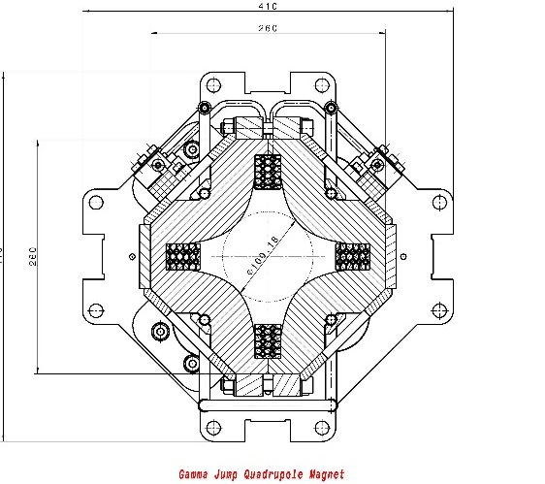
      Design of the Quadrupole Units
Main Quadrupole
Sextupole
Steerer
Multipole Corrector
Gamma Jump Quadrupole

Slide 16
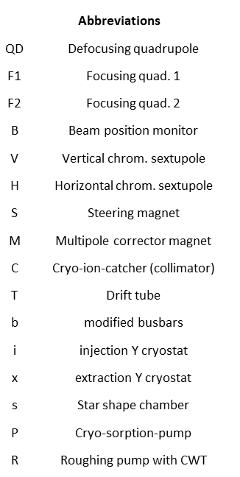
      Design of the Quadrupole Units
Quadrupole Units and Doublet Modules
Unit Configuration |  |  | Doublet Configuration
Upstream | Centre | Downstream | Joined Name | Short Name | Quantity
QDB | -TRP- | SF2 | QDB-TRP-SF2 | 2.123 | 15
QDBs | -TRP- | SF2s | QDBs-TRP-SF2s | 2.13s | 2
QDBb | -T- | SF2Mb | QDBb-T-SF2Mb | 2.4 | 5
QDBx | -T- | SF2Mx | QDBx-T-SF2Mx | 2.4x | 1
VQD | -CR- | SF2B | VQD-CR-SF2B | 2.5 | 6
BQD | -C- | SF1H | BQD-C-SF1H | 1.6A | 12
VQD | -CR- | SF1B | VQD-CR-SF1B | 1.7B | 12
BQD | -C- | SF2H | BQD-C-SF2H | 2.8C | 12
BQD | -CR- | SF2J | BQD-CR-SF2J | 2.9D | 12
MQDb | -C- | SF1Bb | MQDb-C-SF1Bb | 1.E | 5
MQDi | -C- | SF1Bi | MQDi-C-SF1Bi | 1.Ei | 1
 |  |  | Total |  | 83
Example: Type 2.5
Unit (type SF2B)
Integrated QDM
Doublet (cold mass)

Slide 17
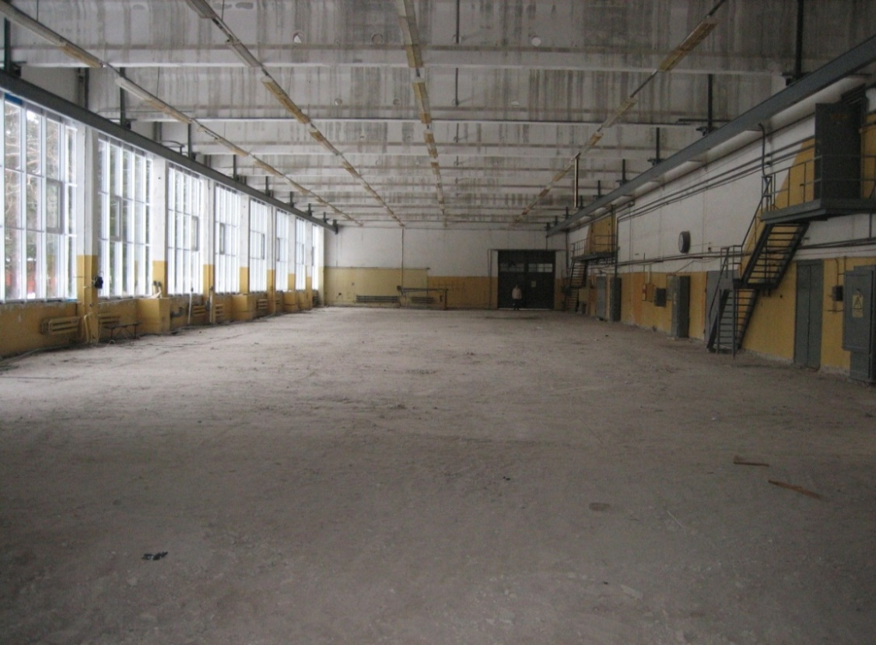
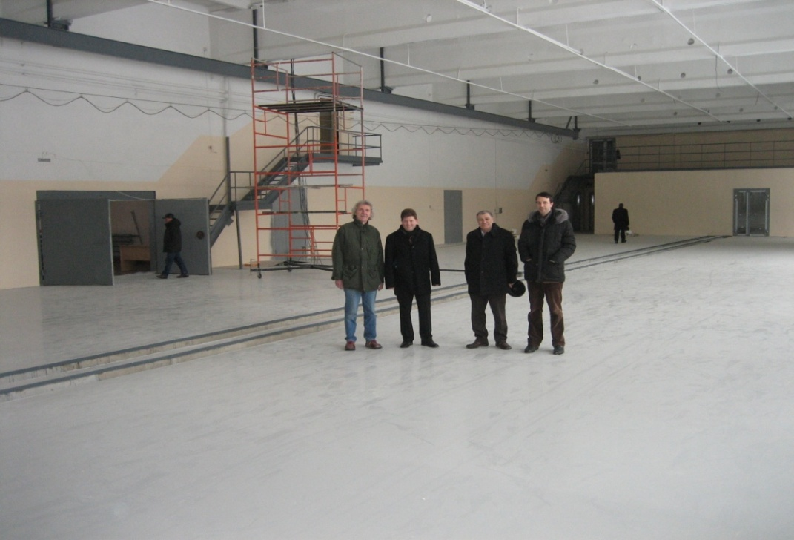
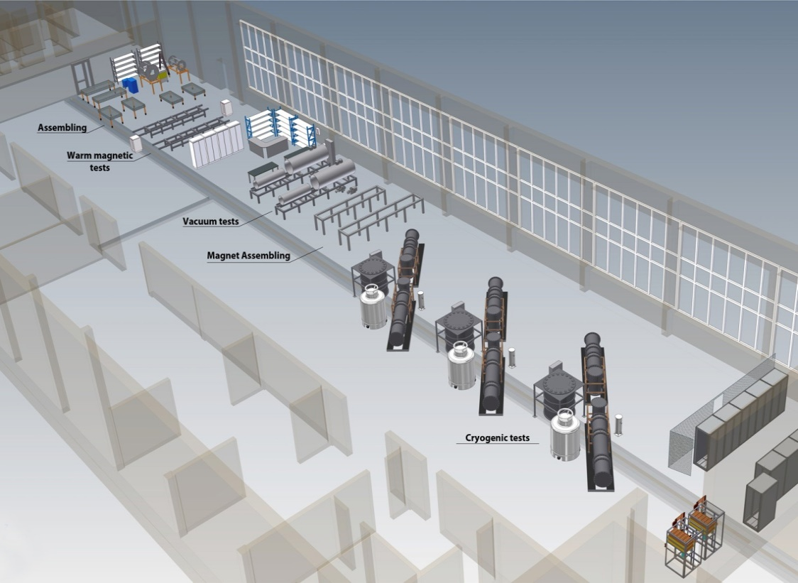
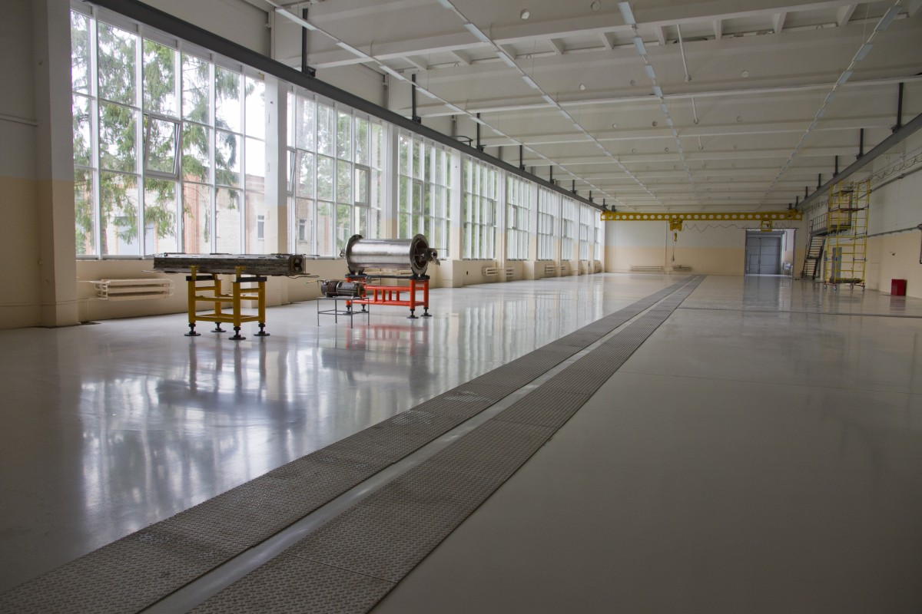
SC Magnet Production and Testing
for NICA and FAIR
Test facility at JINR
December 2010
February 2012
September 2012
Scheme of the new SC-magnet test facility at JINR Dubna
1600 m² main hall
700 m² auxiliary facilities
Egbert Fischer, MAC-7 Meeting, 2-3 April 2012, Jülich
17
Notes:
17

Slide 18
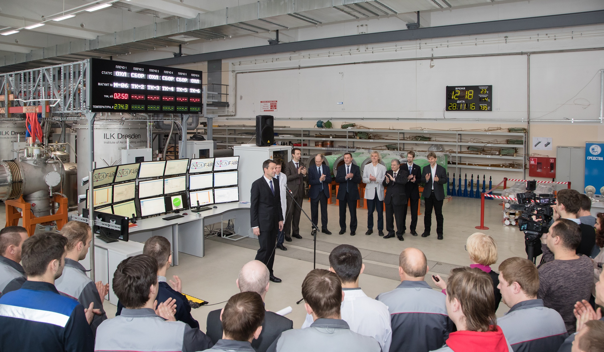
Opening Ceremony for the Production and Test Facility
28.11.2016

Slide 19
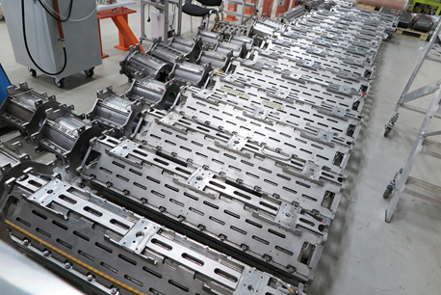
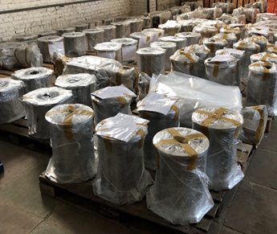
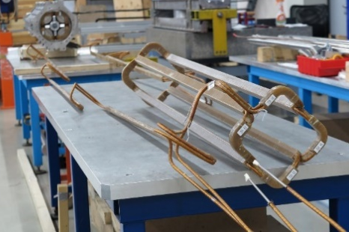
      Production Status
Magnet yokes
Magnet type | at JINR | Completion % | Incoming inspection pass
Quadrupole | 173 | 100 | 173
Sextupole | 85 | 100 | 85
Steerer | 44 | 100 | 44
Superconducting coils
Magnet type | Produced at JINR | Completion % | Incoming inspection pass
Quadrupole | 53 | 32 | 53
Sextupole | 24 | 30 | 24
Steerer | 27 | 61 | 27

Slide 20
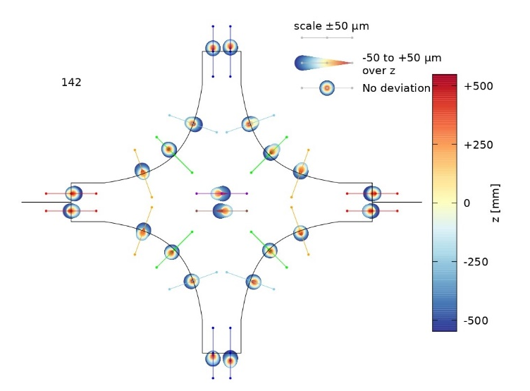
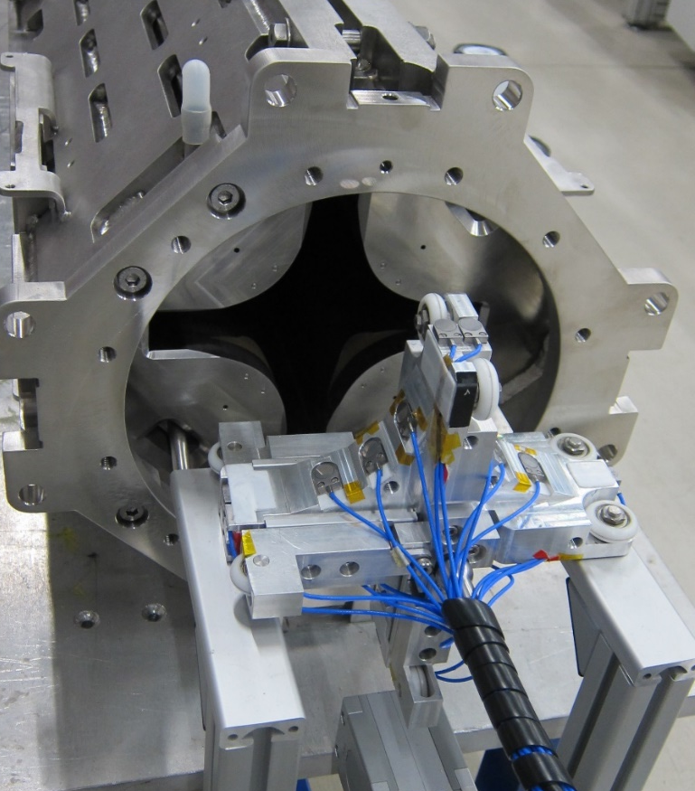
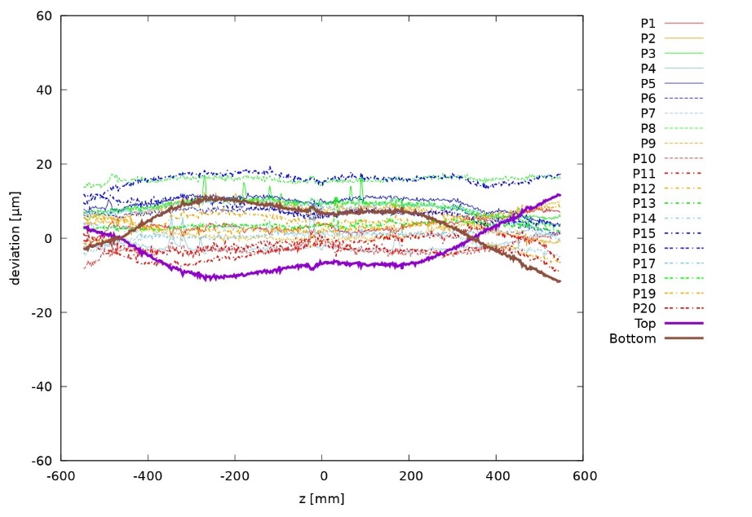
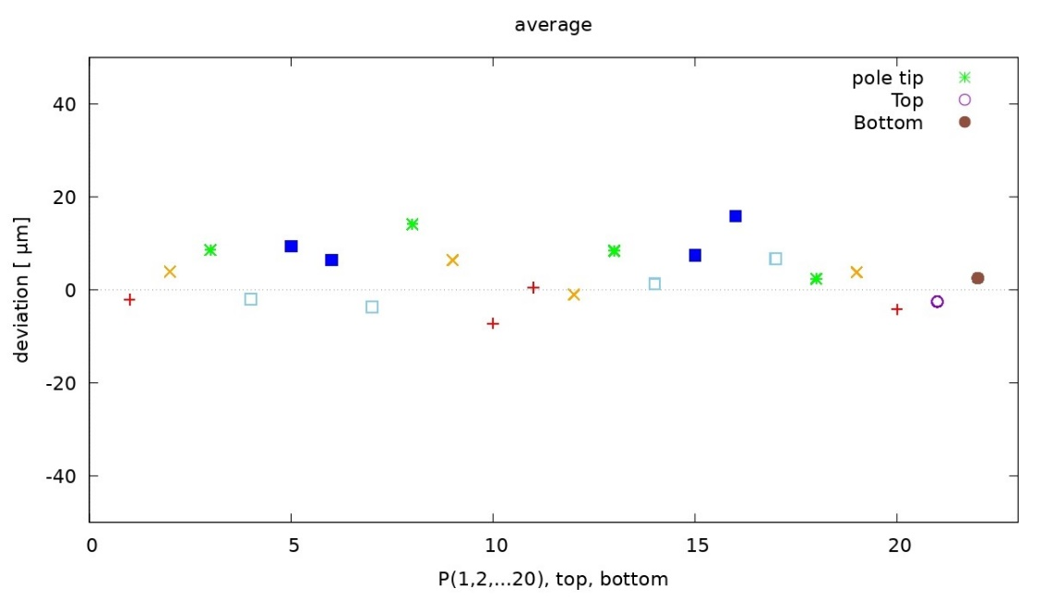
      Production Status: Quality Control
Typical example for geometrical proof of QP aperture
All quadrupole apertures are within the specification

Slide 21
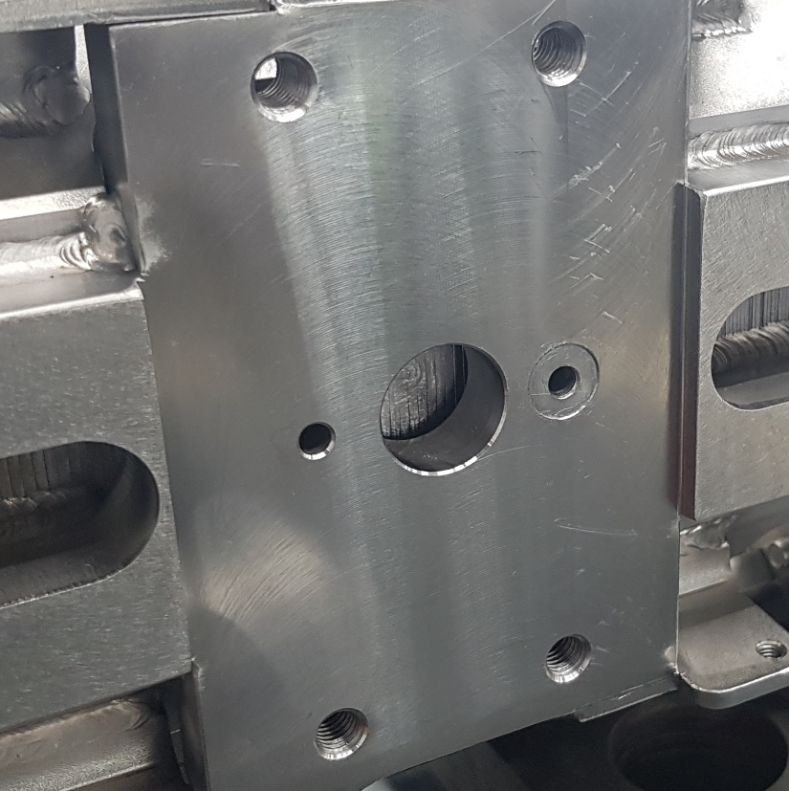
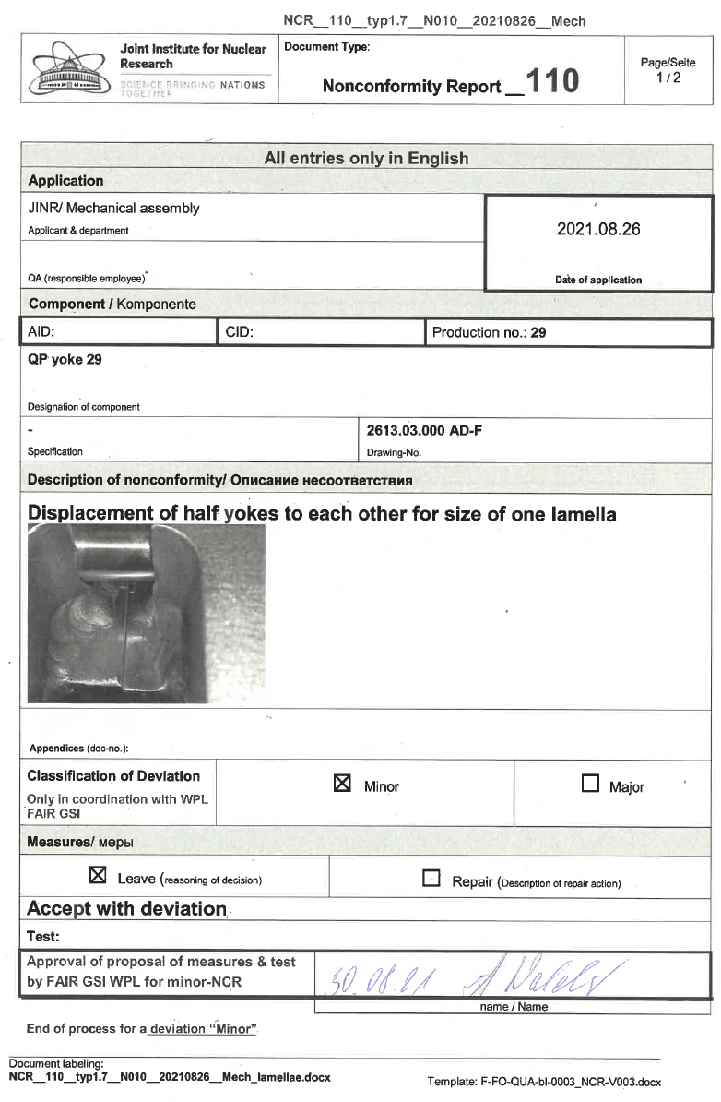
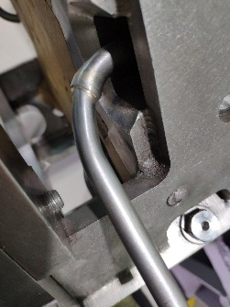
      Production Status
Quality improvement
In the process production appears nonconformity of design documentation and issued Nonconformity Report (NCR)

Slide 22
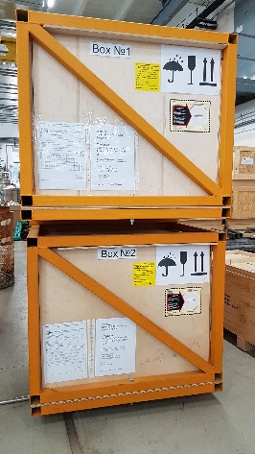
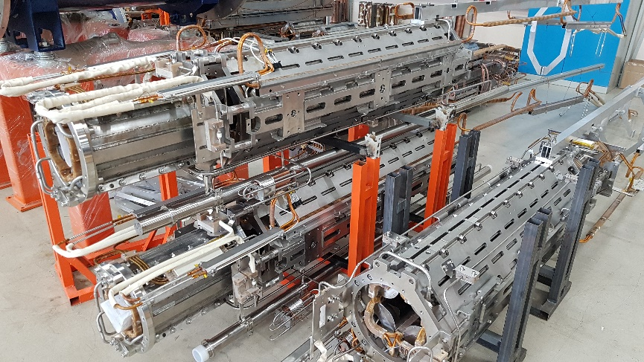
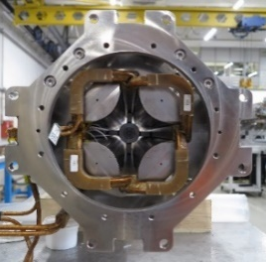
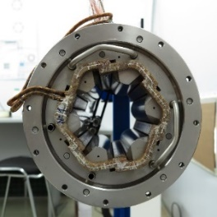
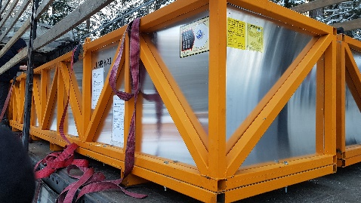

      Status: Production, Testing and Delivery
Magnet and Unit assembling and testing
Units | Ready for test | Ready for delivery | Delivered | Completion %
Series 2.5 | - | - | 12 | 100
Series 1.7B | 2 | 6* | 16 | 92
Series 1.6A | 12 | 0 | 0 | 25
Series 2.8C | 0 | 0 | 0 | 0

Slide 23

      Status: Production, Testing and Delivery
Delivery schedule for SIS100
Actions for high test intensity of the QPUs
Month | 2020 | 2021 | 2022 | 2023
January |  | CV-19
February |  | CV-19 |  | 4
March |  |  | 8* | 6
April |  | 8 |  | 8
May |  |  | 8 | 8
June |  |  |  | 8
July |  |  | 8 | 8
August |  |  |  | 8
September | 2 | 8 | 8 | 8
October |  |  | 8 | 8
November | 2 |  | 8 | 8
December | CV-19 | 8 | 8 | 8
Subtotal | 4 | 24 | 56 | 82
- The rate of unit cryogenic testing was planned to
increase from 4 units per month in February 2022
to 8 units per month in October 2022.
- Completion of testing of all 166 units was planned for December 2023.
- Delivered
- Delay (Covid)
* Contract freeze by FAIR

Slide 24



      Test Results and Operation Performance
Magnetic Axis Measurements @ RT using vibrating wire technique

Slide 25




      Test Results: QPs Magnetic Axis
QPU of the VQD type (QP + Sextupole)

Slide 26




      Test Results: Training of the Quadrupole Magnets
Typical cool down scenario for QPUs
Preparation of a SIS100 Quadrupole Unit for cold tests
Current cycle for magnet training

Slide 27






      Test Results: Learning curve for magnet production
Training Statistics of the Series Quadrupoles
Training current = 12.6 kA
Operating current = 10.5 kA
$$Q\left(N\right)=Q0{∗exp}^{(− \frac{N}{NL})}$$
RMS distribution quenches of training current = 5..6
RMS distribution quenches of operating current = 2
Learning curves (training current)
$Q0$ = 58;
$NL$ = 14;
Learning curves (operating current)
$Q0$ = 34;
$NL$ = 24;
Nummer of the magnets
Batch 1 (Type 2.5)
Batch 2 (Type 1.7B)
Batch 3 (Type 1.6A)

Slide 28




      Test Results: Training and Cooling Rates
Control of the cooling rate is important for mechanical stability and so for magnet field quality !

Slide 29





      Test Results: AC Losses at 4,5 K
Heat release matrix for the quadrupole
Steerer

Slide 30


      Operation Performance
Gradient dependence of the Mean Integrated Transfer Function, errors give the standard deviation within the series. The inset graph shows ITF distribution of 29 series quadrupoles at 900 A.
sextupole

Slide 31
      Operation Performance
Integral Multipoles of the Quadrupole Magnets
Relative variations of gradient at the center of quadrupole magnets vs. yokes production sequence
Current dependence of the b₆ mean value and their standard deviation

Slide 32
Gradient dependence of the standard deviation of the field integral variation
      Operation Performance
Relative variations of the integral gradient vs. production sequence of the quadrupole yokes
Distribution of the relative variations of the integral gradient

Slide 33
Summary
All the iron yokes for the 173 quadrupoles, 85 sextupoles and 44 steerer magnets were manufactured and had passes the incoming inspection.
A stable production, testing and approval process was established in 2021.
About 35% of the work on the manufacture and cryogenic testing of SIS 100 quadrupole units was completed by the beginning of 2022.
JINR had fulfilled all the necessary organisation and practical conditions to complete its SIS100 contracts by end of 2023 timely and with high quality.
Beginning of March this year the contract work was frozen by FAIR management referring to political decisions.

Slide 34

Thank you for your attention !
Additional slides - Main References:

Slide 35
References (1/6)
[1] G. Moritz, C. Muehle, M. Anerella, A. Ghosh, W. Sampson, P. Wanderer, E. Willen, N. Agapov, H. Khodzhibagiyan, A. Kovalenko, W.V. Hassenzahl, M.N. Wilson “Towards fast-pulsed superconducting synchrotron magnets”, Proc. of the 2001 Particle Accelerator Conf., Chicago, pp.211-213.
[2] A. D. Kovalenko, N.N. Agapov, H. G. Khodzhibagiyan,…,et all “Superconducting fast-cycling dipole magnets for the GSI future accelerator facility”, Proceedings of EPAC 2002, Paris, pp.2406-2408.
[3] Kovalenko A, Agapov N, Khodzhibagiyan H and Moritz G “Fast cycling superconducting magnets: new design for ion synchrotrons”, Physica C: Superconductivity, Volumes 372-376, Part 3, August 2002, Pages 1394-1397 (EUCAS 2001)
[4 ] N. Agapov, S.A. Averichev, A.M. Donyagin, I. Eliseeva, I. Karpunina, H.G. Khodzhibagiyan, A. D. Kovalenko, G.L. Kuznetsov, V.N. Kuzichev, G. Moritz, C. Muehle, P. Nikitaev, and A. Starikov “Experimental study of a prototype dipole magnet with iron at T=80 K for the GSI fast cycling synchrotron”, IEEE Trans. Appl. Supercond., vol. 12, N1, 2002, pp.116-119.
[5] A. D. Kovalenko, A. Kalimov, H.G. Khodzhibagiyan, G. Moritz, and C. Muehle, “Optimization of a superferric Nuclotron type dipole for the GSI fast pulsed synchrotron”, IEEE Trans. Appl. Supercond., vol. 12, N1, 2002, pp.161-165.
[6] A. Kovalenko, N. Agapov, S. Averichev, A. Donyagin, H. Khodzhibagiyan, G. Kuznetsov, A. Starikov, G. Moritz, E. Fisher, G. Hess, and C. Muehle “Superferric model dipole magnet with the yoke at 80 K for the GSI future fast cycling synchrotron”, IEEE Trans. Appl. Supercond., vol. 13, N2, 2003, pp.1335-1338.
[7] Alexandre D. Kovalenko, Nicolay N. Agapov, Vladimir G. Aksenov, Irina E. Karpunina, Hamlet G. Khodzhibagiyan, Grigori L. Kuznetsov, Michail A. Voevodin, Gebhard Moritz, Egbert Fisher, Guenter Hess, and Carsten Muehle “Progress in the design and study of a superferric dipole magnet for the GSI fast-pulsed synchrotron SIS100”, IEEE Trans. Appl. Supercond., vol. 14, N2, 2004, pp.321-324.
[8] A. Kovalenko, N. Agapov, A. Donyagin, I. Eliseeva, H. Khodzhibagiyan, G. Kuznetsov, A. Smirnov, G. Moritz, E. Fisher “Design and study of a superferric model dipole and quadrupole magnets for the GSI fast-pulsed synchrotron SIS100”, Proc. EPAC 2004, Lucerne, pp.1735-1737.
[9] E. Fischer, H. Khodzhibagiyan, A. Kovalenko, and G. Moritz “Supraleitendes Kabel und verfahren zur Herstellung desselben”, EU-patent Nr. 04009730.5, 23.04.04.
[10] E. Fischer, P. Akishin, H. Khodzhibagiyan, A. Kovalenko, G. Kuznetsov, G. Moritz, A.Smirnov, “Minimization of AC power losses in fast cycling window frame 2 T superferric magnets with the yoke at 4.5 K”, report at ASC 2004, Jacksonville.

Slide 36
References (2/6)
[11] A. Kovalenko, N. Agapov, E. Fischer, H. Khodzhibagiyan, G. Kuznetsov, G. Moritz, and A. Smirnov “New results on minimizing AC power losses in a fast cycling 2 T superferric dipole with a cold yoke”, IEEE Trans. Appl. Supercond., vol. 16, N2, 2006, pp.338-341.
[12] H. G. Khodzhibagiyan, E. Fischer, and A. D. Kovalenko “New design for the SIS100/300 magnet cooling”, IEEE Trans. Appl. Supercond., vol. 16, N2, 2006, pp.411-414.
[13] E. Fischer, G. Moritz, GSI, R. Kurnyshov, A. Kovalenko, H. Khodzhibagiyan , P. Shcherbakov “Analysis of the Superferric Quadrupole Magnet Design for the SIS100 Accelerator of the FAIR Project”, Proceedings of EPAC 06, Edinburgh, GB, June 2006, pp. 2586-2588.
[14] V. Mikhaylov, A. Alfeev, A. Butenko, A. Eliseev, H. Khodzhibagiyan, A. Kovalenko, O. Kozlov, A. Starikov, V. Seleznev, V. Volkov, JINR, E. Fischer, P. Spiller, J. Stadlmann “Basic aspects of the SIS100 correction system design”, Proceedings of EPAC 06, pp. 240-242, Edinburgh, GB, June 2006, pp. 240-242.
[15] A. Kovalenko, N. Agapov, A. Alfeev, H. Khodzhibagiyan, G. Kuztetsov, V. Seleznev, A. Shabunov, A. Starikov, E. Fischer, G. Moritz, C. Muehle, P. Spiller, A. Kalimov “Full Length Superferric Dipole and Quadrupole Prototype Magnets for the SIS100 at GSI: Status of the Design and Manufacturing”, Proceedings of EPAC 06, Edinburgh, GB, June 2006, pp 2583-2585
[16] G. Moritz, E. Fischer, H. Khodzhibagiyan, A. Kovalenko, A. Nyilas, R. Burgmer, D. Krischel, P. Schmidt, W. Gärtner, M. Gehring, W. Walter and A. Wessner “Mechanical Coil Structure of the FAIR SIS 100 Magnets”, IEEE Trans. Appl. Supercond., vol. 17, N2, 2007, pp.1169-1172. (ASC 06, Seattle, USA, Sep. 2006).
[18] E. Fischer, A. Alfeev, A. Kalimov , H. Khodzhibagiyan, A. Kovalenko, G. Kuznetsov, G. Moritz, C. Muehle, and V. Seleznev “Status of the Design of a Full Length Superferric Dipole and Quadrupole Magnets for the FAIR SIS 100 Synchrotron”, IEEE Trans. Appl. Supercond., vol. 17, N2, 2007, pp.1078-1082. (ASC 2006, Seattle)
[19] E. Fischer, H. Khodzhibagiyan, and A. Kovalenko “Full Size Model Magnets for the FAIR SIS100 Synchrotron”, IEEE Trans. Appl. Supercond., vol. 18, N2, 2008, pp.260-263. (MT-20 August 27 - 31, 2007, Philadelphia, USA)
[20] E. Fischer, H. Khodzhibagiyan, A. Kovalenko, and P. Schnizer „Fast Ramped Superferric Prototypes and Conclusions for the Final Design of the SIS 100 Main Magnets“, IEEE Trans. Appl. Supercond., vol 19, N3, June 2009, pp. 1087-1091 (ASC 2008, Chicago)
[21] K. Sugita, E. Fischer, H. Khodzhibagiyan, H. Mueller, J. Macavei, and G. Moritz “Design Study of the Multipole Corrector Magnet for SIS 100”, IEEE Transactions on Applied Superconductivity, Vol. 19, N 3, June 2009, pp. 1154-1157 (ASC 2008, Chicago).

Slide 37
References (3/6)
[22] A. Kovalenko, N. Agapov, A. Alfeev, A. Bychkov, A. Gromov, H. Khodzhibagiyan, G. Kuztetsov, A. Shabunov, A. Starikov, E. Fischer, G. Moritz, P. Spiller ” Full size prototype magnets for heavy ion superconducting synchrotron SIS100 at GSI: Status of manufacturing and test at JINR”, Proceedings of EPAC08, Genoa, Italy, pp. 2443-2445
[23] E. Fischer, P. Schnizer, A. Akishin, H. Khodzhibagiyan, A. Kovalenko, R. Kurnyshov, P. Sherbakov, G. Sikler, and W. Walter “Full size model manufacturing and advanced design status of the SIS100 main magnets”, WAMSDO-2008 Workshop Proceedings, CERN, pp. 147 – 156.
[24] E. Fischer, A. Mierau, P. Schnizer, A. Bleile, W. Gaertner, O. Guymenuk, H. Khodzhibagiyan, C. Schroeder, G. Sikler, and A. Stafiniak „Thermodynamic Properties of Fast Ramped Superconducting Accelerator Magnets for the FAIR Project“, Advances in Cryogenic Engineering N55, 2010, pp.989-996, (CEC 2009, USA).
[25] E. Fischer, P. Schnizer, A. Akishin, H. Khodzhibagiyan, A. Kovalenko, R. Kurnyshov, P. Sherbakov, G. Sikler, and W. Walter “Full size model manufacturing and advanced design status of the SIS100 main magnets”, WAMSDO-2008 Workshop Proceedings, CERN, pp. 147 – 156.
[26] E. Fischer, P. Schnizer, H. Khodzhibagiyan, A. Kovalenko, R. Kurnyshov, P. Akishin, A. Mierau, B. Schnizer, P. Shcherbakov, K. Sugita “Common design aspects for fast ramped superconducting accelerator magnets”, (Magnet Workshop @ PAC09).
[27] E. Fischer, P. Schnizer, A. Mierau, A. Bleile, C. Heil, H. Khodzhibagiyan, R. Kurnyshov, B. Schnizer, P. Shcherbakov, C. Schroeder, A. Stafiniak, S.Y. Shim, “SIS100 main magnets: Test results and operation parameters”, GSI scientific report 2009, FAIR-Accelerators-02, Darmstadt.
[28] L. Potanina, V. Pantsyrny, A. Shikov, N. Salunin, I. Gubkin, V. Korpusov, H. Khodzhibagiyan, A. Kovalenko, “Superconductor wire and cable development for FAIR”, GSI scientific report 2009, FAIR-Accelerators-30, Darmstadt.
[29] H G Khodzhibagiyan, V M Drobin, E Fischer, A D Kovalenko, V I Pantsyrny, L V Potanina, A K Shikov and N M Vladimirova, “Design and study of new cables for superconducting accelerator magnets: Synchrotron SIS 100 at GSI and NICA collider at JINR”, 2010 J. Phys.: Conf. Ser. 234 022017, doi: 10.1088/1742-6596/234/2/022017.
[30] K. Sugita, E. Fischer, H. Khodzhibagiyan, and J. Macavei „Design Study of Superconducting Corrector Magnets for SIS 100“, IEEE Trans. on Appl. Supercond., Vol. 20, No. 3, pp.164-167, June 2010, (MT-21, October 2009, Hefei, China).
[31] A. Kovalenko, A. Bychkov, E. Fischer, H. Khodzhibagiyan, G. Kuznetsov, J.P. Meier, P. Schnizer, A. Shabunov, P. Spiller, J. Stadlmann, G. Titova “The FAIR SIS100 Synchrotron: Engineering Design of Superconducting Magnetic Modules”, IEEE Trans. on Appl. Supercond., Vol. 20, No. 3, pp.180-183, June 2010 (MT-21, October 2009, Hefei, China).

Slide 38
References (4/6)
[32] L. Potanina, V. Pantsyrny, A. Shikov, N. Salunin, I. Gubkin, V. Korpusov, H. Khodzhibagiyan, A. Kovalenko, E. Fischer, H. Mueller, G. Moritz „Experimental Results on the Development of Superconducting NbTi/Cu-Mn/Cu Wires for Magnet Systems of SIS100 and SIS300 Synchrotrons of FAIR“, IEEE Trans. on Appl. Supercond., Vol. 20, No. 3, pp.1395-1398, June 2010 (MT-21, October 2009, Hefei, China).
[33] E. Fischer, P. Schnizer, K. Sugita, J. Meier,A. Mierau, P. Spiller, O. Kester, GSI, H. Khodzhibagiyan, G. Trubnikov, “Superconducting quadrupole module system for the SIS100 synchrotron”, Proceedings of IPAC2011, San Sebastián, Spain, pp. 143-145.
[34] E. Fischer, H. Khodzhibagiyan, P. Schnizer, and A. Bleile “Status of the superconducting magnets for the SIS100 synchrotron and the NICA project”, IEEE Trans. Appl. Supercond., v. 23, N3, June 2013, pp. 4100504.
[35] Kovalenko A.D., Kekelidze V.D., Trubnikov G.V., Khodzhibagiyan H.G., “Superconducting Magnets of the Nuclotron and Their Improvement for the Heavy Ion Synchrotron SIS100 at FAIR Project”, Nuclear Energy vol. 112, N2, pp. 68-76,
[36] E. Fischer, P. Schnizer, K. Sugita, J. Meier, A. Mierau, P. Spiller, O. Kester, H. Khodzhibagiyan, G. Trubnikov “Superconducting quadrupole module system for the SIS100 synchrotron”, Proceedings of RUPAC2012, Saint-Petersburg, Russia, pp. 143-145.
[37] A Bleile, E Fischer, H Khodzhibagiyan, A Mireau and P Schnizer, “Investigation of the cooling conditions for the fast ramped superconducting magnets of the SIS100 Synchrotron”, Journal of Physics: Conference Series 507 (2014) 032007, doi: 10.1088/1742-6596/507/3/032007.
[38] P.J. Spiller, R. Balss, A. Bleile, L.H.J. Bozyk, J. Ceballos Velasco, T. Eisel, E.S. Fischer, P. Forck, P. Hülsmann, M. Kauschke, O.K. Kester, H. Klingbeil, H.G. König, H. Kollmus, P. Kowina, A. Krämer, J.P. Meier, A. Mierau, C. Omet, D. Ondreka, N. Pyka, H. Ramakers, P. Schnizer, H. Welker, St. Wilfert, A. Iluk, H.G. Khodzhibagiyan, D. Urner, “Status of the FAIR Synchrotron Projects SIS18 Upgrade and SIS100”, Proceeding of IPAC2014, Dresden, pp. 1857-1860.
[39] S.A. Kostromin, N.N. Agapov, V.V. Borisov, A.R. Galimov, V. Karpinsky, H.G. Khodzhibagiyan, V.S. Korolev, D. Nikiforov, N.V. Semin, A.Y. Starikov, G.V. Trubnikov, “Facility for Assembling and Serial Test of Superconducting Magnets”, Proceeding of IPAC2014, Dresden, pp. 2700-2702.
[40] E. Fischer, and H. Khodzhibagiyan, “Superferric magnets: Nuclotron-NICA-FAIR experience and plans”, Proceeding of the International Workshop on celerator Science and Technology for Electron-Ion Collider EIC’14, Newport News, USA, 17-21 March 2014.

Slide 39
References (5/6)
[41] Khodzhibagiyan H., Agapov N., Borisov V., Galimov A., Korolev V., Nikiforov V., Karpinskiy V., Kostromin S., Starikov A., and Trubnikov G., “Facility for Superconducting Magnet Assembling and Serial Testing”, Proceeding of the 13th Cryogenics 2014, IIR International Conference, April 2014, Prague, Czech Republic, pp. 66-70.
[42] Bleile A., Fischer E., Khodzhibagiyan H., Schnizer P., “Heat exchangers for stable two phase Helium cooling in parallel superconducting magnet channels”, Proceeding of the 13th Cryogenics 2014, IIR International Conference, April 2014, Prague, Czech Republic, pp. 30-34.
[43] A. Mierau, P. Schnizer, E. Fischer, H. Mueller, H. Khodzhibagiyan, S. Kostromin, L. Serio, S. Russenschuck, O. Dunkel, “Testing of the superconducting magnets for the FAIR Project”, IEEE Trans. Appl. Supercond., v. 26, Issue 4, June 2016, 4401605.
[44] E. Fischer ; C. Roux ; K. Sugita ; P. Schnizer ; A. Bleile ; A. Mierau ; J. Meier ; H. Khodzhibagiyan, S. Kostromin, “Production Status of the SIS100 Superconducting Magnets for FAIR”, IEEE Trans. Appl. Supercond., v. 26, Issue 4, June 2016, 4005405.
[45] S. Kostromin, V. Borisov, A. Donyagin, A. Galimov, O. Golubitskiy, H. Khodzhibagiyan, S. Korovkin, A. Kudashkin, G. Kuznetsov, D. Nikiforov T. Serochkina, A. Shemchuk, A. Starikov, A. Tikhomirov, “Commissioning of Facility for Assembling and Tests of Superconducting Magnets”, Proceeding of the 7th International Particle Accelerator Conference IPAC 2016, May 2016, Busan, Korea, DOI: 10.18429/JACoW-IPAC2016-TUPMB051.
[46] Egbert Fischer; Kei Sugita; Pierre Schnizer; Hamlet Khodzhibagiyan, “Nuclotron-type cables: from fast ramped superconducting magnets to multipurpose application”, IEEE Trans. Appl. Supercond., v. PP, Issue 99, 2017, DOI: 10.1109/TASC.2017.2663840.
[47] E. Fischer, A. Bleile, J. Meier, A. Mierau, P. Schnizer, P. Spiller, K. Sugita, H. Khodzhibagiyan, S. Kostromin, G. Trubnikov, “The FAIR-NICA Collaboration for Production and Testing of Superconducting Accelerator Magnets”, Proceedings of RUPAC2016, Saint-Petersburg, Russia, Presented on RUPAC2016, Saint-Petersburg, Russia.
[48] Nikiforov D., Galimov A., Kostromin S., Khodzhibagiyan H., Emelianov N., CREATION OF CRYOGENIC TESTING BENCH FOR SUPERCONDUCTING MAGNETS OF NICA AND SIS100 PROJECTS, В сборнике: Refrigeration Science and Technology 24. Сер. "24th IIR International Congress of Refrigeration, ICR 2015" 2015, pp. 4204-4210.
[49] Mierau A., Schnizer P., Fischer E., Mueller H., Khodzhibagiyan H., Kostromin S., Serio L., Russenschuck S., Dunkel, TESTING OF THE SUPERCONDUCTING MAGNETS FOR THE FAIR PROJECT, O.IEEE Transactions on Applied Superconductivity, 2016, v. 26. N 4, p. 7426765.

Slide 40
References (6/6)
[50] Fischer E., Roux C., Sugita K., Schnizer P., Bleile A., Mierau A., Meier J.-P., Khodzhibagiyan H., Kostromin S., PRODUCTION STATUS OF THE SIS100 SUPERCONDUCTING MAGNETS FOR FAIR. IEEE Transactions on Applied Superconductivity. 2016. Т. 26. № 4. С. 7442794.
[50] Fischer E., Sugita K., Schnizer P., Khodzhibagiyan H., NUCLOTRON-TYPE CABLES: FROM FAST RAMPED SC. MAGNETS TO MULTIPURPOSE APPLICATION, IEEE Transactions on Applied Superconductivity. 2017. Т. 27. № 4. С. 7839916.
[51] H. Khodzhibagiyan, V. Borisov, V. Kekelidze, S. Kostromin, D. Nikiforov, A. Starikov, G. Trubnikov, E. Fischer, “Status of Manufacturing and Testing of Superconducting Magnets for NICA and FAIR Projects”, IEEE Transactions on Applied Superconductivity, 2018, vol. 28, N 3, Article Sequence Number: 4000405, DOI: 10.1109/TASC.2017.2772830.
[52] A. Mierau1, E. Fischer, F. Kaether, C. Roux, A. Bleile, V. Marusov, K. Sugita, P. Szwangruber, H. Weiss, H. Khodzhibagiyan, S. Kostromin, “Testing of the superconducting magnets for the SIS100 Synchrotron”, IEEE Transactions on Applied Superconductivity, 2018, vol. 28, N 3, Article Sequence Number: 4001505, DOI: 10.1109/TASC.2017.2777832.
[53] H. G. Khodzhibagiyan, V. V. Borisov, V. D. Kekelidze, S. A. Kostromin, D. N. Nikiforov, A. Yu. Starikov, G. V. Trubnikov, E. Fischer, A. Bleile, V. Datskov, F. Kaether, A. Mierau, C. Roux, P. Spiller, K. Sugita, “Production and Test Status of the Superconducting Magnets for the NICA project and the SIS100 Synchrotron”, IEEE Transactions on Applied Superconductivity, 2019, vol. 29, Article Sequence Number: 4100806, DOI: 10.1109/TASC.2019.2901591.
[54] H. Khodzhibagiyan, A. Bleile, V. Borisov, V. Datskov, E. Fischer, S. Kostromin, A. Mierau and D. Nikiforov, “Cryogenic test results of the superconducting magnets for the NICA complex and the SIS100 synchrotron of FAIR”, Proc. ICEC27-ICMC 2018, September 2018, Oxford, United Kingdom, 2019 IOP Conf. Ser.: Mater. Sci. Eng. 502 012096.
[55] A. Bleile, V. Datskov, E. Fischer, H. Khodzhibagiyan, A. Mierau, D. Nikiforov, “Hydraulic adjustment of the two-phase helium forced flow cooled superconducting magnets of the SIS100 heavy ion synchrotron for FAIR”, IOP Conference Series: Materials Science and Engineering, vol. 502, no. 1, Apr. 2019 (ICEC27-ICMC 2018, September 2018, Oxford, United Kingdom).
[56] P. Spiller, P. Bartolome, J. Blaurock, … H. Khodzhibagiyan, …D.F.A. Winters” The FAIR Heavy Ion Synchrotron SIS100”, Journal of Instrumentation 15(12):T12013-T12013, Dec. 2020, DOI:10.1088/1748-0221/15/12/T12013.
[57] A Bleile, I Datskov, E Fischer, H Khodzhibagiyan, V Marusov, C Roux, P Spiller, K Sugita and A Szwangruber, “Cryogenic testing of fast ramping superconducting magnets for the SIS100 synchrotron”, IOP Conf. Series: Materials Science and Engineering 755 (2020), doi:10.1088/1757-899X/755/1/012133.

