Slide 1
MPD Yoke assembly September 2022
N.Topilin on behalf of the MPD team
JINR, Dubna

Slide 2
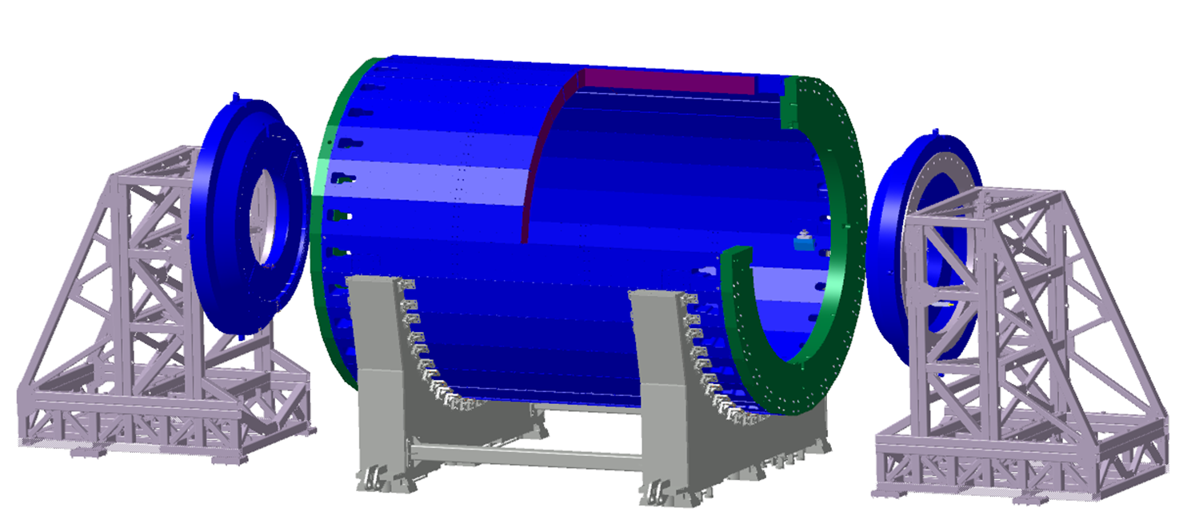
MPD Yoke (L=8970 mm, Ø6625 mm)
28 plates
16 t each
2 support rings
42.5 t each
2 poles
44 t each
Total weight: 621 t
Material:
Steel 10 (AISI 1010)
forging
Lodgement (Yoke support) – 70 tons, ordinary steel St.3 (Fe 360)
Pole transport supports 15 tons each without ballast

Slide 3
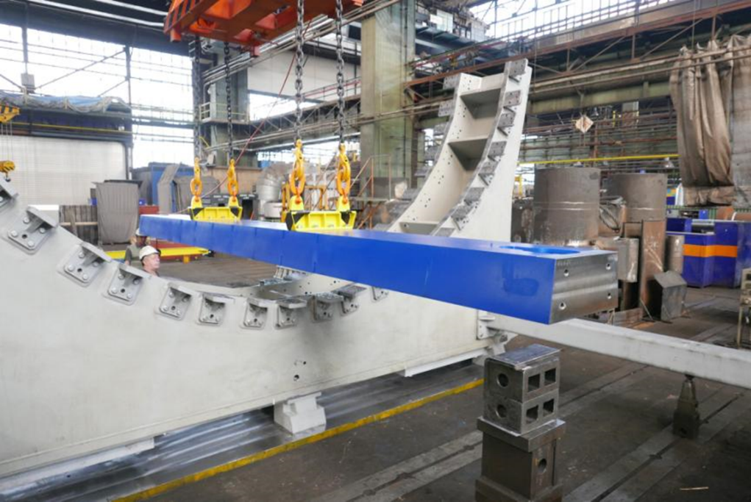
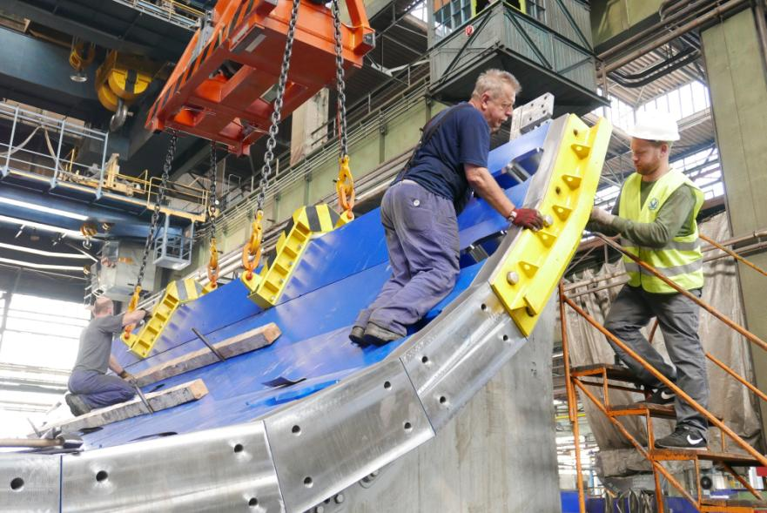
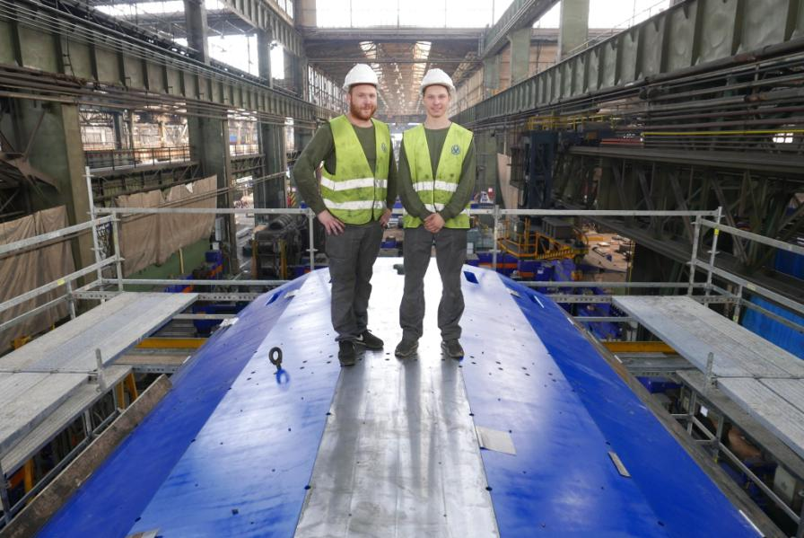
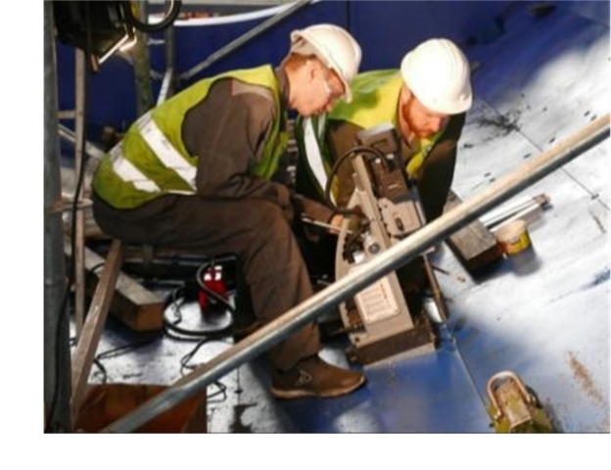
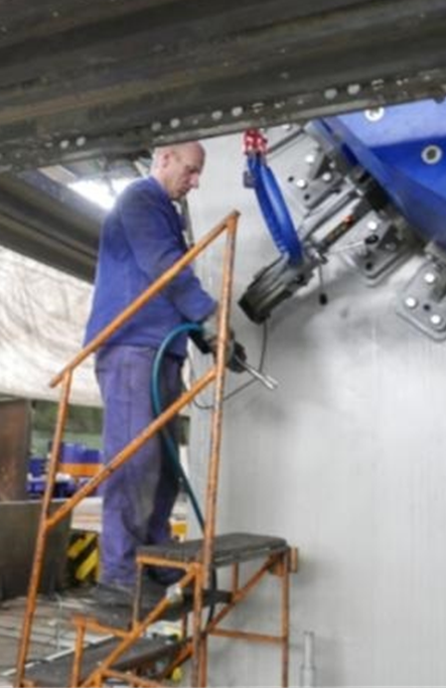
MPD yoke preassembly at VHM, June-August 2018

Slide 4
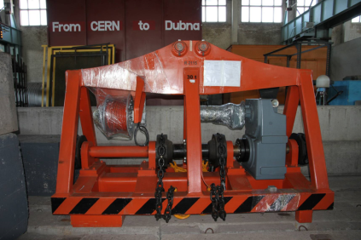
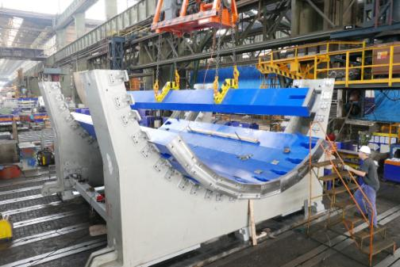
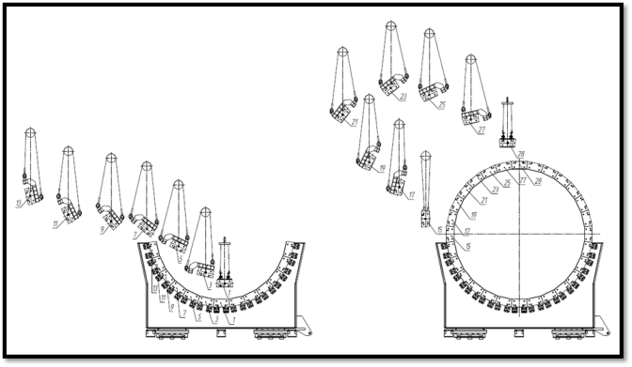
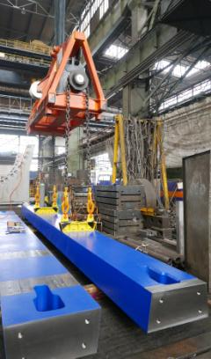
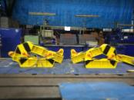
Predicted very useful tool !

Slide 5
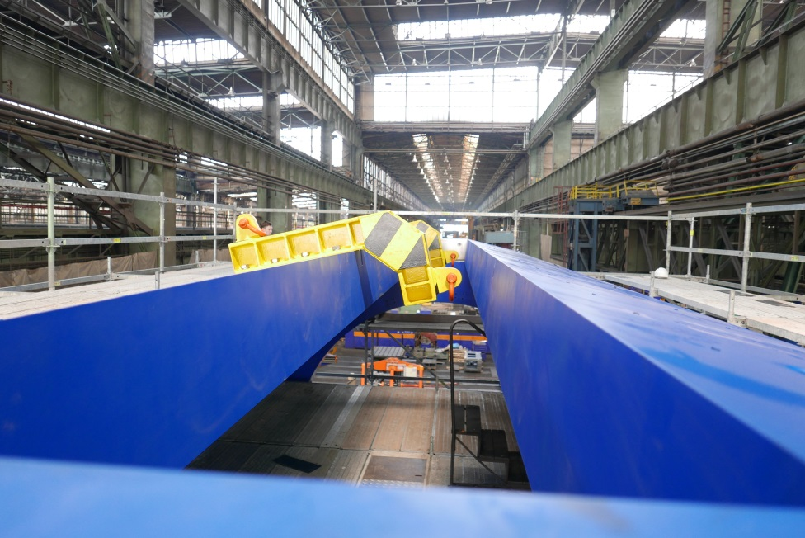
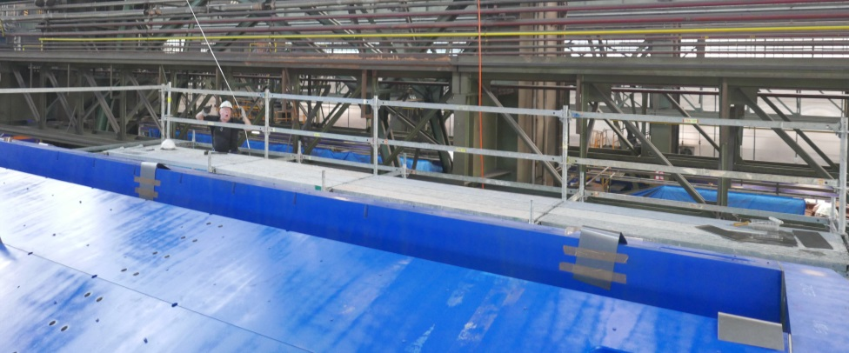
“Final” measurements report (27 plates in assembly)
Side W – 0.55 mm out
Side E – 0.66 mm out

Slide 6
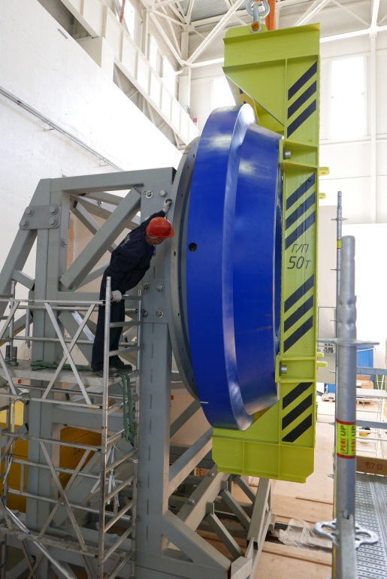
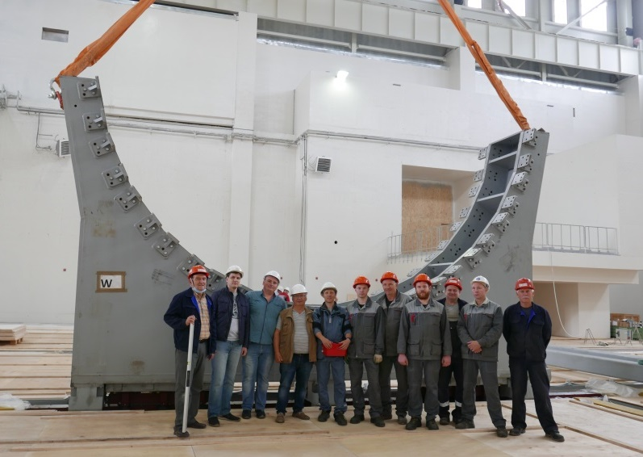
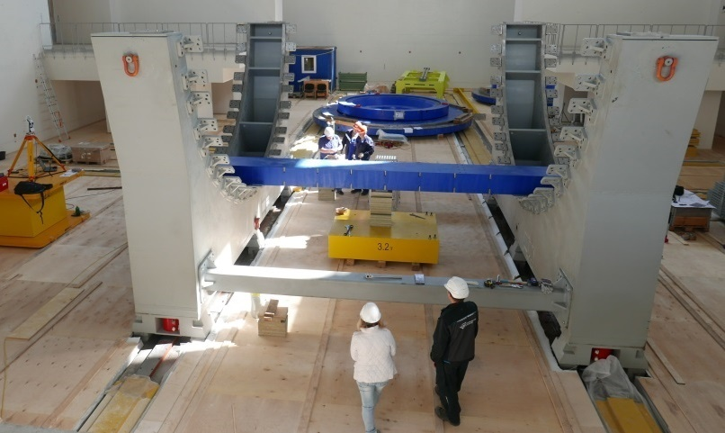
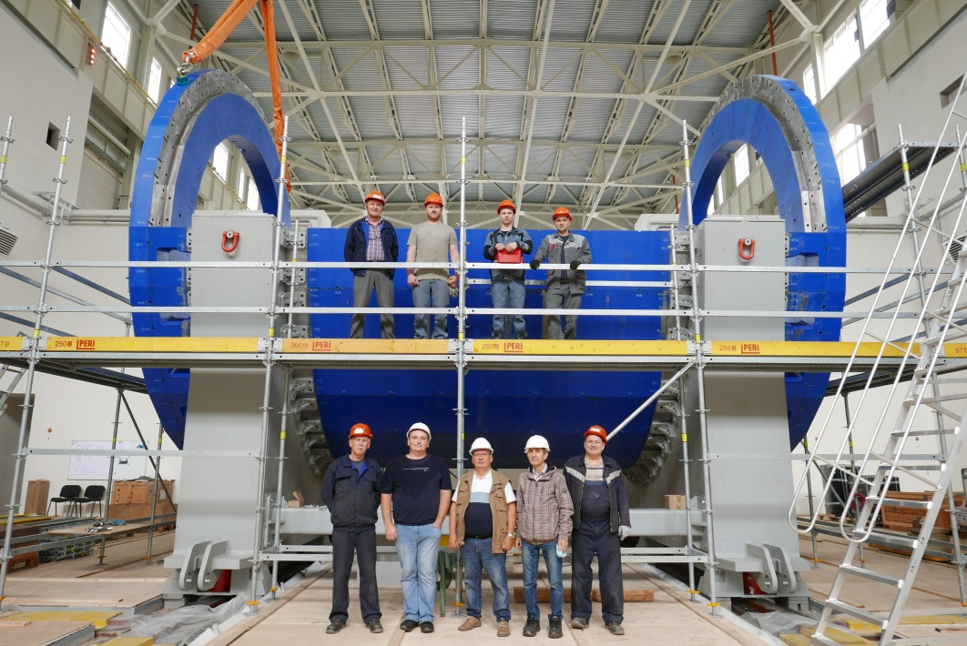
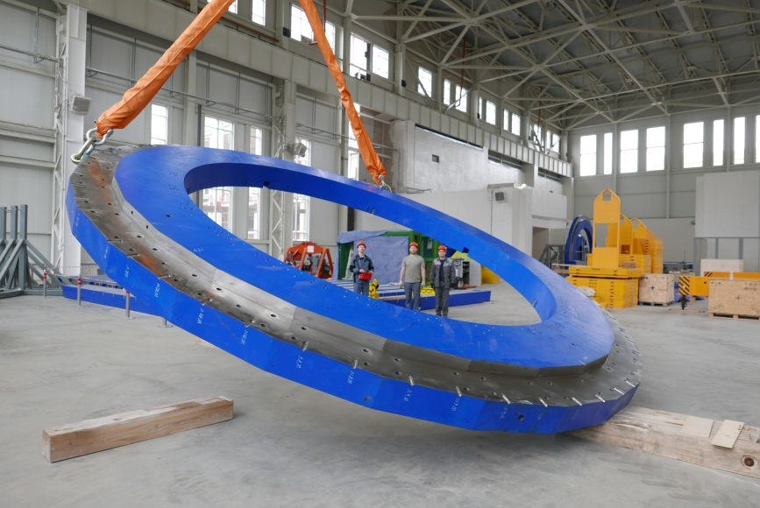
MPD pre assembly at JINR
(13 July – 12 August 2020)
Leading engineer N.Topilin VBLHEP
1-st stand
1-st plate: 8.5 m length, 16 tons
42 t Pole installation
JINR-Pelcom plant team
13 plates and 2 rings as 1 piece
370 tons in total
Support ring lifting, Ø 6.7 m, 44 tons
JINR-Pelcom plant team

Slide 7
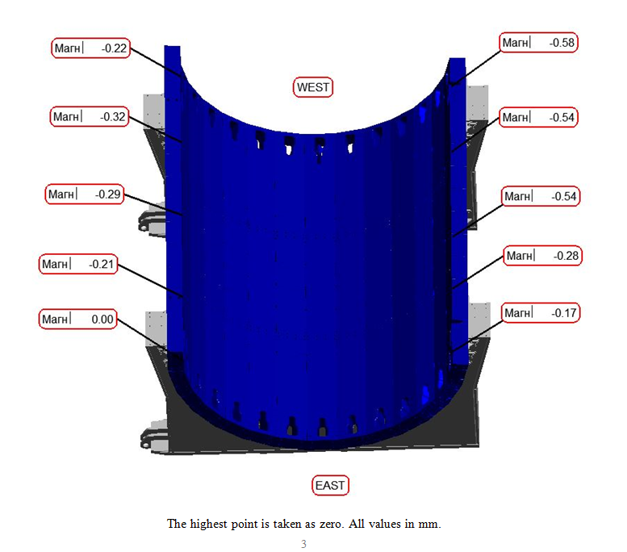
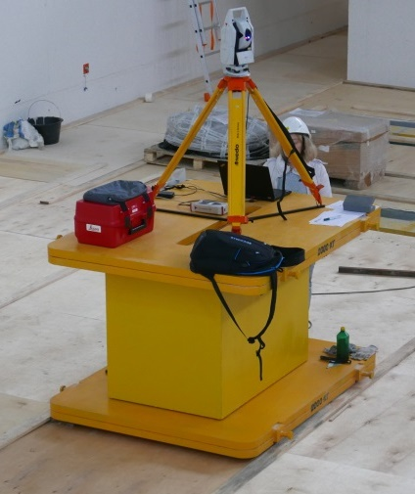
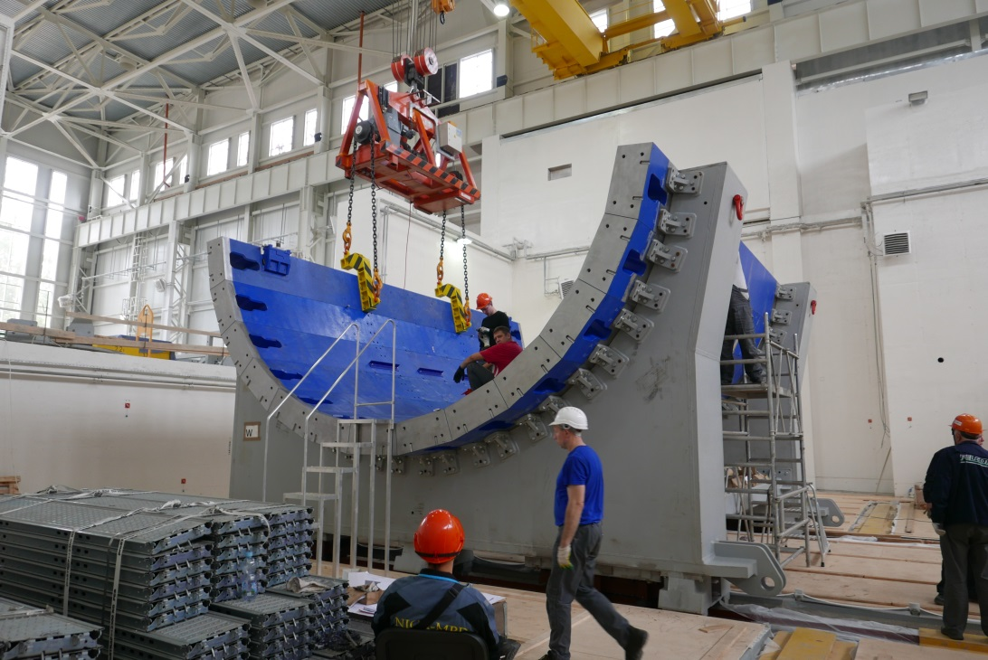
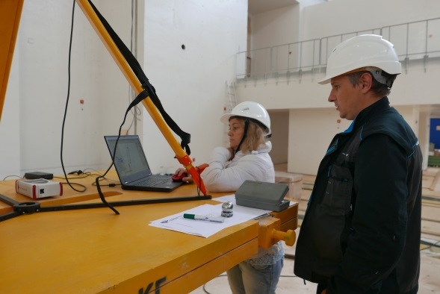
Measurements by “Industrial Measurements” LLC (ООО “Промышленные измерения”) , S.Peterburg
Rails planarity (top and side surfaces) – 0.4 mm on length 30 m
12 stands height deviations – 0.1 mm max
Stands shape deviation – 0.2 mm max
7 plates in assembly – nonplanarity 0.5 mm
13 plates in assembly - nonplanarity 0.58 mm max
13-th plate installation

Slide 8
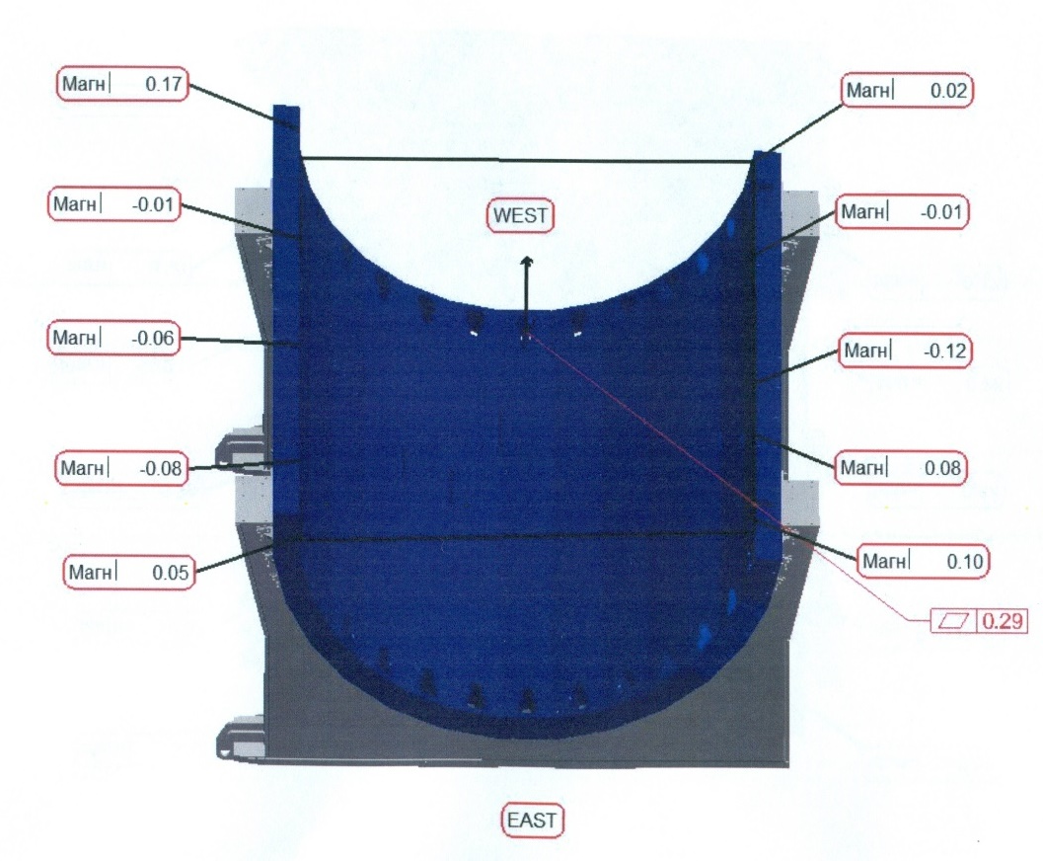
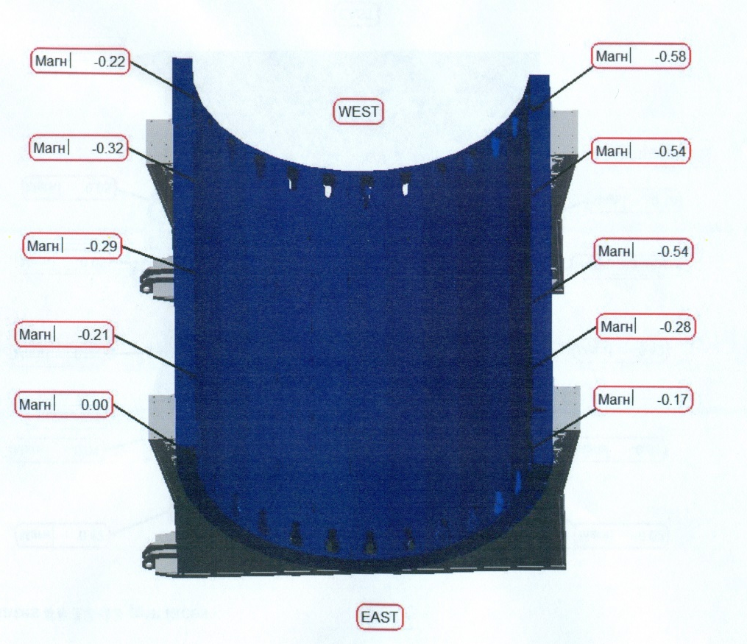
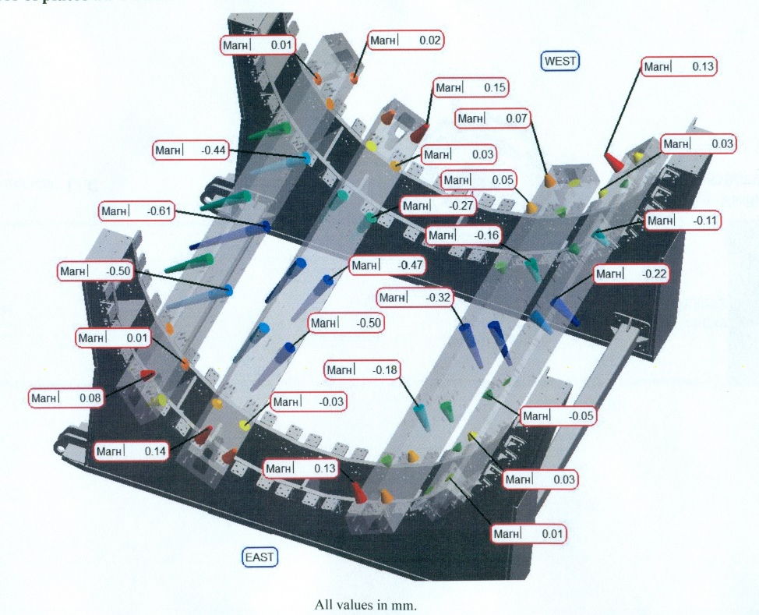
Geometry of 13 plates in the assembly
Nonflatness of plates
## 12-13 per faces
relative to the
horizontal plane
Nonflatness of plates
## 12-13 per faces
Nonflatness of plates
##4-5 and ##8-9

Slide 9
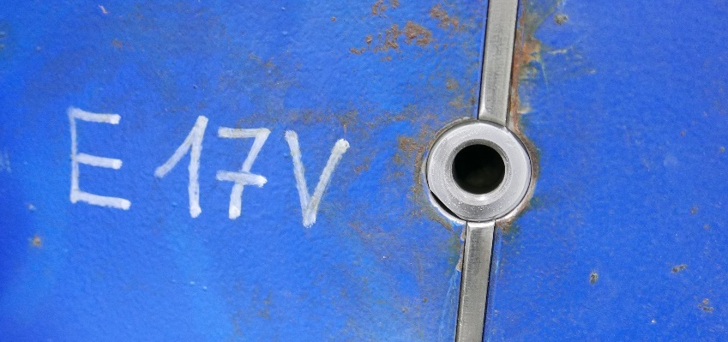
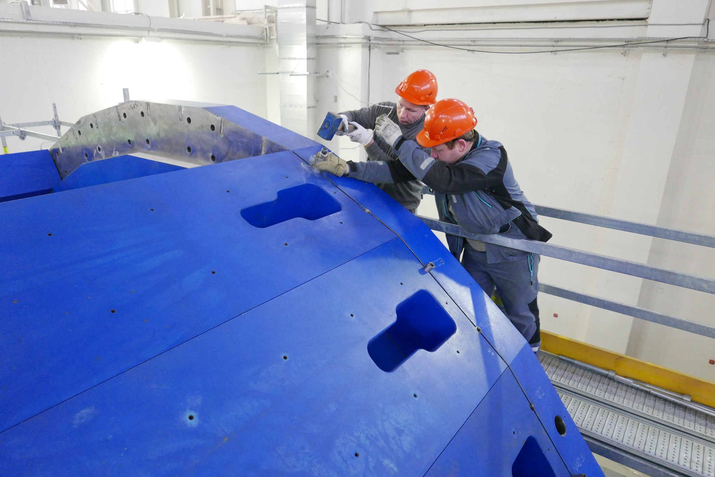
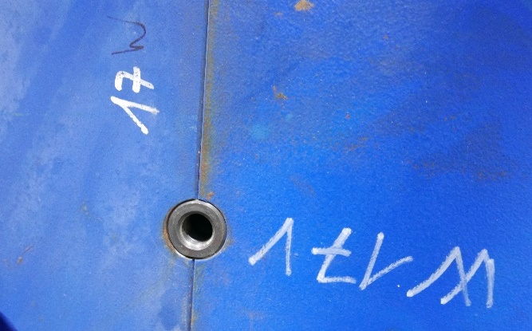
Capturing the position of the plate with micron accuracy
Поимка положения плиты с микронной точностью

Slide 10
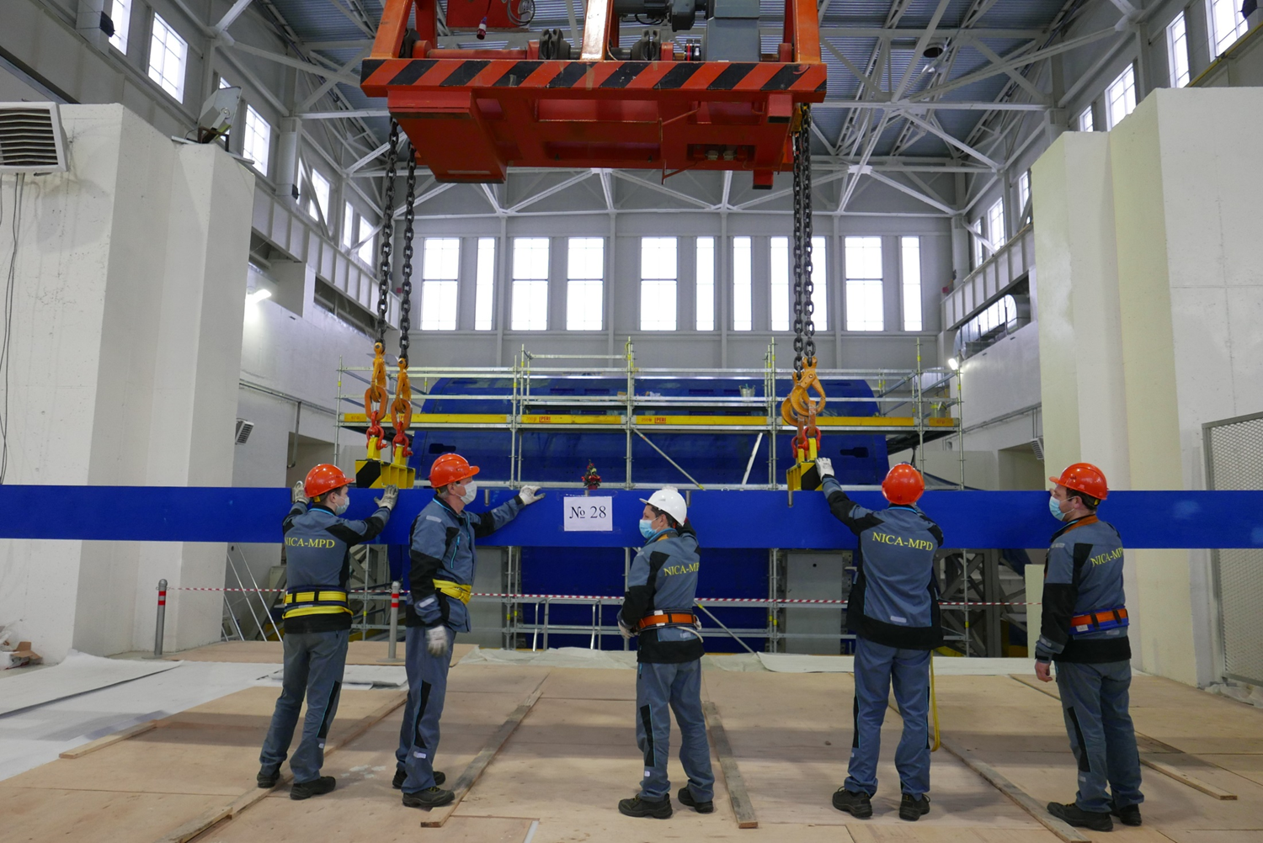
Installation top (last) plate #28

Slide 11
December 25, 2020

Slide 12
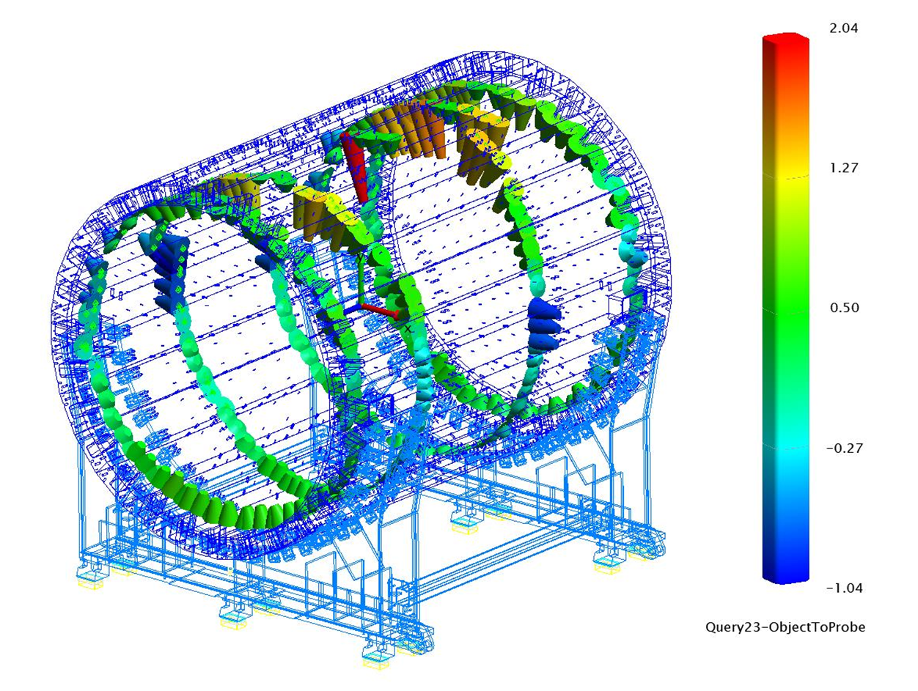
28 plates in assembly

Slide 13
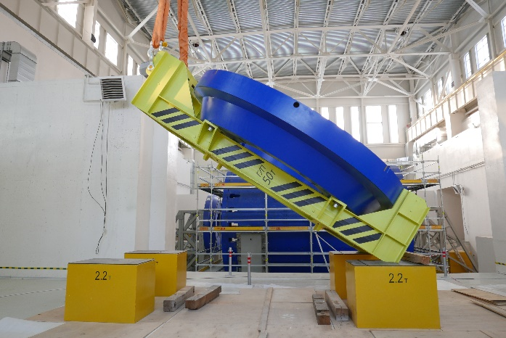
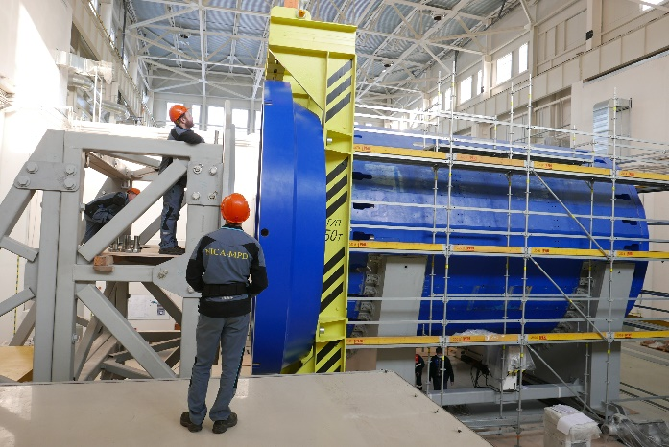
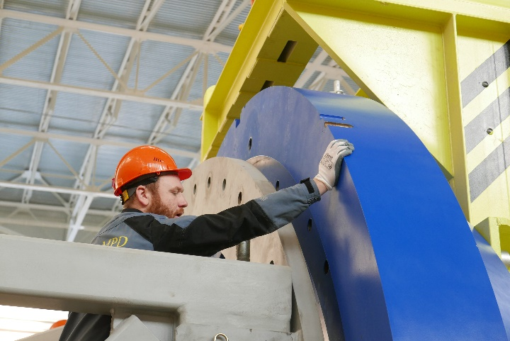
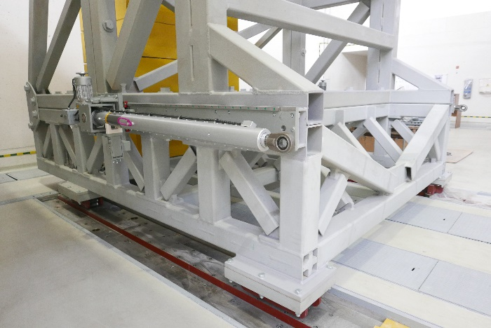
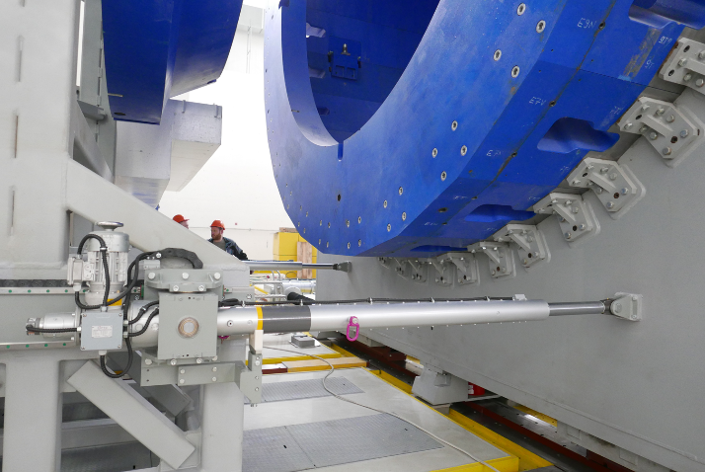
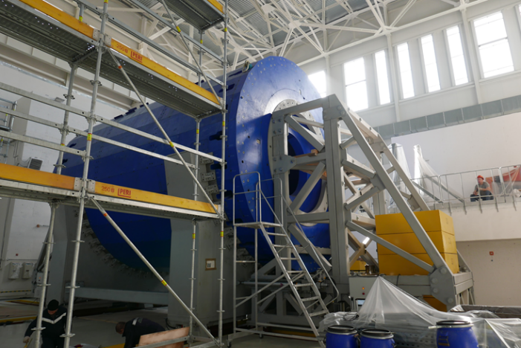
Poles installation

Slide 14
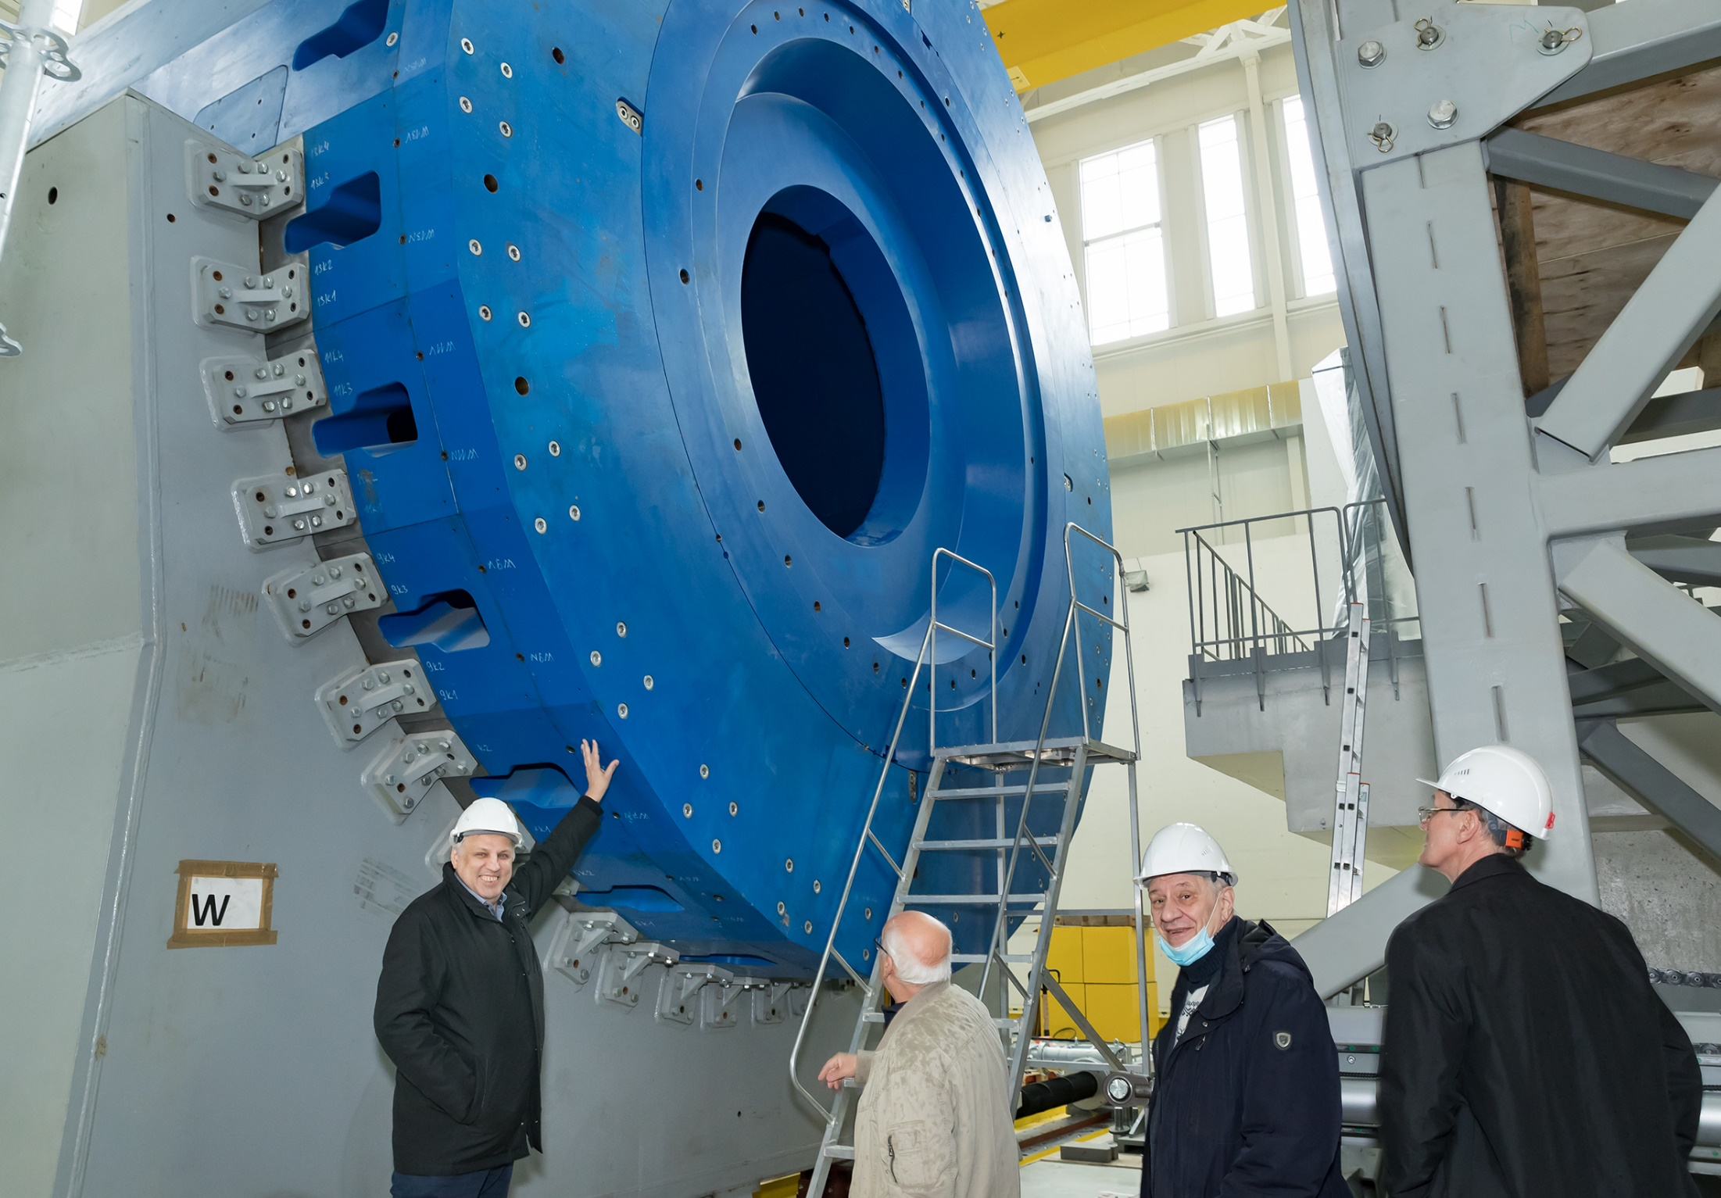

Slide 15
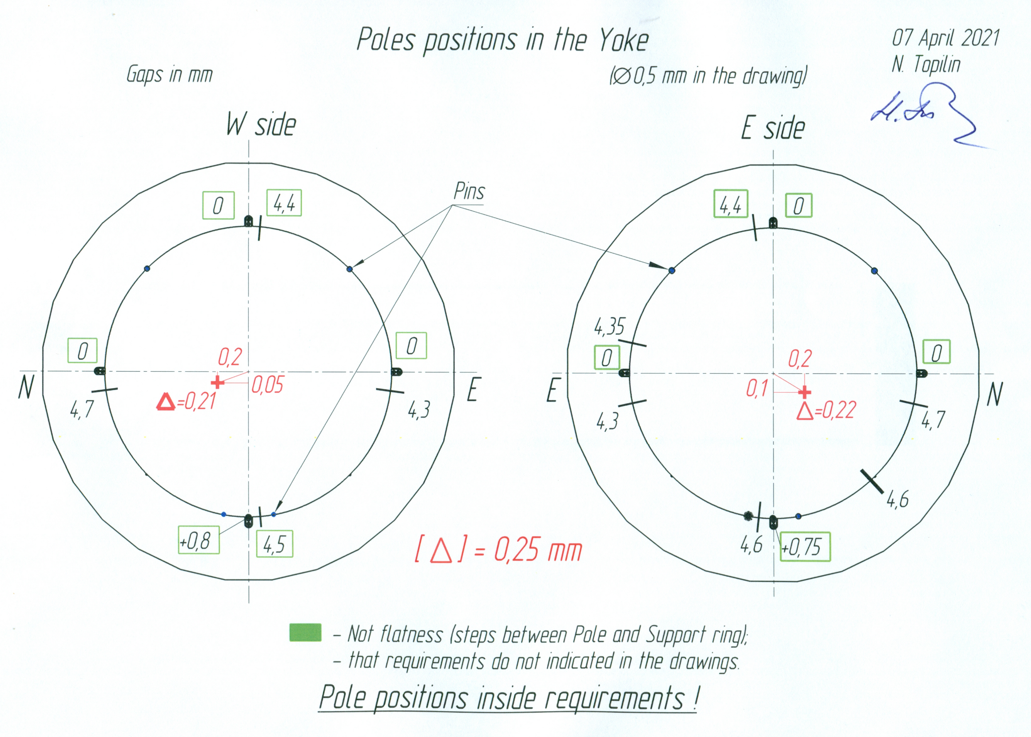

Slide 16
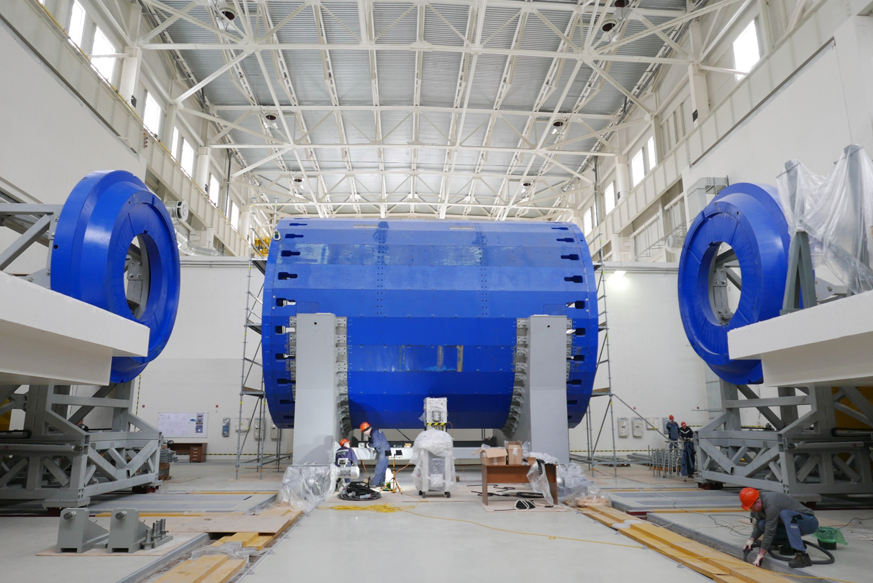
Movement system assembly and test

Slide 17
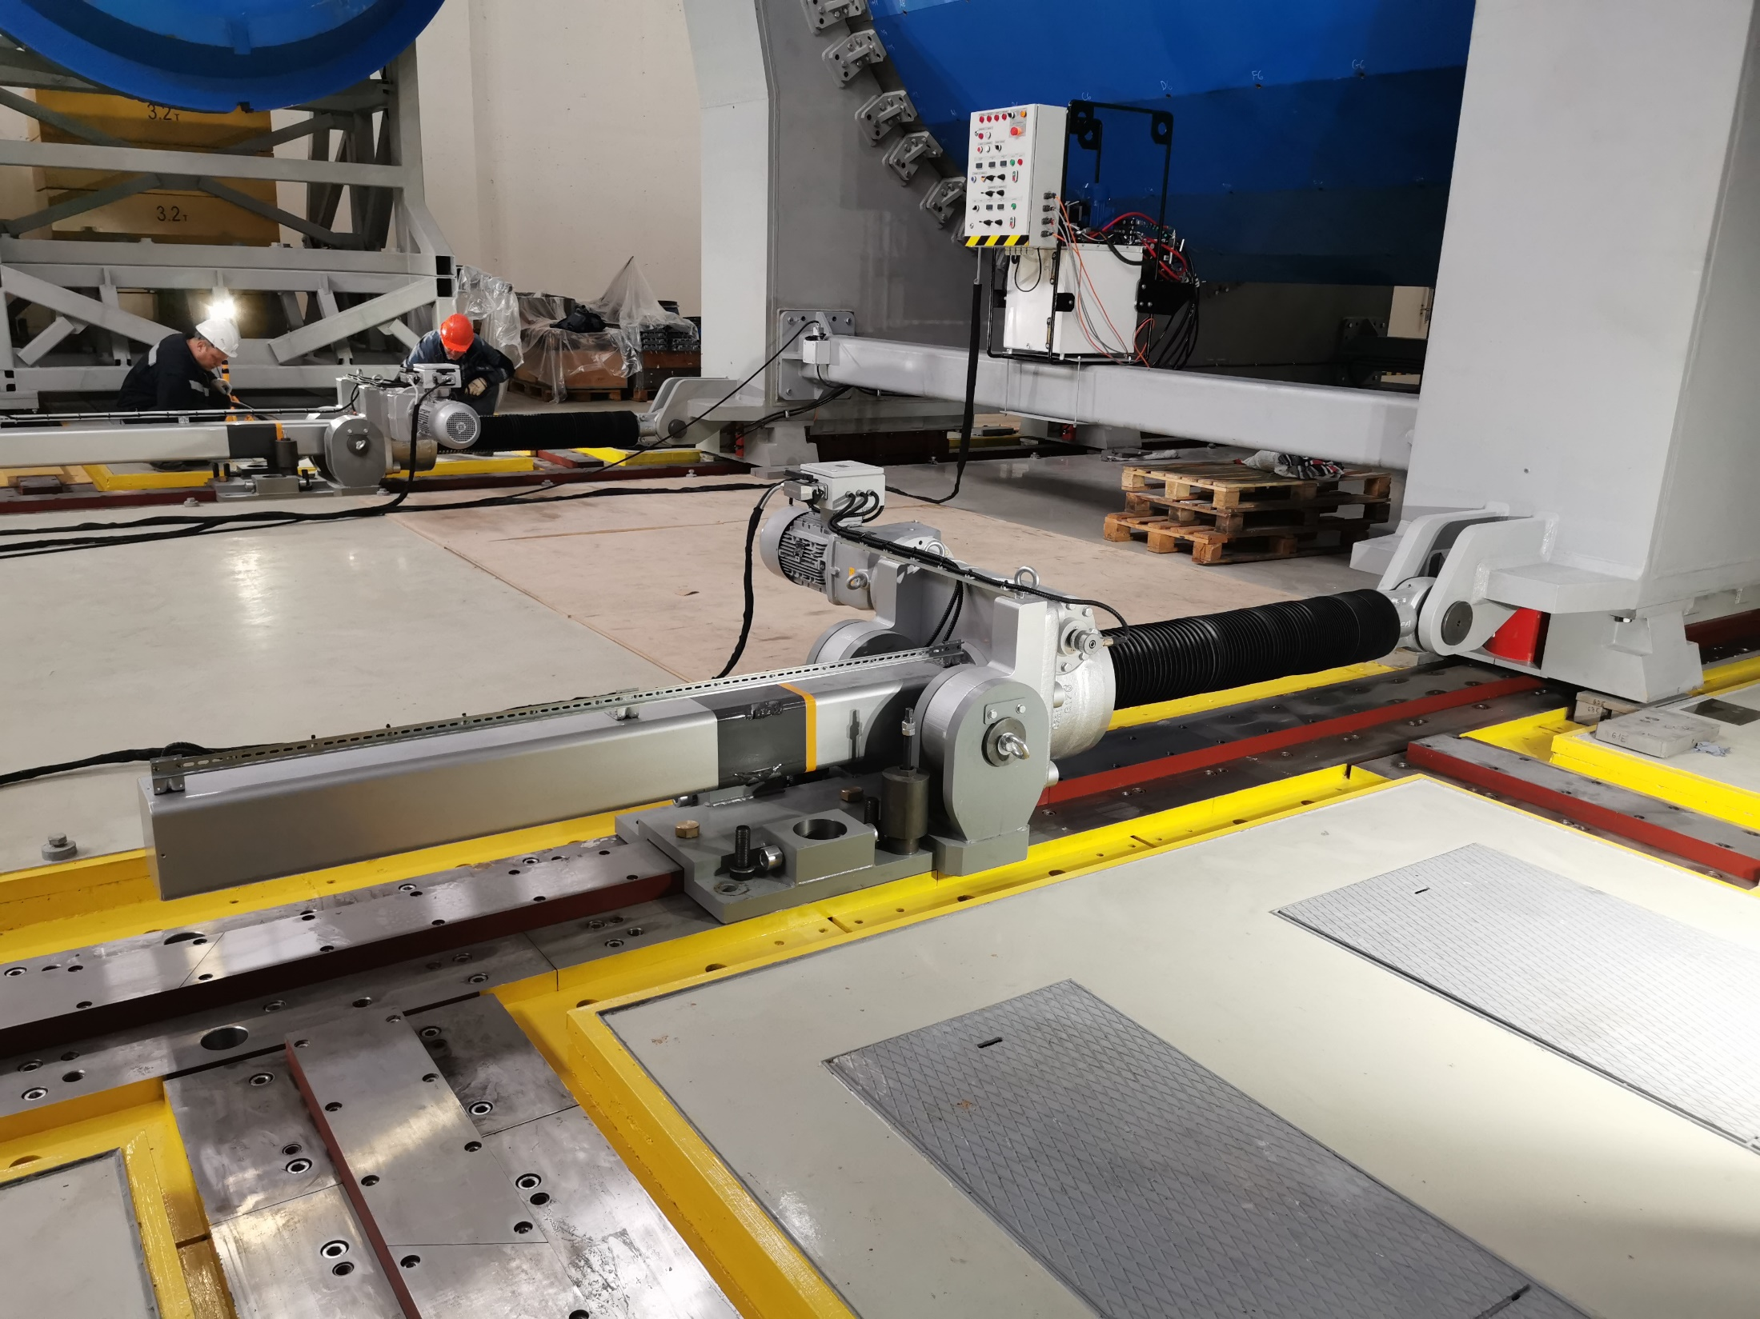
The movement system allows you to move an object weighing
up to 1000 tons with a positioning accuracy of 0.1 mm across
the beam and install it with an accuracy of 0.1 mm in height.
The accuracy of the installation of the pole axis relative to the axis
of the support ring is 0.25 mm (provided technologically).
The speed of movement of all rods is from 0 to 3 mm/s.

Slide 18
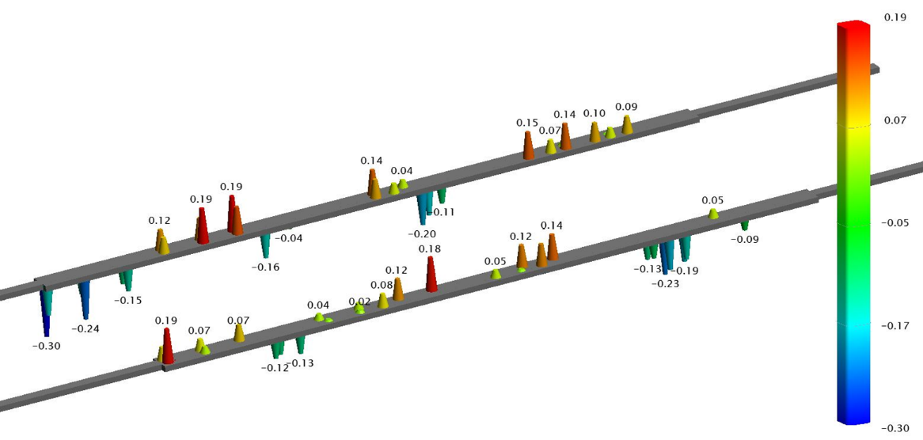
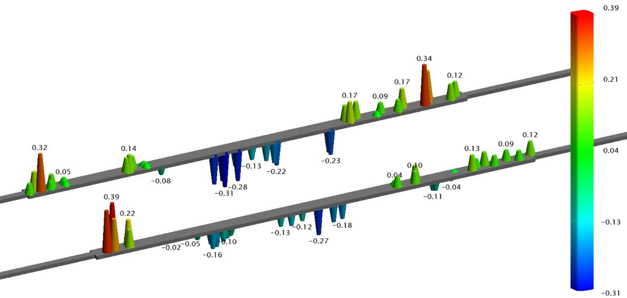
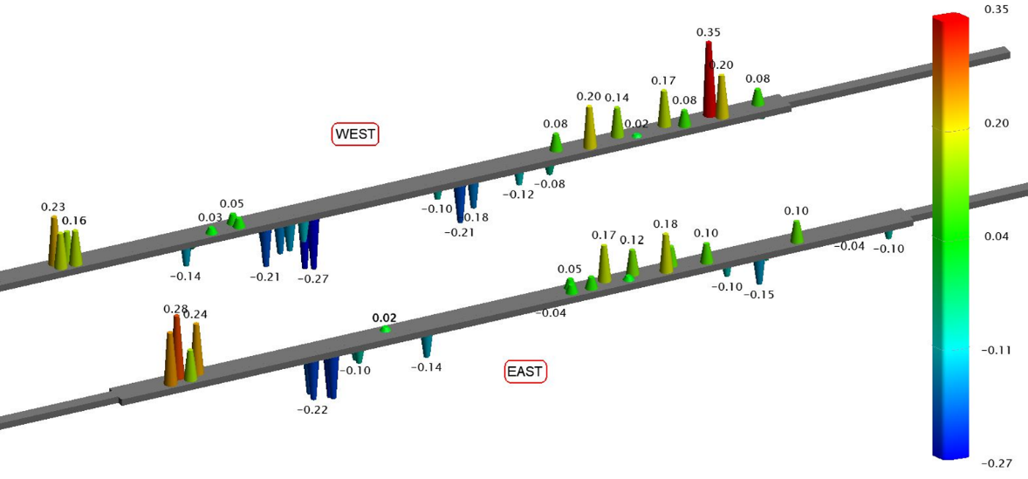
Rails shape during Yoke moving
1 - Assembly zone position
2 - Central position
(poles installation)
3 - Beam position

Slide 19
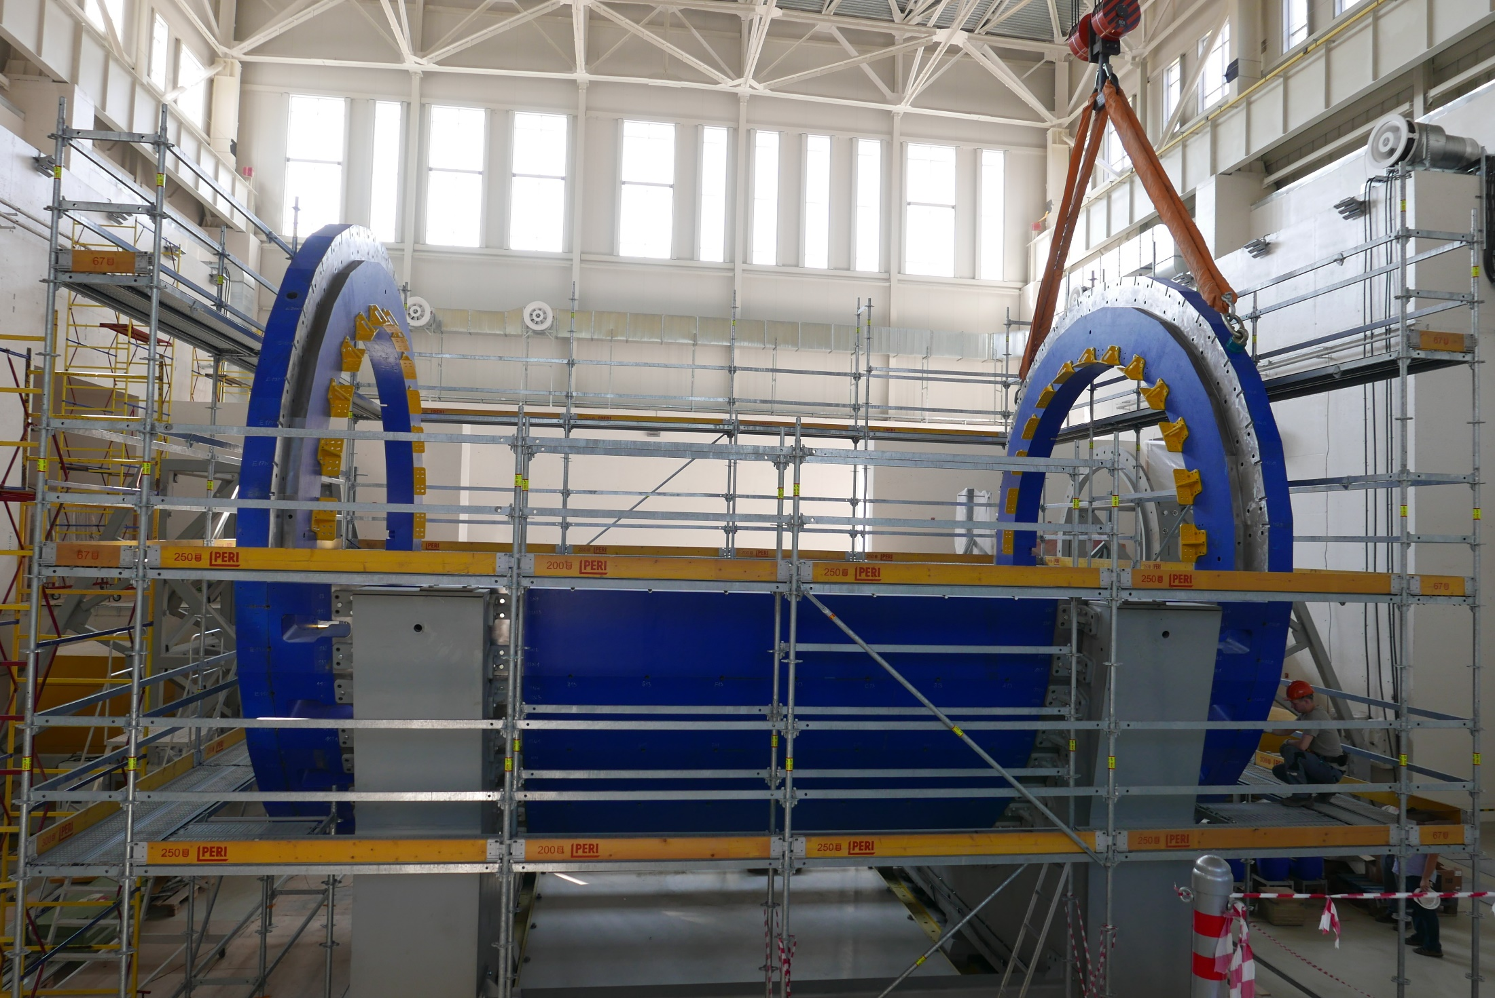
July 16, 2021
Power frame brackets

Slide 20
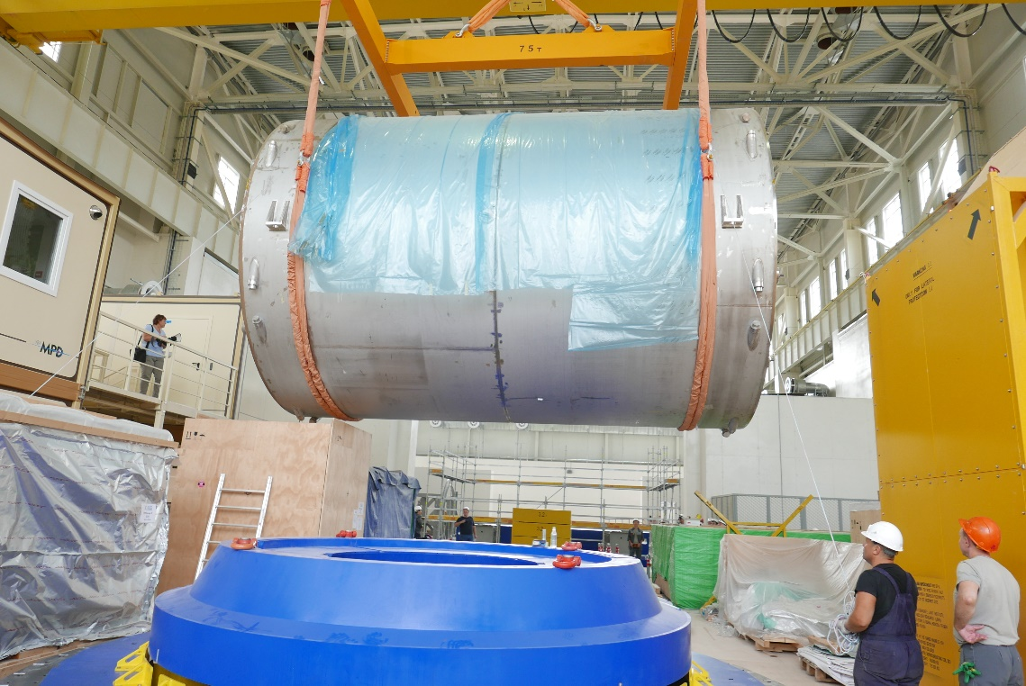
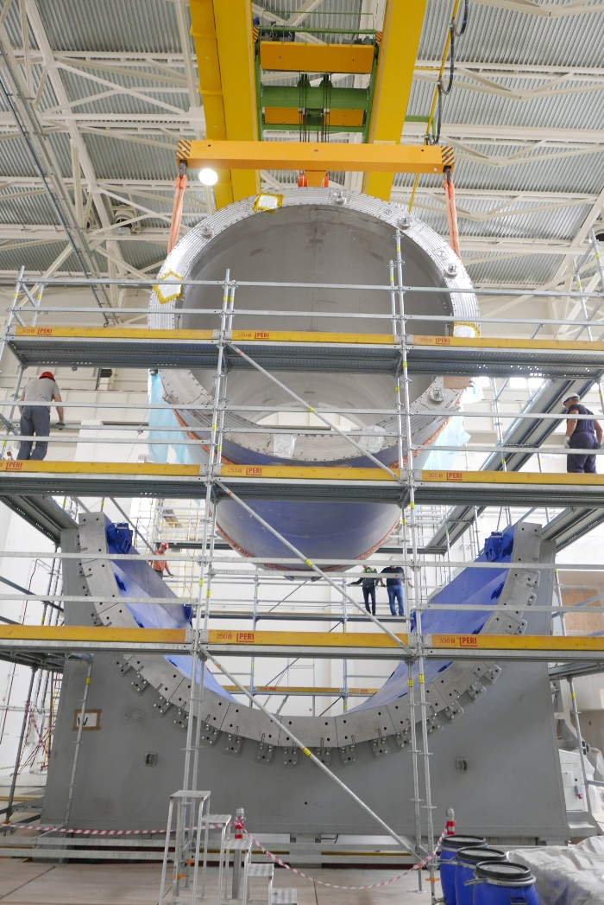
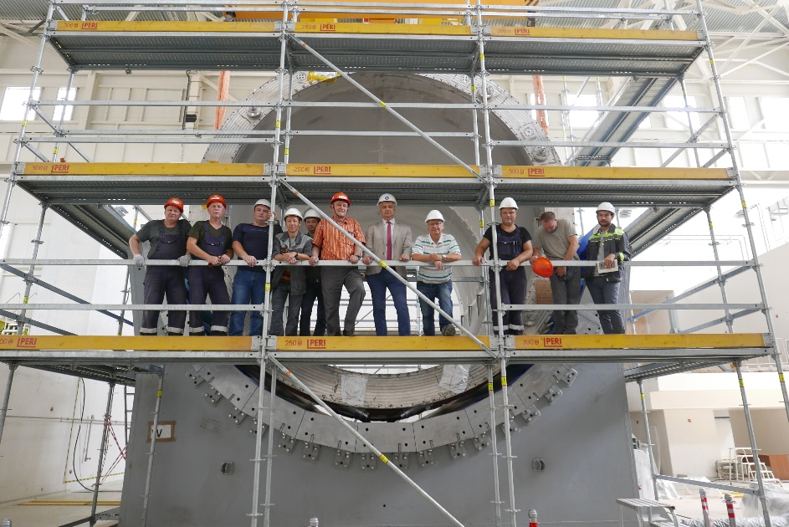
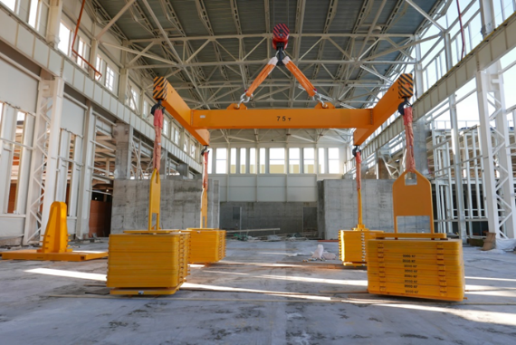
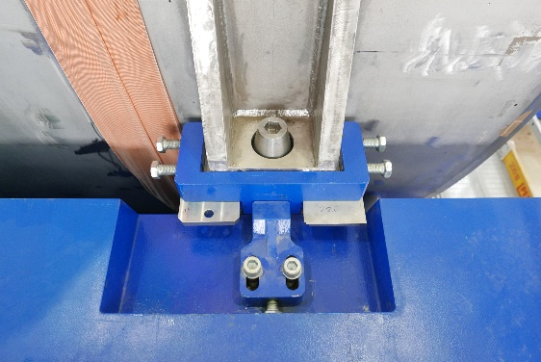
Magnet installation: July 30, 2021
August 2020
Traverse 75 t capacity and
80 t Crane test together

Slide 21
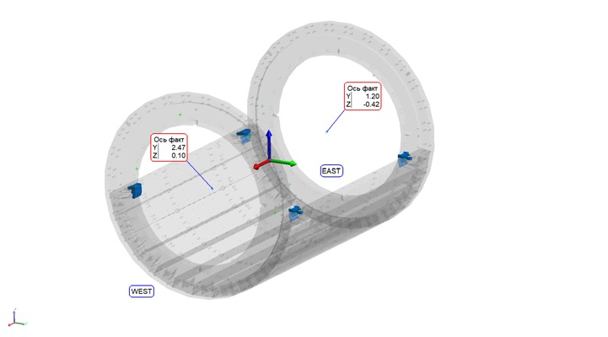
The position of the magnet axis relative to the axis of the Yoke

Slide 22
Related tasks
Evacuation of the ASG magnet transport container
Assembling and modification
the mobile platform

Slide 23
Pole transport support modification
by “Lider” Company, St-Peterburg
Modification reason: Cable space increasing
O-Ring, 3935 mm in diameter,
Overall thickness: 300 mm
Weight: 2.7 t , 2 ps
Installation: end of October 2021

Slide 24
Worm coils installation in the poles
POINT 4
11-13 July 2022
Misalignment of the position of the pole and coil centers is 1 mm

Slide 25
Pole with TRIM coil installation
15 July 2022

Slide 26
Pole with TRIM1 coil installation

Slide 27
Current status on today

Slide 28
Carbon structure for E-Cal modules
Diameter 4.6 m
Length 8.26 m
Weight 8 t

Slide 29
Thanks for your attention !
Conclusion
The working documentation developed in the design department of the LHEP
and the original technology of assembling the yoke of the magnetic circuit,
as well as their filigree production at the factory in Vitkovice (Czech Republic),
made it possible to repeatedly assemble and disassemble the yoke while maintaining
the high accuracy laid down on the geometry of the yoke.
Next steps:
Yoke assembly finishing (last 3 plates installation)
Top platform assembly up to end
Cryogenic equipment installation on the top platform
All of these operations will be done as soon as it will be possible

