Slide 1
Work is partially supported by the JINR youth grant № 14-103-02

Slide 2
Contents
Introduction (photocathodes and photoinjectors)
“Hollow” and “Transmissive” cathode conceptions
Emittance and its calculation
Diagnostic station
Prospects

Slide 3
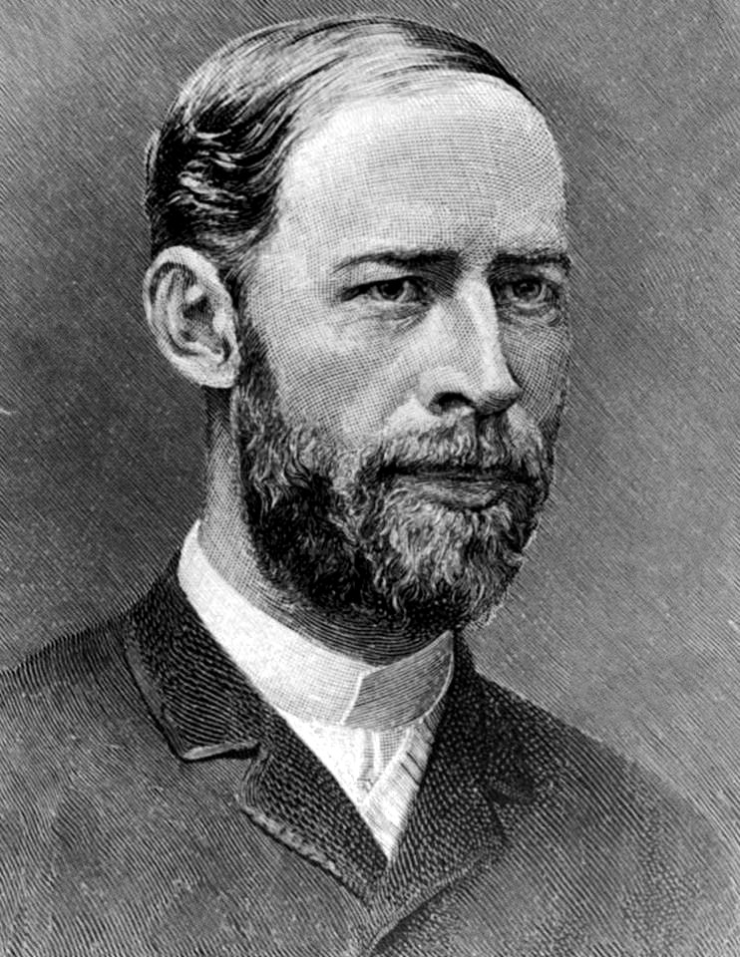
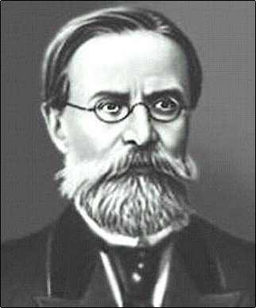
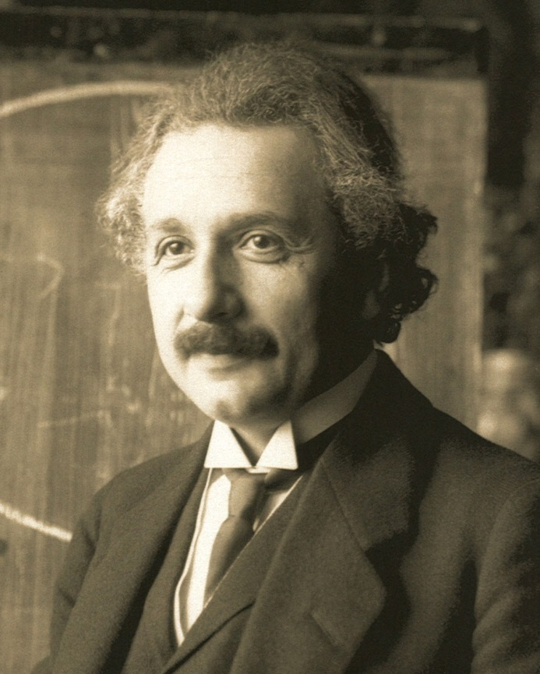
Photoelectric effect
H. Hertz
A. Stoletov
A. Einstein

Slide 4
Three-step photoemission model
Optical excitation of electrons from the valence band into higher empty states in the conduction band
Migration to the surface
Escape across the surface potential barrier into vacuum
$$QE=\frac{N_{e}}{N_{ν}}$$
© R.A. Loch. Master thesis (2005)

Slide 5
Photocathode properties
Parameter | Metals | Semiconductors
Quantum efficiency | Low (less than %) | High (10% and more)
Response time | Low (less than ps) | High (up to ns)
Required wavelength | UV | Visible light, IR
Robustness | High | Low
Lifetime | High (years) | Low (months/days)
Polarisation | No | Yes (NEA)

Slide 6
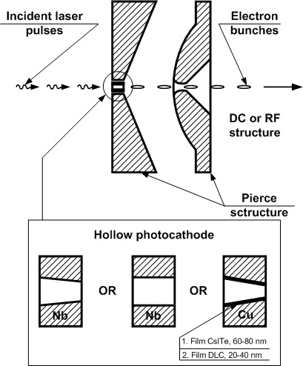
“Hollow” and “Transmissive” cathode conceptions
4-6 mm width washer with a cone (obliquity of 1:50) or cylinder aperture in the middle
Such cathode geometry allows quantum efficiency rising due to surface photoelectric effect concerned to normal to material surface electric field multiplier
Backside irradiation also simplifies laser beam targeting on emitting surface, accelerator equipment alignment and photocathode working surface laser cleaning

Slide 7
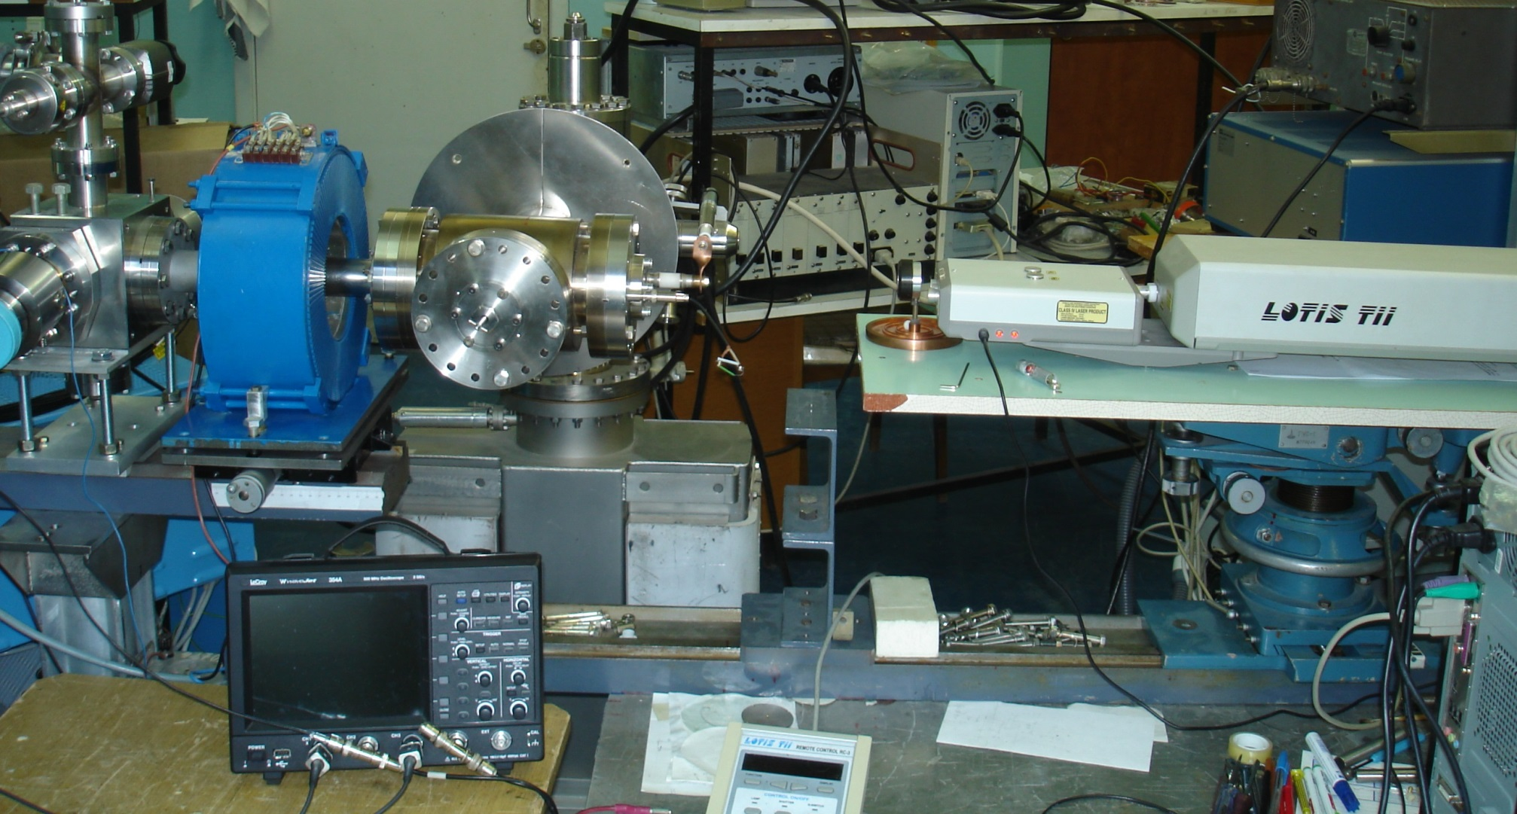
Photo-gun bench

Slide 8
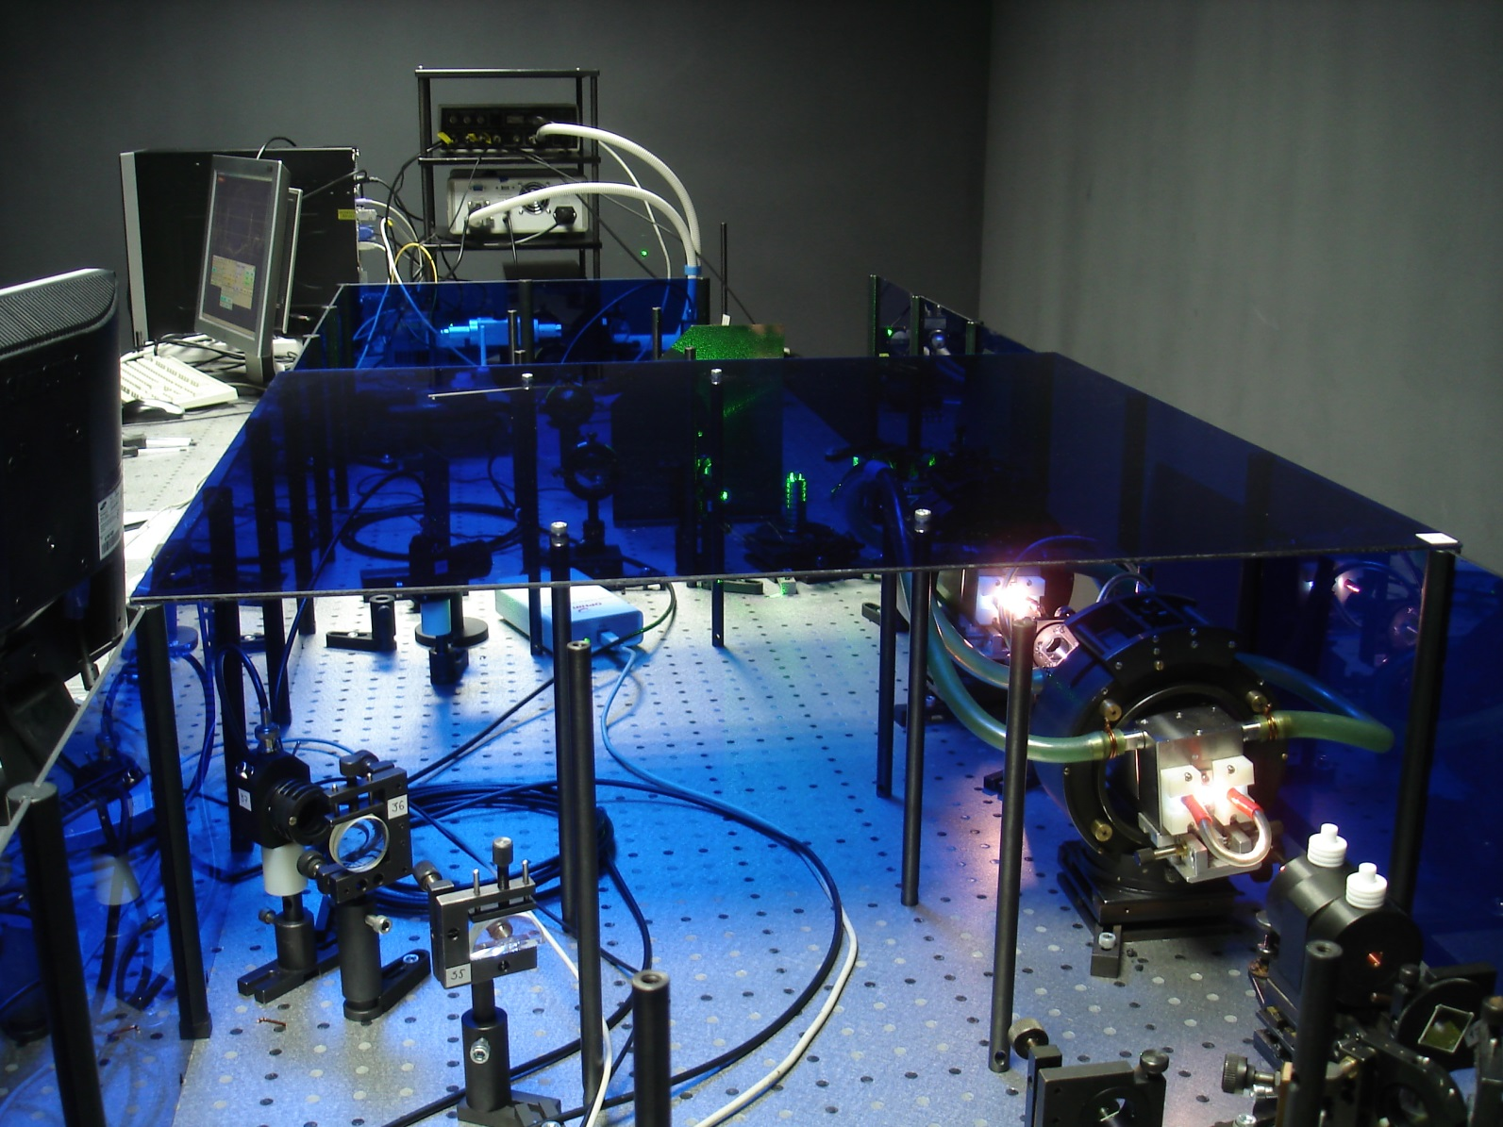
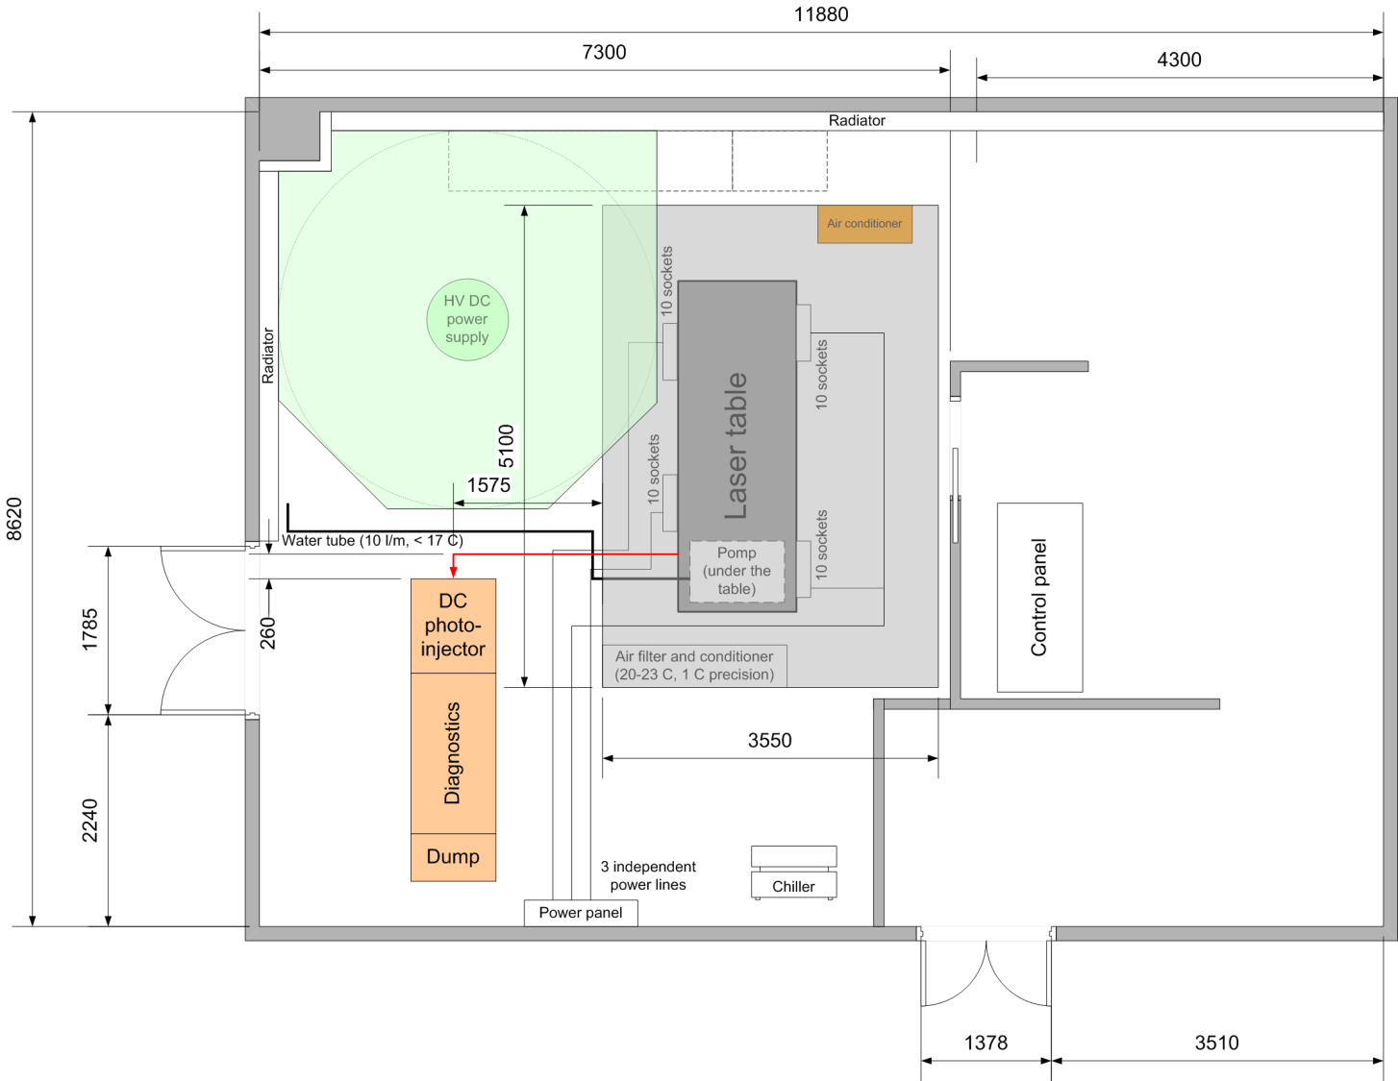
New bench

Slide 9
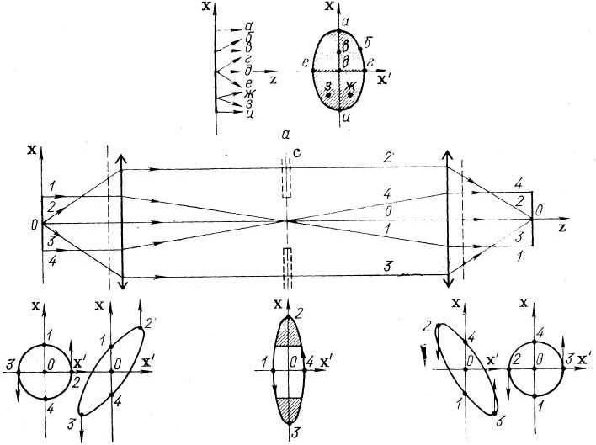
Emittance
© В.Н. Забаев. Применение ускорителей в науке и промышленности, 2008

Slide 10
Pepper-pot technique
Slit mask
Pepper-pot mask
$$ε_{x}^{2}≈ \frac{1}{N^{2}}\left\{\left[\sum_{j=1}^{p}{n_{j}{\left(x_{sj}−\overline{x}\right)}^{2}}\right]\left[\sum_{j=1}^{p}{\left[n_{j}σ_{{x^{′}}_{j}}^{2}+n_{j}{\left(\overline{{x^{′}}_{j}}−\overline{x^{′}}\right)}^{2}\right]}\right]−{\left[\sum_{j=1}^{p}{n_{j}x_{sj}\overline{{x^{′}}_{j}}−N\overline{x}\overline{x^{′}}}\right]}^{2}\right\}$$
© Min Zhang. Emittance Formula for Slits and Pepper-pot Measurement, 1996

Slide 11
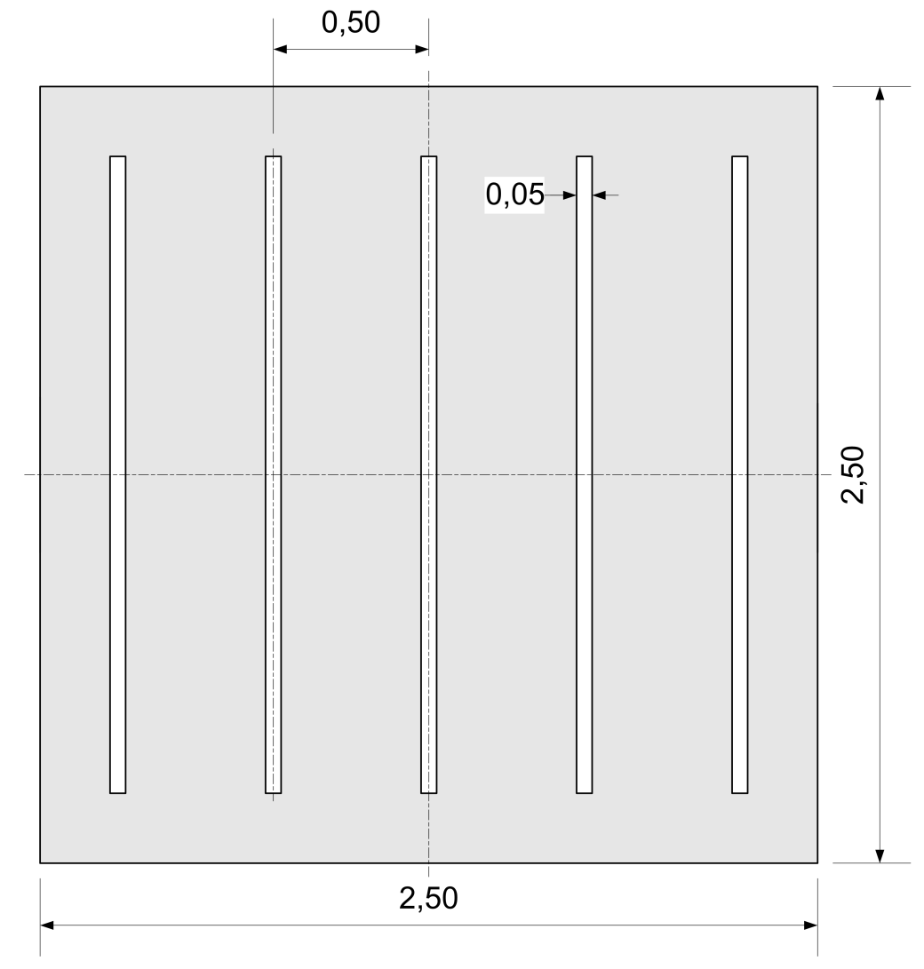
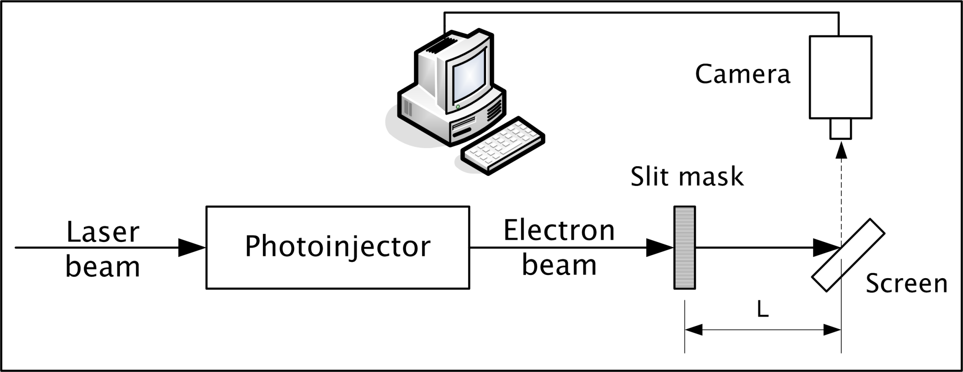
Diagnostic station
Distance from mask to screen:
$$L≥\frac{∆p}{2x′}$$
[1]
$$L≥\frac{∆p}{2x^{′}}= \frac{0,0001×5}{2×0,0025}=0,1 м=10 см$$
Space between slits
$$h_{0}=2x^{′}L=500 мкм$$
[1] Min Zhang. Emittance Formula for Slits and Pepper-pot Measurement, 1996

Slide 12
Prospects
Installation of the screen station instead of the fixed slit mask. Screen station will include the following equipment:
Two slit masks with transversely-spaced slits (this will allow to measure emittance in both phase planes)
Luminescent screen for beam divergence estimation and beam profile observation
Probably, another mask pairs with different slit size or slit spacing

Slide 13
Thank you for your attention!

