Slide 1

PAC on Particle Physics
47th Meeting
Report to Scientific Council
JINR, September 18, 2017
Itzhak Tserruya
Weizmann Institute of Science

Slide 2
47th PAC-PP agenda June 26-27, 2017
Highlights of 47th PAC-PP meeting:
Update Reports on NICA, MPD and BM@N
Report on the Nuclotron run 54 (Feb - March 2017)
New projects and projects seeking continuation

Slide 3
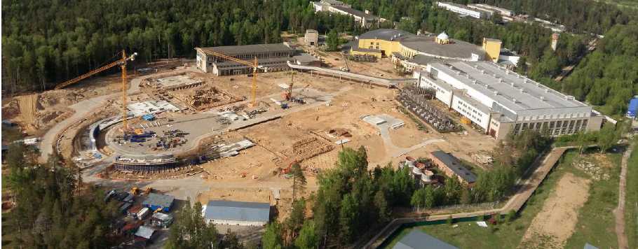
Report on the Nuclotron-NICA project
A. Sidorin
The Committee appreciates the significant progress achieved in the Nuclotron operation during Run 54.
The PAC is very pleased with the preparations for the Booster construction.
The PAC expresses concern about the availability of sufficient manpower for the efficient Booster construction and urges the JINR management to take corrective actions.

Slide 4
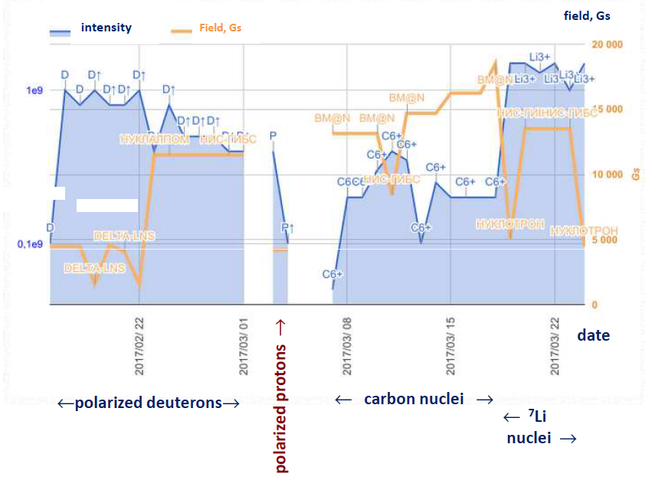
Nuclotron beam use – Run 54
E. Strokovsky
The PAC is pleased to note that a beam of polarized protons was accelerated for the first time in the Nuclotron Run 54.
All requests from the beam users were satisfied.
Feb-March 2017
Total run duration:
~1008 h
SPI source:
- Polarized deuterons
(ALPOM-2, DSS)
- Polarized protons
Laser Source
- ¹²C beam: BM@N
- ⁷Li (HyperNIS)

Slide 5
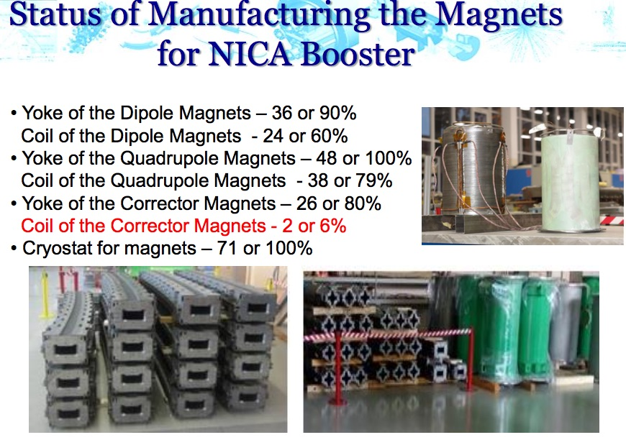
Infrastructure Developments
N. Agapov
The PAC is pleased to learn that the closed circulating water system for the VBLHEP cryogenic complex is now operational, making it possible the non-stop testing of the superconducting magnets.
The Committee also encourages the efforts being undertaken by the laboratory management to increase the site electric power up to 40 MW.
The PAC reiterates its concern about the lengthy tendering procedures.
Status of magnet production for Booster
 | PCs | %%
Yoke of dipole magnets | 36 | 90
quadruple magnets | 48 | 100
corrector magnets | 26 | 80
Coil of dipole magnets | 24 | 60
quadruple magnets | 38 | 79
corrector magnets | 2 | 6
Cryostats | 71 | 100

Slide 6
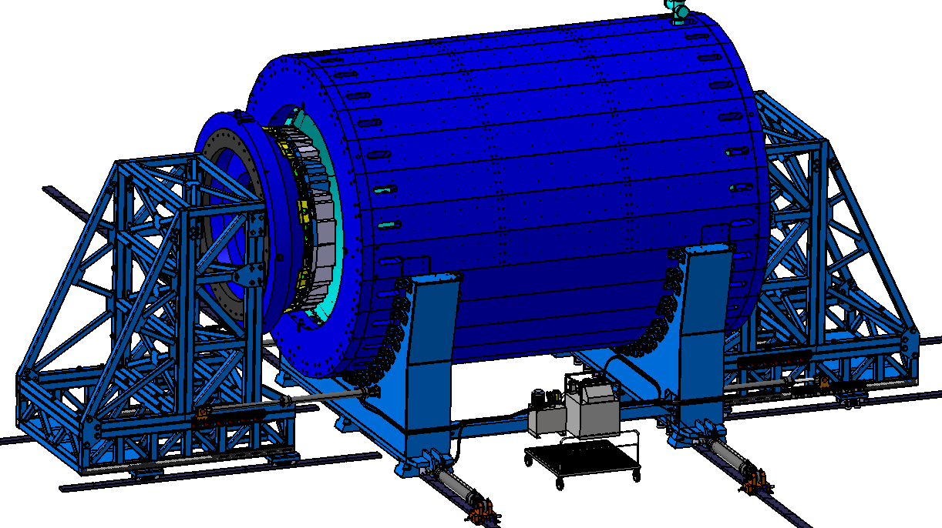
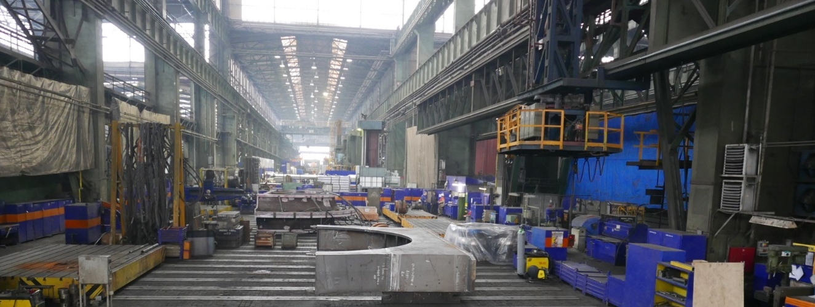
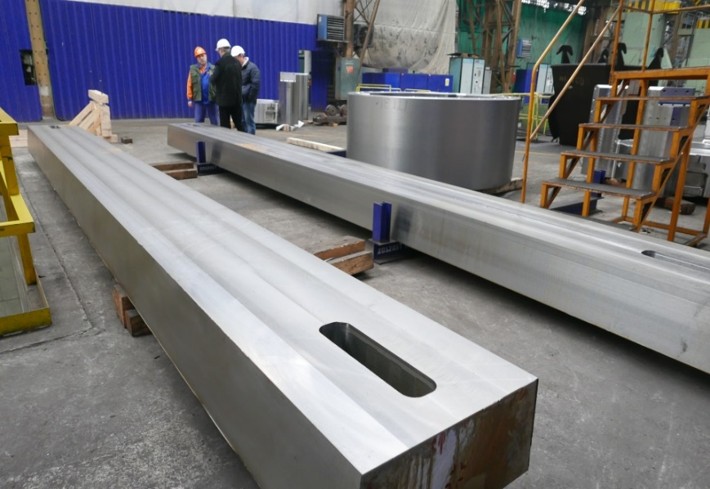
MPD
Vadim Kolesnikov
The PAC welcomes the significant advance in the MPD magnet construction.
The PAC appreciates the ongoing efforts for the development of the MPD-NICA interface, the important decision on the selection of the ECAL projective geometry, and further efforts towards completion of the technical design reports for the different subsystems foreseen in Stage 1.
The PAC appreciates the progress and efforts toward defining the participation and commitments of groups from China and Mexico in the MPD experiment.
MPD Magnet Yoke (L=8970 mm, Ø6625 mm)
28 plates (16 t each) – 80% ready
2 support rings (42.5 t each) - ready
2 poles+trasport support (44 t each) – in progress
Lodgment (Yoke support): 70 t, ordinary steel St.3 (Fe 360) – 80% ready
MPD transport system – project ready, ongoing tender preparations
80/20 tons cranes (MPD & SPD) – contract signed, delivery Nov17- Feb18
Control Assembling in VHМ (Vitkovice, Czech Republic) Sept-Oct 2017
Plates

Slide 7
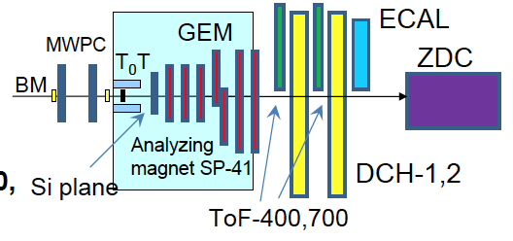
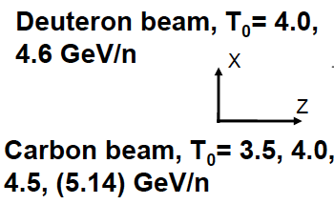
BM@N
Mikhail Kapishin
The PAC appreciates the progress towards realization of the BM@N project and acknowledges the results of the experiment in recent runs with deuteron and carbon beams.
BM@N configuration in technical runs 53 (Dec. 2016) and 54 (March 2017)
All major subsystems are operational.
Plans for next run in Oct--Dec 2017:
- Ar, Kr beams from heavy ion source
- Extended coverage of GEM tracker, 2 planes of Si detectors, extended
outer tracker (2 new CPC).
The PAC expects further development of the project and new results from the next run of the Nuclotron with heavier ion beams.

Slide 8
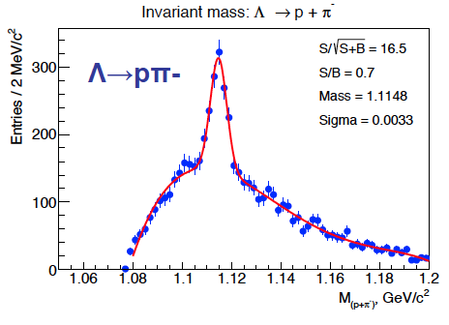
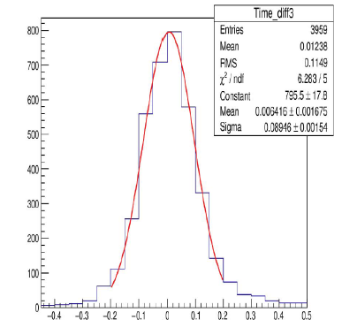
BM@N
Mikhail Kapishin
Λ reconstruction in d+ target interactions
Time resolution TOF400 - TOF700 chambers
Time resolution TOF400: ~53 ps
Time resolution TOF700: ~65 ps
The collected data although within a limited detector configuration can lead to publishable results.
Lack of qualified manpower for data analysis.
The PAC is concerned by the lack of manpower to analyse the data recently collected and urges the project and laboratory management to undertake the necessary steps to attract external groups to the BM@N experiment.

Slide 9
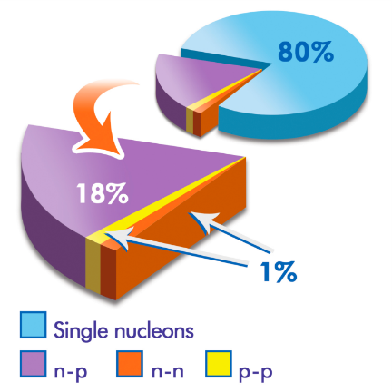


Extension of BM@N physics programme
Eli Piasetzki
The PAC is very pleased to hear the proposal to extend the BM@N physics programme to “Probing Short-Range Correlations” presented by groups from Tel Aviv University, MIT, GSI, and CEA together with the BM@N collaboration.
First outside project proposal to use the BM@N facility. Pioneering measurement that can only be performed at the Nuclotron aiming at studying short-range correlations in the carbon nucleus using inverse kinematics of a carbon beam incident on a hydrogen target.
The PAC recommends approval of this proposal for the period of the BM@N experiment operation until 2021.
What are Short Range Correlations in nuclei?
Interesting results in A(e, e’pN)
SRC ~ R_{N}
LRC ~ R_{A}
2N-SRC
≤1.f
~1 fm
1.7 fm
Inverse kinematics
¹²C on hydrogen target
p
1.7f
_{o} = 0.16 GeV/fm³
Nucleons
A-2
A-2
A pair with large relative momentum between the nucleons and small CM momentum.
beam
p/n

Slide 10
Recommendations on projects approved for completion in 2016 and proposed for continuation
NA61:
NA61 is expected to complete the data-taking phase in 2018, and the collaboration is considering the possibility of extending its programme for the period 2021–2024.
The PAC appreciates the role of the JINR group in data taking, detector and software maintenance but considers that the impact on physics analyses is not commensurate to the group size.
The PAC recommends continuation of the JINR participation in the NA61 experiment with the current group size until the end of the NA61 data-taking phase in 2018. Continuation of the JINR team activities within NA61 on data analysis or R&D beyond 2018 would require submitting a new proposal.
COMPASS II:
The PAC recognizes that the current revised proposal addresses the issues raised at the previous PAC meeting.
The PAC is pleased to see that the two groups from VBLHEP and DLNP laboratories have merged and presented a common proposal with a well-defined management structure, strategy and objectives.
However, the PAC considers that no compelling reason was presented to justify the group size with a total of 49 members (or 28.2 FTE) and the correspondingly large budget. The PAC requests the team and laboratory management to take the necessary measures to significantly reduce the group size and the travel budget. Assuming that this request is accepted and in order to avoid any further delays in the approval process, the PAC recommends continuation of the participation of the JINR group in the COMPASS-II experiment until the end of 2020.

Slide 11
Recommendations on projects approved for completion in 2016 and proposed for continuation
JUNO and Daya Bay:
The PAC appreciates the efforts and scientific achievements of the JINR team in the Daya Bay and JUNO experiments.
The PAC recognizes that the group took sizable responsibilities in the production of the PMTs’ high-voltage units. The JINR team also contributed to the development of the JUNO concept, detector engineering, development of the analysis software tools, and to the collaboration management. The work on the JUNO PMT system must have first priority as the flagship hardware contribution from JINR.
The PAC recommends continuation of JINR’s participation in the Daya Bay/JUNO project until the end of 2020. The PAC also recommends the team and laboratory management to reconsider whether the large manpower and corresponding large travel budget are justified.
NOVA:
The contributions from the JINR group since the start of the experiment in 2014 have been important and visible. The relatively young group was able to substantially contribute to the data taking via Virtual Control Room. The hardware contributions were complemented by studies on the readout electronics, also performed at a full test bench infrastructure in house.
The JINR researchers have addressed several physics items that will be continued in the next years and extended whenever possible.
Taking into account the high potential of the NOvA experiment and the broad scope of the JINR involvement, the PAC recommends continuation of this activity until the end of 2020.

Slide 12
Recommendations on projects approved for completion in 2016 and proposed for continuation
Mu2e and Muon g-2:
The new beam facility and the experiments are making very good progress on the way to their timely completion. The JINR group has made significant contributions to this success and is playing a visible and important role in both experiments.
The Committee recommends continuation of the JINR participation in the Mu2e and Muon g-2 experiments until the end of 2020.
TAIGA:
TAIGA can make a significant contribution to the understanding of the origin of cosmic rays in the region around the knee in the energy spectrum. A number of interesting results have been obtained, demonstrating good quality of the hardware and data processing algorithms.
The PAC notes the importance of the JINR obligations in the TAIGA collaboration and encourages the JINR group and in particular young researchers to increase their participation in the data analysis.
The PAC recommends extension of the project until the end of 2020.

Slide 13
Scientific Reports
The PAC heard two reports:
“Search for muon-to-electron conversion: the Mu2e experiment at Fermilab” presented by J. Miller
“Weak decays of B mesons in the light of the search for new physics” presented by M. Ivanov,
and thanked both speakers for their presentations.

Slide 14
Presentations by young scientists
The PAC reviewed 12 poster presentations in particle physics by young scientists from DLNP and VBLHEP Laboratories.
The PAC is very pleased with the overall very good quality of the posters.
The PAC selected the poster “The TUS space experiment” presented by M. Lavrova to be reported at this session of the Scientific Council.
The PAC recommends the management of laboratories to consider the possibility of presenting the young scientists work using multimedia presentations of a maximal three-minute duration in addition to static posters.

Slide 15
Next PAC-PP Meeting – 31 January – 1 February 2018
The next meeting of the PAC-PP will be held on 31 January – 1 February 2018
The following items are proposed to be included in the agenda:
  Follow-up on the to-do-list from this PAC meeting
  Report on the Nuclotron-NICA project
  Report on infrastructure issues including Nuclotron
  Report from the Coordinator of the Nuclotron experimental programme
  Status report on the MPD project including simulation results
  Status report on the BM@N project including simulation results
  Status report on the SPD experiment
  Reports on the results of the LHC experiments
  Consideration of new projects
  Reports and recommendations on the projects to be completed in 2017
  Posters from young physicists

Slide 16
Thank you!

