Slide 1
SPD ECAL status 31 Marth 2022
ECAL position inside of Cryostat
ECAL Support
End-Cap layout and general sizes inside of RS
End-Cap Module design with cell size 4x4 cm²
Test results with new SiPm S 14160-6015
Development the press form for scintillator production
31.03.2022
Oleg Gavrishuk
1
Notes:
1
1

Slide 2
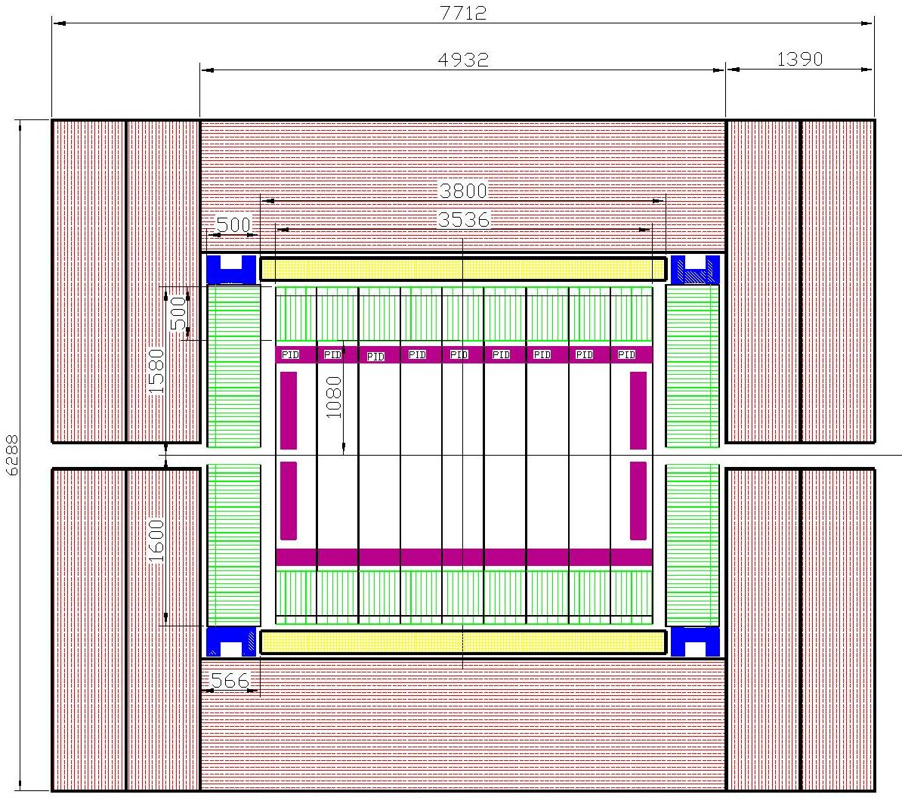
ECAL position (green) in the Cryostat (yellow), PID (magenta)
and RS (red)
EC-support (blue)
ECAL Barrel is located inside of Cryostat and Range System (RS), as shown by green hatched boxes.
ECAL End Cups are located inside of RS
The calorimeter sizes determine by :
thickness itself;
Criostat diameter;
- outer size of PID.
31.03.2022
Oleg Gavrishuk
2
Notes:
2
2

Slide 3
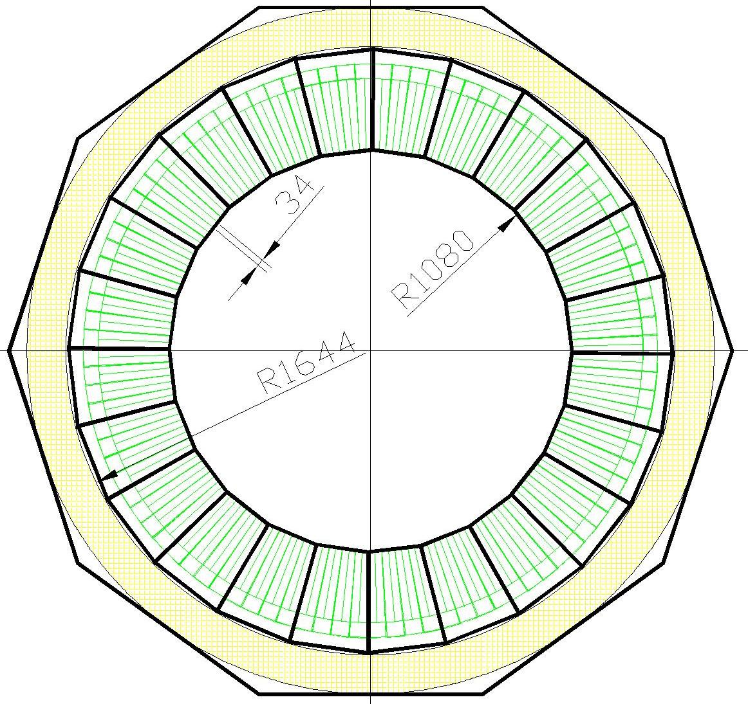
ECAL Barrel composition
Concept:
Barrel consist from 11 Rings
One Ring divided on 24 sectors
Sector connected to One ADC_64
Air cooling assumed
Cables can fixed along the sector
Ring : 1536 cells, ~4.0 t
11 Rings: 16896 cells, ~44 t
FrontEnd Numbers:
Channels: 16896
ADCs : 264
Frontend cards : 1056
HV: 11
Power (kW):
ADC : 4.8
Frontend cards : 1.0
HV: 1.1
Total: 6.9
31.03.2022
Oleg Gavrishuk
3

Slide 4
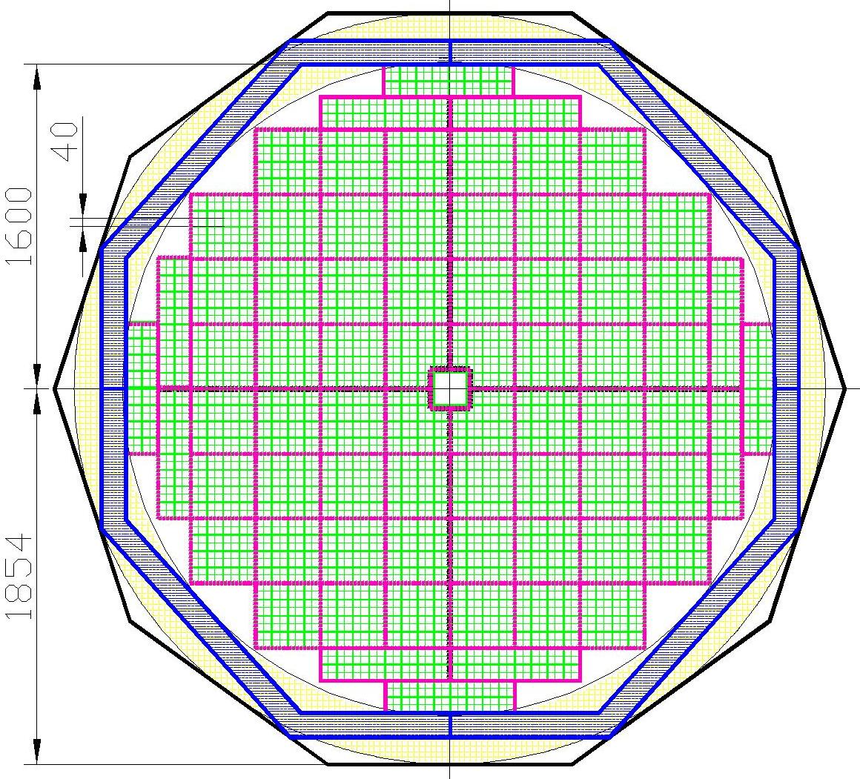
One End-Cap consists from 4 sectors. One sector – 1152 , of 40x40 mm²; One End Cup – 4608 cells ; The weight – 12 tonn (include Frame) Frontend Numbers and Power : ADC64 – 72 – 1296 W Amp_16 ch – 288 – 288 W Power unit – 8 – 800 W Total Power (One) – 2.4 kW End-Cap – installed in a frame that supports it. The frame is mounted directly to the RS as shown in this figure. All dimensions are in millimeters. The holes of size 160 ×160 mm².
ECAL End Cup composition

Slide 5
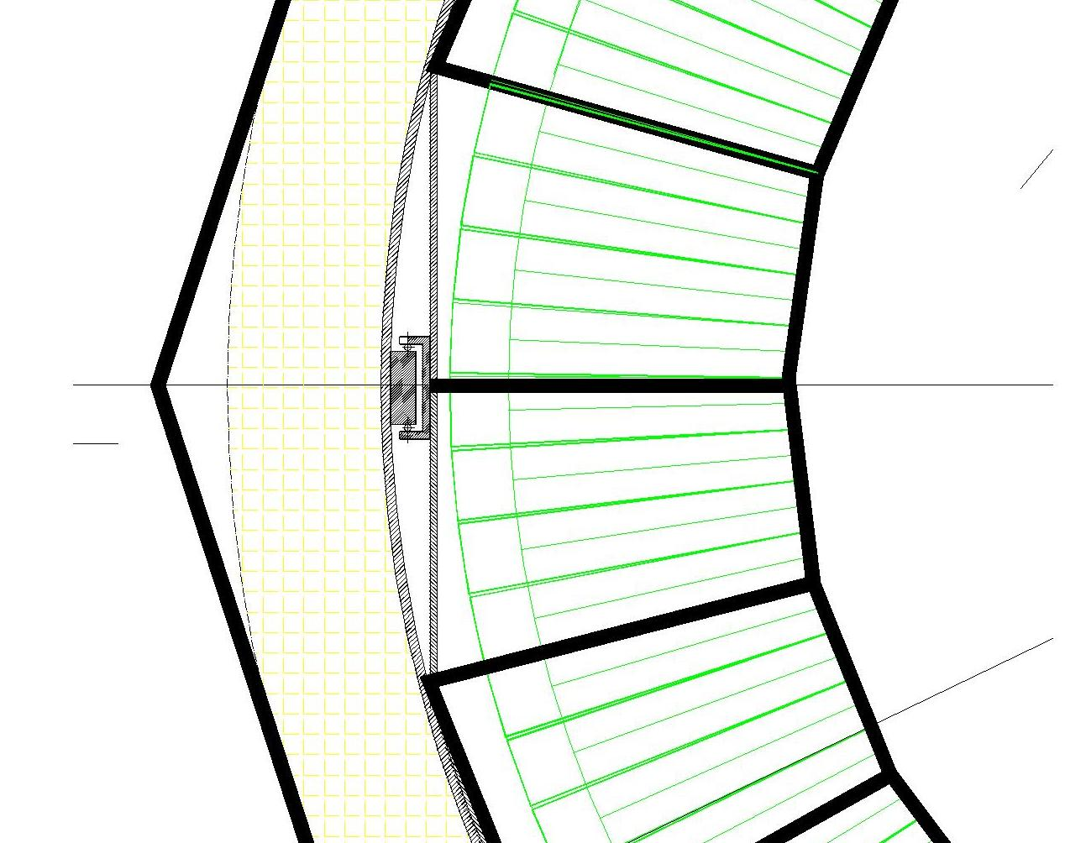
ECAL mounting inside of the cryostat
Concept:
Rails welded to Cryostat inner side
Roller fixed on the ECALs ring
ECAL ring is rolled into the cryostat
31.03.2022
Oleg Gavrishuk
5

Slide 6
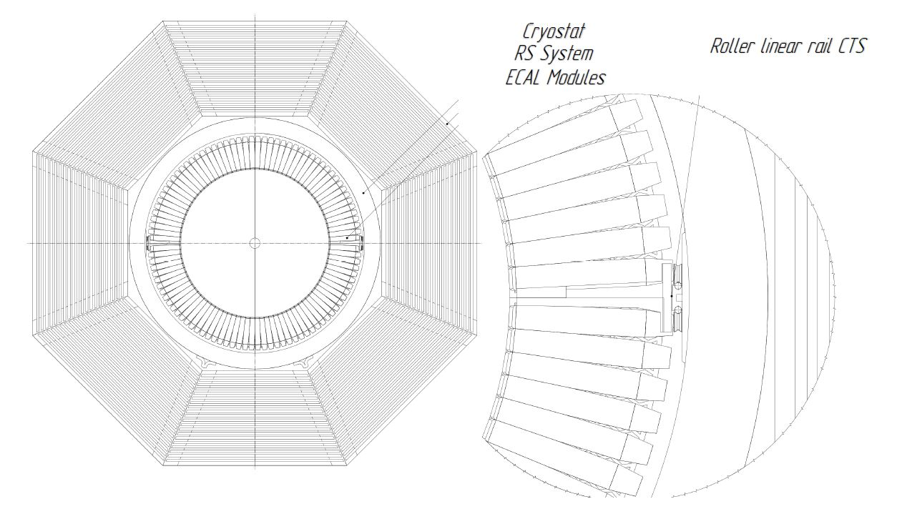
ECAL mounting inside of the cryostat
31.03.2022
Oleg Gavrishuk
6

Slide 7
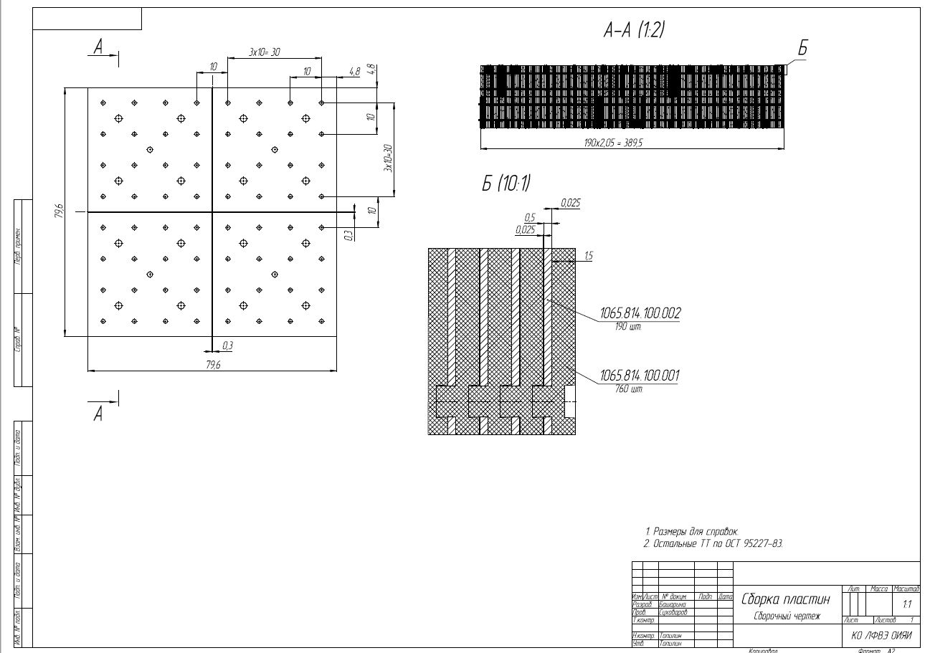
End-Cap Module (4x4) design
Gavrishchuk O.
7
7
Notes:
7
7

Slide 8
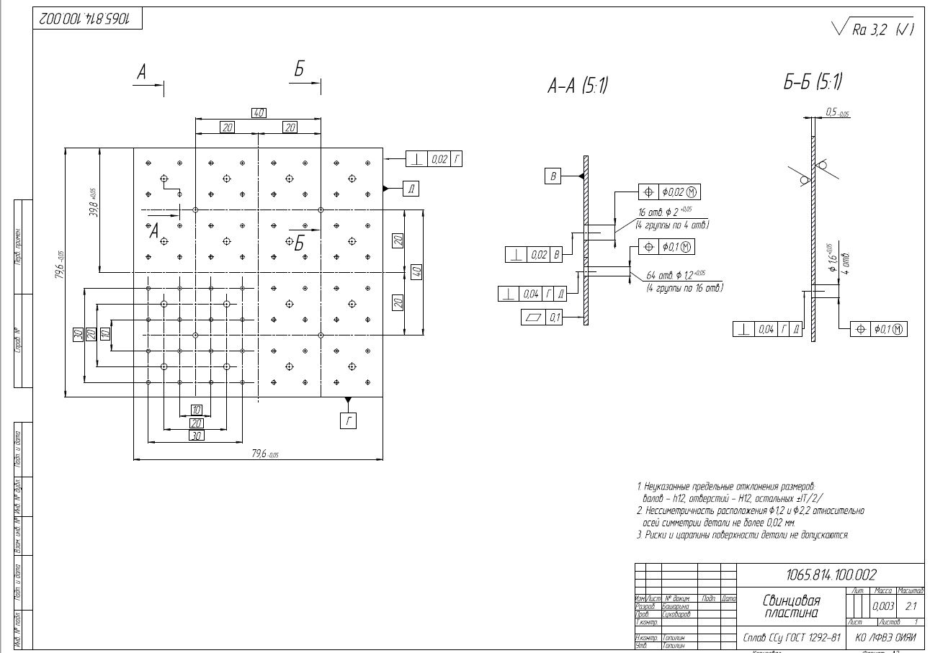
End-Cap module Lead plate
Gavrishchuk O.
8
8
Notes:
8
8

Slide 9
ECAL SPD with new SiPm (MPPC) S14160-6015 series
Pitch size - 15 microns
Sensitive area - 6x6 mm²
PDE ~ 30 %
Pixels Number - 160.000
Signal edge time
Dark current
Break point vs temperature
Temperature stability vs overvoltage
Cosmic tests with 15 and 25 pitch sizes
Press form development for 40x40 cm² cells
Gavrishchuk O.
9
Notes:
9
9

Slide 10
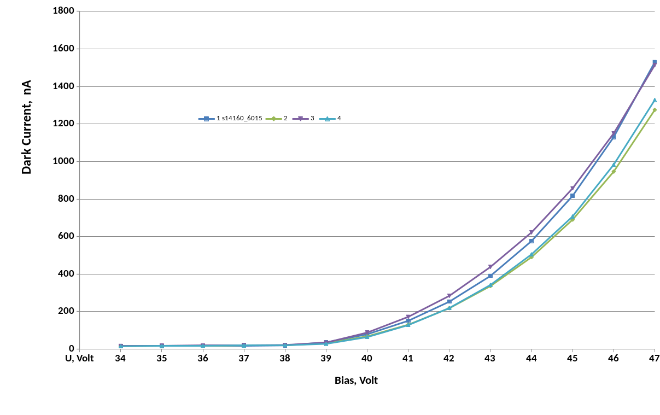
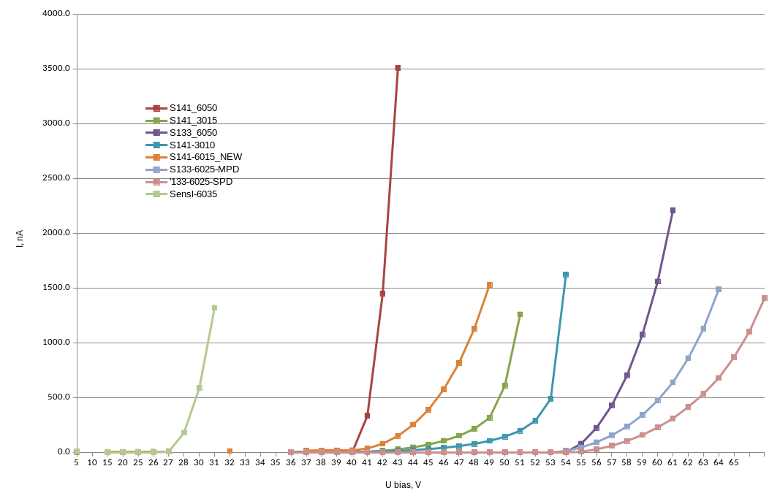
S14160-6015 Dark Current
Gavrishchuk O.
10
10
Notes:
10
10

Slide 11
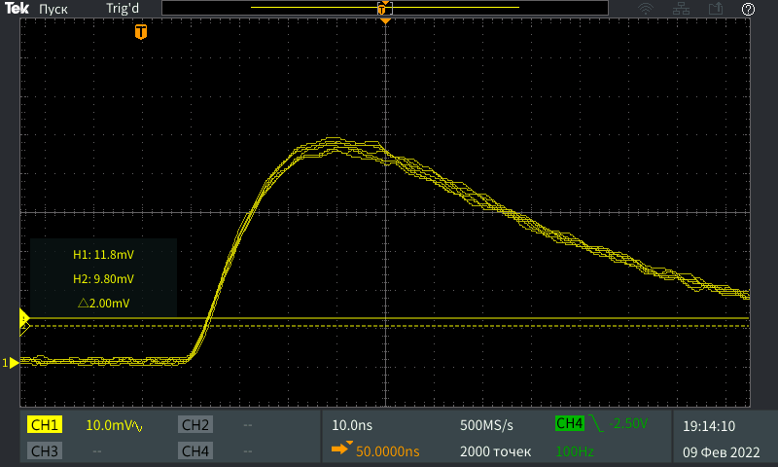
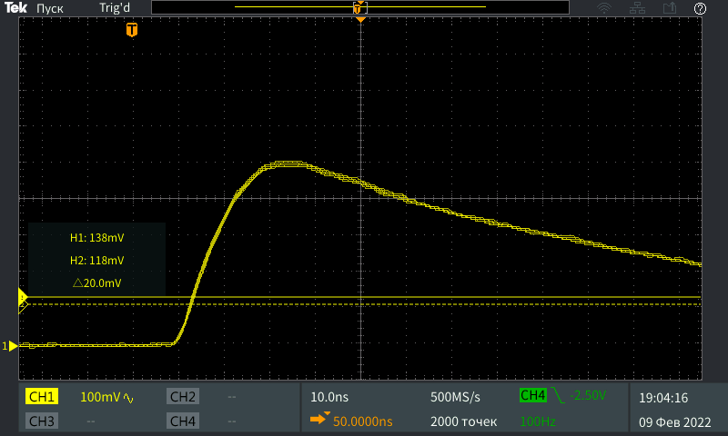
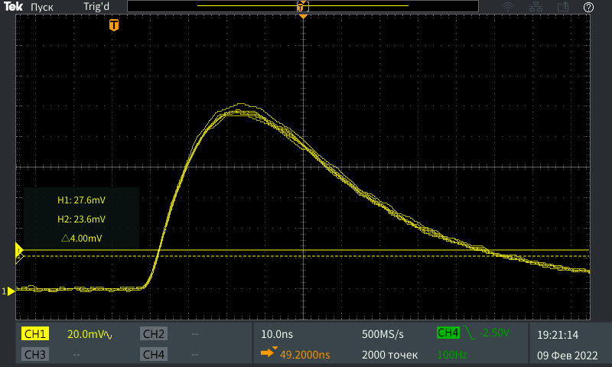
S14160-6015
SiPm Signals edges time :
Leading 30-40 ns
Trailing 80-100 ns
S14160-6050
S13360-6025
Gavrishchuk O.
11
11
Notes:
11
11

Slide 12
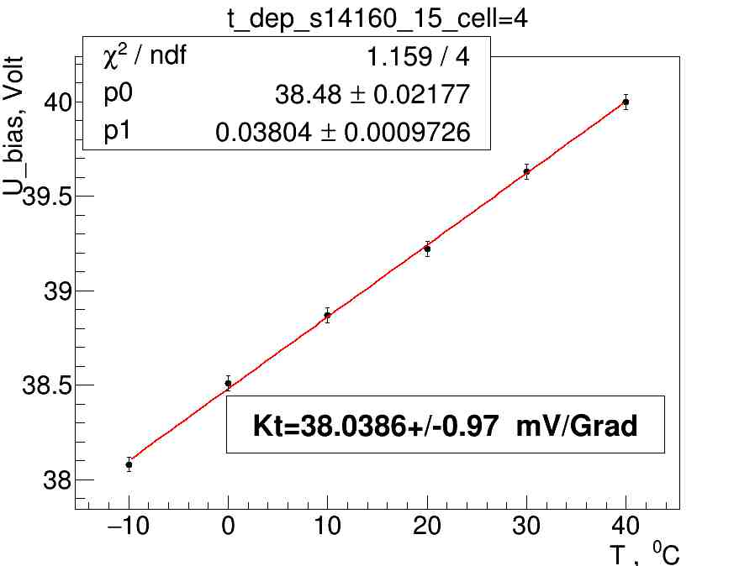
S14160-6015 Break Point vs Temperature
Gavrishchuk O.
12
12
Notes:
12
12

Slide 13
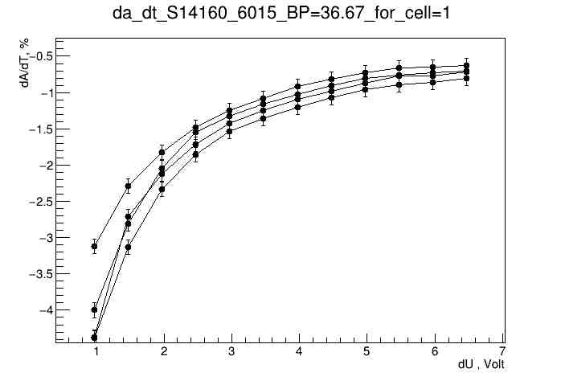
S14160-6015 Temperature Stability vs Overvoltage
Gavrishchuk O.
13
13
Notes:
13
13

Slide 14
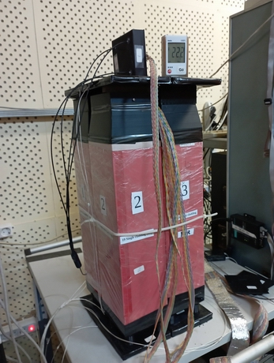
S14160-6015 Test Results in Cosmic Rays
ECAL setup for cosmic tests:
New SiPm S14160-6015
Performed the matrix of 2x2 modules
Each module consist of 55x55 mm² cells
Sampling :
- 190 layers;
- 1.5 mm Sc + 0.5 mm Pb.
ECAL properties:
- X₀=17,6 rad. length;
- R_{M} = 58 mm;
- L =500 mm – module length
31.03.2022
Oleg Gavrishuk
14
Notes:
14
14

Slide 15
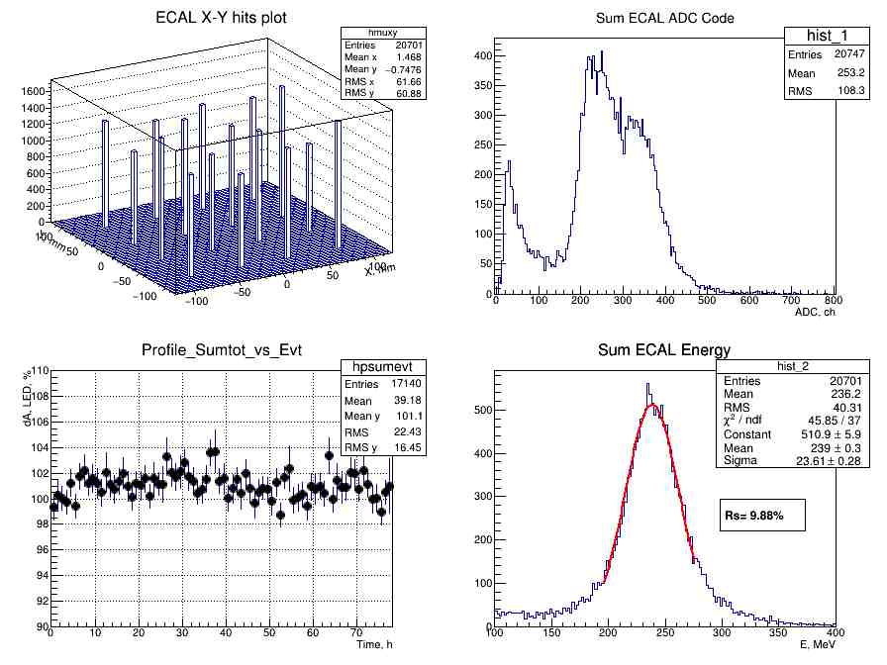
S14160-6015
15
31.03.2022
Oleg Gavrishuk
15
Notes:
15
15

Slide 16
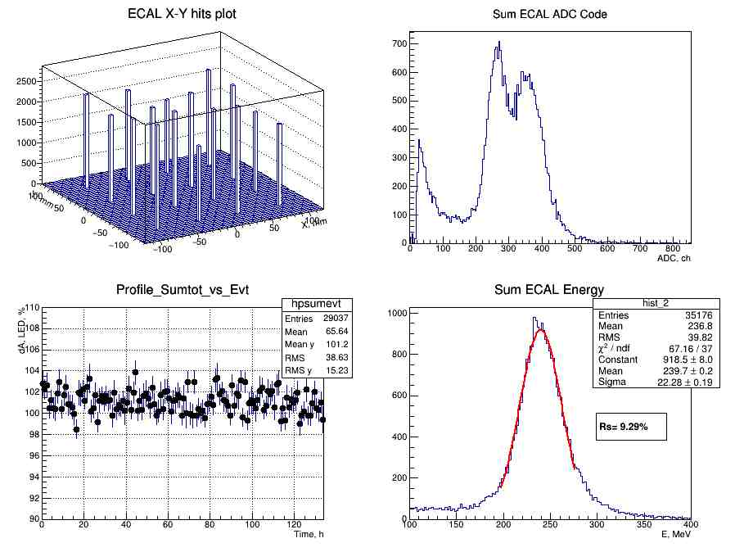
S13360-6025
16
31.03.2022
Oleg Gavrishuk
16
Notes:
16
16

Slide 17
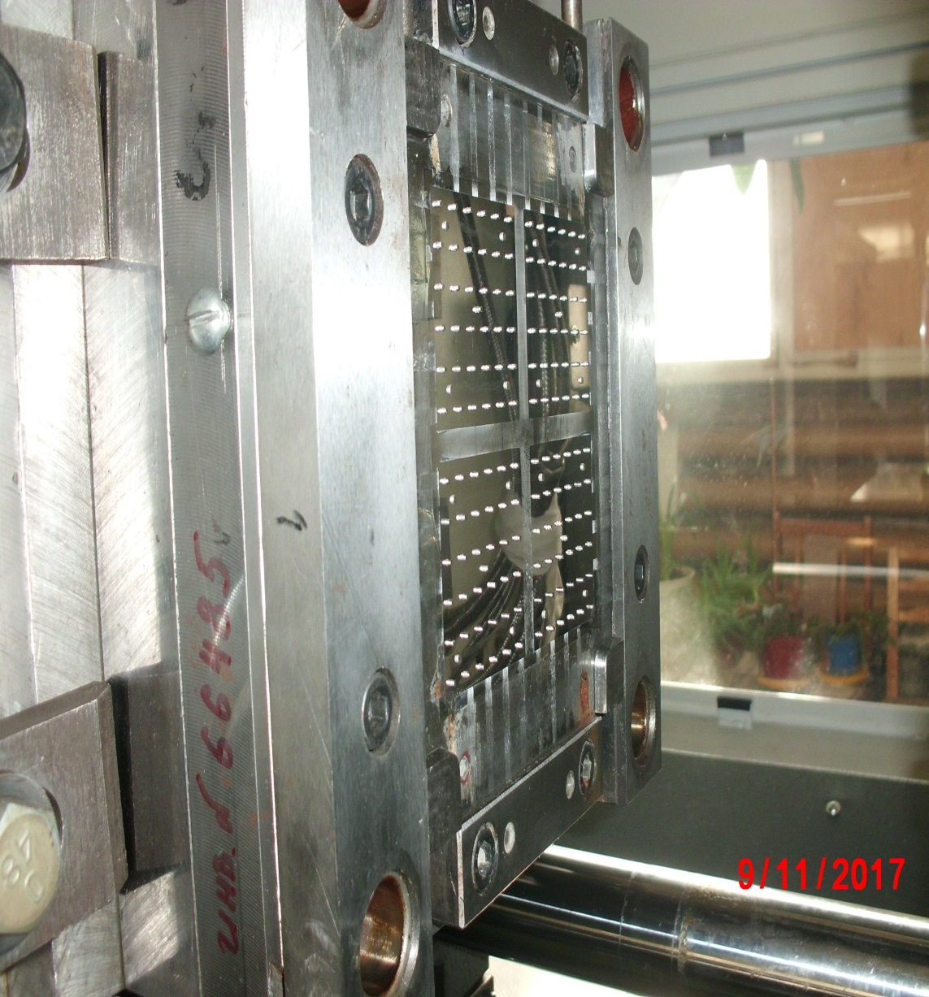
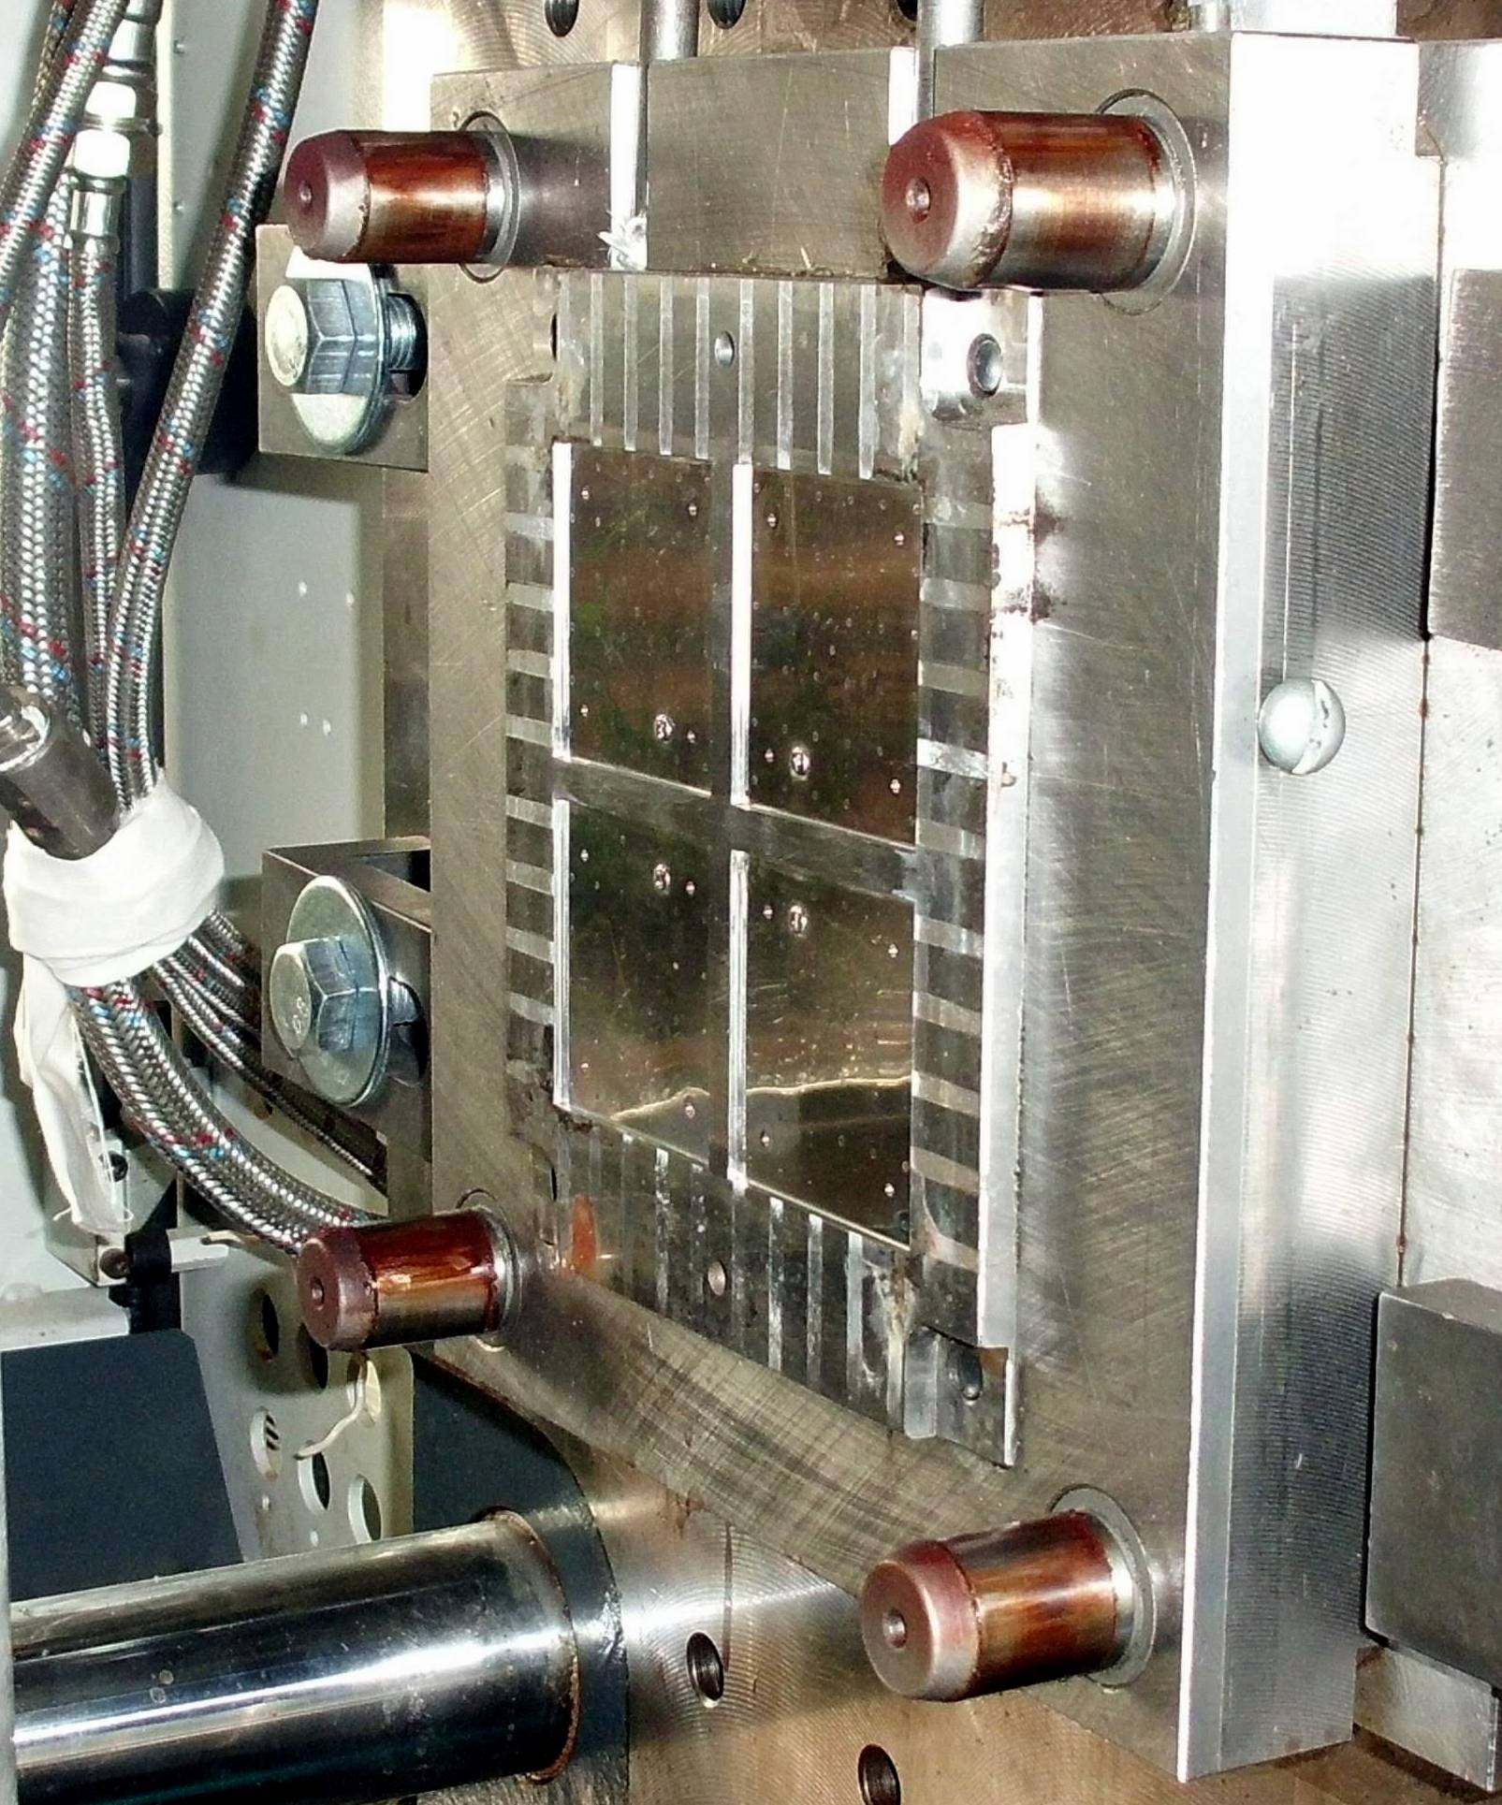
Press Form for scintillator production
31.03.2022
Oleg Gavrishuk
17

Slide 18
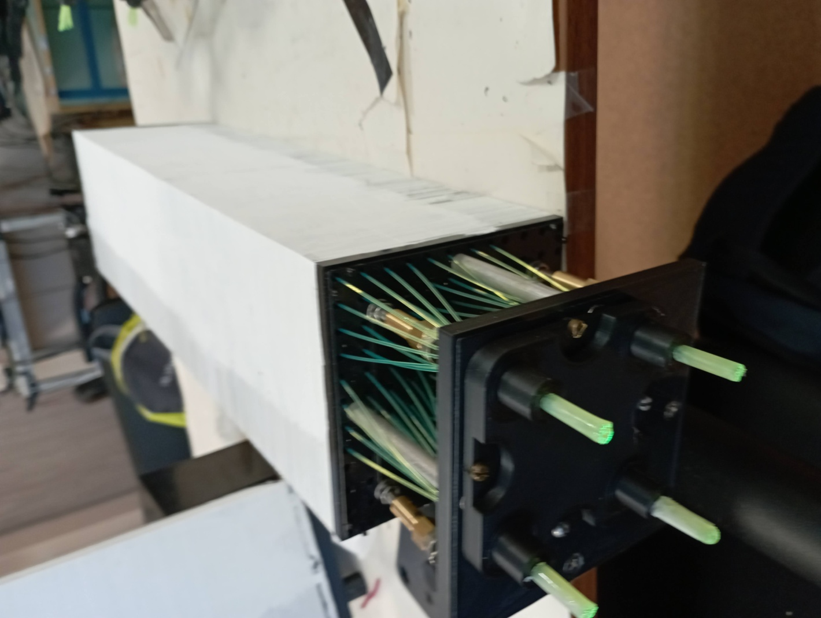
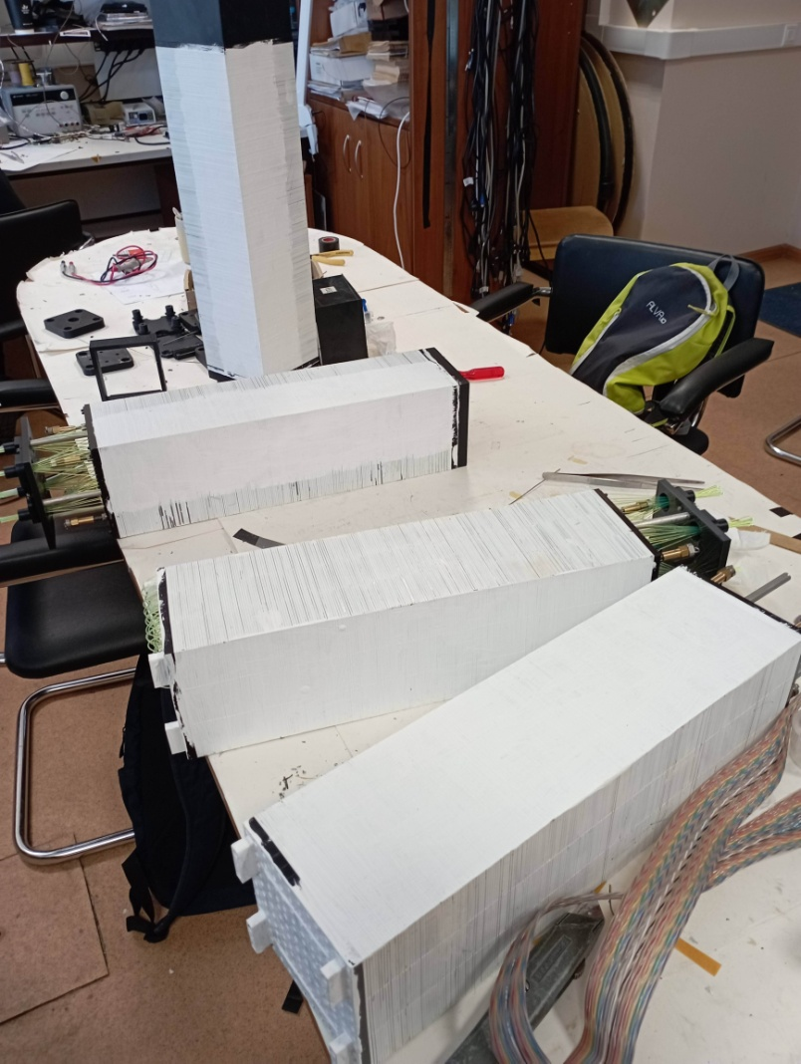
New 4 modules with cells 40x40 mm2 assembling. Preparation for cosmic test wit new S14160-6016.
31.03.2022
Oleg Gavrishuk
18

