Slide 1
Implementation of QnAnalysis framework for flow measurements in MPD
Parfenov Petr, Evgeny Kashirin, Mikhail Mamaev, Oleg Golosov, Valerii Troshin
NRNU MEPhI
Cross-PWG meeting in MPD
12.04.2022

Slide 2
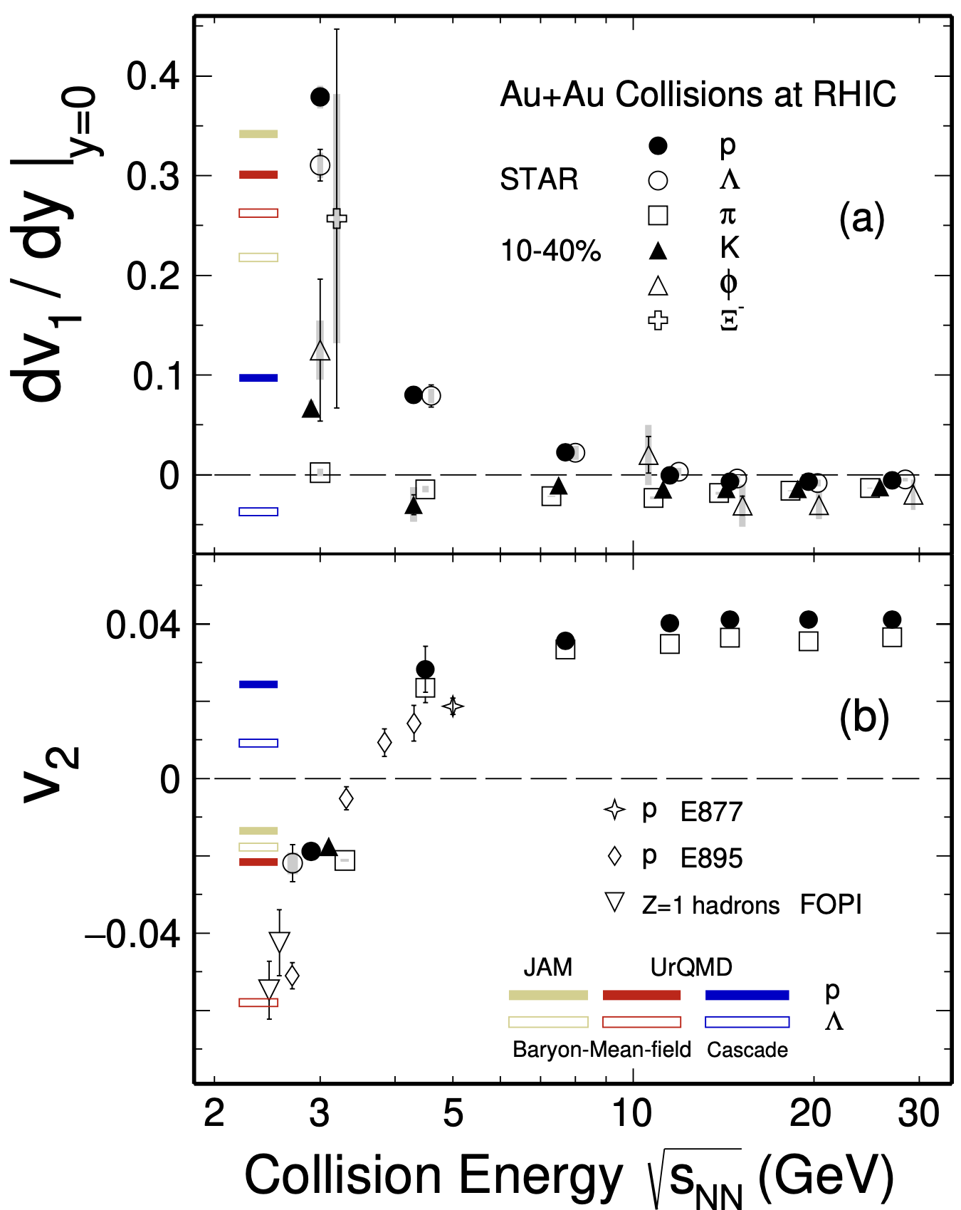
Anisotropic flow in heavy-ion collisions at Nuclotron-NICA energies
M. Abdallah et al. [STAR Collaboration] 2108.00908 [nucl-ex]
$$\frac{dN}{dφ}∝1+2\sum_{n=1}{v_{n}\cos\left[n\left(φ−Ψ_{RP}\right)\right]}, v_{n}=\left\langle \cos\left[n\left(φ−Ψ_{RP}\right)\right]\right\rangle$$
$v_{1}$ – directed flow, $v_{2}$ – elliptic flow, $v_{3}$ – triangular flow, etc.
Strong energy dependence of $dv_{1}/dy$ and $v_{2}$ at $\sqrt{s_{NN}}$=2-11 GeV
Anisotropic flow at FAIR/NICA energies is a delicate balance between:
The ability of pressure developed early in the reaction zone and
Long passage time (strong shadowing by spectators)
Differential flow measurements $v_{n}(\sqrt{s_{NN}}, centrality, pid, p_{T}, y)$ will help to study:
effects of collective (radial) expansion on anisotropic flow
interaction between collision spectators and produced matter
baryon number transport
Several experiments (MPD, BM@N, STAR FXT, CBM, HADES, NA61/SHINE) aim to study properties of the strongly-interacted matter in this energy region
BM@N
CBM
MPD

Slide 3
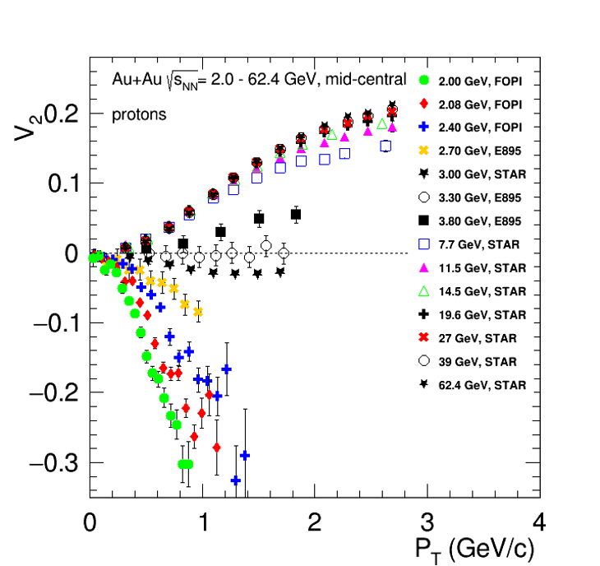
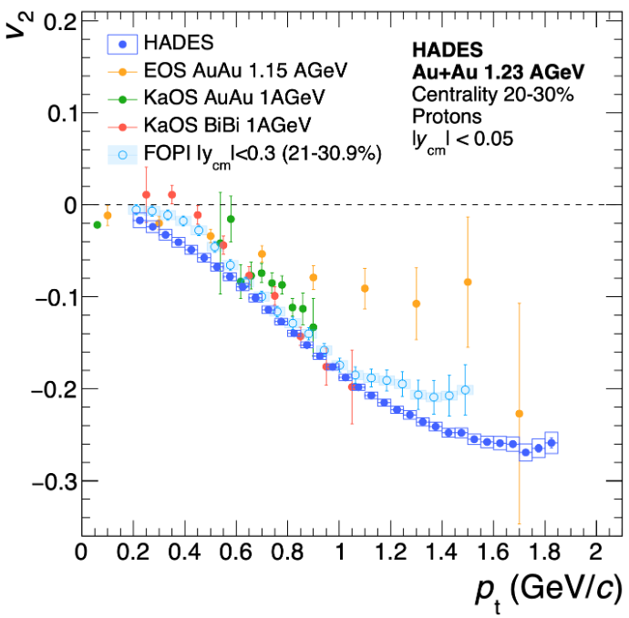
Why do we need unified package for flow analysis?
Biggest systematics – difference between experiments (for example, FOPI vs. HADES)
Problem with correction for detector acceptance

Slide 4
$u_{n},Q_{n}$ vectors formalism for flow measurements
Unit vector of a particle $u_{n}\left(centrality,pid,p_{T},y\right)$:
$$u_{n}=e^{inφ}=\left\{\begin{aligned}u_{n,x}≡x_{n}=\cos{nφ} \\ u_{n,y}≡y_{n}=\sin{nφ}\end{aligned}\right.$$
Event flow vector $Q_{n}\left(centrality\right)$:
$$Q_{n}=\sum_{k=1}^{M}{ω_{n}^{k}u_{n}^{k}}≡\left|Q_{n}\right|e^{inΨ_{n}}=\left\{\begin{aligned}Q_{n,x}≡X_{n}=\left|Q_{n}\right|\cos{nΨ_{n}} \\ Q_{n,y}≡Y_{n}=\left|Q_{n}\right|\sin{nΨ_{n}}\end{aligned}\right.$$
$φ$ – azimuthal angle of the produced particle
$ω$ – weight of the $Q_{n}$ vector (for example, $ω=1$ for participant plane and $ω=E$ for spectator plane)
$Ψ_{n}$ – event plane angle

Slide 5
$u_{n},Q_{n}$ vectors formalism for flow measurements
Flow can be measured using $Q_{n}, u_{n}$ vectors:
$$v_{n}=\frac{\left\langle u_{n}^{±}Q_{n}^{∓∗}\right\rangle }{2\sqrt{\left\langle Q_{n}^{+}Q_{n}^{−∗}\right\rangle }},v_{n,xx}=\frac{\left\langle x_{n}^{±}X_{n}^{∓∗}\right\rangle }{\sqrt{2\left\langle X_{n}^{+}X_{n}^{−∗}\right\rangle }},v_{n,yy}=\frac{\left\langle y_{n}^{±}Y_{n}^{∓∗}\right\rangle }{\sqrt{2\left\langle Y_{n}^{+}Y_{n}^{−∗}\right\rangle }}$$
Where $“±”$ – different subevents
Normalizations of $Q_{n}$ vector:
$\left|Q_{n}\right|$ (event plane method)
$1$ (scalar product method)

Slide 6
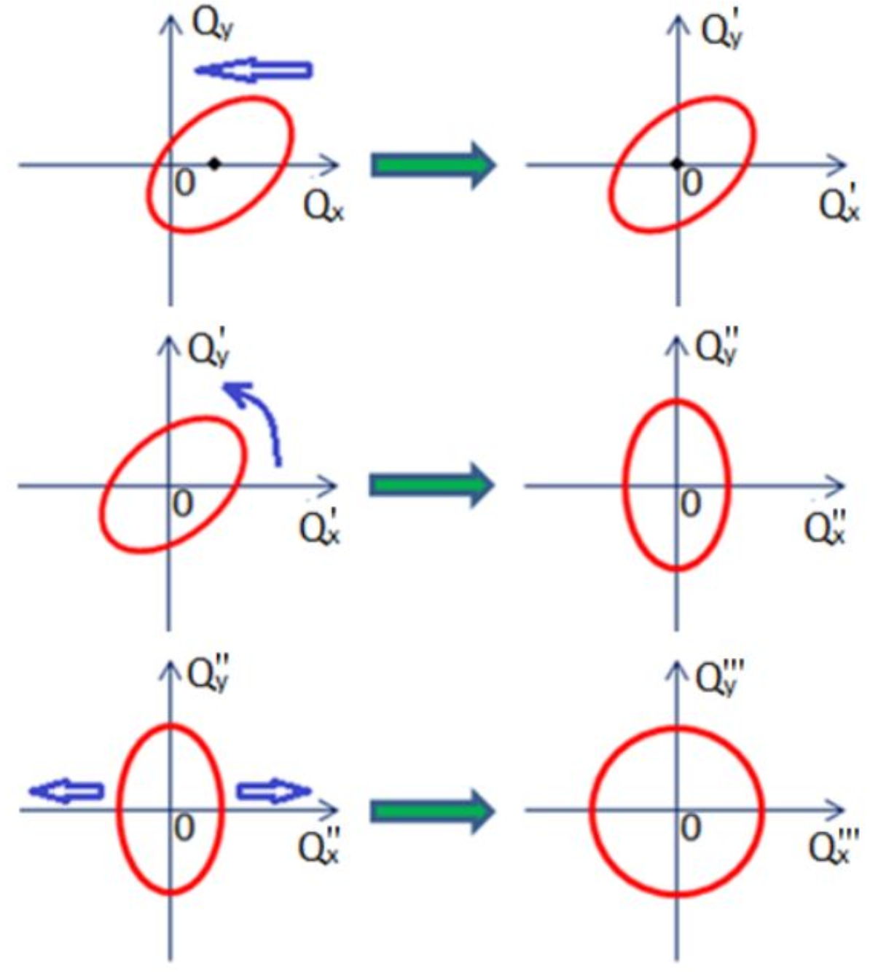
Corrections for non-uniform acceptance
$$Y_{n}$$
$$Y_{n}^{′}$$
Recentering:
$$X_{n}^{′}=X_{n}−\left\langle X_{n}\right\rangle , Y_{n}^{′}=Y_{n}−\left\langle Y_{n}\right\rangle$$
Twist:
$$X_{n}^{′′}=\frac{X_{n}^{′}−λ_{2n}^{s−}Y_{n}^{′}}{1−λ_{2n}^{s−}λ_{2n}^{s+}}, Y_{n}^{′′}=\frac{Y_{n}^{′}−λ_{2n}^{s−}X_{n}^{′}}{1−λ_{2n}^{s−}λ_{2n}^{s+}}$$
Rescale:
$$X_{n}^{′′′}=\frac{X_{n}^{′′}}{a_{2n}^{+}}, Y_{n}^{′′′}=\frac{Y_{n}^{′′}}{a_{2n}^{−}}$$
Where $a_{2n}^{±}=1±\left\langle X_{2n}\right\rangle ,λ_{m∓n}^{s±}=\frac{v_{m}}{v_{n}}\frac{\left\langle Y_{m∓n}\right\rangle }{a_{2n}^{±}}$
$$X_{n}$$
$$X_{n}^{′}$$
$$Y_{n}^{′}$$
$$Y_{n}^{′′}$$
$$X_{n}^{′}$$
$$X_{n}^{′′}$$
$$Y_{n}^{′′}$$
$$Y_{n}^{′′′}$$
$$X_{n}^{′′}$$
$$X_{n}^{′′}$$
Corrections are based on method in: I. Selyuzhenkov and S. Voloshin PRC77, 034904 (2008)
Corrections applicable for both $Q_{n}$ and $u_{n}$ vectors

Slide 7
The QnAnalysis package
QnAnalysis
QnTools configuration
Motivation:
Decoupling configuration from implementation
Persistency of analysis setup
Co-existence of different setups (easy systematics study)
Unification of analysis methods
Self-descriptiveness of the analysis results
Mapping AnalysisTree to internal objects of QnTool
QnTools library
FlowVectorCorrections library
Q-vectors corrections
QnAnalysis requirements:
ROOT ver. ≧ 6.20 (with MathMore library)
C++17 compatible compiler
CMake ver. ≧ 3.13
Can be easily installed on NICA cluster using ROOT and CMake modules
Q-vectors correlations
Building observables
(resolution, flow, etc.)
Git repository: https://github.com/HeavyIonAnalysis/QnAnalysis

Slide 8
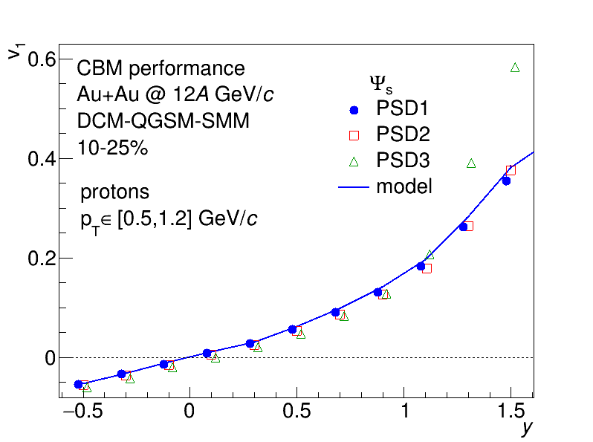
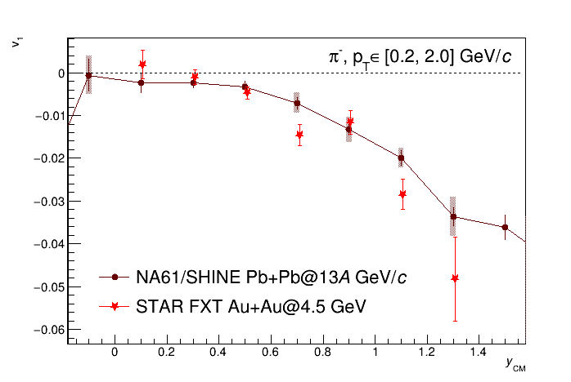
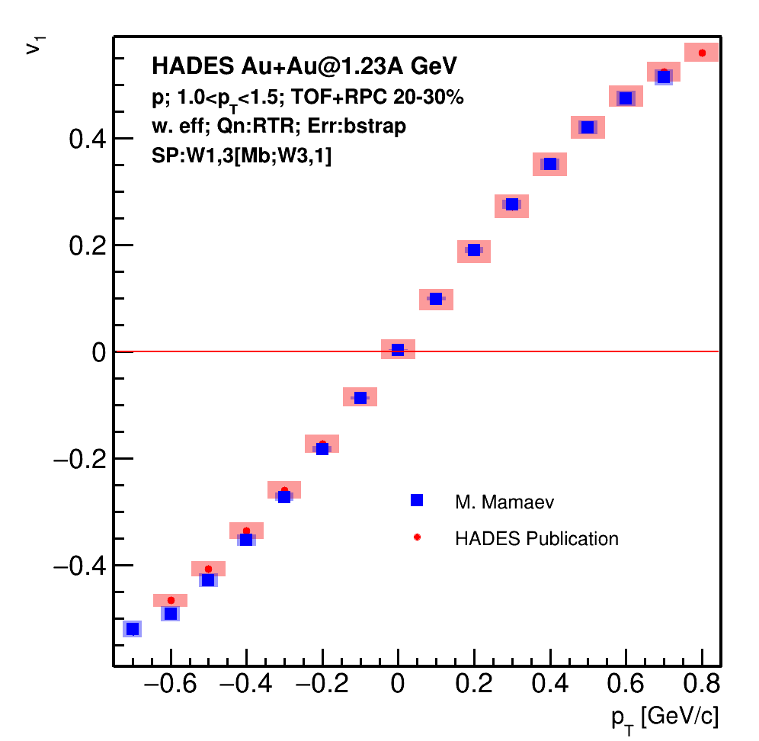
Examples of QnAnalysis usage
HADES (M. Mamaev)
CBM (O. Golosov)
NA61/SHINE (E. Kashirin)
y_{cm}
QnAnalysis is already used in the current (HADES, ALICE) and future (CBM) experiments
Now it is available in MPD

Slide 9
AnalysisTree format for MPD data
AnalysisTree
AnalysisTree:
A framework and experimentally independent, lightweight and flexible data format that stores information in configurable basic objects:
EventHeader – information about general event properties
Track – reconstructed track parameters
Particle – Monte Carlo track parameters
Module – information about module in a module-type detector (FHCal)
Hit – information about hit in a hit-type detector
Each object can contain any number of custom integer, floating or boolean fields
Core library
Data formats:
EventHeader
Track
Particle
Module
Hit
Infra library
Ifrastructure for AnalysisTree:
AnalysisTree reader
AnalysisTree writer
AnalysisTree can store information from any experiment and/or model
AnalysisTree data format:
https://github.com/HeavyIonAnalysis/AnalysisTree

Slide 10
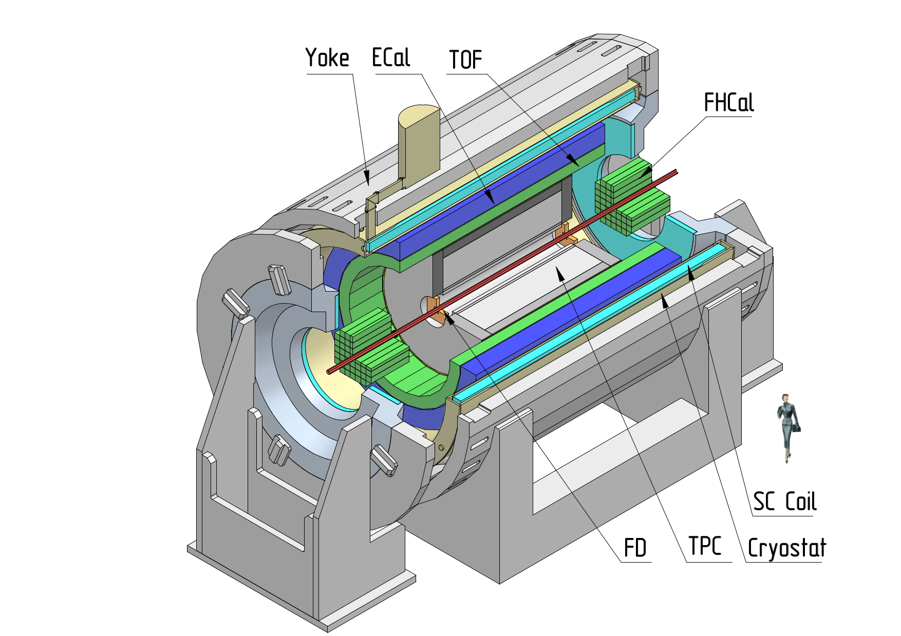
MPD experiment at NICA
Multi Purpose Detector (MPD) Stage 1
Data set – official production (request 9):
Au+Au at $\sqrt{s_{NN}}=$ 7.7 GeV (10M events)
Centrality determination:
$b$ based on MC-Glauber method
Event plane determination: TPC (for $v_{2}$), FHCal (for $v_{1}$)
Track selection:
Primary tracks
$N_{hits}^{TPC}>16$
$|η| < 1.5$
$p_{T}<3.0 GeV/c$
PID based on PDG
UrQMD
GEANT4
Reconstruction
Flow analysis

Slide 11
QnAnalysis implementation in MPD experiment
AnalysisTree
MpdDst
MpdDst$→$AnalysisTree converter
QnAnalysisCorrect
QnTools
mpd-analysis-configuration.yml
QnAnalysisCorrelate
mpd-correlation.yml
QnAnalysis
MPD-specific interface:
MpdDst$→$AnalysisTree converter: converter from MpdDst to AnalysisTree format
YAML configuration files for QnAnalysis:
mpd-analysis-configuration.yml: sets up $Q_{n}, u_{n}$ vectors to collect (cuts, correction steps, …)
mpd-correlation.yml: sets up correlations between previously collected $Q_{n}, u_{n}$ vectors
General interface:
AnalysisTree: A framework-independent, lightweight and flexible data format
QnTools: set of tools for multidimentional Q-vector-based corrections and correlations:
QnAnalysisCorrect: collects $Q_{n}, u_{n}$ vectors
QnAnalysisCorrelate: make correction between collected $Q_{n}, u_{n}$ vectors
Joint development with FAIR (CBM for NICA)
QnAnalysis is already used in the current (HADES, ALICE) and future (CBM) experiments – now available for MPD
QnAnalysis git link: https://github.com/HeavyIonAnalysis/QnAnalysis
AnalysisTree git link: https://github.com/HeavyIonAnalysis/AnalysisTree

Slide 12
Flow measurement procedure in MPD with QnAnalysis
The whole procedure can be divided into 3 main steps:
Preprocessing
Analysis
Postprocessing
Preprocessing
Conversion to AnalysisTree
Necessary calibrations (centrality determination, pid, etc.)
Creating additional AnalysisTree with extended information
Analysis
Configure Q-vectors
Run QnAnalysisCorrect to measure and correct Q-vectors
Configure correlations between Q-vectors
Run QnAnalysisCorrelate to collect correlations
Postprocessing
Obtain $v_{n}$ from correlations
Get TGraphErrors for $v_{n}$
Working templates for all steps can be found here:
https://devel.mephi.ru/PEParfenov/QnAnalysisMPD_scripts

Slide 13
Preprocessing stage
Converter from MpdDst to base AnalysisTree – a simple ROOT macro:
root -l -b -q MpdDst2AT.C’(“mpddst.root”,”AnalysisTree.root”,”System”,$\sqrt{s_{NN}}$)’
Run additional calibration (centrality determination, pid, candidates from KFParticleFinder, etc.) if needed
Create an additional AnalysisTree with extended information from previous step using run_write_task.cpp and UserTaskWrite class (needed to be compiled)
Prepared setup examples for MPD are available here:
https://devel.mephi.ru/PEParfenov/QnAnalysisMPD_scripts

Slide 14
Analysis stage: QnAnalysisCorrect
QnTools
Branches:
Event header(s)
Channel detector(s)
Tracks (reco, mc,…)
AnalysisTree input
Correction step runner
Mapping input to Q-vectors
Corrected Q-vectors
DataHeader:
Channel detector geometry
Q-vectors correction
recentering, twist, rescale
Q-vector definitions
Correction steps
Subevent kinematics
Additional cuts
QA
YAML configuration
Serialazible C++ classes
Event axes
Event QA

Slide 15
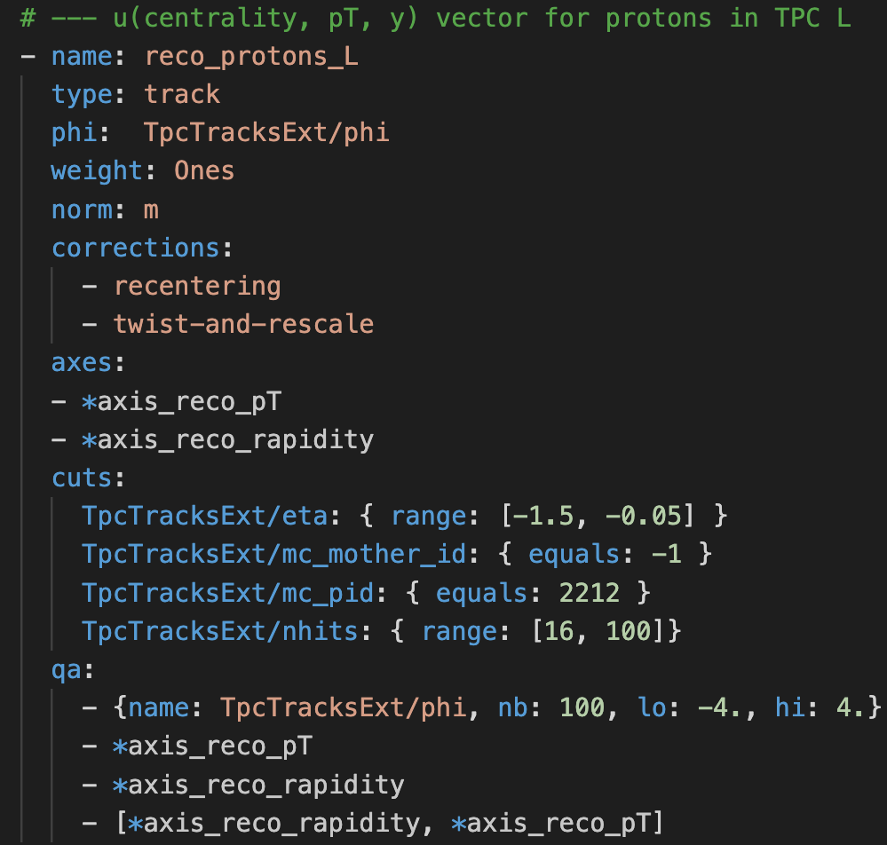
Configuration example: Q-vector definition
AnalysisTree variable
<branch>/<field>
Reusable elements using YAML substitution
Here, the Q-vector was defined with the following cuts:
$−1.5<η<−0.05$ (TPC L)
$motherId=1$ (primary track)
$pdg = 2212$ (protons)
$16<N_{hits}<100$ (track quality)
Prepared setup examples for MPD are available here:
https://devel.mephi.ru/PEParfenov/QnAnalysisMPD_scripts

Slide 16
Analysis stage: QnAnalysisCorrelate
QnTools
Q-vectors correlation
Corrected Q-vectors
Combinig Q-vector tuples
Q-vector correlations
Processing correlations
Sampling options
Event axes
YAML configuration
Serialazible C++ classes
Correlation args:
Query on Q-vector
Component(s) to correlate
Correction steps

Slide 17
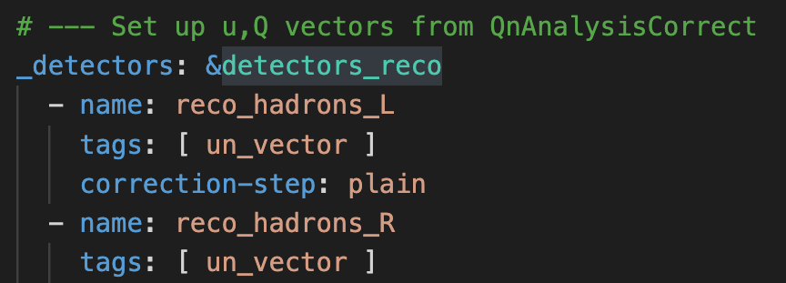
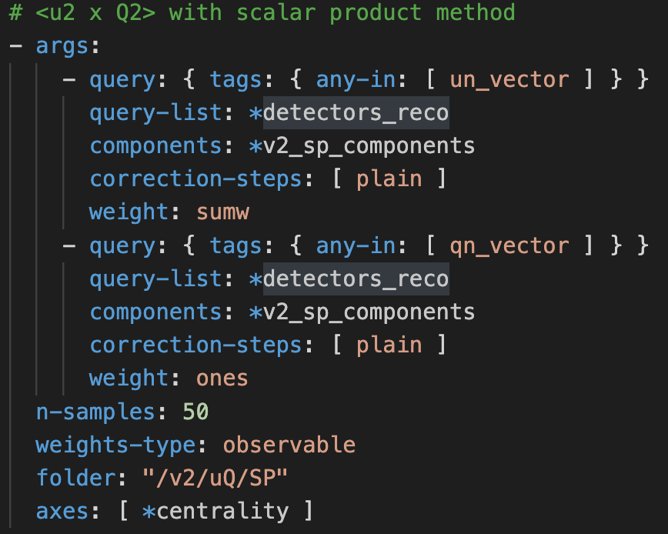
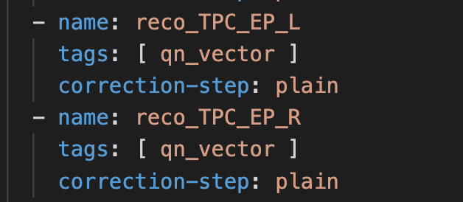
Configuration example: Correlation setup
Here, the correlations $\left\langle u_{2}\left(centrality, p_{T}, y\right)∗Q_{2}(centrality)\right\rangle$ are defined with tags “un_vector” and “qn_vector” correspondingly
Prepared setup examples for MPD are available here:
https://devel.mephi.ru/PEParfenov/QnAnalysisMPD_scripts

Slide 18
Postprocessing stage
Calculate $v_{n}$ from correlations and save them as TGraphErrors – a simple ROOT macro:
root -l -b -q Draw_graphs.C’(“correlation_out.root”,”graphs.root”)’
One can do simple arithmetic operations with correlations (+,-,*,/,sqrt(),…). That way, it is easy to calculate $v_{n}$. For example, for scalar product one can get $\left\langle u_{n}^{±}Q_{n}^{∓∗}\right\rangle$ and $\left\langle Q_{n}^{+}Q_{n}^{−∗}\right\rangle$ and construct $v_{n},v_{n,xx}, v_{n,yy}$.
QnAnalysis allows to contruct differential $v_{n}$ signal for any component of $u_{n}=\left(x_{n},y_{n}\right)$ and $Q_{n}=\left(X_{n},Y_{n}\right)$ separately
Prepared setup examples for MPD are available here:
https://devel.mephi.ru/PEParfenov/QnAnalysisMPD_scripts

Slide 19
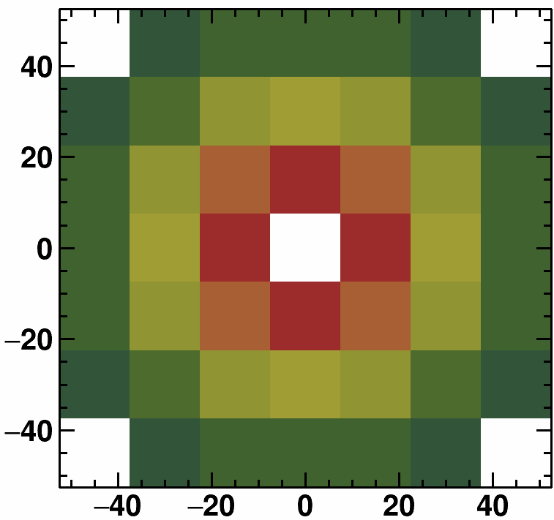
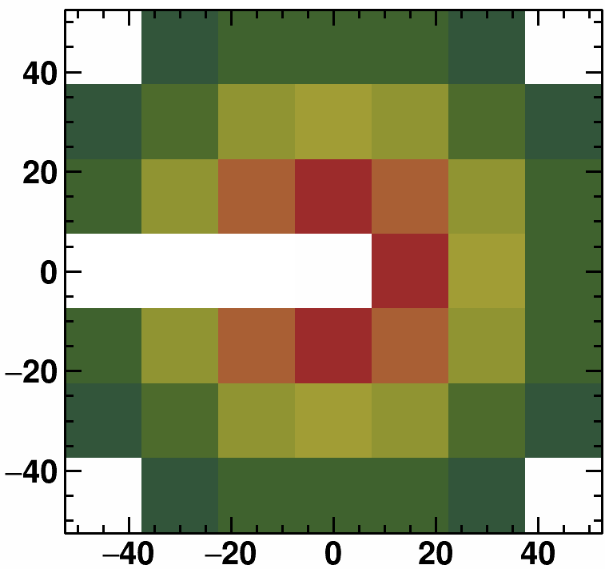
Non-uniform acceptance corrections
FHCal
Correction for non-uniform azimuthal acceptance
TPC
$$Y_{n}$$
$$Y_{n}^{′}$$
Recentering
Twist
Rescaling
$$X_{n}$$
$$X_{n}^{′}$$
$$Y_{n}^{′}$$
$$Y_{n}^{′′}$$
Acceptance filter
$$X_{n}^{′}$$
$$X_{n}^{′′}$$
TPC
FHCal
$$Y_{n}^{′′}$$
$$Y_{n}^{′′′}$$
$$X_{n}^{′′}$$
$$X_{n}^{′′}$$
Corrections are based on method in: I. Selyuzhenkov and S. Voloshin PRC77, 034904 (2008)
$$−165°<φ<165°$$
Modules 23, 24, 25 (L) and 19, 20, 21 (R) are off

Slide 20
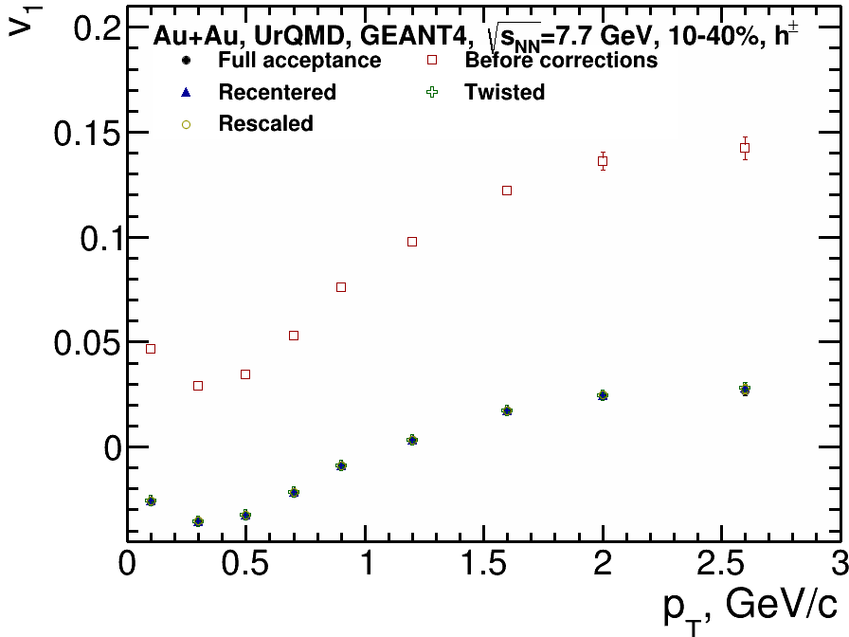
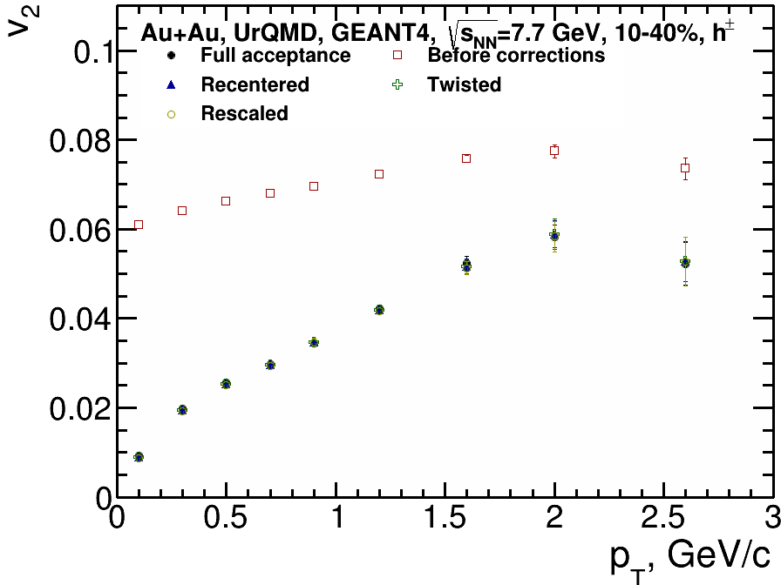
Effects of non-uniformity corrections
Q-vector | $Q_{n}$ weight | Correction axes | Correction steps | Error calculation | $Q_{n}$ normalization
Spectators (FHCal) | Module energy | b [0,12], 9 bins | Recentering Twist Rescaling | Bootstrapping, 50 samples | Sum of weights
Charged hadrons (TPC) | 1 | pT [0,3], 9 bins b [0,12], 9 bins
Good agreement between $v_{n}$ with acceptance non-uniformity corrections and full acceptance

Slide 21
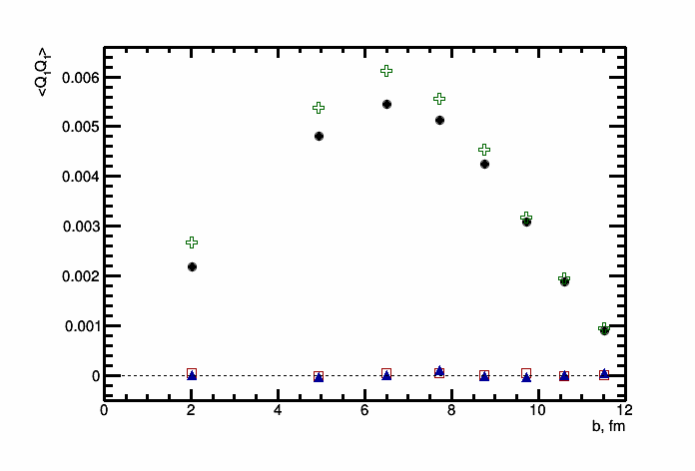
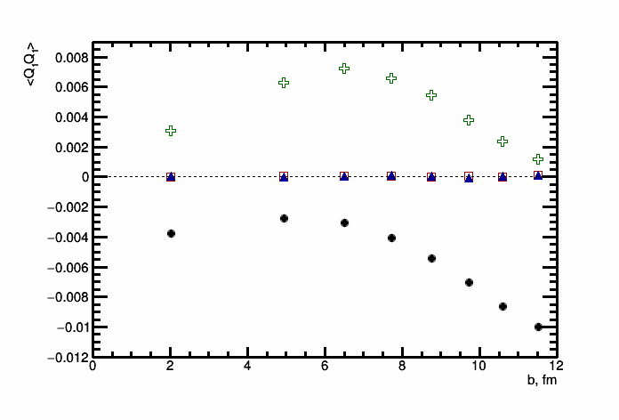
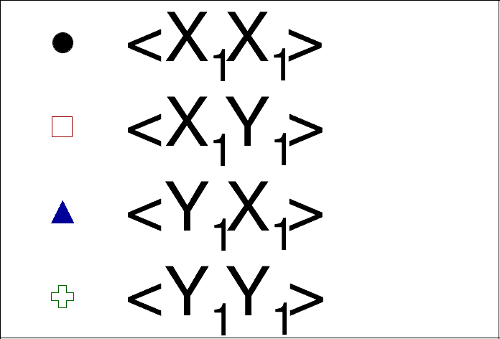
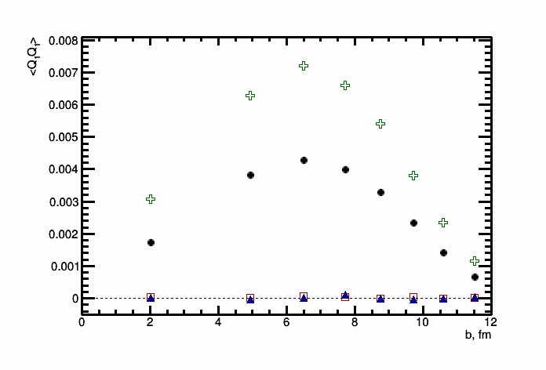
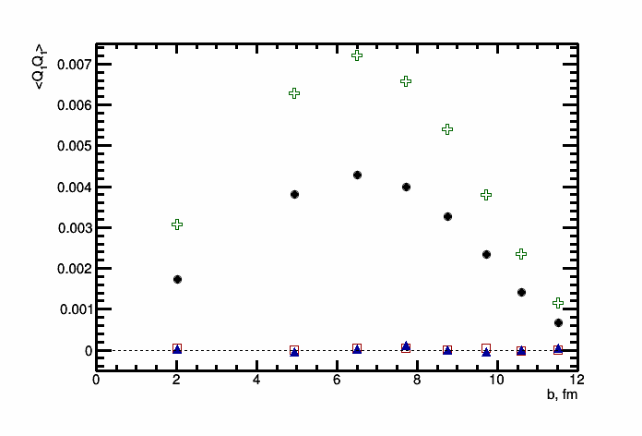
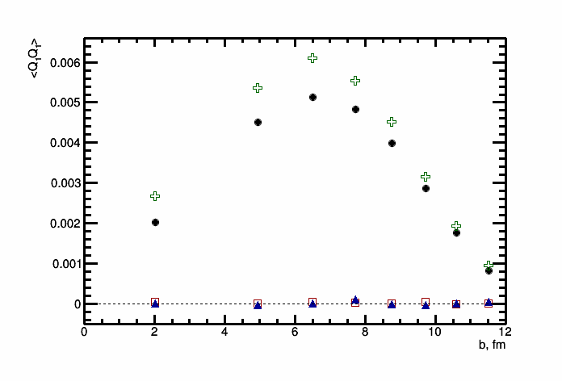
$\left\langle Q_{n}Q_{n}\right\rangle$ components (FHCal)
Full acceptance
Before corrections
Recentered
Twisted
Rescaled
Looking at different components of $\left\langle Q_{n}Q_{n}\right\rangle$ provides more detailed information about effects of non-uniform acceptance

Slide 22
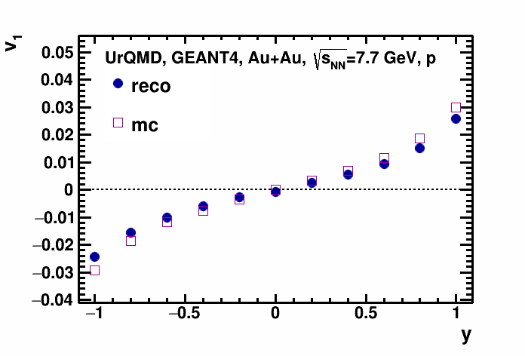
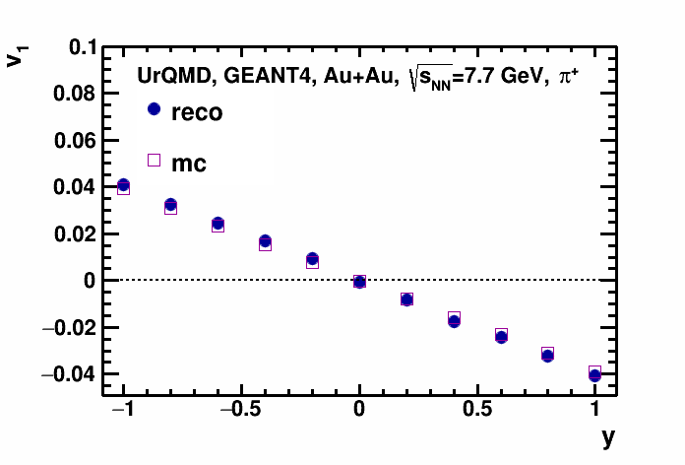
Reco vs. mc: $v_{1}$
10-40%
10-40%
$v_{1}$ from reconstructed tracks is in agreement with $v_{1}$ from model

Slide 23
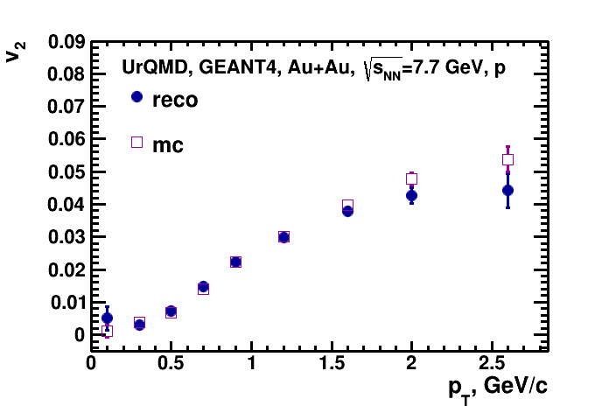
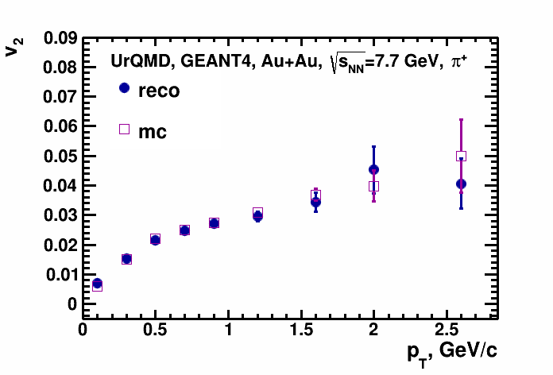
Reco vs. mc: $v_{2}$
10-40%
10-40%
$v_{2}$ from reconstructed tracks is in agreement with $v_{2}$ from model

Slide 24
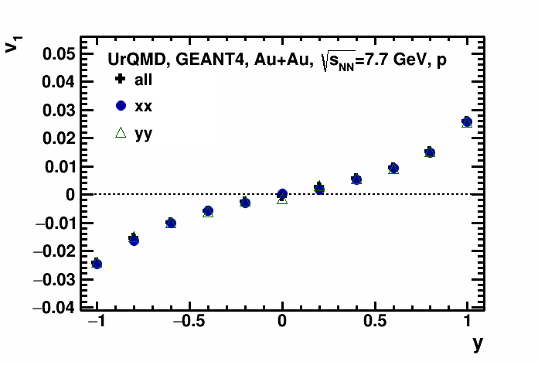
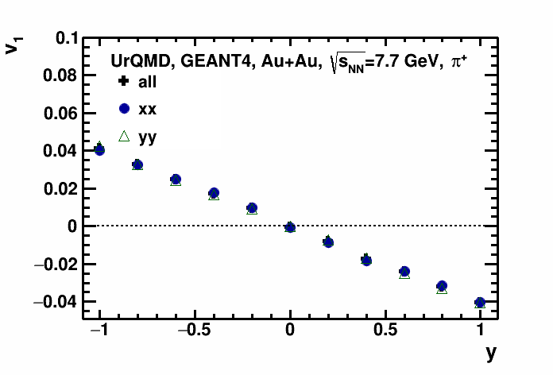
Components comparison: $v_{1}$
10-40%
10-40%
$v_{1,XX}$, $v_{1,YY}$ and $v_{1,all}$ are consistent with each other

Slide 25
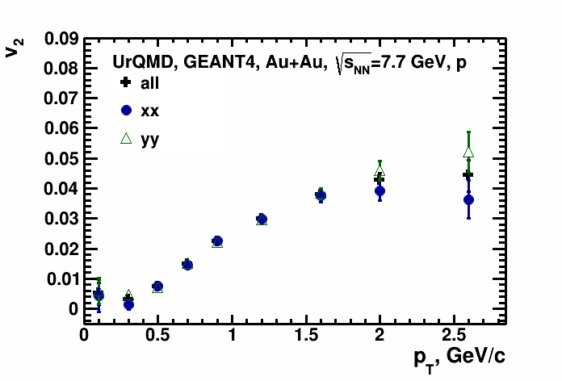
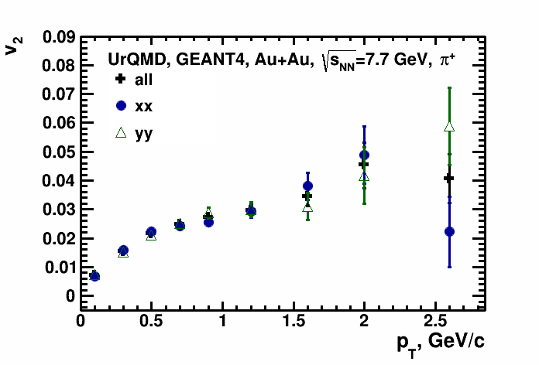
Components comparison: $v_{2}$
10-40%
10-40%
$v_{2,XX}$, $v_{2,YY}$ and $v_{2,all}$ are consistent with each other

Slide 26
Summary and outlook
QnAnalysis framework is ready for use in MPD experiment
Basic setup templates for all stages of flow measurement are available here: https://devel.mephi.ru/PEParfenov/QnAnalysisMPD_scripts
Using acceptance filter it was shown that corrections of the Q-vector employed by the QnAnalysis framework can suppress contribution from non-uniform acceptance of the detector
Simple validation of the results were done by comparing flow coefficients measured from reconstructed and model data
Both directed and elliptic flow show good agreement between reconstructed and simulated (model) data
Flow coefficients obtained using only certain Q-vector components were compared with the averaged value
Both directed and elliptic flow from different components of Q-vectors show consistent results
ToDo: implementation of direct cumulant method for flow measurements is in progress; more detailed study of non-uniform acceptance effects in flow measurements

Slide 27
Thank you for your attention!

Slide 28
Backup slides

Slide 29
AnalysisTree format for MPD data
Main structure of the AnalysisTree format in MPD:
(mandatory default information, added custom information)
RecoEvent (EventHeader):
Vertex (x,y,z)
McEvent (EventHeader):
Vertex (x,y,z)
Impact parameter B
Reaction plane PhiRP
TpcTracks (Track):
Momentum ($p_{x}$, $p_{y}$, $p_{z}$ or $p_{T}$, $φ$, $η$)
Track quality ($N_{hits}$)
DCA (x,y,z)
PID-related information (charge, $dE/dx$, $m^{2}$, tof_flag, pid_probability)
McTracks (Particle):
Momentum ($p_{x}$, $p_{y}$, $p_{z}$ or $p_{T}$, $φ$, $η$)
PID-related information (pdg, $y$)
mother_id
FHCalModules (Module):
Module information (Energy, number)
TpcTracks->McTracks matching
AnalysisTree:
A framework and experimentally independent, lightweight and flexible data format that stores information in configurable basic objects:
EventHeader – information about general event properties
Track – reconstructed track parameters
Particle – Monte Carlo track parameters
Module – information about module in a module-type detector (FHCal)
Hit – information about hit in a hit-type detector
Each object can contain any number of custom integer, floating or boolean fields
AnalysisTree data format:
https://github.com/HeavyIonAnalysis/AnalysisTree

Slide 30
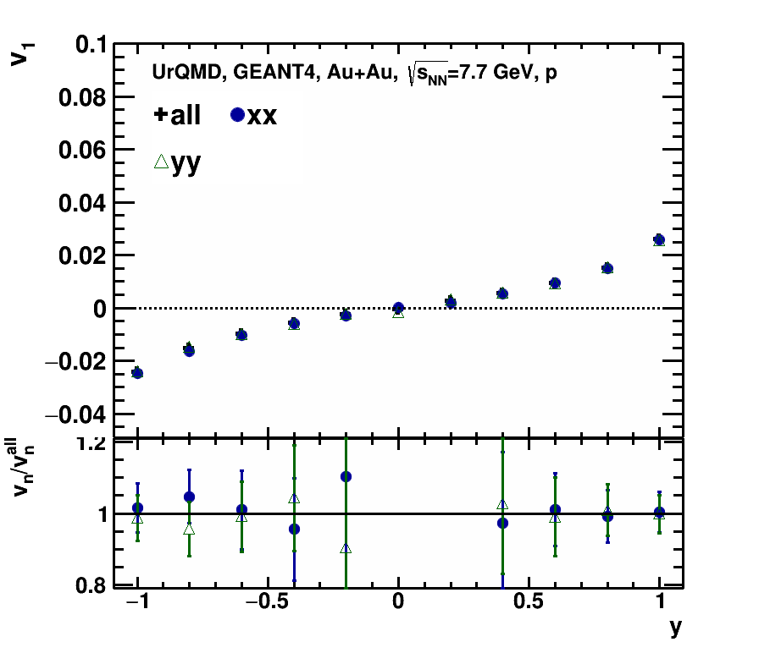
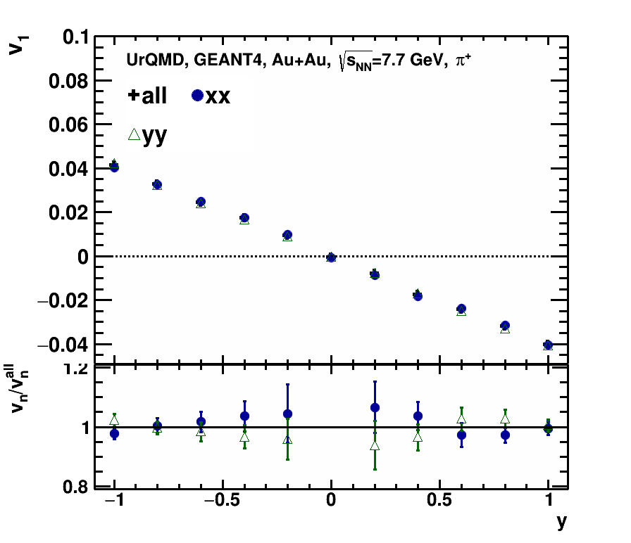
Components comparison: $v_{1}$
All components are in a good agreement

Slide 31
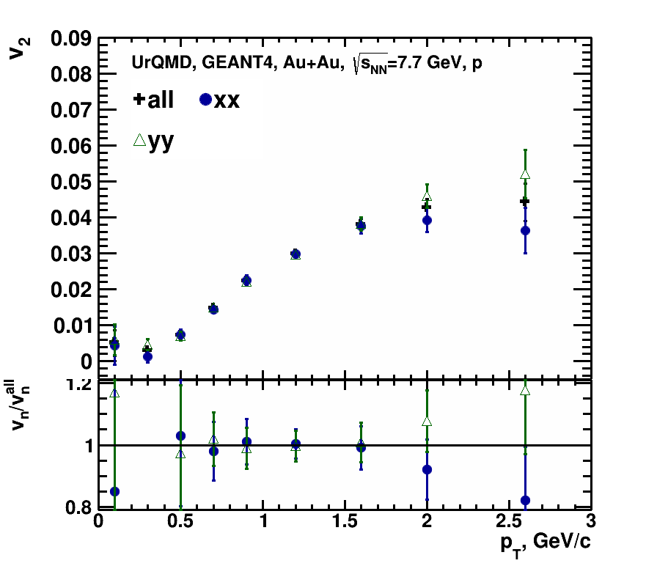
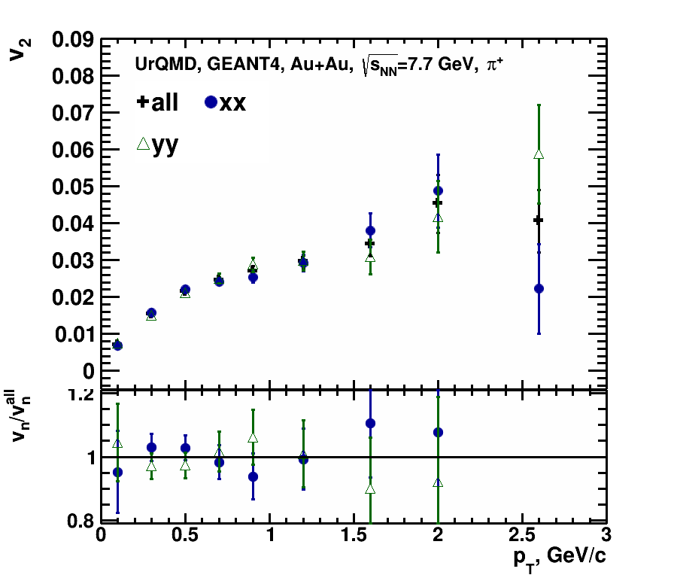
Components comparison: $v_{2}$
Difference between components is larger for $v_{2}$

Slide 32
Flow measurement: scalar product method
QnAnalysisCorrect collects multidimentional $Q_{n}, u_{n}$ vectors and applies corrections for non-uniform acceptance:
$$u_{n}=e^{inφ}, Q_{n}=\frac{\sum_{k=1}^{M}{ω_{n}^{k}u_{n}^{k}}}{\sum_{k=1}^{M}{ω_{n}^{k}}}≡\left|Q_{n}\right|e^{inΨ_{n}^{EP}},$$
$φ$ – azimuthal angle of the produced particle
$ω$ – weight of the $Q_{n}$ vector ($ω=1$ for TPC EP and $ω=E$ for FHCal EP)
$Ψ_{n}^{EP}$ – event plane angle
QnAnalysisCorrelate performs correlations (for example, $\left\langle uQ\right\rangle$ or $\left\langle QQ\right\rangle$) of $Q_{n}, u_{n}$ vectors for $v_{n}$ measurements:
$$v_{n}=\frac{\left\langle u_{n}Q_{n}^{∗}\right\rangle }{2\sqrt{\left\langle Q_{n}^{a}Q_{n}^{b∗}\right\rangle }}, in this work Q_{n}=\left\{\begin{aligned}Q_{1,FHCal} for v_{1} \\ Q_{2,TPC} for v_{2}\end{aligned}\right.$$
$$v_{1}^{mc}=\left\langle \cos\left(φ−Ψ_{RP}\right)\right\rangle , v_{1}^{reco}=\frac{\left\langle u_{1}^{±}Q_{1}^{∓∗}\right\rangle }{2\sqrt{\left\langle Q_{1}^{+}Q_{1}^{−∗}\right\rangle }},\begin{matrix}Q_{1} is taken from FHCal \\ u_{1} is taken from TPC\end{matrix}$$

