Slide 1
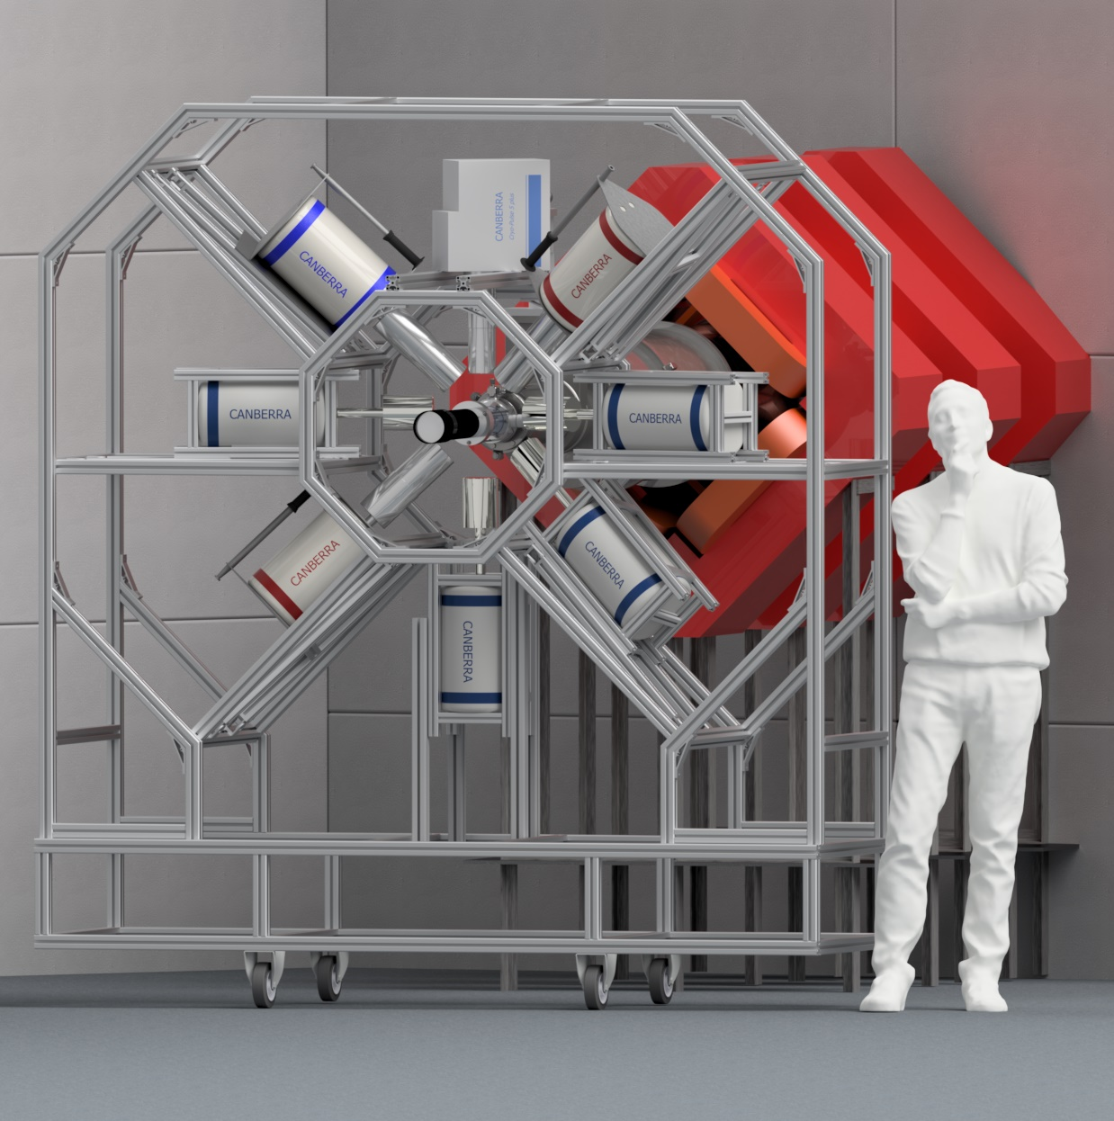
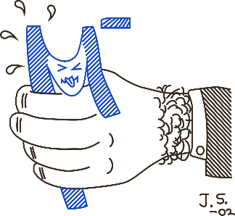

Hardware for OMC4DBD
JINR
OMC4DBD General Collaboration Meeting,
25-26 April 2022
Egor Shevchik 25/04/2022

Slide 2
Tasks overview
OMC targets for 2021-2023 are solid state only. For 2021 campaign it was decided to implement gaseous state target design with several improvements.
There is no more Miniball from ISOLDA in PSI. We have to create our own setup of germanium detectors. Liquid nitrogen auto-filling system is still available and should be implemented for the setup.
One would like to use existing trolley for line movement of the setup
In order to rationalize beam tuning procedure we obliged to use additional stack of electronics. There is also another DAQ branch from LAMA (Mario Schwarz talk)

Slide 3
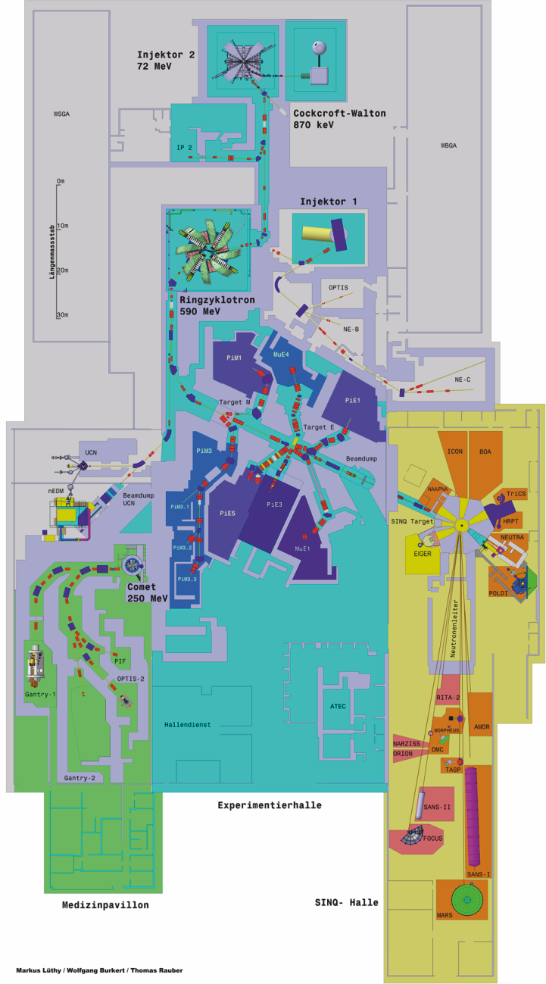
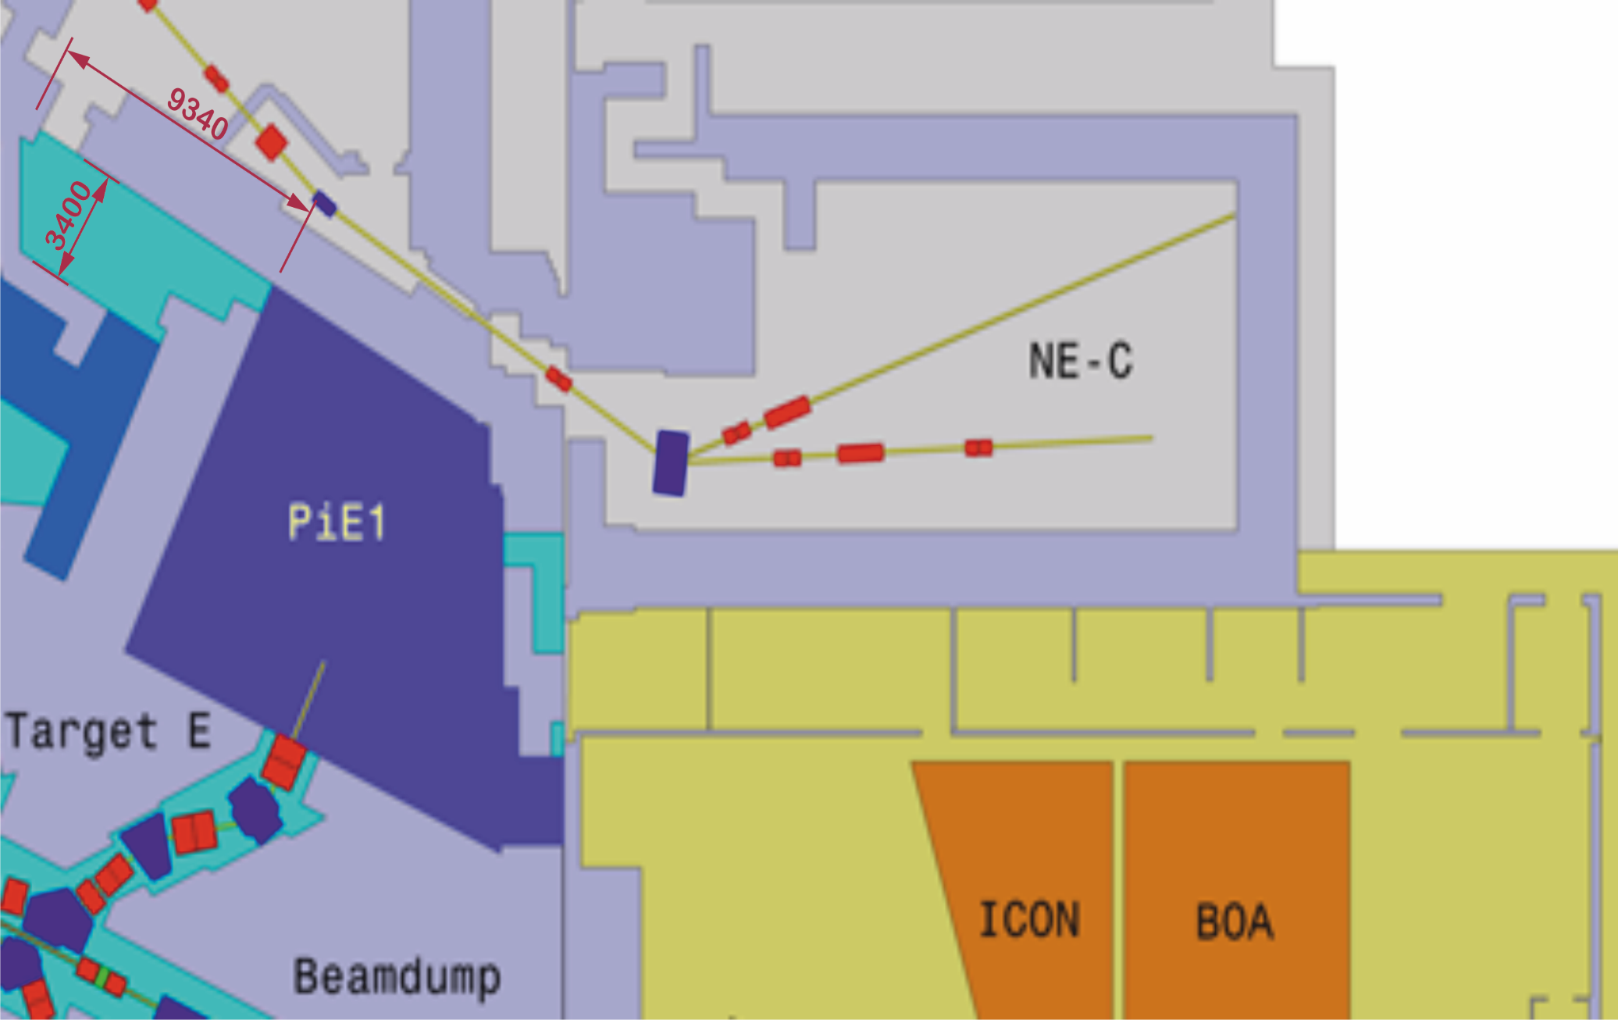
Experimental hall
OMC4DBD setup
Control rooms

Slide 4
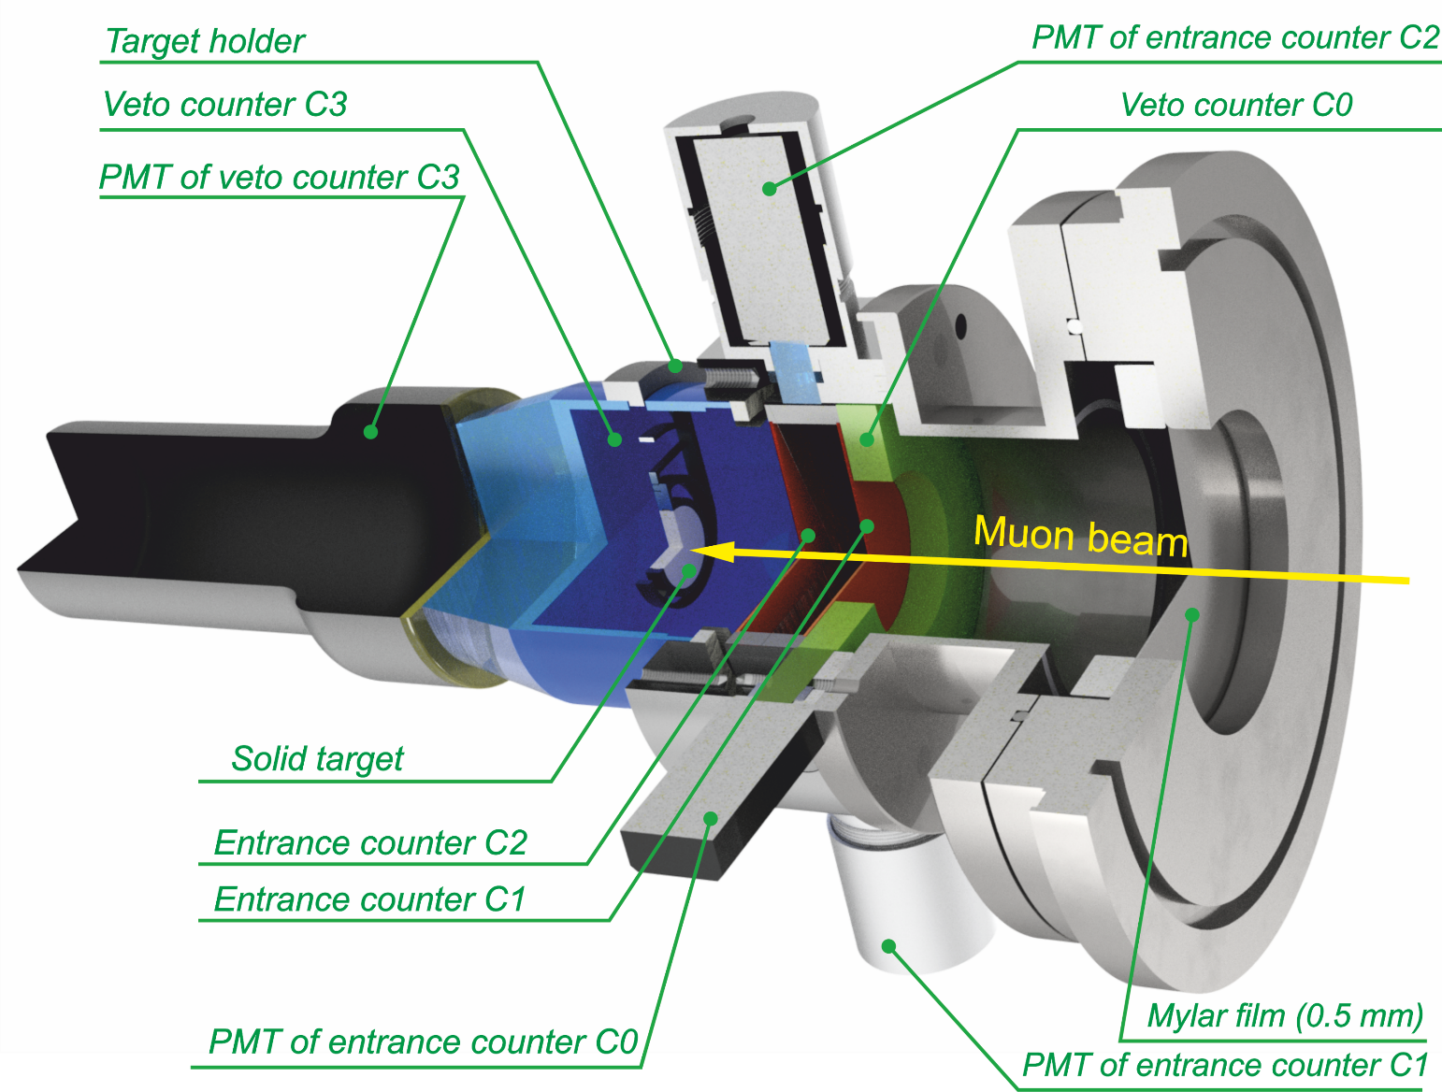
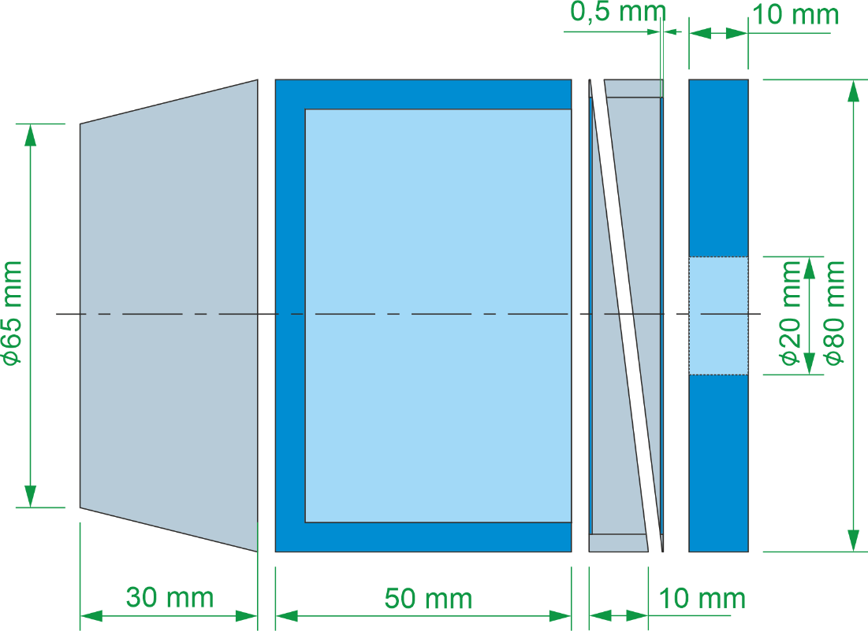
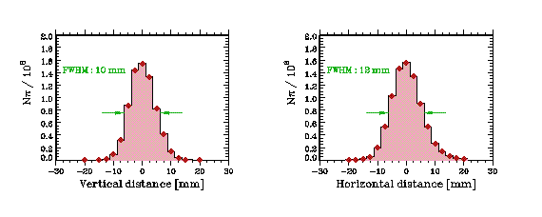

Target setup
$\overline{C0}$& C1 & C2 & $\overline{C3}$ $→EVENT$

Slide 5
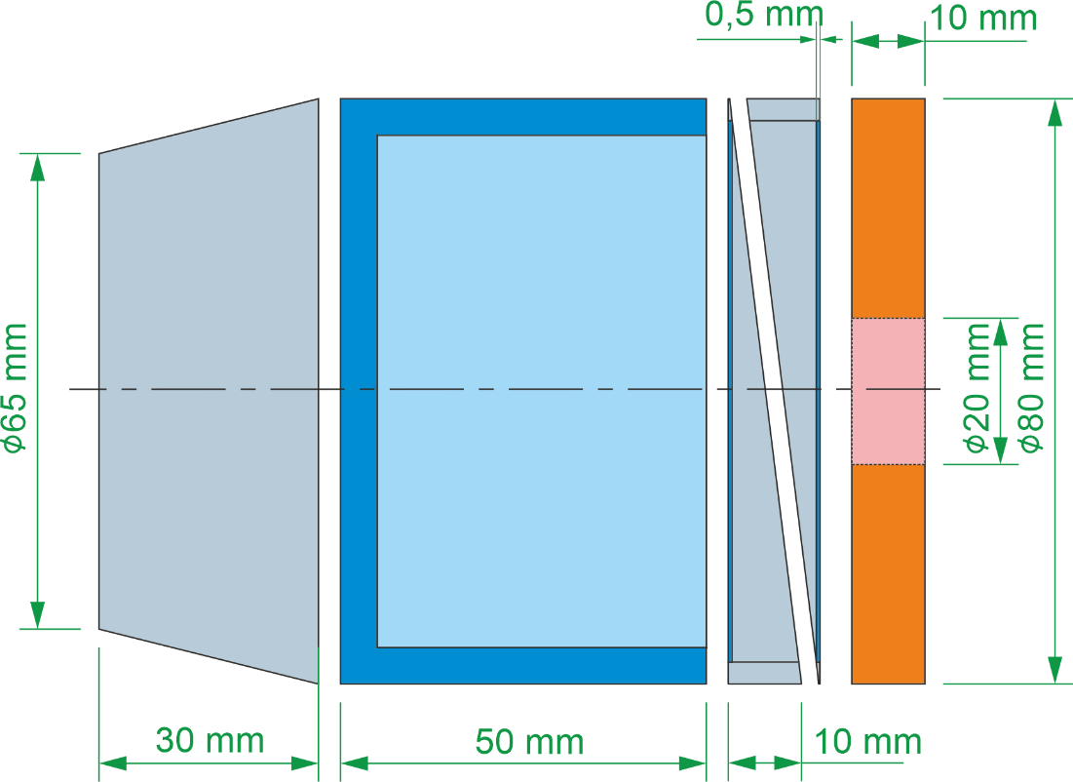
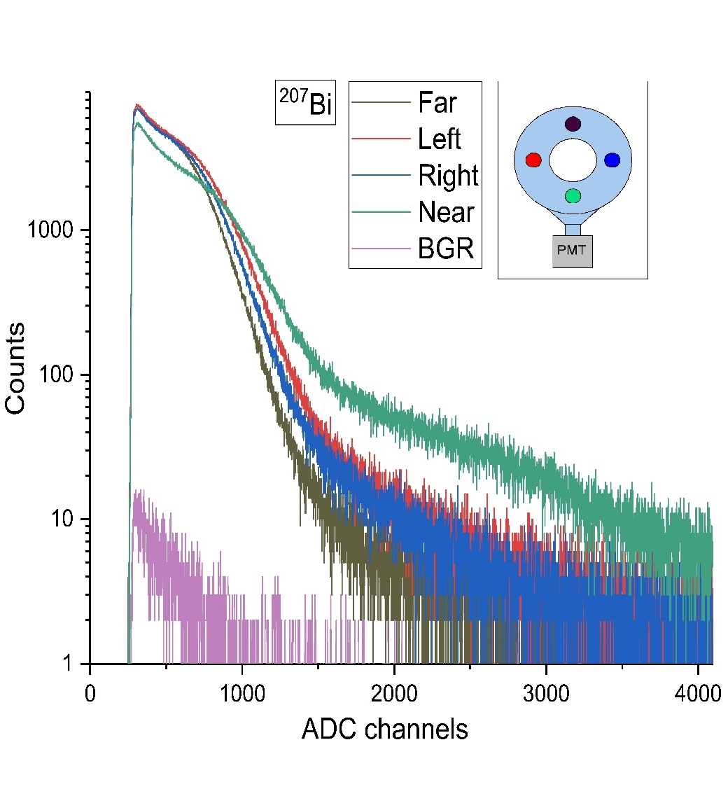
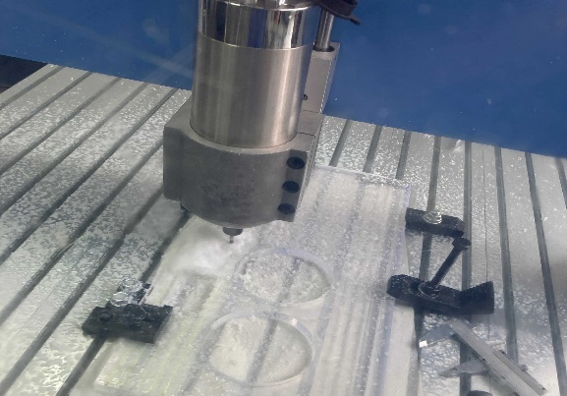
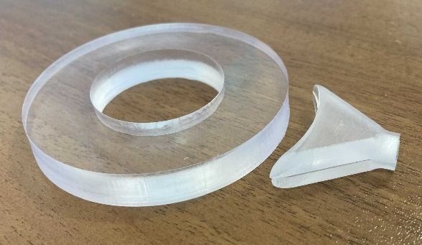
Target setup (C0)
Bi source at different positions @C0
C0
D = 80 mm
Dhole=25 mm
HScint = 10 mm
1 cm ring made of plastic scintillator and wrapped into 5 um mylar film.
The counter is attached to modular PMT by “fishtail” lightguide.
Ligthcollection inhomogeneity doesn’t exceed ~30% from the Bi source measurements in different positions.

Slide 6
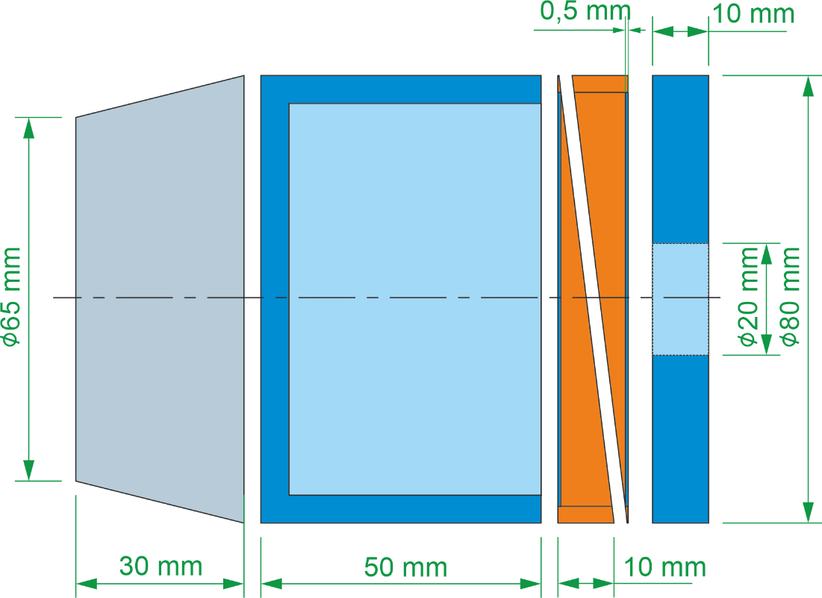
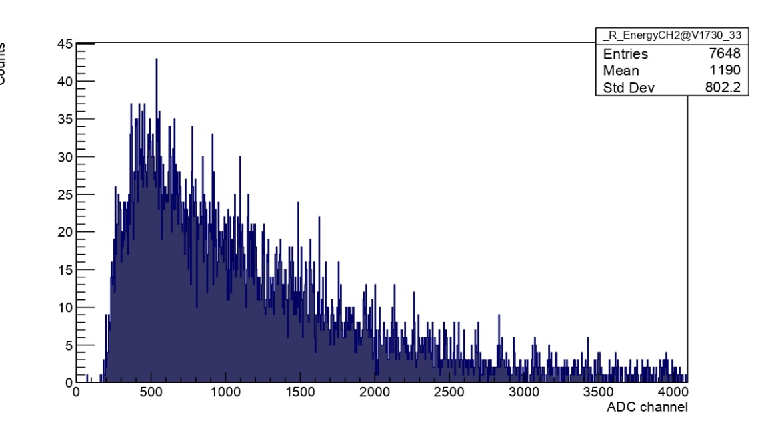
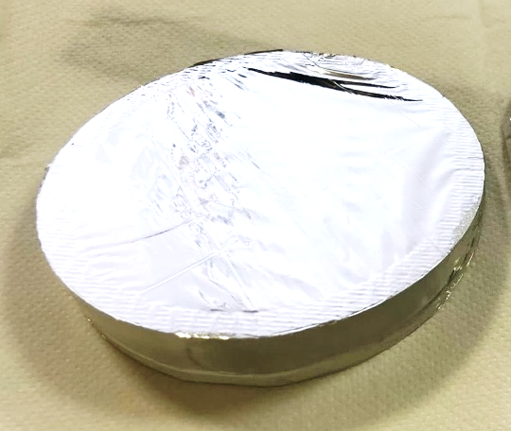
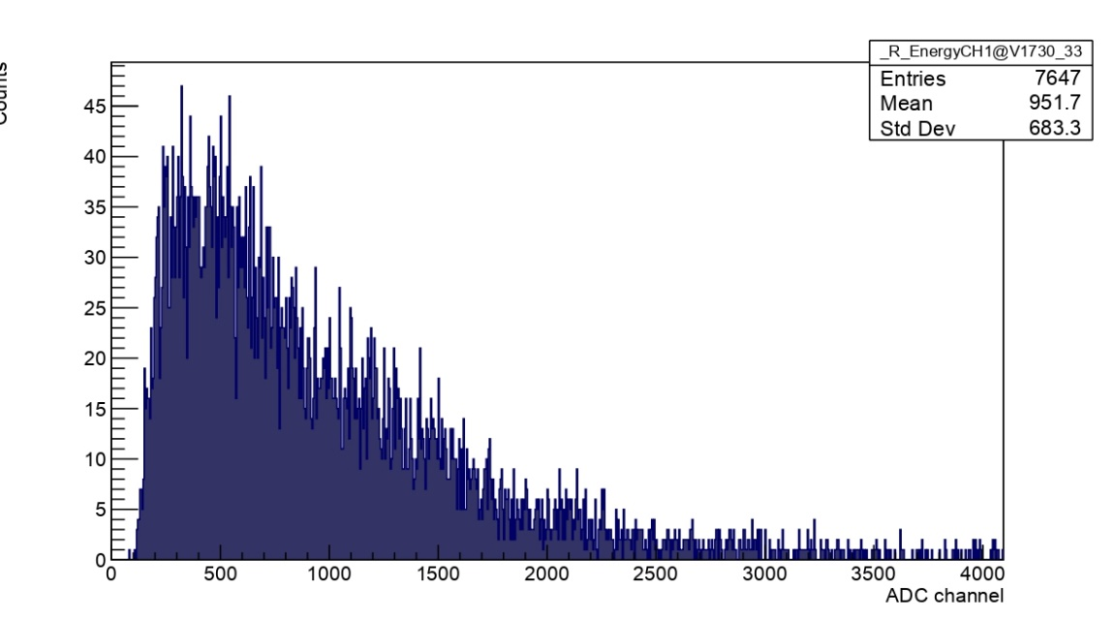
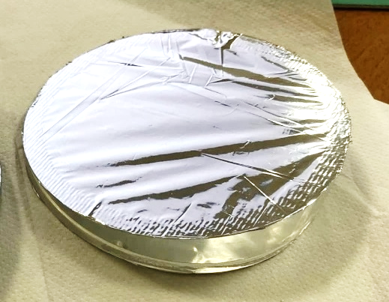
Target setup (C1 &C2)
Cosmic muons @C1
С1 & С2
D = 80 mm
HScint = 0.5 mm
Cosmic muons @C2
Thin 0.5 mm plastic scintillator circle glued into acrylic lightguide.
The lightguide has ring shape with wedge profile.
The counters are covered with 5 um mylar films and separated by the same thickness from each other.
The counters are readout by modular PMTs individually.
We saw different light collection for the counters, especially with beam muons (pictures in Igor’s or Elisabetta’s talks?). One has to fix it for the next beam time

Slide 7
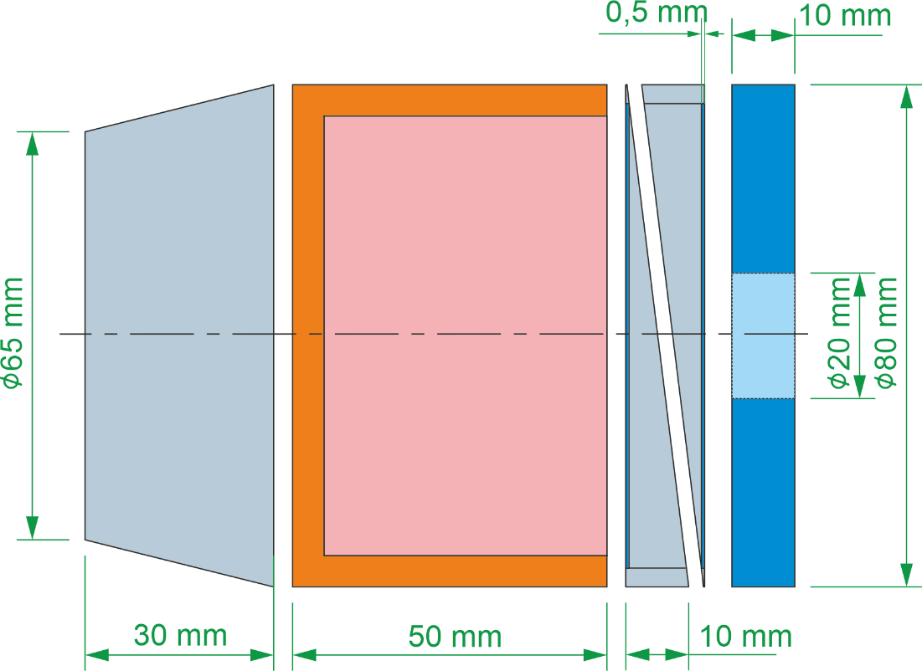
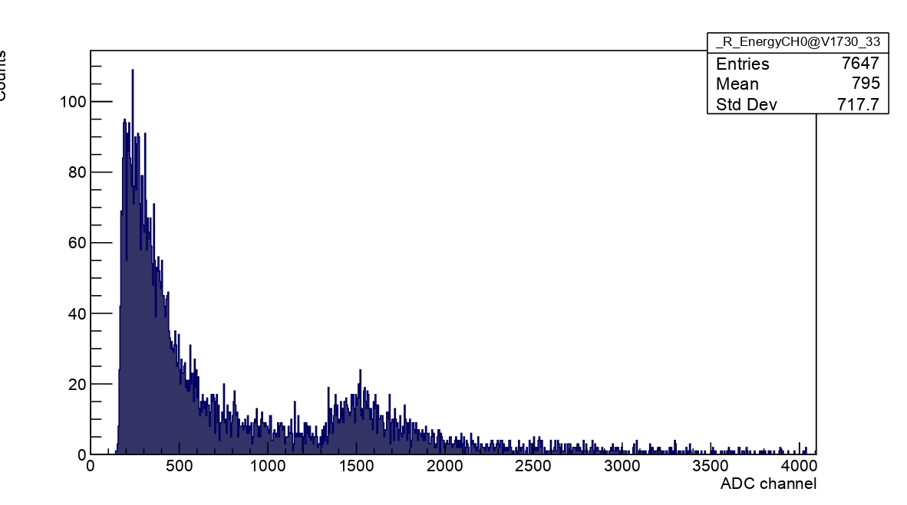
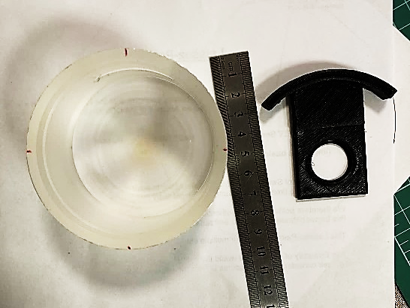
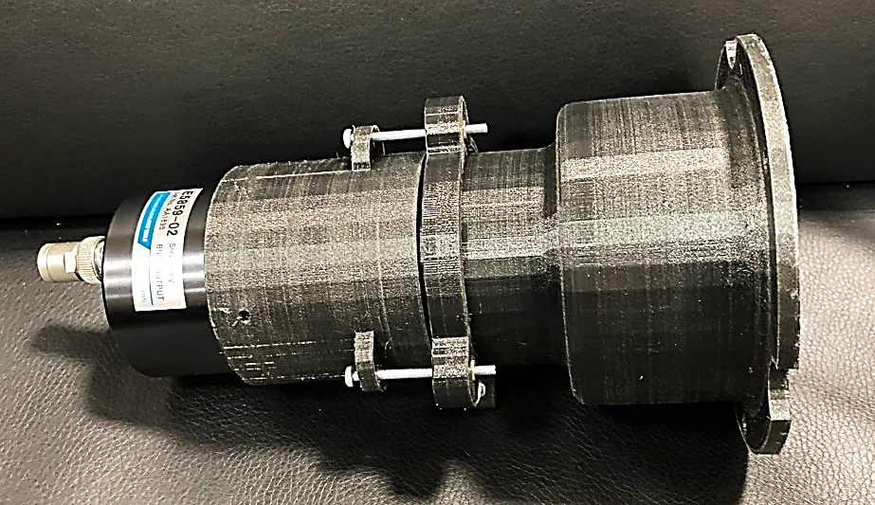
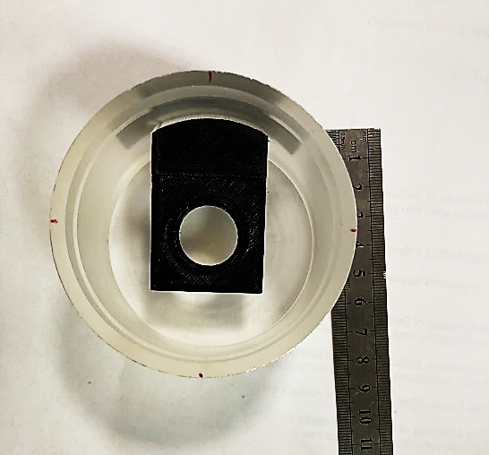
Target setup (C3)
Cosmic muons @C3
С3
D = 80 mm
HScint = 5 mm
Cup-like scintillator surrounding a target holder
Thickness of the C3 counter walls is 5 mm.
A target holder can be inserted through the cut in the wall of С3. The same way for calibration sources.
The counter is attached to R6091 PMT through a light guide made of plastic scintillator (during the beam time we recognized it was not the best decision) .

Slide 8
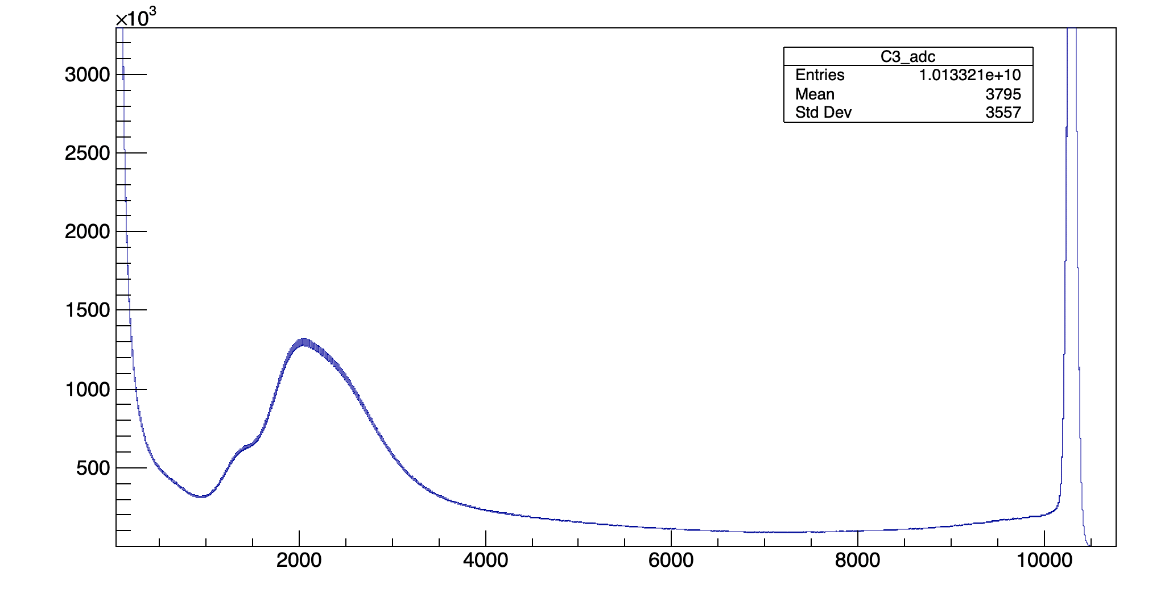
Target setup (C3)
Beam @C3
Some bumps and quite high rate at saturation region

Slide 9
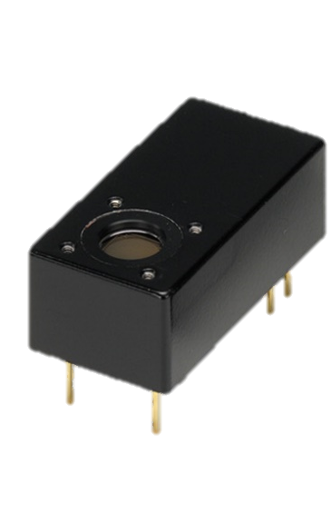
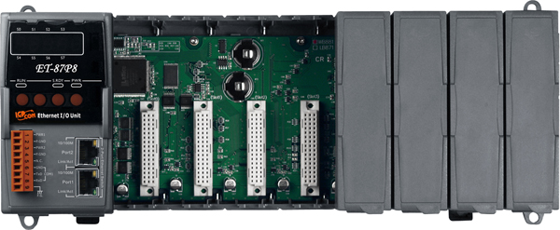

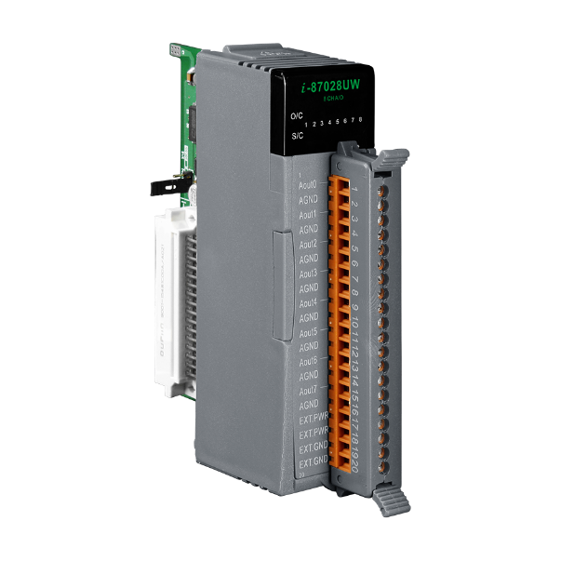
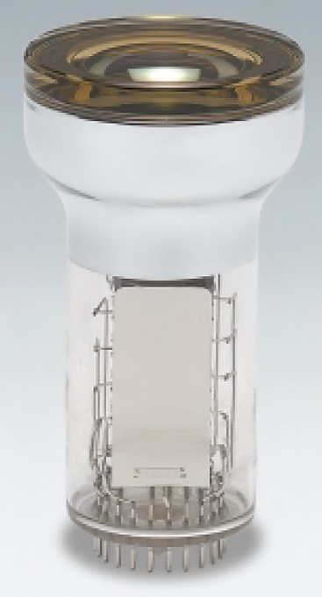
Target setup equipment
Remote control with
ICPDAS ET-878P
C0 counter
H10720 x2
Built-in HV power supply
0.5 – 1.1 VDC adjustable
C1, C2 counters
H6780
Built-in HV power supply
0.5 – 1.1 VDC adjustable
ICPDAS DAC I-87028UW-G
C3 Counter
3” PMT R6091
With Traco DC-DC for HV
0-4 VDC adjustable

Slide 10
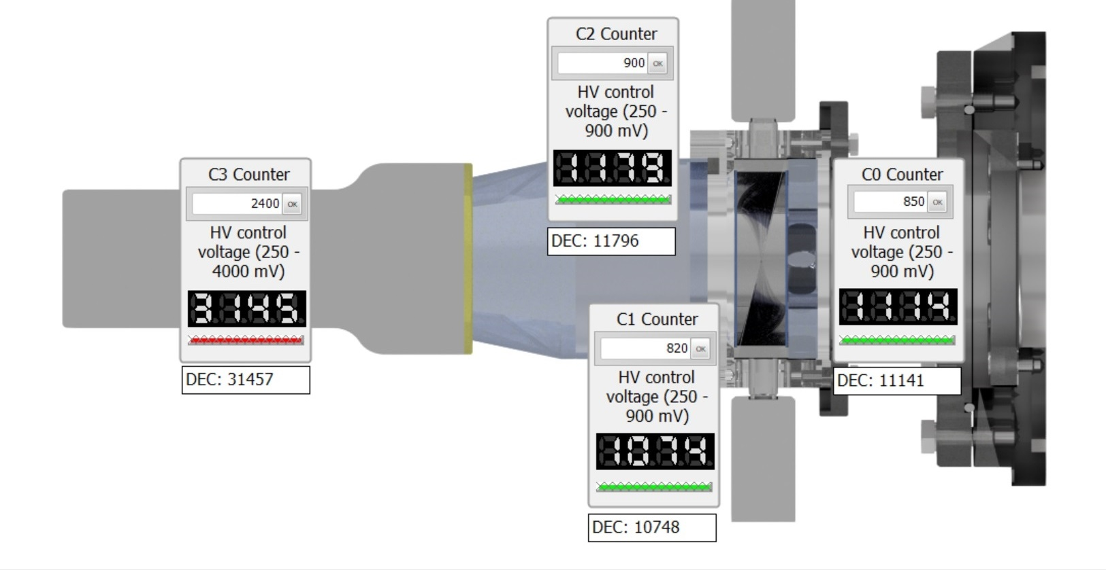
Target setup equipment
C2 Counter
Lightguide
C3 CUP
C1 Counter
C1 Counter

Slide 11
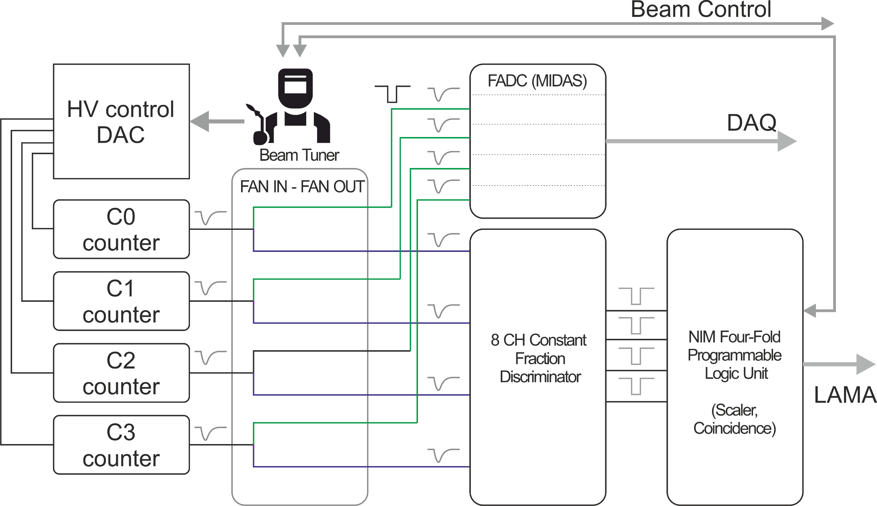
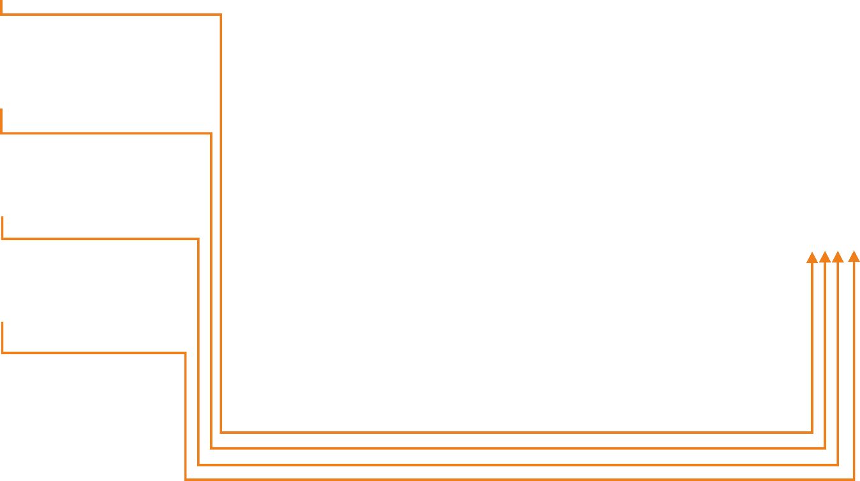

Beam tuning
$$\overline{C0}\&C1\&C2\&\overline{C3}$$
Optimal conditions:
Minimize C0 and C3
Maximize C1 and C2
Minimize muonic X-rays
from oxygen and carbon

Slide 12
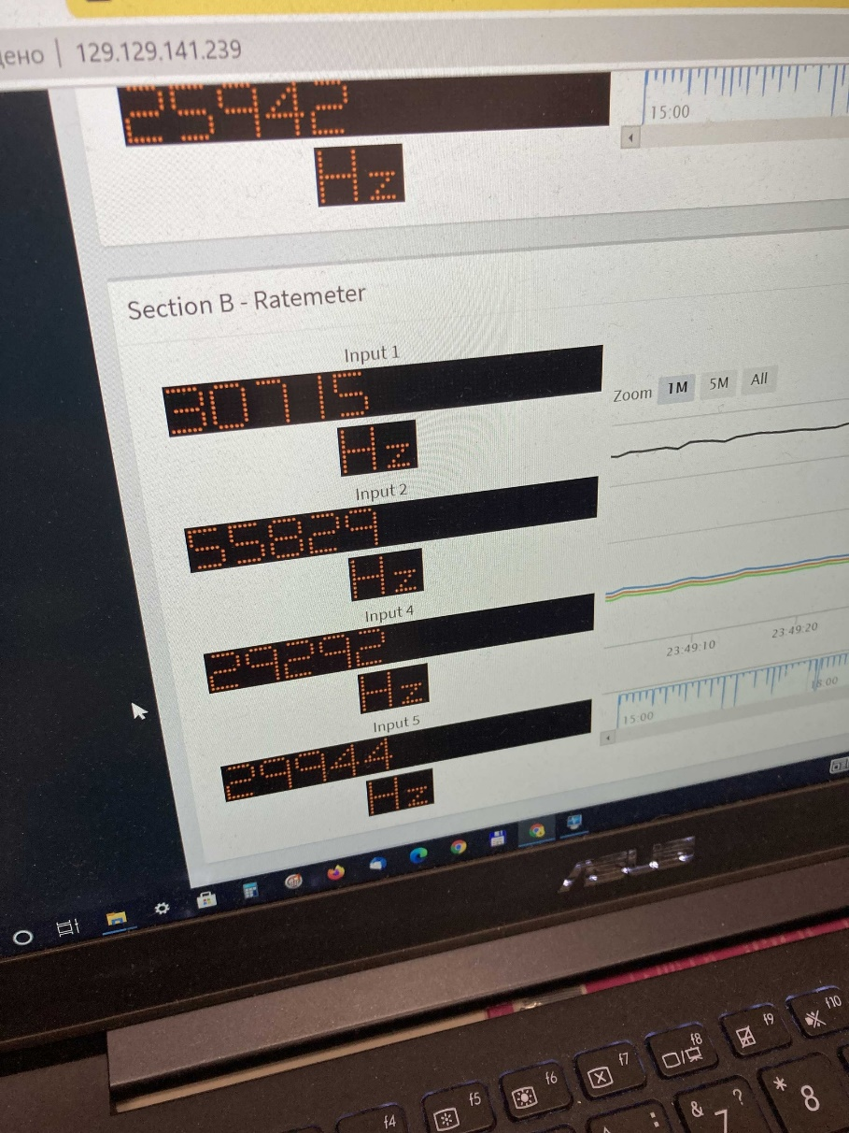
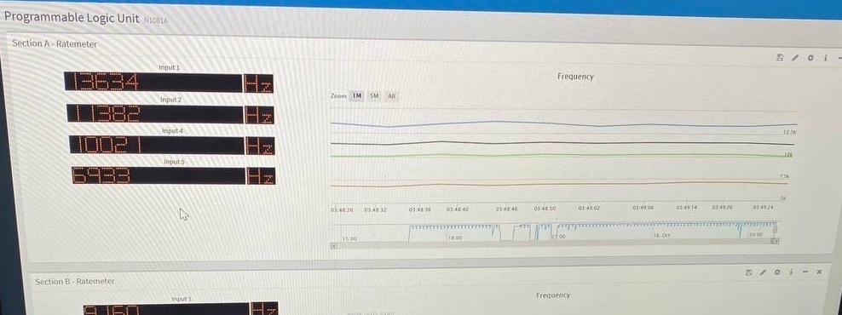
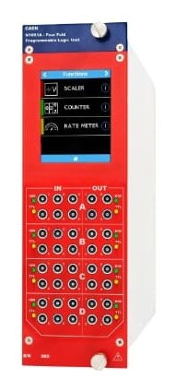
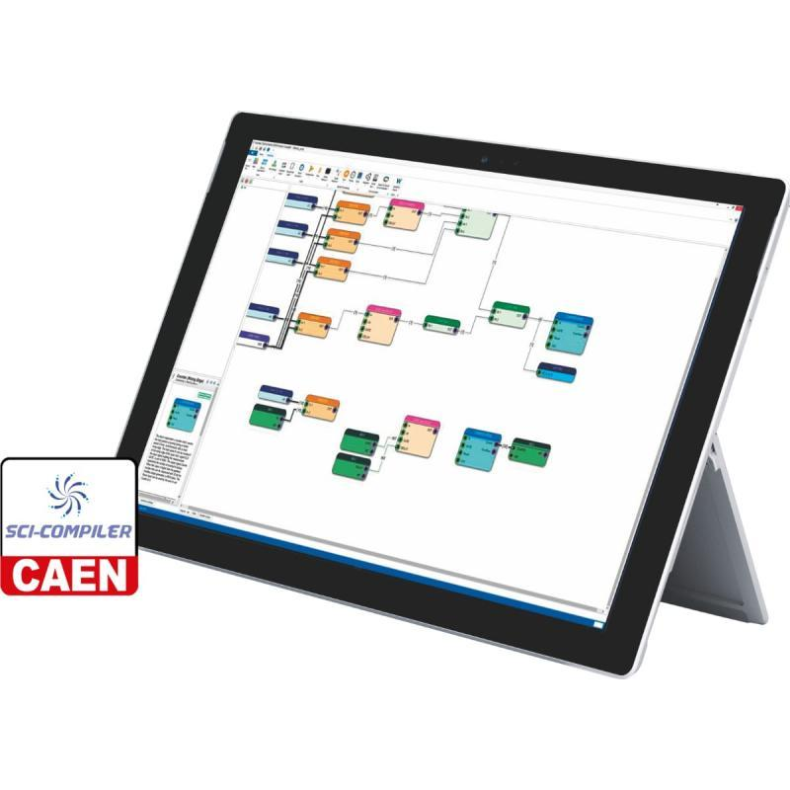
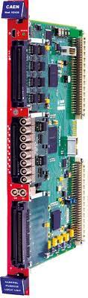
Beam tuning

Slide 13
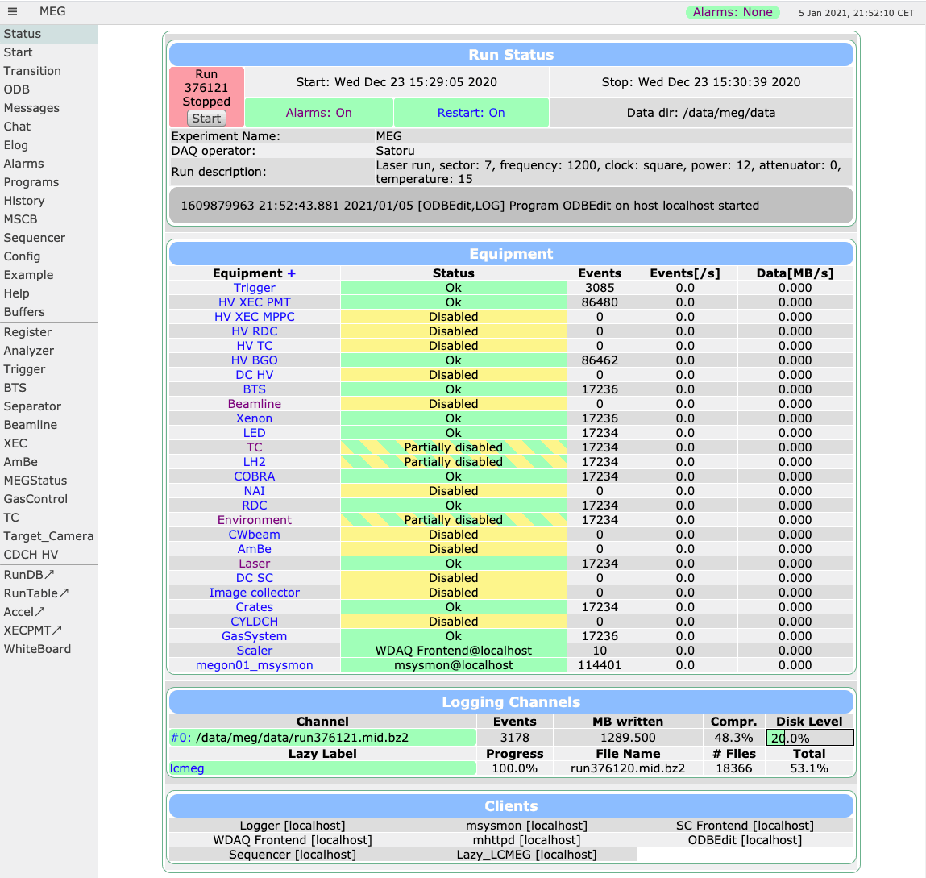
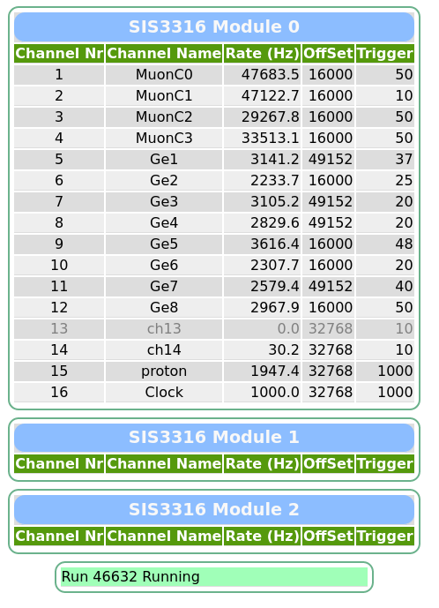
Beam tuning

Slide 14
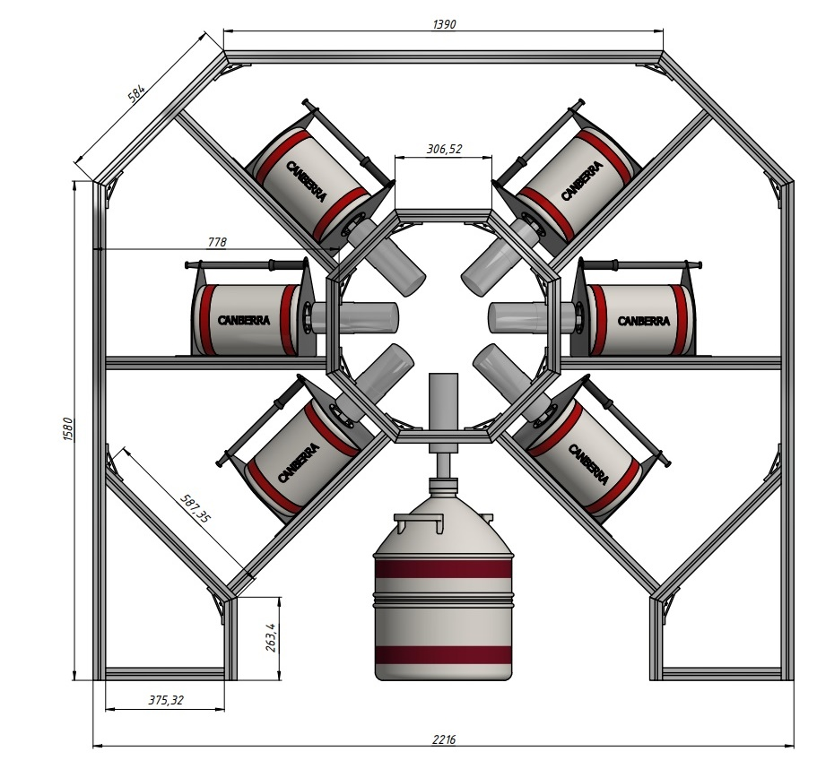
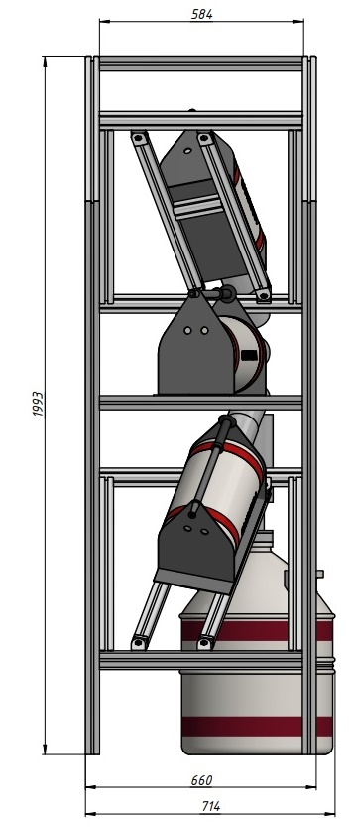
Ge-detectors setup assembly
The moveable frame
Made of aluminum profile (ITEM like) in JINR.
The frame was delivered to TUM in the end of July, 2021. After a test assembly several mistakes were fixed.
On October, 6 all the equipment including the frame were delivered to PSI. Time for the final assembly.
The problem: the movable frame is immovable. One should dock the frame to the existing trolley.

Slide 15
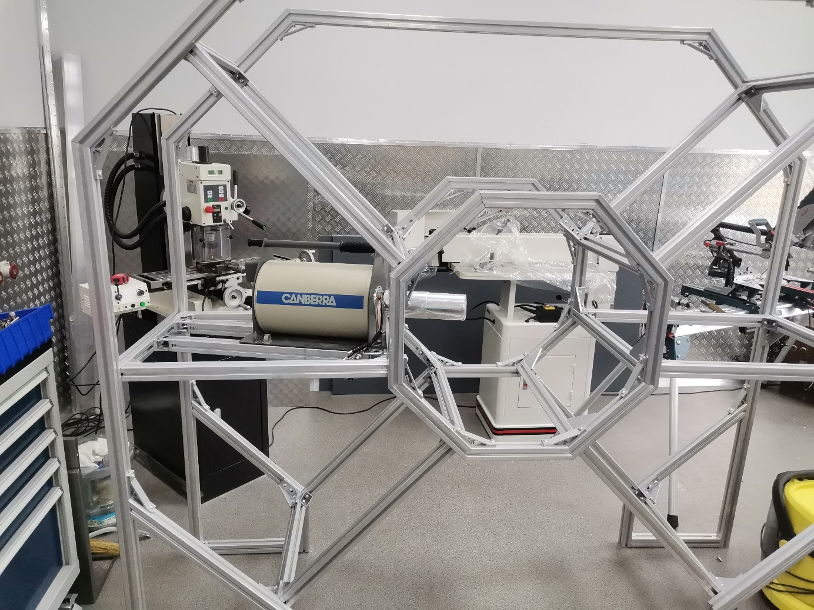
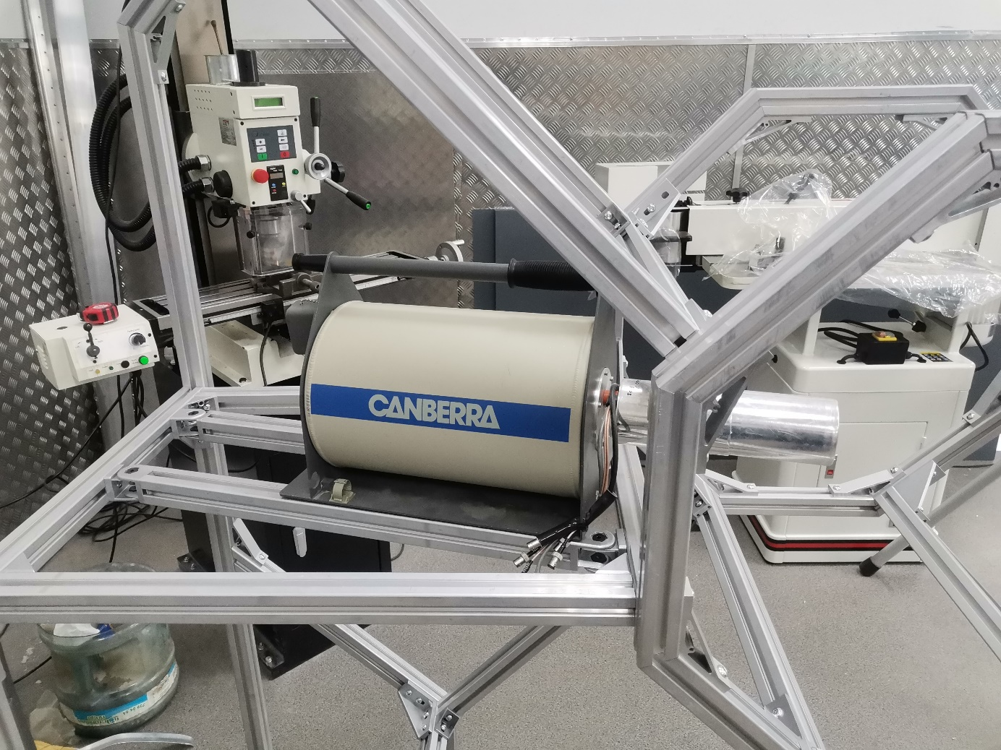
Ge-detectors setup
First assembly of the frame at the end of March (some parts are missed)

Slide 16
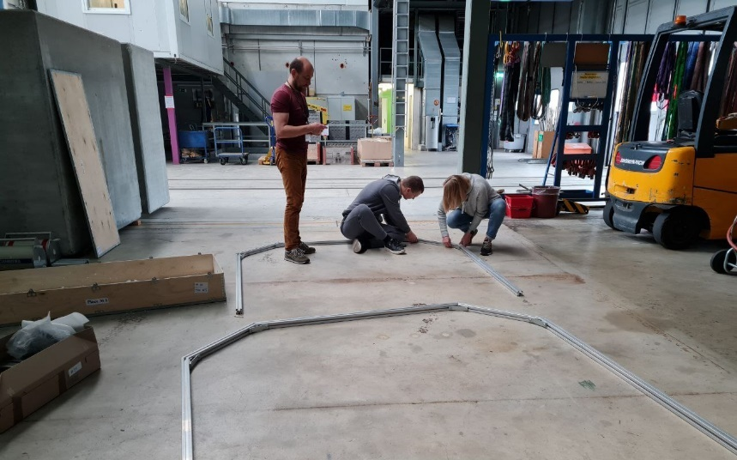
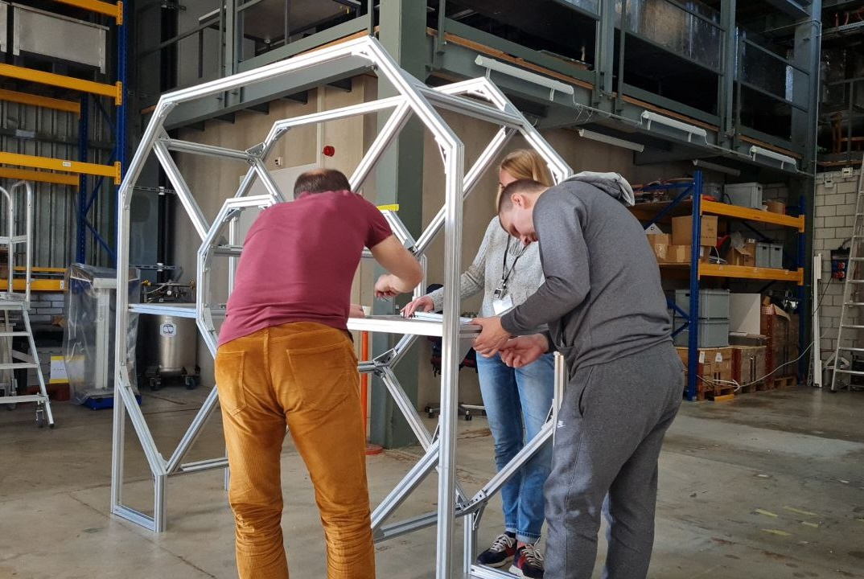
Ge-detectors setup assembly
Assembly beginning
Step | Time
Equipment delivery | 6.10.2021
Assembling and tuning of the setup | 7.10.2021-11.10.2021
Calibration runs | 11.10.2021-12.10.2021
^{nat}Ba measurements | 12.10.2021-15.10.2021
¹³⁶Ba | 20.10.2021-24.10.2021
Calibration runs | 25.10.2021
^{nat}Se measurements | 26.10.2021-28.10.2021
⁷⁶Se measurements | 29.10.2021-3.11.2021
Calibration runs | 4.11.2021
¹³⁶Ba measurements | 5.11.2021-7.11.2021
Calibration runs | 7.11.2021
Deconstruction | 8.11.2021-10.11.2021

Slide 17
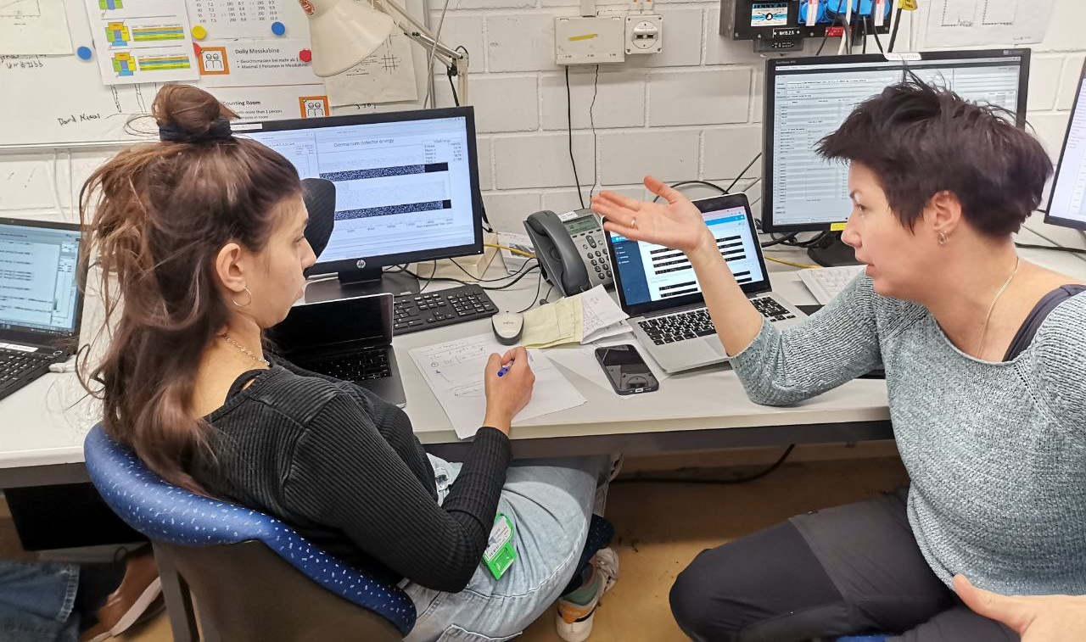
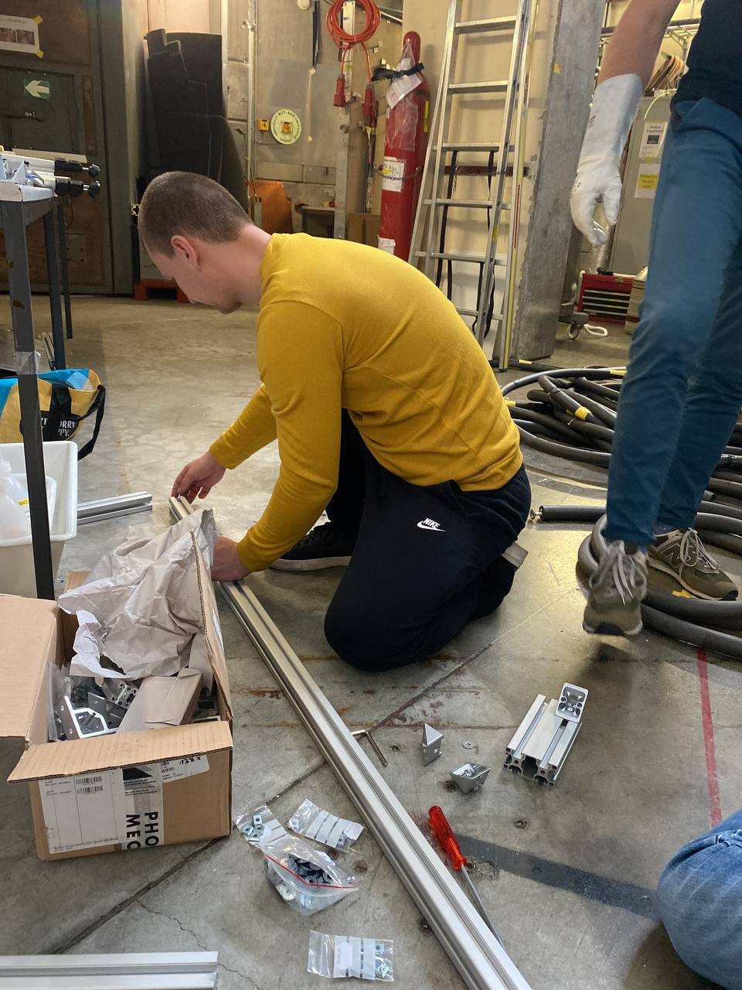
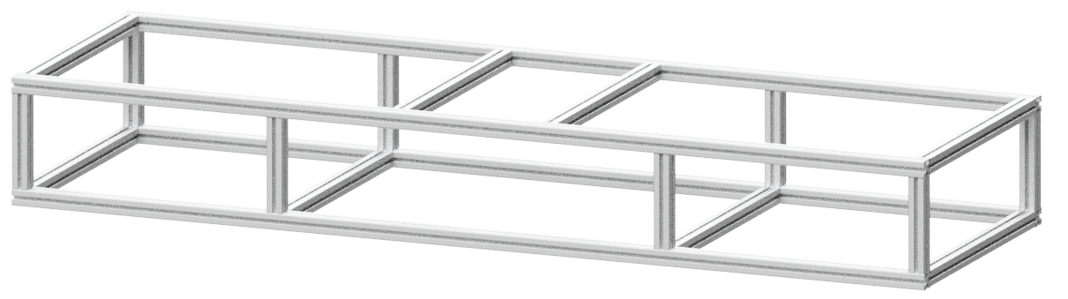
Ge-detectors setup assembly
We have to lift the frame!
Daniya!
Done!
Arranging the frame axis along the beam line

Slide 18
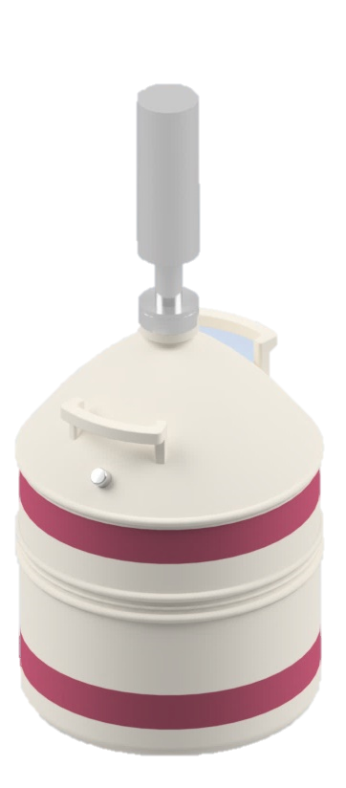
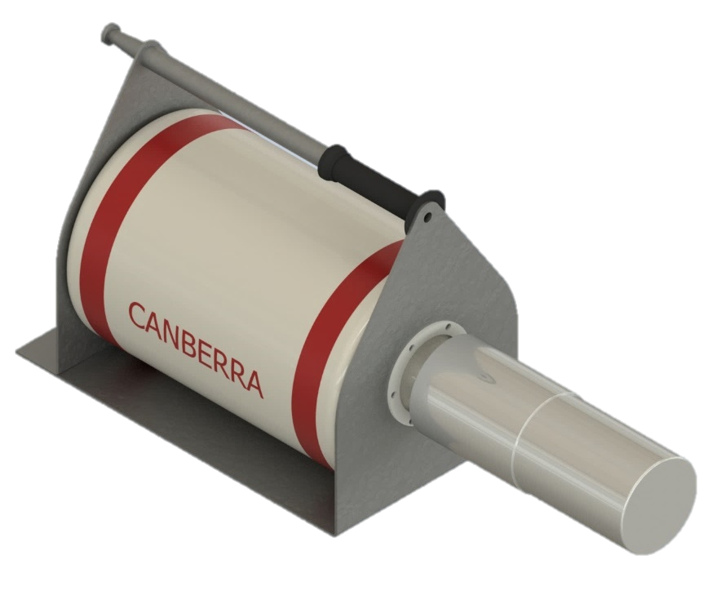
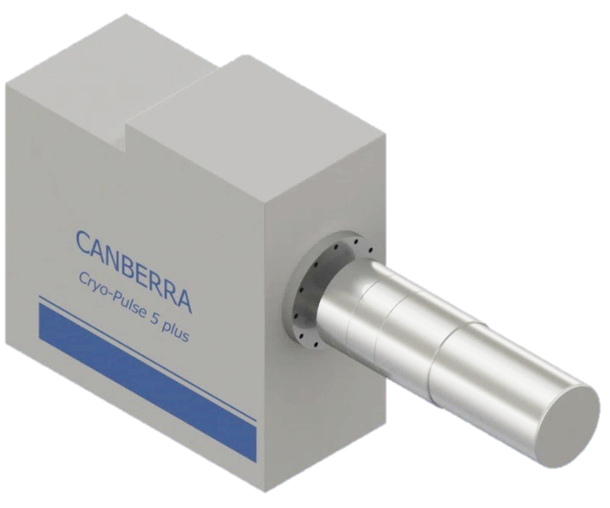
Ge-detectors set (planned)
x6
x1
x1
BigMac cryostat
with sheet steel frame
CryoPulse 5
(Electrically Refrigerated Cryostat)
Vertical Dipstick cryostat
Konstantin Gusev & Nadezda Rumyantseva talks

Slide 19
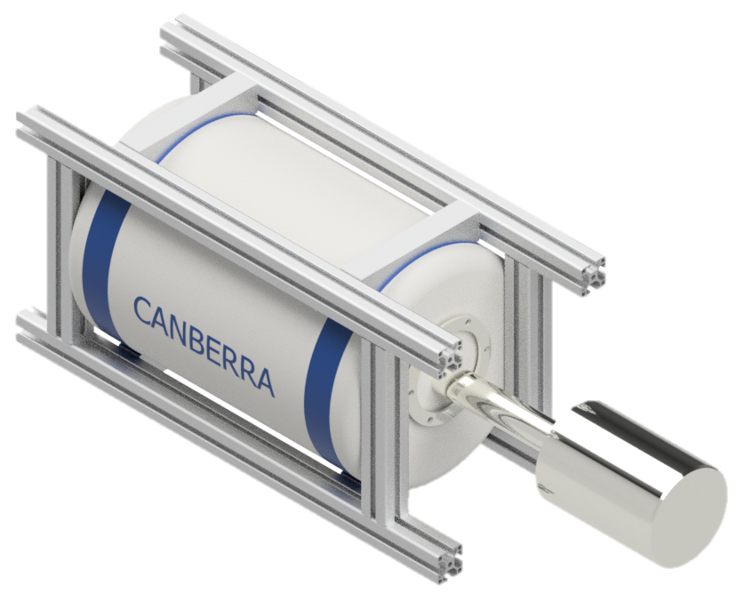
Ge-detectors set (actual)
x3
x1
x4
BigMac cryostat
with sheet steel frame
CryoPulse 5
(Electrically Refrigerated Cryostat)
BigMac cryostat
with ITEM frame
Konstantin Gusev & Nadezda Rumyantseva talks

Slide 20
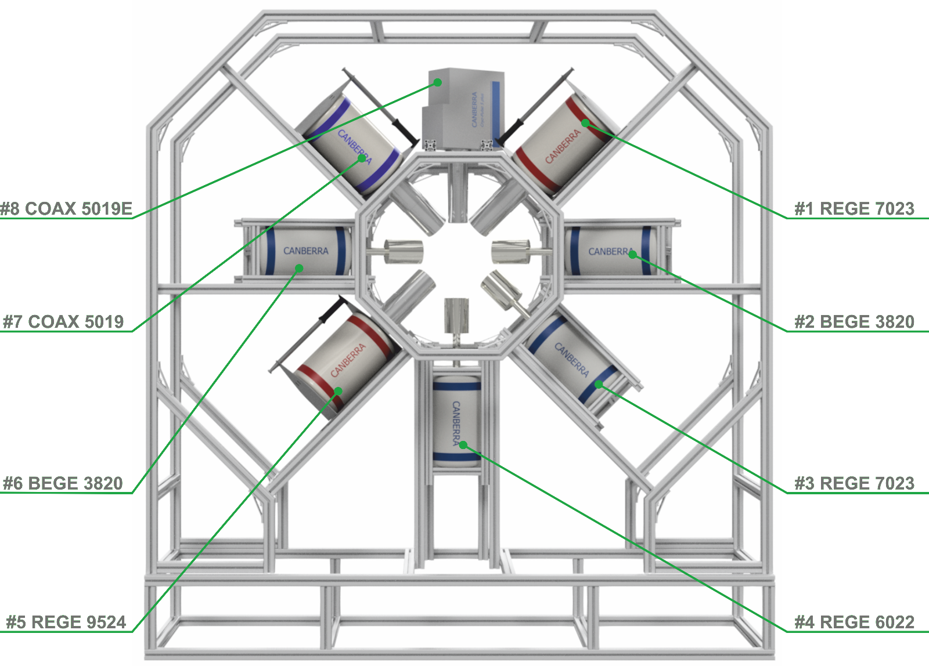

Ge-detectors setup assembly
The final configuration

Slide 21


Ge-detectors setup assembly
8 Ge-detectors mounted on the custom frame.
6 detectors with LN auto filling system
The frame can be moved along the beam axis
The final configuration

Slide 22


Experimental hall
Beam line
Trolley with Ge-detectors
LN Dewars
Racks with electronics

Slide 23

Outlooks
The target device allows tune the beam with enough accuracy, but has several drawbacks:
  Different light yields for C1 & C2 counters assume nonuniform settings (thresholds, ranges, etc.) for the DAQs and require individual tunning approach.
  Hard to distinguish events from muons, electrons and gammas in C3. Probably another light guide or replacement of PMT with SiPM are needed.
  More flexible and reliable light insulation should be considered.
The frame was successfully placed on the wheels with an additional part which was made in the place.
4 germanium detectors from PSI were used. Different mounting procedure, but relatively quick and successful.
The frame is still in PSI and will be mounted for the next beam time.
Target device is in JINR. Necessary to overcome logistic challenges and restrictions.

Slide 24
Conclusion
The target setup had stable operation during the hole beamtime. After preliminary analysis we made few decisions concerning future improvement.
The aluminum frame was reliable enough. We were able to install unexpected cryostats in limited time period.
Almost ready for the next beam time, one can use the same equipment.

Slide 25
Thank you for your attention!

Slide 26
NIM electronics

Slide 27

NIM electronics

Slide 28

Ge-detectors setup
Holders for the BicMac cryostat made of stainless steel with necessary holes.
7 pcs will be ordered in next 2 weeks, may be delivered with other equipment for the full assembly test in TUM.

