Slide 1
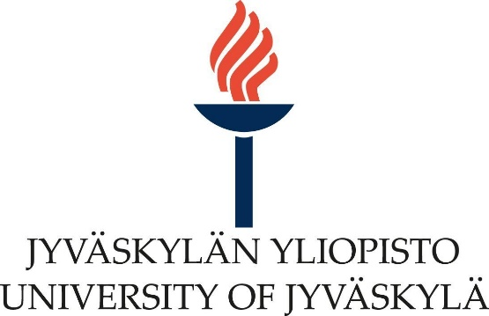
General OMC4DBD collaboration on-line meeting, 25 – 26th April 2021

Slide 2
Round table Q&A
Daniya Zinatulina , 26.04.2022 2

Slide 3
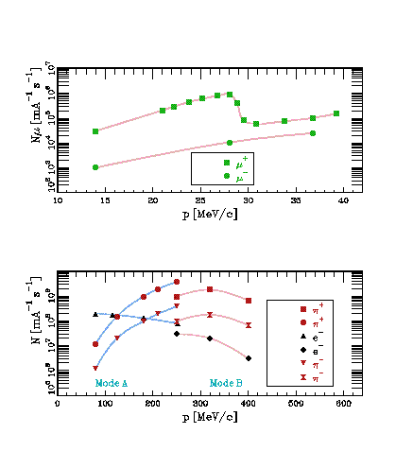
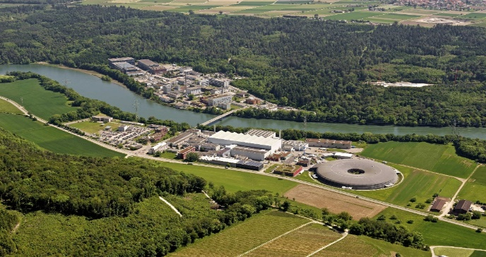
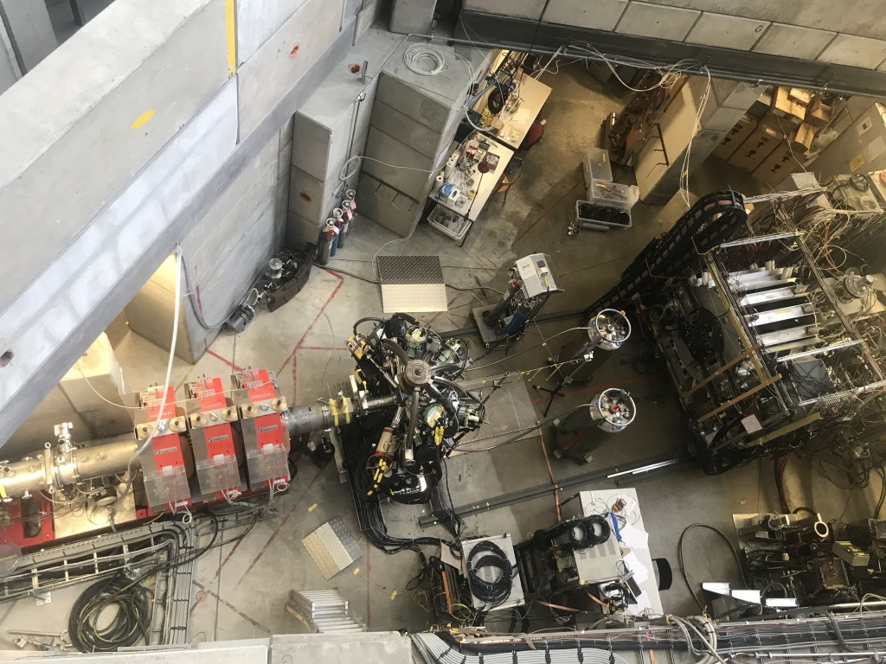
πE1-2 beam-line (PSI)
Beam momentum -> 15 – 40 MeV/C
Muon flux -> 2 x 10³ – 6 x 10⁴ s⁻¹
Daniya Zinatulina , 26.04.2022 3

Slide 4
Astrophysics with ¹⁰⁰Mo (H. Ejiri talk in detail)
Astro neutrino (including solar and supernovae neutrino study) observation provides evidences for neutrino matter oscillation, nuclear fusion reaction in sun and as tools for probing the supernovae (SN) explosion process
It was proposed to measure SN antineutrinos on ¹⁰⁰Mo (MOON) [1, 2]
OMC in ¹⁰⁰Mo will give experimental input for theoretical calculations of this process
≈100MeV
ν_{μ}
¹⁰⁰Mo(ν_{e}, e⁺)¹⁰⁰Nb (SN)
¹⁰⁰Mo(μ⁻, e⁺)¹⁰⁰Nb (OMC)
e⁺
ν_{e}
μ⁻
¹⁰⁰Nb
[1] H.Ejiri, J.Suhonen, K.Zuber. //
Phys. Rep 797 (2019) 1 – 102
[2] H.Ejiri, J.Engel, N. Kudomi //
PLB 530 (2002) 27-32
¹⁰⁰Mo
Daniya Zinatulina , 26.04.2022 4

Slide 5
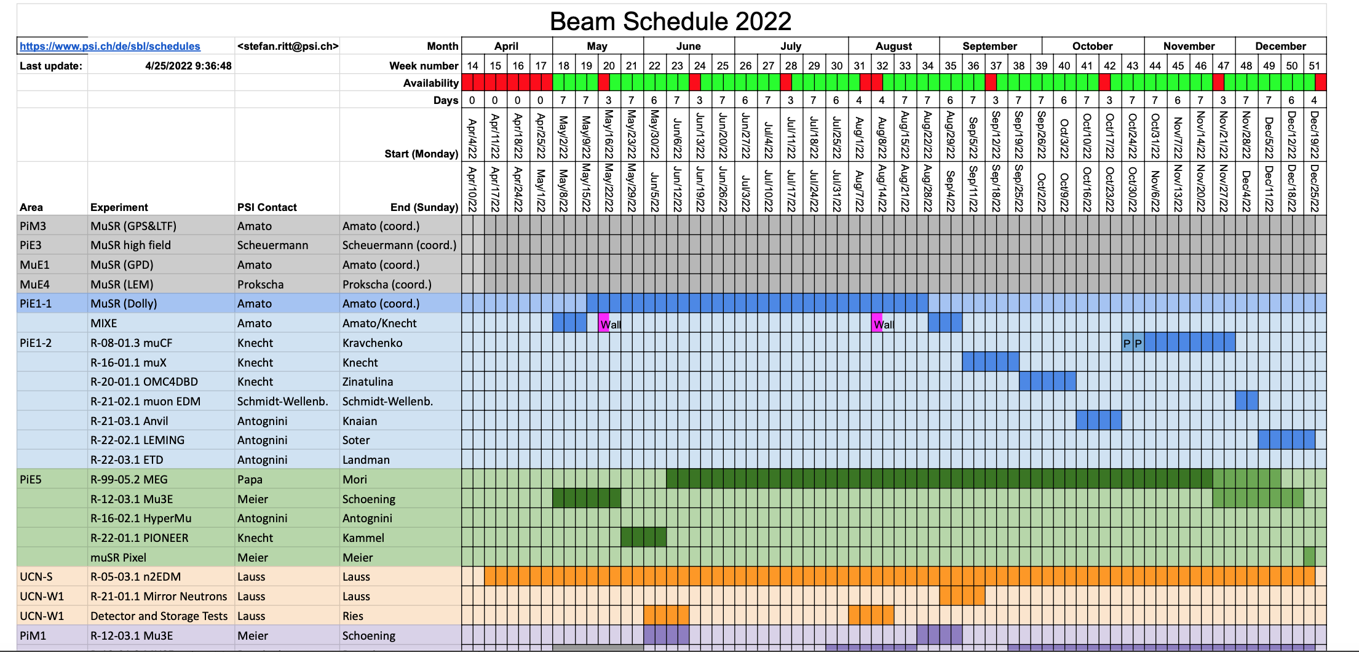
Beam Schedule 2022 (OMC: 22th September – 9th October )
Daniya Zinatulina , 26.04.2022 5

Slide 6
Questions and answers:
Questions from TUM group:
Why does 2vbb reach 1+ states only and is low-momentum (few MeV), while 0vbb (and OMC) reaches higher Jpi multipoles and a momentum of around 100 MeV?
Mentioned in arXiv:1803.10960v3 and M. Kortelainen and J. Suhonen 2002 EPL 58 666.
It would be also nice to clarify what is needed for the calculations from us and with what precision; meaning what is still needed to start performing calculation and how can we facilitate that to start the calculations as soon as possible?
Which nuclear matrix elements models are the ones you are focussing on for the calculation of the isotopes we are studying and what are the reason for that selection?
Daniya Zinatulina , 26.04.2022 6

Slide 7
Questions and answers:
Questions from JINR group:
While 0vbb (and OMC) reaches higher Jpi multipoles and a momentum of around 100 MeV, is it possible to calculate the maximum expected value of the Jpi excitation?
How can OMC experimental results also help with ab-initio calculations?
Is it possible to make meeting in person with Juoni and Lotta to spend more time with understanding of calculations?
Can the OMC results also cover other fields (not only 0vbb and astrophysics) of the theory calculations? What do you need for this, we can try to measure…
Daniya Zinatulina , 26.04.2022 7

Slide 8
Questions and answers:
Questions from other members:
Daniya Zinatulina , 26.04.2022 8

