Slide 1
General OMC4DBD collaboration on-line meeting, 25 – 26th April 2021

Slide 2
Plans and upcoming 2022 beam-time @ PSI
Daniya Zinatulina , 25.04.2022 15

Slide 3
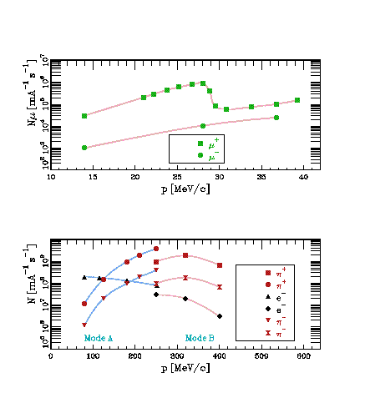
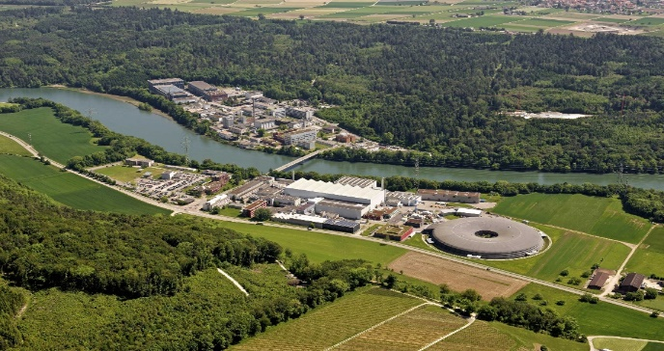
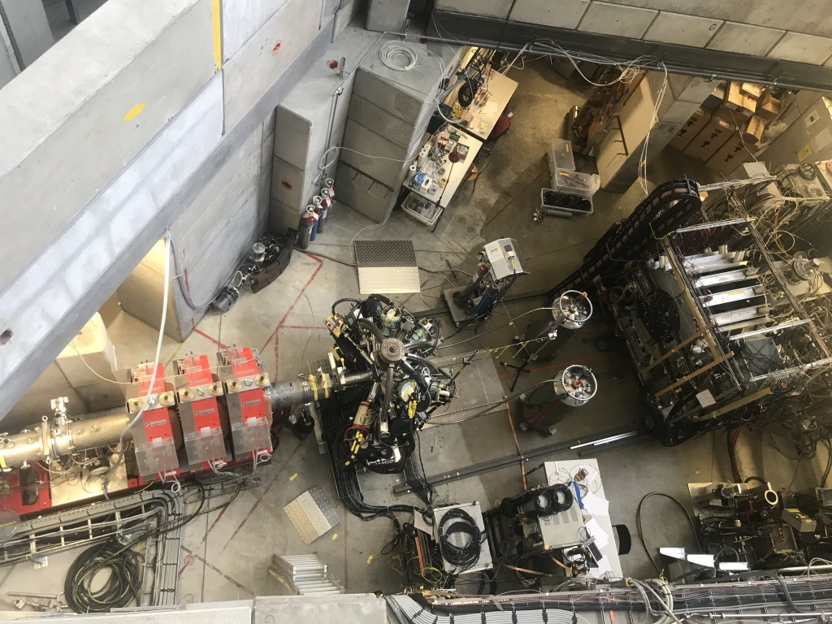
πE1-2 beam-line (PSI)
Beam momentum -> 15 – 40 MeV/C
Muon flux -> 2 x 10³ – 6 x 10⁴ s⁻¹
Daniya Zinatulina , 25.04.2022 16

Slide 4
Astrophysics with ¹⁰⁰Mo (H. Ejiri talk in detail)
Astro neutrino (including solar and supernovae neutrino study) observation provides evidences for neutrino matter oscillation, nuclear fusion reaction in sun and as tools for probing the supernovae (SN) explosion process
It was proposed to measure SN antineutrinos on ¹⁰⁰Mo (MOON) [1, 2]
OMC in ¹⁰⁰Mo will give experimental input for theoretical calculations of this process
≈100MeV
ν_{μ}
¹⁰⁰Mo(ν_{e}, e⁺)¹⁰⁰Nb (SN)
¹⁰⁰Mo(μ⁻, e⁺)¹⁰⁰Nb (OMC)
e⁺
ν_{e}
μ⁻
¹⁰⁰Nb
[1] H.Ejiri, J.Suhonen, K.Zuber. //
Phys. Rep 797 (2019) 1 – 102
[2] H.Ejiri, J.Engel, N. Kudomi //
PLB 530 (2002) 27-32
¹⁰⁰Mo
Daniya Zinatulina , 25.04.2022 17

Slide 5
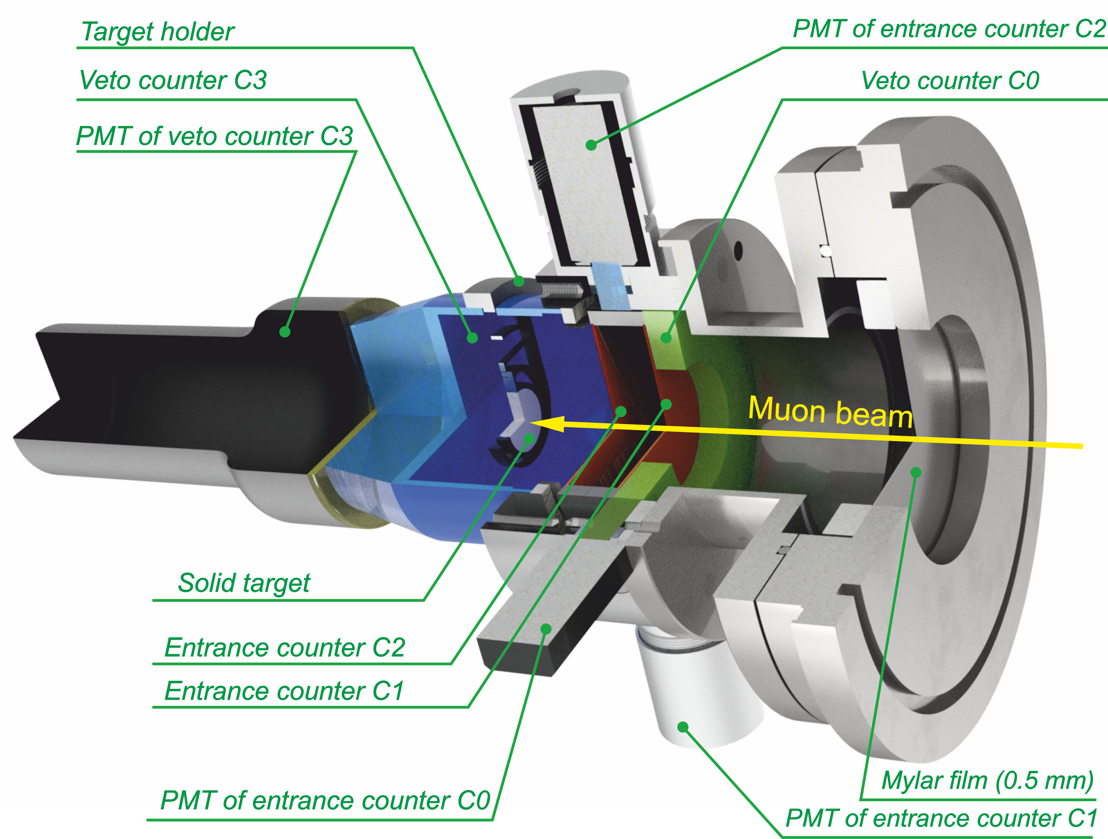
Proposed measurements in 2022
Purpose | OMC targets | Quant-ty
experimental input for astrophysics investigations with SN | ¹⁰⁰Mo (97.3%) | 2 g
identification, total cap. rates, yields | ^{nat}Mo | 2 g
Daniya Zinatulina , 25.04.2022 18

Slide 6
Rate estimations:
Parameter | Value | Comment
Muon rate | 30-40 kHz | Rate for the muon trigger system with ⁷⁶Se (2 g)
Beam momentum | 35-40 MeV/c | Used for ⁷⁶Se solid target
Solid angle | 1.5 - 2 % / detector | 60% germanium detector at 10 cm distance
Detection efficiency | 50% | For ~ 1 MeV
Time resolution | 10 ns
Detection rate | 2,5-3 kHz | Per detector unit in case of ⁷⁶Se
Daniya Zinatulina , 25.04.2022 19

Slide 7
Beamtime request:
2022: 3 weeks beam time in πE1 ->
1 week: setup and beam tuning,
2 weeks: data taking with ¹⁰⁰Mo target
Isotopicaly enriched ¹⁰⁰Mo is in production
Almost all parts of the setup and HPGe detectors are at PSI (we do not need to organize special logistic)
No new development of the equipment will be made (just some corrections with cup-counter)
Daniya Zinatulina , 25.04.2022 20

Slide 8
Conclusions:
Five additional high-purity germanium (HPGe) detectors were provided by the PSI MIXE and muX groups – for which we are very grateful – we look forward to further communication with them;
Winner with Research Preparation Grants with Russia 2020 (Leading House for Swiss Science and Technology Cooperation with Russia and the CIS Region);
The measurements with ⁷⁶Se and ¹³⁶Ba targets in 2021 campaign successfully have been done, and we got very nice data with enough statistics for the analysis;
During the 2020-2021 years we have made significant progress on the offline analysis of the 2019 test campaign. This led to improvements to the offline Analyzer’s code that enabled us to get preliminary results of the 2021 measurements faster, as we estimated;
In frame of DFG-RFBR Grant with this project the parallel data acquisition system, called LLAMA, has been incorporated into the setup by the TUM group – during the experimental campaign there are was no any problems with using two DAQs;
The unique information obtained at OMC in ¹⁰⁰Mo will provide an experimental contribution to the theoretical calculations of the the supernovae (SN) explosion process;
The OMC measurements with ⁹⁶Mo as it was requested in the Progress Report postponed to the next time (since this isotope will not be ready this year)
Daniya Zinatulina , 25.04.2022 21

Slide 9
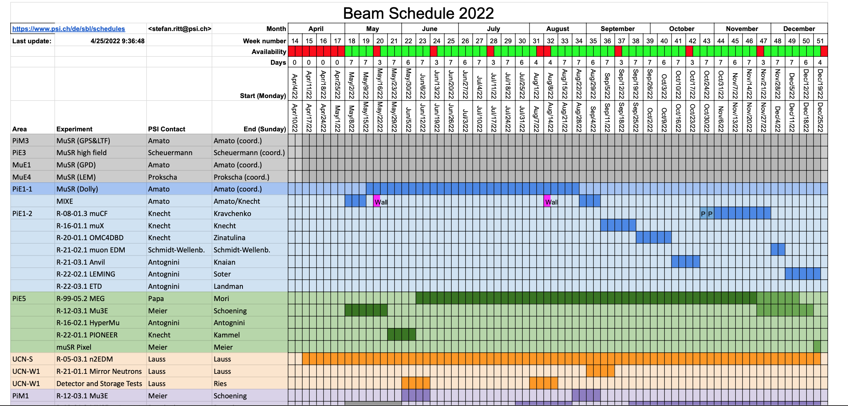
Beam Schedule 2022 (OMC: 22th September – 9th October )
Daniya Zinatulina , 25.04.2022 22

Slide 10
How do we perform the measurements (22th September – 9th October ):
I.Preparation before the beam time – we are not allowed to enter the zone
1.Equipment delivery
2.Unpackaging with checklist (to be made in advance)
3.Mechanical parts and crates preassembling (if possible)
4.Tests of C3counter and all trigger system
5.Check of the software performance and compatibility - > stay the same
II.Beam time – no beam
III.Beam time – beam is on IV. End of beam time
1.Beam tuning Continue the off-line measurements
2.Target measurements
3.Unbelievable night shifts
4.Unforgettable on-line/off-line night shifts
5.Incredible on-line/off-line night shifts
6.Deconstruction of the setup
LLAMA stuff and trigger
counters for target!
Should be done before
22th of September
First group | Second group
1.Frame assembly | 1. Electronics installation
2. Detector installation, auto filling system connection and commissioning | 2. Target equipment installation
 | 3. Cabling
 | 4. Counters tuning
Need less time
for this
Shorter,
as soon as this
time it will be
1 target
Daniya Zinatulina , 25.04.2022 23

Slide 11
Member's availability, shifts and useful links:
The preliminary presence list and measurements plan is here
The preliminary agenda of the shifts
The status of the beam
DUO
Guest House
Elog (electronic logbook)
Contact list
Corona requirements
Daniya Zinatulina , 25.04.2022 24

Slide 12
Extra plans/ notes or duties (22th September – 9th October):
Need to think with TUM and PSI group when it is better to come, to be ready for short period, since the beam time this year is not so long
Also, the plan B should be discussed -> if JINR group can’t participate
List of the needful things (from JINR and TUM → PSI (Stella and Andreas))
Egor and Sergey → C3 counter light guide -> JINR or Workshop @TUM??
Neutron detector?
Place for the frame and detectors into the ZONE before MIXE-muX measurements ????
Help with assembling of the detectors to the frame and night shifts
Daniya Zinatulina , 25.04.2022 25

