Slide 1

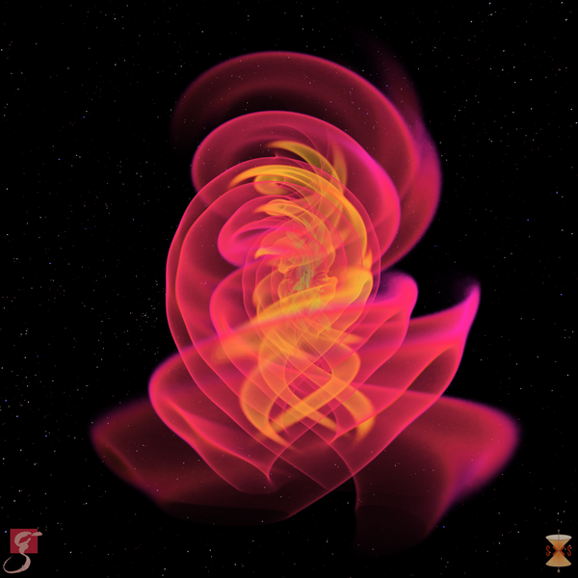
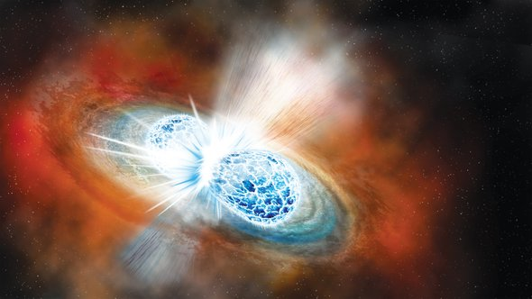
Gravitational waves: Astrophysical and cosmological inferences
Konstantin Postnov
Sternberg Astronomical Institute, Moscow U.
International Conference on Quantum Field Theory, High-Energy Physics, and Cosmology

Slide 2
Plan
Introduction
10-1000 Hz: ground-based laser interferometers
LIGO/Virgo O1-O3
Astrophysical implications
NanoHz: pulsar timing arrays results

Slide 3
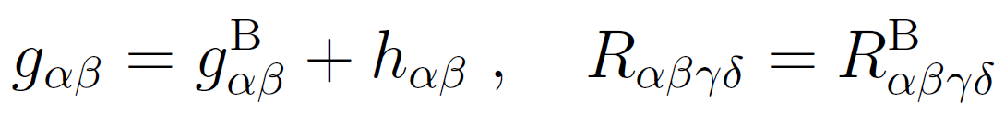
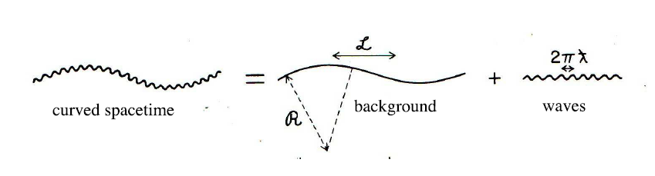


Gravitational waves

Slide 4

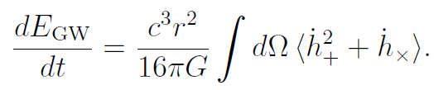
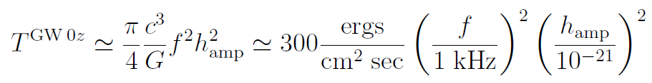
GW energy flux
Energy density
Power
Flux

Slide 5
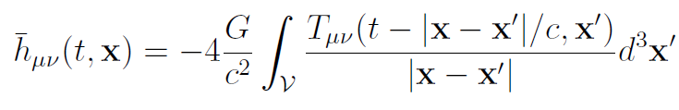


GW emission
Quadrupole radiation for v/c<<1:

Slide 6
EM vs GW
 | EM | GW
Charge | q | m
Size | R
Dipole radiation |  | no
Quadrupole radiation | Dipole x (v/c)
Energy flux
Power

Slide 7
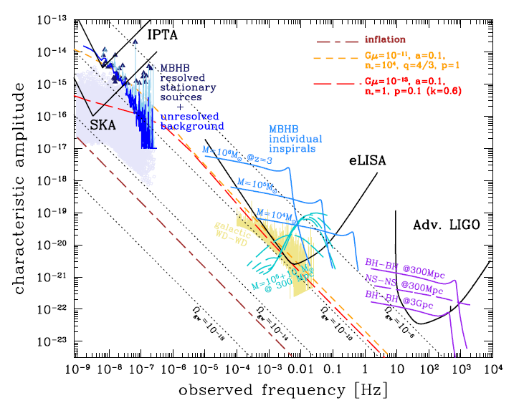
Astrophysical sources

Slide 8
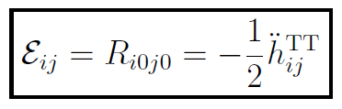

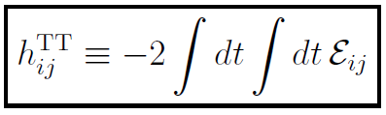
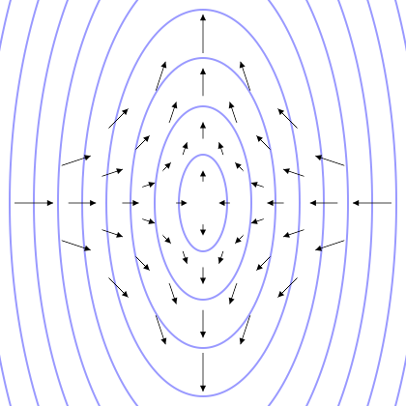

GW produces tidal field
18.07.2022

Slide 9
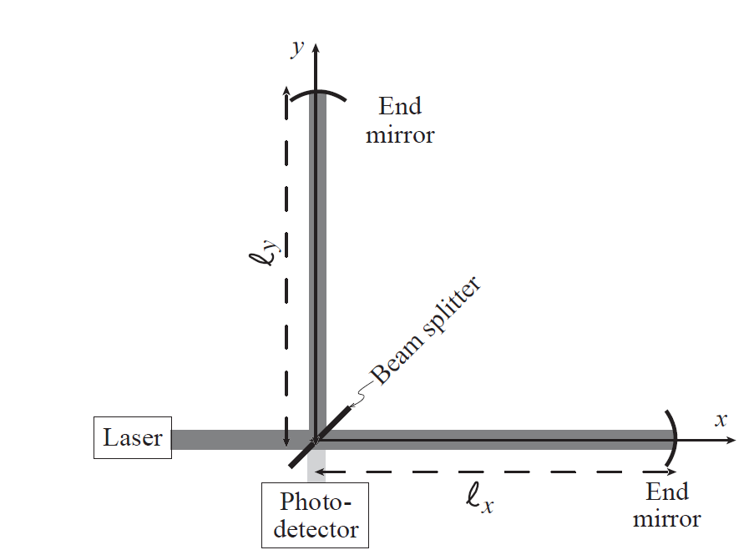

Laser interferometers
LIGO 1990-2017 ~690 MUSD

Slide 10
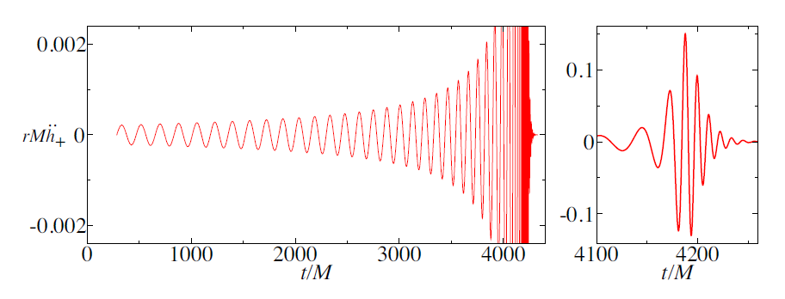
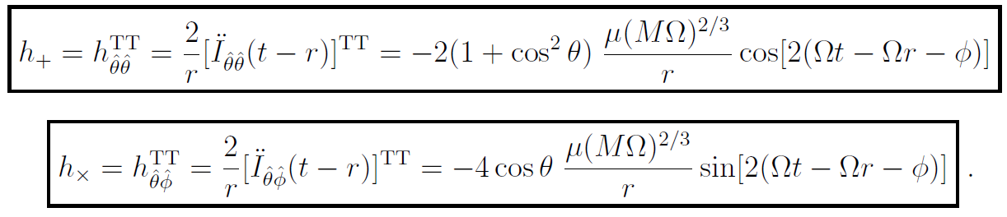
Chirp signal from coalescing binary system

Slide 11
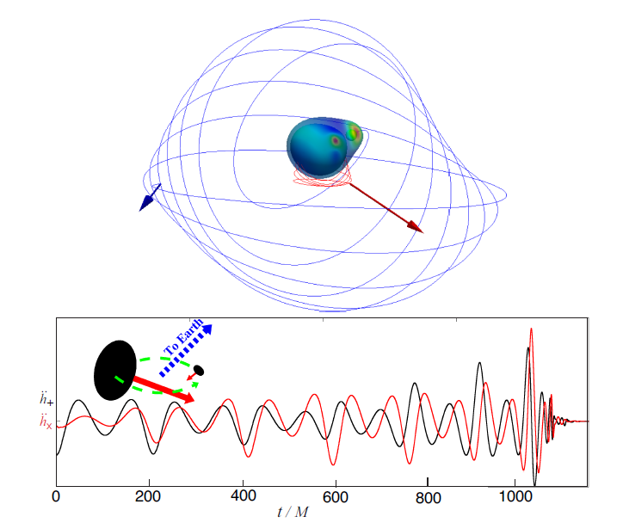
GW from inspiraling binary BH

Slide 12
LIGO
D. Reitze, 2017

Slide 13
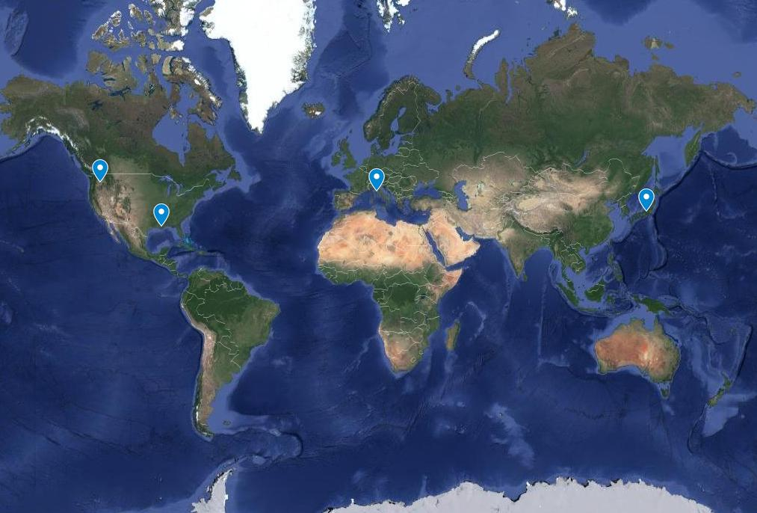
Working GW-interferometers

Slide 14
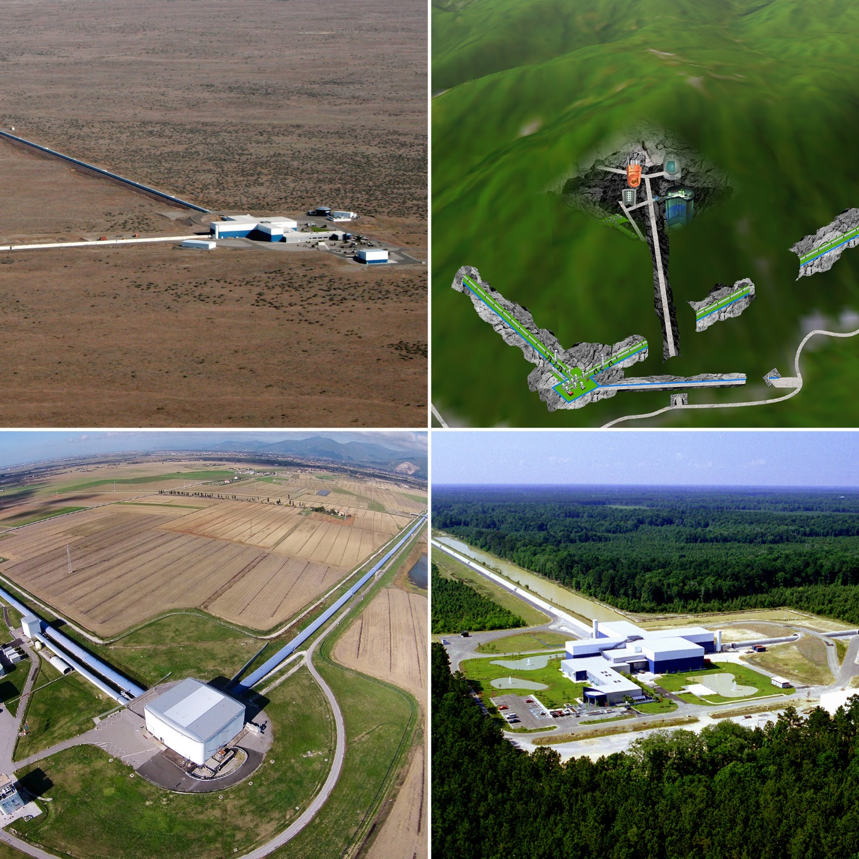
LIGO
Hanford
USA
KAGRA
Kamioka
Japan
Virgo
Pisa
Italy
LIGO
Livingston
USA
Credit: LVC collab., Univ. of Tokyo

Slide 15
GW150914
PRL 116, 061102 (2016)
35-350 Hz bandpass
filter applied

Slide 16
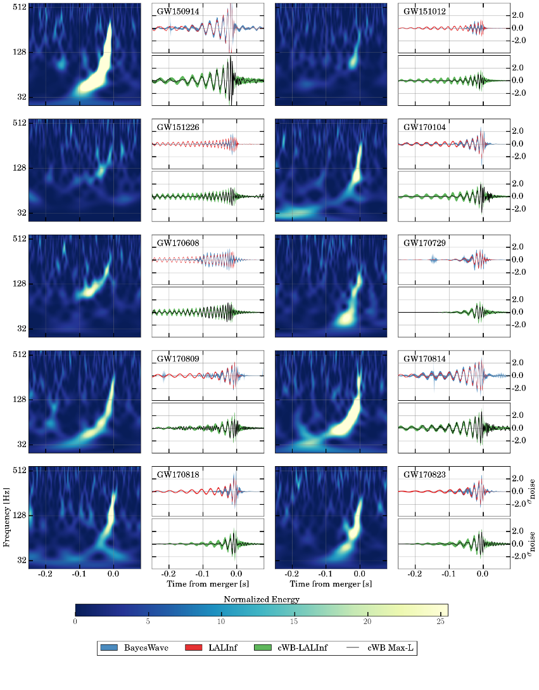
Binary BHs
LIGO/Virgo
GWTC-1 Catalog arXiv:1811.12907

Slide 17
Chirp signal from inspiraling binaries
Chirp-mass determined inspiraling signal

Slide 18
Chirp mass determines detection horizon. h_{lim} ~ M^{(5/6)}

Slide 19
Mass-redshift degeneracy
Luminosity distance

Slide 20
Parameters from GW observations
Chirp mass
Effective spin
arXiv:1811.12907

Slide 21
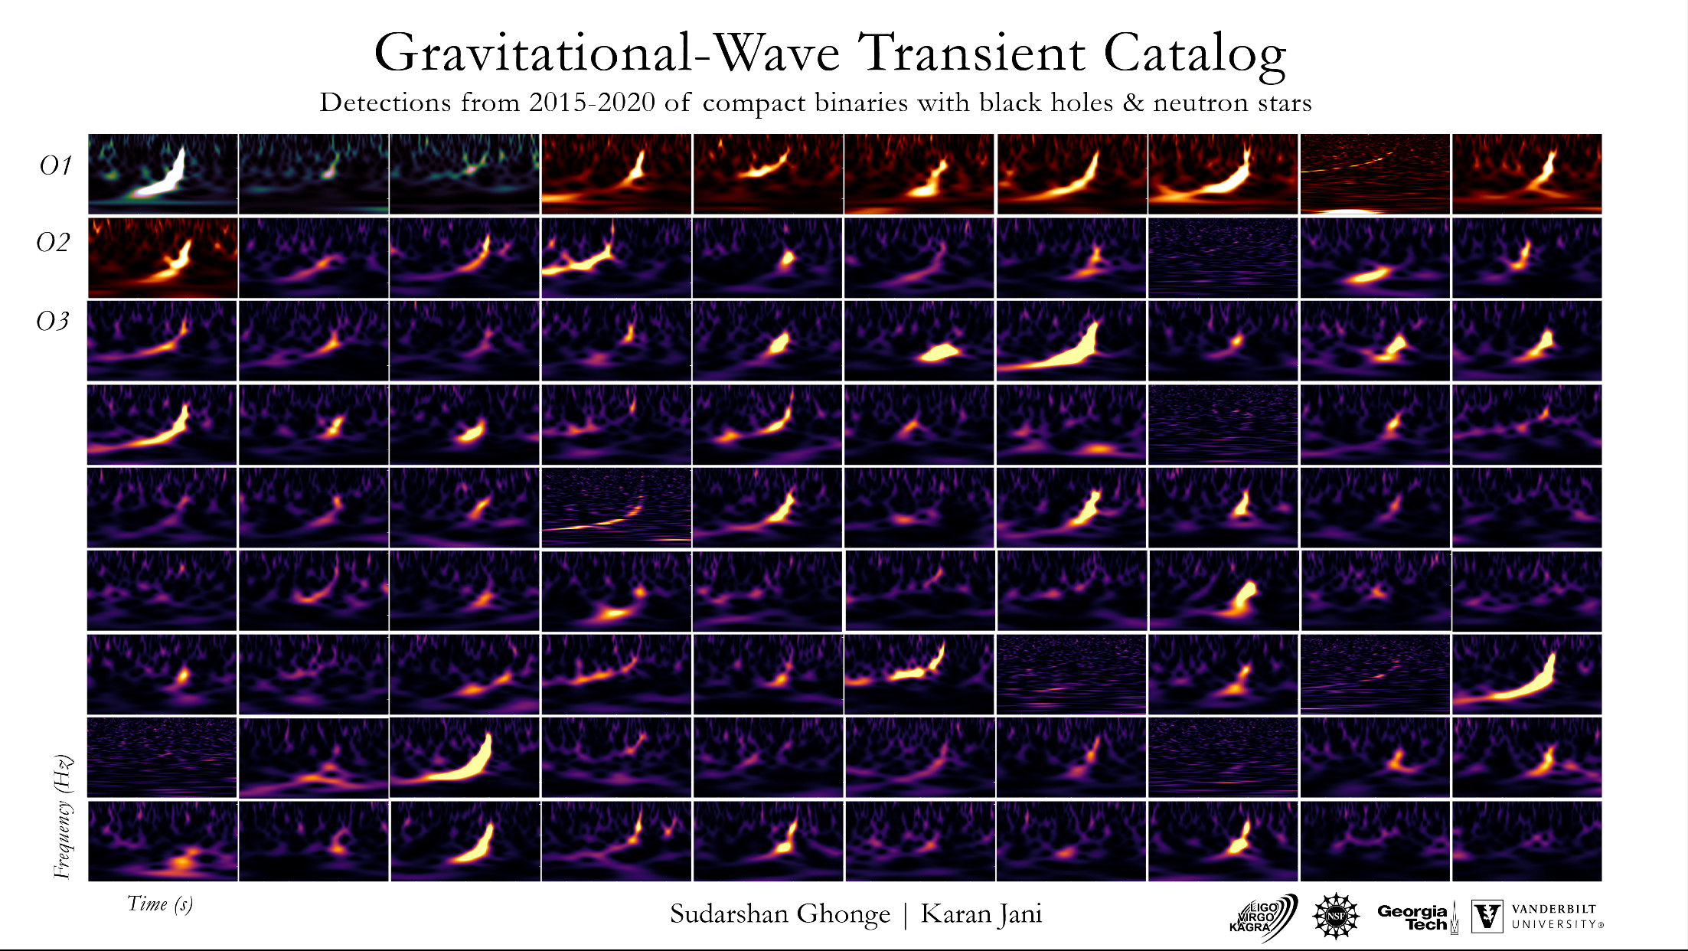
Coalescing binaries LIGO/Virgo

Slide 22
LIGO

Slide 23
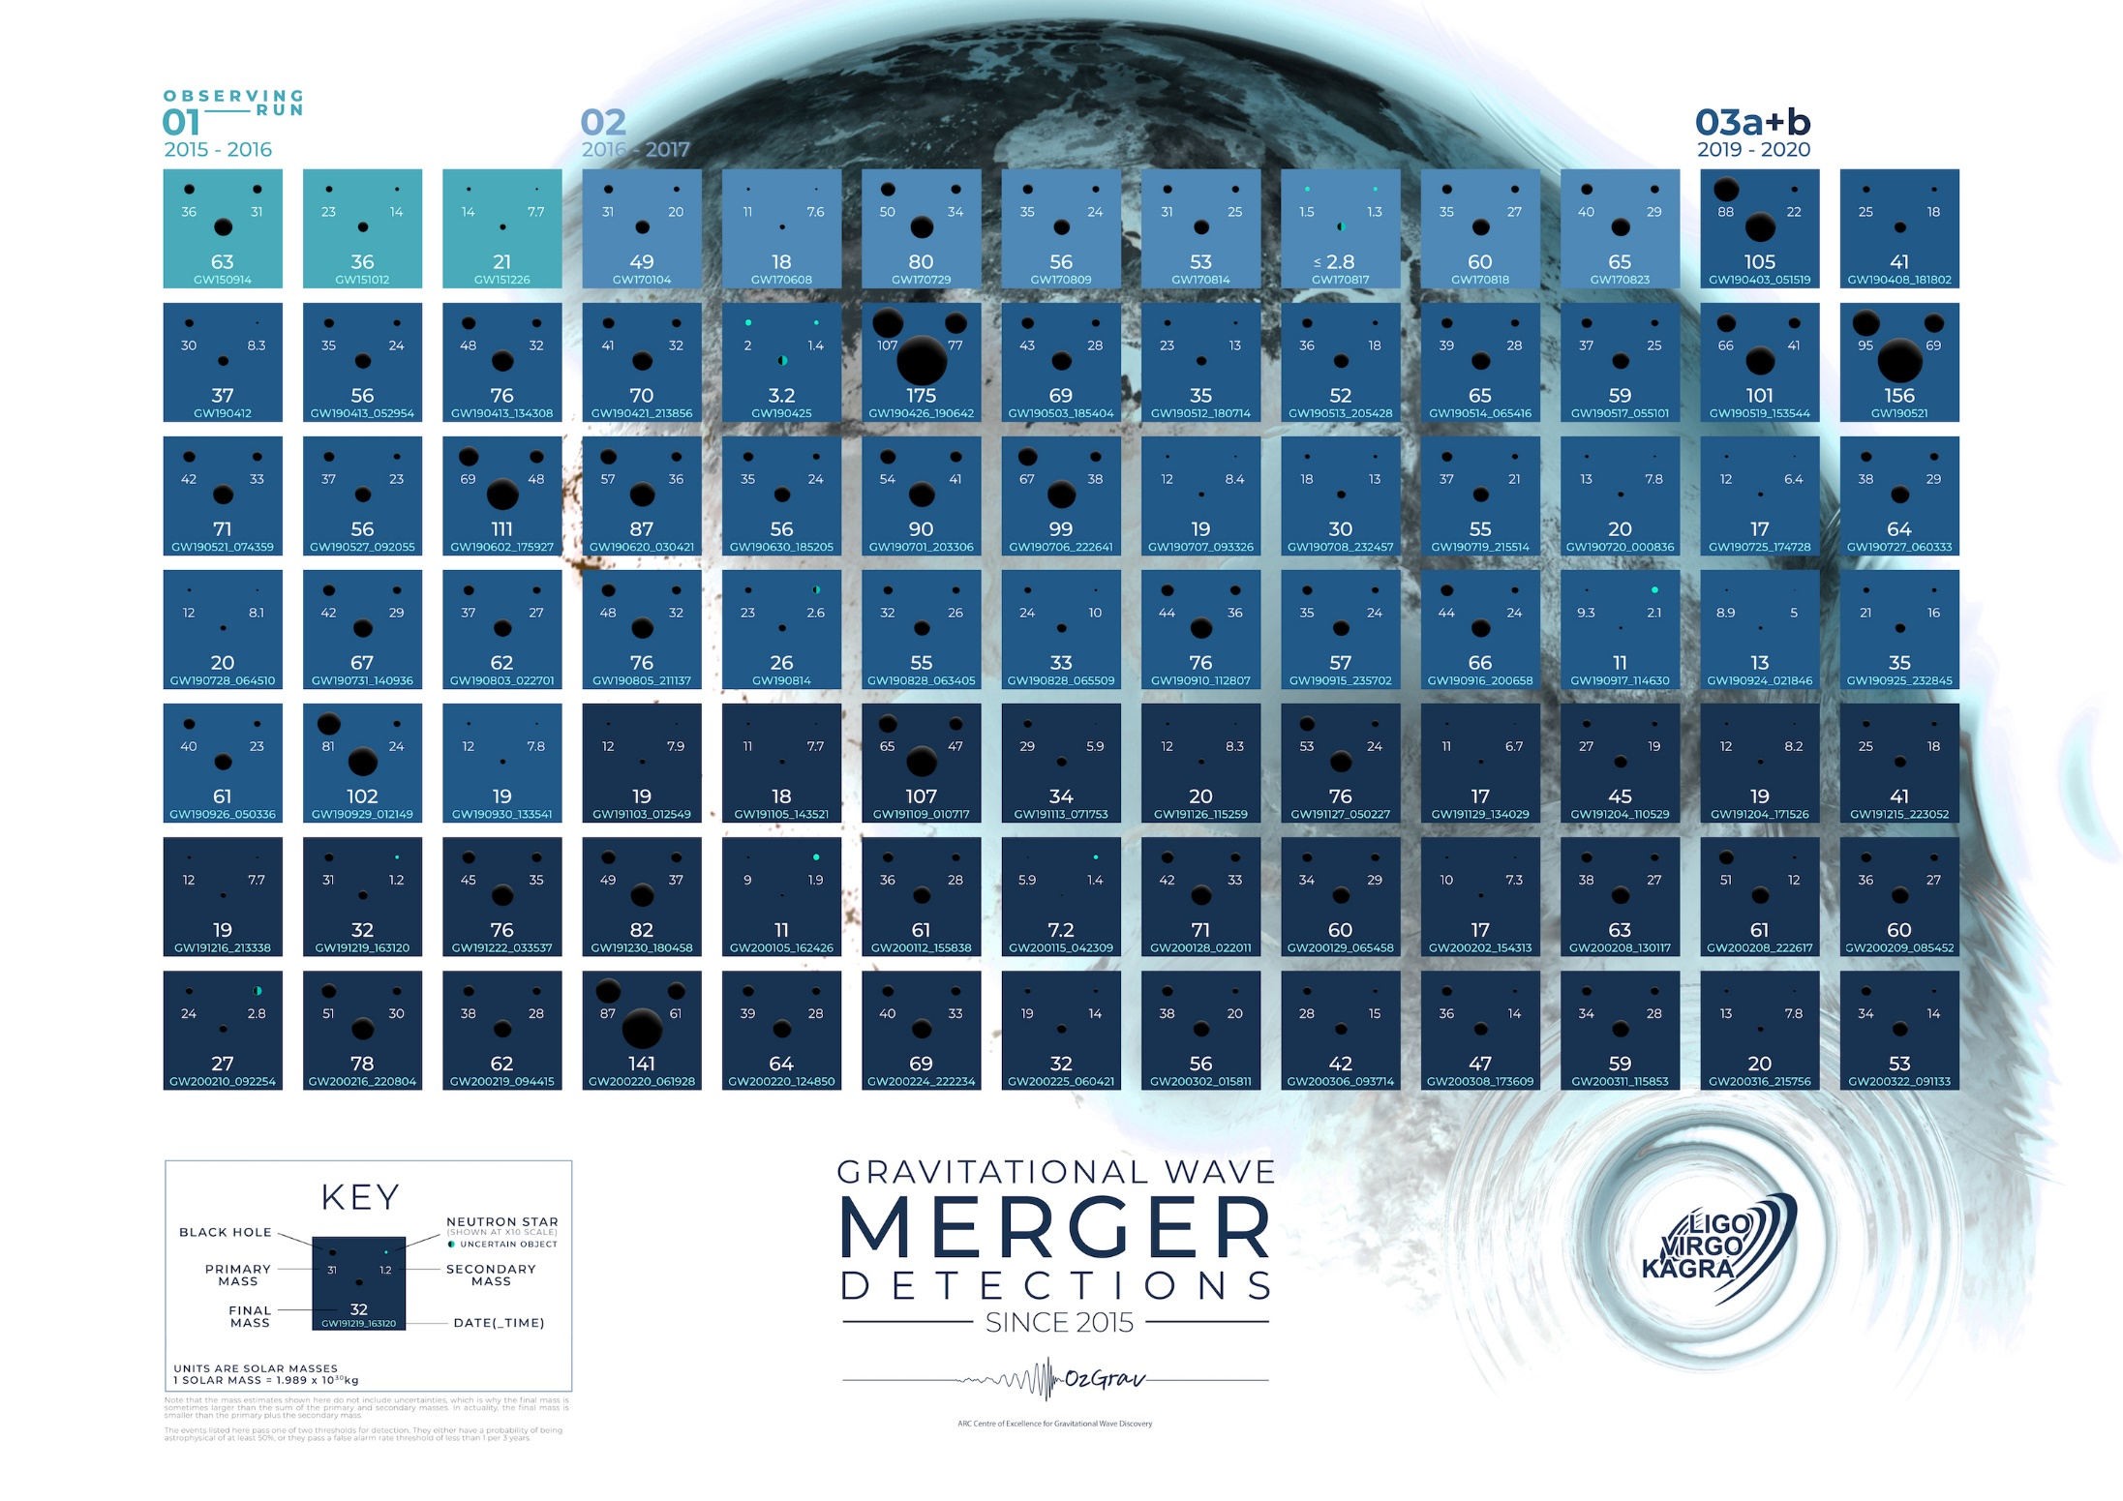

Slide 24
Statistical properties: summary
O1+O2+O3: 91 robust (S/N>8) detections
Isotropic on the sky (2207.05792)
Signal properties in agreement with GR up to a few % accuracy
2 NS+NS mergings, EM from GW 170817
4 BH+NS candidates. No electromagnetic signals.

Slide 25
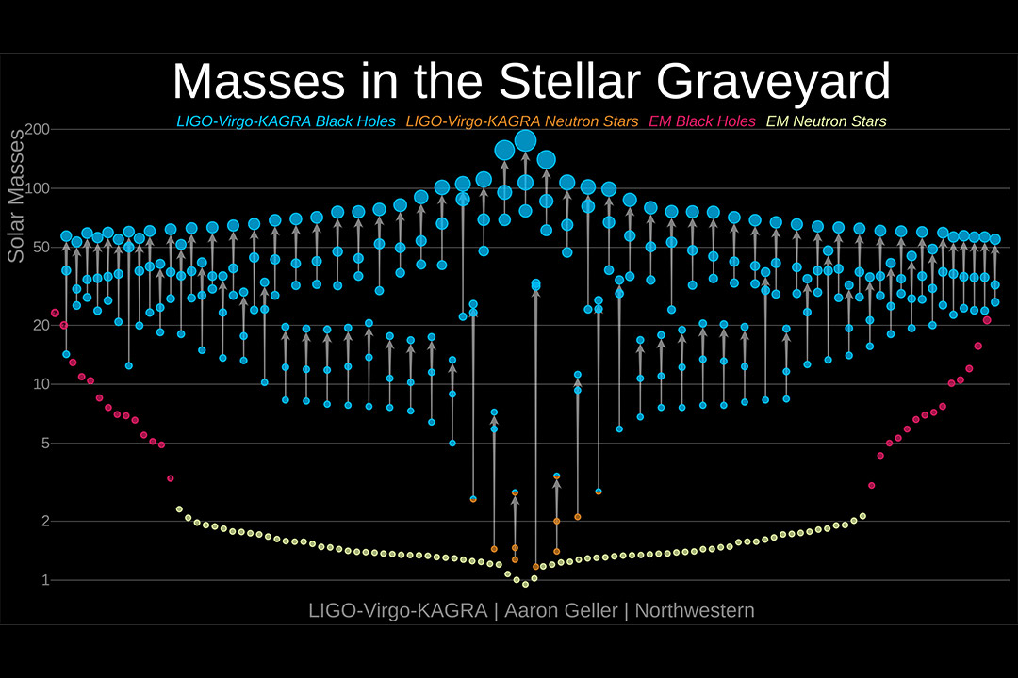

Slide 26
Simplest scenario:
BH+BH from massive star evolution

Slide 27
Astrophysical issues:
BH from stellar collapses, binary BH formation
Mass loss from massive stars
BH mass gaps (2.5-5, 60-130 M_{sun})
BH kicks
BH spins
…

Slide 28
Wind mass-loss
Low metallicity is required to have no severe mass loss
2206.15392

Slide 29
Pair-instability SN (PISN) mass gap
T_{c}> 7 x10⁸K ➔ γ+γ →e⁺e⁻
He cores 34-64 M_{sun} – pulsational pair instability (PPISN) with large mass loss, 64-130 M_{sun} – stellar explosion without remnant; M_{He}>130 M_{sun} – direct collapse to BH
Pop III stars ➔ up to 85 M_{sun}
SEVN code, Spera, Mapelli 2017

Slide 30
Other scenarios
Dynamical capture in dens stellar clusters (can produce BH with M>50 and non-parallel BH spins)
“Exotic” scenarios – primordial BH (Zeldovich,Novikov 1967…Carr 1975… Dolgov&Silk 1993…)

Slide 31
Example: log-normal PBH mass function GWTC1+GWTC2
Dolgov+’19

Slide 32
Exceptional BHBH mergers
GW 190814, M₁=26 , q=0.112, M₂=2.6 in lower mass gap? NS? Strange quark star? Outlier population? Formation from a triple star? Formation in AGN disk? Primordial BH?
GW190521 in upper mass gap (60-120), large effective spin
(Or even ??)
Repeated meggers in stellar clusters or AGN disks?? Primordial BH?
GW190412 high spin
➔ Hierarchical merger?

Slide 33
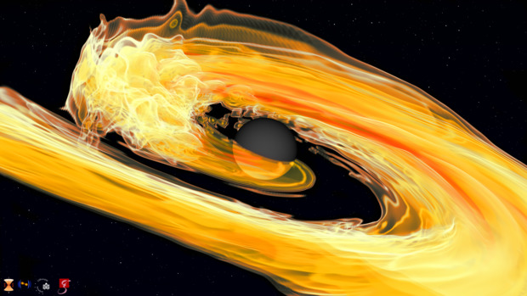
NSBH mergers
GW 200105_1162426 (8.9+1.9)
GW 299115_042309 (5.4+1.5) ??

Slide 34
Predictions from binary star evolution
NS+BH upper limit
610 Gpc⁻³ yr⁻¹
1811.12907
PK+ 2019; 1907.04218

Slide 35
Detection rate BH+BH, BH+NS
Actual detections
1907.04218

Slide 36
EM emission from NS+BH
EM-favorable

Slide 37
R_{tid}>R_{ISCO}
R_{tid}<R_{ISCO}
R_{tid}~R_{ISCO}
Kyotoku+’11

Slide 38
Mass shedding and tidal disruption
R_{tid}~R_{ns}(M_{bh}/M_{ns})^{1/3}
Mass shedding if R_{tid}>R_{ISCO}
Depends on NS compactness C=M_{ns}/R_{ns} (EOS)
Tidal parameter ☹=2k₂/(3C⁵)
Depends on the BH spin
Barbieri+ 1908.08822

Slide 39
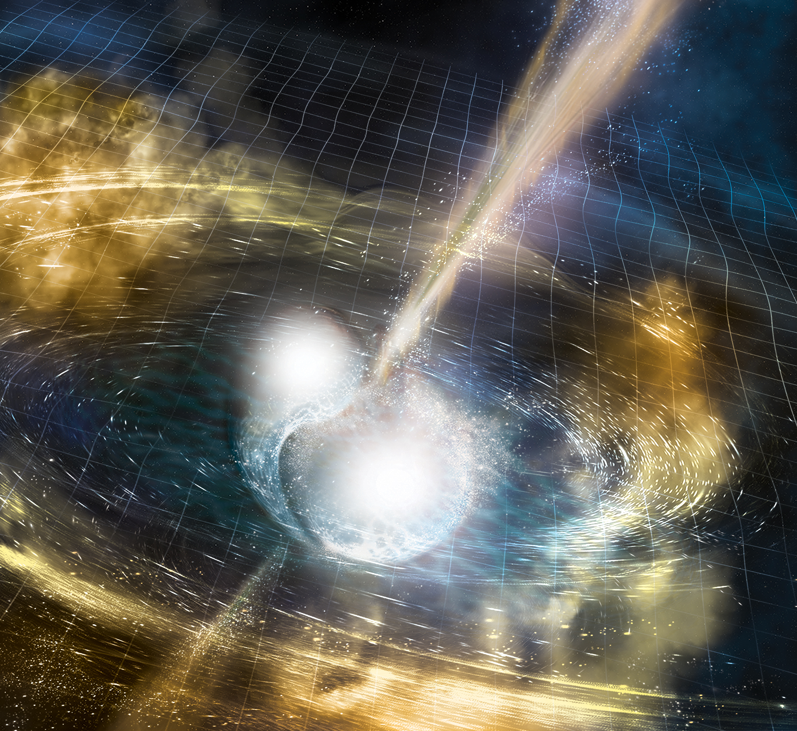
Binary NS and multimessenger astronomy
Image credit: LIGO/Caltech/MIT/Sonoma State (Aurore Simonnet)

Slide 40
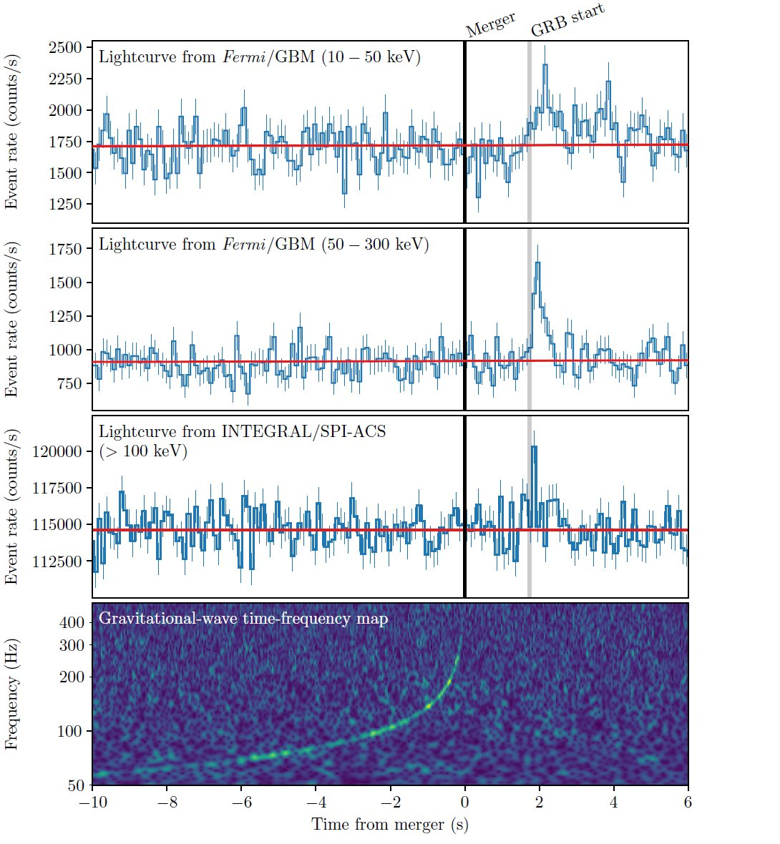
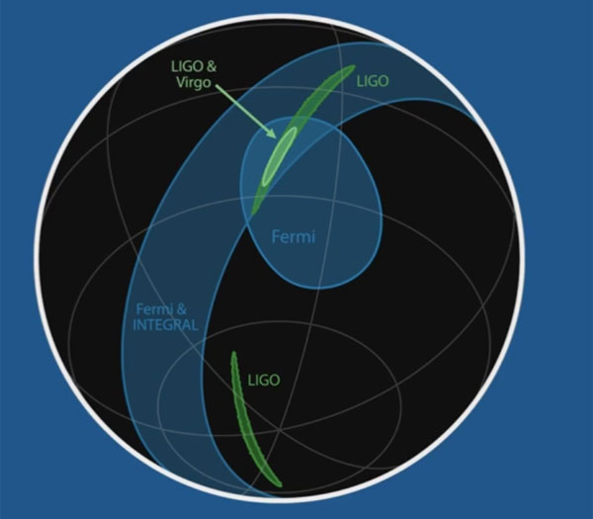
GRB170817A and GW170817
GRB association with NS+NS was predicted
by Blinnikov et al. 1984 SvAL

Slide 41
Fundamental inferences
1) EM and GW speed:
2) Equivalence principle
10-s EM delay
Instantaneous, D>26 Mpc
MW: M=2.5x10¹¹M
R<100 kpc
Shapiro delay
Cf. from Cassini mission: 2.1+/-2.3 х 10⁻⁵
ApJL, 848, L13, 2017

Slide 42
3) Number of additional dimensions
arXiv:1801.08160

Slide 43
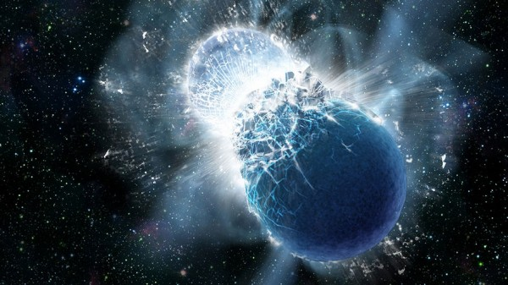
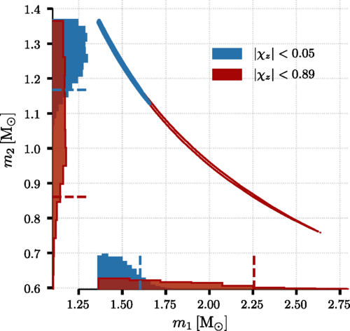
Parameters from GW signal
Merging rate
PRL 119, 161101 (2017)

Slide 44
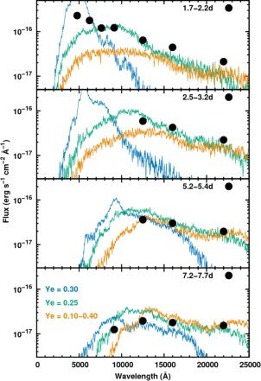
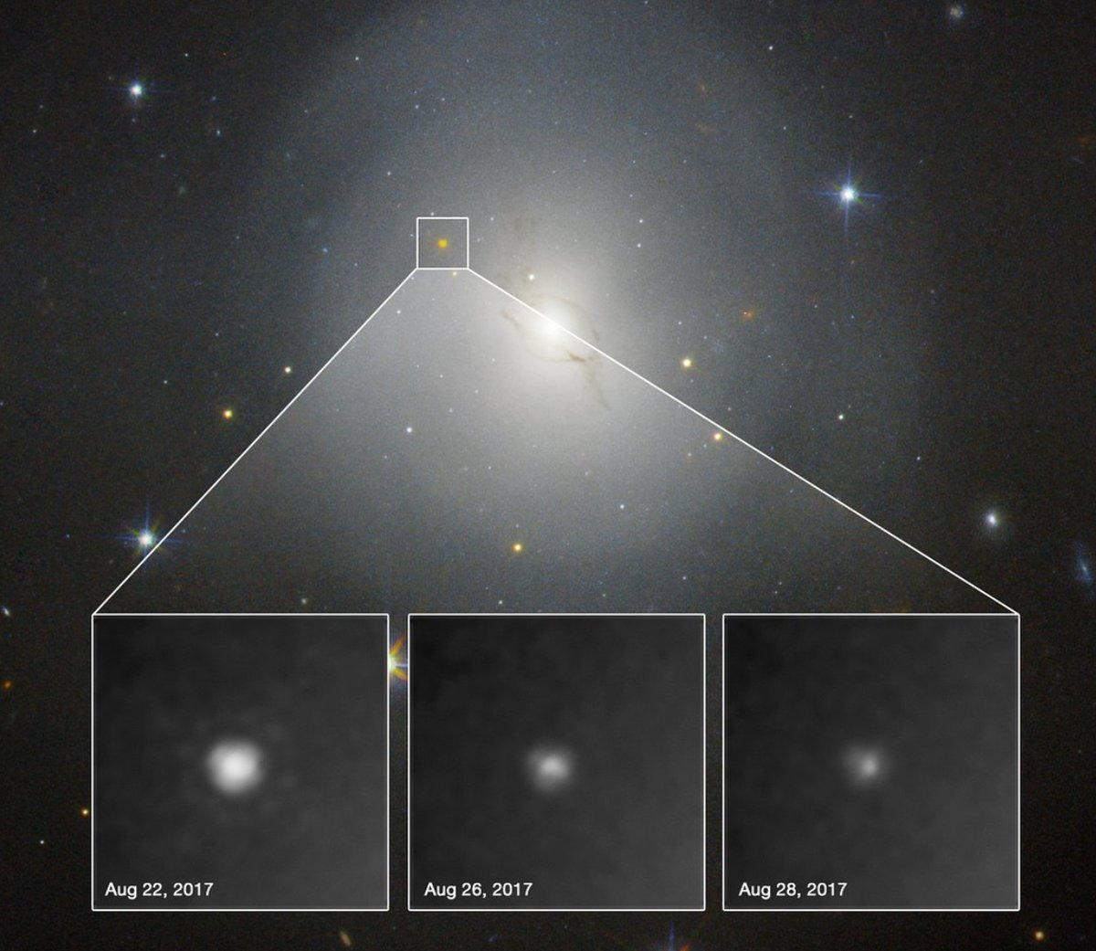
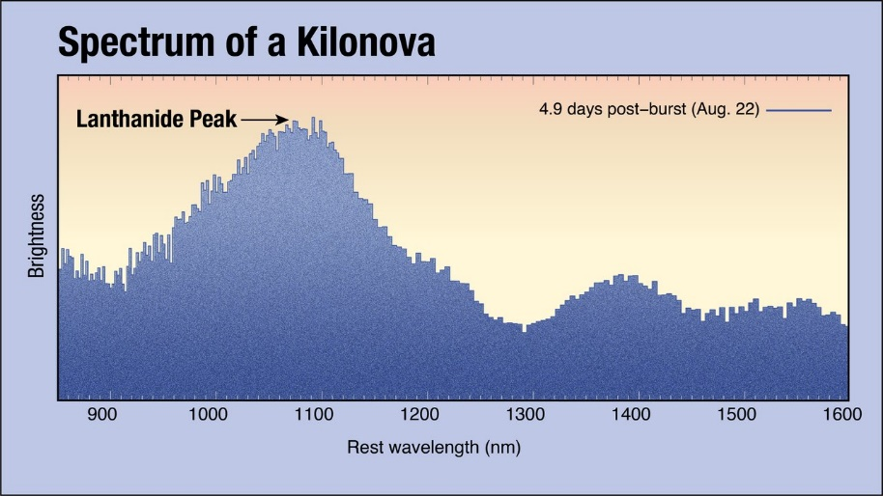
Optical and IR observations of kilonova
NGC 4993
40 Mпк, E/S0
1710.05850

Slide 45
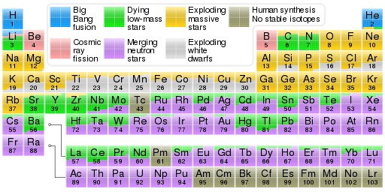
Binary NS as main production channel for r-elements

Slide 46
Joint GW+kilonova analysis
B.Metzger 1710.05931

Slide 47
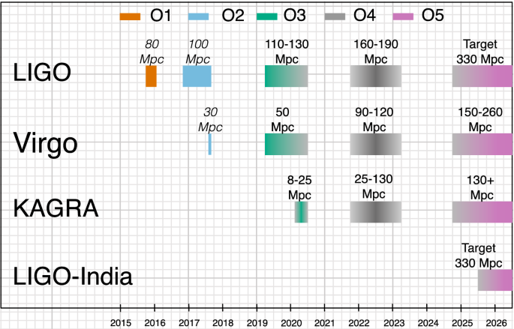
Future prospects (LVK collaboration)
Abbot et al. 2020

Slide 48
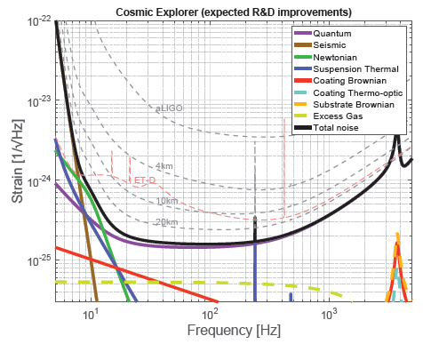
40-km LIGO Cosmic Explorer (2035)
Sensitivity of detectors with different lengths.
Solid curves are for a 40km long detector
LIGO Scientific Collaboration,arXiv:1607.08697 [astro-ph.IM]

Slide 49
LIGO, Virgo, and KAGRA are closely coordinating to start the O4 Observing run together in ~March 2023, despite local and global adversities.
LIGO projects a sensitivity goal of 160-190 Mpc for binary neutron stars. Virgo projects a target sensitivity of 80-115 Mpc. KAGRA should be running with greater than 1 Mpc sensitivity at the beginning of O4, and will work to improve the sensitivity toward the end of O4.

Slide 50
Pulsar timing arrays
Pulsar timing (Estabrook & Walquist’75, Sazhin’78, Detweiler’79)
Working collaborations
  European PTA (EPTA) [42 msPSR]
  Indian PTA (In PTA)
  North American Nanohertz Observatory for GW (NANOGrav) [48 msPSR]
  Parkes PTA (PPTA) [~30 msPSR]
  >Join into International PTA (IPTA)
R(ns)~10 (h/10⁻¹⁶)/ (f/10⁻⁸ Hz)

Slide 51
NanoHz GW from PTA observations
Stochastic GW backgrounds:
  Inspiral binary SMBH (M>10⁷) (e.g. Sesana+’08, α=-2/3)
  Cosmic strings (e.g. Oelmez+’10, α=-7/6)
  Cosmological phase transitions, primordial GW (Grishchuk’05 α=-2, Lasky+’16 α=-1)
  …
Pol+’21

Slide 52
IPTA DR2 results
Stochastic common spectrum process (CP)
Marginally consistent with SMBH GWB (α=-2/3) with space density
Cosmic string tension μG<4x10⁻¹¹
Antoniadis+ 2201.03980

Slide 53
Cosmological inferences if detected CP signal is GWB
2d-order GWs accompanying formation of PBH from collapse of inflationary scalar perturbations
De Luca, Franciolini, Riotto ’21

Slide 54
Conclusions
LVK O1+O2+O3: ~ 100 detections of binary BH and NS mergings, mostly binary BH, rate ~10-200 Gpc⁻³ yr⁻¹
Astrophysical problems in formation of massive BH with M~100 M, extreme mass ratio BH+BH inspirals, BH+NS
Stochastic nanoHz CP signal is detected by NANOGrav and IPTA collaborations. If GWB, it may be produced by SMBH binaries ~10⁻⁵ Gpc⁻³ or cosmic strings with tension μG<4x10⁻¹¹
Pulsar timing as a sensitive probe to new theoretical models of nanoHz GWBs!

Slide 55
Backup slides

Slide 56
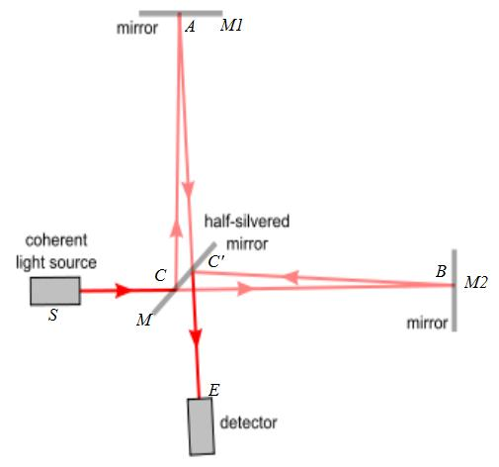
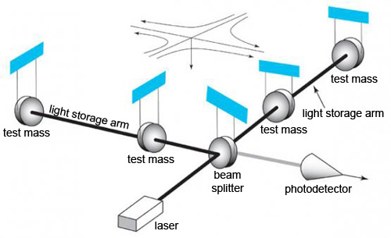
How to detect GWs?
Michelson interferometer
Laser interferometry
h~ΔL/L

Slide 58
Phase change in interferometer

Slide 59



GW interferometer
Разность фаз в плечах интерферометра
Модуляция интенсивности

Slide 60
How to measure tiny displacements?

Slide 61
Hellings-Downes correlation

