Slide 1
On Asymptotic Universality of Strong Interactions at Large Distances
International Conference on
Quantum Field Theory, High-Energy Physics, and Cosmology
18-21 July 2022
BLTP, JINR, Russia
Vladimir A. Petrov
A. A. Logunov Institute for High Energy Physics
of
the National Research Centre “ Kurchatov Institute”

Slide 2
Terms definition
Asymptotic : energy “infinity”.
Universality: independence of the initial collision channel.
Strong: inaccessible to perturbative treatment in terms of the gauge coupling.
Distance: average size of the interaction region ( = average impact parameter)
Large: noticeably larger than 1 Fermi.

Slide 3
Simple example of universality
Low energies
U = - G $\frac{{ E}_{∗}^{2}}{r}$
High energies $E_{1,2 }=E_{∗}≫m_{2}, m_{1},$

Slide 4
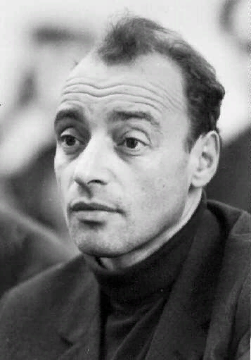
Universality types in High Energy Physics
Pomeranchuk Theorem (1958)
$$σ_{\overline{A}B}^{tot}− σ_{AB}^{tot} →0, E→∞$$
Pomeranchuk type universality
?
$$σ_{AB}^{el}− σ_{CD}^{el} →0, E→∞$$
Gribov type universality (1973)
$$\frac{σ_{AB}^{tot}}{σ_{CD}^{tot}}→1, E→∞$$

Slide 5
X-Sections on the Rise

Slide 6
It’s a long way to Tipperary…
$$0.7 fm$$
$$1.25 fm$$

Slide 7
Longitudinal Direction ?
0.0004 fm
7

Slide 8
E = $𝓞$( 1÷3 TeV )
8

Slide 9
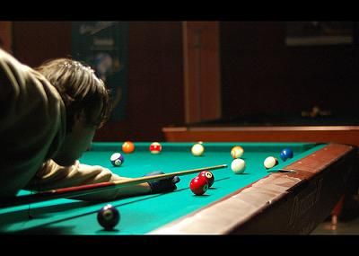
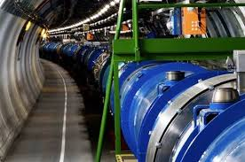
Elastic Scattering

Slide 10
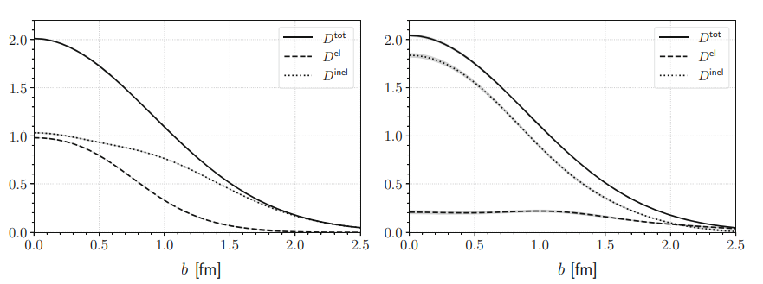
Elastic Scattering:Central or Peripheral?
Kundrat-Prochazka ( 2020)
$$\tilde{T}\left(b\right)= \frac{1}{8πs}\int_{0}^{∞}{qdqJ_{0}(bq)T(s,t=−q^{2}})$$
$$D^{el}\left(s,b\right)=4{\left|\tilde{T}\left(s, b\right)\right|}^{2}$$
$$D^{tot}\left(s,b\right)=4Im \tilde{T}(s,b)$$
$D^{inel}\left(s,b\right)$ =$D^{tot}\left(s,b\right)$ - $D^{el}\left(s,b\right)$
$${σ_{tot}(s)=π\int_{0}^{∞}{bdb}D}^{tot}\left(s,b\right)$$
$${σ_{el}(s)=π\int_{0}^{∞}{bdb}D}^{el}\left(s,b\right)$$
$${σ_{inel}(s)=π\int_{0}^{∞}{bdb}D}^{inel}\left(s,b\right)$$

Slide 11
Procházka -
Kundrát (2020)

Slide 12
Conclusions (still to be done):
$$∎ Dilemma remains:$$
$$if elastic scattering is$$
$$of central \left(non universal\right)$$
$$or$$
$peripheral \left(universal\right)character$ ?
$$∎ Peripherality→Universality$$
12

