Slide 1

Dark Matter Searches at the LHC
International Conference on Quantum Field Theory, High-Energy Physics, and Cosmology, BLTP JINR, Dubna, July 18–21, 2022
Maria Savina, LHEP JINR
Maria.Savina@cern.ch

Slide 2
Dark matter candidates:
stable (non-interacting directly, MET signatures) or with a
lifetime high enough (LLP signatures)
electrically neutral
with a mass reachable at the LHC
DM portals (mediators, “simplified models” of
DM/SM interactions)
Notes:
2

Slide 3
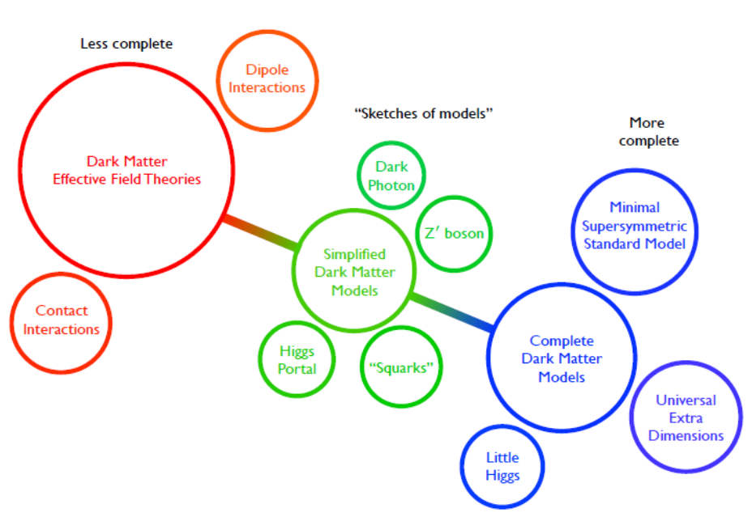
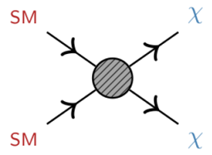
Dark matter approaches: from EFT to complete models
Notes:
3

Slide 4
The simplest DM: one DM particle + one mediator
Visible sector: SM
H, q, l, G, V…
mediator: S_{med}, M_{med}
Hidden sector: DM
Φ, S..,Ψ.., V’…
g_{f,V,H}
g_{DM}
only one DM particle:
S_{DM} = 0, ½, 1…, M_{DM}
S=0,1/2, 1…
Model free parameters: a mass of a mediator, a mass of a DM particle, couplings to the visible and hidden sector

Slide 5
DM signatures (two substances – DM particle and mediator):
fully visible (mediator only, a new resonance
in dijet/dilepton/diboson etc. spectra)
MET - decay to DM particle pair (+ a visible “tag”)
non-standard properties of SM particles
(higgs sector – higgs boson pair production, h₁₂₅ to invisible…)
flavor violating processes
“general” or model-specified interpretation
Notes:
5

Slide 6
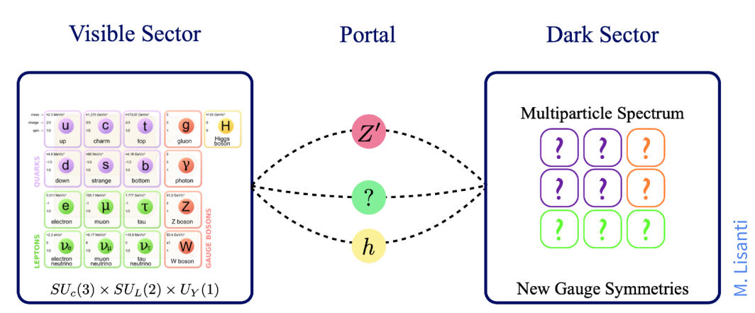
Dark sector, how might it look?
DS might be extended and rich
presence of new “dark” particles that
manifests itself through SM-dark
interactions (portals)
new symmetries (new “dark”
QCD, EW, SUSY…)
Notes:
6

Slide 7
Higgs portal
Higgs sector constructions:
  SM+S
  2HDM (flavor conserving or flavor violating)
  2HDM+s(a)
  Higgs triplets…
Signatures:
  Exotic Higgs decays:
    H₁₂₅ → (semi)invisible
    decay to light (pseudo)scalars H₁₂₅ → aa/ss →4 SM particles
  Enhanced Higgs pair production (X → H₁₂₅ H₁₂₅)
  H₁₂₅ (bb) + MET/ Z(ll) + MET
  New scalar decay to 2t(b)/4t(b)/2t+MET, 2τ, diboson…
Notes:
7

Slide 8
SDM with (pseudo)scalar mediator: S/PS vs 2HDM+a
S/PS simplified vs extended: model specific vs model non-specific channels
S/PS
MET
visible
MET/visible
2HDM, 2HDM+a
MET

Slide 9
Exotic H₁₂₅ decays
Dark gauge bosons,
new (pseudo)scalars
from extended Higgs
sector etc.
Current constraints from fit to SM Higgs couplings
not included in the combination, yet undetected
measured through MET signatures
Notes:
9

Slide 10
Higgs to invisible, ATLAS&CMS, LHCP 2022
talks by Laurent Thomas,
Alexander Nikitenko
in the SM:
- visible particle(s) recoiling against the
invisible Higgs
significant MET portion
VBF is the most sensitive mode
ttH + VBF
VBF
Notes:
10

Slide 11
Higgs to invisible, ATLAS&CMS, LHCP 2022
talks by Laurent Thomas,
Alexander Nikitenko
VBF
Z(ll)+H
Notes:
11

Slide 12

Search for the Higgs decay to light scalars in 2HDM+a
PRD 90, 075004 (2014)
$$ζ=m_{s}^{2}/v^{2}$$

Slide 13
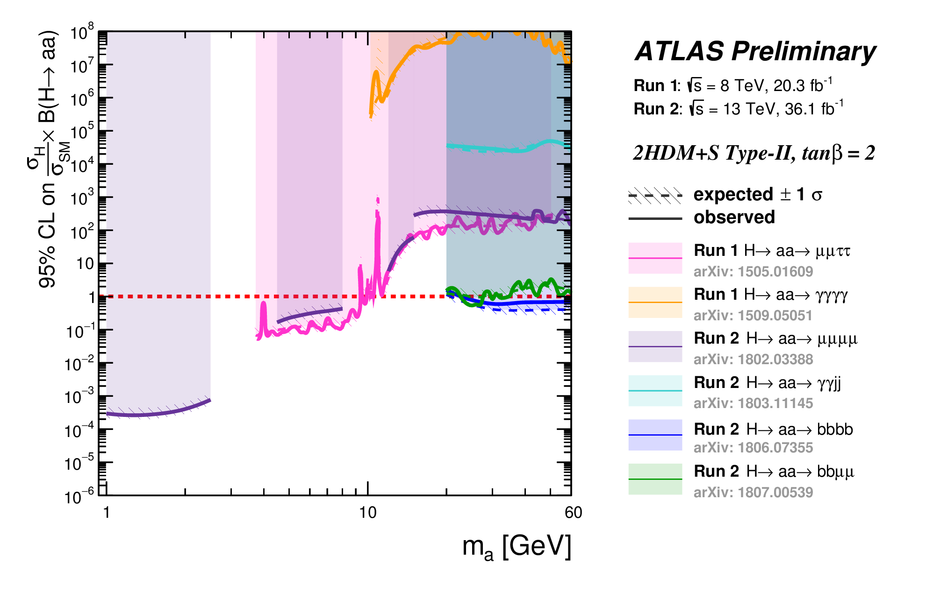
Search for the Higgs decay to light scalars in 2HDM+a
from slides by Sasha Nikitenko
h₁₂₅→ aa→ 4b/2b2μ/4τ/2b2τ/2μ2τ/4μ/ggγγ
m_{a}<1/2 m_{h125}
CMS/ATLAS limits need to be update for the RUN 2 analyses:
Notes:
13

Slide 14
Exotic decay to very light pseudoscalars H₁₂₅→ aa→ 4γ
Two collimated (very highly boosted) photons are considered as a single object Γ
- Interesting in the search for ALPs
CMS-HIG-21-016
Notes:
14

Slide 15
Search for enhanced Dihiggs production
SMEFT approach (HL-LHC)
search for new scalar resonances (2HDM,
2HDM+S, RS-type…)
Picture by Tania Robens,
LHCP 2022
Notes:
15

Slide 16
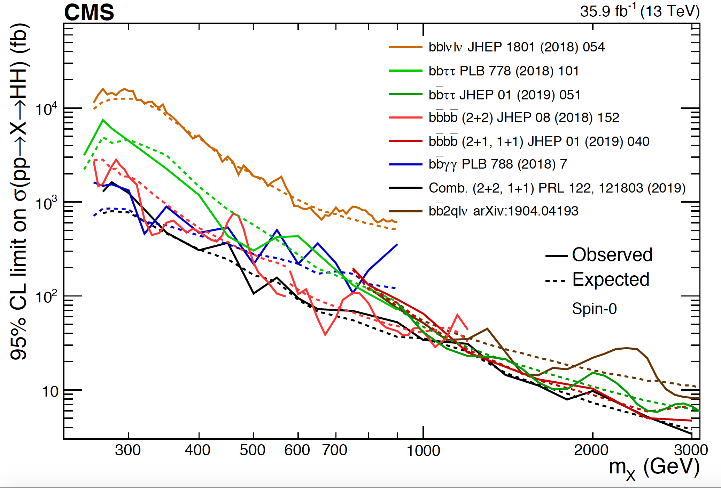
Search for enhanced resonant Dihiggs production
CMS HIG summary plots
Notes:
16

Slide 17

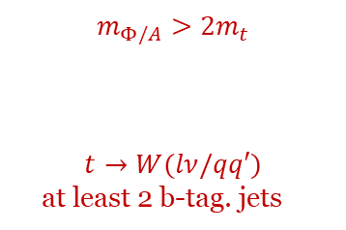





$t\overline{t}$/ $t\overline{t}$ + $E_{T}^{mis}$/$t\overline{t}t\overline{t}$, generalized interpretation for S/PS
$$m_{Φ/A}>2m_{t}$$
$$t→W(lν/qq′)$$
at least 2 b-tag. jets
$$t\overline{t}$$
$t\overline{t}$ + $E_{T}^{mis}/$ $t\overline{t}t\overline{t}$
Φ/A
The channel provides
the most stringent
limits !
$t\overline{t}t\overline{t}$, CMS, full RUN 2
EPJC 80 (2020) 75
Model independent interpretation,
$plot (m_{H\left(A\right)},g_{H(A)t\overline{t}}$), width values:
1 %, 5 %, 10 %, 25 %.
$t\overline{t}$ + $E_{T}^{mis}$, full RUN 2
ATLAS-CONF-2020-003
pseudoscalar
Also CMS $t\overline{t}$/tW + $E_{T}^{mis}$
JHEP 04 (2020) 171
JHEP 03 (2019) 141

Slide 18
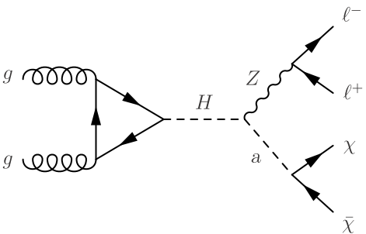
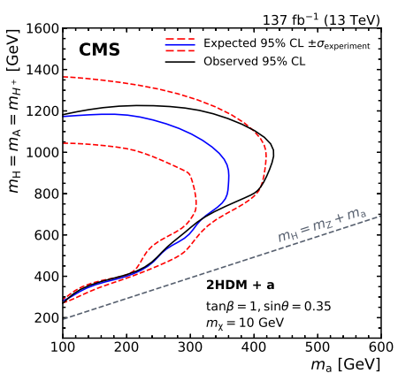
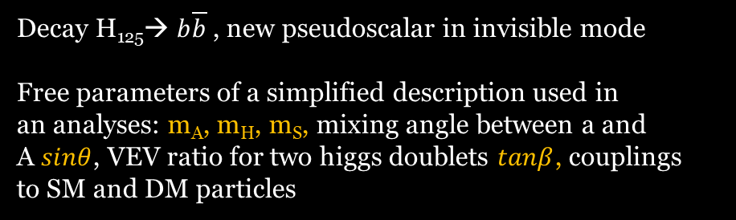
Mono H + $E_{T}^{miss}$ (boosted$b\overline{b}$ pair) and Mono Z(ll) + $E_{T}^{miss}$, 2HDM+a interpretation
EPJC 79 (2019) 280
EPJC 81 (2021) 13
2HDM+a
Decay H₁₂₅→ $b\overline{b}$ , new pseudoscalar in invisible mode
Free parameters of a simplified description used in
an analyses: m_{A}, m_{H}, m_{S}, mixing angle between a and
A $sinθ$, VEV ratio for two higgs doublets $tanβ$, couplings
to SM and DM particles
2HDM+a
H(bb)
H(bb)
Z(ll)

Slide 19
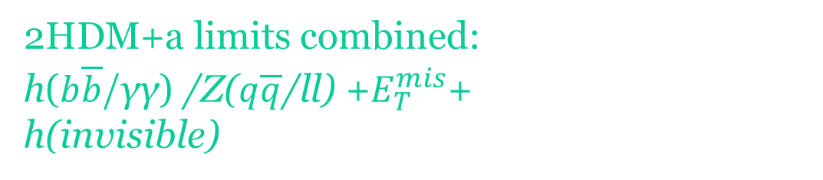
2HDM+a limits combined:
h($b\overline{b}$/γγ) /Z($q\overline{q}$/ll) +$E_{T}^{mis}$+
h(invisible)
JHEP 05 (2019) 142

Slide 20
2HDM+a parameter limits combined
ATLAS-CONF-2021-036
ATL-PHYS-PUB-2021-045
Notes:
20

Slide 21
2HDM+a DD combined results, 2016-2017
neutrino
floor
    LHC Dark Matter Working Group: Next generation spin-0 dark matter models

Slide 22
2HDM+a DM relic density predicted
    LHC Dark Matter Working Group: Next generation spin-0 dark matter models

Slide 23
Dark sector:
  Mediator search
  Dark showers…
  LLP signatures !!
Notes:
23

Slide 24
Dark sector with Long-Lived Particles at the LHC
LLP White Paper:
arXiv:1903.04497
LLP theory motivations:
arXiv:1806.07396
LLP:
a proper lifetime cτ₀ is greater than or comparable to the characteristic size of the (sub)detectors
small cτ₀ that
comparable to the
inner tracker size, no
displaced tracks →
“standard” prompt decay
intermediate cτ₀ → LLP
very large/infinite
large cτ₀ → stable particles, “standard” MET signatures
displaced jets
Notes:
24

Slide 25
LLP signatures with displaced vertexes
small coupling
sizable mediator
mass
small mass
gap
Notes:
25

Slide 26
LLP signatures with displaced vertexes
Notes:
26

Slide 27


Dark photon, prompt/displaced jets
The coupling to SM particles
proportional to electric charge
1 or 2 loops: naively ${10}^{−5}≲ε≲{10}^{−3}$
$$α^{′}=ε^{2}α_{EM}$$
LLP

Slide 28
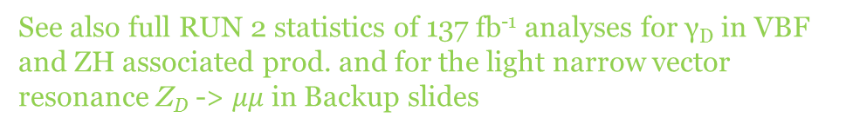
Dark photon from dark SUSY, displaced LJ
SUSY portal
h – Higgs boson (visible)
n₁ – neutralino,
n_{D} – dark neutralino
γ_{D}→γ conversion, ε
See also full RUN 2 statistics of 137 fb⁻¹ analyses for γ_{D} in VBF
and ZH associated prod. and for the light narrow vector
resonance Z_{D} -> $μμ$ in Backup slides

Slide 29
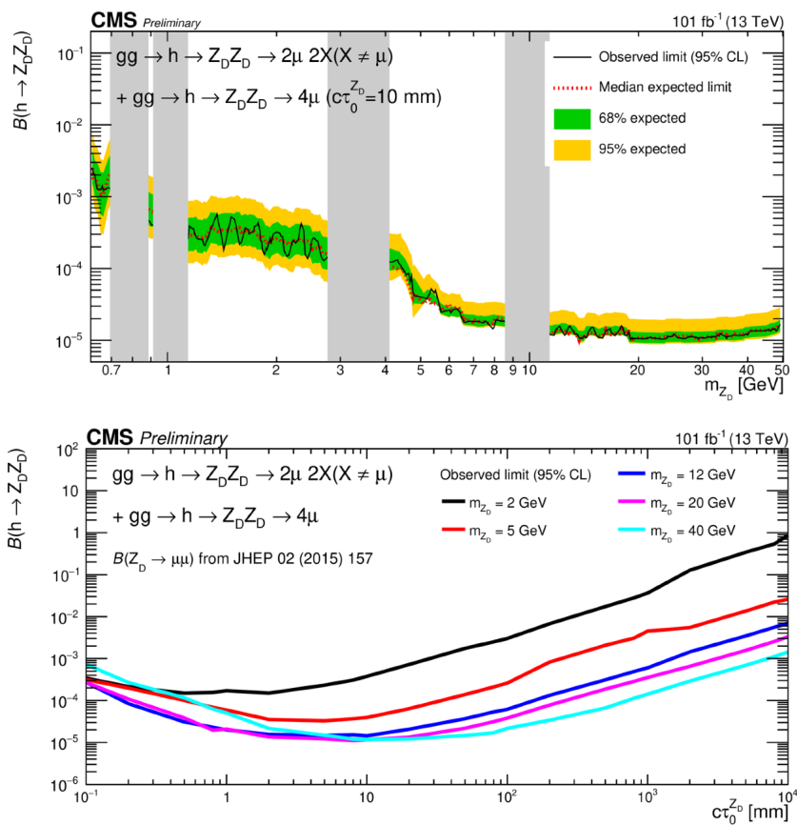
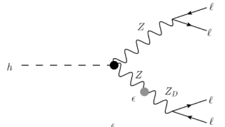
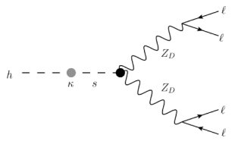
Higgs decay to dark photons: displaced muon jets
CMS-PAS-EXO-20-014
Z–Z_{D} conversion, ε²
Higgs – dark higgs conversion, κ
Notes:
29

Slide 30
Backup slides
Notes:
30

Slide 31

Gauge portal
Gauge sector constructions:
  SM+$Z_{V/A}^{′}$
  2HDM+$Z_{V}^{′}$…
Signatures:
  $Z_{V/A}^{′}$→ invisible
  $Z_{V/A}^{′}$ → dijet/dilepton
  H₁₂₅ (bb) + MET/ Z(ll) + MET
  flavor violating processes…
Notes:
31

Slide 32
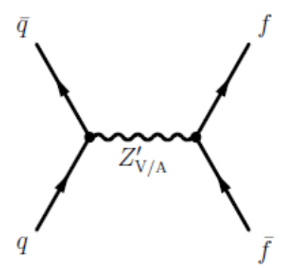
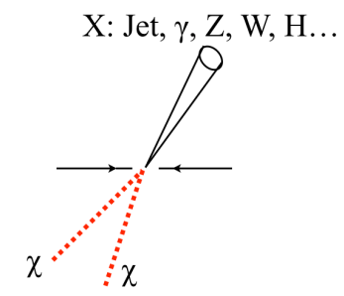
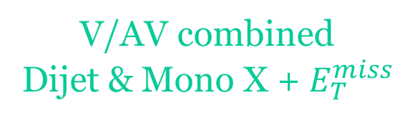
V/AV combined
Dijet & Mono X + $E_{T}^{miss}$
The leptophobic mediator, g_{l} = 0
CMS EXO summary plots
interpretation for the axial-vector mediator
interpretation for the vector mediator
V/VA
g_{q}
g_{q}
Visible (ffbar) and invisible (X+MET) channels combined

Slide 33
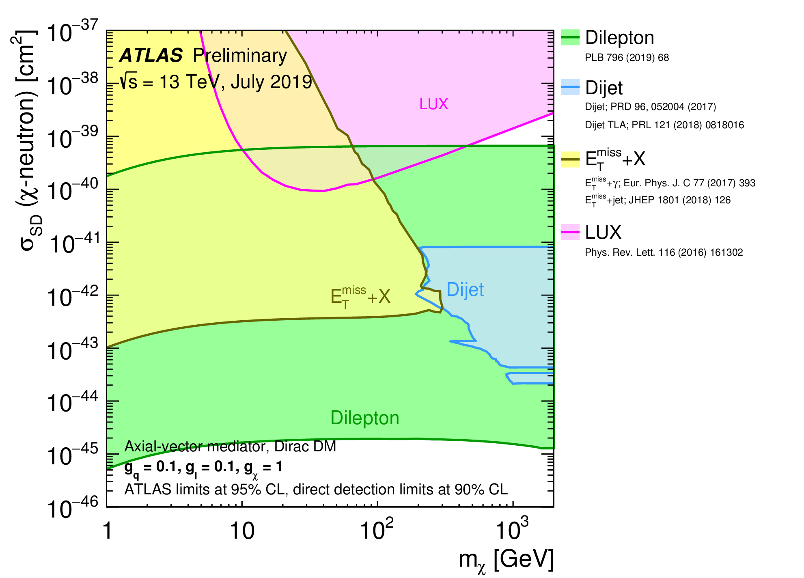
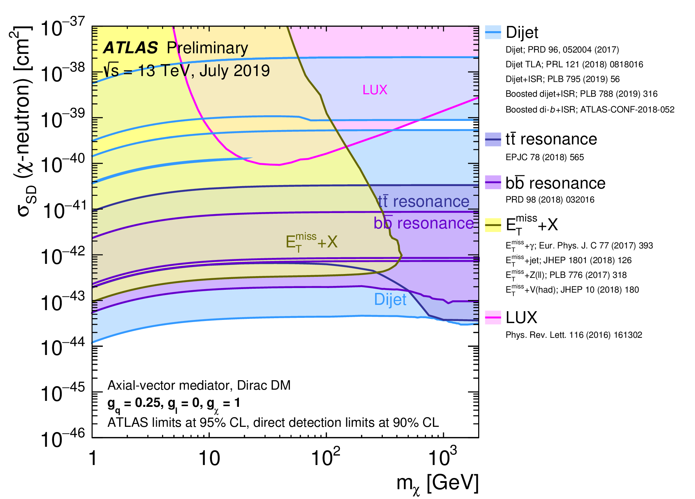
ATLAS: combination of collider and DD
constraints on DM
interpretation for leptophobic and leptophilic
VA mediator
A comparison of the inferred limits with the constraints from direct-detection experiments
on spin-independent and spin-dependent WIMP-nucleon scattering cross- section

Slide 34


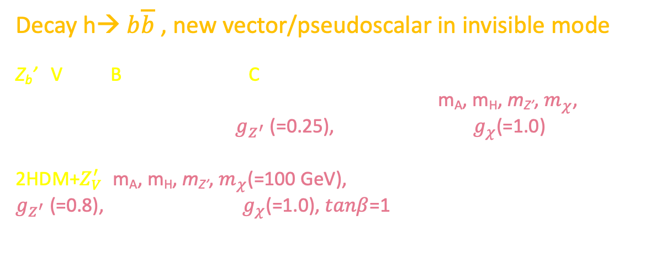
Mono h($b\overline{b}$) + $E_{T}^{miss}$, SDM $Z_{V}^{′}$ interpretations
Decay h→ $b\overline{b}$ , new vector/pseudoscalar in invisible mode
Z_{b}’ : Vector Baryon-number-Charged mediator (VBC)
Free parameters of the SDM used in the analyses: m_{A}, m_{H}, m_{Z’}, $m_{χ}$, coupling $Z_{V}^{′}$ to SM matter $g_{Z^{′}}$ (=0.25), coupling to DM $g_{χ}$(=1.0)
2HDM+$Z_{V}^{′}:$m_{A}, m_{H}, m_{Z’}, $m_{χ}$(=100 GeV), coupling $Z_{V}^{′}$ to SM matter $g_{Z^{′}}$(=0.8), coupling to DM $g_{χ}$(=1.0), $tanβ$=1
$$h(b\overset{̿}{b})/Z(ll)$$
VBC
2HDM+$Z_{V}^{′}$
EPJC 79 (2019) 280
ATLAS-CONF-2018-039
Z_{b}’
Z_{b}’
Notes:
34

Slide 35
Two doublet Higgs Model (2HDM)
Two complex scalar doublets, $Φ_{1}$ and $Φ_{2}$, 8 real d.o.f, after SSB –
5 physical scalar states:
neutral CP-even h,H
neutral CR-odd A
charged H⁺, H⁻
Mass hierarchy is not fixed exactly, but the state h considered light and
the rest 4 are considered heavy.
Decoupling limit: (H does not contribute)
Most LHC studies, including for dark matter, are done in this limit
2 non-zero VEVs: v₁ ($Φ_{1}$) and v₂ ($Φ_{2}$):
$v_{1}^{2}$+$v_{2}^{2}=v^{2}≡{\left(246 GeV\right)}^{2}, \frac{v_{1}}{v_{2}}≡tanβ$
4 types of flavor conserving models
MSSM

Slide 36
2HDM, couplings to SM fermions and gauge bosons, normalized to these of the SM
coupling in Yukawa sector like in the SM (MFV), the strongest with the third generation

Slide 37
Neutral Higgses (h/H/A)
Charged Higgses (H⁺/H⁻)

Slide 38
H → ZA (A → ZH) → llbb
H⁺ → tb

Slide 39
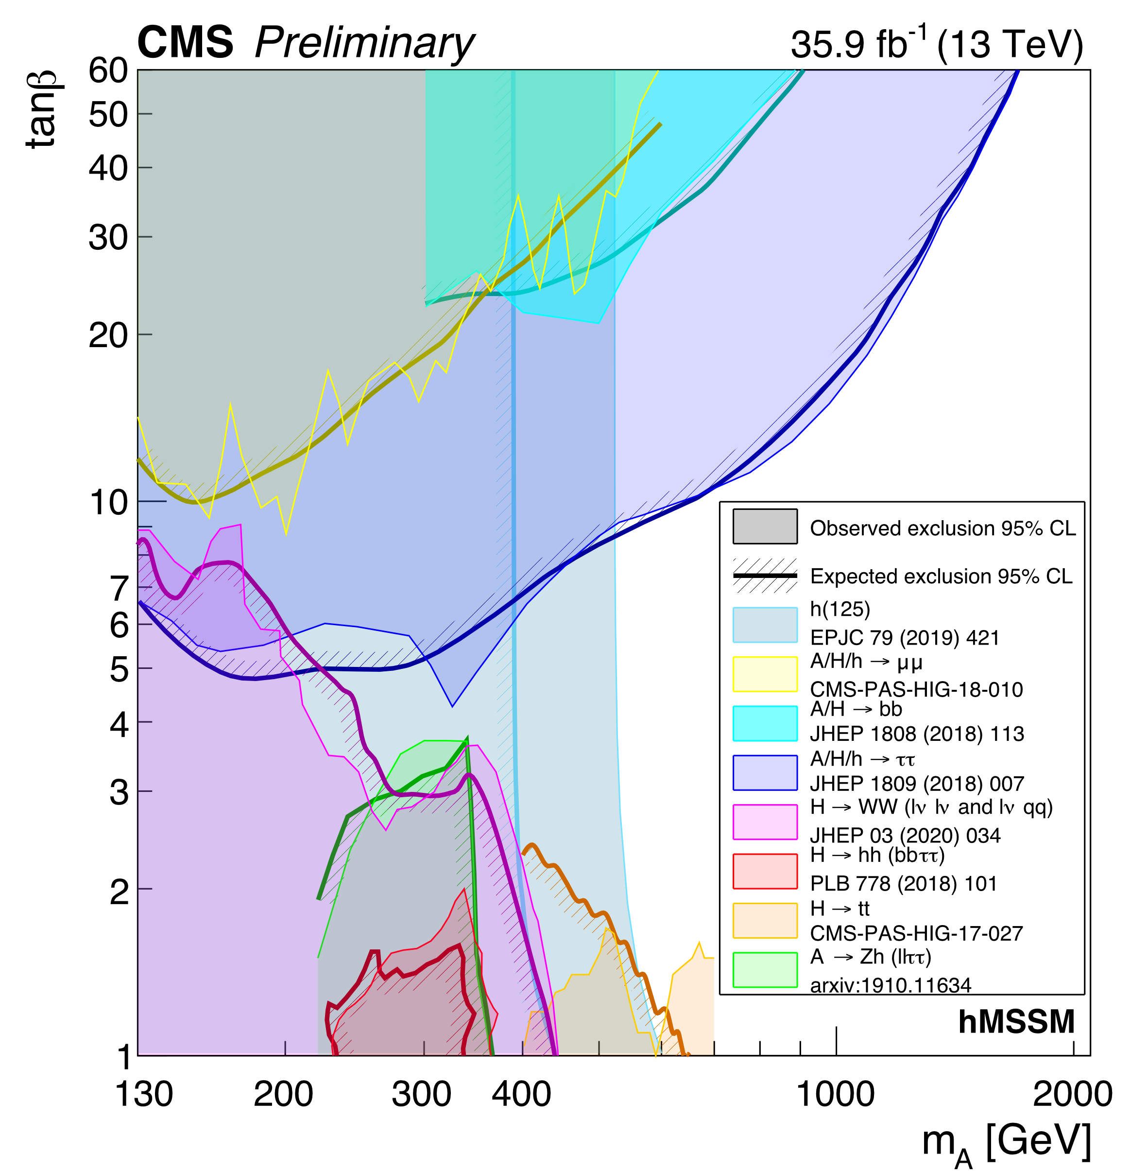
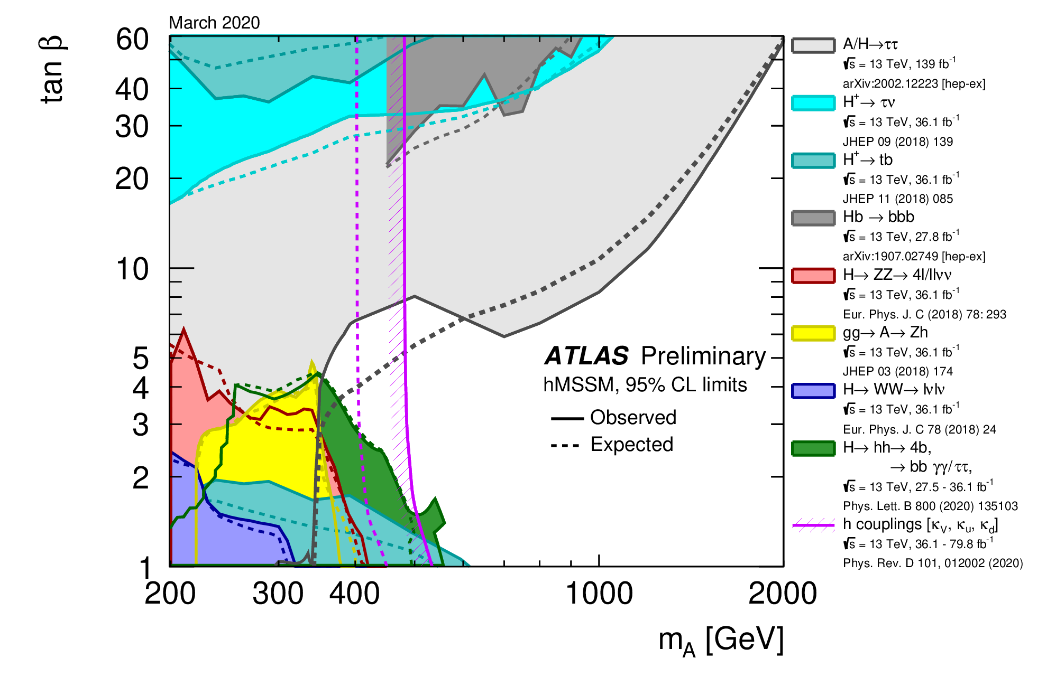
2HDM hMSSM combined results, RUN2
Much more details see in a talk by Adam Bailey
(+ comprehensive list of analyses for ATLAS & CMS)!

Slide 40
Astrophysics constraints on 2HDM Type-II DM (MSSM)

Slide 41
2HDM+S extension
PRD 90, 075004 (2014)

Slide 42
2HDM+a parameter space
Notes:
42

Slide 43
Exotic decay to very light pseudoscalars H₁₂₅→ aa→ 4γ
2HDM+a
resonant/
non-resonant
signatures
Notes:
43

Slide 44
LHC Dark Matter Working Group documents for RUN 2 analyses
        arXiv:1507.00966
        arXiv:1603.04156
        arXiv:1506.03116
Simplified DM models – main requirements:
  1. Minimal set of DM fields, s- and t-channel mediated models
  2. Minimal set of physically relevant parameters (couplings, masses and widths)
  3. Minimal flavor violation (MVF): new interactions are invariant under global flavor symmetry group
  or all violating transitions are governed by the CKM matrix (SM FCNC structure, also CPV)
DM mediator(s): spin-0, ½, 1
  1. The (axial)vector Z’, spin-1 – gauge portals
  2. The (pseudo)scalar, spin-0 – Higgs portals (special importance of Higgs connected studies).
  3. Fermionic portals, spin-1/2 – SUSY, dark SUSY… (often – with flavour violation)
  4. “Double” (scalar-vector) portals…
DM particle(s): spin-0, ½, 1 (and even spin-2 for Kaluza-Klein DM in TeV-scale gravity models)
  Spin-1/2 DM: for fermion case only one DM particle → nonperturbative description for the scalar mediator
  (see f. e. arXiv:1903.03616) → need to extend fermion sector
    Isodoublet-isosinglet model (faces difficulties in imposing collider and astrophysical constraints
    for minimal mediator models, higgs portals)
    New vector-like fermion family (VLL, VLQ, VLF in general)
  Spin-0 DM: inert higgs doublet
  Spin-1 DM: dark photon
Notes:
44

Slide 45
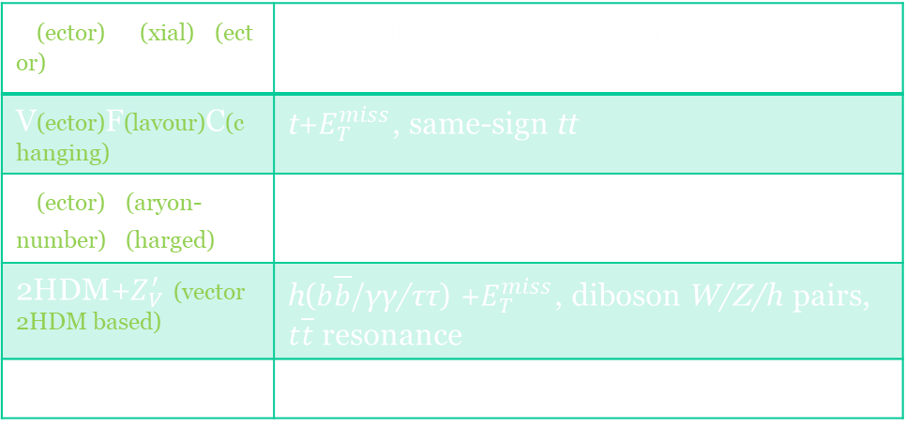
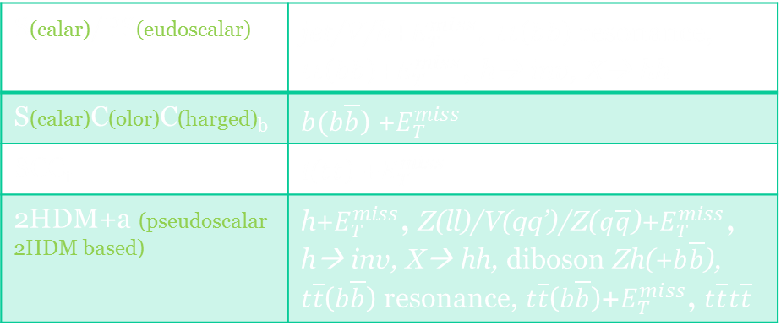
SDM models and signatures
Generalized or model specific search, combinations of visible and MET signatures
The (axial)vector mediator
The (pseudo)scalar mediator
V(ector)/A(xial)V(ector) | dijet (dilepton), diboson hW/Z pair, $t\overline{t}$ resonance
V(ector)F(lavour)C(changing) | t+$E_{T}^{miss}$, same-sign tt
V(ector)B(aryon-number)C(harged) | h($b\overline{b}$/γγ/ττ) +$E_{T}^{miss}$
2HDM+$Z_{V}^{′}$ (vector 2HDM based) | h($b\overline{b}$/γγ/ττ) +$E_{T}^{miss}$, diboson W/Z/h pairs, $t\overline{t}$ resonance
Dark higgs $Z_{V}^{′}$+s | s($b\overline{b}$) +$E_{T}^{miss}$
S(calar)/PS(eudoscalar) | jet/V/h+$E_{T}^{miss}$, $t\overline{t}$($b\overline{b}$) resonance, $t\overline{t}$($b\overline{b}$)+$E_{T}^{miss}$, h→ inv, X→ hh
S(calar)C(olor)C(harged)_{b} | $b(b\overline{b}$) +$E_{T}^{miss}$
SCC_{t} | t($t\overline{t}$) +$E_{T}^{miss}$
2HDM+a (pseudoscalar 2HDM based) | h+$E_{T}^{miss}$, Z(ll)/V(qq’)/Z($q\overline{q}$)+$E_{T}^{miss}$, h→ inv, X→ hh, diboson Zh(+$b\overline{b}$), $t\overline{t}$($b\overline{b}$) resonance, $t\overline{t}$($b\overline{b}$)+$E_{T}^{miss}$, $t\overline{t}t\overline{t}$
A key: separation/reinterpretation and a wide complementary search with all available signatures

Slide 46
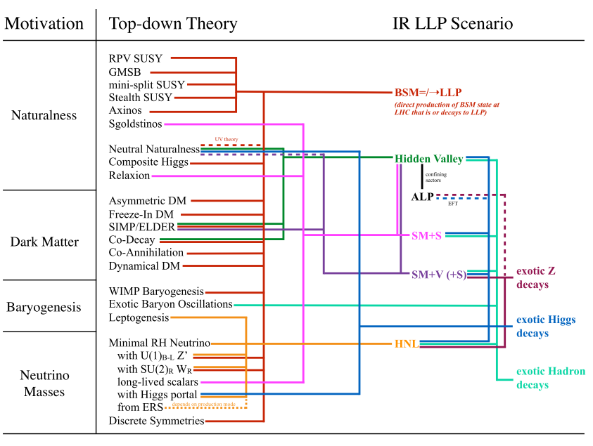
Inelastic dark matter at the LHC/LLP
https://arxiv.org/abs/1901.04040
Dark photon
Heavy neutral leptons (quarks)
Dark GB and/or Higgs(es)…
Higgs/GB/gluon/SUSY portals
    (Asymmetric DM/
    Baryogenesis)
      Dark SUSY
      Dark QCD
    Twin Higgs
    ALPs (CP-violation)…
DS: small couplings, compressed spectra, large hierarchy → large cτ
Notes:
46

