Slide 1
International Conference
on Quantum Field Theory, High-Energy Physics, and Cosmology
Joint Institute for Nuclear Research,
the Institute for Nuclear Research of Russian Academy of Science,
and Skobeltsyn Institute of Nuclear Physics of Lomonosov Moscow State University.
19 July 2022
JOINT INSTITUTE for Nuclear Research
Bogoliubon Laboratory of Theoretical Physics
Hadron interaction at large distances
and new peculiarities of the differential cross sections
13 TeV.
O.V. Selyugin
(JINR, BLTPh, Dubna)
“…although asymptopia may be very far away indeed, the path to it is not through a desert but through a flourishing region of exciting Physics…”
-Elliot Leader in CERN Courier

Slide 2
Introduction (TOTEM<FELIX>ATLAS)
Asymptotic regime at LHC
Standard fit picture
Models (theoretical problems)
Oscillations
New approaches
Summary

Slide 3
With the construction of large accelarators, it is hoped that the mysteries of high-energy scattering will unfold in the near future.
Hung Cheng, Tsai Tsun Wu
Phys.Rev.Lett. (1970)

Slide 4
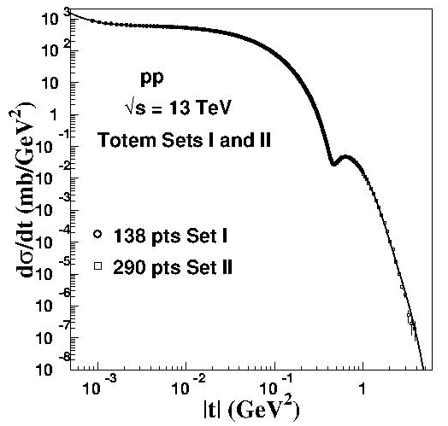

Slide 5
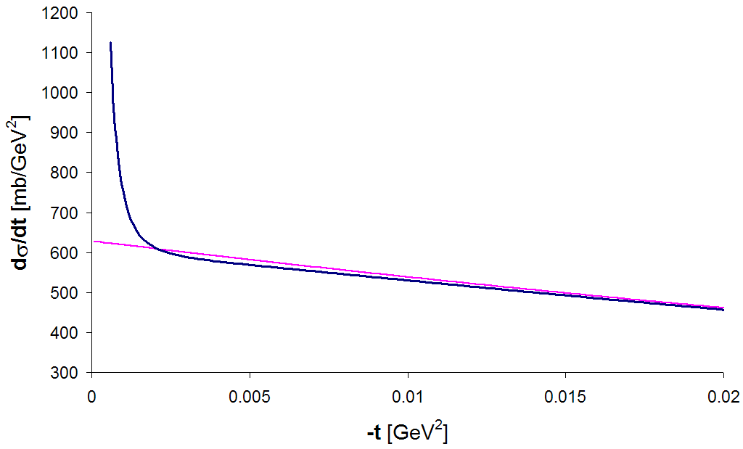
Elastic scattering at the CNI region
Coulomb region: ∝1/t²
C–N interference
Sensitivity to ρ
2*10⁻³<|t|<8 (GeV²)
BSW - 2003
Nuclear slope: ∝e^{bt}
Using the optical theorem, the measured elastic rate at small t values can be expressed as:
  which can be fitted to obtain: σ_{tot}, ρ, b, and L
“structure”

Slide 6
Total cross sections
TOTEM
ATLAS

Slide 7
TOTEM
ATLAS

Slide 8
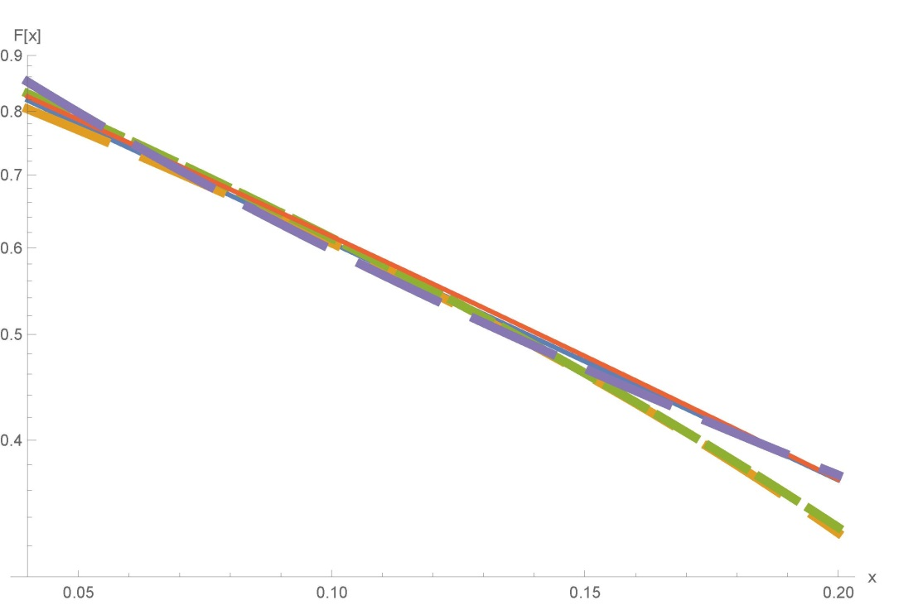
Notes:
Diffraction-2018 (Regio Calabria)

Slide 9
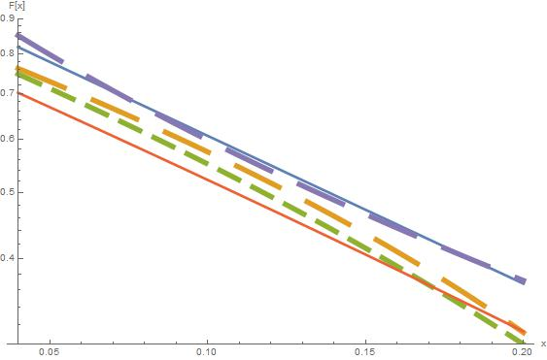

Slide 10
Scattering process described in terms of Helicity Amplitudes φ_{i}
All dynamics contained in the Scattering Matrix M
(Spin) Cross Sections expressed in terms of
spin non–flip
double spin flip
spin non–flip
double spin flip
single spin flip
?
⟨ M ⟩
observables:
3 ×-sections
5 spin asymmetries
identical spin ½ particles
- GPDs → electromagnetic FF
- GPDs → gravimagnetic FF

Slide 12
O.V. Selyugin, Phys.Rev. D 91, 113003 (2015)
Обобщенные партонные распределения
Generalized Parton Distributions -GPDs
Electromagnetic form factors
(charge distribution)
Gravitomagnetic
form factors
(matter distribution)

Slide 13
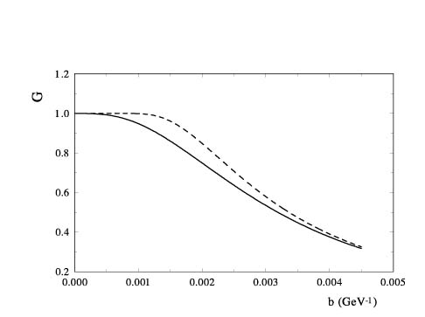

Slide 14
High Energy General Structure (HEGS) model O.V.S. - Eur. Phys. J. C (2012) 72:2073
Extending of model (HEGS1) – O.V. S. Phys.Rev. D 91, (2015) 113003

Slide 16
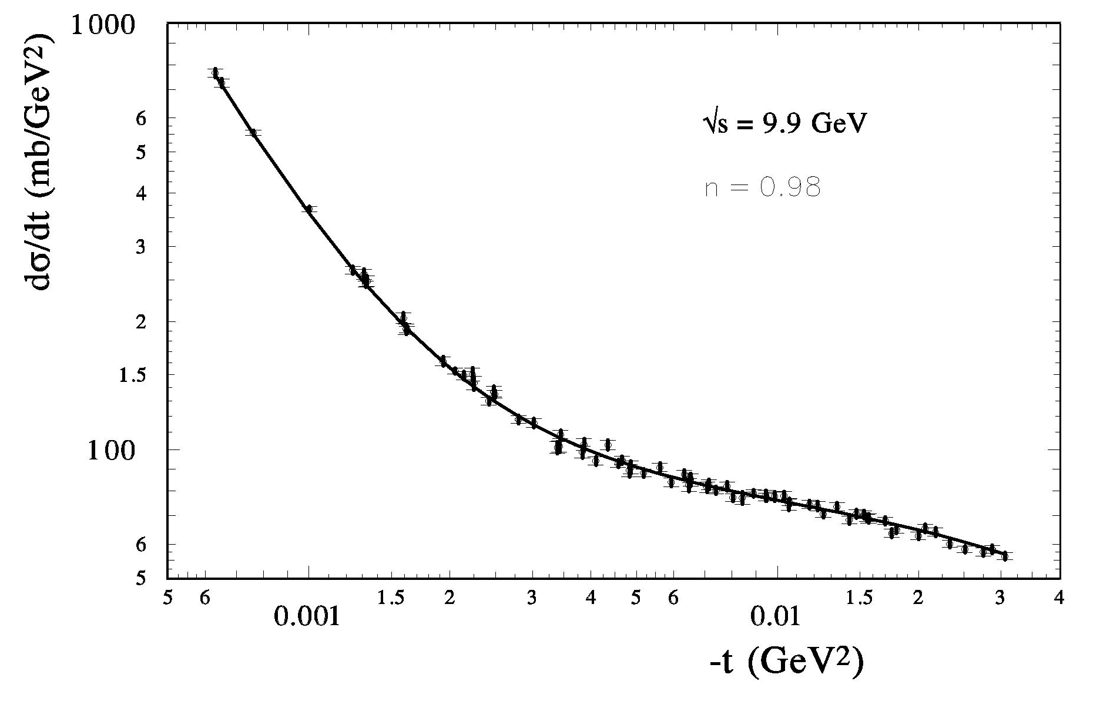

Slide 17
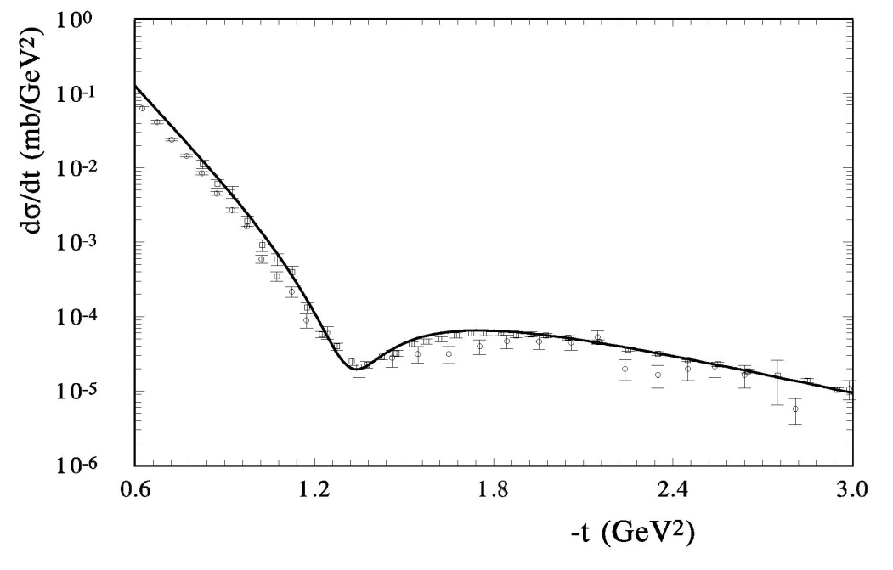
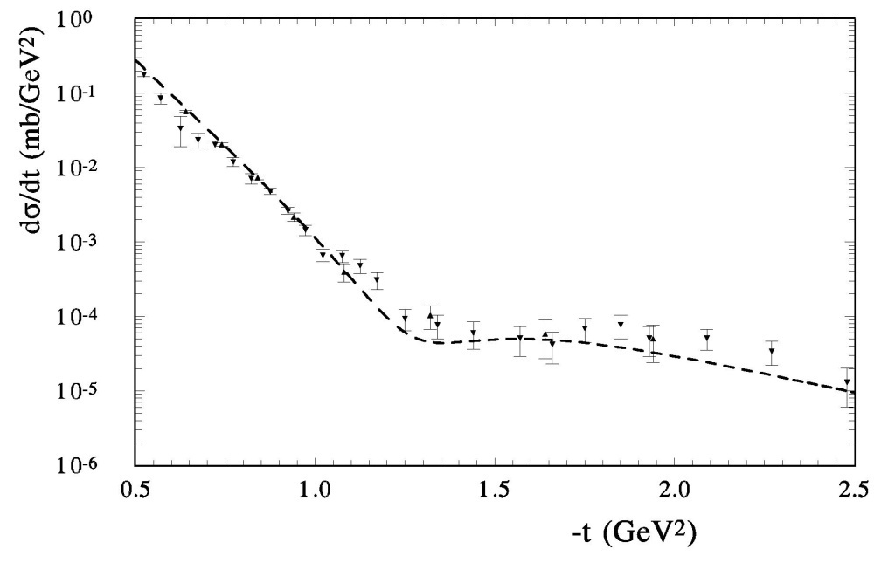

Slide 19
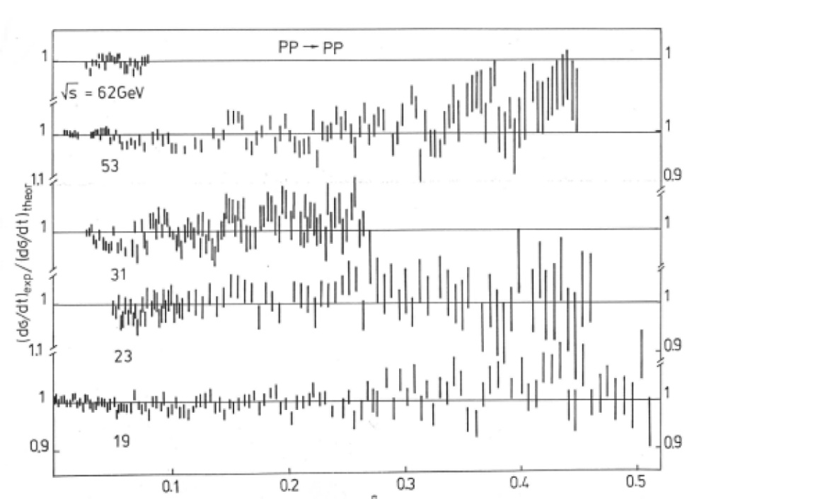
-t GeV²

Slide 20
V.A. Tzarev
Model of complex Regge poles
Preprint NAL-Pub-74/17, 1974; DAN-USSR, v.95 (1977)

Slide 21
K. Chadan, A. Martin: “Scattering theory and dispersion relations for a class of long-range oscillating potentials”, CERN (1979)
2. a) Van-der-Waals potential V_{ad} ~ h/r⁴
b) F. Ferrer, M. Nowakowski (1998)
(Golstoun boson – long range forces) V_{ad} ~ h/r³
3. S-L interaction
N-dimensional gravipotential (ADD-model) Oscillations”- I. Aref’eva [1007.4777:arXiv-hep-ph]
Universal scenario?

Slide 22
Potential of rigid string
O.V. Selyugin
Fit over (q)
Ukr.J. Phys., v.41 (1996)

Slide 24
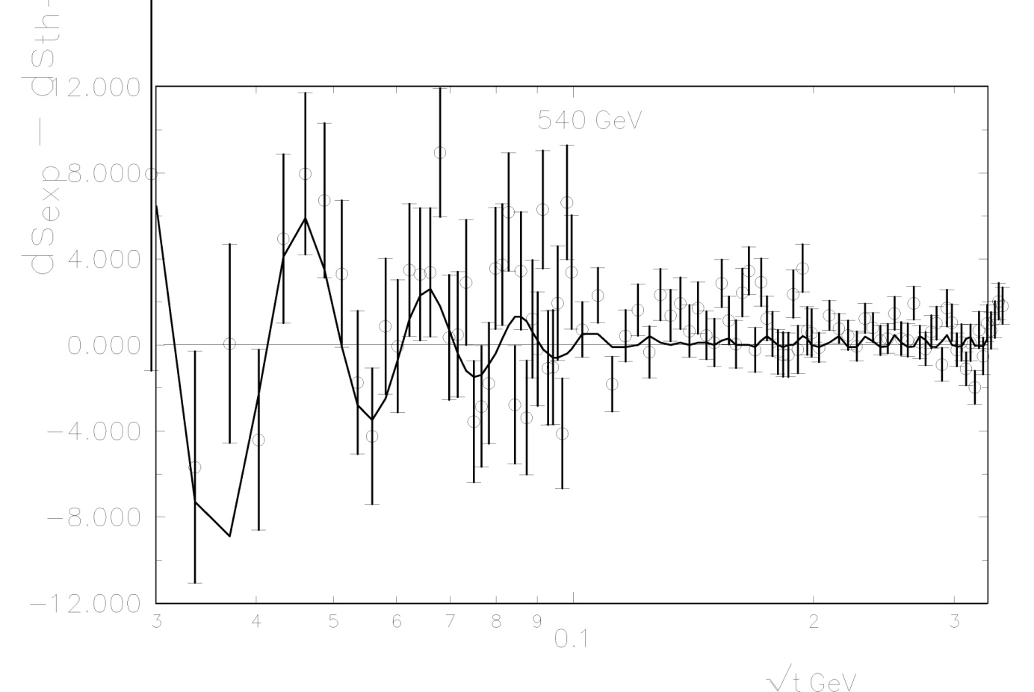
Experimental data UA4/2

Slide 25
HEGS model analysis
Results:
with F(osc)
Witout F(osc)

Slide 26
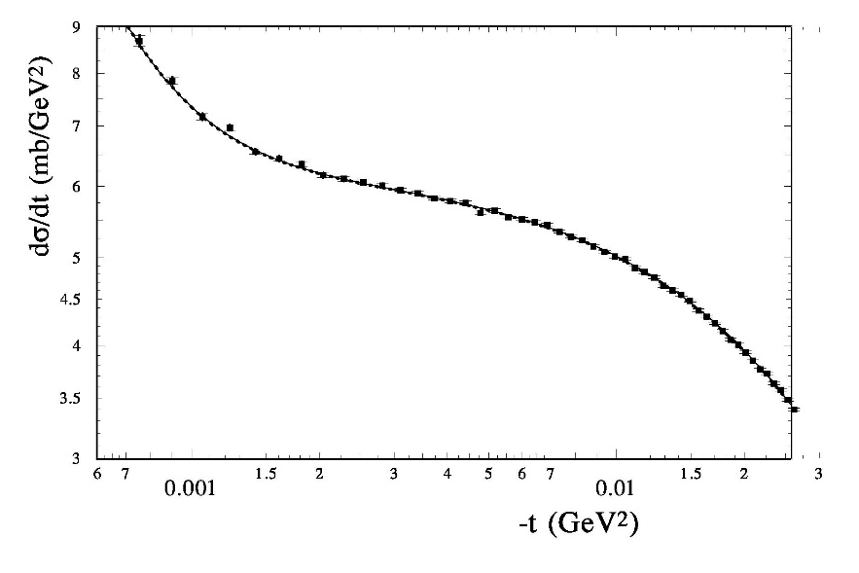
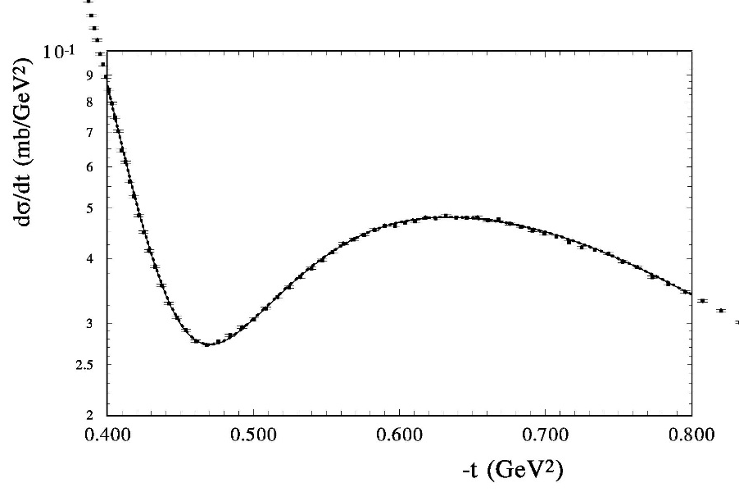

Slide 27
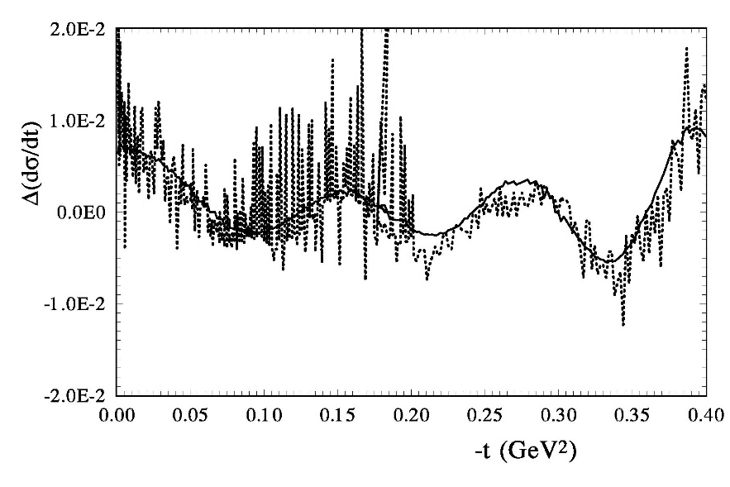
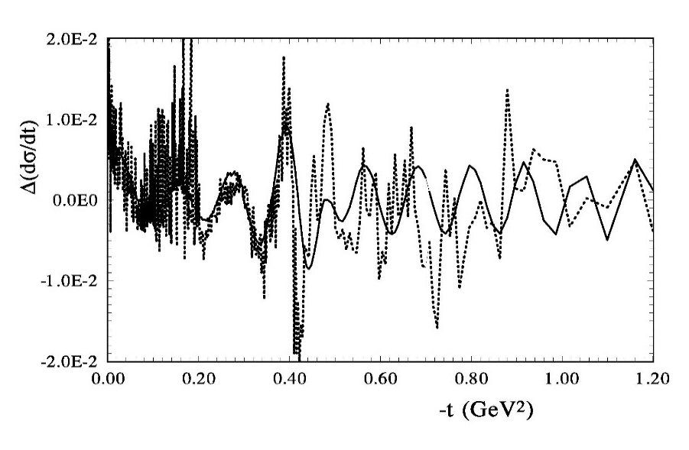
O.V. Selyugin, Phys.Lett. B 797, 134870 (2019).

Slide 28
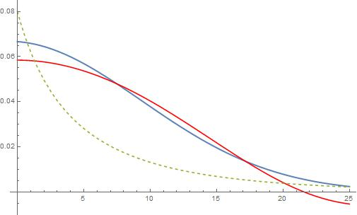
R (GeV-1)

Slide 30
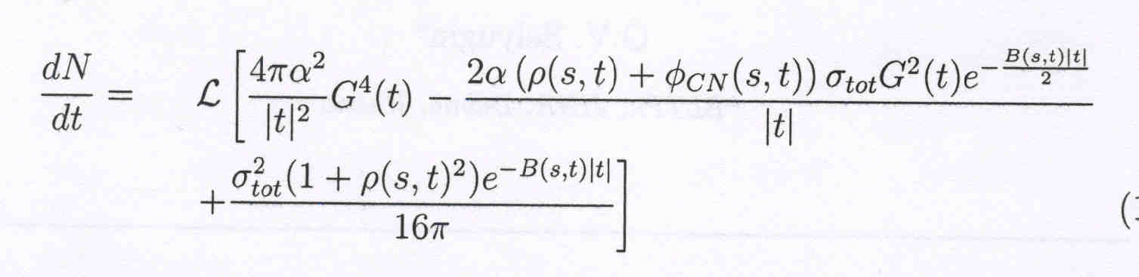

Slide 31
arXiv: 2009.10129 [hep-ph, hep-ex] (2020).
(accepted in Mod.Phys.Lett. A)
The result was obtained with a sufficiently large addition coefficient of
the normalization n = 1/k = 1.135. It can be for a large momentum transfer, but
unusual for the small region of t.
Let us put the additional normalization coefficient to unity and continue
to take into account in our fitting procedure only statistical errors.
We examined two different forms. One is the simple exponential form
The parameters of the additional term are well defined
hd = 1.7 ± 0.01; ρd =−0.45 ± 0.06; Bd = 0.616 ± 0.026; d = 1.119 ± 0.024.

Slide 32
O.S. Mod.Phys.Lett. A, {\bf 36}, No. 18 (2021) 2150148.
k(d) | model
0.87 |  | 525/415 | 106.1 | 0.146
0.87 | Fd=0 | 515/425 | 106.2 | 0.142
0.87 |  | 527/425 | 106.2 | 0.148
1 | Fd(rd) | 539/425 | 113.2 | 0.109
1 | Fd (rd) | 549/425 | 113.2 | 0.113
1 | Fd(exp) | 550/425 | 112.6 | 0.115

Slide 33
Analysis of the all LHC data (715 experimental points)

Slide 34
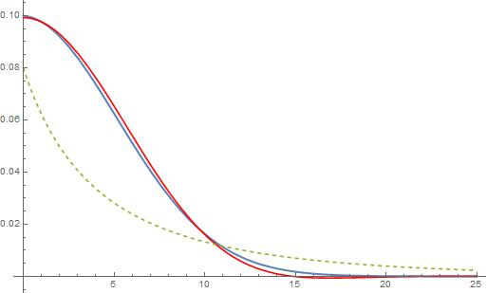
R (GeV-1)

Slide 35
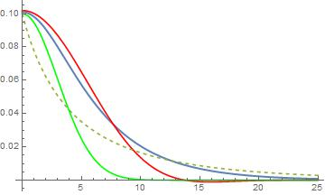
b (GeV⁻¹)
b (GeV-1)

Slide 36
R (GeV-1)

Slide 37
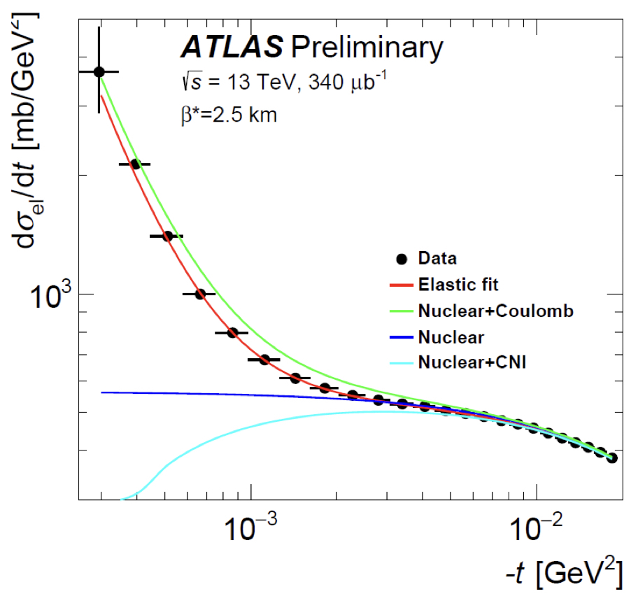

Slide 38
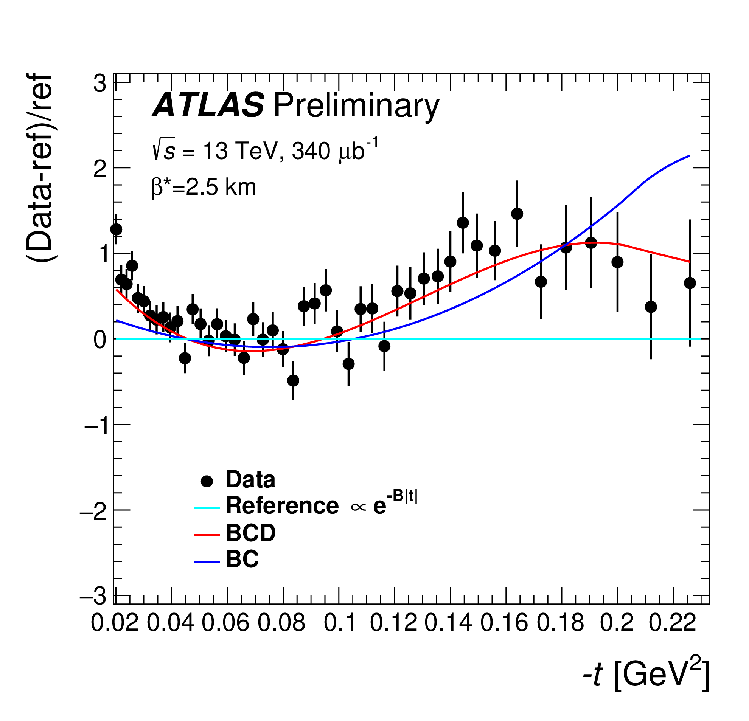

Slide 39
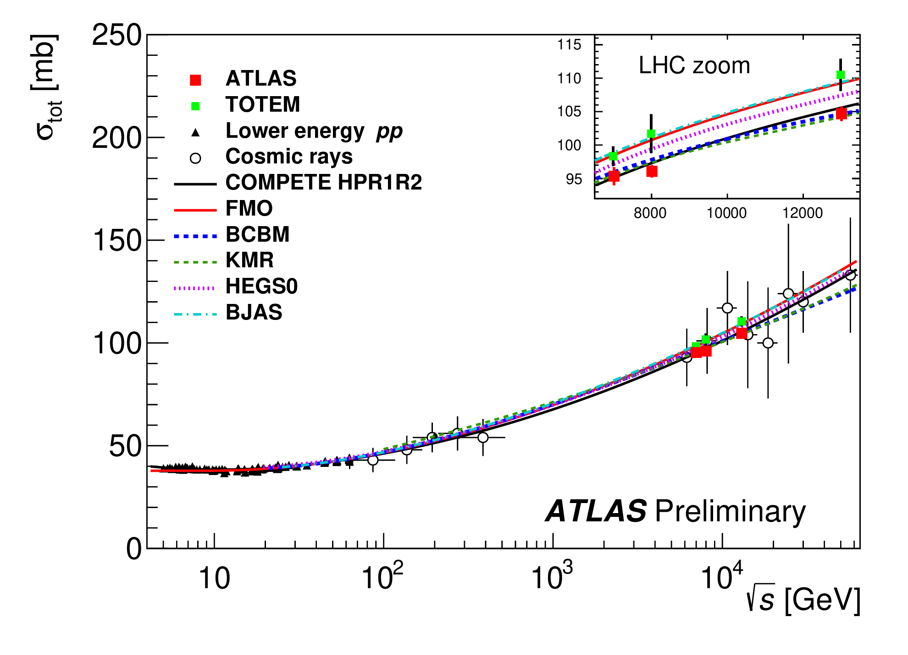

Slide 40
Summary
An additional term with large slope is require for the quantitatively description of the experimental data
in the case of the standard normalization of 13 TeV data
Such term leads to the increasing the size of
and decreasing the size of
Preliminary analysis of whole sets of high energy experimental data
support the existence such anomalous term.
More experimental data in the Coulomb-hadron interference region are needed. [NICA (low energy) and LHC(high energy)] It is crucial that the experiments measure – and simultaneously.

Slide 41
Summary
The experimental data show some periodical structure in the
Coulomb-hadron interference region of t and in a wide energy region.
The small period of the “oscillation” is related with the long hadron
screening potential at large distances.
It is likely that this effect has an electromagnetic origin, or
it comes from the odderon.
More experimental data in the Coulomb-hadron interference region are needed. [NICA (low energy) and LHC(high energy)] It is crucial that the experiments measure – L, s, B, ρ simultaneously.

Slide 42
Спасибо за внимание

Slide 44
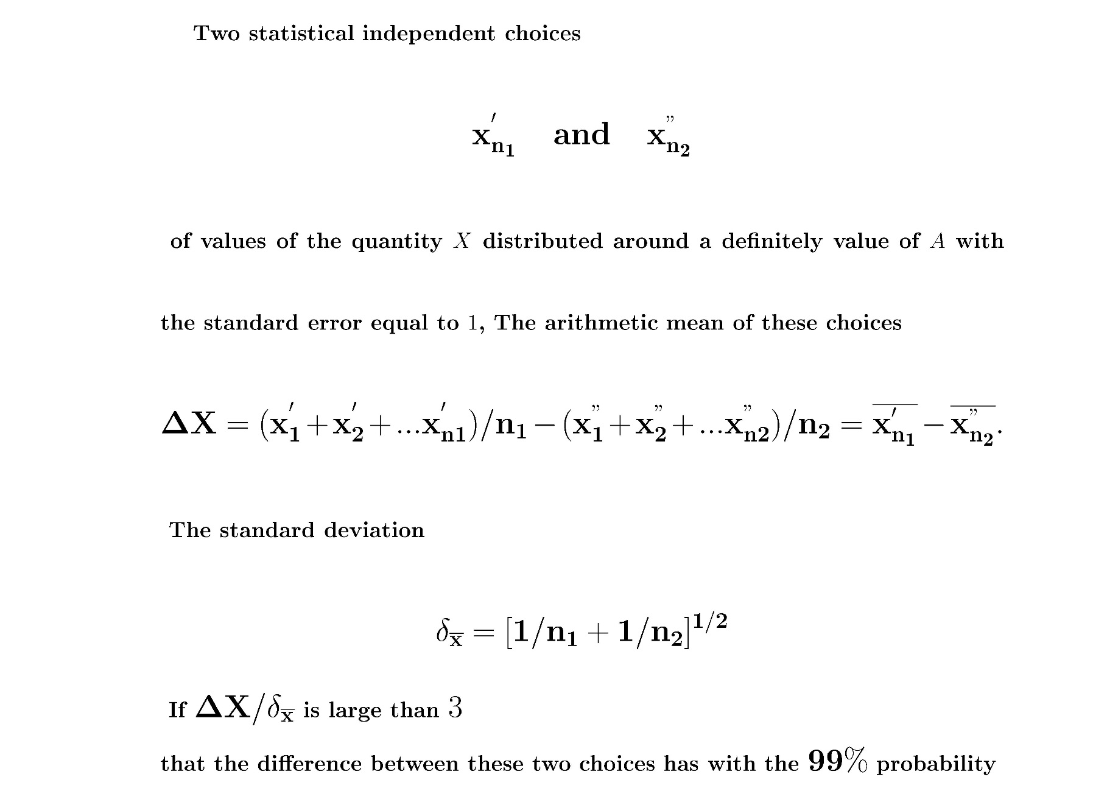

Slide 45
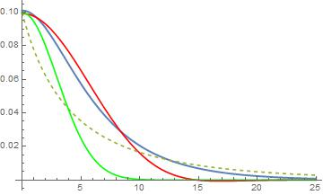
R (GeV-1)

Slide 46
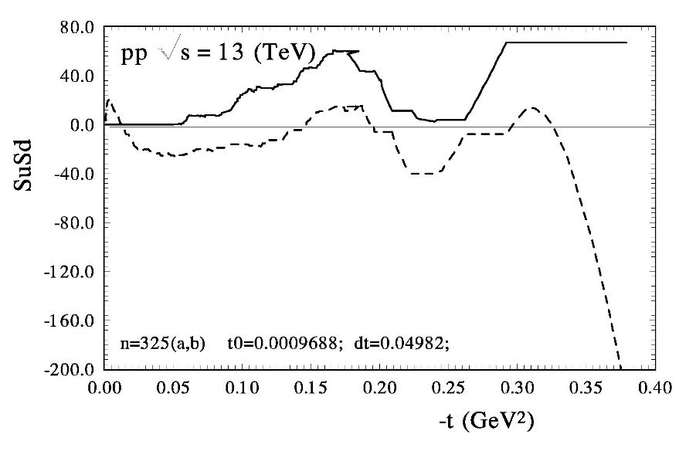
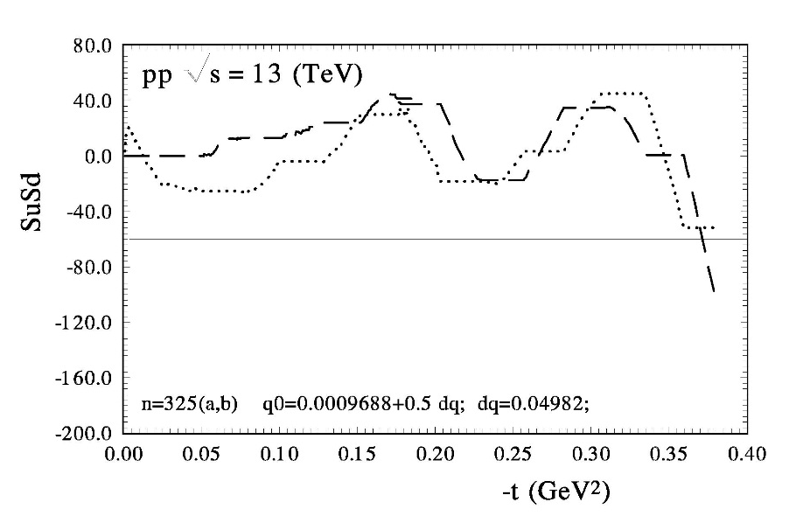
O.V. Selyugin, Phys.Lett. B 797, 134870 (2019).

Slide 47
Answers
1. regions of t ?;
Coulomb-hadron interference region of t.
The effect is large for the smaller values of t.
The effect does not come from statistical fluctuations, otherwise it would appear for any t.
size of the periodical structure?
Order 10⁻² of the main hadron amplitude.
. phase of the additional amplitude?
Almost real, changes sign when it goes
from particle to antiparticle.
. energy dependence?;
Constant or small energy dependence log(s)

Slide 48
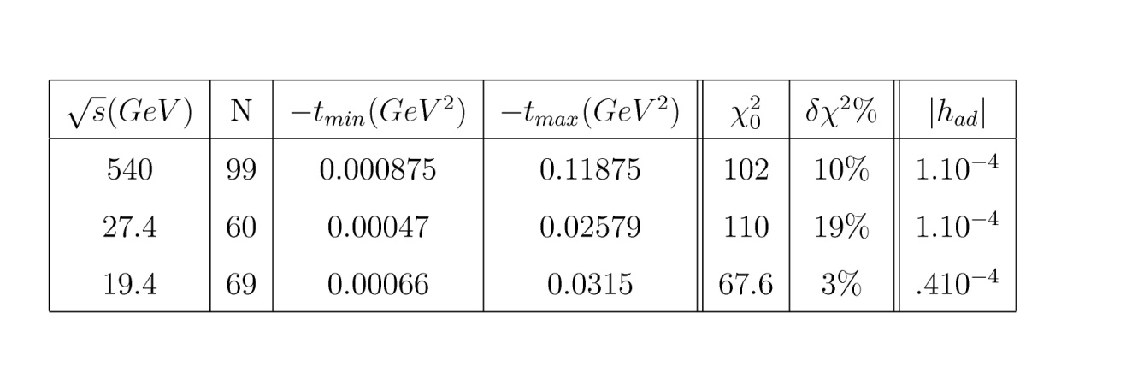

Slide 49
Screening long range potential

Slide 50
The amplitude F_dop(b) in the impact parameter representation
hard line – the imaginary part; dashed line – the real part

