Slide 1
National Research Centre “Kurchatov Institute”
Centre of the nature-like NBICS technologies
Neuromorphic algorithms research group
The research was supported by RSF (project No. 20-11-20246)
Relation Extraction from Texts Containing Pharmacologically Significant Information on base of Multilingual Language Models
Speaker: Anton Selivanov
Authors:
Anton Selivanov
p.h.d. Roman Rybka
p.h.d. Alexander Sboev
aaselivanov.10.03@gmail.com; sag111@mail.ru

Slide 2
Relevance
Analysis of the texts on pharmacological topic has great significance for the various tasks;
Open access pharmacological text data is massive (PMC, MEDLINE, DrugBank, Internet texts etc.);
That gave an opportunity to pre-train transformer language models for the topic (BioBERT, PubMedBERT, bioRoBERTa, bioALBERT);
However, these models primarily aimed at English language;
One of the ways to solve this problem is to use multilingual models like XLM-RoBERTa;
This also requires to develop annotated datasets on the languages we want to analyze – for example, Russian Drug Review Corpus.

Slide 3
Research goals
Estimate accuracy of solving the task of relation extraction from texts containing pharmacologically significant information on the set of corpora in two languages:
1) the expanded version of RDRS corpus, that contains texts of internet reviews on medications in Russian;
2) the DDI2013 dataset containing MEDLINE abstracts and documents from DrugBank database in English;
3) the PhaeDRA corpus containing MEDLINE abstracts in English.

Slide 4
Relation extraction task formulation
Review containing medication and hypothetic adverse effects:
The task is to determine if there is a relation between the pair of entities:

Slide 5
Datasets overview
RDRS 2022 contains texts of internet reviews on medications in Russian.
Annotation includes named entities of Medication, Disease and ADR types;
Each entity additionally annotated to contexts, that used as a base for relation extraction task;
RDRS 2022 extended as the previous dataset – RDRS 2022, extended with the 1000 texts;
Drug-drug Interaction 2013 (DDI 2013) contains MEDLINE abstracts and documents from DrugBank database in English;
Annotation includes named entities (medications, substances and so on) and relations between them (mechanisms, effect, interaction);
PhaeDRA contains MEDLINE abstracts in English with annotation for Relation Extraction (equivalence, subject of the disorder, , Coreference and Event Detection.

Slide 6
Datasets statistics
 | RDRS2022 | RDRS2022 extended | DDI2013 (separate sentences) | PhaeDRA
Language | Russian | Russian | English | English
Data split | 5-fold CV | 5-fold CV | BLURB official | Owners official
text number | 230 | 426 | 8920 | 597
avg text length (in words) | 173 | 186 | 20 | 186
min text length | 49 | 49 | 1 | 29
max text length | 241 | 321 | 136 | 634
Entity types number | 5 | 5 | 4 | 4
Entity number | 2431 | 5149 | 19179 | 13892
Relation types number | 4 | 4 | 4 | 3
Relation number | 5228 | 11784 | 11811 | 3710

Slide 7
Language models
model name | hidden layers # | hidden layer size | intermediate layer size | attention heads # | vocab size | approx. # of parameters
bioBERT v.1.0 | 12 | 768 | 3072 | 12 | 28996 | 108M
bioALBERT xxlarge | 12 | 4096 | 16384 | 64 | 30000 | 222M*
BioLink BERT large | 24 | 1024 | 4096 | 16 | 28895 | 333M
XLM-RoBERTa large | 24 | 1024 | 4096 | 16 | 250002 | 559M
XLM-RoBERTa sag large | 24 | 1024 | 4096 | 16 | 250002 | 559M
BioBERT v. 1.0. – basic biomedical language model used as a LM baseline;
bioALBERT xxlarge* -- bioALBERT was mentioned as a SotA for the DDI2013 dataset;
BioLink BERT large – model that uses structural information during pre-training, current leader of the BLURB biomedical benchmark;
XLM-RoBERTa large – general domain multilingual model;
XLM-RoBERTa large sag – XLM-RoBERTa large, additionally trained on Russian texts on medicine and pharmacological topic.
* - there is lower number of parameters, because hidden layers share the same weights in ALBERT architecture. However, there are more neurons, therefore more weights (just with the same value).

Slide 8
LM pipeline: Named entity recognition
Named entity recognition prediction has the following steps:
Text tokenization for words using NLTK Punkt;
Word tokenization with LM tokenizer to prepare words for vectorization;
Multiple tag classification for each token (BIO annotation scheme);
Token aggregation back to words;
Evaluation of the prediction using the script from the CONLL NER challenge.

Slide 9
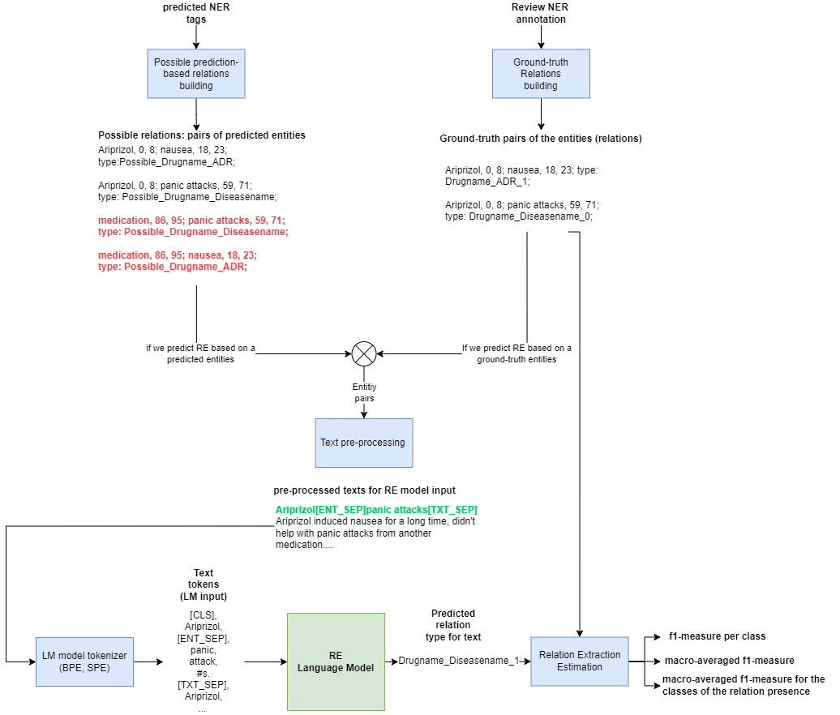
LM pipeline: Relation Extraction
Relation extraction has the following steps:
1) Text pre-processing;
2) Tokenizing for the LM;
3) LM prediction;
4) Estimation of the prediction.

Slide 10
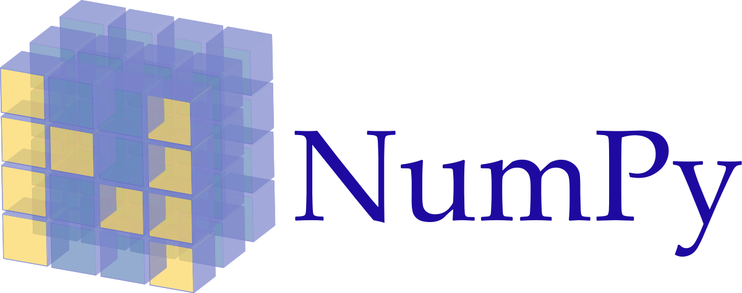
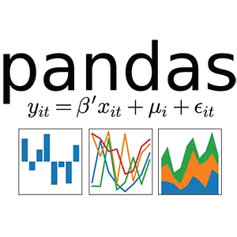
Software implementation
This work has been carried out using computing resources of the federal collective usage center Complex for Simulation and Data Processing for Mega-science Facilities at NRC “Kurchatov Institute”, http://ckp.nrcki.ru/.

Slide 11
Experimental setup
We used the following data splits:
RDRS – 5-fold cross-validation with fixed texts ids to guarantee proper comparison;
DDI2013 – official split of the BLURB benchmark;
PhaeDRA – official split from the dataset owners.
Random seeds were fixed for the whole experiment set;
All the experiments except the ones with the bioALBERT were carried out using the following hyperparameters (chosen manually):
Optmization function: Nadam;
Initial learning rate: 0.00001;
Batch size: 8;
Max input sequence length: 512;
Float16 as the base for the computation;
Tech platform parameters:
CPU: 16 cores;
GPU: 1 x NVIDIA V100 16 GB;
RAM: 16 GB.

Slide 12
Results for the RDRS dataset
macro-averaged f1-score for the positive relations
Named entities type | Language model | RDRS 2022 | RDRS 2022 extended
Ground-truth named entities | XLM-RoBERTa large | 86,74 | 87,19
 | XLM-RoBERTa large sag | 87,31 | 86,41
Predicted named entities | XLM-RoBERTa large | 55,88 | 60,03
 | XLM-RoBERTa large sag | 57,10 | 60,13

Slide 13
Results for the DDI dataset
lang | Model | f1-macro | relation types
 |  |  | int | effect | advice | mechanism
1 | BioBERT v.1.0 | 68,74 | 55,94 | 75,27 | 74,55 | 69,21
1 | BioLink BERT large | 68,30 | 45,71 | 78,28 | 74,19 | 75,00
1 | BioALBERT xxlarge | 78,45 | 59,26 | 81,25 | 86,59 | 86,71
108 | XLM-RoBERTa large | 70,63 | 51,98 | 78,42 | 80,00 | 72,11
108 | XLM-RoBERTa large-sag | 69,39 | 43,75 | 76,86 | 84,24 | 72,69

Slide 14
Results for the PhaeDRA dataset
lang | Model | f1-macro | relation types
 |  |  | Subject Disorder | Is equivalent | Coreference
1 | BioBERT v.1.0 | 84,51 | 95,17 | 76,47 | 81,90
1 | BioLink BERT large | 81,77 | 94,30 | 72,59 | 78,43
1 | BioALBERT xxlarge | 86,78 | 97,74 | 79,43 | 83,17
108 | XLM-RoBERTa large | 84,15 | 95,91 | 75,36 | 81,19
108 | XLM-RoBERTa large-sag | 84,04 | 96,24 | 72,86 | 83,02

Slide 15
Conclusions
multilingual XLM-RoBERTa-sag macro-averaged f1-score equals to 86.41% on the ground-truth named entities;
XLM-RoBERTa-sag acheves relation-extraction macro-averaged f1-score equals to 60.13% on the predicted named entities;
Additionally, XLM-RoBERTa-sag was estimated on the datasets for relation extraction in English (DDI2013, PhaeDRA) and achieves accuracy comparable with the top specialized models;
Consequently, XLM-RoBERTa-sag model sets the state-of-the-art for considered type of texts in Russian, and achieves accuracy comparable with the SotA results in Engilsh for the models of the same size.

Slide 16
TO DO (in current research)
RE results for the English datasets with predicted NER;
Analysis on the texts of the different RDRS dataset versions with statistics on the prediction errors;
Research on pipeline modifications, comparison with another pipeline.

Slide 17
Further perspectives
More language models to test;
Various pipeline options, including joint approaches to NER and RE solution simultaneously;
Hyperparameter search and expanding the feature space;
More relation types in Russian language;
Event extraction in Russian language on base of the context annotation of the RDRS dataset;
Multilingual models comparison on the datasets on different languages (for example, Spanish, Portuguese, Chinese etc.);

Slide 18
Thanks for your attention

Slide 19
RDRS dataset filtering
In relation extraction task we use modified version of the RDRS dataset, modifications including:
Filtering named entities tags, left only the ones that participate in relations:
Adverse Reactions (ADR);
Disease name (Diseasename);
Medication name (Drugname);
Indication of the disease (Indication);
Source of the recommendation about the medication (SourceInfoDrug);
Using only texts, where annotators marked up more than one context (meaning lines).

Slide 20
Results for the RDRS dataset
macro-averaged f1-score
 |  | RDRS 2021 | RDRS 2021 extended | RDRS 2022 | RDRS 2022 extended
Ground-truth named entities | XLM-RoBERTa large | 69,47 | 72,81 | 72,18 | 73,00
 | XLM-RoBERTa large sag | 70,23 | 70,98 | 72,47 | 73,74
Predicted named entities | XLM-RoBERTa large | 42,98 | 47,96 | 43,81 | 49,45
 | XLM-RoBERTa large sag | 42,45 | 47,68 | 46,04 | 50,70
macro-averaged f1-score for the 1st class
 |  | RDRS 2021 | RDRS 2021 extended | RDRS 2022 | RDRS 2022 extended
Ground-truth named entities | XLM-RoBERTa large | 85,44 | 85,51 | 86,74 | 87,19
 | XLM-RoBERTa large sag | 85,37 | 85,58 | 87,31 | 86,41
Predicted named entities | XLM-RoBERTa large | 53,23 | 58,30 | 55,88 | 60,03
 | XLM-RoBERTa large sag | 53,94 | 57,11 | 57,10 | 60,13

Slide 21
Results for the DDI dataset
lang | Model | f1-micro | f1-macro | f1-micro w/o false | f1-macro w/o false | relation types
 |  |  |  |  |  | int | effect | advice | mechanism | FALSE
EN | BioBERT v.1.0 | 91,91 | 74,20 | 71,34 | 68,74 | 55,94 | 75,27 | 74,55 | 69,21 | 96,06
EN | BioLink BERT large | 92,29 | 73,86 | 73,15 | 68,30 | 45,71 | 78,28 | 74,19 | 75,00 | 96,11
EN | BioALBERT xxlarge | 95,43 | 82,38 | 81,98 | 78,45 | 59,26 | 81,25 | 86,59 | 86,71 | 98,07
ML | XLM-RoBERTa large | 92,95 | 75,82 | 74,24 | 70,63 | 51,98 | 78,42 | 80,00 | 72,11 | 96,60
ML | XLM-RoBERTa large-sag | 93,16 | 74,86 | 73,99 | 69,39 | 43,75 | 76,86 | 84,24 | 72,69 | 96,77

Slide 22
Results for the PhaeDRA dataset
lang | Model | f1-micro | f1-macro | f1-micro w/o false | f1-macro w/o false | relation types
 |  |  |  |  |  | Subject Disorder | Is equivalent | Coreference | Generated false
EN | BioBERT v.1.0 | 97,45 | 88,03 | 87,43 | 84,51 | 95,17 | 76,47 | 81,90 | 98,58
EN | BioLink BERT large | 97,06 | 85,92 | 85,22 | 81,77 | 94,30 | 72,59 | 78,43 | 98,37
EN | BioALBERT xxlarge | 97,93 | 89,80 | 89,85 | 86,78 | 97,74 | 79,43 | 83,17 | 98,85
Multi | XLM-RoBERTa large | 97,45 | 87,76 | 87,38 | 84,15 | 95,91 | 75,36 | 81,19 | 98,58
Multi | XLM-RoBERTa large-sag | 97,37 | 87,66 | 87,25 | 84,04 | 96,24 | 72,86 | 83,02 | 98,54

Slide 23
RDRS dataset statistics
 | RDRS2021* | RDRS2022* | RDRS2021 extended* | RDRS2022 extended*
text number | 166 | 230 | 362 | 426
avg text length (in words*) | 173 | 173 | 188 | 186
min text length | 49 | 49 | 49 | 49
max text length | 241 | 241 | 321 | 321
Entity number | 1899 | 2431 | 4617 | 5149
by type:
ADR | 181 | 180 | 729 | 728
Drugname | 685 | 902 | 1567 | 1784
SourceInfoDrug | 222 | 293 | 521 | 592
DiseaseName | 464 | 522 | 768 | 826
Indication | 347 | 534 | 1032 | 1219
Relation number | 4568 | 5228 | 11124 | 11784
by type:
ADR_Drugname | 750 | 775 | 3353 | 3378
Drugname_Diseasename | 1792 | 1997 | 3232 | 3437
Drugname_SourceInfoDrug | 994 | 1190 | 2359 | 2555
Diseasename_Indication | 1032 | 1266 | 2180 | 2414
* - All the statistics are for the filtered versions of the datasets.
Filtering procedure decribed on the previous slide.
The experiments on RDRS dataset use K-Fold cross-validation with the fixed random seed and k value equals to 5.

Slide 24
DDI2013 dataset statistics
DDI2013* | Dataset part
 | train | valid | test | overall
text number | 6970 | 642 | 1308 | 8920
avg text length (in words*) | 22 | 24 | 14 | 20
min text length | 1 | 2 | 2 | 1
max text length | 136 | 85 | 111 | 136
Entity number | 14677 | 1438 | 3064 | 19179
by type:
drug | 9364 | 883 | 1876 | 12123
group | 3375 | 330 | 668 | 4373
brand | 1435 | 102 | 369 | 1906
drug_n | 503 | 123 | 151 | 777
Relation number | 3941 | 2109 | 5761 | 11811
by type:
mechanism | 1319 | 134 | 302 | 1755
effect | 1608 | 173 | 360
int | 188 | 11 | 96 | 295
advise | 826 | 87 | 221 | 1134
generated_false | 22082 | 1704 | 4782 | 28568
* - All the statistics are for the DDI dataset that was split for separate sentences (each sentence represents particular relation).
We use the official BLURB sets for training, validation and test.

Slide 25
PhaeDRA dataset statistics
PhaeDRA | train | valid | test | overall
text number | 359 | 120 | 118 | 597
avg text length (in words*) | 209 | 228 | 121 | 186
min text length | 30 | 40 | 29 | 29
max text length | 610 | 634 | 527 | 634
Entity number | 7986 | 2998 | 2908 | 13892
by type:
Pharmacological substance | 4609 | 1678 | 1810 | 8097
Subject | 852 | 333 | 366 | 1551
Disorder | 2443 | 929 | 692 | 4064
Coreferring mention | 82 | 58 | 40 | 180
Relation number | 625 | 2829 | 256 | 3710
by type:
is equivalent | 161 | 75 | 69 | 305
Subject_Disorder | 364 | 148 | 135 | 647
Coreference | 100 | 67 | 52 | 219
generated_false | 6456 | 2539 | 2257 | 11252

