Slide 1
Deep neural network applications for particle tracking at the BM@N and SPD experiments
Goncharov Pavel, Rusov Daniil, Lubchenkov Leonid, Shchavelev Egor, Ososkov Gennady

Slide 2
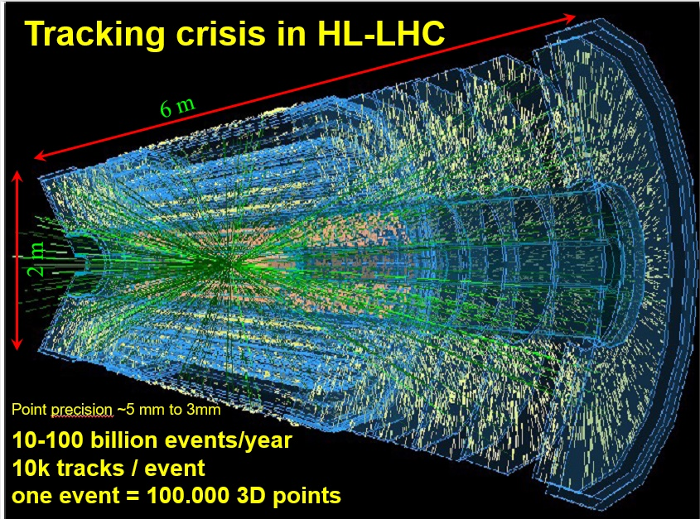
Problem Statement
Particle track reconstruction in dense environments such as the Run-4 detectors of the High Luminosity Large Hadron Collider (HL-LHC) and of MPD NICA is a challenging pattern recognition problem.
Expected that SPD experiment will produce events with frequency of 3 MHz
Well-known tracking algorithms based on the Kalman filter are not scaling well with the amounts of data being produced in modern experiments

Slide 3
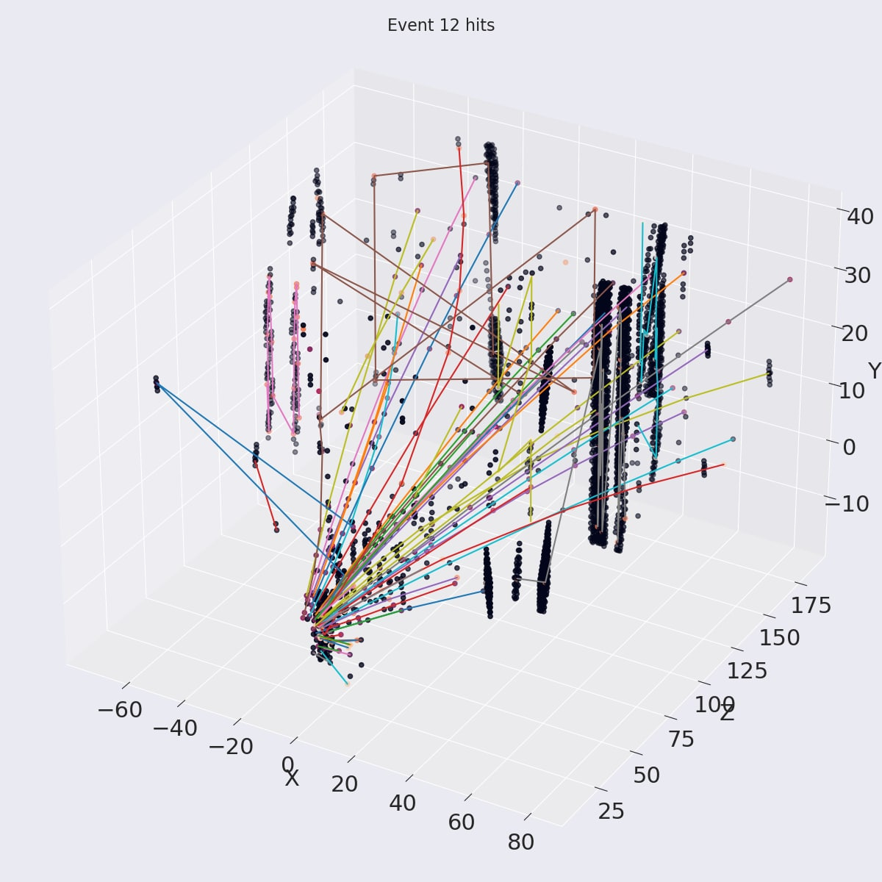
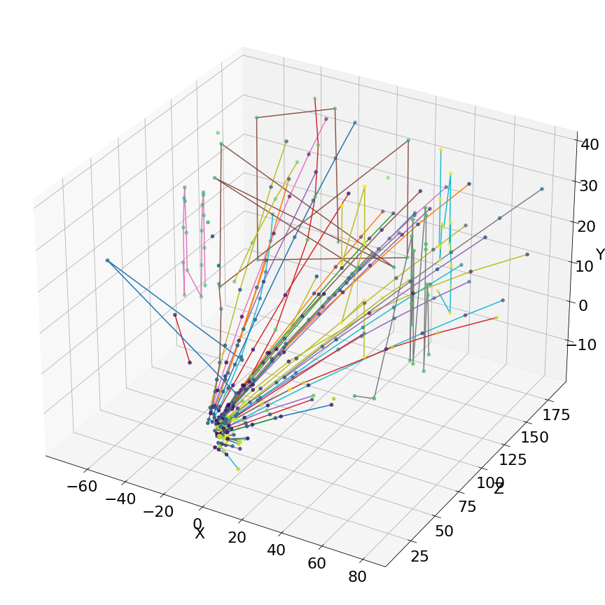
Deep Learning Comes to the Rescue
Deep learning algorithms bring a lot of potential to the tracking problem, due to
their capability to model complex non-linear data dependencies,
learn effective representations of high-dimensional data through training
parallelize easily on high-throughput architectures such as GPUs
What we propose for tracking?
Neural network
(online)
Kalman filter (offline)
Reconstructed event
High recall, low precision
Very fast
High recall, high precision
Too slow

Slide 4
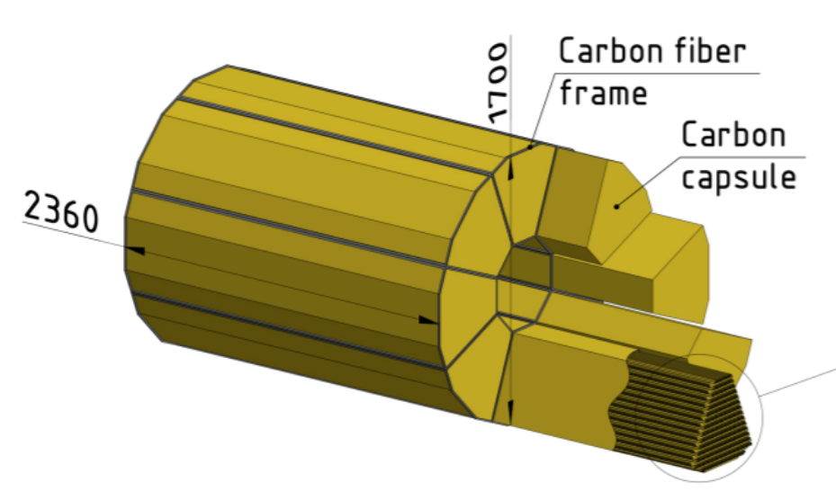
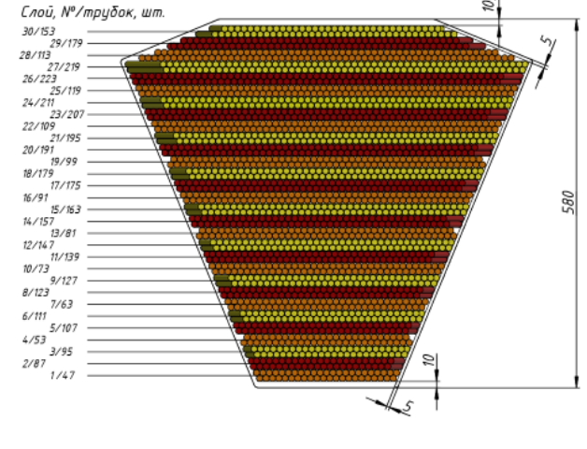
SPD Experiment
SPD (Spin Physics Detector) – is a future experiment of NICA facility in Dubna. The main goal of the experiment is to test the foundations of quantum chromodynamics (QCD).
Expected that SPD experiment will produce events with frequency of 3 MHz (20 Gb/s)
Only 2-5% of all data is interesting for physicists!
It is required to develop modern system for fast event reconstruction in straw detector
(x2 zoom)
Without cover
Layer, № / tubes, pcs
External view of the SPD straw detector (left) and its module in section (right)

Slide 5
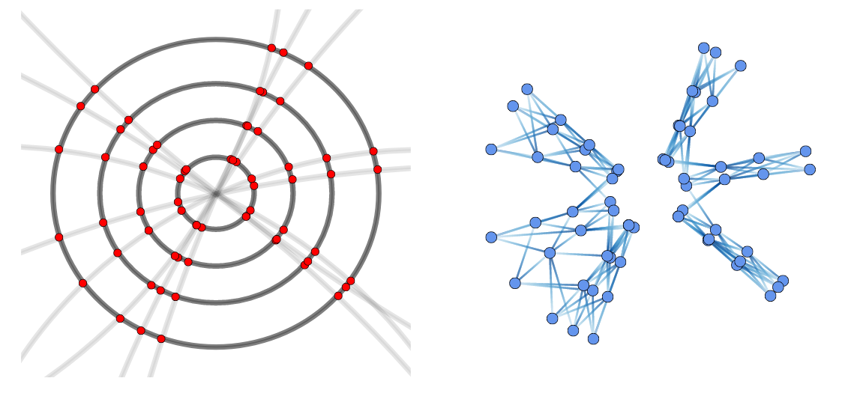
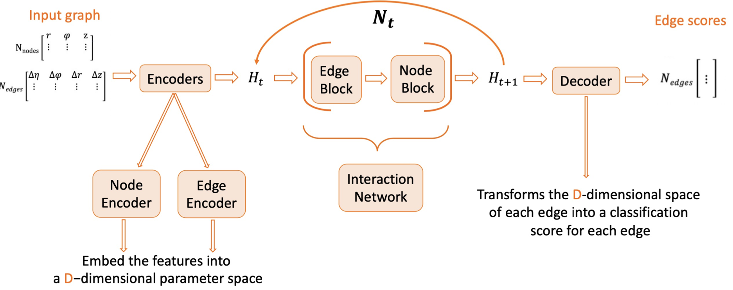
Graph Neural Network (GNN) for Particle Tracking
Event as a graph conception
Nodes are hits. The nodes between the adjacent stations may be connected by edges that are the possible segments of tracks
Nodes are not connected within one layer
Most of the edges will be pruned during preprocessing according to spatial features ($dφ,dz, w$)
Another type of input is reversed graph – edges become nodes, and pairs of nodes become edges (segment of three hits will be one edge with two nodes in the new graph representation)
https://iris-hep.org/projects/accel-gnn-tracking.html
The goal of the GNN is to classify the edges of the graph and throw out the non-existing hit connections
https://indico.ijclab.in2p3.fr/event/5999/contributions/25965/attachments/18789/25271/ltd_representation_summary.pdf

Slide 6
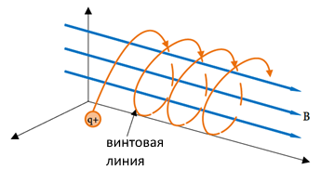
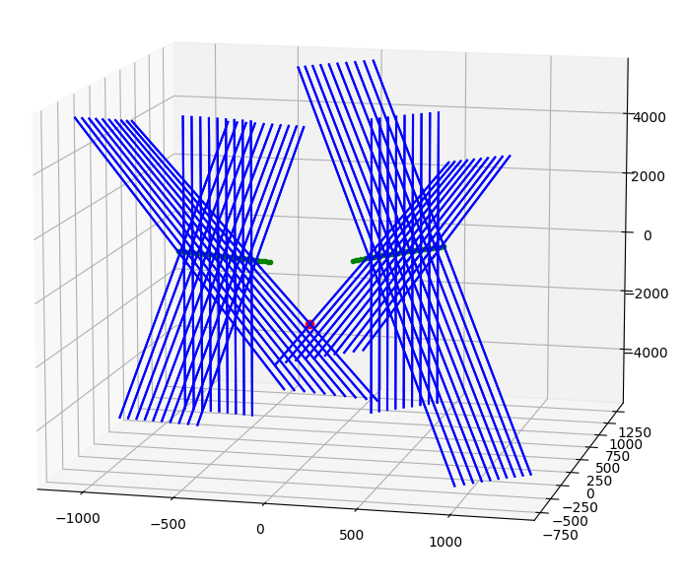
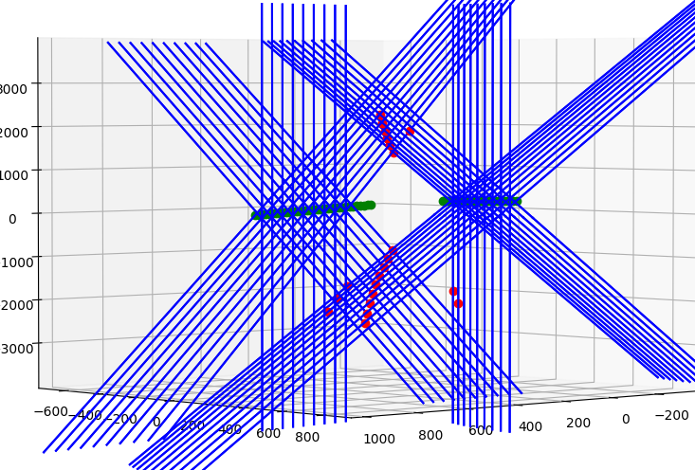
Events Data Generator
Generator is a simple Python program
Multiplicity in each event is given by a random number from 1 to 10
The transverse momentum of a particle is a random number with a uniform distribution in the range of values from 100 to 1000 MeV/s
Vertex coordinates are also random
The particle trajectory is represented by a selection of points on a segment of a helix with a helix pitch $h= \frac{2π}{B}|\frac{m}{q}|vcosα$ and radius $R=\frac{1}{B}|\frac{m}{q}|vsinα$
Detector inefficiency is also modelled (some hits may be missed)
Helix
Process of fakes generation
(two tracks in the event)

Slide 7
Dealing with Detector Inefficiency
GNN makes prediction for the edges
Apply classification threshold to drop out not interesting segments
Collect all continuous track segments (full tracks and parts of tracks)
Save track segments as pairs of nodes – node without input edge, node without output edge
If
the station number of the 1st element of the j-th pair is 2 more than the station number of the 2nd element of the i-th pair
AND the corresponding coordinate differences do not exceed $2dφ_{max}$, $2dz_{max}$ and exceed $2dφ_{min}$, $2dz_{min}$ (criterion from the graph pruning)
Connect such nodes and traverse the new graph

Slide 8
Testing Results (SPD)
Data for testing:
5000 generated events
Detector inefficiency – 1%
Used metrics:
$recall= \frac{N_{true}^{rec}}{N_{in}}$
$precision= \frac{N_{true}^{rec}}{N^{rec}}$
$N_{true}^{rec}$ - no. real tracks that the network found
$N_{in}$ - no. all real tracks known from Monte-Carlo
$N^{rec}$ - no. all reconstructed tracks
 | No. generated fakes | Preprocessing time (event/sec.) | GNN inference time (event/sec.) | Track bulding procedure (event/sec.)
Ordinary graph | 100 | 427.59 | 312.99 | 319.33
 | 1000 | 46.26 | 299.52 | 309.83
 | 10000 | 10.5 | 250.69 | 184.71
Reversed graph | 100 | 261.52 | 208.94 | 248.86
 | 1000 | 32.61 | 211.57 | 214.43
 | 10000 | 12.51 | 166.64 | 134.59
 | Standard algorithm (no handling of missed hits) |  | Improved algorithm (dealing with inefficiency)
 | Ordinary graph | Reversed graph | Ordinary graph | Reversed graph
Recall | 0.6767 | 0.6887 | 0.9104 | 0.9113
Precision | 0.8582 | 0.9543 | 0.8324 | 0.9364

Slide 9
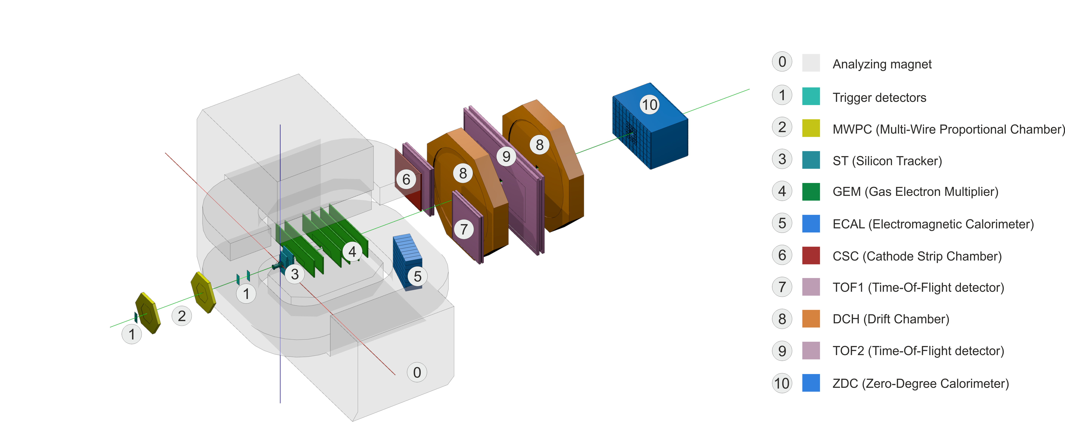
BM@N Experiment Run 7
Dataset
Run 7 has a configuration - 6 GEM stations and 3 silicon stations before the GEM ones
Monte-Carlo simulation using LAQGSM
1 000 000 events for training and validation
Beam energy equal to 3,2 GeV
Interactions with the argon beam and plumbum target (Ar+Pb)
Magnet amperage was set to 1250 A
Target distribution: X (mean: 0,7 cm, std: 0,33 cm), Y (mean: -3,7 cm, std: 0,33 cm), Z (center: -1,1 cm, thickness: 0,25 cm)
Multiplicity of events varies up to 100 tracks per event, and 37 tracks per event on the average
Number of hits can be more than 500 per station
About 68% of all hits are fakes
Tracks containing less than 4 hits, spinning tracks and tracks with holes are removed from the dataset
BM@N Run 7 Front View
https://bmn.jinr.ru/gallery/
With such amount of hits and fakes ratio it is not very easy to fit into memory with the event graph!

Slide 10
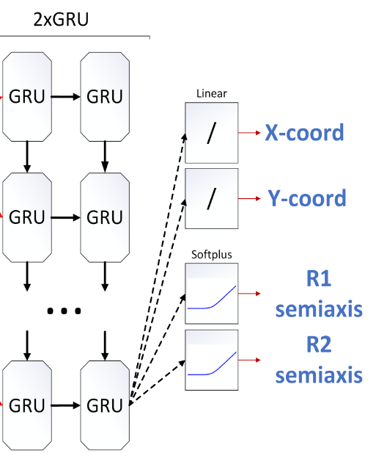
Local Tracking with TrackNETv3
TrackNETv3 model
How the model works?
TrackNETv3 is a model for local track reconstruction
Locality – one particular track-candidate during the prediction phase
The model predicts the center and semi-axes of the ellipse on the next coordinate plane where to search for the next hit
All hits are placed in the spatial search index (Faiss)
Only K nearest to the center of ellipse hits are checked (we set K=5)
Candidate tracks are extended by hits that fall into ellipse
Extended track-candidates are fed back to the model input
Pros:
Fast
Lightweight
No problems with memory consumption
Each track can be processed separately in parallel
Cons:
lot of false positives or so-called ghosts, because of its local nature of prediction

Slide 11
Graph Neural Network as a Global Classifier
TrackNETv3
1) Raw event hits
Reconstructed event
2) Graph from TrackNET predictions
4) Track building
3) Pruned graph from GNN
GNN with ordinary directed graph

Slide 12
Testing Results (BM@N Run 7)
Testing setup:
25 000 generated events
Xeon(R) Gold 6148 CPU @ 2.40GHz
Two types of GNN with different weights for positive and negative edges
No spinning tracks, tracks with less than 4 hits, tracks with missing hits
Used metrics:
$recall= \frac{N_{true}^{rec}}{N_{in}}$
$precision= \frac{N_{true}^{rec}}{N^{rec}}$
- $N_{true}^{rec}$ - no. real tracks that the network found
- $N_{in}$ - no. all real tracks known from Monte-Carlo
- $N^{rec}$ - no. all reconstructed tracks
- Track is reconstructed if >=70% of hits are reconstructed
 | TrackNETv3 | TrackNETv3 + GraphNet (pos. weight = 24) | TrackNETv3 + GraphNet (pos. weight = 10)
Track efficiency (recall) (%) | 97,67 | 94,89 | 93,34
Track purity (precision) (%) | 2,35 | 74,98 | 85,23
Event/sec | 12,78 | 7,56 | 7,56

Slide 13
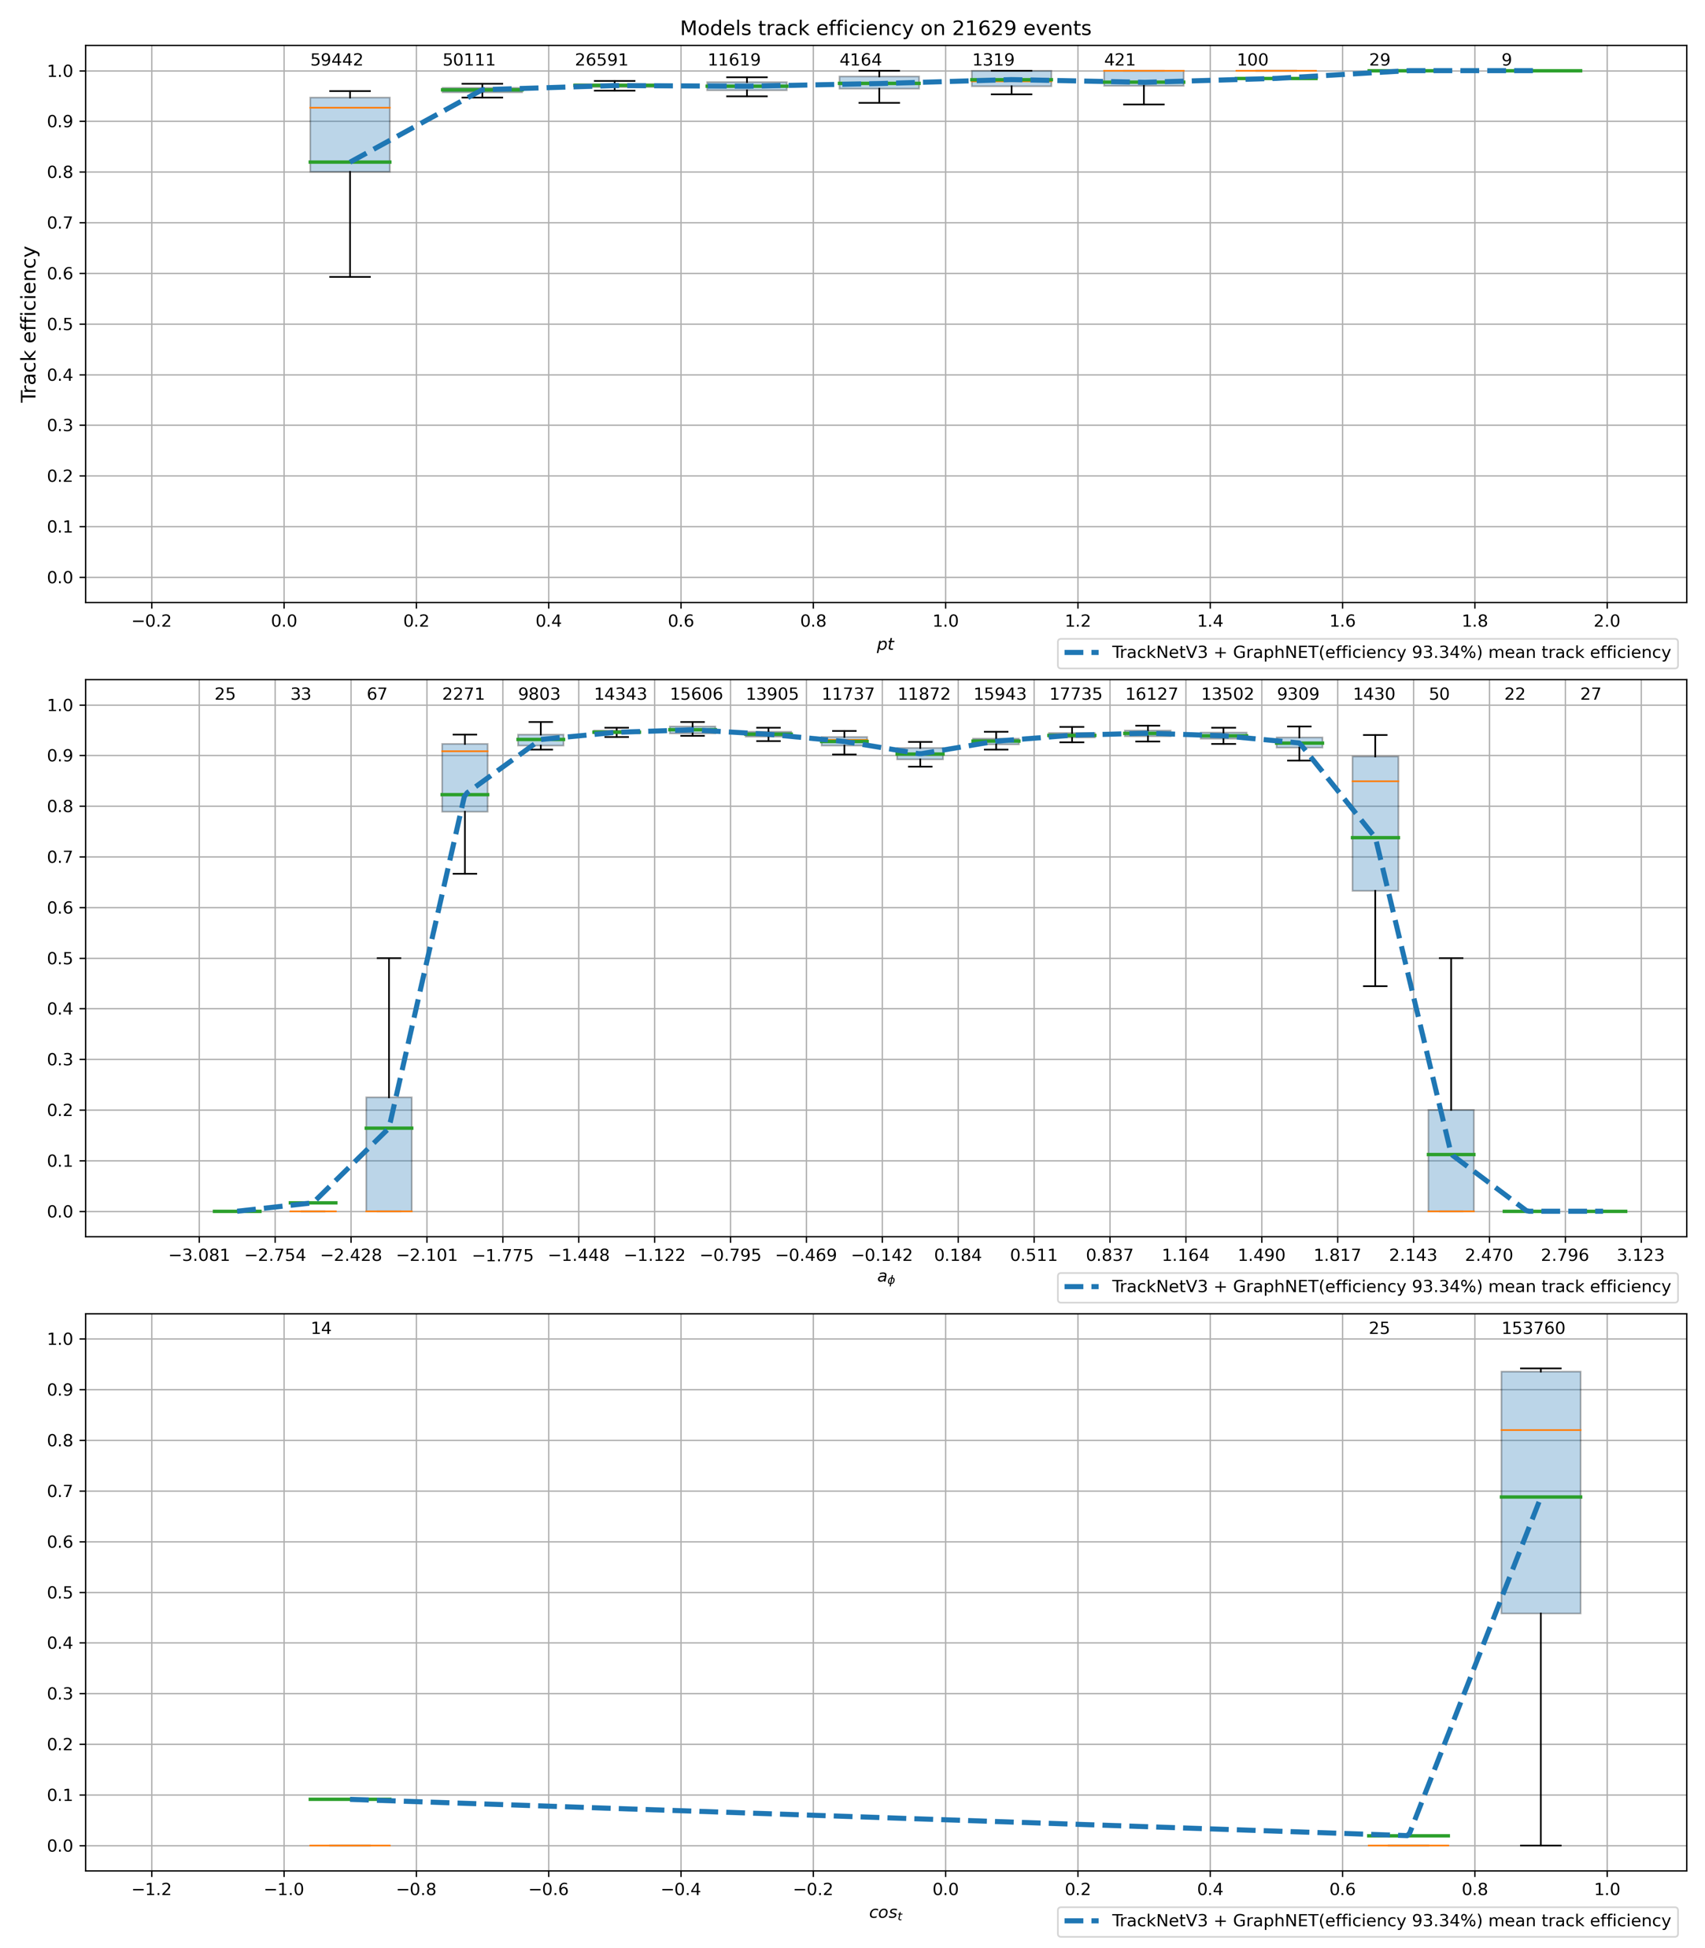
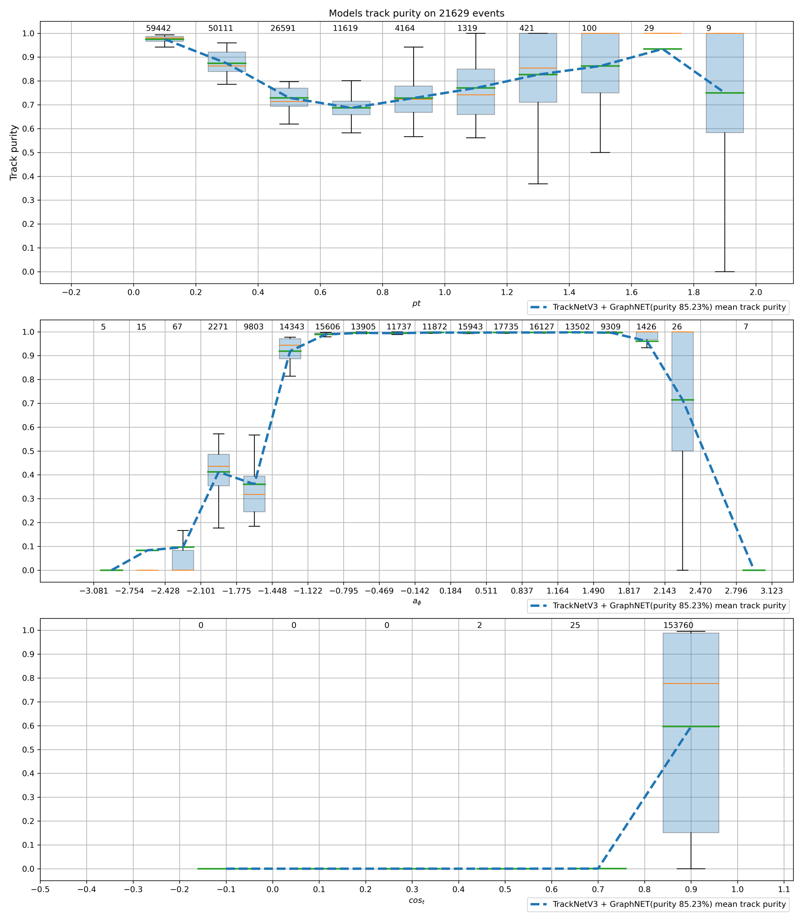
Results analysis
pt
pt
Track Efficiency (recall)
Track Purity (precision)
$$a_{φ}$$
$$a_{φ}$$
$$\cos_{t}$$
$$\cos_{t}$$

Slide 14
Conclusion and Outlook
Discussion
The current GNN model achieves great results on generated data for SPD, but still more sophisticated simulation is required.
To increase precision of the models for BM@N we tried to fit each track-candidate by helix to filter out tracks with hi-square greater then a threshold. Attempts to use the helix fitting did not show any improvement.
The results presented for BM@N were achieved for the event data with short tracks, tracks with holes and spinning tracks being excluded.
Handling tracks with holes is a specific process which requires extra tricks. For example, during the TrackNETv3 inference we can decide where to place a virtual point instead of prolonging the candidate with the hits from the predicted ellipse (in progress).
Tracks fitting with parameters calculation is required for better analysis of the results.
Acknowledgment
The calculations were carried out on the basis of the HybriLIT heterogeneous computing platform (LIT, JINR).
[G. Adam et al., CEUR Workshop Proc., Vol. 2267, 638-644 (2018).]

Slide 15
Deep neural network applications for particle tracking at the BM@N and SPD experiments
Goncharov Pavel, Rusov Daniil, Lubchenkov Leonid, Shchavelev Egor, Ososkov Gennady

