Slide 1
Visual clustering of ocean sediment grains using a combination of unsupervised machine learning methods
Viktor Golikov¹, Mikhail Krinitskiy¹, and Dmitry Borisov²
¹1Moscow Institute of Physics and Technology, Department of Aerophysics and Space Research, Russian Federation
²Shirshov Institute of Oceanology, Russian Academy of Sciences, Moscow, Russian Federation

Slide 2
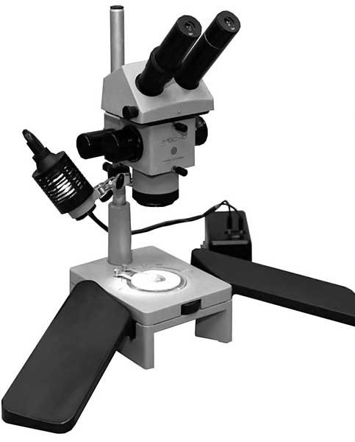
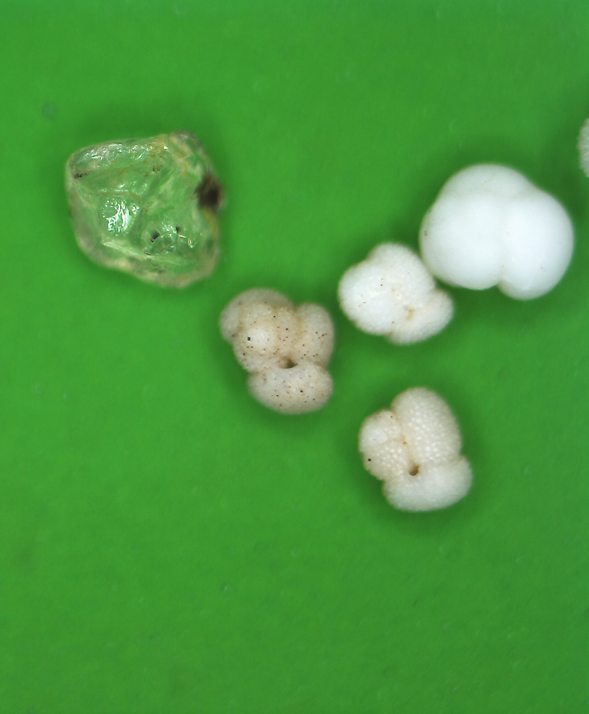
Motivation
1/10
Why sea-floor sediments are important:
sea-floor sediments are natural archive of information about the history of the ocean and climate on our planet
Knowing the substance of sediments is necessary for planning geotechnical work in the ocean
Why is it necessary to automate the process :
A person is not able to process the entire set of particles
Working with a microscope is harmful production
Few specialists

Slide 3
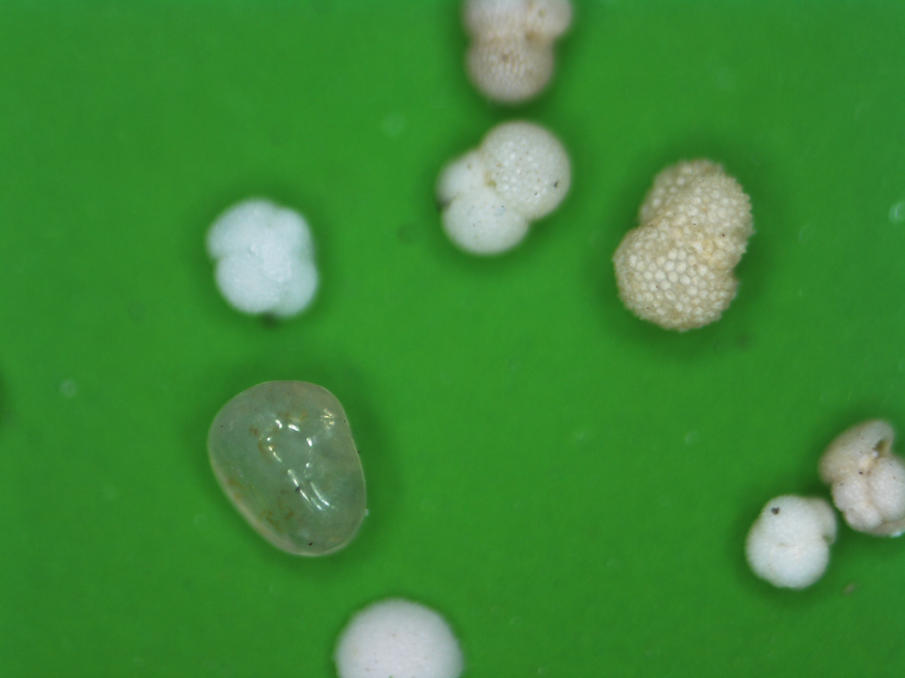
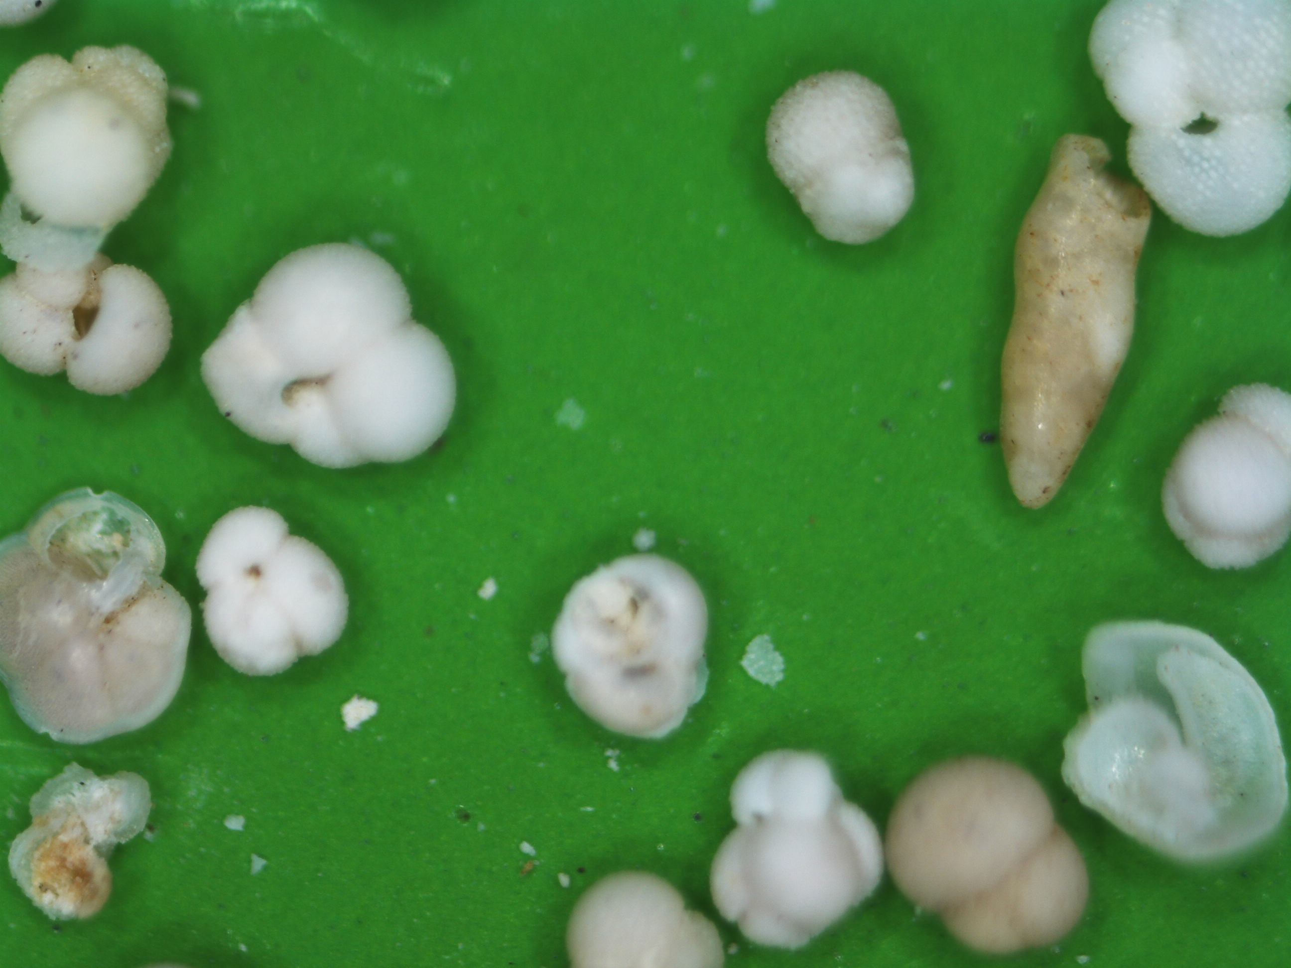
Data collection and preparing
2/10
Set of images made with microscope is examined
There are various particles with size of 0.1mm on images which are need to be divided into groups of similar grains
Different particles are on the images(fraction > 0.1mm), which we need to split into groups of similar ones
Levenhuk DTX 90 microscope
with contrast backing
Photos are made by laboratory of paleooceanology

Slide 4
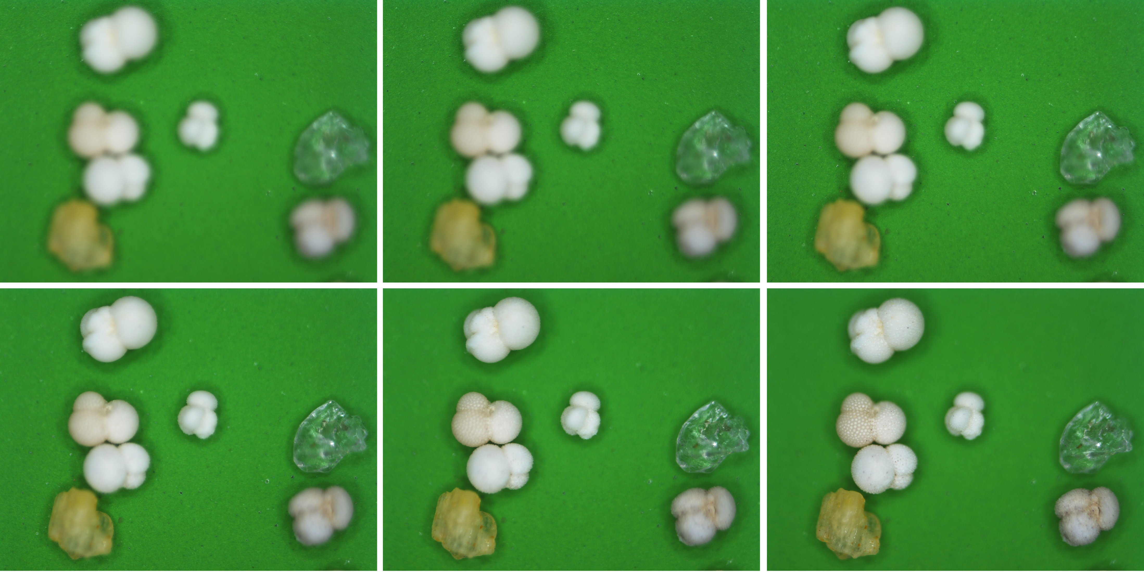
Data collection and preparing
3/10
Levenhuk DTX 90 microscope
with contrast backing
On every part of backing we take the series of 6 images with different focal distance

Slide 5
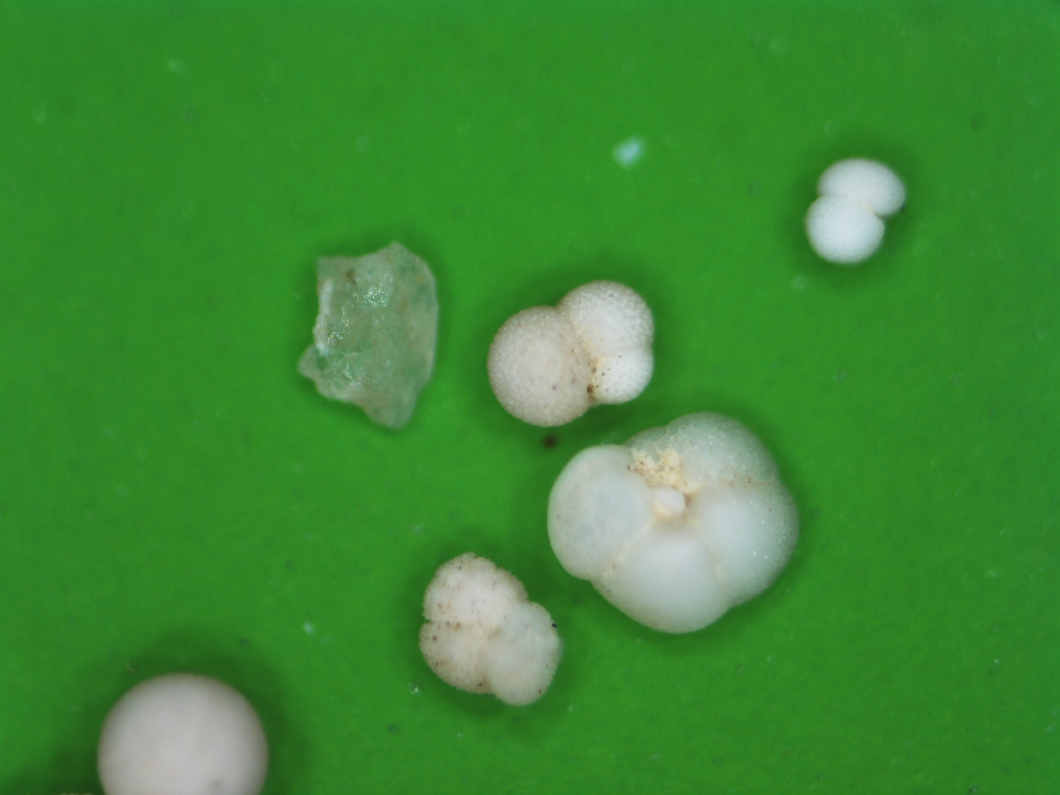
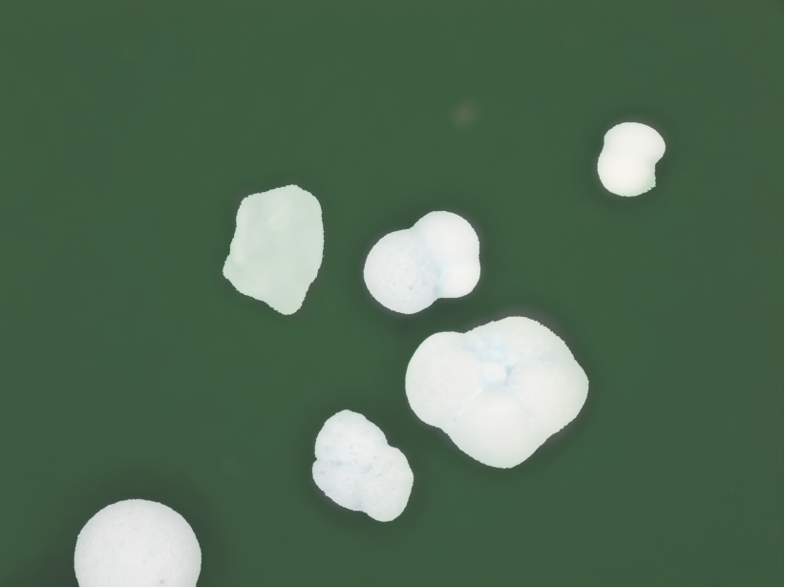
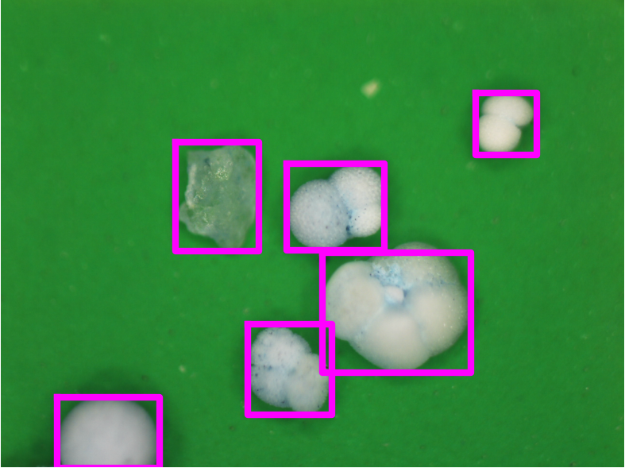
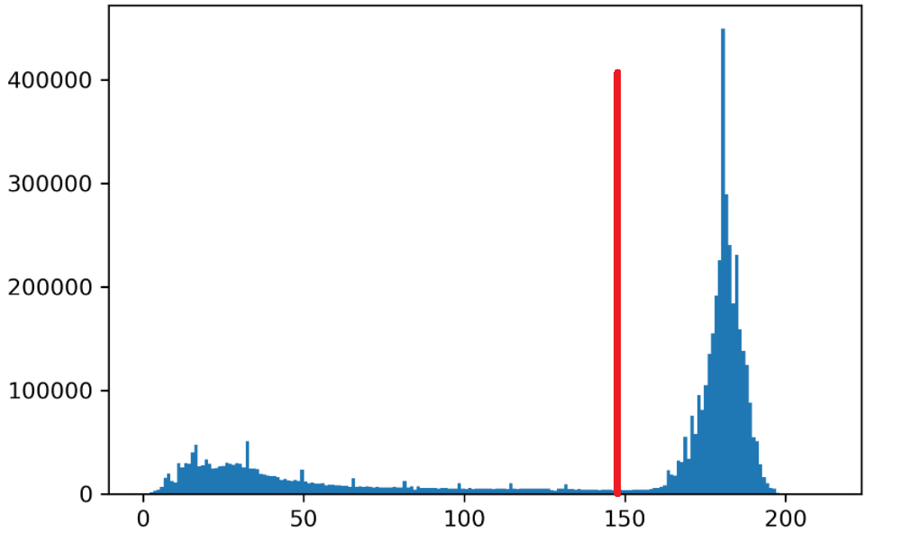
Primary photo processing
4/10
Distinguishing particles in images
Backing pixels
Particle pixels
Number of pixels
These are particles for clustering
Saturation value(0-255)

Slide 6
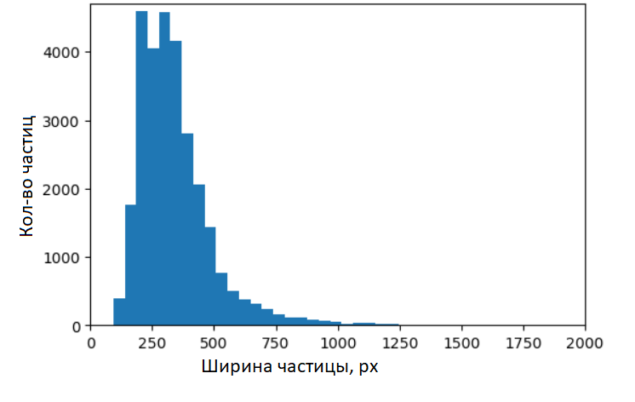
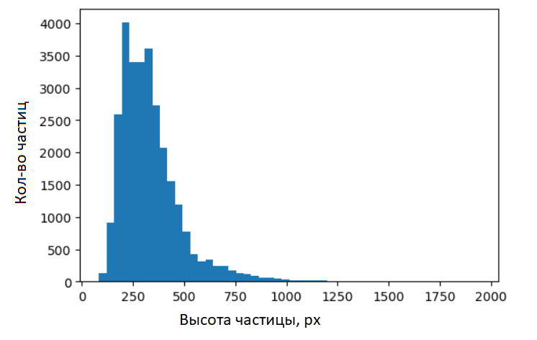
General characteristic of dataset
5/10
In total, 58302 photos were processed - 9717 sets of 6 images with different focus
On these images are 28,800 unique particles
Average particle size is about 300 pixels
number of particles
particles number
particles number
particle width, px
particle height, px

Slide 7
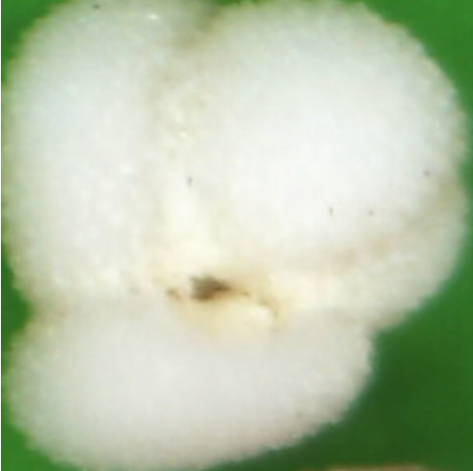
Variational auto encoder
6/10
Original image in high dimensional space
Reconstructed image
$$ℝ^{280х280x3}$$
We get the embedding vectors of the reduced dimension. We apply the clustering algorithm to these vectors.
$$ℝ^{512}$$

Slide 8
Other examples of how the autoencoder works
7/10

Slide 9
Variational autoencoder: pros and cons
8/10
Pros
A space of small dimension convenient for clustering
Embeddings of similar images are close to each other
Cons
Due to the fact that the data is normally distributed, a clear structure disappears, so it is impossible to single out individual clusters unambiguously
This means that it is necessary to divide the samle into a much larger number of groups than we expect to get in the end

Slide 10
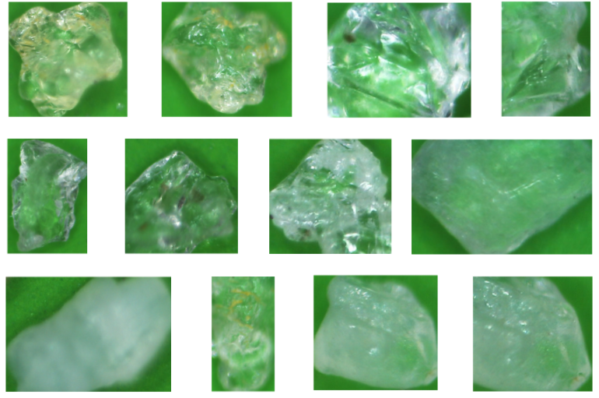
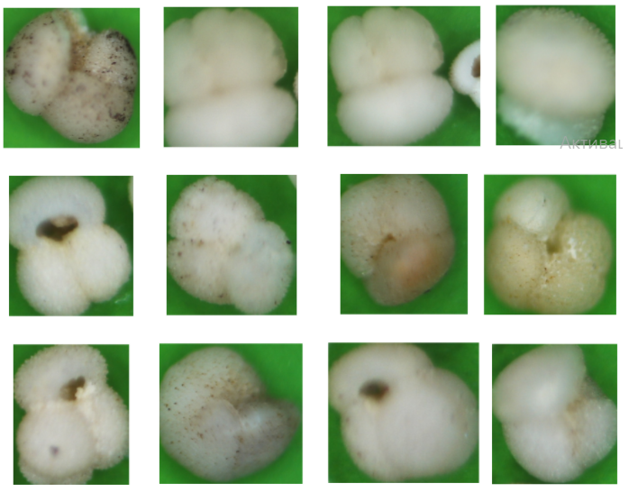
Clustering
9/10
We divide the particles into a much larger (~100) number of clusters than we expect to end up with
Сlustering was performed by the k-means method
Examples:
mineral grains (quartz)
intact foraminifera

Slide 11
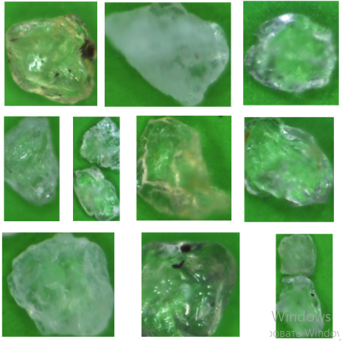
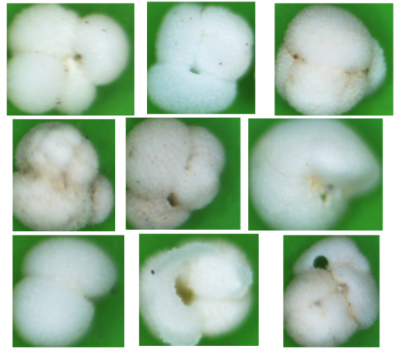
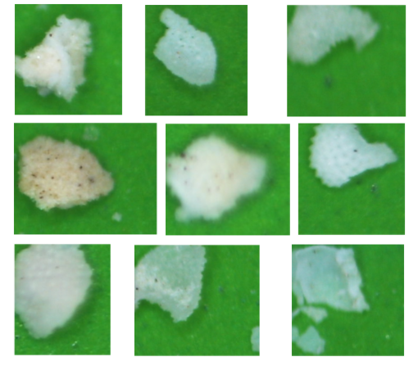
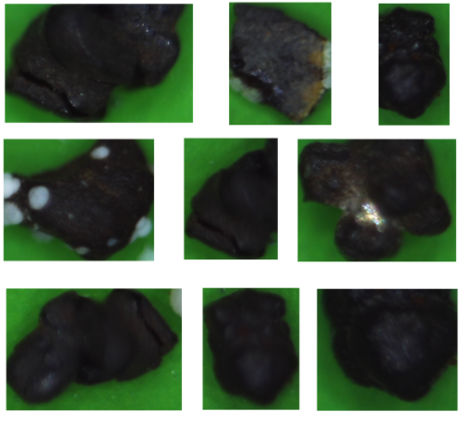
Results
10/10
Variety of groups have been obtained. Within each of them particles are approximately the same in terms of semantic properties
There are groups with similar particles, the expert will combine them, also there are different ones. In any case, it will greatly simplify his work.
Current results identify 2 important paleo-indicators
the ratio of the biogenic carbonate substance, and the rest of the substance (mainly terrigenous)
The ratio of the number of whole foraminifera and fragments
mineral grains (quartz)
Intact foraminifera
Broken foraminifera

Slide 12
Thank you for your attention!

Slide 15
Simple Linear Iterative Clustering

Slide 16
VAE ResNet-152

