Slide 1
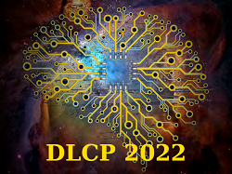
Hazy Images Dataset With Localized Light Sources For Experimental Evaluation Of Dehazing Methods
Andrei Filin*, Andrei Kopylov, Oleg Seredin, Inessa Gracheva
Russia, Tula State University
andrewifilin@gmail.com, And.Kopylov@gmail.com, oseredin@yandex.ru, gia1509@mail.ru
The work is supported by the Russian Fund for Basic Research. Grant no: 20-07-00441 and Grant no: 20-07-00055. Oleg Seredin is supported by the Ministry of Science and Higher Education of the Russian Federation within the framework of the state task FEWG-2021-0012
DLCP-2022, Dubna, Russia

Slide 2
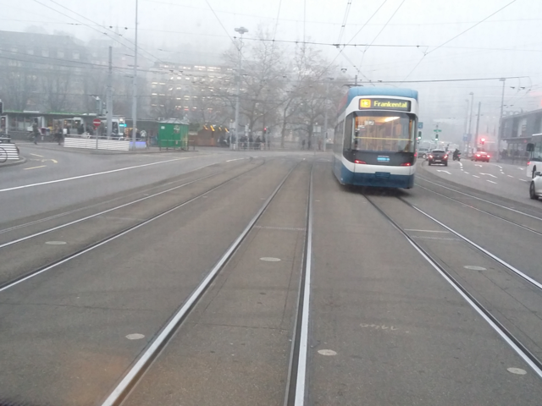
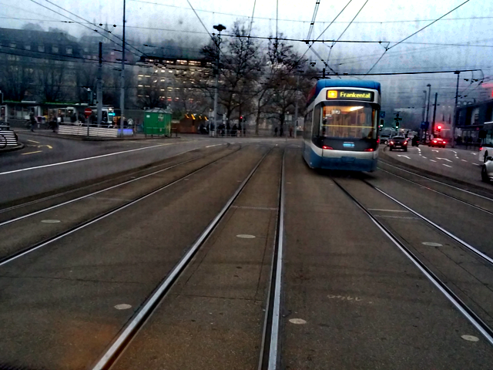
Image dehazing task
Original image
Dehazed image

Slide 3
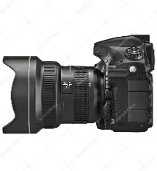
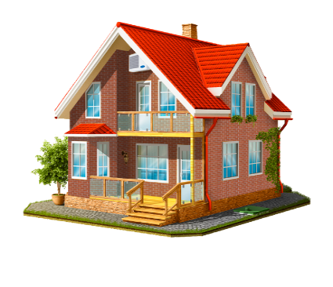
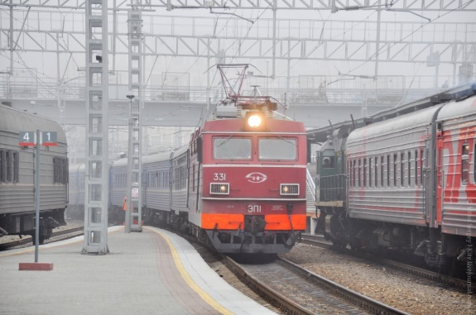
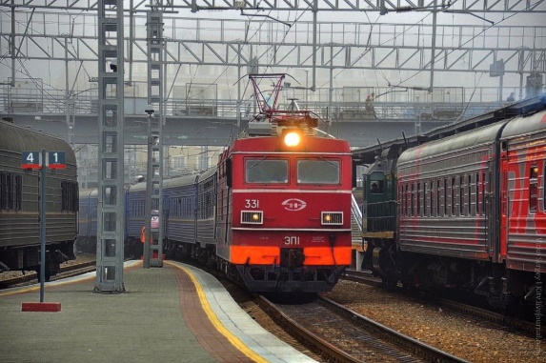
Atmospheric scattering model
Atmospheric
light
$$A_{c}\left(1−T\left(s\right)\right)$$
Reflected
light
$$I_{c}\left(s\right)$$
Scattering
$$J_{c}\left(s\right)T\left(s\right)$$
$$J_{c}\left(s\right)$$
Camera
Scene
$I_{c}\left(s\right)=J_{c}\left(s\right)T\left(s\right)+A_{c}\left(1−T\left(s\right)\right), T\left(s\right)=e^{−βd\left(s\right)}$,
$β$– scattering coefficient, d(s) – scene depth, T(s) – transmission map,
$c ϵ \left\{R, G, B\right\}$- color in the RGB color space
$$I_{c}\left(s\right)$$
$$J_{c}\left(s\right)$$
$$T\left(s\right)$$
* Koschmieder H (1924) Theorie der horizontalen Sichtweite. Beitr Phys freie Atmos 12:33–55

Slide 4
Dehazing datasets with ground truth
Haze type | Name | Number of images
synthetic | D-hazy¹ | 1400+
 | Reside² (SOTS, OTS) | 2560+
real | BeDDE³ | 208
 | Dense-haze⁴ | 33
 | I-haze⁵ | 30
 | NH-haze⁶ | 55
 | O-haze⁷ | 45
Atmospheric scattering model:
$I_{c}=J_{c}\left(s\right)T\left(s\right)+A_{c}\left(1−T\left(s\right)\right)$;
$T\left(s\right)$in case of hazy images synthesizing - is the depth map
[1] Ancuti C., Ancuti C. O., DeVleeschouwer C. D-hazy: A dataset to evaluate quantitatively dehazing algorithms //2016 IEEE international conference on image processing (ICIP). – IEEE, 2016. — С. 2226-2230.
[2] Li B. et al. Benchmarking single-image dehazing and beyond //IEEE Transactions on Image Processing. – 2018. — Т. 28. – №. 1. – С. 492- 505.
[3] S. Zhao, L. Zhang, et al. Evaluation of defogging: A real-world benchmark dataset, a new criterion and baselines. In ICME, pp.1840-1845, 2019.
[4] Ancuti C. et al. Dense-haze: a benchmark for image dehazing with dense-haze and haze-free images //2019 IEEE international conference on image processing (ICIP). – IEEE, 2019. – С. 1014-1018.
[5] Ancuti C. et al. I-HAZE: a dehazing benchmark with real hazy and haze-free indoor images //International Conference on Advanced Concepts for Intelligent Vision Systems. – Springer, Cham, 2018. — С. 620-631.
[6] Ancuti C. O., Ancuti C., Timofte R. NH-HAZE: An image dehazing benchmark with non-homogeneous hazy and haze-free images //Proceedings of the IEEE/CVF Conference on Computer Vision and Pattern Recognition Workshops. – 2020. — С. 444-445.
[7] Ancuti C. et al. O-haze: a dehazing benchmark with real hazy and hazefree outdoor images //Proceedings of the IEEE conference on computer vision and pattern recognition workshops. – 2018. — С. 754-762.

Slide 5
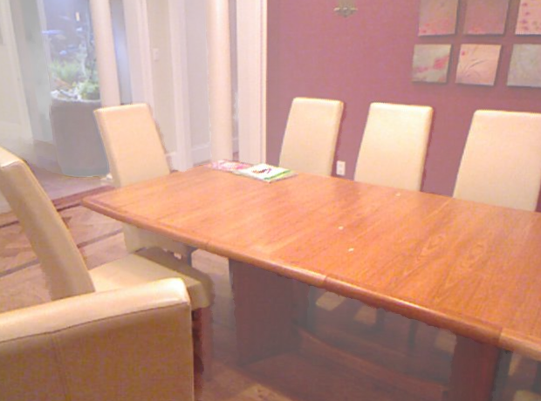
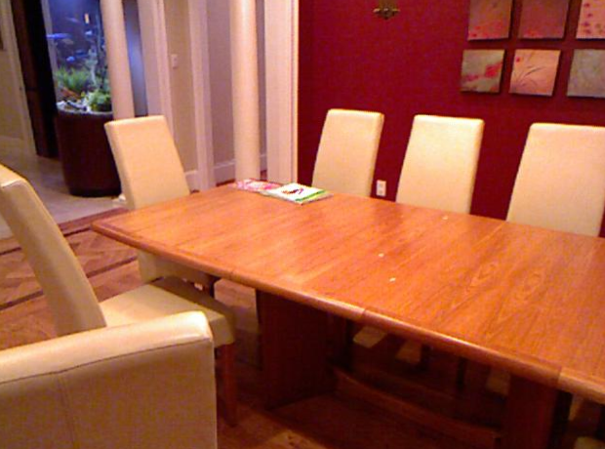
Problem of synthetic haze
improperly generated haze
Synthetic haze image
Ground truth image
Images from SOTS dataset. Red squares are visible haze distortion areas

Slide 6
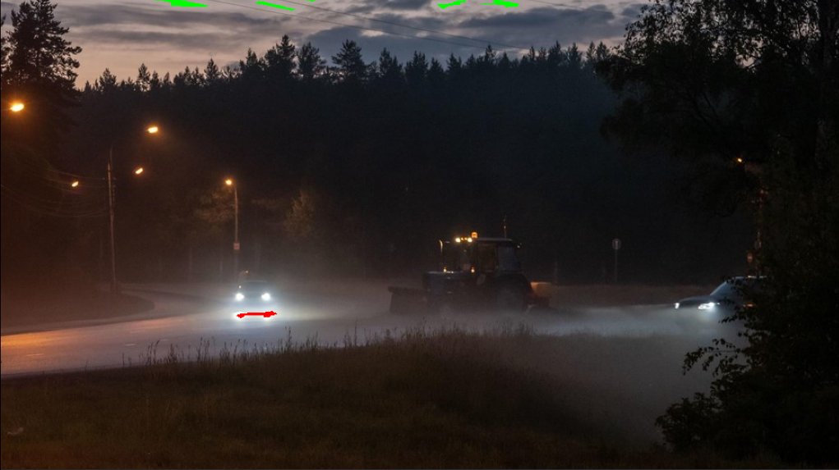
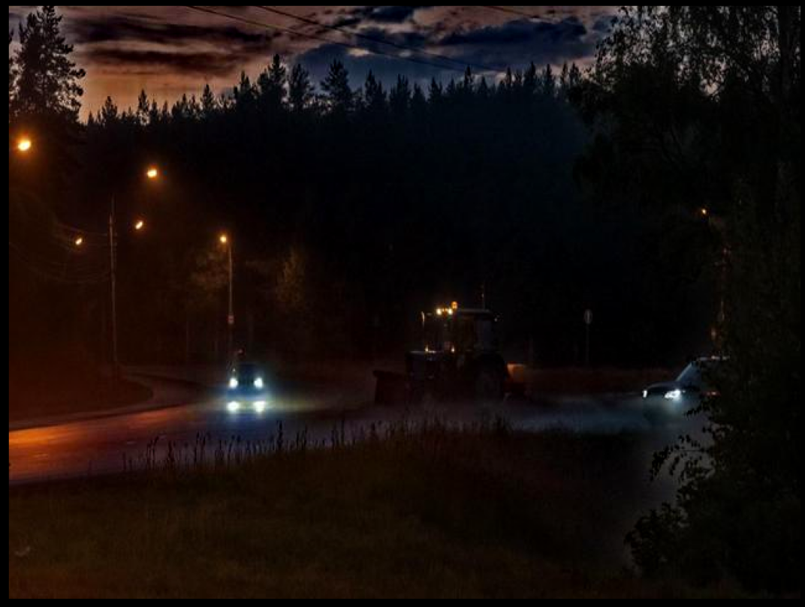
Haze removal in low light conditions with artificial light sources
Ac
Ac
Original image
Dehazed image

Slide 7
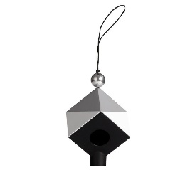
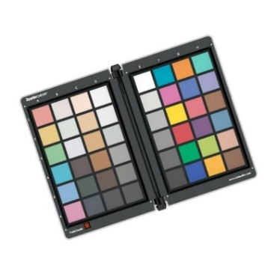
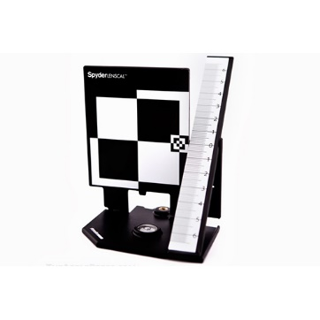
Basic principles of hazy images collection
The most straightforward way to achieve a hazy environment is using a smoke machine
For more homogeneous haze, windlessness should be held on a few minutes before taking pictures
ColorChecker plate should be placed on the camera field of view. Optionally, also place other camera calibration tools.
The camera parameters (aperture, shutter speed, ISO) should be controlled
White balance tool
(Datacolor SpyderCUBE)
ColorChecker
(Datacolor SpyderCheckr)
Camera Lens Calibration Tool
(Datacolor SpyderLensCal)

Slide 8
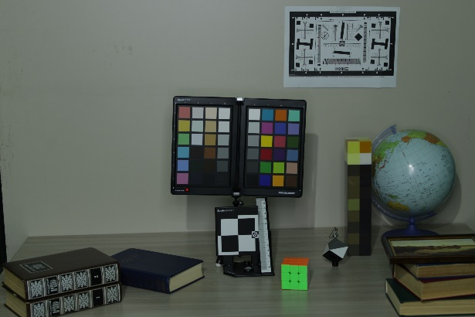
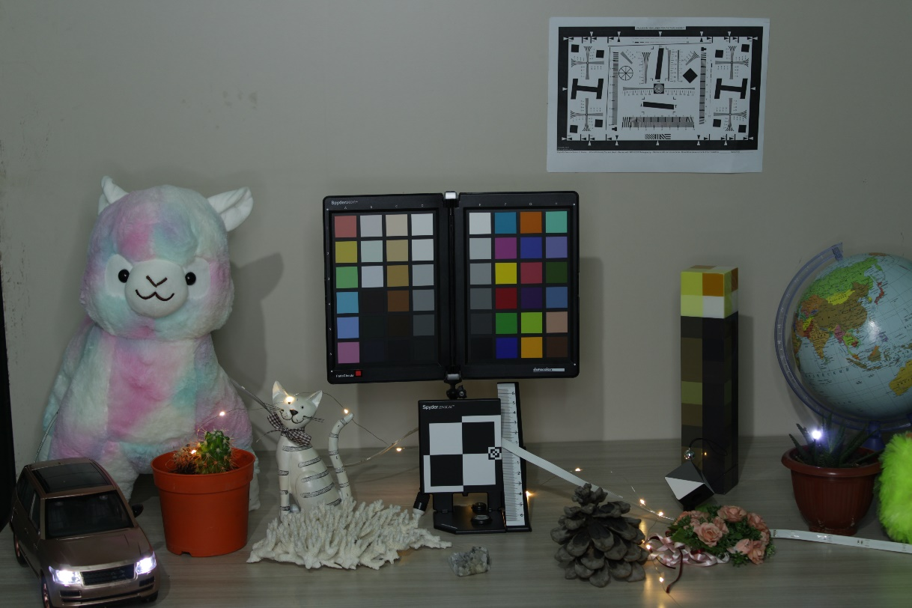
Dataset collection. Scene complexity
Localized light sources
Scene 1 (easy)
Scene 2 (advanced)
Datacolor SpederCheckr
Datacolor SpyderLensCal
Datacolor SpyderCUBE

Slide 9
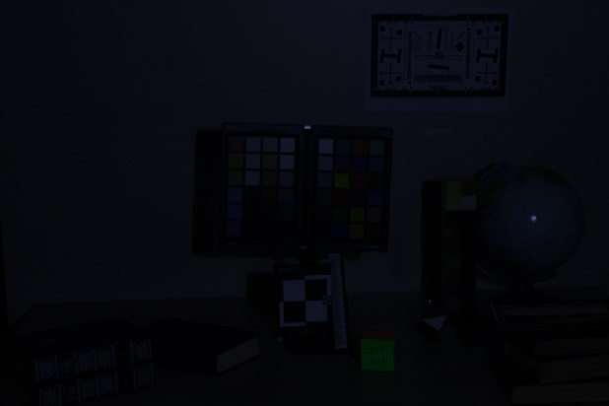
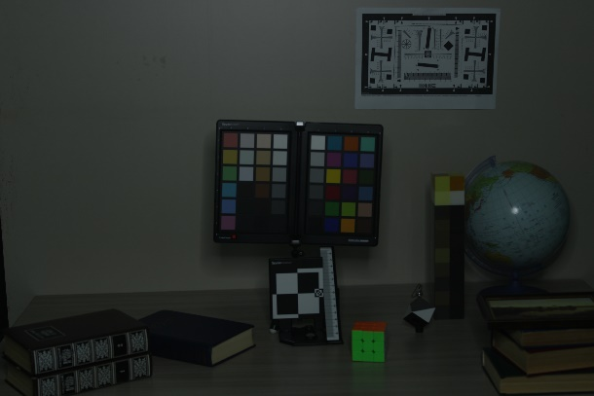
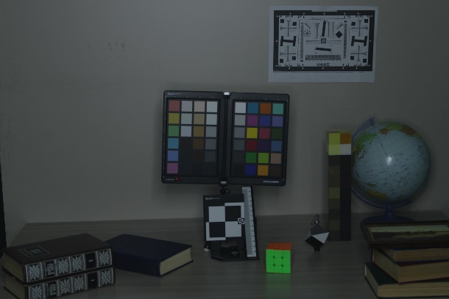
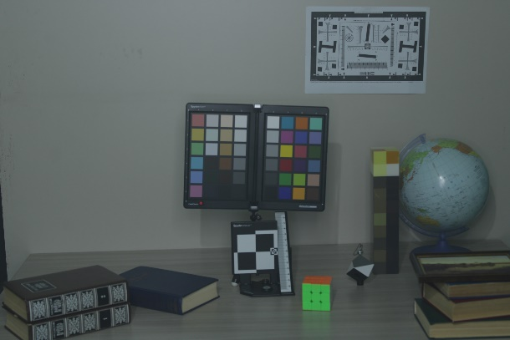
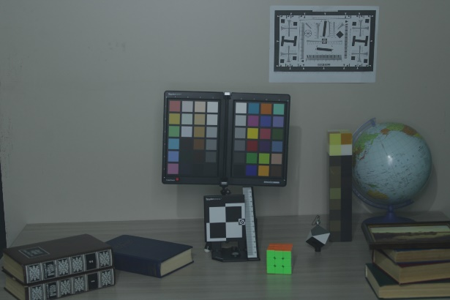
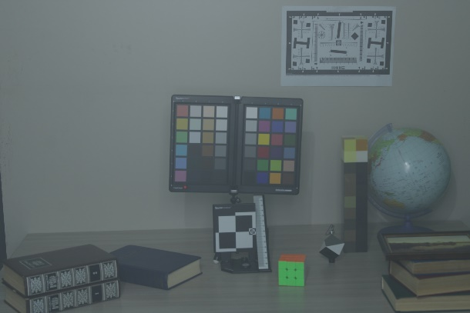
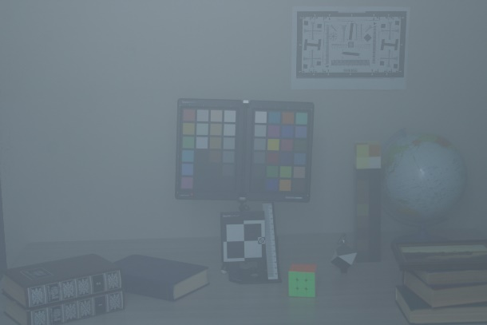
Dataset collection. Environment
Increasing brightness
Increasing haze density
Datacolor SpederCheckr
Datacolor SpyderCUBE
Datacolor SpyderLensCal

Slide 10
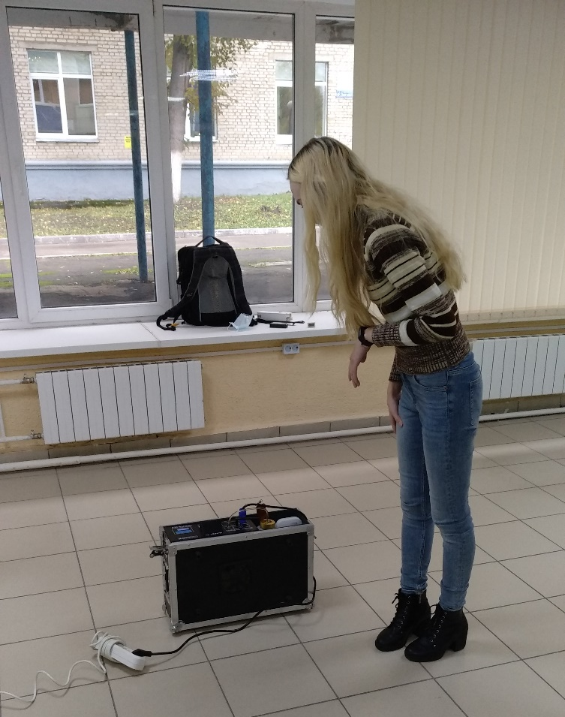
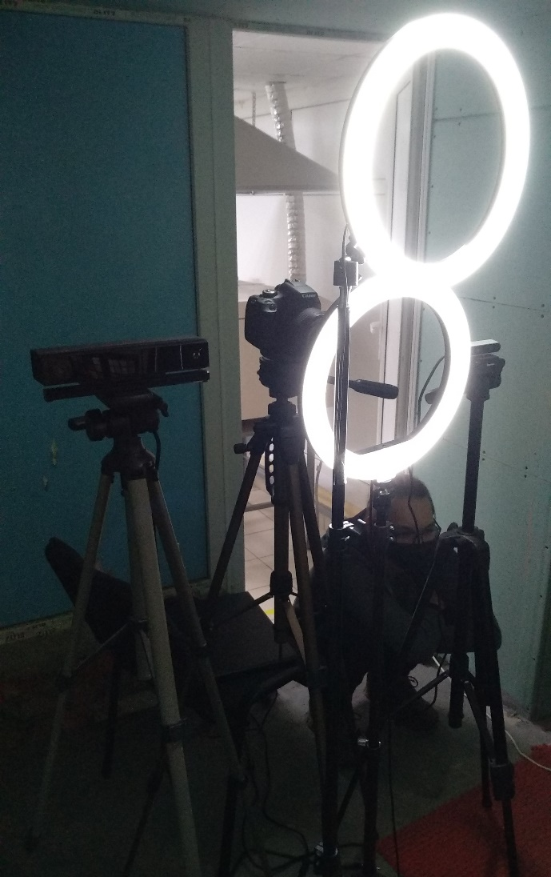
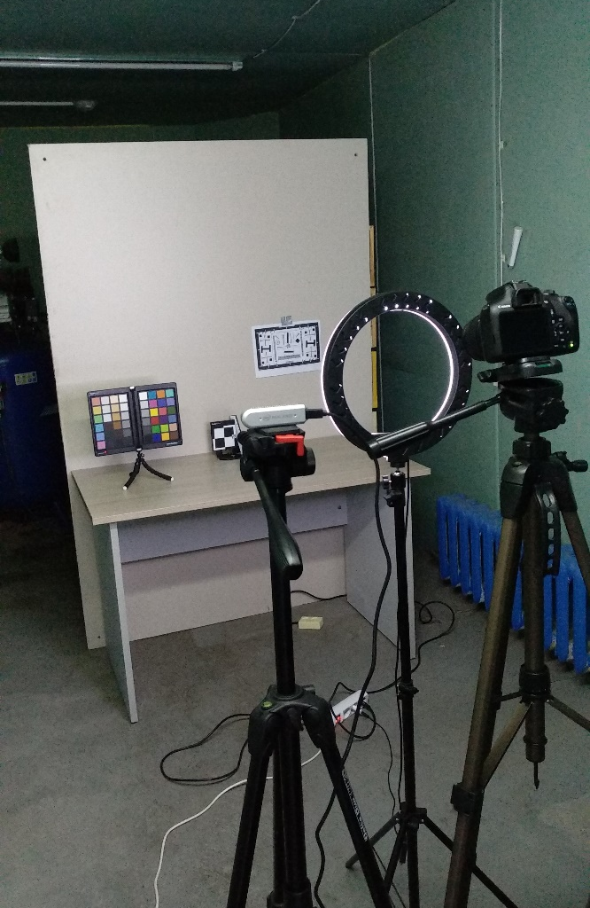
Dataset collection. Backstage

Slide 11
Experimental evaluation
Mean of i-haze and o-haze datasets
Proposed dataset
Метод | Mean PSNR | Mean SSIM
Zhu et al.¹² | 16.58 | 0.70
Berman et al.⁸ | 15.76 | 0.74
Qin et al.¹¹ | 15.16 | 0.65
Dhara et al.⁹ | 14.85 | 0.67
He et al.¹⁰ | 13.51 | 0.62
Method | Mean PSNR | Mean SSIM
Qin et al.¹¹ | 19.37 | 0.74
Dhara et al.⁹ | 18.59 | 0.71
Zhu et al.¹² | 17.65 | 0.62
He et al.¹⁰ | 17.42 | 0.49
Berman et al.⁸ | 15.76 | 0.73
[8] Berman D. et al. Non-local image dehazing //Proceedings of the IEEE conference on computer vision and pattern recognition. – 2016. — С. 1674-1682.
[9] Dhara S. K. et al. Color cast dependent image dehazing via adaptive airlight refinement and non-linear color balancing //IEEE Transactions on Circuits and Systems for Video Technology. – 2020. – Т. 31. – №. 5. — С. 2076-2081.
[10] He K., Sun J., Tang X. Single image haze removal using dark channel prior //IEEE transactions on pattern analysis and machine intelligence. – 2010. – Т. 33. – №. 12. — С. 2341-2353.
[11] Qin X. et al. FFA-Net: Feature fusion attention network for single image dehazing //Proceedings of the AAAI Conference on Artificial Intelligence. – 2020. – Т. 34. – №. 07. — С. 11908-11915.
[12] Zhu Q., Mai J., Shao L. A fast single image haze removal algorithm using color attenuation prior //IEEE

Slide 12
THANK YOU FOR ATTENTION!

