Slide 1
A spiking neural network with fixed synaptic weights based on logistic maps for a classification task
Authors:
Dmitriy Kunitsyn (NRNU "MEPhI")
Dr Alexander Sboev (NRC "Kurchatov Institute"; NRNU "MEPhI")
Alexey Serenko (NRC "Kurchatov Institute")
Dr Roman Rybka (NRC "Kurchatov Institute")

Slide 2
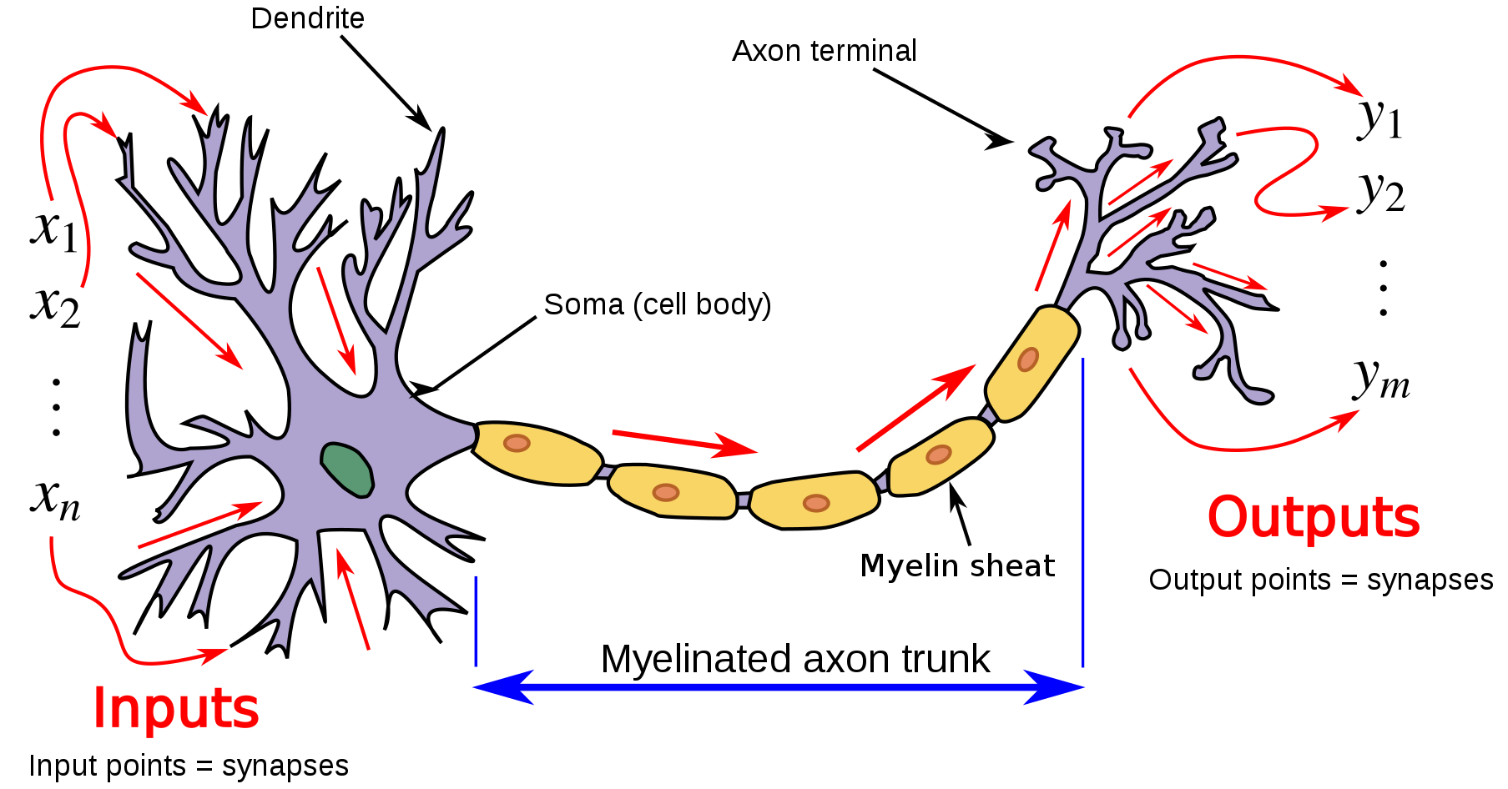

Spiking neuron model
Leaky Integrate-and-Fire neuron model
The membrane potential V obeys
$$C_{m}\frac{dV}{dt}=\frac{V_{rest}−V(t)}{τ_{m}}+I_{syn}\left(t\right)$$
The postsynaptic current is of exponential form:
$$I_{syn}\left(t\right)=\sum_{i}{w_{i}\sum_{pre−spikes s}{\frac{q_{syn}}{τ_{syn}}e^{\frac{t−s}{τ_{syn}}}}}Θ(t−s)$$
As soon as $V≥V_{th}=−66.98 mV$, $V←V_{rest}=−70 mV$, the neuron fires a spike, and during the refractory period $τ_{ref}=2$ms the neuron is insensitive to its input.
$q_{syn}=5 fC$ $τ_{syn}=5 ms$.

Slide 3
Spiking neuron model
Output
spikes
time, ms
$$V_{th}$$
Membrane
potential
time, ms
Input
spikes
time, ms

Slide 4
Work objective: to study whether synaptic weights fixed on base of logistic maps* can be used in a layer of spiking neurons as an encoder in a classification task.
* Velichko, A. Neural Network for Low-Memory IoT Devices and MNIST Image Recognition Using Kernels Based on Logistic Map. Electronics 2020, 9, 1432.

Slide 5
Preprocessing
Normalized input data$\overset{⃑}{x}$
The input feature vector is normalized from 0 to 1.
Preprocessing consists in increasing the dimension of the vector $\overset{⃑}{x}$ by a factor of k.
The elements of the vector $\overset{⃑}{\tilde{x}}$ were obtained as follows:
${\tilde{x}}_{ij}= e^{−\frac{{\left(x_{i}−μ\right)}^{2}}{2σ^{2}}}$, where $x_{i}$ is an element of the vector $\overset{⃑}{x}$,
$$μ=\min_{x in X_train}{x_{i}}+j\frac{\max_{x in X_train}{x_{i}}−\min_{x in X_train}{x_{i}}}{k−1},$$
$${ σ}^{2}= \frac{2}{3}{(\frac{\max_{x in X_train}{x_{i}}−\min_{x in X_train}{x_{i}}}{k−2})}^{2},$$
$$j=\overline{0,k} is a field number.$$
Preprocessing with Gaussian receptive fields: $\overset{⃑}{\tilde{x}}=GRF(\overset{⃑}{x})$

Slide 6



Frequency encoding and network topology
Initializing weights *
Normalized input data$\overset{⃑}{x}$
$$W_{\left[i\right][p+1]}=1−r∗W_{\left[i\right]\left[p\right]}^{2}$$
$$W_{\left[i\right][1]}=A∗\sin\left(\frac{i∗π}{N∗B}\right)$$
$i$ is the generator number,
$p$ is the neuron number, $N$ is the amount of generators, $A$ and $B$ are constants.
Preprocessing with Gaussian receptive fields: $\overset{⃑}{\tilde{x}}=GRF(\overset{⃑}{x})$
Poisson spike sequences with rates $θ_{i}$= $x_{i}∗rate$, where $rate$ is adjustable parameter, $θ_{i}$ and $x_{i}$ are elements of the vector $\overset{⃑}{θ}$ and the vector $\overset{⃑}{\tilde{x}}$, respectively.
Parameters
time, ms
number of neurons = 33 ;
spike threshold ≈ -66.98 mV;
capacity of the membrane ≈ 262.55 pF;
coefficient $r$ ≈ 1.68;
coefficient $rate$ = 25642 Hz;
number of fields in GRF-transformer = 4;
$A$ = 0.3, $B$ = 5.9;
Simulation time = 5 seconds;
GradientBoostingClassifier parameters (n_estimators=1000, learning_rate=0.01, max_depth=15)
Spiking neural network
1
2
...
16
1
...
33
The vector of numbers of postsynaptic spikes is fed into the gradient boosting classifier.
Gradient Boosting Classifier
* Velichko, A. Neural Network for Low-Memory IoT Devices and MNIST Image Recognition Using Kernels Based on Logistic Map. Electronics 2020, 9, 1432.

Slide 7
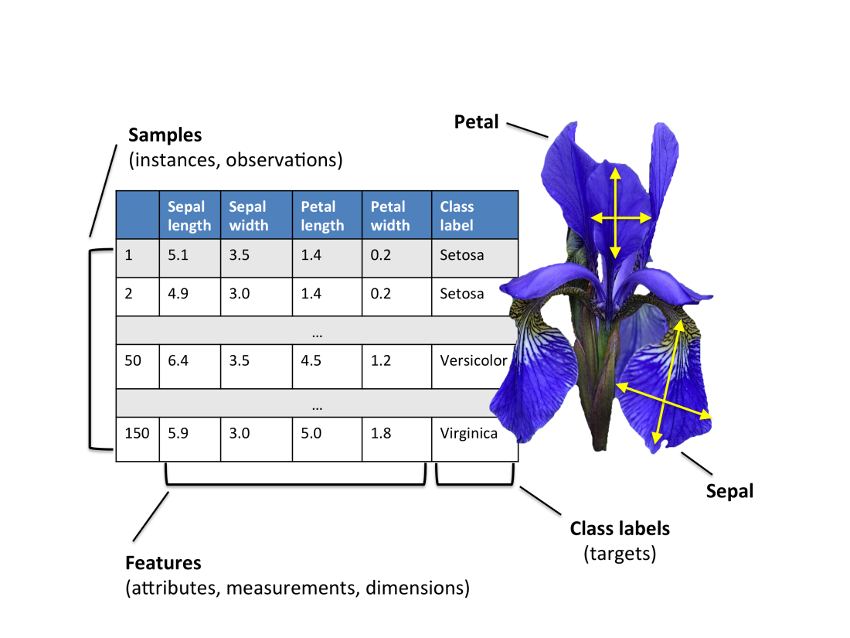
Fisher's Iris classification benchmark
There are 3 classes in the dataset: iris setosa, iris virginica, iris versicolor.
Totally, 150 samples: 50 of each class.
40 samples of each class were allocated for training.
10 samples of each class were allocated for testing.
The accuracy obtained on the Fisher's Iris classification task is 95%, with the deviation range of 5% over the five cross-validation folds.

Slide 8
Conclusion
Spiking neurons with synaptic weights fixed based on logistic maps can transform real-valued vectors of Fisher's Iris preserving their classes. A layer of such neurons could prospectively be used as an encoder within a multi-layer network.

