Slide 1
In situ wind speed nowcasting using data-driven approach.
Viktor Golikov¹, Mikhail Krinitskiy², and Anton Frolov
¹1Moscow Institute of Physics and Technology, Department of Aerophysics and Space Research, Russian Federation
²Shirshov Institute of Oceanology, Russian Academy of Sciences, Moscow, Russian Federation

Slide 2
Motivation
Wind speed forecasting is vital for: wind energy management, sea fishing, wind surfing, daily planning.
Numerical model:
Physic-based forecast
High range and accuracy
Computationally expensive
Neural network model:
Data-based forecast
Low accuracy on high range
Сomputationally efficient
Task is to predict the wind speed module at a point 6 hours ahead.

Slide 3
Data used
GFS parameters in the domain around the point under study. Namely surface pressure, wind speed along latitude and wind speed along longitude
Ground truth is wind speed data from the station located at the point under study
We take data 72 hours before current time and predict wind speed for 6 hours ahead
To increase model accuracy we also use GFS data for 6 hours ahead as a basis for neural model forecast
GFS + station data
GFS
“Falconara” weather station: 43.616342, 13.362319
Domain size +- 10 degrees
T = -72 hours
Time = 0
T = +6 hours

Slide 4
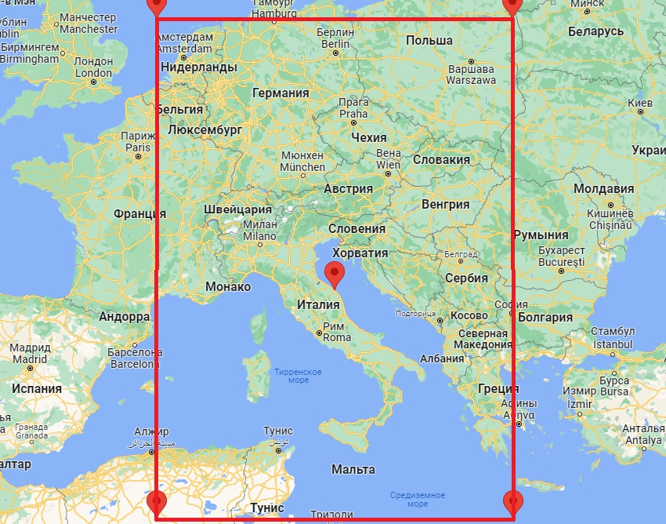
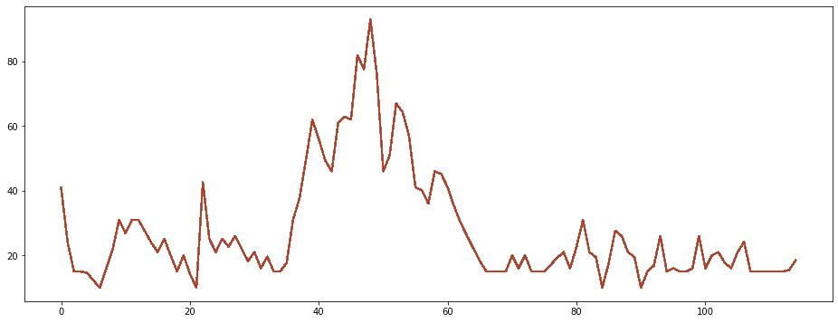
Method
Station data
GFS field
Past
Future
72 x 3 x Domain size
6 x 3 x Domain size
We extract features from 3 channel GFS data as if it is image
Station data and gfs features goes through LSTM neural block
LSTM output and GFS forecast goes through fully connected layer
Output is 6-dim vector – other model forecast adjustment (persistence, GFS or others)
72x 1
ResNet Feature Extractor
Fixed weights
Long short-term memory network
Fully Connected Network
Wind speed prediction

Slide 5
Metrics
To evaluate our network accuracy we propose 2 metrics: weighted-RMSE and category change metric

Slide 6
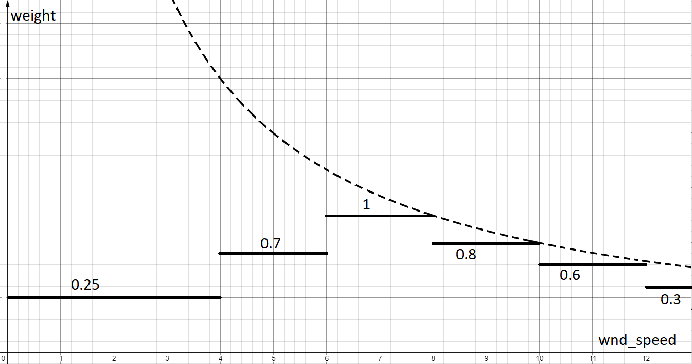
Weighted RMSE
wRMSE $=\sqrt{\frac{{weight∗\sum_{k=0}^{n}{(TrueSpeed−gfsSpeed )}}^{2}}{n}}$

Slide 7
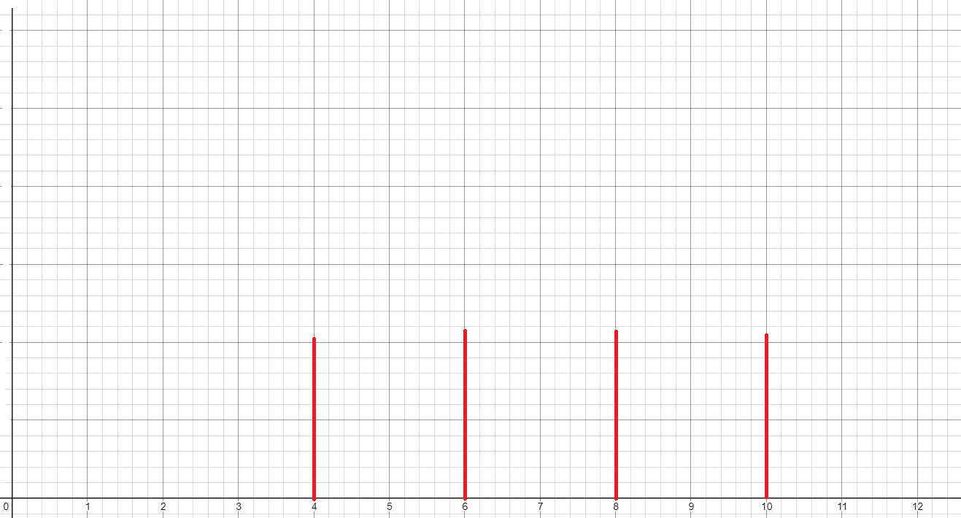
Category Change Metric
Metric $=\overline{|∆C_{pred}−∆C_{true}|}$
$$∆C=С_{t_n}−C_{t_n−1}$$
$$∆C=+2$$
$$∆C=+1$$
$$∆C=−1$$

Slide 8
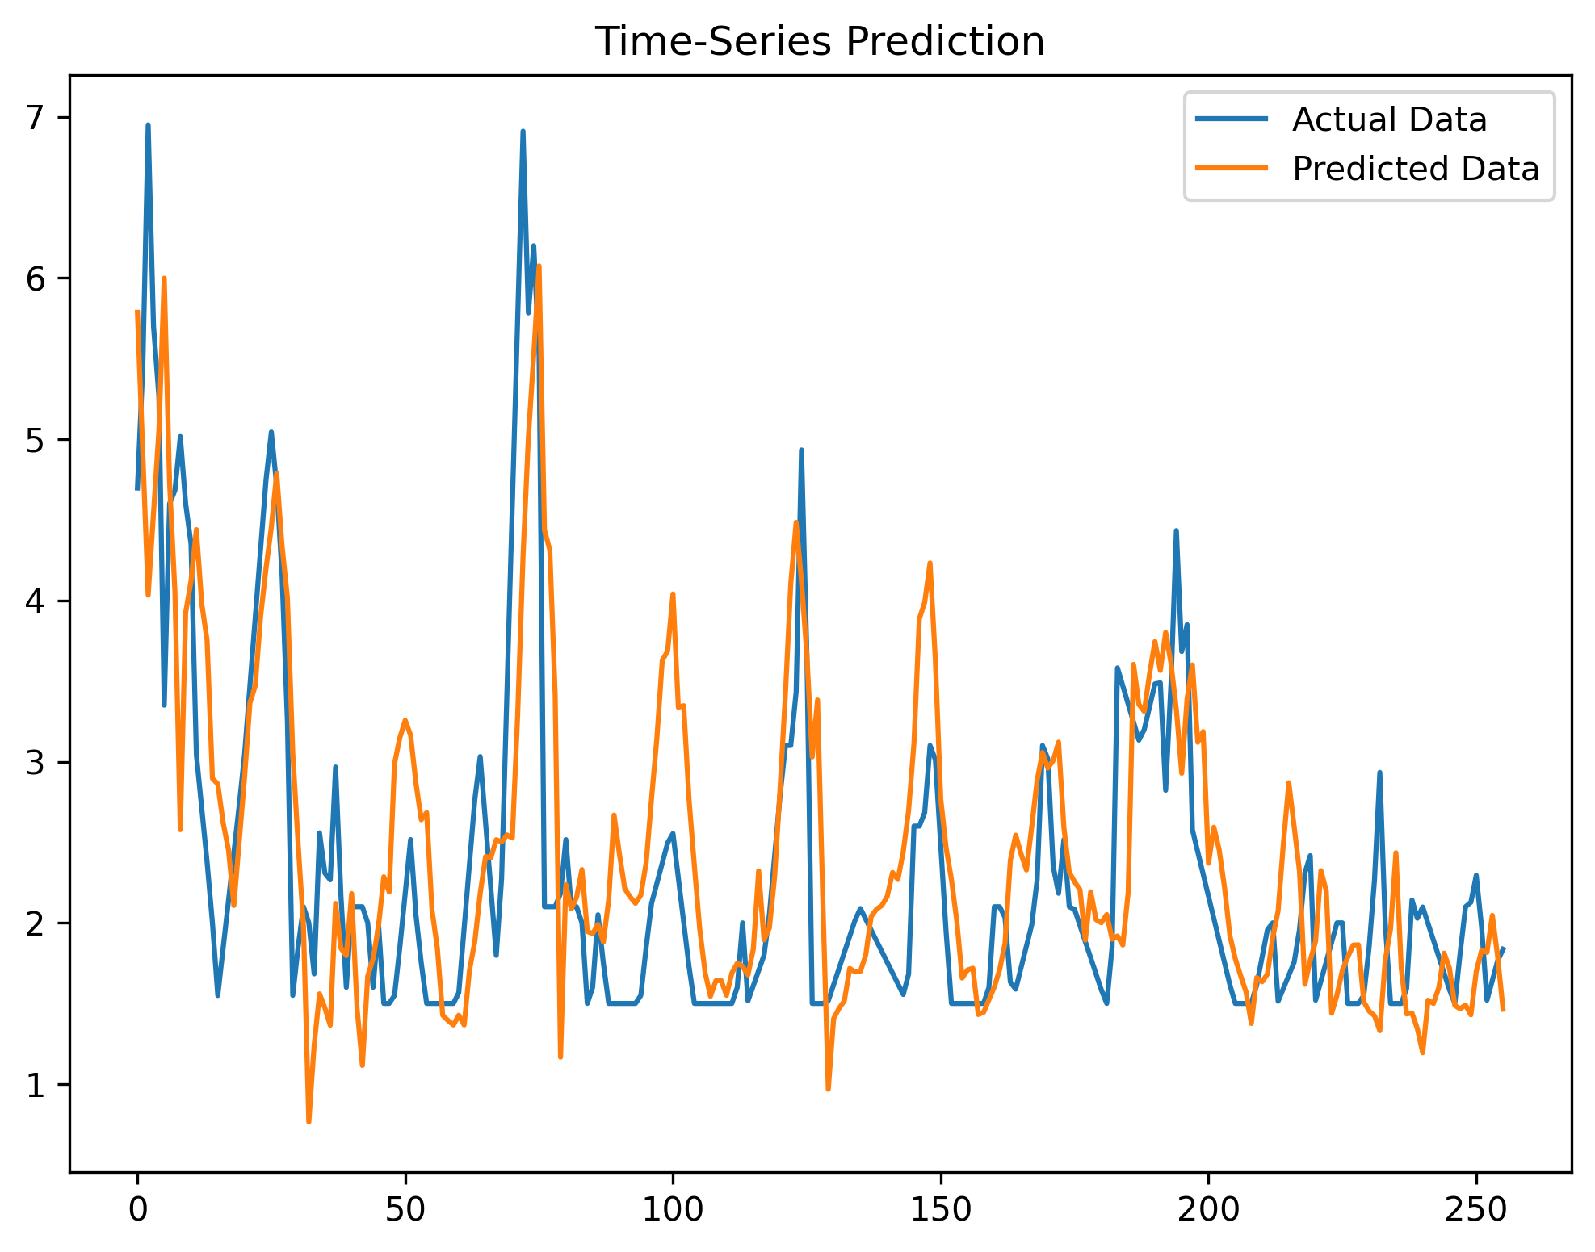
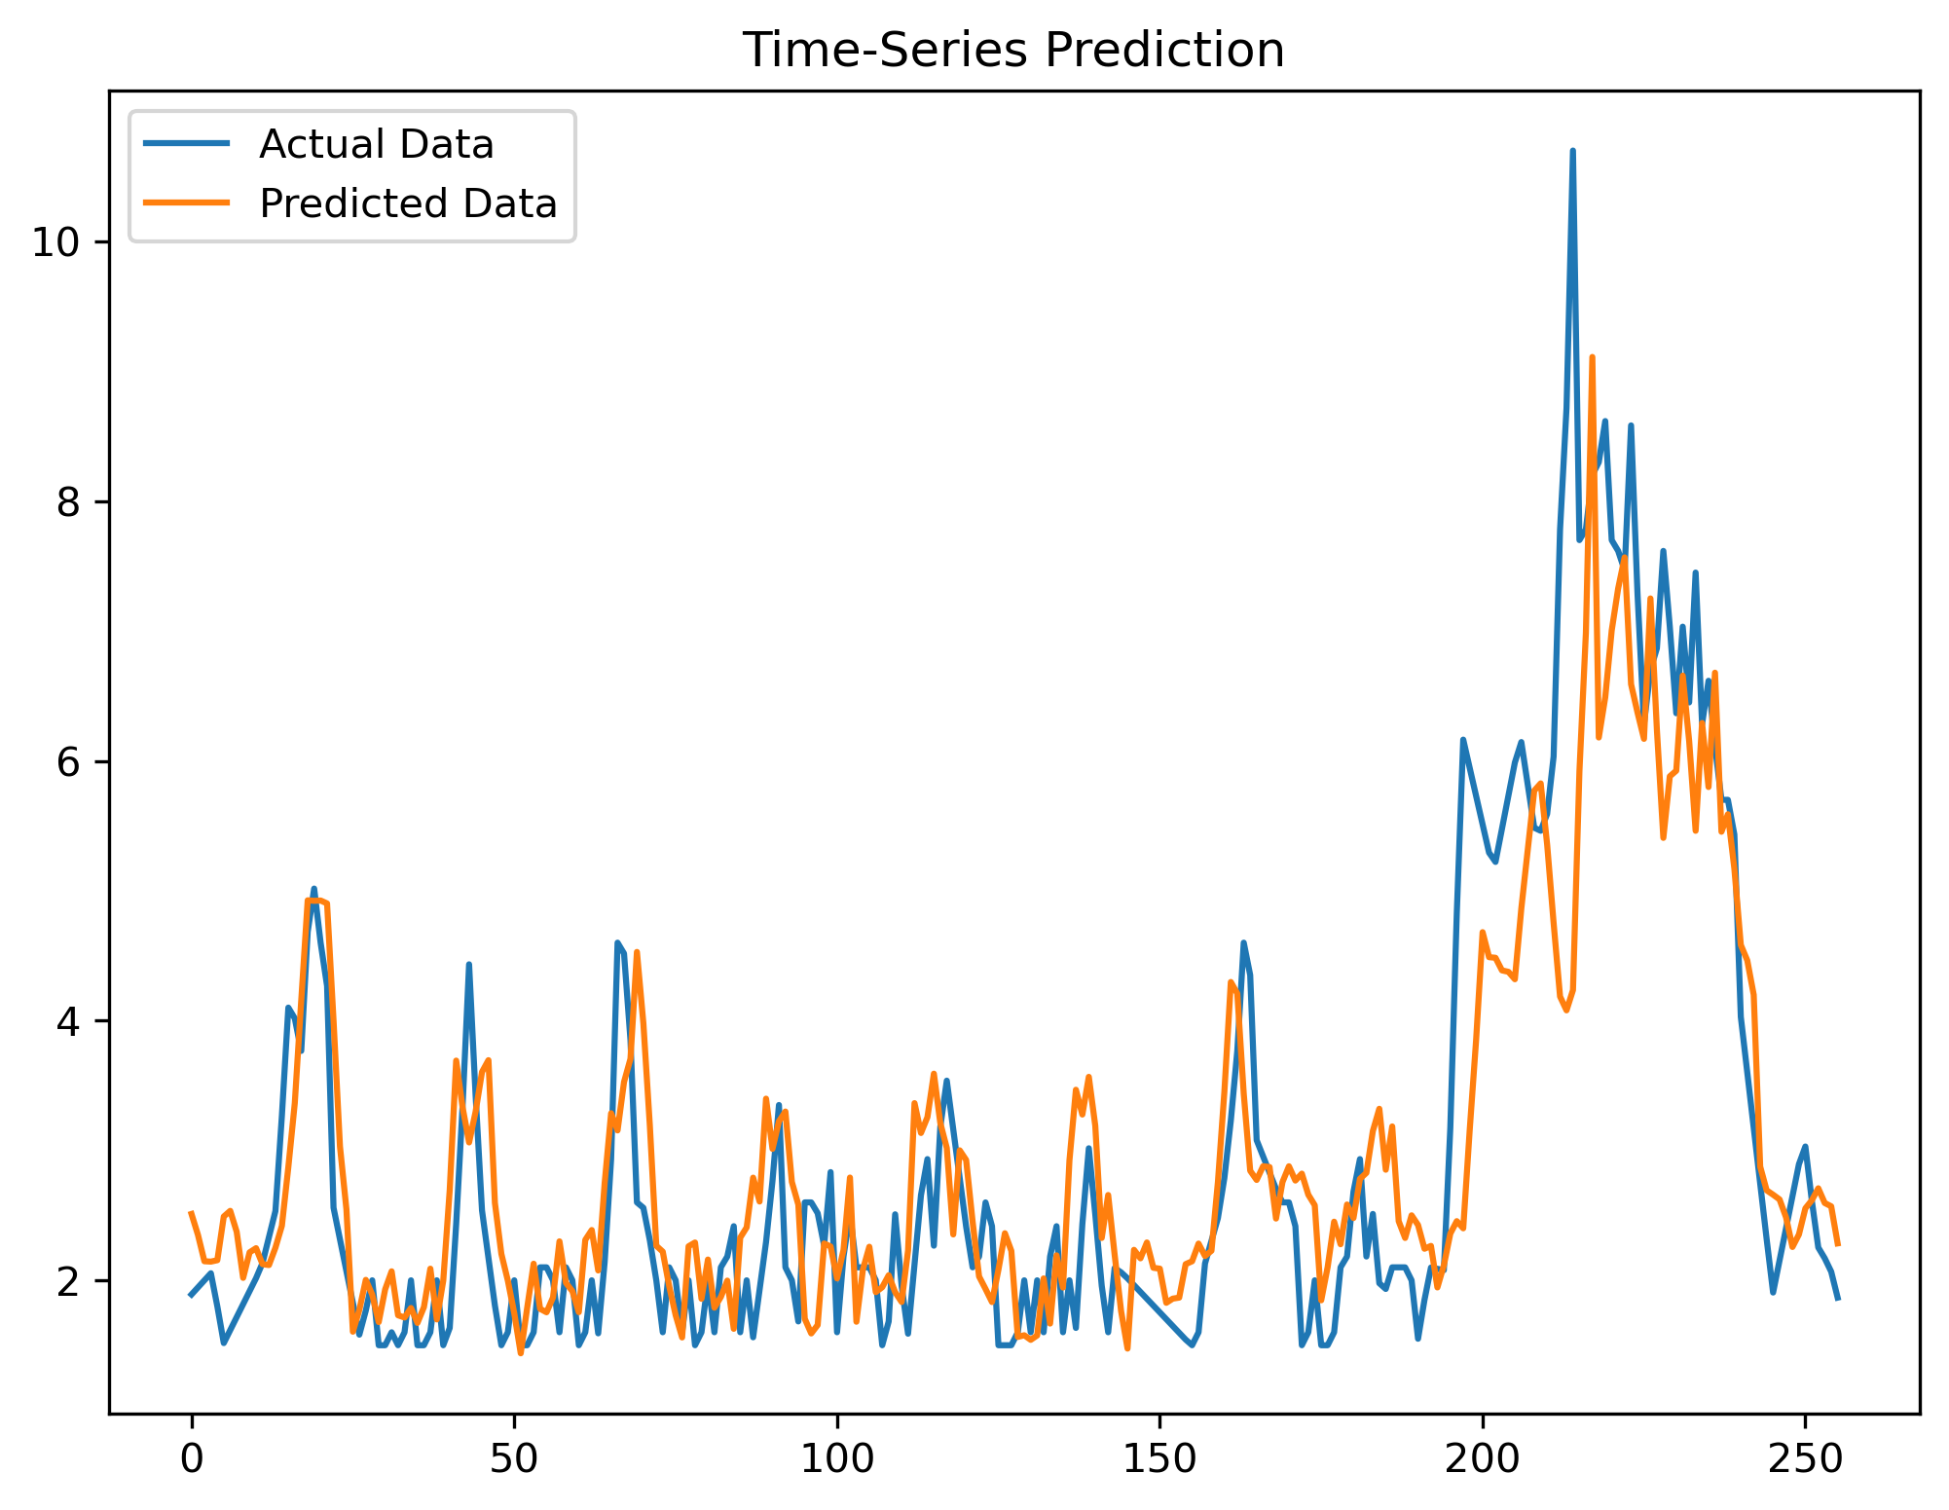
Results
3 hours forecast
Wind speed, m/s
Wind speed, m/s
Time, h
Time, h

Slide 9
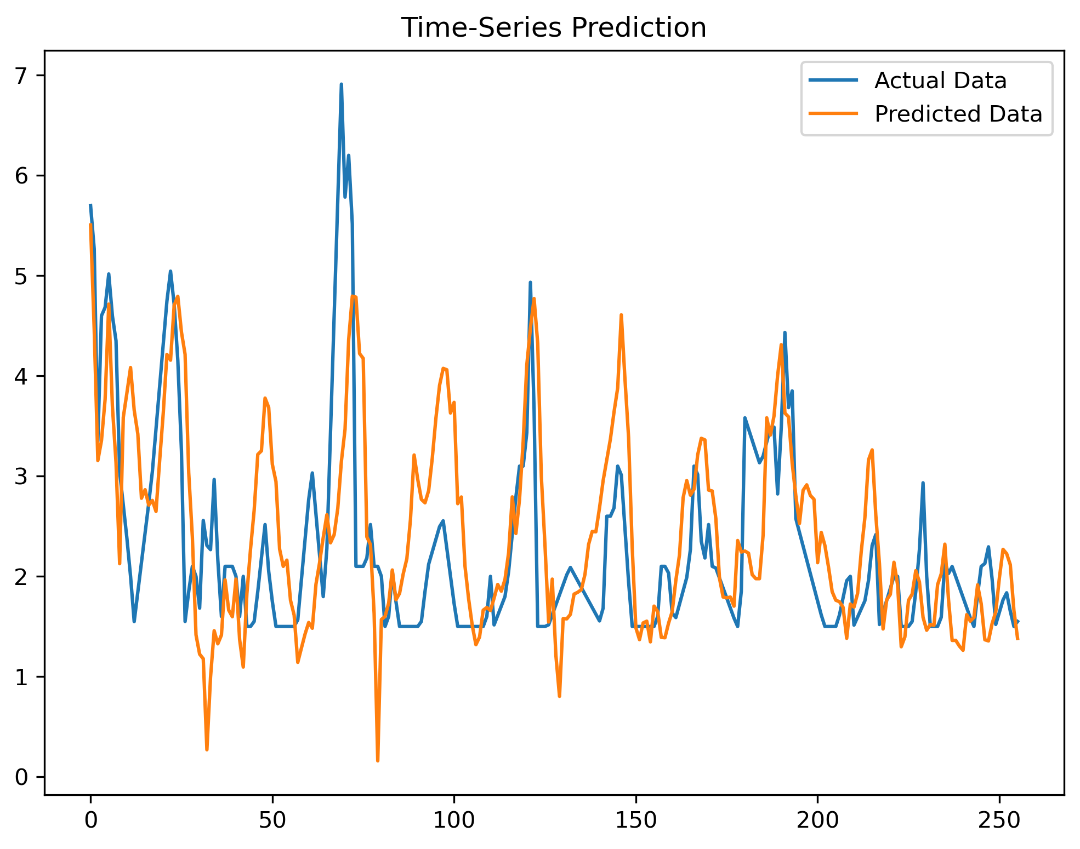
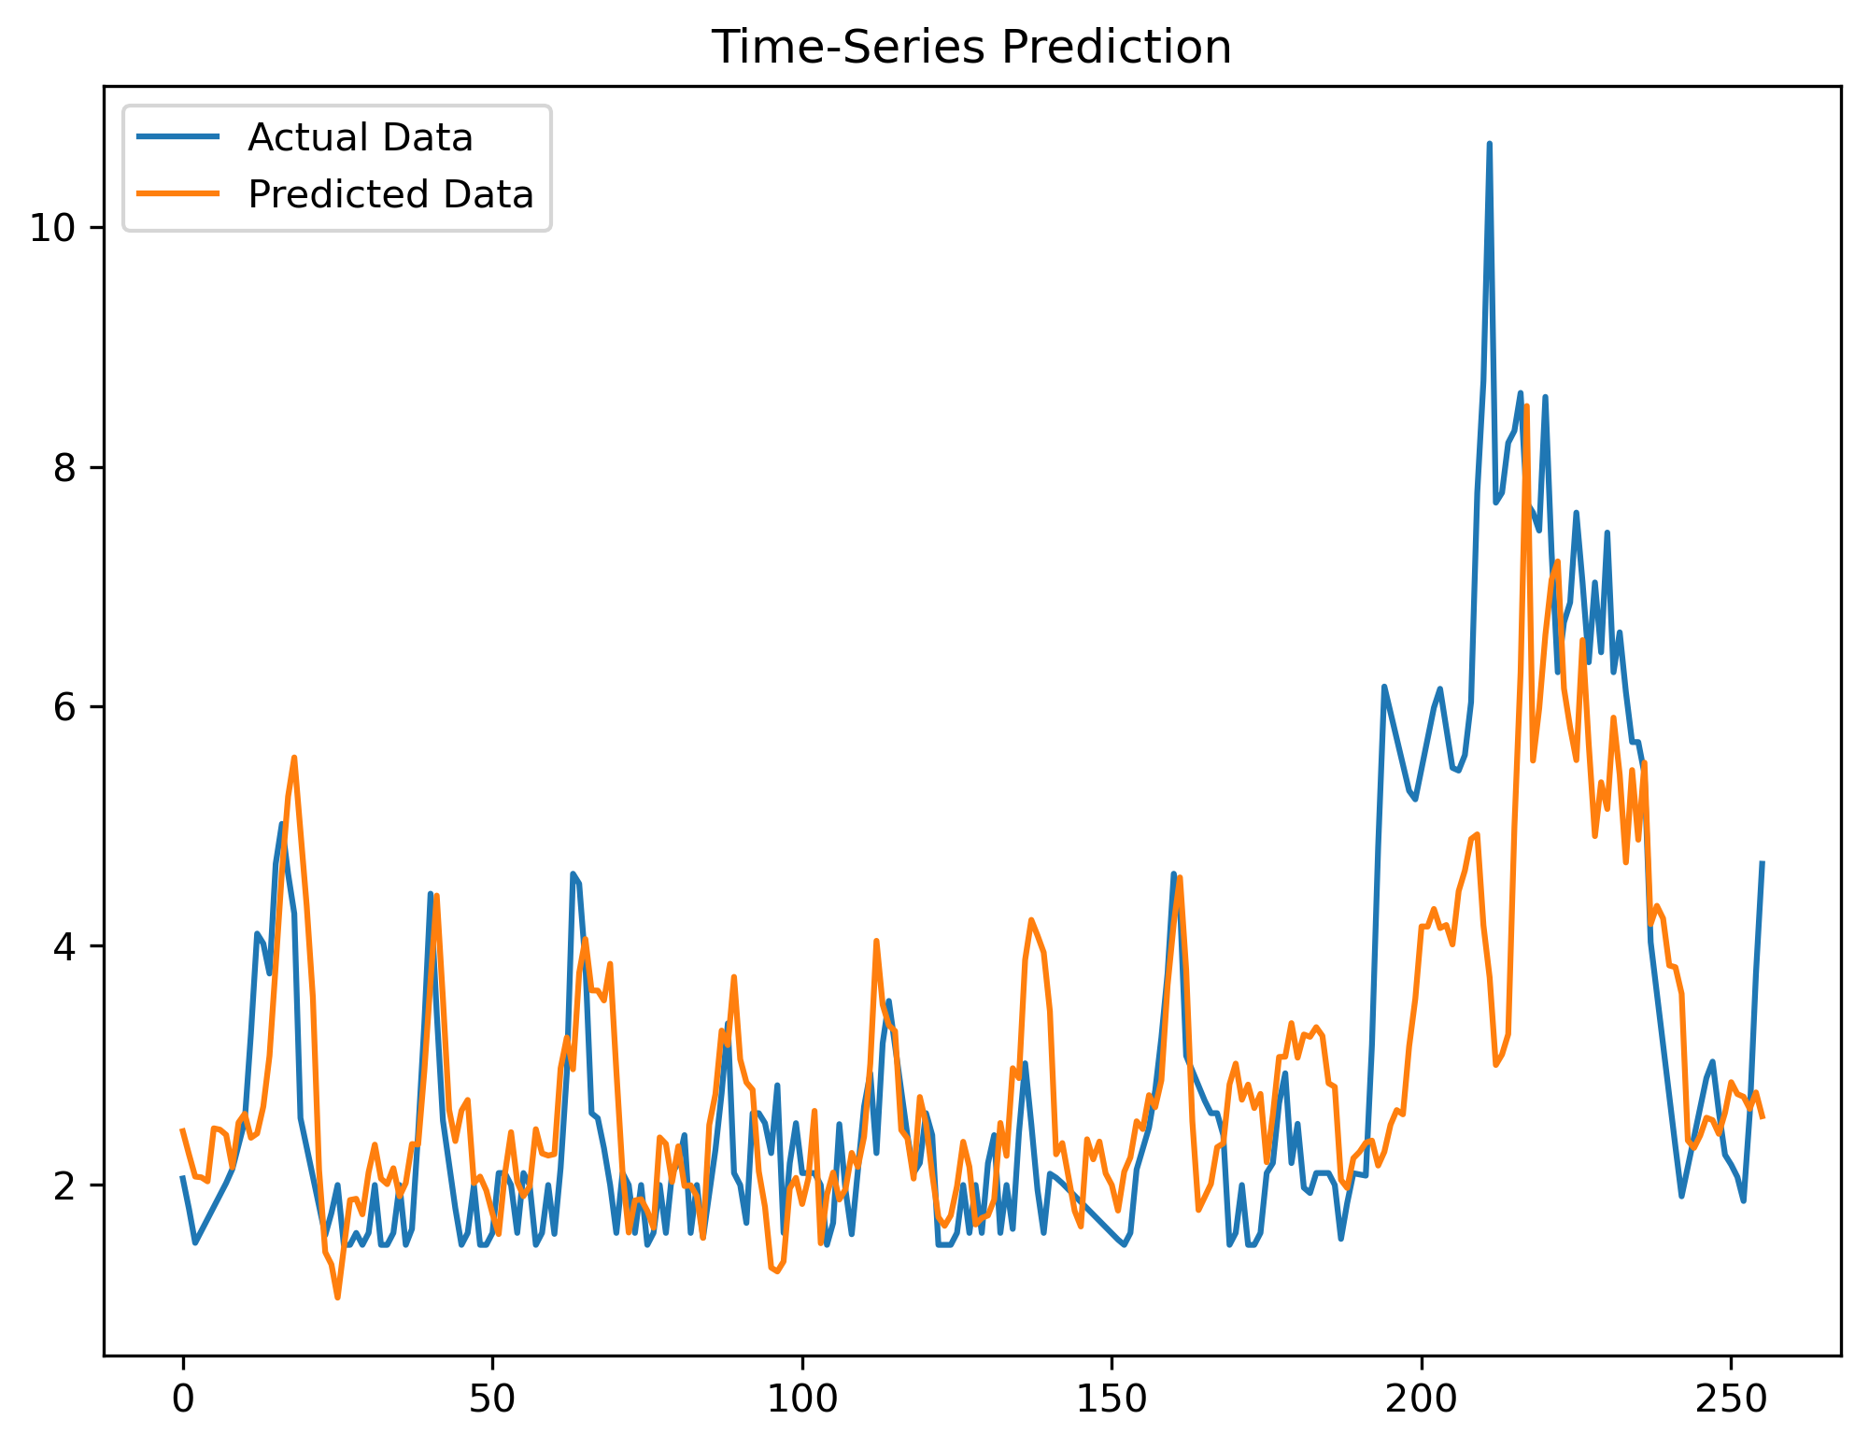
Results
6 hours forecast
Wind speed, m/s
Wind speed, m/s
Time, h
Time, h

Slide 10
Results
Persistence Forecast is a forecast that the current weather condition will persist and that future weather will be the same as the present
LASSO (Least Absolute Shrinkage and Selection Operator) is linear regression variation
wRMSE | +1 h | +2 h | +3 h | +4 h | +5 h | +6 h
Our model | 0,416 | 0,594 | 0,688 | 0,760 | 0,815 | 0,852
Persistence | 0,416 | 0,617 | 0,747 | 0,847 | 0,922 | 0,977
LASSO | - | - | 0,645 | - | - | 0,669
We outperform persistence forecast!
Category change | +1 h | +2 h | +3 h | +4 h | +5 h | +6 h
Our model | 0,178 | 0,197 | 0,199 | 0,199 | 0,192 | 0,193
Persistence | 0,228 | 0,226 | 0,227 | 0,230 | 0,233 | 0,235
LASSO | - | - | 0,325 | - | - | 0,199

