Slide 1
Strip Si-plates simulation with scintillator trigger and
data analysis at MiniSPD
Group № 1
Physics Weekly Meeting
24.05.2022

Slide 2
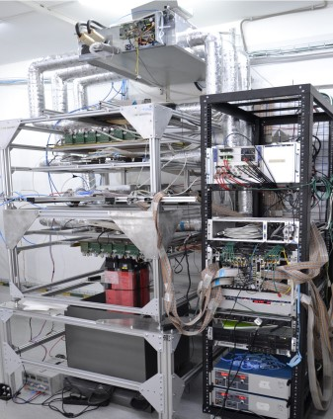
MiniSPD stand

Slide 3
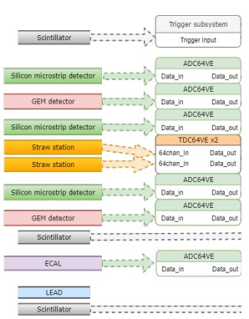
Structure of MiniSPD
Top scintillator
Si
Trigger subsystem consists of
two (top and bottom) scintillators. Top: ScintPos[2] = 3 mm.
Bottom: ScintPos[2] = 931,5 mm.
Si
Si
Bottom scintillator

Slide 4
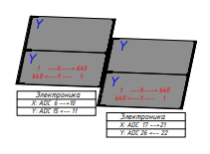
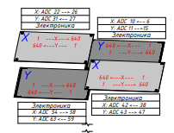
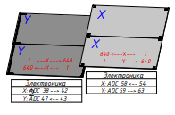
TOP Scint
We pick out events when top and bottom scintillators trigger.
At that one, two or three Si-plates can trigger.
1
2
3
4
5
6
7
8
BOTTOM Scint

Slide 5
Comparison between
Monte-Carlo simulation (50000 events) results
and experimental data
from MiniSPD

Slide 6
Numeration of strips for X and U plates (MC)
X3 | Right -> left | U3 | Left -> right
X4 | Left -> right | U4 | Left -> right
X5 | Left -> right | U5 | Right -> left
X6 | Right -> left | U6 | Left -> right
Numeration of strips for X and U plates (data file)
X3 | Left -> right | U3 | Right -> left
X4 | Right -> left | U4 | Left -> right
X5 | Left -> right | U5 | Right -> left
X6 | Right -> left | U6 | Left -> right

Slide 7
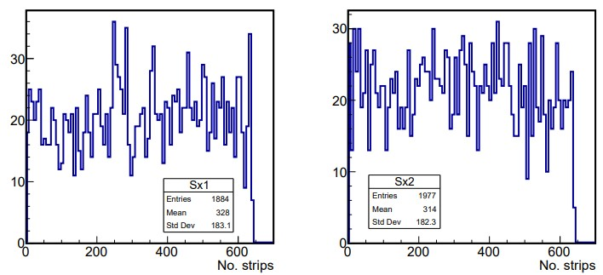
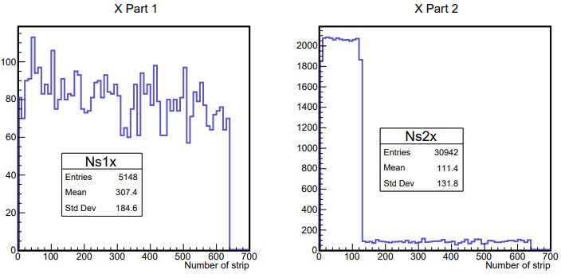
Strip number distributions for X1, X2 plates
Monte-Carlo simulation of 50000 muons (~4000 triggered muons). Operation of two scintillator triggers.
X1 - good agreement
X2 ~ 100 channels
make enhanced noise
Experimental data
(~4000 events)

Slide 8
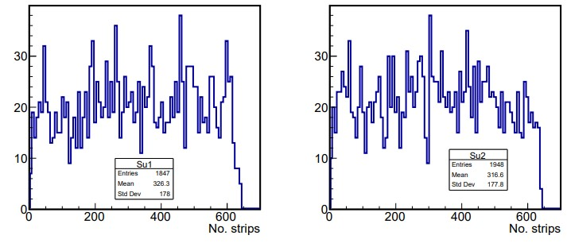
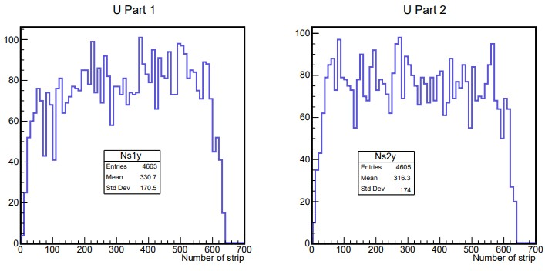
Strip number distributions for U1, U2 plates
Monte-Carlo simulation (50000 muons). Operation of two scintillator triggers.
Almost good agreement
for I-st module
Experimental data
(~4000 events)

Slide 9
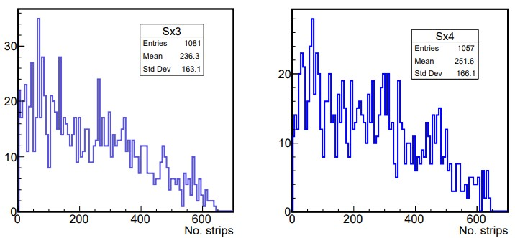
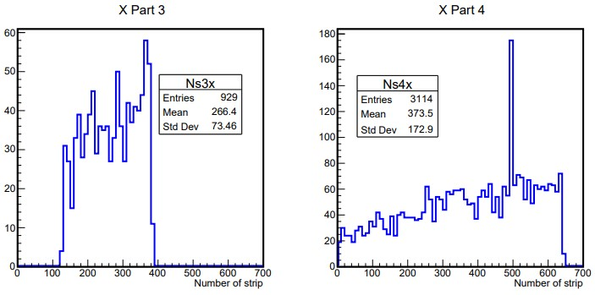
Strip number distributions for X3, X4 plates
Monte-Carlo simulation (50000 muons). Operation of two scintillator triggers.
X3 - ~ half of the strips don’t work
X4 - good agreement, but there’re noise channels
Experimental data
(~4000 events)

Slide 10
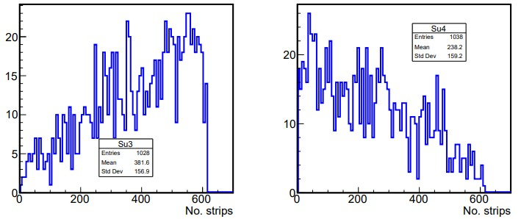
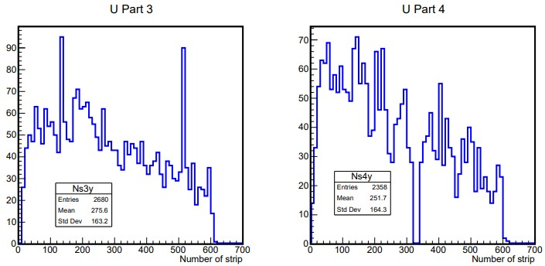
Strip number distributions for U3, U4 plates
Monte-Carlo simulation (50000 muons). Operation of two scintillator triggers.
U3 - noise channels
U4 - broken channels
Experimental data
(~4000 events)

Slide 11
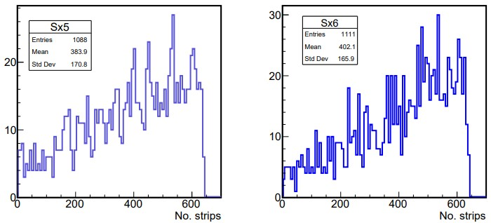
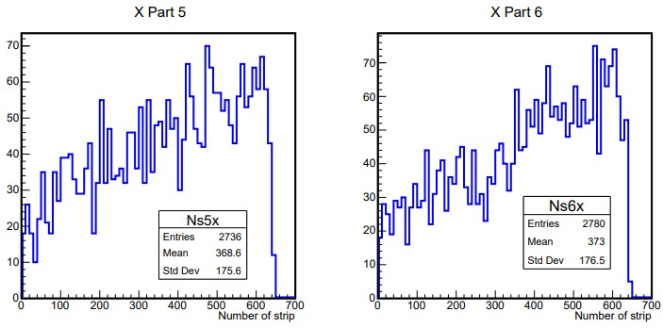
Strip number distributions for X5, X6 plates
Monte-Carlo simulation (50000 muons). Operation of two scintillator triggers.
Good agreement
Experimental data
(~4000 events)

Slide 12
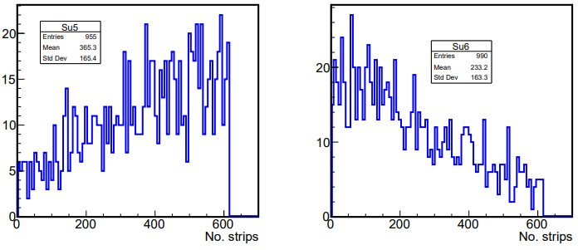
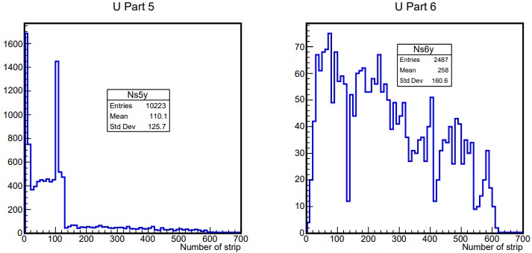
Strip number distributions for U5, U6 plates
Monte-Carlo simulation (50000 muons). Operation of two scintillator triggers.
U5 - ~quarter of channels make noise
U6 - almost agree
Experimental data
(~4000 events)

Slide 13
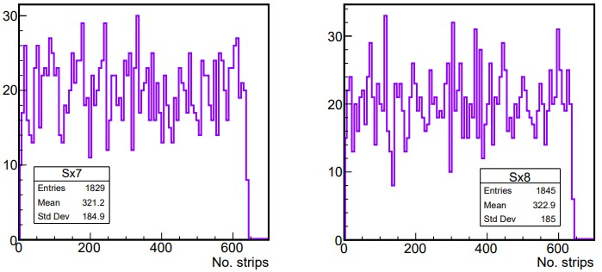
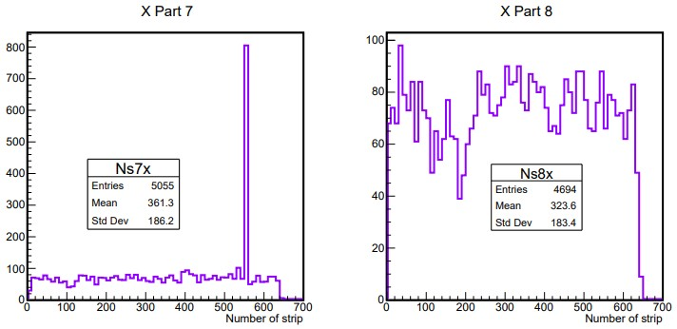
Strip number distributions for X7, X8 plates
Monte-Carlo simulation (50000 muons). Operation of two scintillator triggers.
X7 - there’re noise channels
X8 - almost agree
Experimental data
(~4000 events)

Slide 14
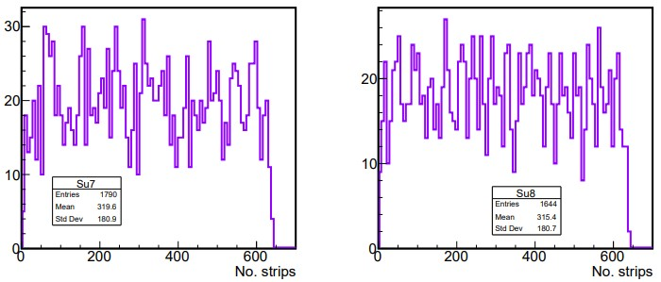
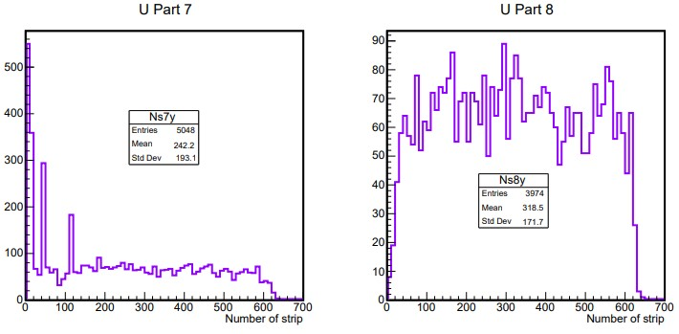
Strip number distributions for U7, U8 plates
Monte-Carlo simulation (50000 muons). Operation of two scintillator triggers.
U7 - almost agree, some noise channels
U8 - almost agree
Experimental data
(~4000 events)

Slide 15
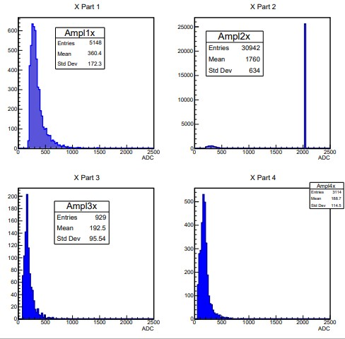
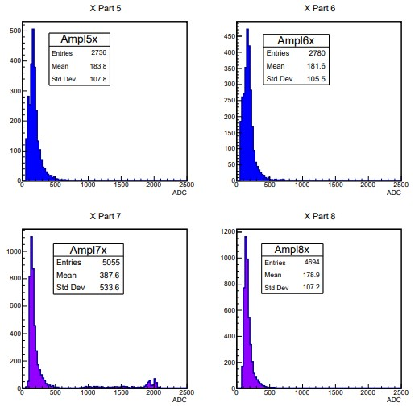
ADC for X-plates ( * - problem with electronics)
*
*
*
*

Slide 16
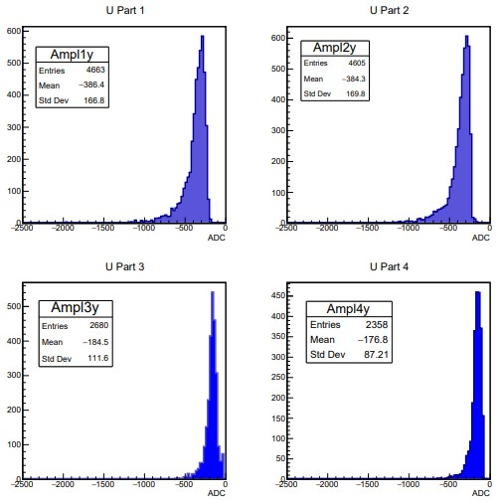
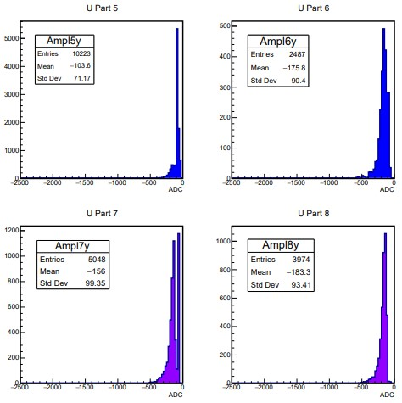
ADC for U-plates ( * - problem with electronics)
*
*
*
*

Slide 17
Set of lower registration threshold of ADC for MC sim.
The average value of ADC ~
the average value of energy deposition in a single strip,
the lower threshold of ADC ~
the lower threshold of energy deposition.
Using good plates (X1, X6, U2, U8) we get E_cut (the lower threshold)
30 keV < E_cut < 60 keV and its average value is equal ~ 55 keV.

