Slide 1

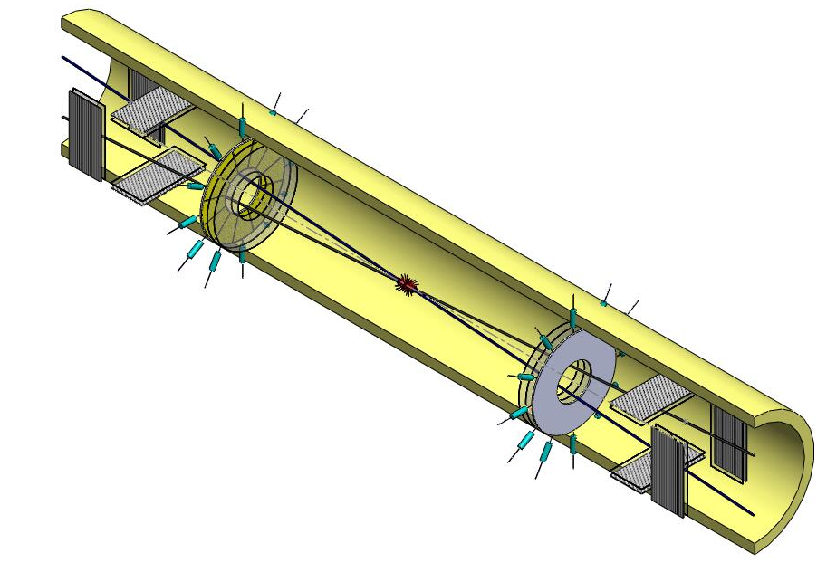



Fast Beam-Beam Collisions Monitor for experiments at NICA
А.Baldin (1), G.Feofilov*(2), K. Galaktionov(2),N.Kalinichenko (2), N.Makarov (2), P.Har’yuzov (1), F.Valiev (2), V.Sandul (2)
(1) JINR and Institute for Advanced Studies "OMEGA", Dubna, RF
(2) V.Fock Institute for Physics, Laboratory of Ultra-High Energy Physics, Saint-Petersburg State University
Reported by G.Feofilov at the MPD Cross-PWG meeting, Tuesday, 31.05.2022
Job was partially supported by the RFBR grant #18-02-40097-mega
Notes:
1

Slide 2

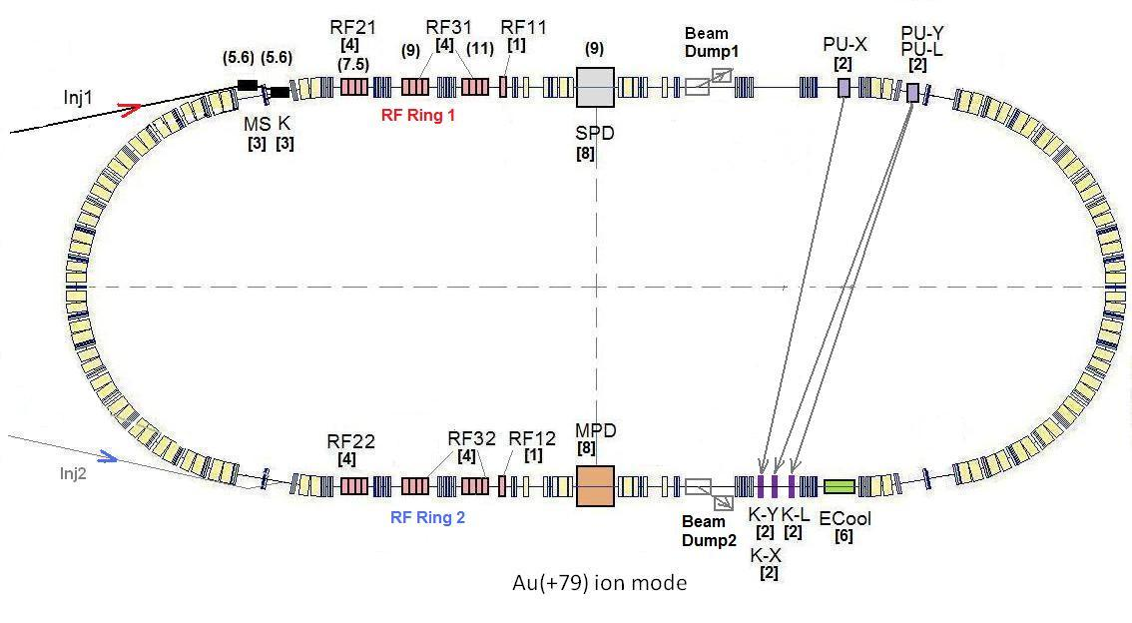
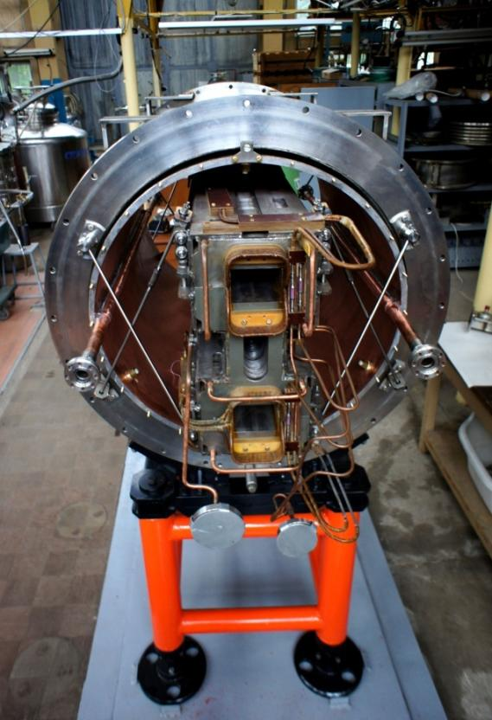
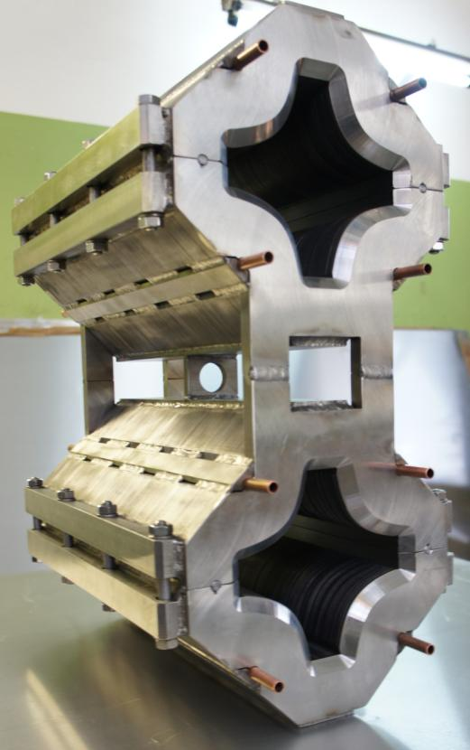
The Collider
45 T*m, 4.5 GeV/u for Au⁷⁹⁺
SPD
Ring circumference, m | 503,04
Number of bunches | 22
r.m.s. bunch length, m | 0,6
β, m | 0,35
max. int. Energy, Gev/u | 11,0
r.m.s. Δp/p, 10-3 | 1,6
IBS growth time, s | 1800
Luminosity, cm⁻² s⁻¹ | 1x10²⁷
MPD
Double aperture magnets:
dipole & quadrupole
prototypes
[1] http://nica.jinr.ru/projects/collider.php
Notes:
The lattice design and prototyping of most collider elements are completed. The ring circumference is twice as one of the Nuclotron. For the gold beam a Luminosity at the energy above 10 GeV per nucleon will be 10 to the 27

Slide 3
Talk Layout
MicroChannel Plate (MCP) for BBC- Conceptual ideas
General requirements to functionality of the beam-beam collisions monitoring at NICA
MCP-based solutions for
Beam Position Monitor (BPM) and
Fast Beam-Beam Collisions counters (FBBC) for NICA
Model simulations
First test results and prototyping
Some plans

Slide 4
General requirements to functionality
of the beam-beam collisions monitoring at NICA
1) To provide the event-by-event measurements of:
  beam location and profile
  3D-beam profile (2 dimensional + time structure)
  luminosity monitoring
2) Additional functionality in determination of:
  the reaction plane
  the multiplicity class relevant to the event centrality in nucleus-nucleus collisions
  of precise collision time –T0
  Location of the Interaction Point (IP)
  Possible application in local polarimetry

Slide 5
Two compact detector systems are proposed to meet the challenges of the fast beam-beam collisions monitoring, event selection and the precise timing determination in proton-proton and nucleus-nucleus collisions at NICA. Beam Position Monitor (BPM or Profilometer) and Fast Beam-Beam Collision (FBBC) monitor are capable to provide the information for each bunch crossing both on the beams location and on the intensity of collisions, as well as on the azimuthal distribution of the particles in the event.
The systems use fast Micro Channel Plate detectors (MCPs). The ultra-high vacuum (UHV) compatibility and low-mass compact design of the BPM and FBBC components allow one to consider their application inside the vacuum beam line of the NICA collider. The BPM is based on the effect of the residual gas ionization and provides high accuracy, fast, bunch-by-bunch measurements of the beam position. The FBBC provides precise (∼ 50ps) timing for the multi-pad readout of short (∼ 1ns) MCP signals, produced by the particles in the collisions of the beams.
Two configurations of MCP setup could be considered :
BBC MCP can be installed either inside the vacuum volume of the beam pipe or
in a special vacuumed box outside the vacuum beam line.

Slide 6
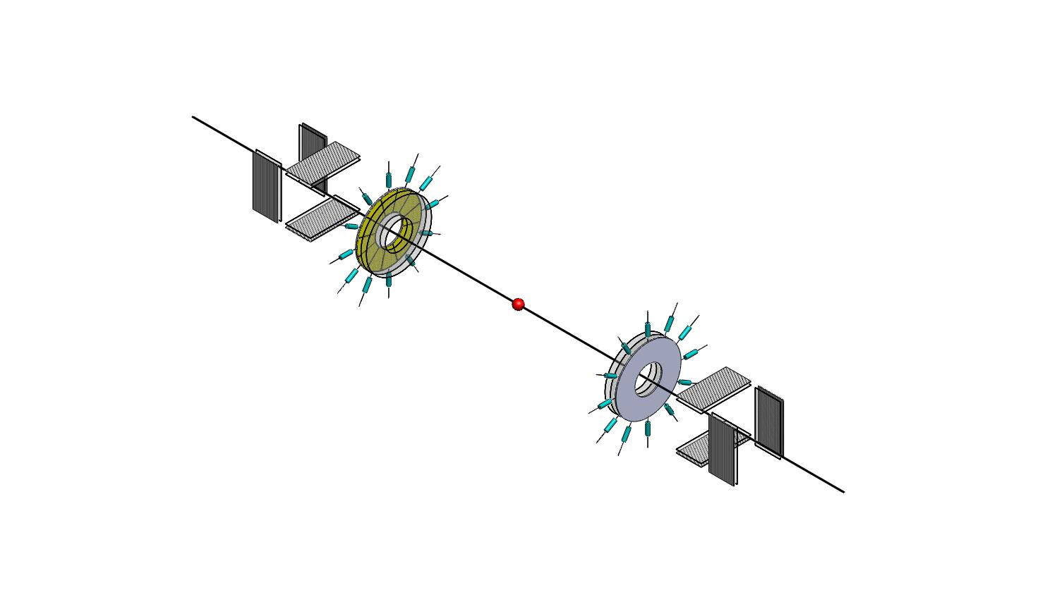
MCP detectors positioned inside the beam pipe
(1) Fast monitoring of the beam position and profile (BPM - Profilometer)
(2) The event-by-event fast monitoring of beam-beam collisions (FBBC)
(FBBC)
(BPM -- Profilometer)
(BPM – Profilometer)
)
Baldin, G. A. Feofilov, P. Har'yuzov, F. F. Valiev
NIMA, 958, 162154, 2019
Reported at the VCI2019
DOI:10.1016/j.nima.2019.04.108..

Slide 7
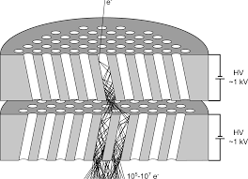
Micro Channel Plates (MCPs) as a MIP detector [1,2]
MCP-active target-converter
MCP-Amplifier
Readout anodes
[1]A.Baldin,G.Feofilov,F.F.Valiev et al.
Microchannel plates as a detector for 800 MeV/c charged pions
and protons. // JINR Rapid Communications. 1991. No 4/50/-91. p.27-36.
[2] A.A.Baldin, G.Feofilov,Yu.Gavrilov, A.Tsvinev,F.Valiev,
Proposals for a new type of microchannel-plate-based vertex detector// NIM A323. 1992. p. 439-444.

Slide 8

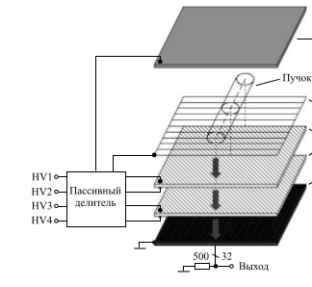
Beam Position Monitor (BPM) [1].
Anode
Gating grid
MCP-1
MCP-2
Strip readout
Beam
[1] A.Baldin, A.Berlev, I.Kudashkin, A.Fedorov, Letters to ECHAIA, 2014, vol.11, №2 (186), p.209-218

Slide 9
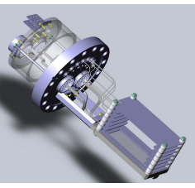
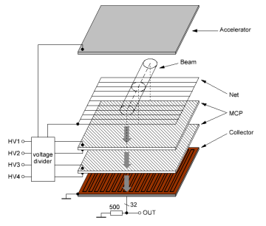
Profilometer
at the NUCLOTRON
The 1st MCP-based device for fast monitoring of the beam profile (BPM) at the NUCLOTRON [1]
[1] A.Baldin, A.Berlev, I.Kudashkin, A.Fedorov, Space-time characteristics of the circulating beams, Letters to ECHAIA, 2014, vol.11, №2 (186), p.209-218

Slide 10

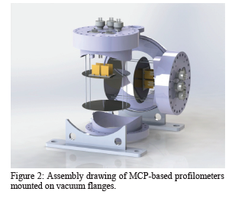
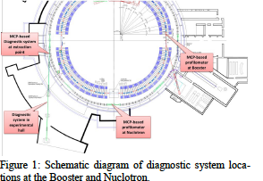
NONDESTRUCTIVE DIAGNOSTICS OF ACCELERATED ION BEAMS
WITH MCP-BASED DETECTORS AT THE ACCELERATOR COMPLEX
NICA. EXPERIMENTAL RESULTS AND PROSPECTS
A. A. Baldin, V. I. Astakhov, A. V. Beloborodov, D. N. Bogoslovsky, A. N. Fedorov,
P. R. Kharyuzov, A. P. Kharyuzova, D. S. Korovkin, A. B. Safonov, Joint Institute for Nuclear Research, Dubna, Russia
27th Russian Particle Acc. Conf. RuPAC2021, Alushta, Russia JACoW Publishing
ISBN: 978-3-95450-240-0 ISSN: 2673-5539 doi:10.18429/JACoW-RuPAC2021-WED05

Slide 11
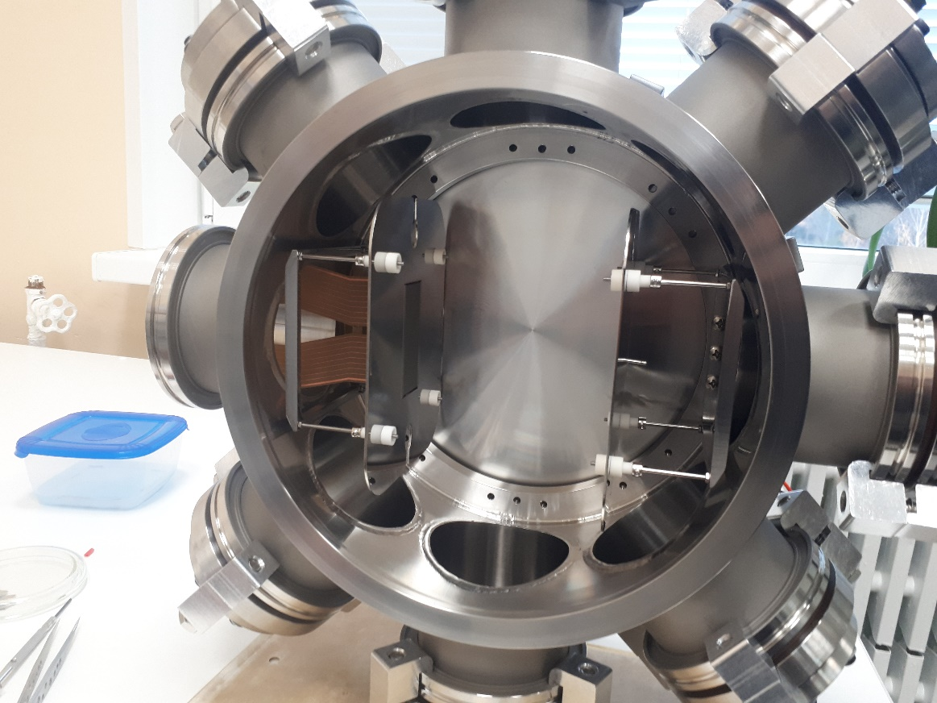
Profilometer
The question of high vacuum compatibility of MCP based detectors was answered positively during the latest Booster and Nuclotron run in January, 2022. The two-coordinate profilometer based on MCPs was used to monitor the time evolution of the circulating C beam profile and intensity.
Photo of the profilometer mounted in a high vacuum chamber.
The profilometer proved capable of operating in ultrahigh vacuum of the beam line and provide information on the circulating beam during the whole cycle from injection into the Booster to transmission into Nuclotron, thus proving that all the applied materials and technologies are appropriate for manufacturing detectors for the NICA collider.

Slide 12

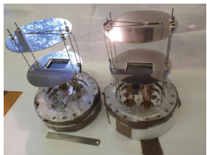
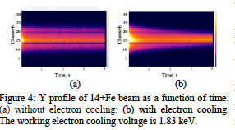
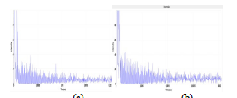
Figure 8: 14+Fe beam intensity as a function of time im-
mediately after injection in run 2 of the Booster: (a) along X (horizontal); (b) along Y (vertical).
NONDESTRUCTIVE DIAGNOSTICS OF ACCELERATED ION BEAMS
WITH MCP-BASED DETECTORS AT THE ACCELERATOR COMPLEX
NICA. EXPERIMENTAL RESULTS AND PROSPECTS
A. A. Baldin, V. I. Astakhov, A. V. Beloborodov, D. N. Bogoslovsky, A. N. Fedorov,
P. R. Kharyuzov, A. P. Kharyuzova, D. S. Korovkin, A. B. Safonov, Joint Institute for Nuclear Research, Dubna, Russia
27th Russian Particle Acc. Conf. RuPAC2021, Alushta, Russia JACoW Publishing
ISBN: 978-3-95450-240-0 ISSN: 2673-5539 doi:10.18429/JACoW-RuPAC2021-WED05

Slide 13

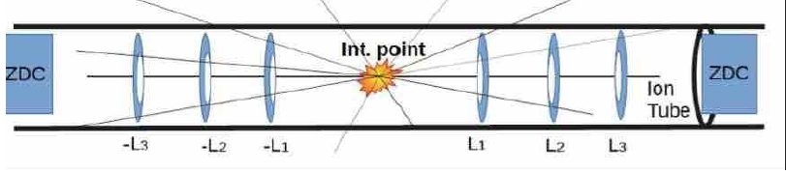
Modeling of microchannel plate (MCP) arrays with a multi-anode system for a beam-beam collisions monitor/T0 detector using the QGSM, SMASH, UrQMD generators and the GEANT package.
Figure. 3.2. The concept of the compact fast collision detector FBBC on
ring MCPs with segmented multi-anode systems. [Report 21.10.2020 at the conference “RFBR Grants for NICA”, G. Feofilov et al., “Investigation of initial states and development of methods for their analysis in proton and nucleus collisions at energies of NICA collider “]

Slide 14
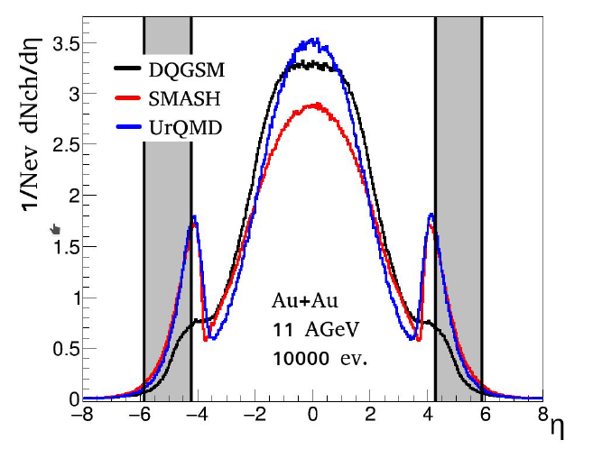

Slide 15
Fig.40. Conceptual diagram of FBBC with 6 ring MCP detectors[6]
(BPM -- Profilometer)
FBBC rings
(BPM -- Profilometer)
1- beam collision point,
2-FBBC
3-beam profile detector (BPM -- Profilometer)

Slide 16
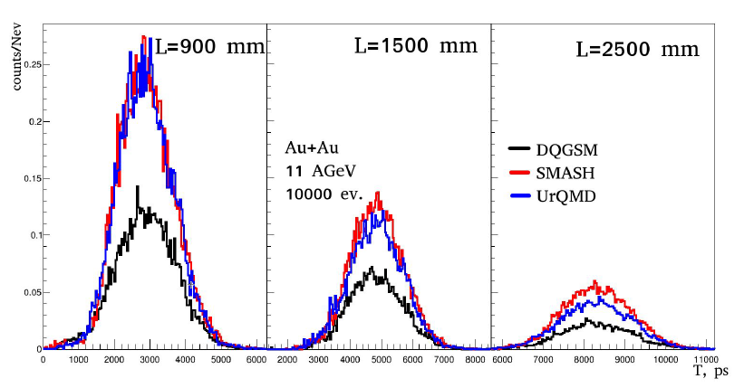
Fig.18. Histograms of arrival time distributions T of charged particles at MCP_detectors placed at different distances from the setup center (90 cm, 150 cm and 250 cm)

Slide 17
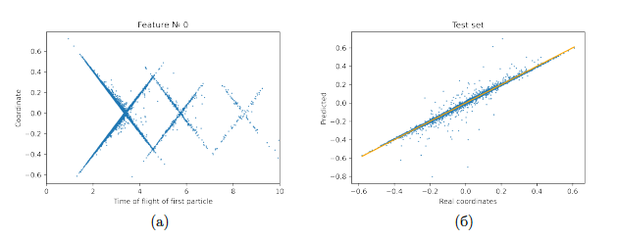
Fig. 14: Dependence of the predicted coordinates of the collision on the true coordinate (orange diagonal - ideal case). (a) All registered particles, (b) Only the first particles from each detector [1]
If we evaluate only the first particles from each of the six detectors used, managed to improve the accuracy to sigma =9.4mm
[1] K.A. Galaktionov, "Application of machine learning methods for direct extraction of the impact parameter in high-energy collisions», Batchelor Diploma. Saint-Petersburg State University, May 2022.

Slide 18
Model simulations
An important part of experiment preparation at NICA SPD is the development of an adequate software for event reconstruction and analysis.
The possibility of application of MCP-based FBBC for determination of the coordinate Z (ion interaction point in the given event) by the difference of the times of flight of particles from the symmetrically situated MCP detectors was studied numerically.
The Monte Carlo event generator DQGSM was used. 1 million events of Au+Au collisions at √s=11 GeV were simulated. A special library FBBClib was applied. The efficiency of charged particle registration by MCP was taken equal to 90%, the time tagging precision was 50 ps. The Z coordinate of a vertex event was reconstructed using machine learning, in particular neural networks and the algorithm of gradient boosting on decision trees XGBoost.
Learning samples included the following parameters: average times of particles arrival at separate MCPs, time of the first particle arrival at separate MCPs, multiplicity of charged particles, ratios of multiplicities at separate MCPs and the total event multiplicity. The neural network included 6 layers: the input layer, the normalization layer, three inner layers with the number of neurons equal to the number of parameters, one summing inner layer, and an output layer. The maximum decision tree depth in XGBoost was equal to 6. All possible detection configurations were considered with an ideal time resolution (σ = 0 ps) and a realistic time resolution (σ = 50 ps and 100 ps).
The numerical study showed that the root mean square deviation of event vertex coordinate is on a level of 7 mm and the maximum RMS does not exceed 12 mm even for MCP time resolution σ = 100 ps.

Slide 19
Application of neural networks for event-wise evaluation of the impact parameter
K.Galaktionov, V. Roudnev, F. Valiev
(St. Petersburg State University)
(Paper was submitted to PEPAN)
Evaluation of the impact parameter in a single event is crucial for correct and efficient data processing in collision-based nuclear and particle physics experiments. Real-time estimates of the impact parameter allows experimentalists to preselect the most informative events at the data acquisition stage, before any processing. The presented computational experiments prove application of neural network techniques for direct impact parameter evaluation useful for future experimental setups.

Slide 20
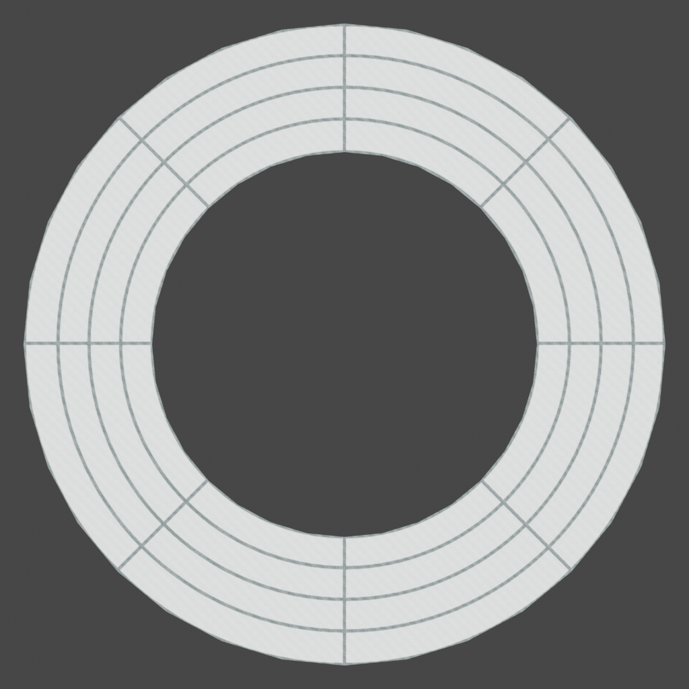
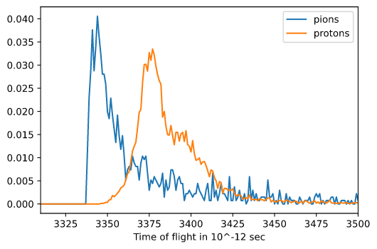
Application of neural networks for event-wise evaluation of the impact parameter
Fig.15.
(a)Segmentation according to angle and radius of ring MCP detector.
(b)Timing information obtained from detectors.

Slide 21
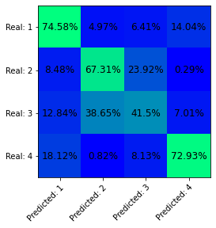
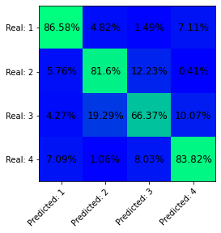
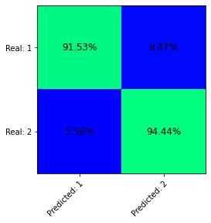
Application of neural networks for event-wise evaluation of the impact parameter
Рис.16. Матрицы ошибок: (а) - для сбора детектора в виде трех пар колец с учетом времени прилета, (б) - для сбора детектора в виде трех пар колец с учетом разниц времени прилета пионов и протонов.
Рис._17. Матрица _ошибок._ _Матрица _ошибок _для _бинарного _классификатора _с _границей _между _классами _в _7_ _ферми._

Slide 22
Impact parameter.
The application of neural networks for the event-wise estimation of the impact parameter from the data obtained from the MCP-based FBBC was tried out numerically. Au+Au collisions at √s=11 GeV were simulated using QGSM event generator. The simulated data set was divided into the reference and test samples with a ratio of 80/20. The reference sample was used to determination of the weights in the artificial neural network to match the given parameters in the best way. Then the network parameters were fixed and it was applied to processing the test sample. The obtained error matrix provided information on the network operation efficiency.
On the whole, the general accuracy of correct event identification in a certain class (part of the detector) was about 80%. Taking into account that average times of pion and proton arrival are close, an additional possibility of distinguishing between these types of particles would increase the network efficiency. It should also be noted that this approach proved quite efficient for separation between events with large and small impact parameters, demonstrating the highest error in the intermediate interval of impact parameters. For small impact parameters, which are of most interest in collision experiments, an additional binary classifier was constructed. This increased the accuracy of the network operation to 93%.
Thus, it is possible to use the developed numerical tools for processing experimental data from MCP-based BBC detector at SPD in order to select central collisions both on-line and in post-processing.

Slide 23
Testing in-lab
Microchannel plates circular plates with diameters of 18 mm and 25 mm.
MCPs were manufactured by VTC “Baspik” (Vladikavkaz, Russia)
Chevron MCP setups.

Slide 25
FBBC developments
Fig.20. Photograph of three MCP detectors in a chevron assembly
Fig.21. Pulse shape from MCP detector.
The voltage at the MCP assembly is 1.8 kV. The anode area is 0.25 cm2.
Signal edge <1 nsec, amplitude 300 mV

Slide 26
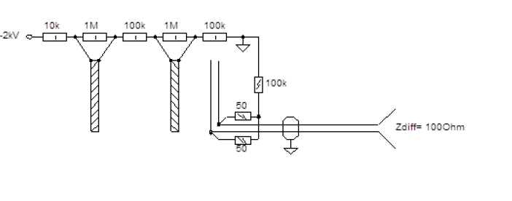
FBBC developments: electronics
A differential matched scheme is selected as a result of testing of the MCP detectors with different readout
systems.
This choice is associated with a lower sensitivity
to pickups up of the UHF noise signals by the fast readout electronics.

Slide 27
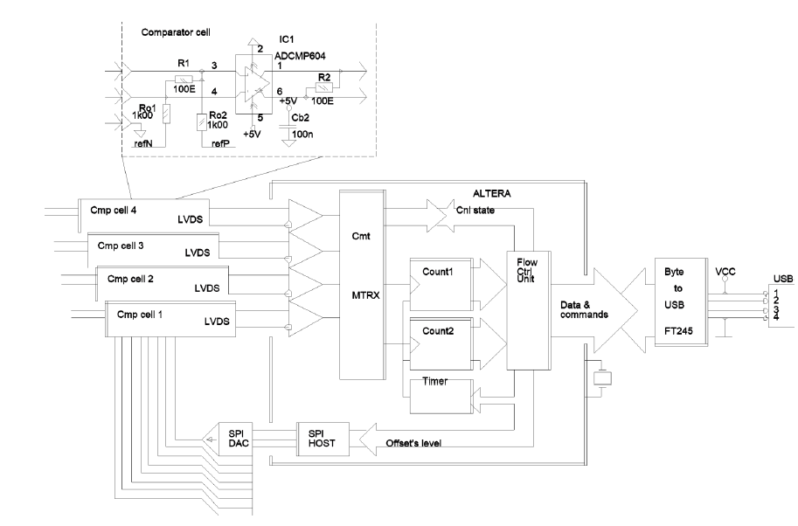
FBBC developments: electronics
Fig. 26. Block diagram of fast electronics and detailed diagram of one registration channel
We propose to develop a next prototype of a registration system basing on high-speed discrete comparators of the ADCMP572 / ADCMP573 type as primary recorders in a multichannel time-code converter based on the FPGA. These ADCMP572 / ADCMP573 type comparators feature a high switching rates (35 ps) with jitter of the order of 15 ps with a minimum signal duration of 85 ps.
Work is in progress.

Slide 28
FBBC developments:
first prototypes of electronics
Fig.29. Four-channel electronics module on discrete comparators with differential inputs for timing measurements.
Fig.34. Photo of the device of the two-channel fast electronics module based on discrete comparators. Work is in progress.

Slide 29
Conclusions-1
Two compact systems based on MCPs are proposed for the fast beam-beam collisions monitoring, event selection and determination of the precise timing signal (T0) of the collisions, We propose to use the MCP-based Beam Profilometer and the Fast Beam-Beam Collisions counters (FBBC) as devices potentially capable to extend the performance and the physics outreach of experiments at NICA.
This includes the event-by-event measurements of:
  Beam-beam IP location in z-coordinate
  3D-beam profile (2 dimensional + time structure)
  Luminosity
  Reaction plane
  Event centrality class in A-A collisions
  Precise timing signal (T0) of the collisions
  Beam-gas events suppression

Slide 30
Conclusions-2
We evaluated the effectiveness of the conceptual design of the proposed FBBC system using Monte Carlo simulation based on event generators SMASH, LAQGSM and UrQMD
We show the possibility of increasing the acceptance of the SPD setup up to 6 units of pseudorapidity by using several MCP-based ring detectors located inside the beam pipe of the NICA collider. This also provides an extension of the possibilities for physical measurements.
The Beam Profilometer was succesfully tested at the NUCLOTRON beams,
At the end of December 2020, the first test of a prototype multi-anode detector of the MCP system, made in the design of ultrahigh vacuum, was carried out on the line of the circulating helium ion beam of the NICA collider booster
Another test of a prototype was done during the latest Booster and Nuclotron run in January, 2022.

Slide 31
Conclusions-3
The technology for ultra-high vacuum (UHV) design of MCP detectors was tested. It allows the application of the MCP detectors inside the vacuum beam line.
The first prototypes were prepared in the UHV and UHF design. The in-lab and in-beam tests show subnanosecond MCP signal rise time (<800 ps)
We produced, using modern high-speed discrete comparators, the prototype of a multichannel fast electronics module for time reference to signals from MCP detectors
We proposed to develop a next prototype of a registration system basing on high-speed discrete comparators of the ADCMP572 / ADCMP573 type as primary recorders in a multichannel time-code converter based on the FPGA. These ADCMP572 / ADCMP573 type comparators feature a high switching rates (~35 ps) with jitter of the order of 15 ps with a minimum signal duration of 85 ps.
We applied the machine learning method using event-by-event information from MCP detectors in our studies of event-by-event selection of the primary collision vertex and for the fast selection of collision centrality class. We show the method to be feasible for the bunch-by-bunch crossing analysis at NICA.

Slide 32
BACK-UP SLIDES

Slide 33
Micro Channel Plates (MCPs)
as a MIP detector
[1]A.Baldin,G.Feofilov,F.F.Valiev et al. ,”Microchannel plates as a detector for 800 MeV/c charged pions and protons.” // JINR Rapid Communications. 1991. No 4/50/-91. p.27-36.
[2] A.A.Baldin, G.Feofilov,Yu.Gavrilov, A.Tsvinev,F.Valiev, “Proposals for a new type of microchannel-plate-based vertex detector”, // NIM A323. 1992. p. 439-444.
…
[3]V.Bondila, L.Efimov D.Hatzifotiadou, G.Feofilov, V.Kondratiev, V.Lyapin, J.Nysten, P.Otiougova, T.A.Tulina, W.H.Trzaska, F.Tsimbal, L.Vinogradov, C.Williams, Results of in-beam tests of an MCP-based vacuum sector prototype of the T0/centrality detector for ALICE, NIM A, Volume 478, Issues 1–2, 1 February 2002, Pages 220-224.
…
[4] G. Feofilov, V. Kondratev, O. Stolyarov, T. Tulina, F. Valiev, and L. Vinogradov, Development and Tests of MCP Based Timing and Multiplicity Detector for MIPs, ISSN 1547-4771, Physics of Particles and Nuclei Letters, 2017, Vol. 14, No. 1, pp. 150–159. © Pleiades Publishing, Ltd., 2017.
…
[5] A. Baldin, G. A. Feofilov, P. Har'yuzov, F. F. Valiev
NIMA, 958, 162154, 2019, Reported at the VCI2019
DOI:10.1016/j.nima.2019.04.108
...
[6] NONDESTRUCTIVE DIAGNOSTICS OF ACCELERATED ION BEAMS
WITH MCP-BASED DETECTORS AT THE ACCELERATOR COMPLEX
NICA. EXPERIMENTAL RESULTS AND PROSPECTS
A. A. Baldin, V. I. Astakhov, A. V. Beloborodov, D. N. Bogoslovsky, A. N. Fedorov,
P. R. Kharyuzov, A. P. Kharyuzova, D. S. Korovkin, A. B. Safonov, Joint Institute for Nuclear Research, Dubna, Russia
27th Russian Particle Acc. Conf. RuPAC2021, Alushta, Russia JACoW Publishing
ISBN: 978-3-95450-240-0 ISSN: 2673-5539 doi:10.18429/JACoW-RuPAC2021-WED05

Slide 34
In 2021 : The loading characteristics were studied in a range from single pulses to 5∙10⁶ particles/cm² s. Thus, the possibility of application of detectors of this type for BBC SPD was demonstrated.

Slide 35
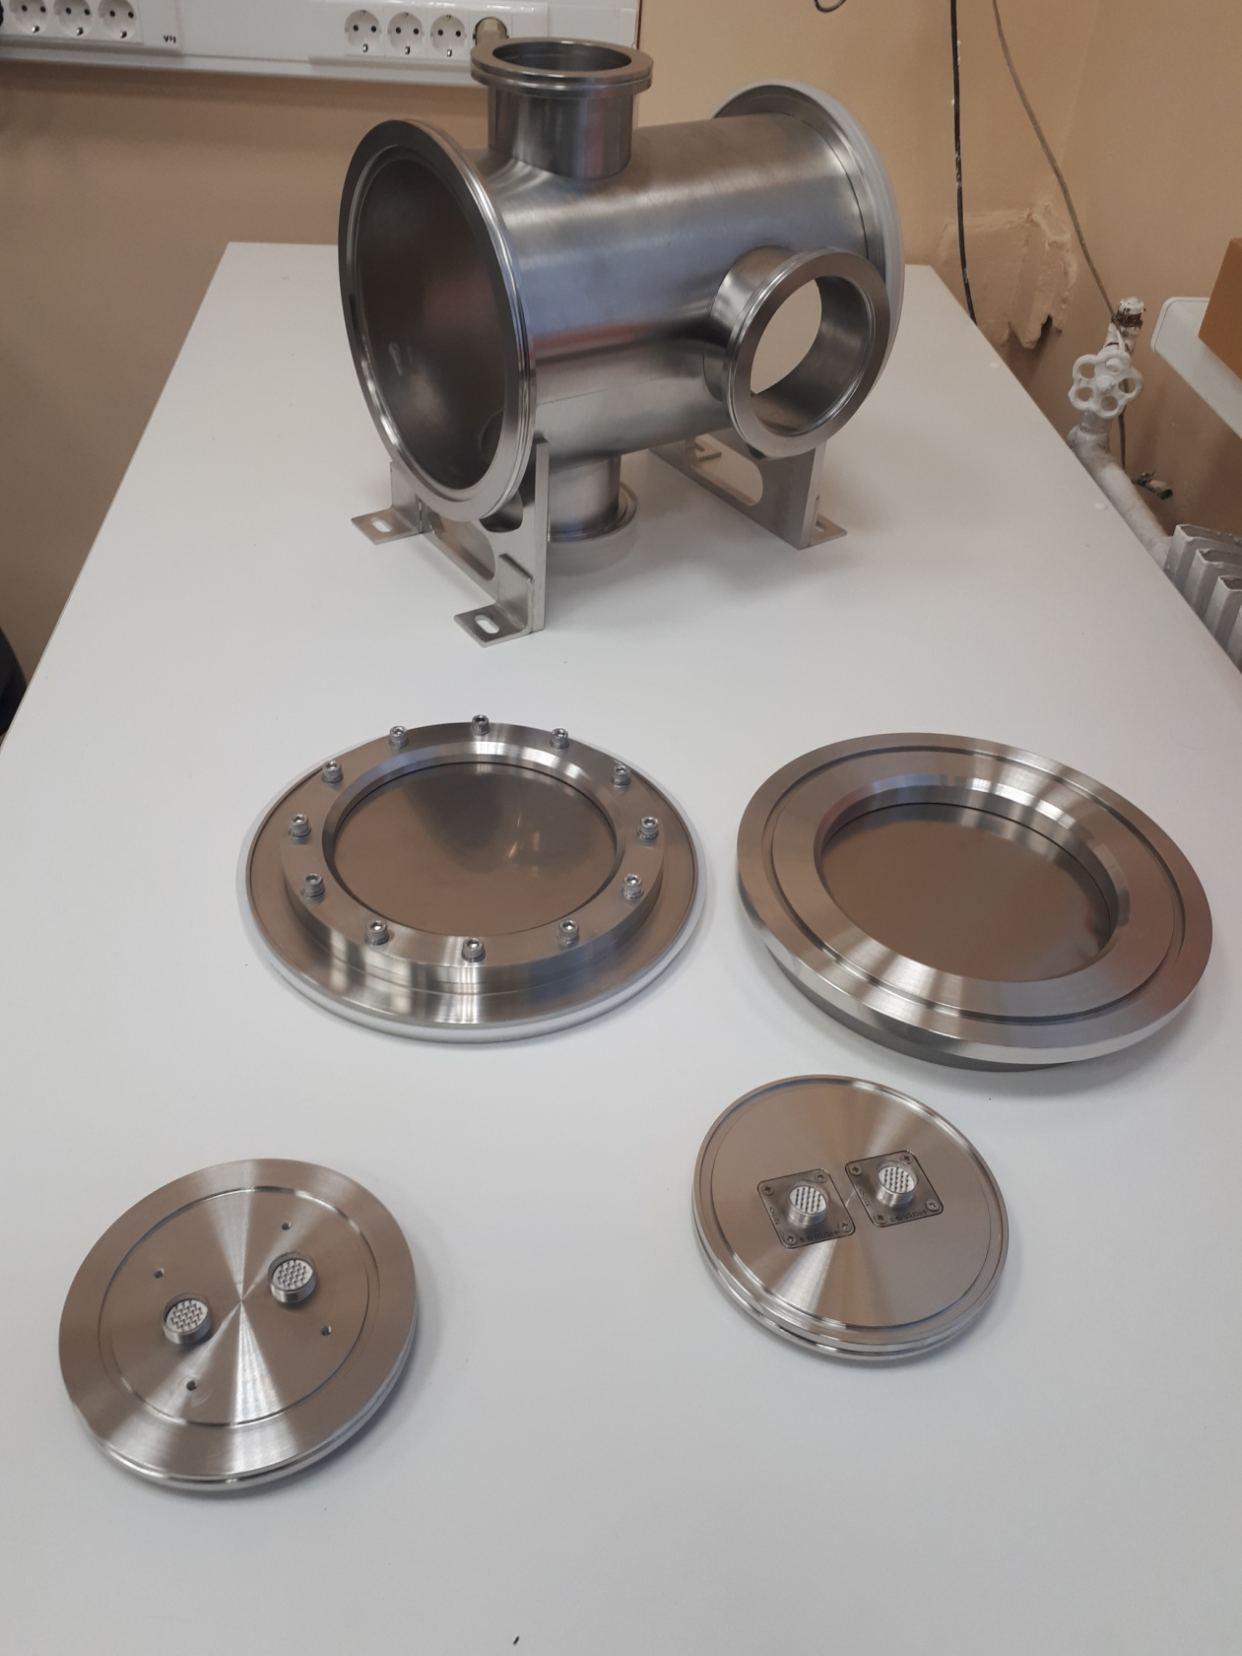
A specialized portable vacuum chamber with thin (50 mkm) Ti windows was manufactured for investigation of particle registration efficiency by chevron MCPs in the case of particles with minimum ionizing power; two independent prototypes of MCP detectors can be installed in this vacuum chamber. It is planned to perform full-scale testing of registration efficiency, time resolution, and loading characteristics of such detectors at extracted beams of Nuclotron and electron beams of the linear accelerator LINAC-200 (LNP JINR).
Figure
shows the photo of the specialized vacuum chamber and its flanges.

Slide 37
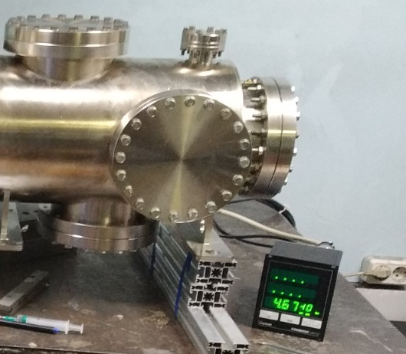
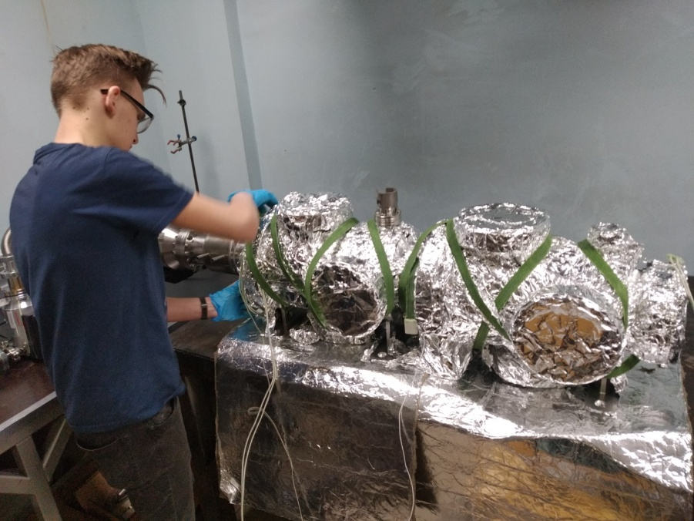
Вакуумные испытания камеры с прогревом.
Достигнут вакуум 5*10⁻¹⁰ Торр

Slide 38
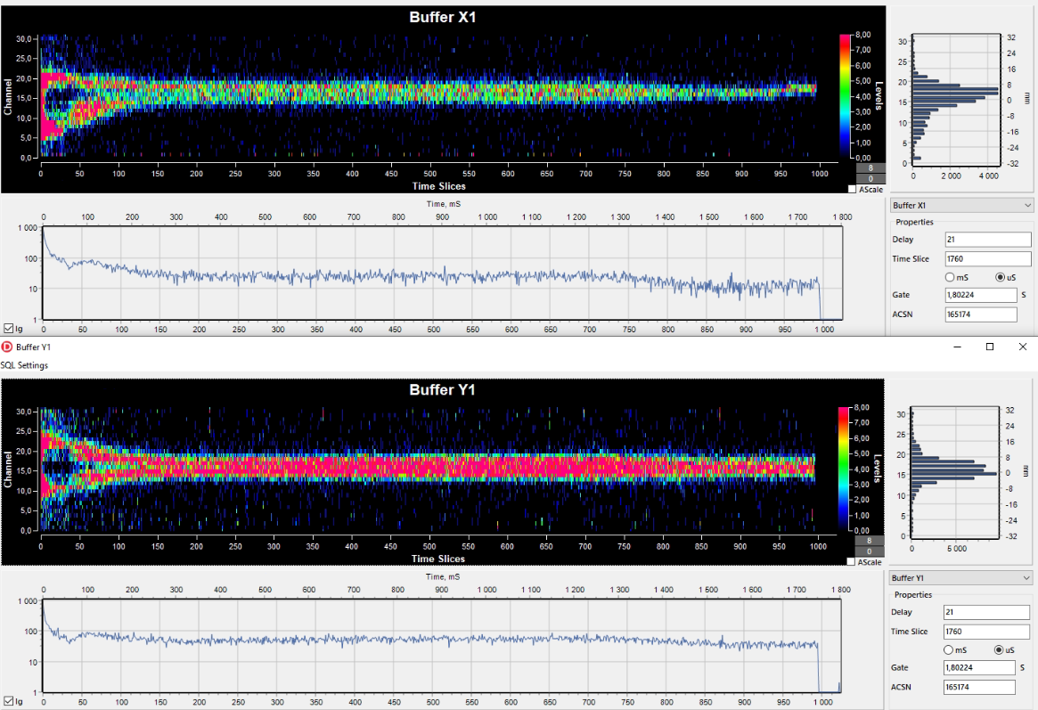
Figure 8 shows an example of C beam acceleration in the Booster from injection to transmission into Nuclotron (a total time of about 1.5 s).
Rice. Fig. 17. Horizontal (x) and vertical (y) beam profile versus time, measured with an MCP XY profilometer installed in the booster UHV beamline.

Slide 39
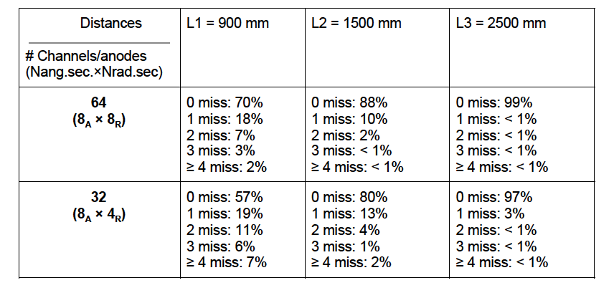
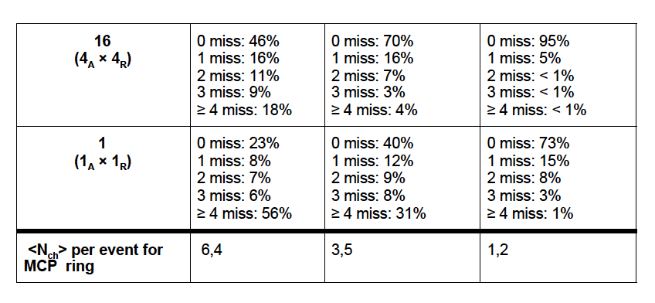

Slide 40
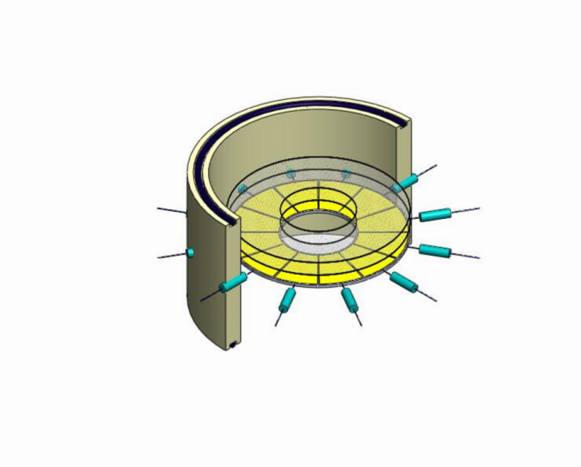
FBBC developments
Figure : Compact module of the Fast Beam-Beam Collision Monitor (FBBC) based on the circular MCPs. Sector cathode readout pads and two MCP set-ups are embedded into a separate flange with hermetic 50 Ohm signal feedthroughs
and
HV feedthroughs (the last ones are not shown).

