Slide 1

























Concept of the next
JINR 7-year Plan (2024-2030).
acad. Grigory V.Trubnikov
04 July 2022, SPb

Slide 2
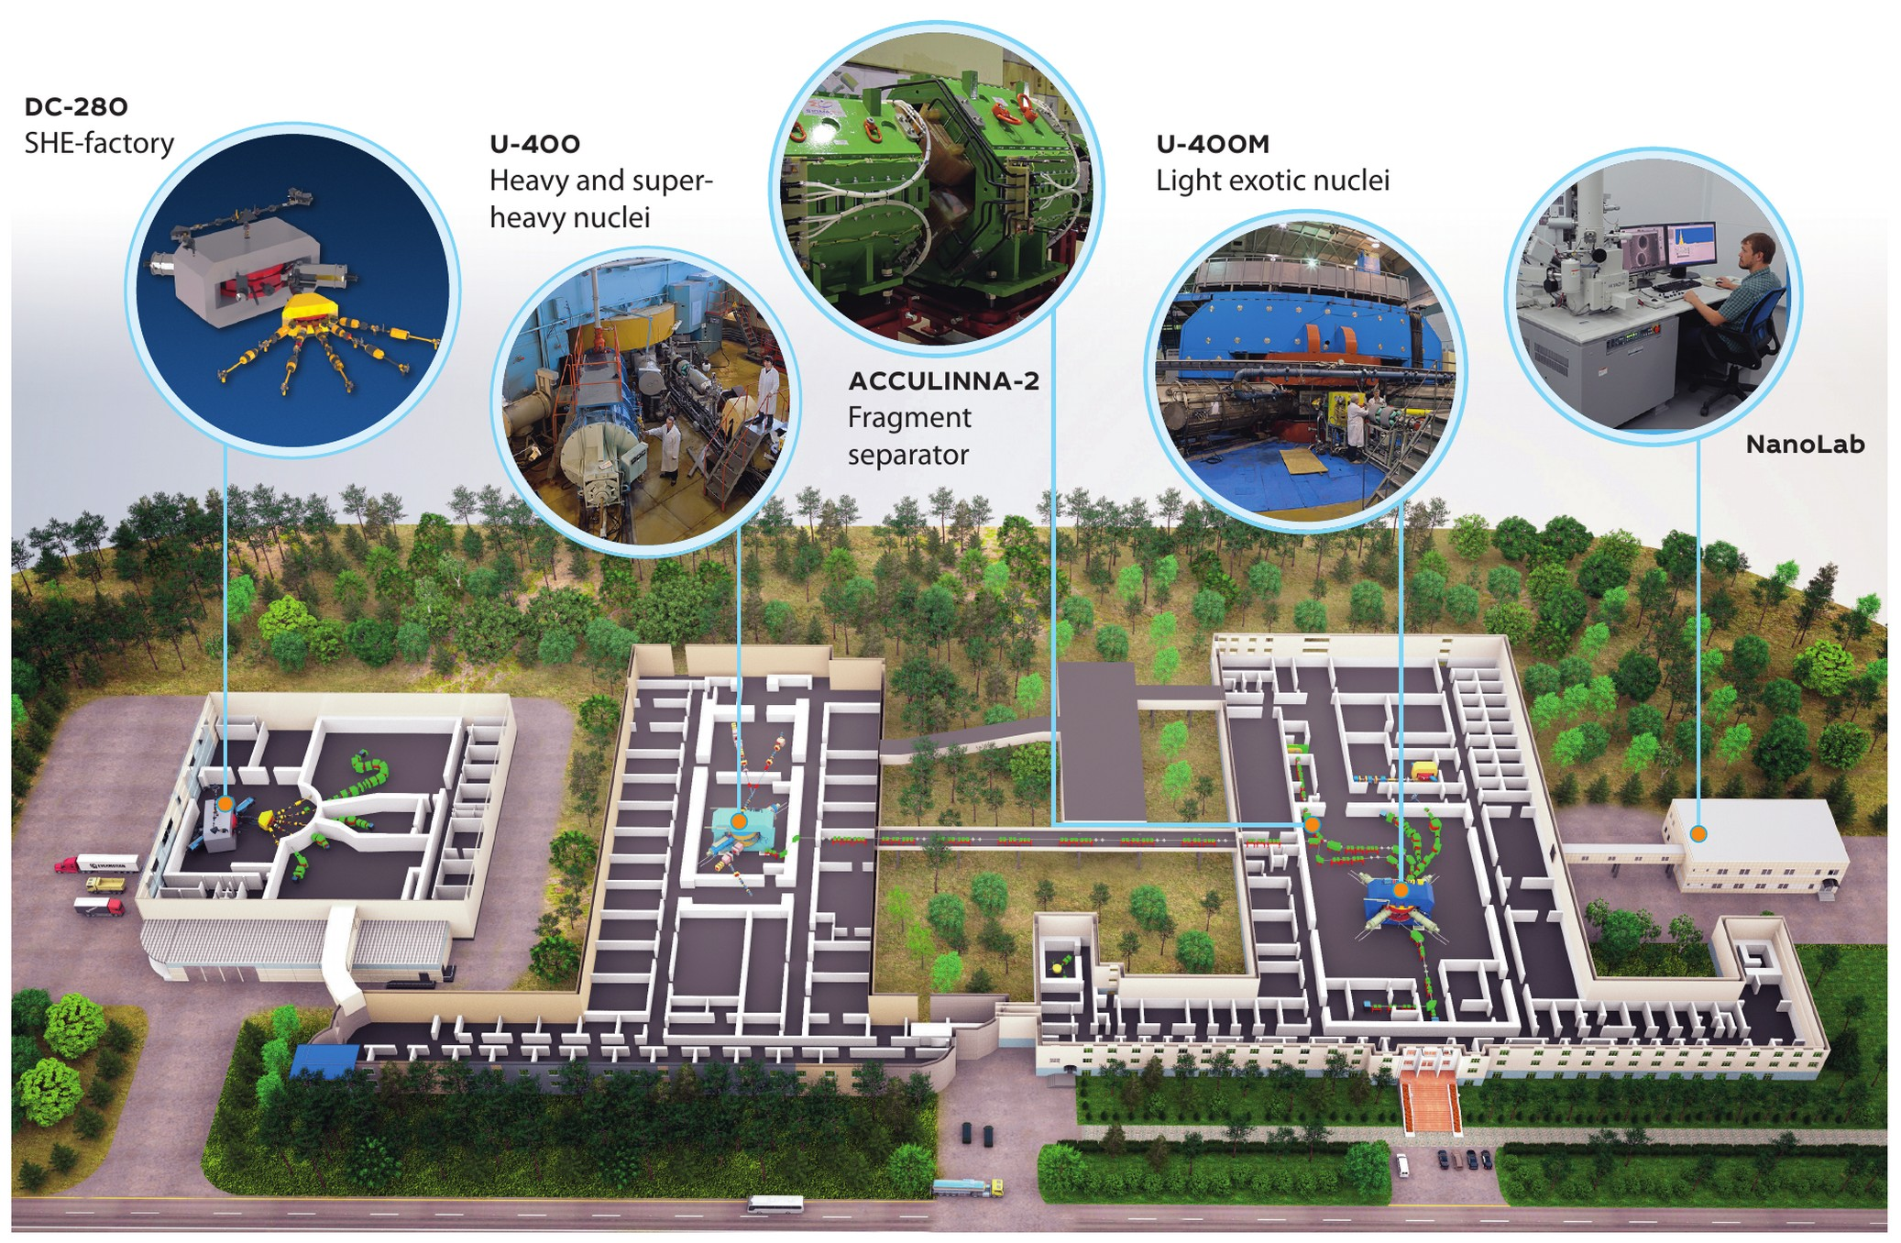
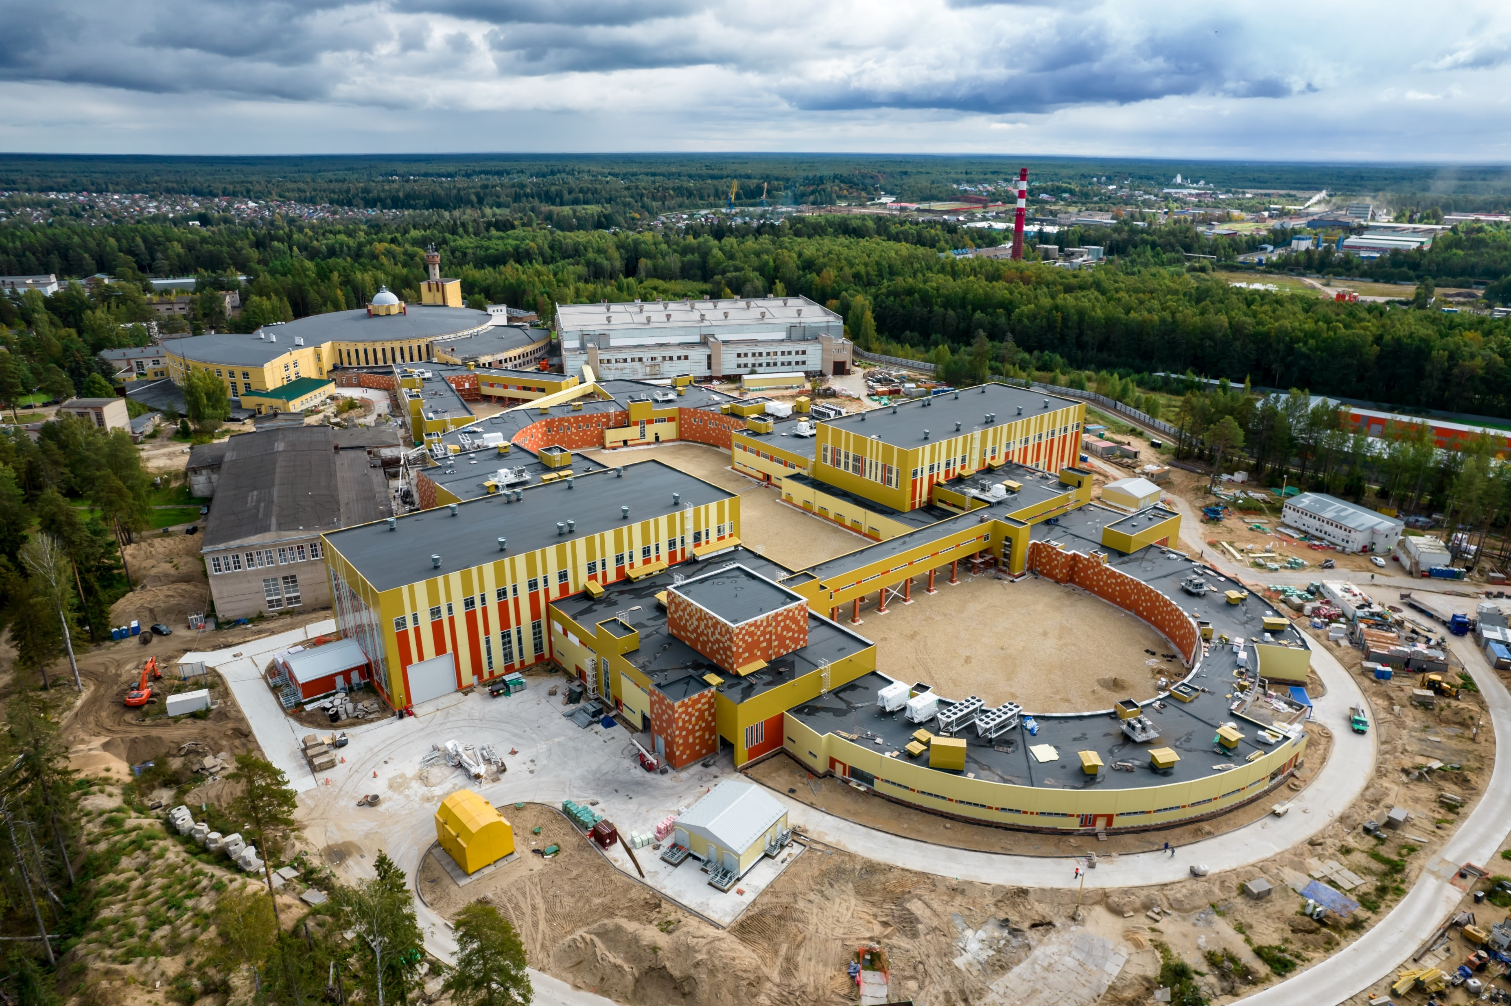
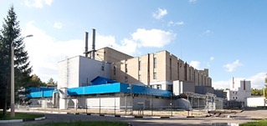


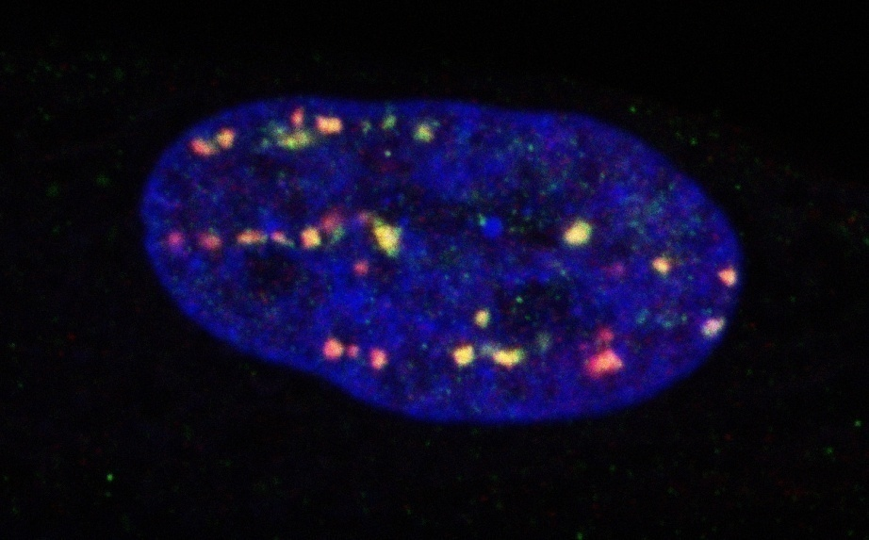
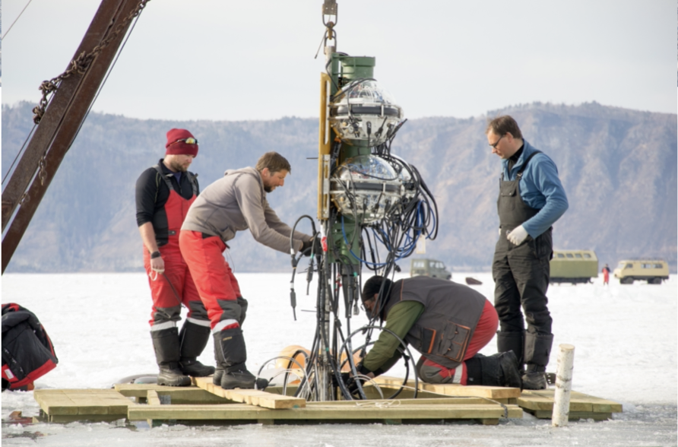
Flagship directions/projects of the JINR 7-year Plan
RHIP & Spin Physics
NICA complex
Low Energy Nuclear Physics (DRIBs – III)
Condensed matter and Neutron physics (IBR-2М+spectrometers)
ν & Astroparticle physics
Baikal-GVD
IT and HPC
MICC
Life Sciences
RB, AB, BM
Notes:
2

Slide 3
THEORETICAL PHYSICS (BLTP)
Theory of
Fundamental
Interactions
Theory
of Atomic
Nucleus
Theory of
Condensed
Matter
Modern
Mathematical
Physics
Interlaboratory cooperation
Research and
educational project
DIAS-TH
“Dubna International
Advanced School of
Theoretical Physics”
VBLHEP Hot and dense nuclear matter in heavy-ion collisions
FLNP
Condensed Matter,
New materials
DLNP
Neutrino physics
FLNR
Superheavy and exotic nuclei
FLNR
Nanoporous 2D membranes,
Ion irradiation
MLIT
Lattice QCD calculations
DLNP Few-body systems,
Exotic nuclei
MLIT Computational methods for
nuclear physics and quantum chemistry
Human strategy:
Attraction of leading scientists
Attraction of young researchers
Stimulation of scientific activity
Scientific strategy:
Extension of international collaboration
Keeping up with current scientific trends
Interplay of research and education

Slide 4
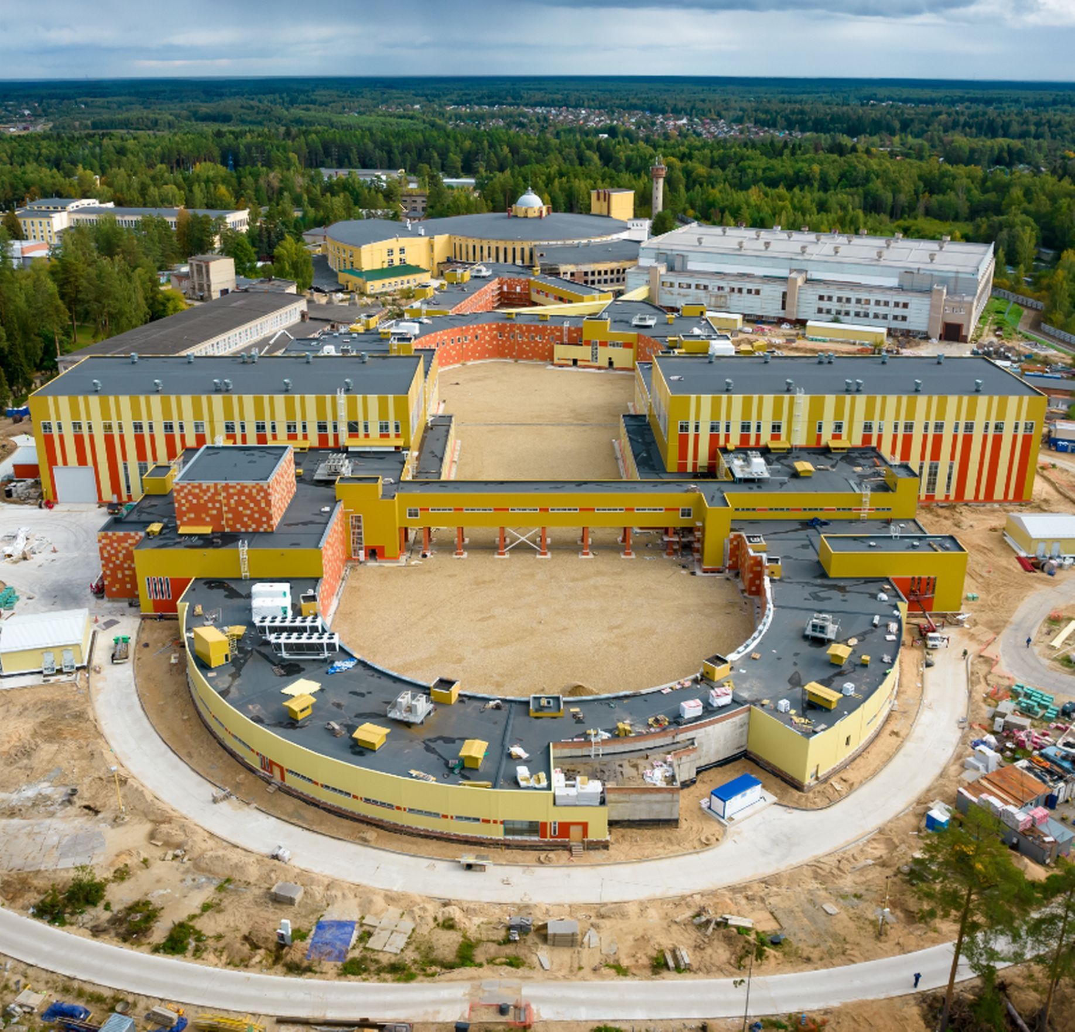
Relativistic Heavy Ion Physics and Study of nucleon structure. Near and Long-Term Future
The timely completion of the NICA project, its commissioning and steady and efficient operation.
Completion of the detectors: BM@N, MPD and SPD at NICA and successful data taking over the decades to come. JINR will make significant contribution to the basic configuration of the SPD detector.
After several years of running of MPD, an Upgrade is foreseen, responding to an increase in luminosity of NICA. Adding detectors in the forward region as planned.
Studies of possible future extension of NICA for acceleration of electrons, opening new physics potential via e-p and e-A collisions.
ARIADNA
BM@N
MPD
SPD
Notes:
For the next two decades, the principal focus in heavy ion physics and spin physics, that will influence to a large extent the JINR strategic development is the timely completion of the JINR flagship facility - NICA. The aim of the NICA project is to create a world-class experimental infrastructure for fundamental research in contemporary High Energy Physics (HEP), applied research, and in development of novel nuclear power technology. The format of close interlaboratory cooperation will contribute to the development of modern detectors and to further achievements in the area of high-temperature superconductivity. This base should be utilized by a global scientific community of users from member and non-member states of JINR.

Slide 5
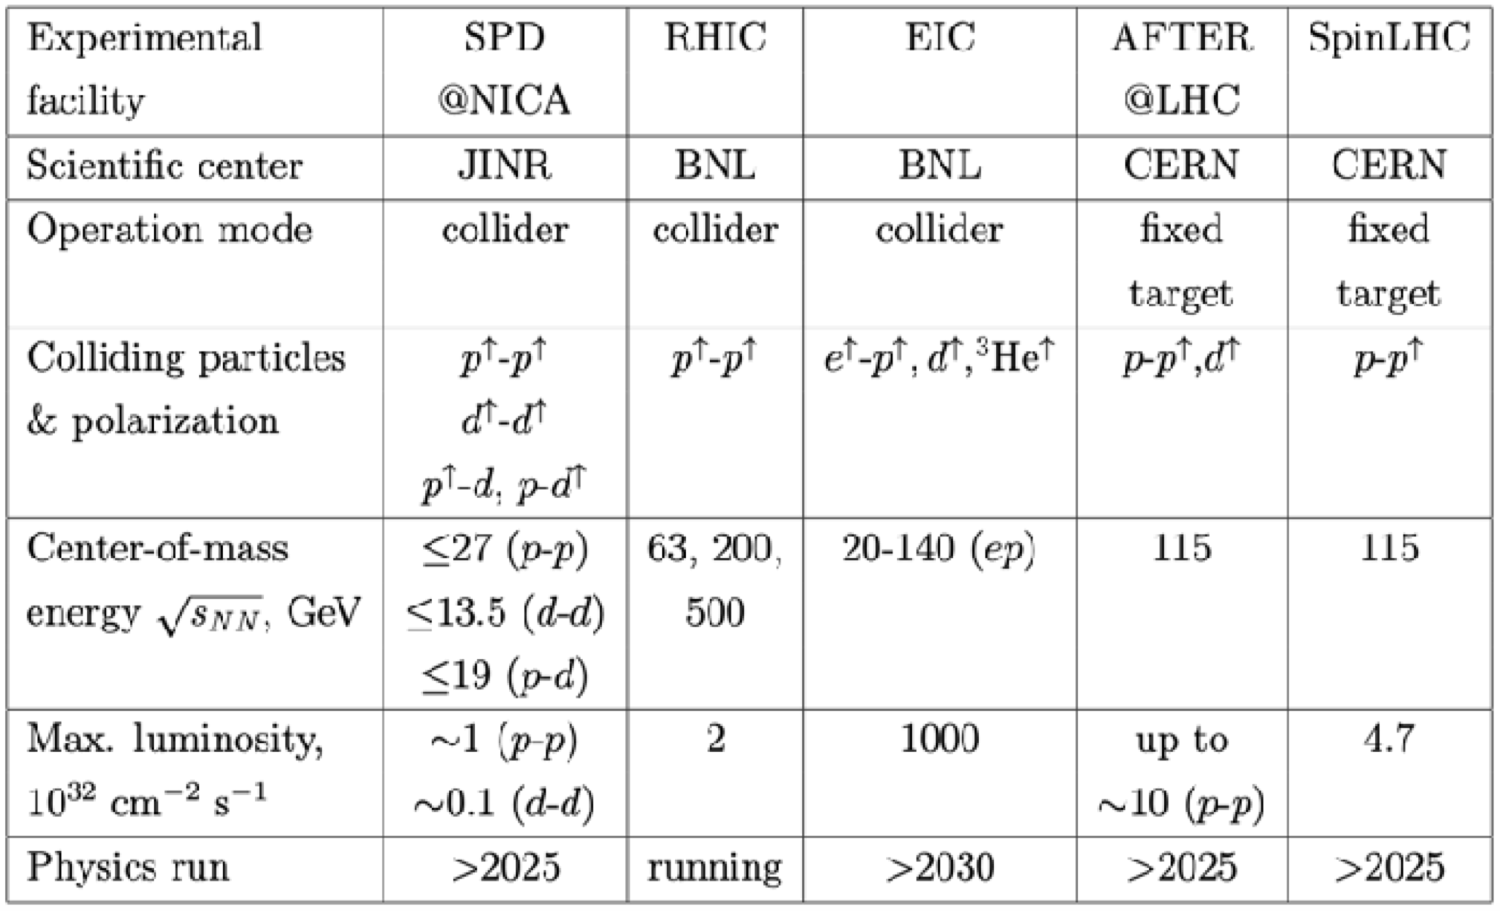

BM@N & MPD NICA SPD
The SPD experiment is aimed at studying the properties of strong interactions in the nonperturbative region, at measuring the proton and deuteron spin structures, and at the development of a three-dimensional model of the nucleon. It is unique in its methodology, breadth of coverage and variety of tasks.
MPD covers this interesting region providing powerful combination of large luminosity, collision energy and system size scan (including isobars), large and consistent acceptance, full centrality range.
NICA is complementary to existing and planned world facilities (FAIR, SPS), and will be a natural and necessary continuation and significant expansion of studies at RHIC BES.
Notes:
Advantages of the MPD & NICA
NICA covers an energy range where most important an interesting physics appears to take place - transition from hadronic to partonic effect dominance, possible appearance of first order phase transition in QCD phase diagram, transition from baryon to meson dominance in particle production. All of this is also connected to astrophysical studies which are strongly developing now and may pose additional questions for us. In summary there are a lot of interesting open questions and MPD has the capabilities to answer many of them.
MPD covers this interesting region providing powerful combination of large luminosity, collision energy and system size scan (including isobars), large and consistent acceptance, full centrality range.
NICA is complementary to existing and planned world facilities (FAIR, SPS), and will be a natural and necessary continuation and significant expansion of studies at RHIC BES.
Other facilities:
HADES and SIS18 provide energies below 3 GeV;
FAIR is not going to provide data before 2028 - so it will not provide data in timescale comparable to NICA;
SPS operates at higher energies, and is fixed target (and also mostly limited to highest centralities);
STAR BES (Beam Energy Scan) covered the energy range of 3-20, however:
- the data taking is finished,
- data sample of 100M at most energies may be
enough to "pose interesting questions", or
highlight the region of interest, but not provide
"definite answers",
- data below 8 GeV is in fixed-target mode,
- no collision system size scan was done,
- isobar run of RHIC showed new interesting physics
that may be explored at NICA.
BM@N
Baryonic Matter at Nuclotron (BM@N) experiment is focused on measurement of Au+Au collisions up to a kinetic beam energy of 3.8·A GeV in order to investigate the equation-of-state (EOS) and the microscopic degrees-of-freedom of QCD matter at neutron star core densities, as EOS defines relation between density, pressure, temperature, energy and isospin asymmetry of nuclear matter.
The “hot” topics of the experiment are:
Study isospin symmetric matter EOS at densities of ρ=3-5 ρ₀ (saturation density) by the following measurements:
- elliptic and direct flows of protons, mesons and hyperons,
- sub-threshold production of multi-strange hyperons and
anti-hyperons.
Constrain symmetry energy E_{sym} - difference between binding energy of isospin symmetric and asymmetric matter by the following measurements:
- collective flow of neutrons vs protons,
- sub-threshold production of particles with opposite isospin.
Searches for quark degrees-of-freedom and the critical endpoint of the first order phase transition at high baryonic densities.
Role of hyperons in neutron stars (ΛN and ΛNN interactions) by measurements of yields and lifetime of light hyper-nucleus at high baryonic densities.
О возможности изучения на NICA столкновений изобарных ядер, имеющих тот же атомный номер, но разный заряд: в частности - не можем ли мы столкнуть свинец-208 и висмут-208?
RICH закончил набор данных, но на последнем рабочем совещании (закрытом) они говорили об интересных результатах, которые могут быть очень важны для понимания структуры ядра. В этом плане низкие
энергии NICA могут быть дополнительным преимуществом. Если столкновения идут с большим прицельным параметром, то возникают
сильные электромагнитные поля и соответствующая физика - Chiral Magnetic Effect.
Есть давние работы по теме. Например, С.Волошин (Phys.Rev.Lett.105 (2010) 17230) предлагает сталкивать Ru-44 и Zr-40 (A=96).

Slide 6
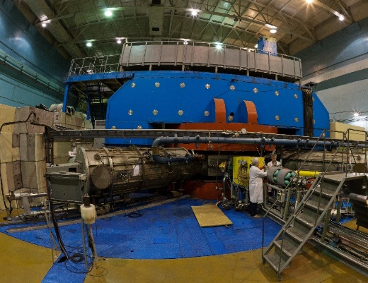
Synthesis of new elements @ SHE Factory
Radioactive Ion-Beam research Basic facility: U-400M
Nuclear reaction studies @ U-400R
Ambitions: up to 2.6 mA (U-beam)
10¹⁰⁻¹¹ , smooth energy variation
Ambitions: E up to 80AMeV, I x 2
Upgrade in 2023-25. Operation from 2026
TARGETS:
- Rosatom and ORNL (USA): Isotopically enriched heavy actinide materials;
- Radiochemical Lab of class 1
Operation from end of 2023.
Multinucleon transfer reactions:
Production of new isotopes of heavy,SH nuclei;
Study of properties of new nuclei.
Decay spectroscopy of heavy nuclei: actinides and light transactinides
Study of fusion-fission and quasifission reactions leading to heaviest nuclei
Low-energy and spontaneous fission of heaviest nuclei
Study of nuclei at high excitation energies (several hundred of MeV)
Nucleon halo, neutron skin;
Exotic decays:
b-delayed, 2p,2n radioactivity;
Soft excitation mode;
New magic numbers;
Spectroscopy of exotic nuclei;
Cluster states;
Reactions with RIBs;
Astrophysical applications.
BEAMS:
- Production of high-intensity beams of ⁵⁰Ti, ⁵⁴Cr and others
- New ECR-28 GHz (2024)
Notes:
Test reactions (2022-2023):
²³⁸U + ⁵⁴Cr → ²⁹²Lv*
²⁴²Pu + ⁵⁰Ti → ²⁹²Lv*
²⁴⁵Cm + ⁴⁸Ca→ ²⁹³Lv*
σ_{3n}= 4pb

Slide 7
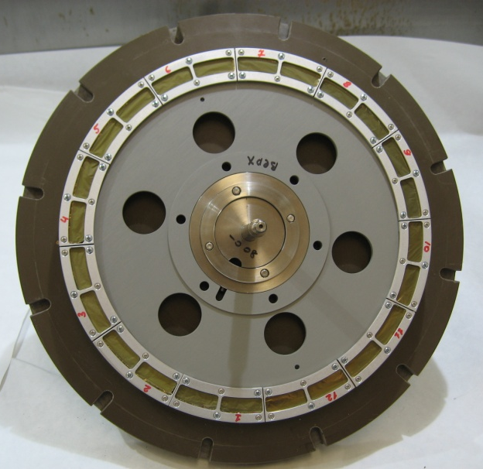
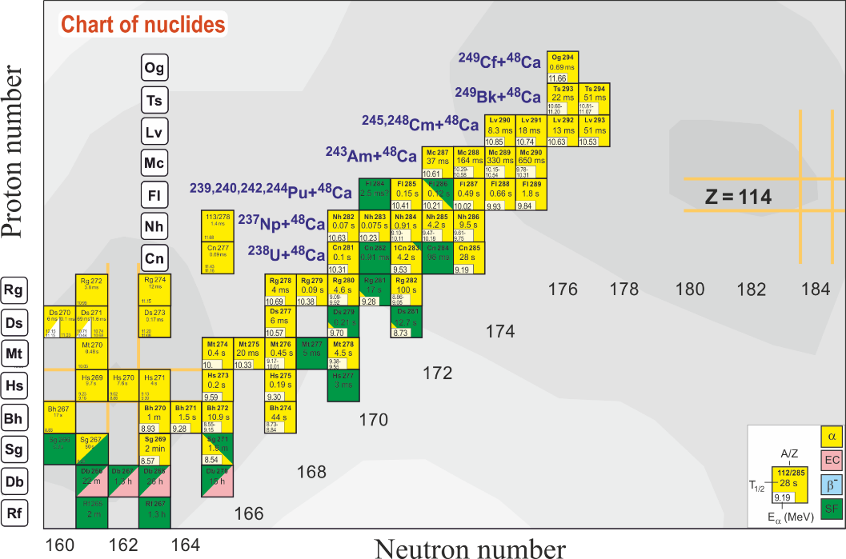
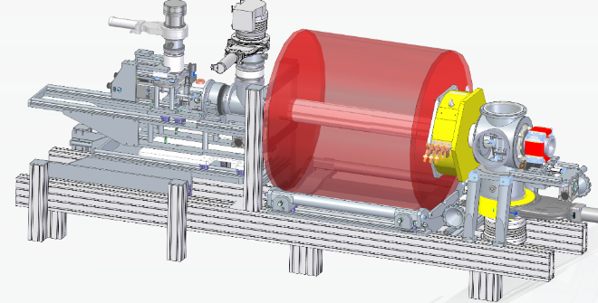
Synthesis of new elements @ SHE Factory
⁵⁰Ti + ²⁴⁹⁻²⁵¹Cf → 3n + ²⁹⁶⁻²⁹⁸120
⁵⁴Cr + ²⁴⁸Cm → 3n + ²⁹⁹120
TARGETS
⁵⁰Ti + ²⁴⁹Bk → 3n + ²⁹⁶119
Cooperation with Rosatom (Russia) and ORNL (USA):
Isotopically enriched heavy actinide materials
Radiochemical laboratory of class 1:
Stability studies;
Manufacturing and regeneration
298
Fl
known nuclei
BEAMS
Test reactions (2022-2023):
²³⁸U + ⁵⁴Cr → ²⁹²Lv*
²⁴⁴Pu + ⁵⁰Ti → ²⁹⁴Lv*
²⁴⁵Cm + ⁴⁸Ca→ ²⁹³Lv*
σ_{3n}= 4pb
Production of high-intensity beams of ⁵⁰Ti, ⁵⁴Cr and others
New ECR-28 GHz (2024)
Notes:
Experiments at the extremely low (σ<100 fb) cross sections:
- Synthesis of new SHE with Z = 119 and 120 in reactions with ⁵⁰Ti, ⁵⁴Cr ...;
- Synthesis of new isotopes of SHE;
- Study of decay properties of SHE;
- Exploring limits the Island of Stability;
- Study of excitation functions.
Experiments requiring high statistics:
- Nuclear spectroscopy of SHE;
- Precise mass measurements;
- Study of chemical properties of SHE.

Slide 8
Nuclear reaction studies @ reconstructed U-400R
Multinucleon transfer reactions:
Study of reaction mechanism;
Production of new isotopes of
heavy and SH nuclei;
Study of properties of new nuclei.
Decay spectroscopy of heavy nuclei: actinides and light transactinides
Study of fusion-fission and quasifission reactions leading to heaviest nuclei
Low-energy and spontaneous fission of heaviest nuclei
Study of nuclei at high excitation energies (several hundred of MeV)

Slide 9
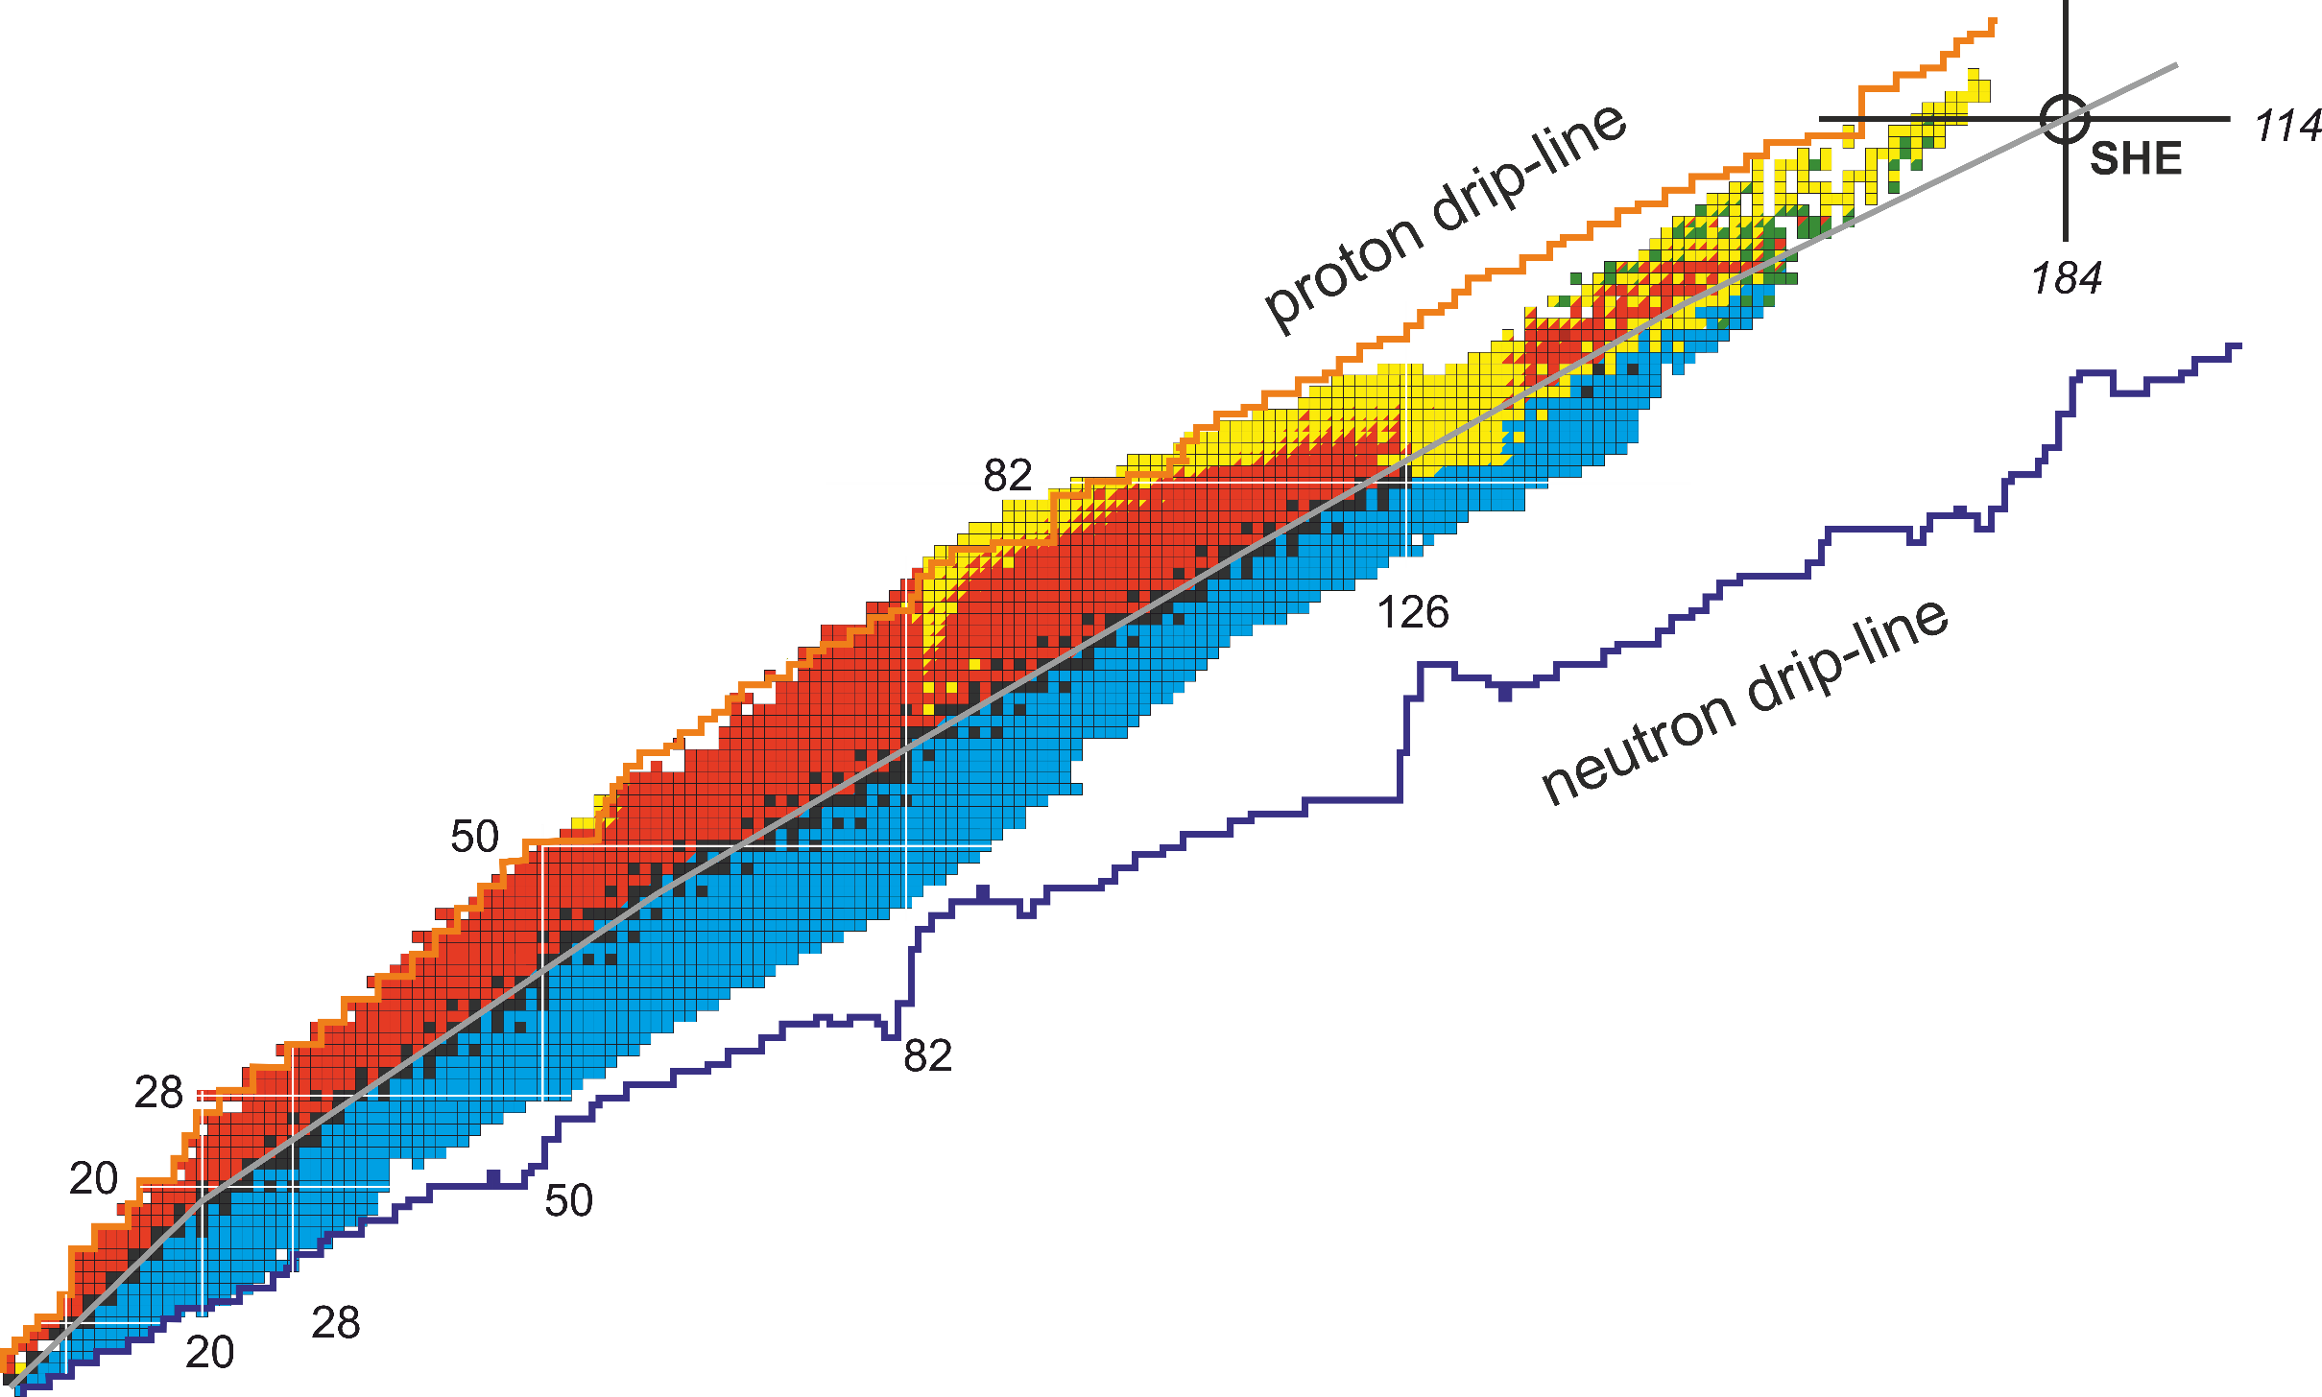
Rare isotope research: long-term perspectives
In the forthcoming decade, RIBs experimental program will be realized mainly at the fragment-separator ACCULINNA-2 at the U-400M cyclotron complex.
Two principal ways of long-term RIB technique development up to 2030
and beyond are being considered
SHE Factory
I
Production at U400M;
Transport and post-acceleration at U400R.
Secondary beams:
Energy range: 0.8 – 28A MeV
Intensity: up to 10⁹ s⁻¹
II
Nuclides up to Xenon:
New accelerator complex:
beams of heavy ions up to Xe
with energies up to 100A MeV
(tandem of two new
cyclotrons or a LINAC).
Multinucleon transfer @ U400R
A new complex
Nuclides heavier than Xenon:
Production in
multinucleon transfer reactions at U400R
ACCULINNA-2
@ U400M

Slide 10
Long-term plan up to 2030
 | 2022 | 2023 | 2024 |  | 2025 | 2026 | 2027 | 2028 | 2029 | 2030
SHE Factory | Operation. Development of new setups
U400M | Moderni-zation | Operation. Development of new detectors
U400R | Operation | New experimental hall constr. Modernization of U400→U400R Development of new setups |  |  |  | Operation. Development of new setups
DC-140 | Construction |  | Operation
Class I Radio-Chemical Lab | Pre-design |  | Design |  |  | Construction |  |  | Operation
New RIBs complex | Feasibility Studies, Pre-Design |  |  | International Evaluation, Design |  |  |  |  | Start of construction (Funding is required)
A: Minimal+ program. RIBs on the base of the operating cyclotrons U400M+U400R
B: Maximal program. RIBs on the base of a tandem of new cyclotrons E1-E2 (100 AMeV), or 100 AMeV LINAC.

Slide 11
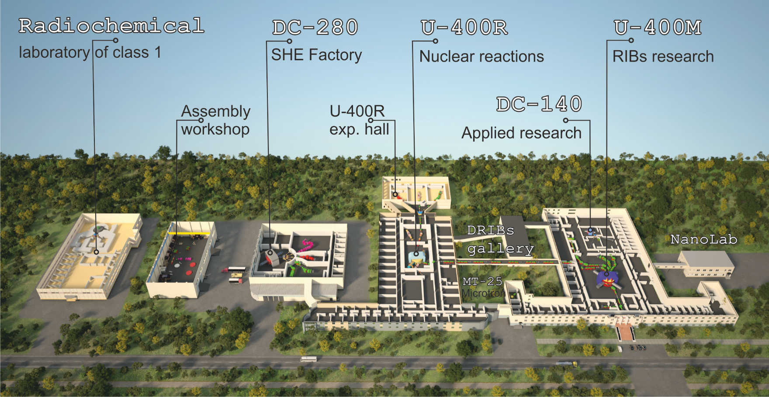
FLNR 2030
Notes:
A: Minimal+ program. RIBs on the base of the operating cyclotrons U400M+U400R
B: Maximal program. RIBs on the base of a tandem of new cyclotrons E1-E2 (100 AMeV), or 100 AMeV LINAC.

Slide 12

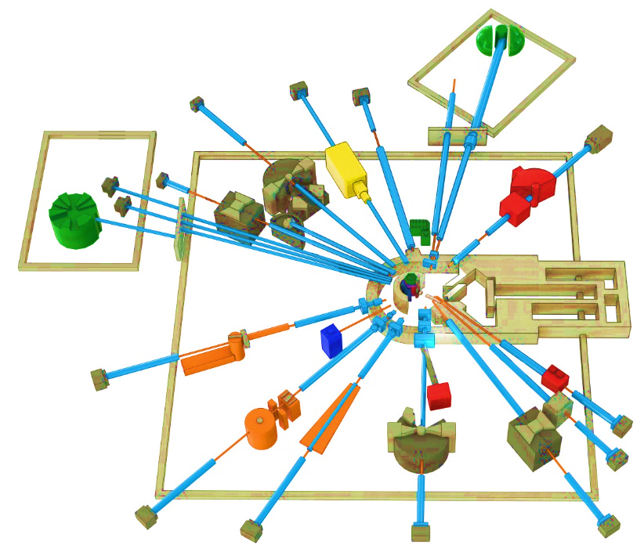
Condensed Matter Physics, Neutron Physics. Priority research in 2024-2030
THE IBR-2 FACILITY
SPECTROMETER COMPLEX
The service life of the core IBR-2 reactor is expected to end in 2032-35. The possibility to extend the operation of the IBR-2 until 2040 is being studied. To extend the reactor core campaign – new fuel (manufacture of FA with FR) around 2025.
Considering the present-day tendency, after 2030 only five sources will be available in Europe: ISIS (Didcot, UK), SINQ (PSI, Villige), FRM II (TU Munich), and two new sources: ESS (Lund, Sweden) and reactor PIK (NRC KI, Gatchina, Russia), both under construction with the start of operations planned for 2023-2024. Oak Ridge (STS SNS) –is planned in 2037.
Development of the basic configuration elements of the inverse geometry inelastic n-scattering spectrometer BJN.
Completion of basic configuration of the small angle n-scattering and imaging spectrometer.
BJN
(project)
HRFD
YuMO
EPSILON
DN-6
SKAT
RTD
KOLKHIDA
NERA
NRT
REMUR
FSS
REFLEX
DN-12
GRAINS
FSD
Modernization and reconstruction of spectrometers HRFD, YuMO, RTD, DN-6, DN-12, FSD, NERA, REMUR, REFLEX, SKAT, EPSILON, FSS, NRT, focused on improvement of technical parameters and extension of research capabilities.
Development of laboratory equipment for samples characterization and physical properties measurements.
Support and modernization of the complex of cryogenic moderators. New operating reliable UCN channel.
JINR provides FS for new neutron source (IBR-3 = “NEPTUNE”). The goal – is to have the best pulsed neutron source in the world by 2037: with brightness of 7*10^15 (for TN), and 9*10^14 (for CN)
Notes:
Эксплуатационный проектный ресурс установки ИБР-2, как одного из лучших нейтронных импульсных источников заканчивается в 2032-35 годах. В настоящее время в ЛНФ изучается возможность продления кампании реактора до 2040 года. Для этого, в частности, необходимо изготовить дополнительную партию свежего топлива с аналогичными характеристиками до 2025 года.
Учитывая существующие тенденции, после 2030 года в Европе для проведения исследований будет доступно 5 источников, включая три действующих: ISIS (Didcot, UK), SINQ (PSI, Villigen, Switzerland), FRM II (TU Munich, FRG), и два новых, начало эксплуатации которых планируется в 2023- 2024 годах: (ESS (Lund, Sweden) and steady-state reactor PIK (PNPI NRC KI, Gatchina, Russia). Ввод в эксплуатацию 2-х мишенной станции на источнике (STS SNS) of Oak Ridge National Laboratory (USA) планируется в 2037 году. Таким образом, потребность в новом поколении высокопоточных источников нейтронов возрастает на фоне общего уменьшения их количества в мире.
Приоритетными задачами развития комплекса спектрометров реактора ИБР-2 будут являться:
Разработка и создание элементов основной конфигурации нового спектрометра неупругого рассеяния нейтронов в обратной геометрии BJN.
Завершение работ по разработке и созданию основной конфигурации спектрометра малоуглового рассеяния и имиджинга.
Модернизация и реконструкция действующих установок HRFD, YuMO, RTD, DN-6, DN-12, FSD, NERA, REMUR, REFLEX, SKAT, EPSILON, FSS, NRT, направленная на улучшение технических параметров и расширение экспериментальных возможностей.
Развитие лабораторного оборудования для характеризации образцов и измерений физических свойств.
Поддержка и модернизация комплекса криогенных замедлителей

Slide 13
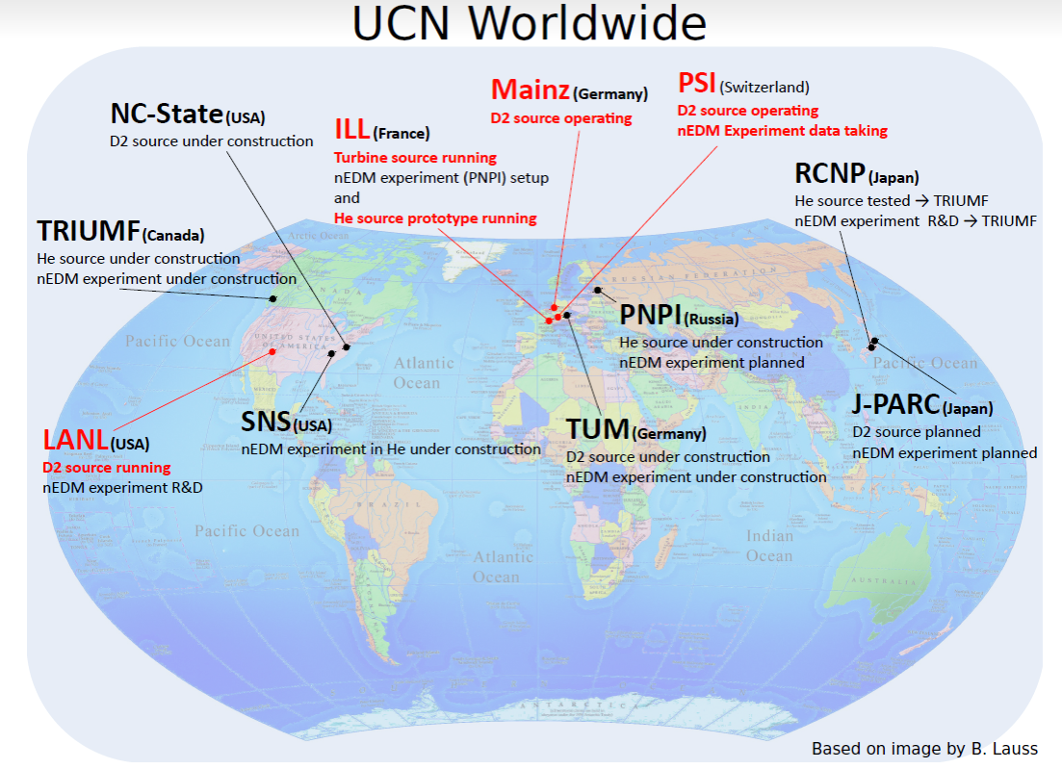
RESEARCH WITH ULTRACOLD NEUTRONS
Precision experiments in the field of low energy physics are a source of information about the properties of fundamental interactions, about the parameters of the SM and physics beyond the SM. A striking example is studies with UCN.
UCN physics was born at FLNP JINR in 1968.
There is no UCN source at JINR.
Plan for the next seven years is to build UCN source at IBR-2 reactor with world-class parameters.
Scientific program for UCN source in Dubna:
Measurement of the neutron lifetime (abs.error <1 sec).
Investigation of abnormal UCN losses
Non-stationary quantum effects and neutron optics
Dubna (Russia, JINR)
IBR 2 and at the future Neptune IBR 3
For IBR-3 the program will be extended
Search for the neutron Electric Dipole Moment
Quantization of neutron states in a gravitational field and search for new interactions
Neutron Microscopy
Notes:
Nowadays an actively developing and rather demanded field of research with neutrons is the ultracold neutron (UCN) physics. It allows to perform very precise experiments for testing the limits of the Standard Model (SM).
In spite of the fact that the ultracold neutrons were discovered at FLNP in 1968, there is no UCN source in Dubna now.
It is planned to build a UCN source at the IBR-2 reactor with world-class parameters.
With such a source the following experimental program will become possible:
measurement of the neutron lifetime with the accuracy of about 1 sec;
Investigation of abnormal UCN losses ;
study of non-stationary effects and neutron optics.
In the future, at IBR-3, with an increase in the intensity of the source, this program can be expanded with experiments, like:
search for the electric dipole moment of the neutron;
study of neutron quantum states in the gravitational field and search for new interactions;
development of neutron microscopy.

Slide 14
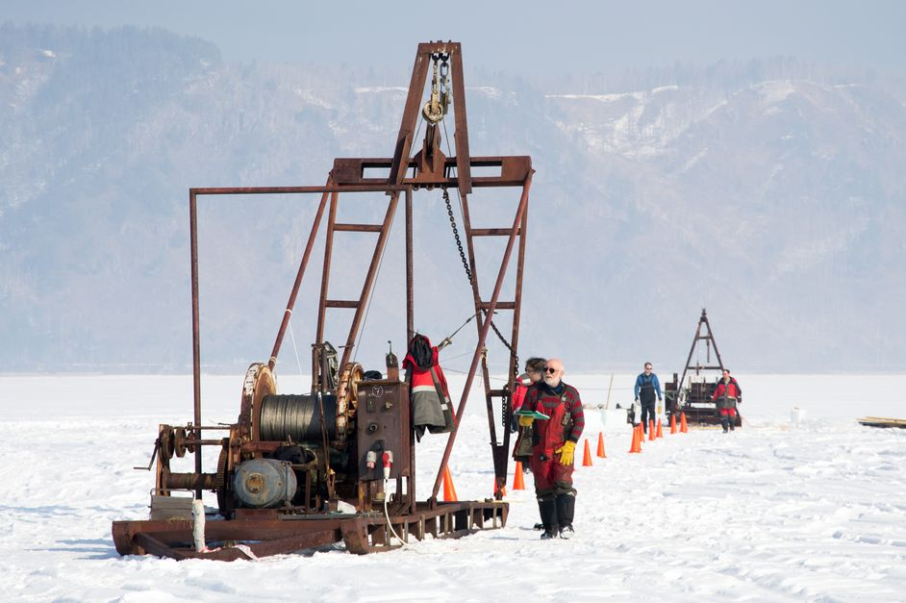
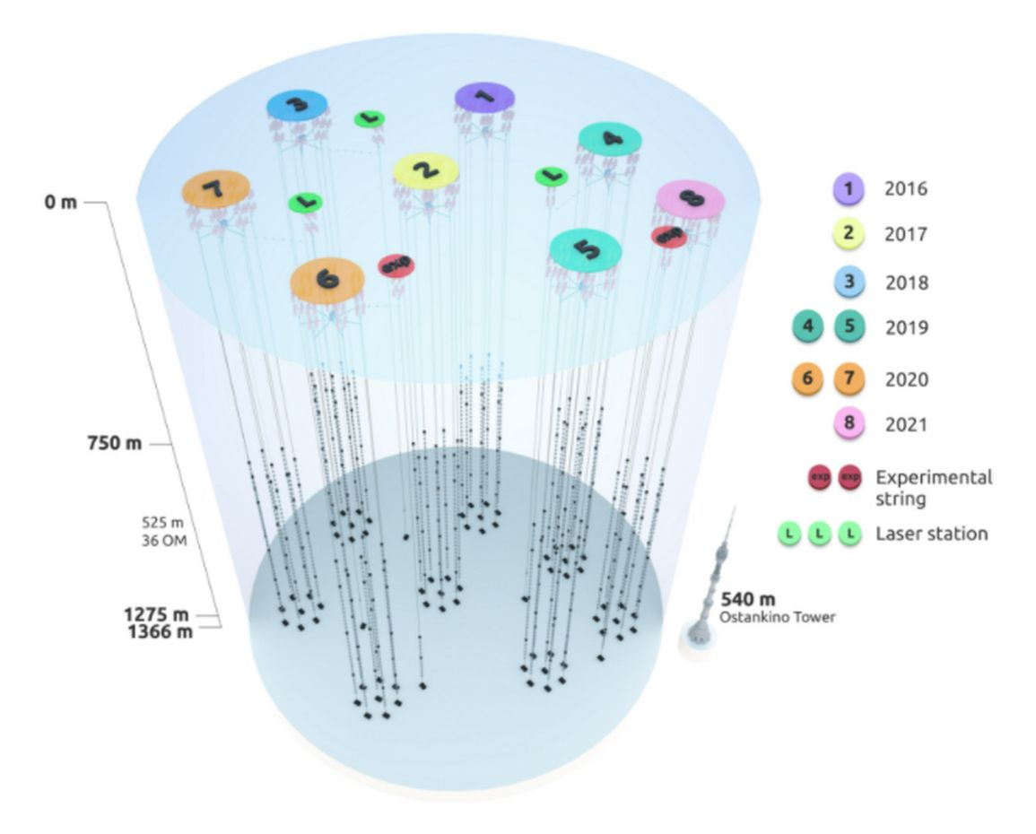
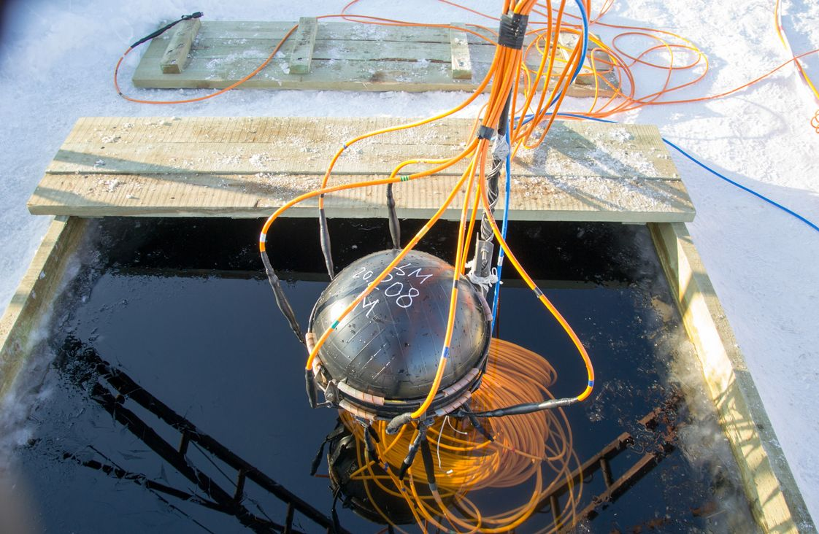
NEUTRINO AND ASTROPARTICLE PHYSICS
PROJECT BAIKAL-GVD
Baikal-GVD: Identification of astrophysical sources of ultra-high energy (exceeding tens of TeV) neutrinos. Actuality: their sources are still unknown. The identification of sources will help to elucidate mechanisms of galaxies creation and evolution.
Main advantage of Baikal-GVD: pure and t-stable water. Angular resolution of muon tracks 0.3-0.5 grad (IceCube: 0.5-1); angular resolution of shower direction 2-3 grad (IceCube: 15);
Northern detectors have better view to the Galaxy center.
Year | Number of clusters | Number of OMs
2016 | 1 | 288
2017 | 2 | 576
2018 | 3 | 864
2019 | 5 | 1440
2020 | 7 | 2016
2021 | 8 | 2304
2022 | 10 | 2880
2023 | 12 | 3456
2024 | 14 | 4032
Baikal-GVD: flagship experiment of JINR with a leading role in the collaboration. Gain new experience in the detector design,
construction, deployment, maintenance, simulation and data analysis. Expected breakthrough discoveries.
More dense configuration, + light sensors, fiber vs Cu, smart data transmission, + radio-antennas => New Quality and Efficiency
Global competence in 2030 horizon: Ice-Cube: 2025-2034 -> 8km³ (w RA 100 km3 => PeV); Km3NET: -> few km³;
Baikal-GVD (Phase II) = new type of OM, trigger-less operation, ML&AI, -> ~ 10 km³ ? (CDR in 2024),

Slide 15
Frontier Accelerator R&D (preliminary list):
Intensive ion sources: ESIS, ECR (Z>35+, I>e9, > 28GHz);
HTSC (77K+) magnets (>4T, >4T/s) and coils (>30 kA);
Ultrafast beam cooling (~ 10-100 msec) for bright ion beams (I>e9);
SC RF for linear accelerator structures (>10MV/m, @4.5K);
Colliders studies: high luminosity, Interaction region, novell optics (pp, ii, ep, ei, ig);
FCC challenges for metrology, feed-back systems, nano- pico- sensitive laser inclinometry (PLI);
Beam therapy: flash-technology, pencil beam, investigations of neutron and e- beam opportunities;
Will be synchronized with Global and European R&D Roadmaps for detector and accelerator technologies
Frontier Detector R&D (preliminary list)
New HPGe detectors and new Si detectors: HPGE, NewSiPM. For ultra-low recoil energies of target nuclei in dark matter searches, CEvNS. Provide a “colorful” tomography. Calibration of ECAL detectors @ e-Linac.
Development of positron annihilation spectroscopy: PAS.
New generation Vertex and Pixel Shower Detectors (for ITS of NICA, ALICE, etc), others.
Development of advanced position-sensitive gas detectors with ³Не gas converter.
Development of gas neutron counters, position-sensitive detectors with ¹⁰В₄С boron carbide converter.
Implementation of novel advanced data acquisition electronics to ensure record parameters.

Slide 16
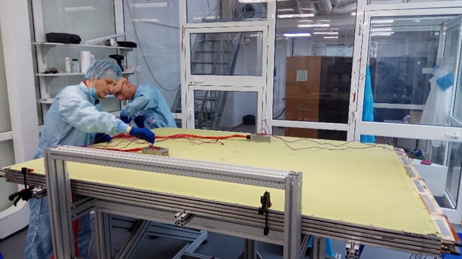
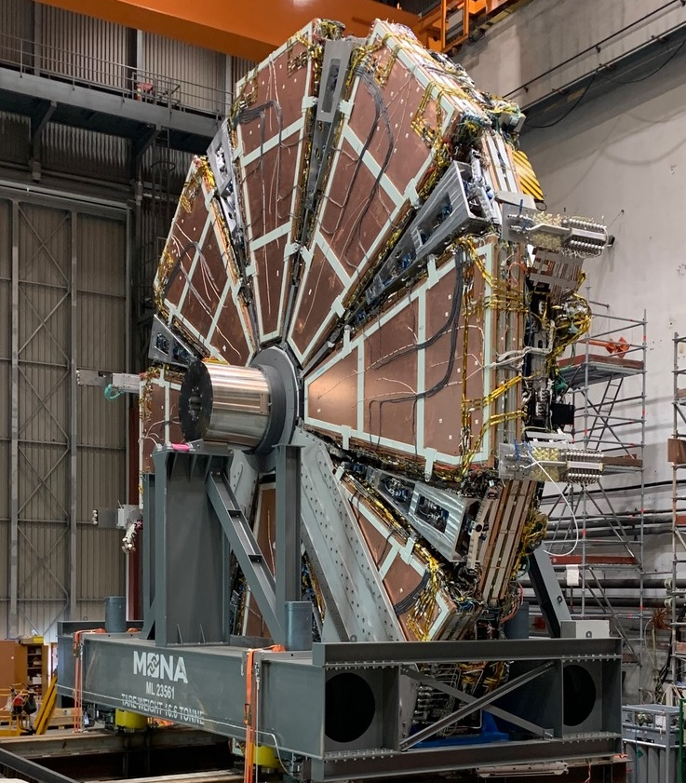
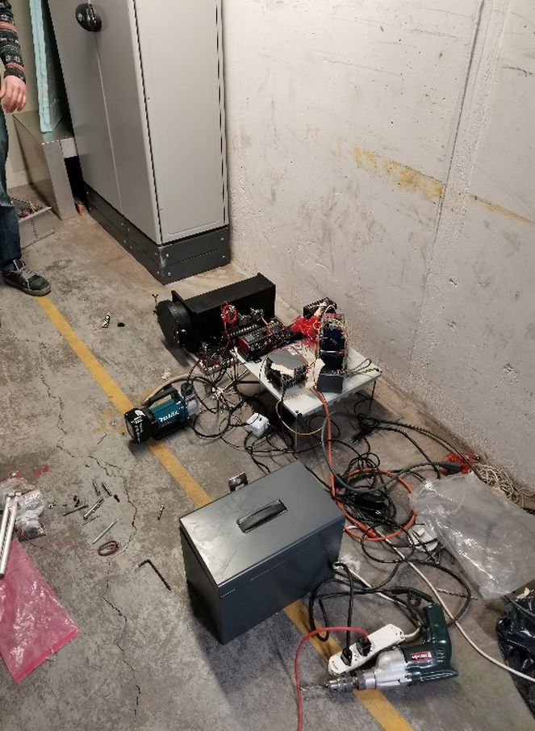
Detector technology in fore-front experiments
ATLAS – calorimeters; muon spectrometer
of high-granularity timing detector,
enlargement of Micromegas technology.
ALICE – upgrade of PHOton Spectrometer.
CMS – muon system, calorimeters,
high-granularity endcap calorimeter.
ATLAS: Large Micromegas module production
COMET, NA62 - ultra-thin (12 µm) straw;
large area of straws in vacuum.
EDELWEISS – low radioactivity materials.
SuperNEMO - scintillator detectors;
low background measurements
with HPGe & BiPo d-etectors.
GERDA - automation of det. movement in gloves box.
PLI - New method to measure surface inclination
with nano-radian accuracy
MPD –TPC, TOF based on MRPC,
ECal with projection geometry.
required in
gravitational waves detect. (LIGO, VIRGO, Einstein),
colliders (LHC, NICA),
early warning of earthquakes.
BM@N, RD-51 – GEM chambers.
JUNO – high resolution liquid scintillators
DUNE – light detection in LAr TPC

Slide 17
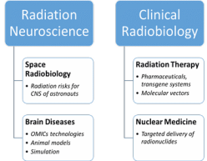
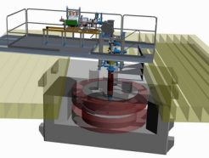

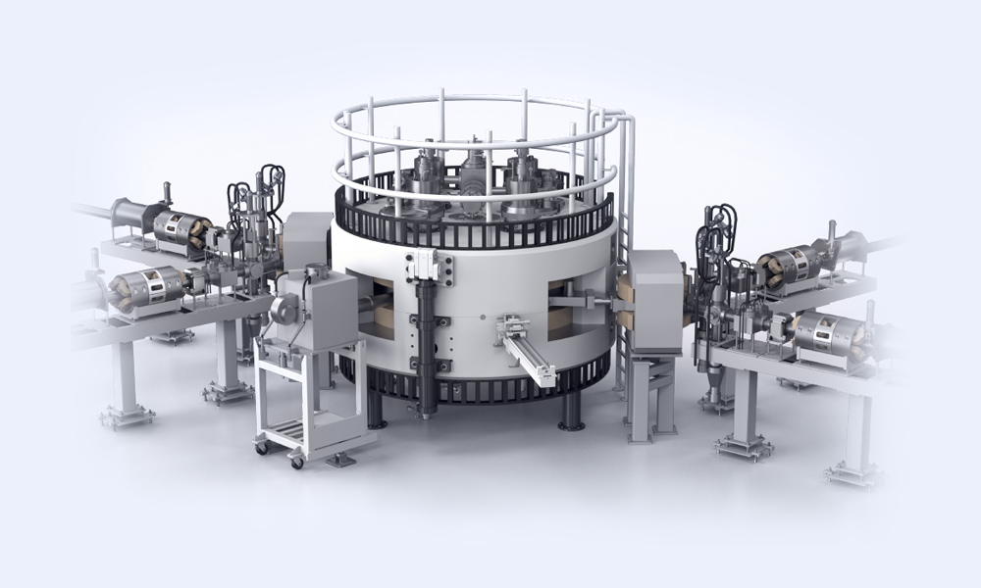
International Centre for Innovative Nuclear Technologies Research
Development of technologies and methods in the field of nuclear and radiation medicine, radiation materials science, advanced training of specialists for JINR Member States for radiation biology, medical physics, material studies.
OMICS@LRB and neuro-RB studies. Radiation neuroscience. Approaches to increase radiosensitivity: pharmaceuticals, transgene systems, targeted delivery (molecular vectors) and radionuclide;
ARIADNA: Applied beams@NICA : radiobiological studies (400-800 MeV/n); radiation testing of semiconductor electronics (3; 150-350 MeV/n); nuclear physics @ 1-4.5 GeV/n. Start in 2023;
DC-140 cyclotron for electronic component testing, radiation material science, track pore membrane research. 2021–2023;
SC proton cyclotron (MSC-230) for R&D in beam therapy: treatment planning; radiomodificators for γ− and p- therapy, flash-therapy, pencil beam (10 µA, >5 Grey/l @ 50 ms pulse). 2021–2024 (beam in 2023).
Radiochemical Laboratory Class-I for production of radioisotopes (Ac²²⁵, ^{99m}Tc), nuclear medicine R&D in photonuclear reactions @ 40MeV (e-beam, Rhodotron). 2022–2027.
DC-140 (schematic design)
Radiochemical Lab Class-I
MSC-230 (general view)
Notes:
17

Slide 18

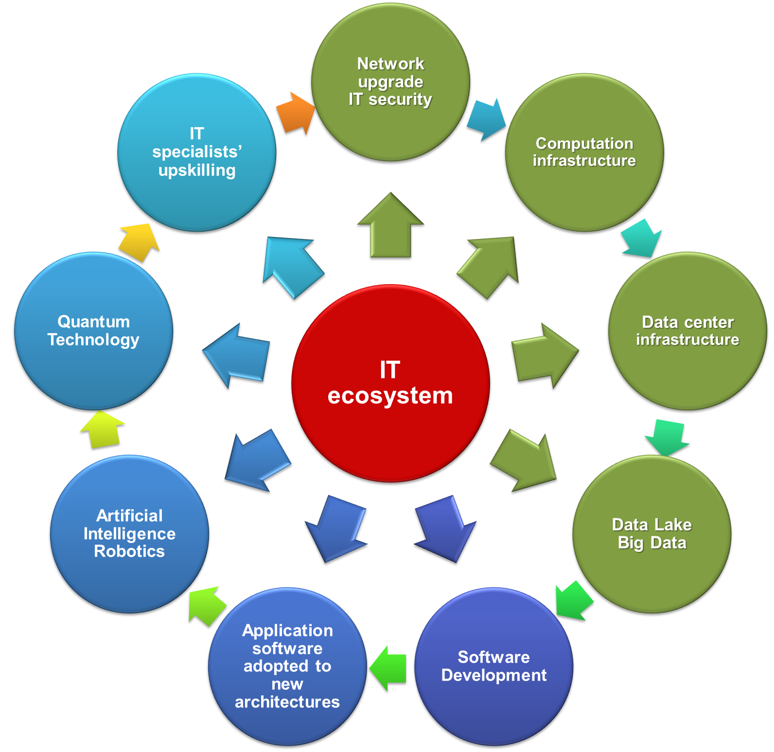
Strategy for Information Technology and Scientific Computing at JINR
CONCEPT
of the development of IT technologies & scientific computing is aimed at solving the strategic tasks of JINR through advanced IT solutions integrated into a unified computing environment that combines a variety of solutions, concepts and methods.
Steady implementation/upgrades of Networking (>Tb/s range), Computing infrastructure within the Multifunctional Information & Computing Complex (MICC) and “Govorun” Supercomputer (~15-20 Pflops), Data center infrastructure, Data Lake & long-term storage for all the experiments (-> EB).
A variety of means will be used for IT specialists upskilling.

Slide 19

Matrix of JINR Key Projects
2020 | 2023 | 2026 | 2029 | ~ 2032 | ~ 2035 | ~ 2038
DRIBS, SHE-Factory
Operation and development
FRB @ Flerov Lab
R&D
Feasibility Studies + R&D
Decision
Phased construction
Operation
NICA MPD
Construction
Operation
upgrade
Operation
NICA SPD
R&D + Design
Construction and commissioning
Operation
upgrade
NICA - III (EIC, others)
Feasibility Studies + R&D
International Program + R&D
Technical design and prototyping
Operation
DNS-IV
Technical design and prototyping
Decision
Construction
Operation
Baikal - GVD
Construction and data acquisition
upgrade and data acquisition
Operation
ν & AP Physics
International scientific program
Life Science
Formulation of Internati-onal scientific program
International scientific program
FCC, ILC, GWI, …
Participation in Feasibility Studies, advanced R&D
Decision
Participation in construction
Innovation center
R&D + Design
Construction
Operation and regular modernization
Risks and Challenges: International political sanctions and barriers (expertise, mobility, delivery, payment, inflation), budget underfilled -> staff + operation, new ecological and safety standards, global cataclysms.

