Slide 1
Current work and prospects of heavy ion research at JINR
(meeting program with comments)
by Yuri Oganessian
Flerov Laboratory of Nuclear Reaction
Joint Institute for Nuclear Research
July 4-8, 2022. St. Petersburg, RF

Slide 2
Формат
- Совет РАН по физике тяжелых ионов
Грант РАН / МОН «Сверхтяжелые элементы»
Научно-техническое сотрудничество
институтов РОСАТОМА и ОИЯИ

Slide 3
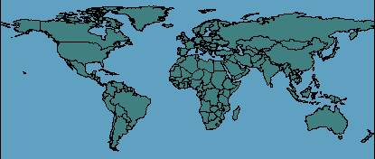
Heavy ion physics from the beginning to now, 65 years old…
JINR
GSI
JINR
GSI
GSI
GANIL
GSI
NICA
MSU
GANIL
NICA
MSU
ANL
INFN
ANL
ORNL
IPN
ORNL
IPN
CERN
CERN
INFN
RIKEN
LBL
BNL
INFN
RIKEN
LBL
A&M
BNL
A&M
Pioneers
Heavy ion accelerators
Heavy Ion National Laboratories
Heavy Ion Colliders

Slide 4
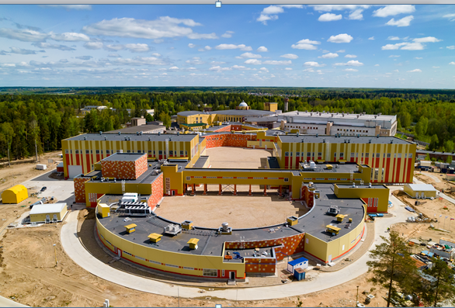
NICA Facility
May 2022, Dubna
Prof. V.D. Kekelidze
Yu. Oganessian Heavy Ion Research at JINR, July 4-8, 2022, St. Petersburg

Slide 5
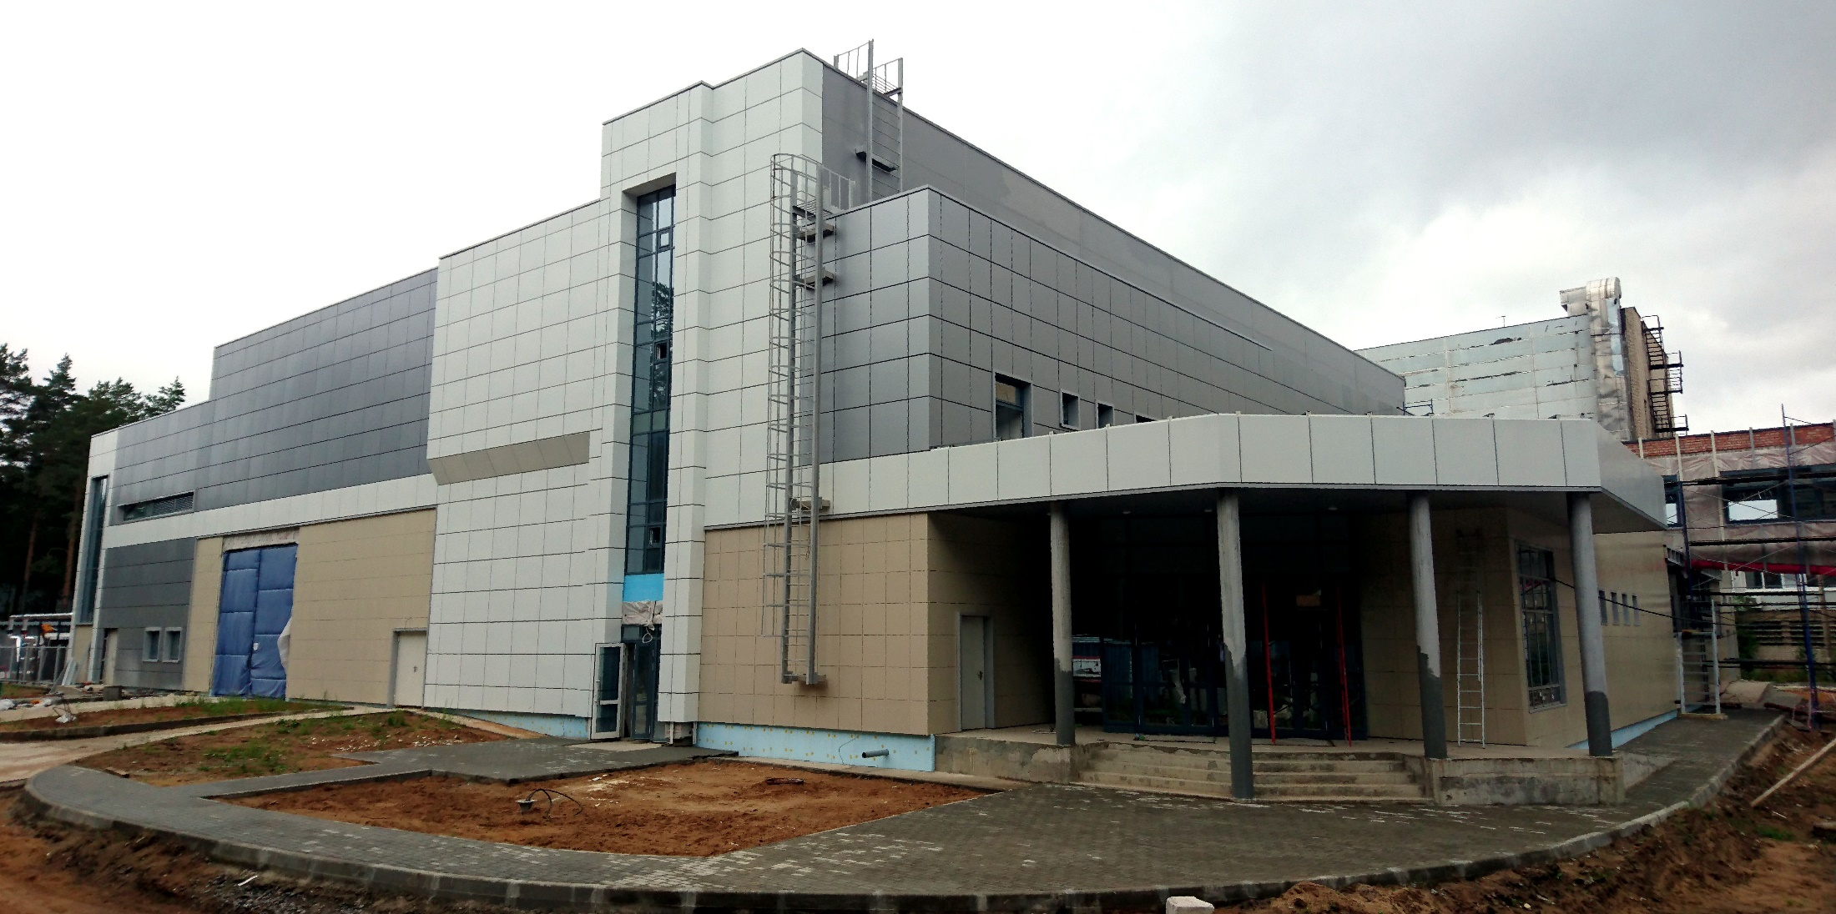
August 2017, Dubna
SHE-Factory
Yu. Oganessian Heavy Ion Research at JINR, July 4-8, 2022, St. Petersburg

Slide 6
SHE-Factory
Isotope production:
Pu 240-244
Cm 245-248
Bk-249
Cf-249-251
New accelerator & high beam dose of :
Ca-48
Ti-50
Cr-54
Ni-64
separators & detectors
of the new generation
Factor 3-5
is closely linked
to the intellect
To be increased
10 times
Factor 10-20
High-flux isotope reactor
SM-3 at Dimitrovgrad
New accelerator
DC-280
3 experimental halls
5 ion beam channels
Recoil
Separators
DGFRS-2
DGFRS-3
GASSOL (project)
Highly productive isotope
separator in Sarov
ROSATOM
isotopic enrichment of elements for acceleration
in Lesnoy

Slide 7
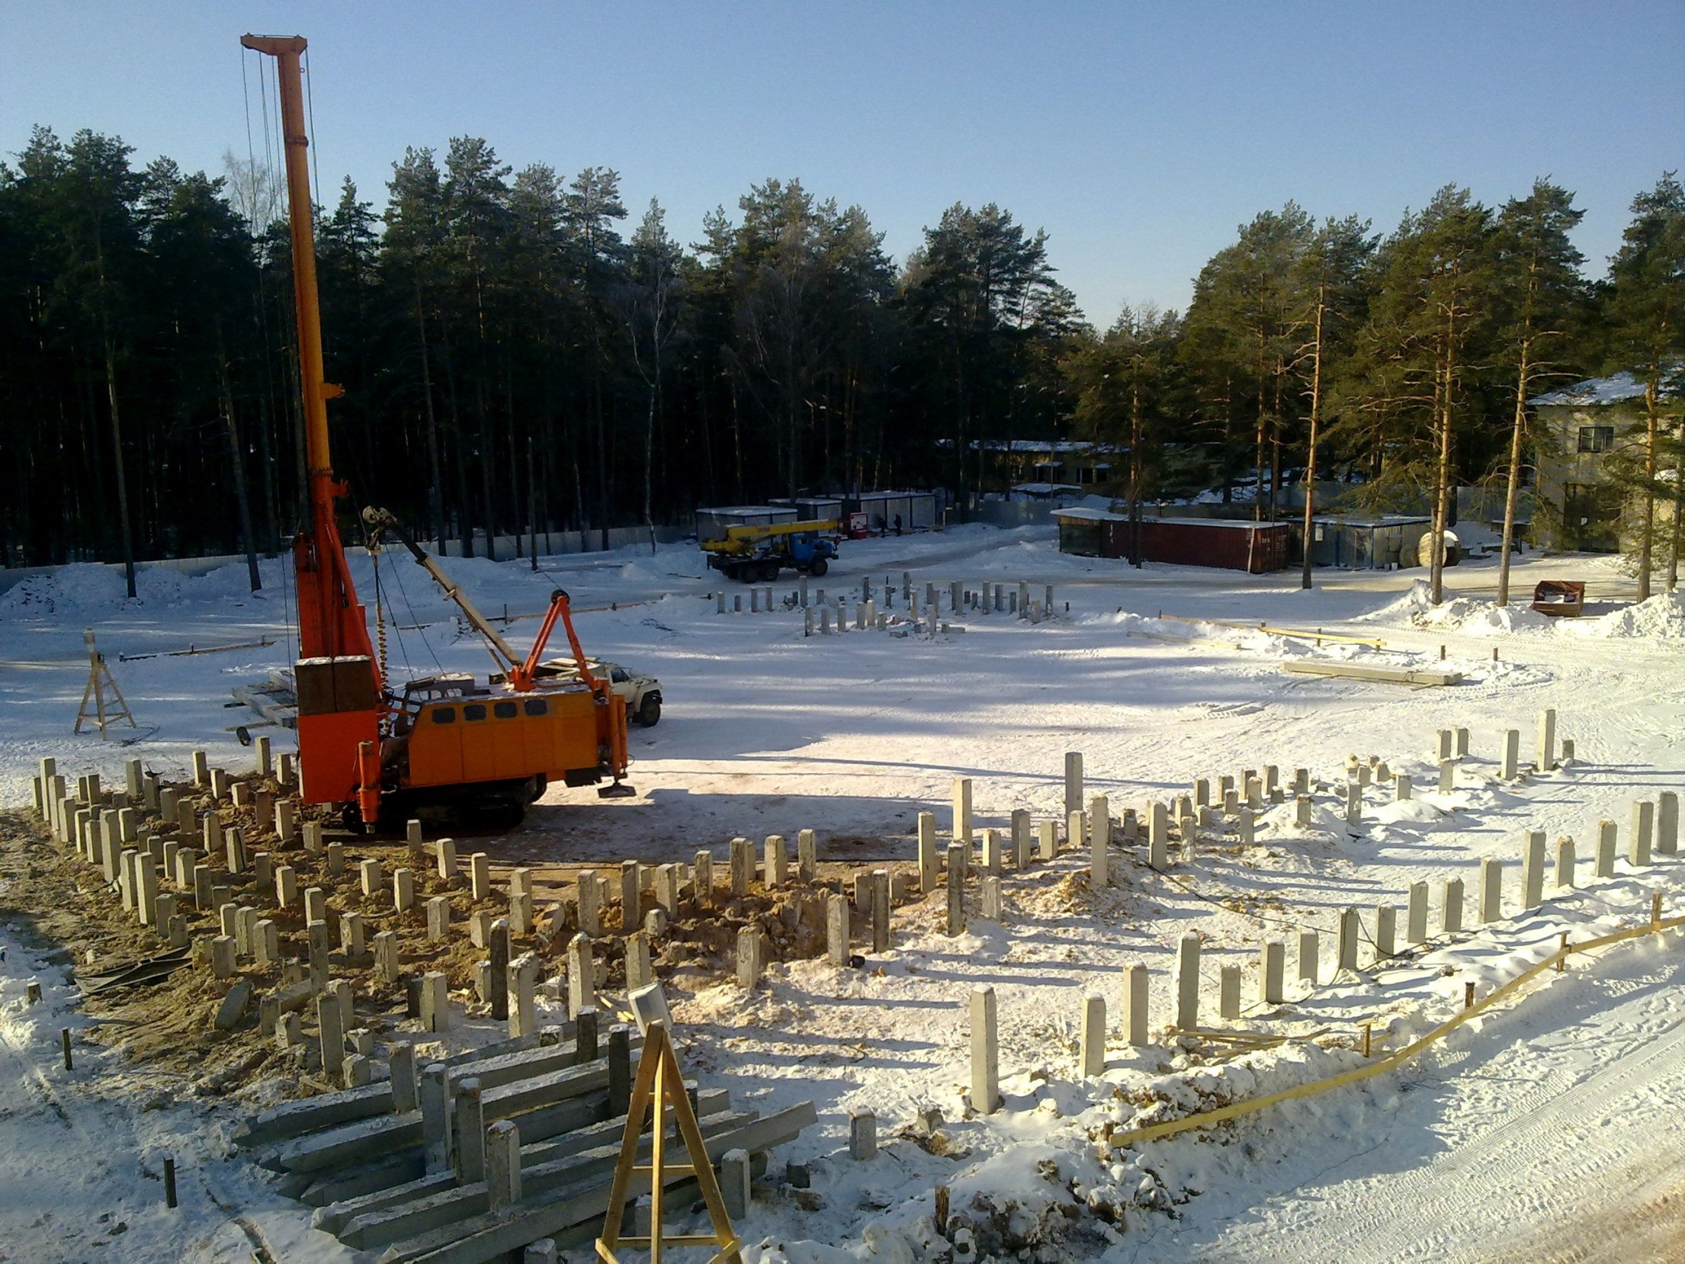
March 2012, Dubna
Yu. Oganessian Heavy Ion Research at JINR, July 4-8, 2022, St. Petersburg

Slide 8
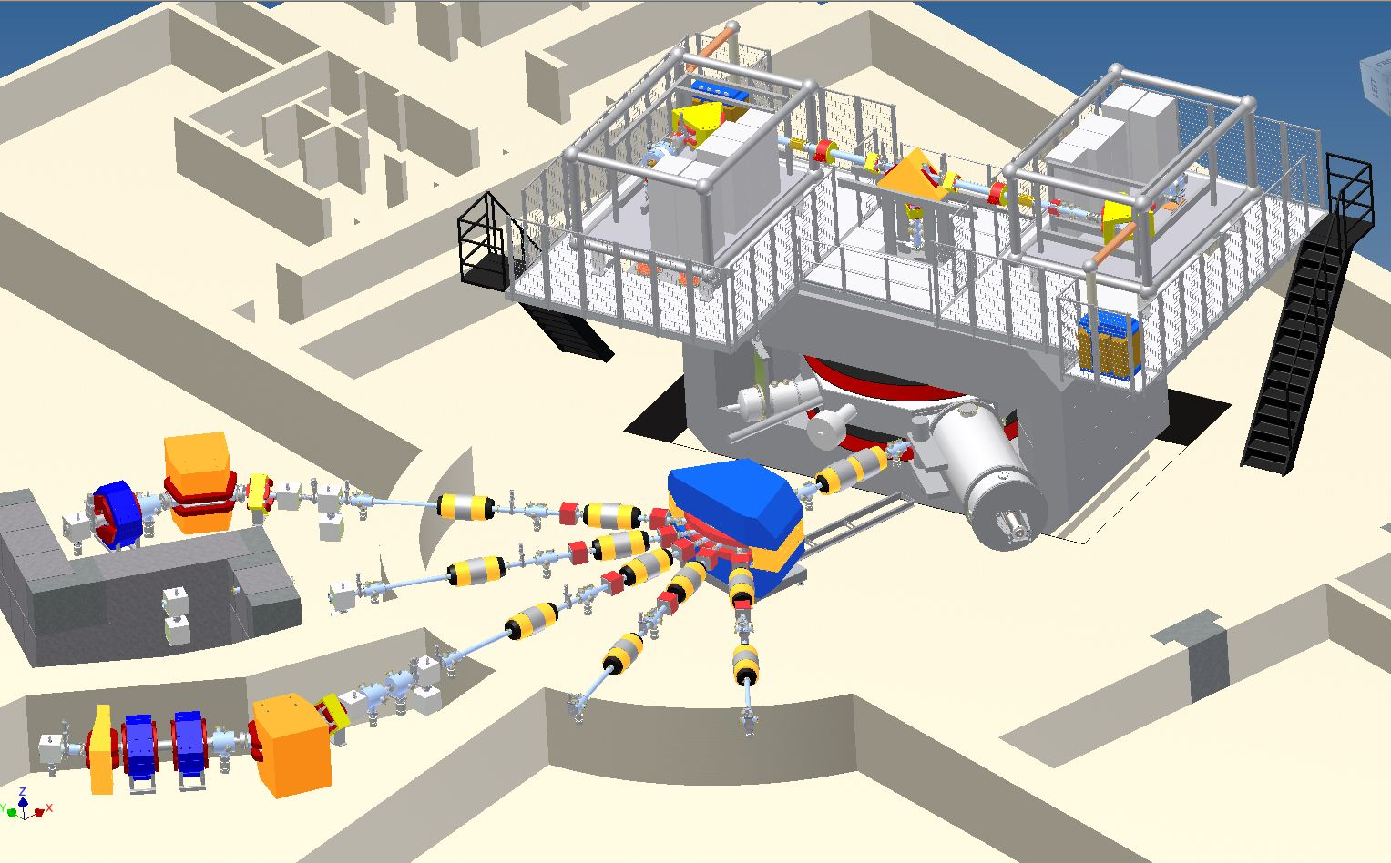
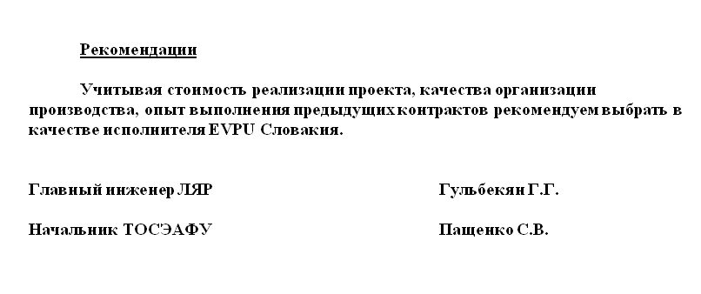
30kV Ion Beam Separation
100 kV Ion Beam Bending
30kV ECR Source
100kV Platform
1
5
2
3

Slide 9
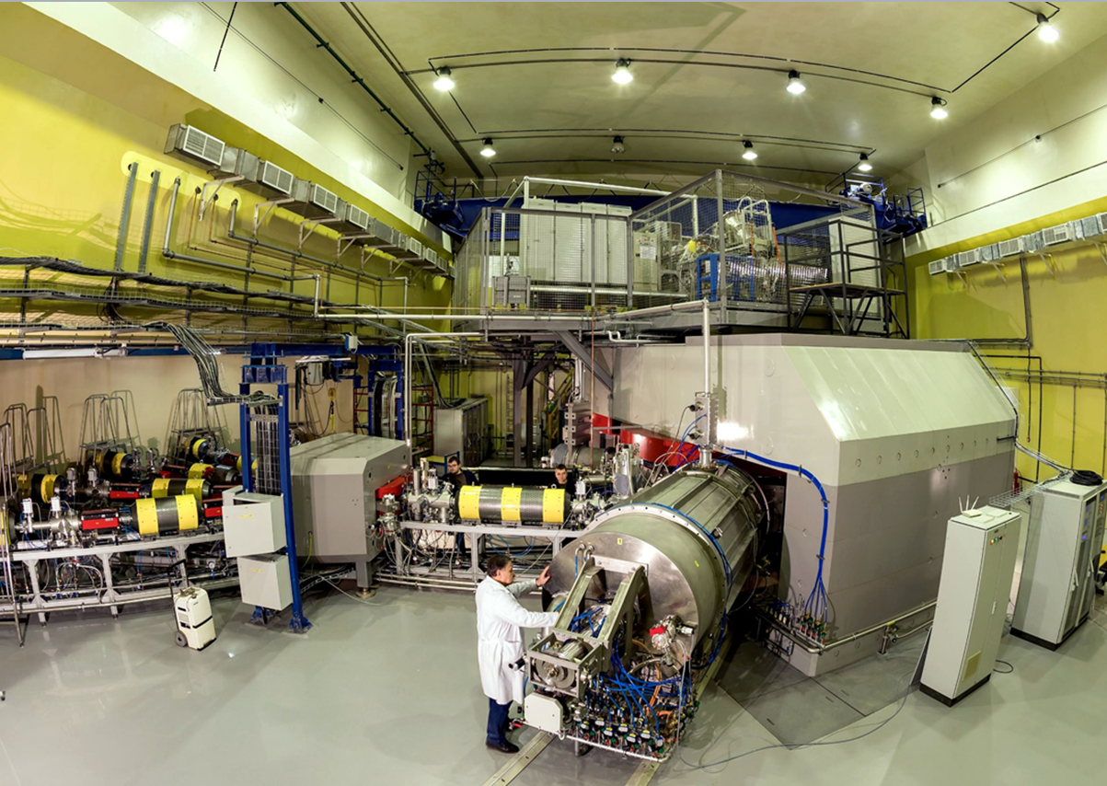
⁷Li – ⁴⁸Ca – ¹³⁶Xe | 10 pµA
²³⁸U | 0.01 pµA
March 2018, Dubna
New cyclotron DC-280
Yu. Oganessian Heavy Ion Research at JINR, July 4-8, 2022, St. Petersburg
Notes:
SHE-Factory is equipped with new accelerator capable of deliver the ion beams with an intensity 10 times higher what we currently have.

Slide 10
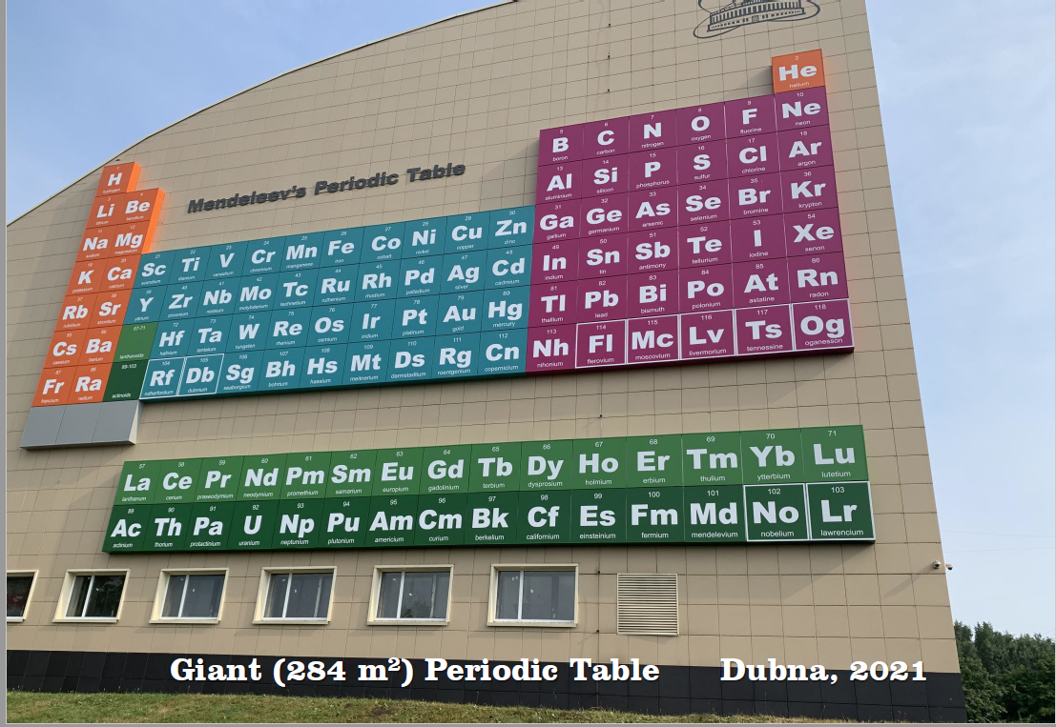

Slide 11
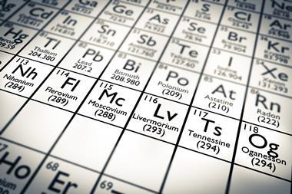
2000-2015
From ⁴⁸Ca induced reactions

Slide 12
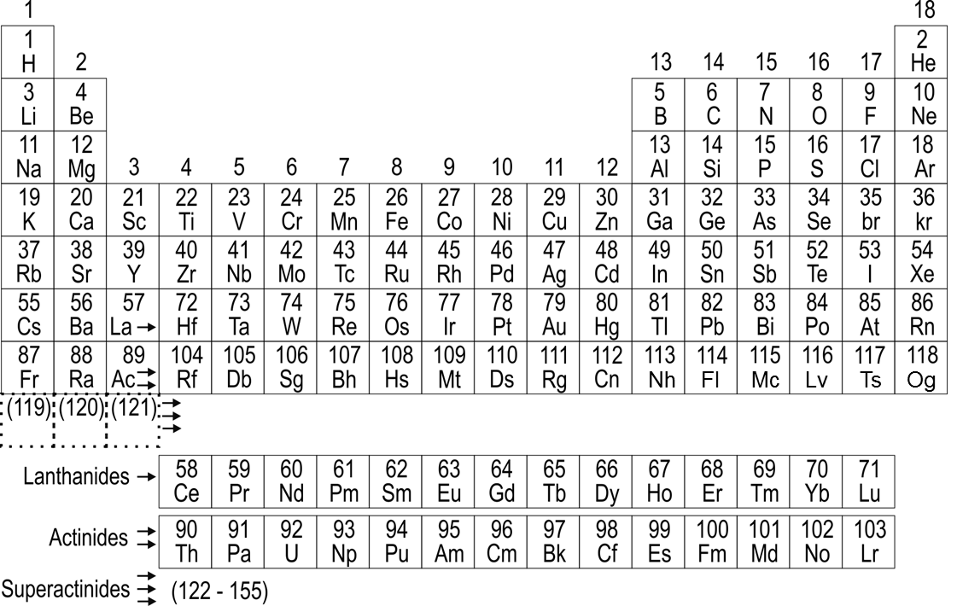
Beams
2.5 pµA
1670⁰С
melting
1455⁰С
Ca
Ti
Cr
Fe
Ni
Fe
Ni
Zn
Kr
7.5 pµA
on target
at 1.5 mg/h
Pb
Bi
28 GHz ECR
Ion source
U
1-3 pµA
Yu. Oganessian Heavy Ion Research at JINR, July 4-8, 2022, St. Petersburg
Notes:
So far, various calculations give different scenarios for the continuation of the Periodic Table. In one case, similar to the previously presented calculations, after element 121, a new series of Super actinides will begin including 122, 123, .155 elements.
In another version, the elements will be located in the 8th row. But as the atomic number increases, the group difference in the chemical properties of the heaviest elements will disappear.

Slide 13
²³⁸U beam at SHE-Factory
50
32⁺
10
35⁺
39⁺
Beam intensity from the ion source (pµA)
42⁺
ECR 28 GHz
0.1
ECR 14 GHz
32⁺
5
6
7
8
9
10
E_{LAB} (MeVˑA)
Yu. Oganessian Heavy Ion Research at JINR, July 4-8, 2022, Dubna, St. Petersburg

Slide 14
FIRST EXPERIMENTS

Slide 15
Luminosity
target weight 30 mg
Setup | Beam Intensity (pµA) | Luminosity (10³¹/cm²ˑs) | Factor | Years
DGFRS-1 | 1.0 | 0.16 | 1 | 2000-2020
DGFRS-2 test | 1.25 | 0.4 | 2.5 | March 2021
 | 1.50 | 0.5 | 3.0 | May 2021
 | 3.0 | 1.2 | 7.2 | June 2021
 | 4.0 1.2 kW | 1.6 | 9.6 | June 2022
 | 6.51 | 2.6 | 15.5 | Apr.- May 2022
SHE
σ_{3n}= 1-10 pb
Th- target
σ_{3n} ≤ 0.1 pb
U- target
Yu. Oganessian Heavy Ion Research at JINR, July 4-8, 2022, St. Petersburg

Slide 16
2000

Slide 17
Доплывают до берега, а поднимаются на вершину,,
120
Og
Z
2010
Ts
Lv
Mc
²⁹⁸Fl
Fl
Nh
Exp.
Cn
110
²⁷⁰Hs
Theory
²⁵²Fm
Island of SHE
100
²³⁸U
90
140
150
160
170
N
180
190
Yu. Oganessian Heavy Ion Research at JINR, July 4-8, 2022, St. Petersburg

Slide 18
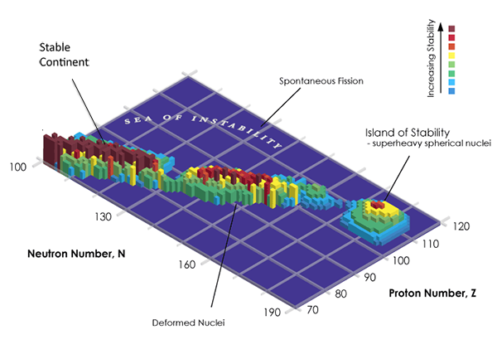
SH-nuclei forms an Island of Stability
Search for Island of Stability
- super heavy compound nuclei
Yu. Oganessian Heavy Ion Research at JINR, July 4-8, 2022, Dubna, St. Petersburg

Slide 19
SH-nuclei forms an Island of Stability
This confirm once again
the original definition about
an Island of Stability of SHN
170
Yu. Oganessian Heavy Ion Research at JINR, July 4-8, 2022, St. Petersburg

Slide 20
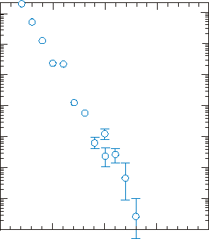
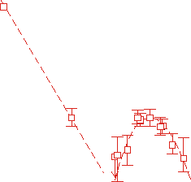
Neutron evaporation residues cross sections
(pb)
100000
Cross sections
10000
1000
100
SHE
10
6.4
⁴⁸Ca-induced
reactions
5.7
5.5
1
Cold fusion
5.6
4.1
0.1
0.01
100
105
110
115
120
Atomic number

Slide 21
SH-nuclei forms an Island of Stability
Search for
Z=110, N=170
²³²Th + ⁴⁸Ca reaction
strait is rather deep!
170
Yu. Oganessian Heavy Ion Research at JINR, July 4-8, 2022, Dubna, St. Petersburg

Slide 22
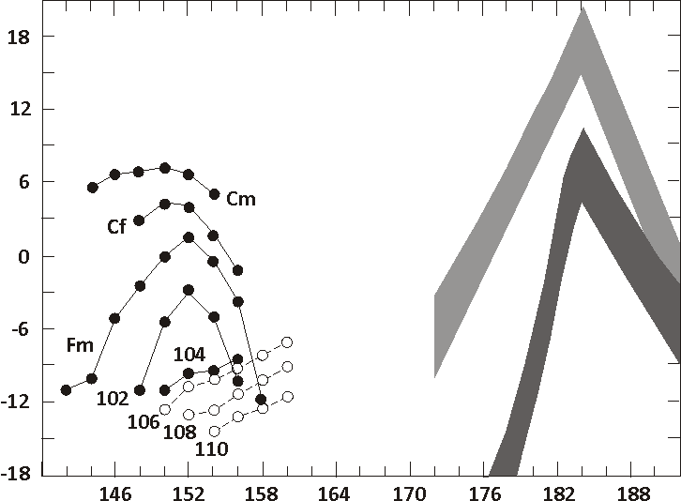
predictions
our world
Fiset and Nix
(1972)
Age of Earth
Log of the Spontaneous Fission Half Lives (years)
1 y
?
Randrup et al.
(1974)
1 s
Z=114
```````````````````````````
1 μs
Z=114
Z=110
Neutron number
Yu. Oganessian Heavy Ion Research at JINR, July 4-8, 2022, St. Petersburg

Slide 23
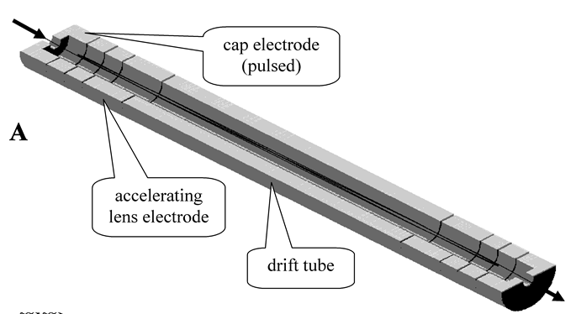
A very promising in this area is a MR-TOF method
(multiple reflections of an SH-atom from electric mirrors)
developed at GSI (Darmstadt).
General view of the ion mirror.
cap electrode
(pulsed)
ΔM/M ≤ 10⁻⁶
accelerating
lens electrode
drift tube)
The upper half electrode
is removed

Slide 24
RARE DECAYS

Slide 25
Experiments at SHE-Factory
Mc (Z=115)
3 events
2003
6
55 events
²⁴³Am + ⁴⁸Ca
290
289
Mc
286
285
Nh
EC
not found
281
Rg
EC
not found
289
Mt
289
Bh
What decay modes
does this nucleus have:
α, EC, SF?
289
Db
Yu. Oganessian Heavy Ion Research at JINR, July 4-8, 2022St. Petersburg

Slide 26
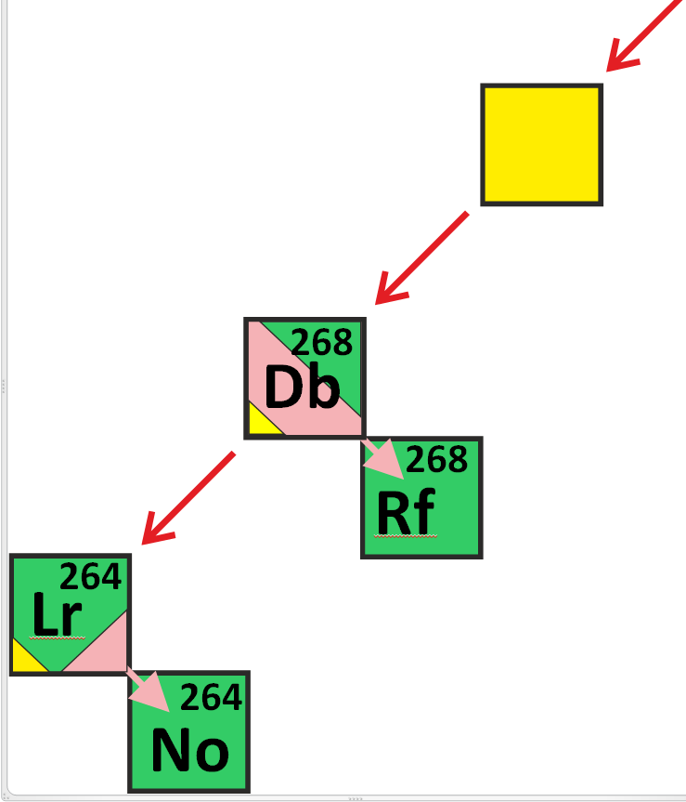
272
Bh
α₅
(T_{1/2} )_{exp} = 16 h
α₆
~ 50%
EC
~ 50%
T_{EC} ≈ 2-10 h
T_{SF} ≈ 1s
(T_{SF/EC} )_{exp}~ 5 h
Super-symmetric
spontaneous fission
T_{SF} ≈ 1s
Yu. Oganessian Heavy Ion Research at JINR, July 4-8, 2022, St. Petersburg

Slide 27
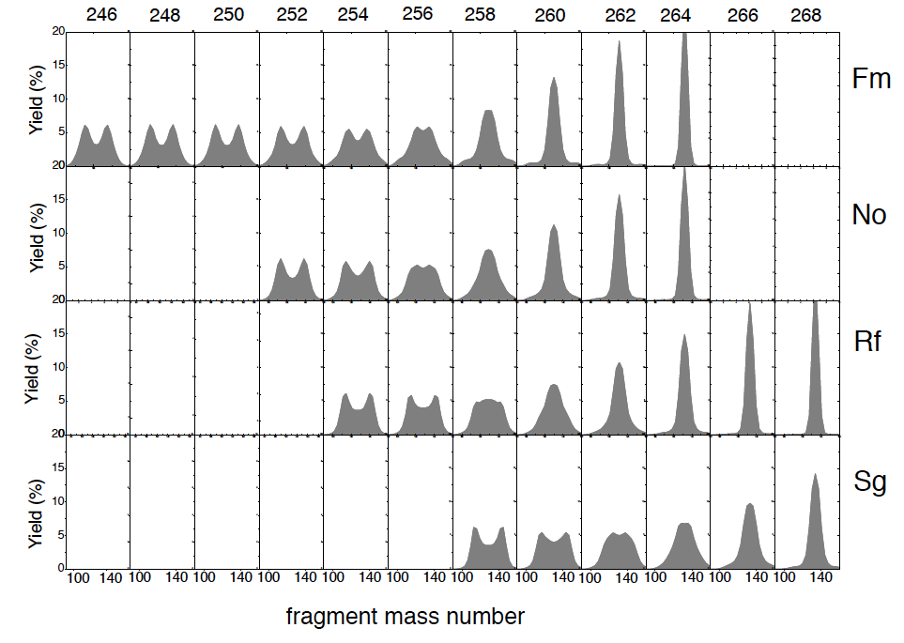
Spontaneous fission
Mass spectra of fission fragsents
²⁶⁴Rf
²⁶⁰Rf
Calc. N. Carjan, 2015
super
symmetric
fission

Slide 28
Cluster decay
Isotope | Emitted particle | Branching ratio | Log T(s) | Q (MeV)
²¹²Po | ⁴He | 1.00 | - 6.52 | 8.95
²²²Ra | ¹⁴C | 3.72 · 10⁻¹⁰ | 11.01 | 33.05
²²⁸Th | ²⁰O | 1.13 · 10⁻¹³ | 20.72 | 44.72
²³²U | ²⁴Ne | 9.15 · 10⁻¹² | 20.40 | 62.31
²³⁶U | ²⁸Mg | 2.7· 10⁻¹⁴ | 21.52 | 79.67
²⁴²Cm | ³⁴Si | 1 · 10⁻¹⁶ | 23.15 | 96.51
²⁹⁴Og | ⁸⁶Kr | ? | ?? | 304.3
Yu. Oganessian Heavy Ion Research at JINR, July 4-8, 2022, St. Petersburg

Slide 29
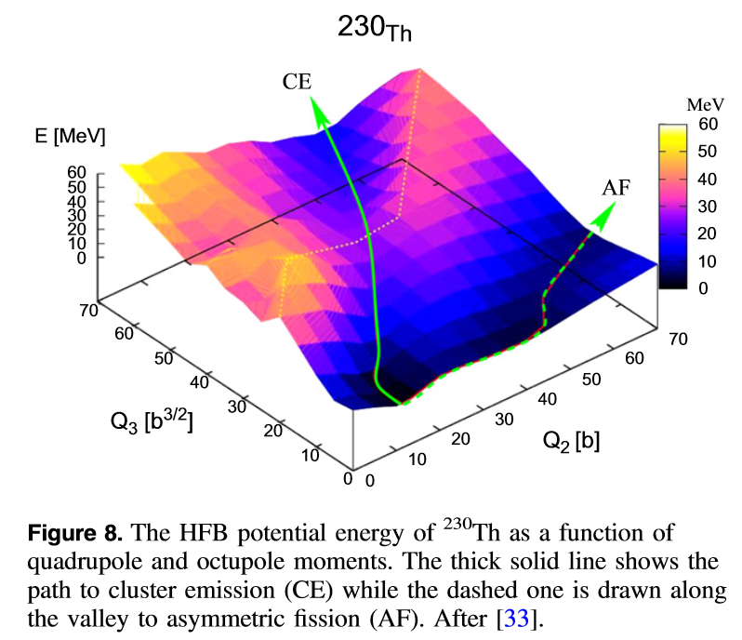
Cluster ²²O
²³⁰Th
emission
T_{1/2}=1.8ˑ10¹³ y
Asymmetric
Fission
Cluster radioactivity of ²⁹⁴Og
W. Nazarewitz et al. 2018
T_{1/2} >10²⁰ y
²⁹⁴Og
α-emission
B_{f}
²⁹⁰Lv
Cluster
α - particle
⁸⁶Kr _{(N=50)}
emission
T_{1/2}=7.5ˑ10⁴ y
²⁰⁸Pb _{(Z=82, N=126)}

Slide 30
Cluster decay
Isotope | Emitted particle | Branching ratio | Log T(s) | Q (MeV)
²¹²Po | ⁴He | 1.00 | - 6.52 | 8.95
²²²Ra | ¹⁴C | 3.72 · 10⁻¹⁰ | 11.01 | 33.05
²²⁸Th | ²⁰O | 1.13 · 10⁻¹³ | 20.72 | 44.72
²³²U | ²⁴Ne | 9.15 · 10⁻¹² | 20.40 | 62.31
²³⁶U | ²⁸Mg | 2.7· 10⁻¹⁴ | 21.52 | 79.67
²⁴²Cm | ³⁴Si | 1 · 10⁻¹⁶ | 23.15 | 96.51
²⁹⁴Og | ⁸⁶Kr | ? | ?? | 304.3
Yu. Oganessian Heavy Ion Research at JINR, July 4-8, 2022, Dubna, St. Petersburg

Slide 31
HEAVIEST ATOMS
&
CHEMISTRY OF SHE

Slide 32
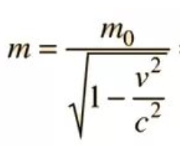
“Relativistic effect” in the electronic structure
of the heaviest elements
4.0
m/m₀
Z=174
3.0
R
2.0
Z=118
Au
standard
114
1.0
NR
0.0
0.2
0.4
0.6
0.8
1.0
v/c
Yu. Oganessian Heavy Ion Research at JINR, July 4-8, 2022, Dubna, St. Petersburg
Notes:
In fact, changes in the Periodic Table may appear much earlier than reaching the critical field due to the so-called “relativistic effect" in the electronic structure of atoms. Indeed, as the atomic number increases, the speed of all orbital electrons increases also. From the theory of relativity it is known that as the particle approaches the speed of light, its relativistic mass increases.
This effect will be greatest for electrons closest to the nucleus where electrons have highest speed. As will follow, the “relativistic effect” will lead to compression of the internal orbits, which will affect entire electronic structure of the atom.

Slide 33
Relativistic contraction
Z=118
n=2
n=3
n=4
n=1
Electron density (a.u.)
This screens the nuclear charge
for the outer electrons
… and Interactions
from all external electrons
must be taken into account
n=5
non
relativistic
n=6
nucleus
n=7
Distance (in a_{B})
Yu. Oganessian Heavy Ion Research at JINR, July 4-8, 2022, St. Petersburg

Slide 34
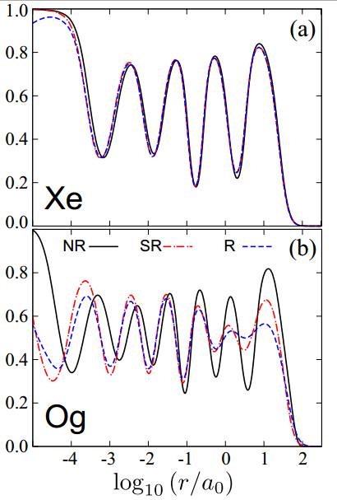
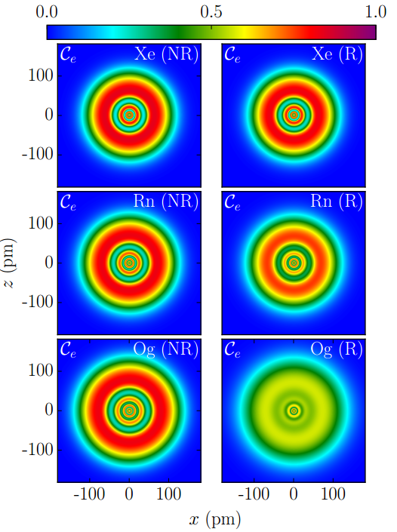
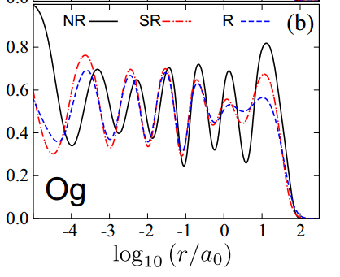
Phys. Rev. Lett.120, 053001 (2018)
P. Jerabek, B. Schuetrumpf, P. Schwerdtfeger, and W. Nazarewicz
Electron Localization Functions of SHE
non-relativistic
relativistic
1
2
3
4
5
Xe
Distance from the nucleus
(NR) - non-relativistic
(SR) - scalar-relativistic
(R) - Dirac- Hartree - Fock
Electron localization functions
Rn
1
2
3
4
5
6
7
Fermi-gas
limit
Og

Slide 35
Noble gases
P. Schwerdtfeger et al/
Angewandte Chemie 2020 (to be published)
Og
relativistic
boiling
melting
room
temperature
Temperature (K)
Rn
Xe
Kr
Ar
Ne
He
Atomic number
Yu. Oganessian Heavy Ion Research at JINR, July 4-8, 2022, St. Petersburg

Slide 36
But the relativistic effect will manifest itself already
in synthesized SHEs with Z = 112-118
Z=118
SHE
Z=112-118
P. Indelicato et al. Theor. Chim. Acta 120, 495 (2011)
-0.4
In this area the “relativistic effect”
will have a strong influence on the
electronic structure and chemistry
of the heaviest elements
-0.6
1s-electron binding energy (MeV)
-0.8
173.17
-1.0
120
130
140
150
160
170
Atomic number
Yu. Oganessian Heavy Ion Research at JINR, July 4-8, 2022, St. Petersburg

Slide 37
Thermal adsorption of
elements 114-117
on the Au-surface
COLD
new setup (PSI)
He/Ar
Rn
SHE
1-3 cm³
He-filled
stopping chamber
Hg
from GASSOL

Slide 38
Thermo chromatography of the Сn and Hg on the gold surface
Cn
Boiling point
Hg
84 ± 110 ⁰C
356.8 ⁰C
group 12
Yu. Oganessian Heavy Ion Research at JINR, July 4-8, 2022, St. Petersburg

Slide 39
Thermo chromatography of the SHE (Z=112 and 114)
and its light homologies on the gold surface
Z
Cn
Fl
Boiling point
~[-90] ⁰C
Hg
84 ± 110 ⁰C
~[20] ⁰C
Pb
356.8 ⁰C
1750 ⁰C
Gas at the room
temperature!
group 12
group 14

Slide 40
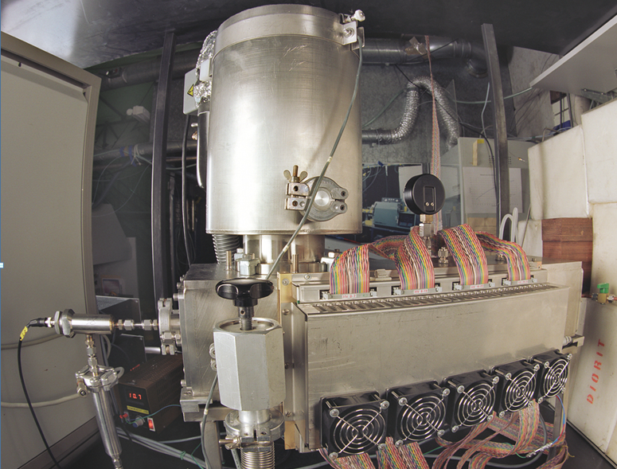
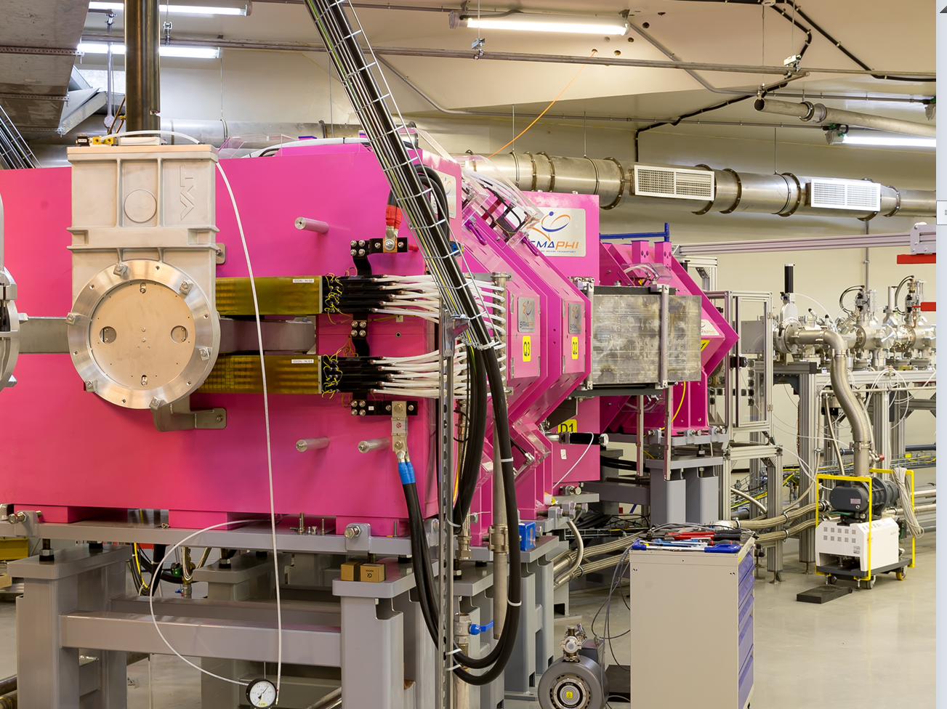
DGFRS-III separator
Targetbox
COLD
setup COLD (PSI)
Yu. Oganessian Heavy Ion Research at JINR, July 4-8, 2022,, St. Petersburg

Slide 41
Super heavy atoms
Z | Isotope | Half-life
112 | ²⁸³Cn | 3.6 s
113 | ²⁸⁴Nh | 0.9 s
114 | ²⁸⁷Fl | 0.5 s
114 | ²⁸⁹Fl | 1.9 s
115 | ²⁸⁸Ms | 0,16 s
116 | ²⁹³Lv | 57 ms
117 | ²⁹⁴Ts | 51 ms
118 | ²⁹⁴Og | 0.6 ms
First experiment was conducted at Dubna
R. Eichler et al., Nature 447, (2007) 72
We will start with DGFRS-3 separator
GASSOL SC gas-filled solenoid will allow us to stop SHE in a small volume of 1-2 cm³ and study the isotopes
with T_{1/2} ≥ 30 ms
Certainly, the “relativistic effect will increase rapidly with increasing
atomic number of SHE, which may be observed today for all SHE
from 112 to element 118
Yu. Oganessian Heavy Ion Research at JINR, July 4-8, 2022, Dubna, St. Petersburg

Slide 42
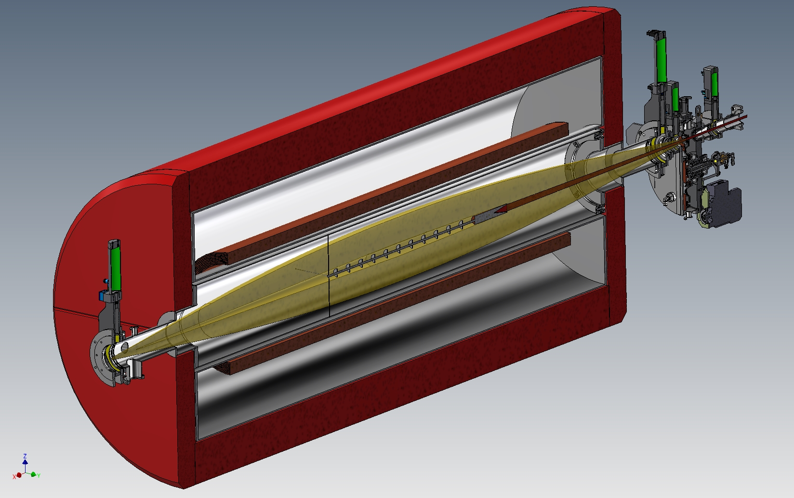
rotating
target
GASSOL
beam
axial screens
radial
screens
EVRs
beam
to He-gas
catcher
SC-coils
axial screens
beam stopper
recoil’s stopper
Yu. Oganessian Heavy Ion Research at JINR, July 4-8, 2022, St. Petersburg

Slide 43
ON THE WAY TO NEW ELEMENTS

Slide 44

A₁/A₂ = 5.17
τ_{QF}
to CN
200 MeV
touching
point
SHES
neutrons
FLNR 1962
270 MeV
SHE
SF- isomer
γ-rays
quasi
fission
SF
►
FLNR 1998►
2.36
fission from
the excited state of the CN
α
decay from
the ground state
FLNR 1963►
spontaneous
fission
1.24
Yu. Oganessian Heavy Ion Research at JINR, July 4-8, 2022, St. Petersburg

Slide 45
⁴⁸Ca + ²³⁸U
A.S. Umar et al., PRC 81, 064607 (2010)
one nucleus
di-nuclear
⁴⁸Ca
²³⁸U

Slide 46
²⁰⁸Pb
95%
²⁴⁸Cm + ⁴⁸Ca
E_{x} = 33 MeV
QUASI-FISSION
M. Itkis,
G. Knyazheva et al.
¹³²Sn
≈ 5%
FUSION-FISSION
Yu. Oganessian Heavy Ion Research at JINR, July 4-8, 2022, St. Petersburg

Slide 47
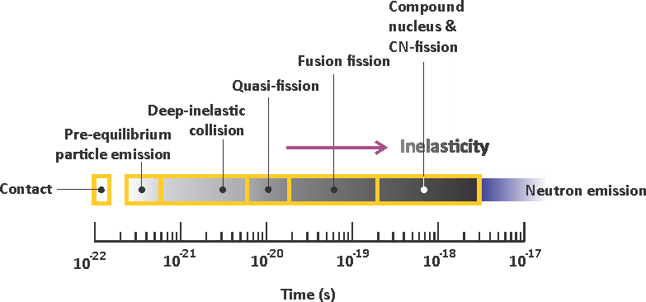
DIC
«no return»
CAPTURE
Yu. Oganessian Heavy Ion Research at JINR, July 4-8, 2022, St. Petersburg

Slide 48
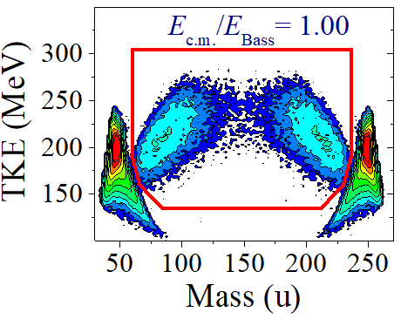
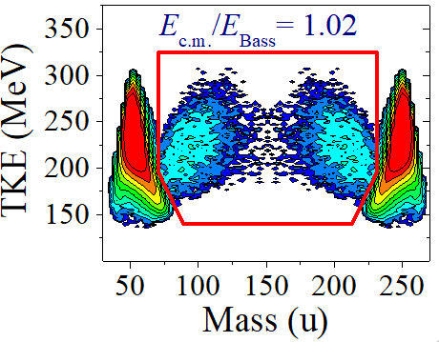
Fragment mass – energy correlations of quasi-fission
Z=116
⁴⁸Ca + ²⁴⁸Cm
Z=120
⁵⁴Cr + ²⁴⁸Cm
σ_{QF} = 65 mb
σ_{QF} = 13 mb
Yu. Oganessian Heavy Ion Research at JINR, July 4-8, 2022, St. Petersburg

Slide 49
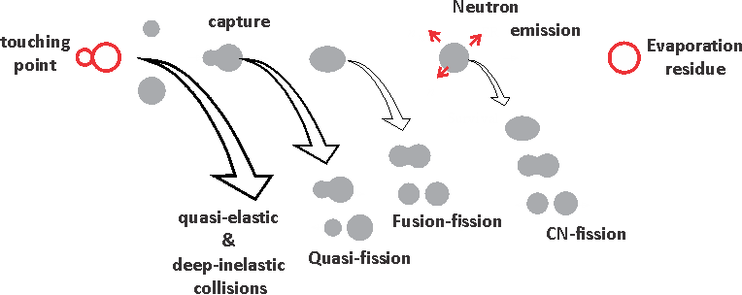
5%
0.25%
0.02%
10⁻⁹ %
50 mb
2.5 mb
0.2 mb
10⁻⁸ mb
touch
capture
survival
Yu. Oganessian Heavy Ion Research at JINR, July 4-8, 2022, St. Petersburg

Slide 50
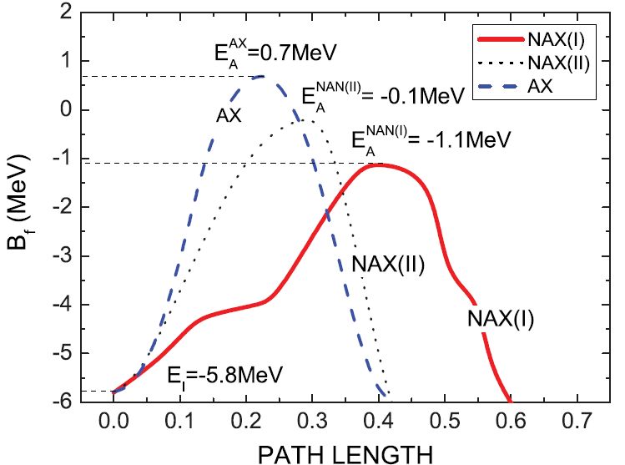
Fission barriers for even-even super heavy nuclei
M. Kowal, P. Jachimowicz and A. Sobiczewski PRC 82, 014303 (2010)
Yu. Oganessian Heavy Ion Research at JINR, July 4-8, 2022, St. Petersburg

Slide 51
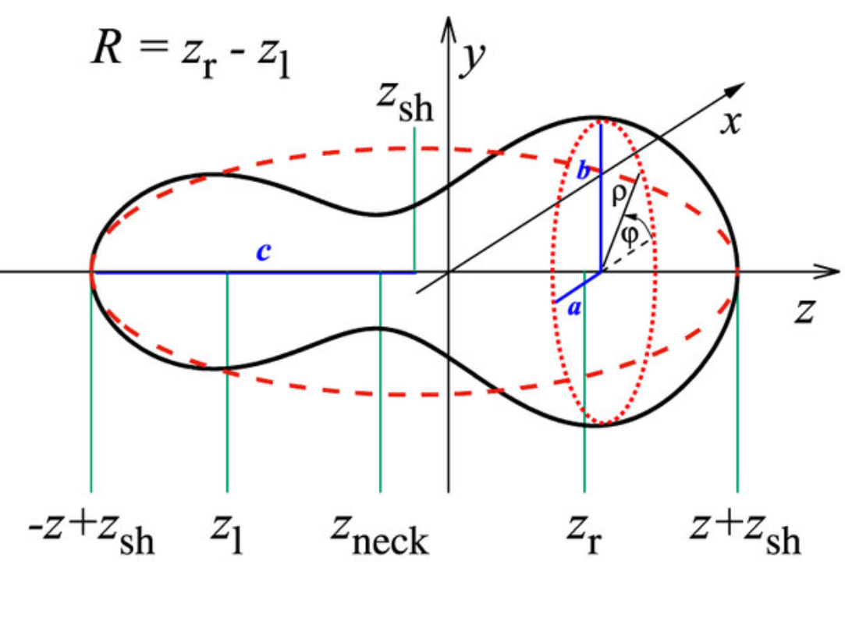
Fourier expansion of deformed nuclear shapes
Yu. Oganessian Heavy Ion Research at JINR, July 4-8, 2022, St. Petersburg

Slide 52
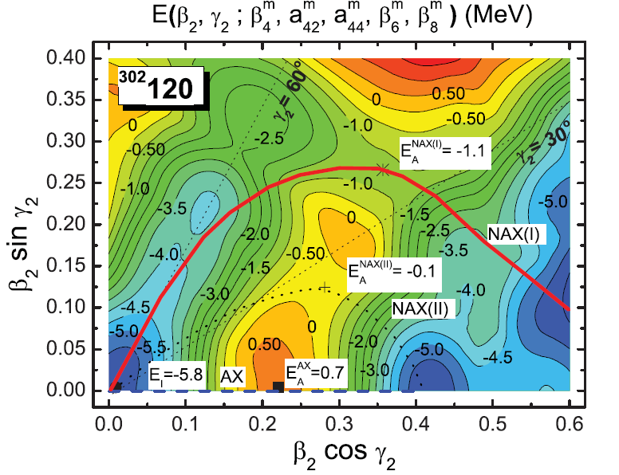
Yu. Oganessian Heavy Ion Research at JINR, July 4-8, 2022, St. Petersburg

Slide 53
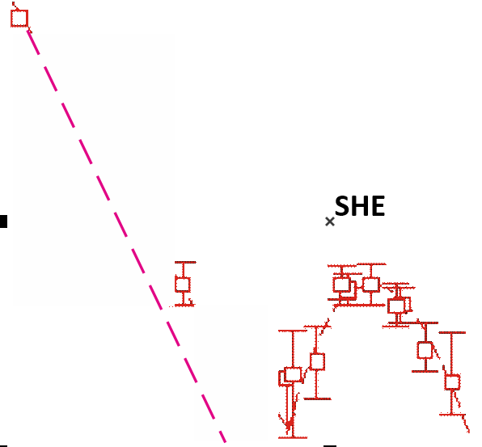
Neutron evaporation residues cross sections
(pb)
100000
Cross sections
10000
²³²Th+⁴⁸Ca → ²⁸⁰Ds
1000
²⁷⁶Ds
SF~ 80 µs
100
10
⁴⁸Ca-induced
reactions
6.4
5.7
1
5.5
Cold fusion
4.1
5.6
0.1
3.3
5.1
⁵⁴Cr+²⁴⁶Cm
0.01
²⁷⁶Ds
100
105
110
115
120
Atomic number

Slide 54
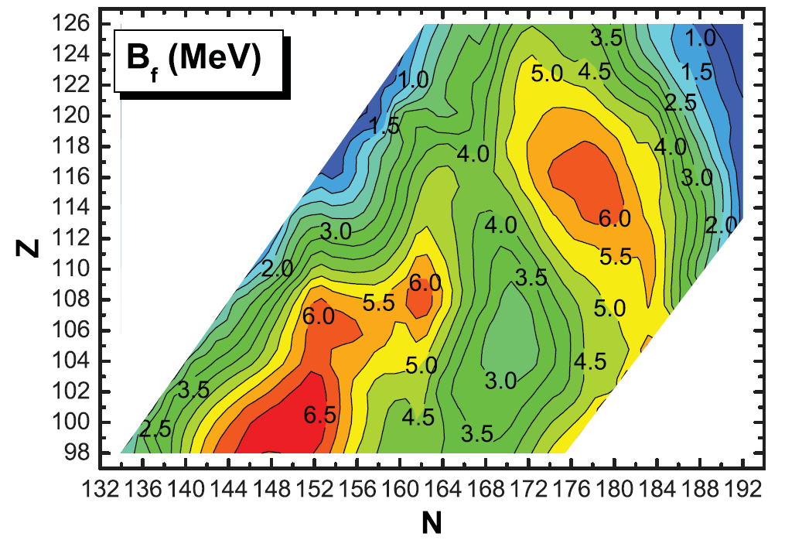
Fission barriers for even-even superheavy nuclei (MeV)
^{245, 246}Cm + ⁵⁴Cr
²⁴⁸Cm + ⁵⁴Cr
²⁴⁵Cm + ⁴⁸Ca
²⁴⁰Pu + ⁴⁸Ca
²³²Th + ⁴⁸Ca

Slide 55
LONG RANGE PLAN FOR THE ISOTOPE PROGRAM
High isotopic purity required for continued production of super heavy elements and exploration of the island of stability include:
^{233, 235}U, ²³⁷Np, ^{239, 240, 242, 244}Pu, ^{241. 243}Am,
^{245, 246, 247, 248}Cm, ²⁴⁹Bk, and ^{249, 251}Cf.
Note that with new accelerator facilities coming on-line such as the Super Heavy Element Factory in Dubna, Russia,
demand for these isotopes will increase because thicker and larger targets will be required;
current targets require ~30 mg /target.
while future requirements will increase depending on isotope, target size as well as number of targets (radiation hardness) up to 100 mg.
Yu. Oganessian Heavy Ion Research at JINR, July 4-8, 2022, St. Petersburg

Slide 56
Geography of installations
PIK (Russia)
GSI (Germany)
JINR (Dubna)
GANIL (France)
SHE-Factory
SM-3 (Russia)
ВНИИЭФ (Саров)
FRIB (USA)
ЭХП (Россия)
INFN (Italy)
2
RIKEN (Japan)
LBNL (USA)
HFIR (USA)
IMF (China)
Heavy ion Accelerator fassilities
High Flux Neutron Reactors
Isotope Separators 1
Isotope Separators 2
Yu. Oganessian Heavy Ion Research at JINR, July 4-8, 2022, St. Petersburg
Notes:
And over the next 150 years, the Periodic Table, as a pearl of knowledge, was perceived by human society with increasing interest. Many laboratories in the world created new facilities: nuclear reactors, accelerators, sophisticated setups. Many people of several generations are involved in the science of new elements.

Slide 57
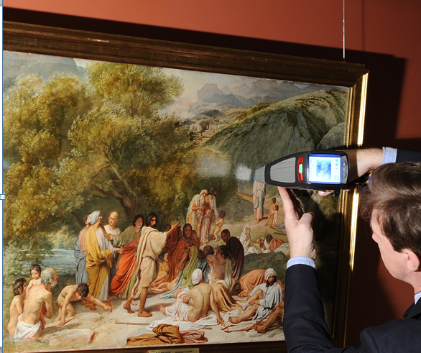
Русский музей, Санкт-Петербург
Увидеть невидимое
Римская-Корсакова
Светлана Викторовна
Ведущий научный
сотрудник

Slide 58
Благодарю за внимание!

Slide 60
Chemistry of Cn and Fl
²⁴²Pu + ⁴⁸Ca.
Temperature distribution
of the [Cn∙Au]
and
[Fl∙Au]
compounds
287
Fl
Hg
Rn
283
10.03 MeV
temperature
gradient
Cn
0.48 s
279
9.53 MeV
Ds
4.2 s
Exp.
2007
0.21 s
Cn
He/Ar gas jet →
+
Hg / Cn / Rn
T_{ads}
100
0
-100
C⁰
Au -surface

Slide 61
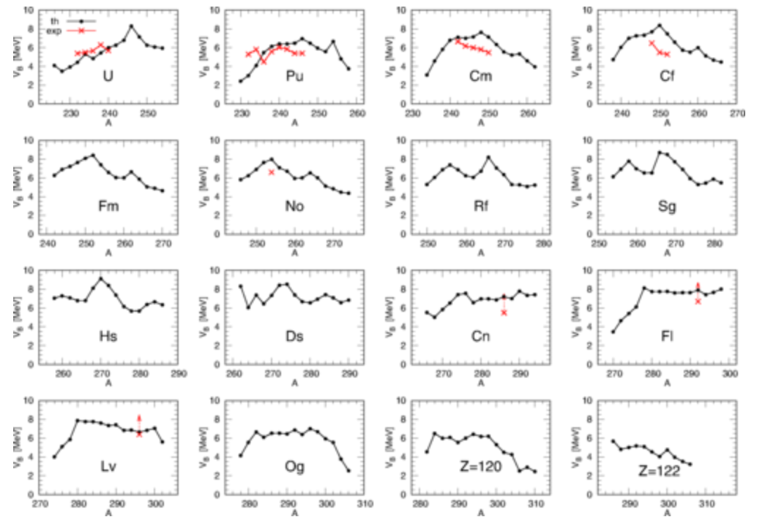
Fission barrier highs (MeV)

Slide 62
The role of triaxiality on static fission barriers is
the reduction of the barrier height due to the
quadrupole (γ2) nonaxial deformation.
It is largest (about 2 MeV) and appears in two regions of the nuclei:
one for
Z ≈ 100 and N ≈ 158 (T_{SF}=370 µs)
and the other with
Z ≈ 122 and N ≈ 180
the barrier height, which is still quite substantial for a
nuclei with Z = 118 becomes lower than 4.5 MeV for
nuclei with Z = 126 (B_{f} = 1.7 MeV)

Slide 63

SHE
SHE-Factory

Slide 64
Лауреаты Премии им Г.Н.Флерова
1993 В.В. Волков (ОИЯИ), Ю.Ц. Оганесян (ОИЯИ)
Исследования реакций передач и вклад в развитие физики тяжелых ионов.
1995 А.А. Оглоблин (Россия), Х.Г. Болен (ФРГ), В. фон Эртцен (ФРГ). 1995).
Исследование свойств легких ядер».
1997 Ю.Л. Лазарев (ОИЯИ), А. Собичевский (Польша), З. Хофманн (ФРГ).
Исследования свойств сверхтяжелых элементов вблизи Z=108 и N=162»,
2000 Г.Г. Гульбекян, В.В. Кутнер, В.Н. Гикал (ОИЯИ).
Ускорение тяжелых ионов
2003 Д. Гамильтон (США), Ф. Генненвайн (ФРГ), М.Г. Иткис и Г.М. Тер-Акопьян (ОИЯИ).
Спонтанное и вынужденное деления ядер
2007 Б.Ф. Мясоедов (РАН), М. Юссунуа (Франция) и С.Н. Дмитриев (ОИЯИ)
Радио-химические исследования в физике тяжелых ионов
2010 С. Галес (ГАНИЛ), Д. Гиймо-Мюллер (ИЯФ, Орсэ), Ю.Э. Пенионжкевич (ОИЯИ)
Синтез и свойства экзотических ядер у границ нуклонной стабильности».
2013 Ю.Н. Новиков (ПИЯФ), М. Блок (ГСИ), К. Блаум (Ин-тут М. Планка), Х.-Ю. Клюге (ГСИ).
Высокоточная масс-спектрометрии, основанная на ловушках Пеннинга.
2017 В. Назаревич (NSCL)
Теоретические исследования атомных и ядерных свойств тяжелейших ядер,
2017 Д.Б. Роберто (ORNL), В.К. Утенков, А. Шушкин (Электрохимприбор, Лесной)
Синтез тяжелейших элементов (специальная Премия).
2019 М. Полякофф (NU), Н.П. Тарасова (РХТУ им. Менделеева)
За распространении знаний и привлечение молодых ученых к к науке о новых элементах

Slide 65
Лауреаты Премии им Г.Н.Флерова
1993 В.В. Волков (ОИЯИ), Ю.Ц. Оганесян (ОИЯИ)
За исследования реакций передач и вклад в развитие физики тяжелых ионов.
1995 А.А. Оглоблин (Россия), Х.Г. Болен (ФРГ), В. фон Эртцен (ФРГ). 1995).
Исследование свойств легких ядер».
1997 Ю.Л. Лазарев (ОИЯИ), А. Собичевский (Польша), З. Хофманн (ФРГ).
Исследования свойств сверхтяжелых элементов вблизи Z=108 и N=162»,
2000 Г.Г. Гульбекян, В.В. Кутнер, В.Н. Гикал (ОИЯИ).
Ускорение тяжелых ионов
2003 Д. Гамильтон (США), Ф. Генненвайн (ФРГ), М.Г. Иткис и Г.М. Тер-Акопьян (ОИЯИ).
Спонтанное и вынужденное деления ядер под действием нейтронов и заряженных частиц.
2007 Б.Ф. Мясоедов (РАН), М. Юссунуа (Франция) и С.Н. Дмитриев (ОИЯИ)
«Радио-химические исследования в физике тяжелых ионов»
2010 С. Галес (ГАНИЛ), Д. Гиймо-Мюллер (ИЯФ, Орсэ), Ю.Э. Пенионжкевич (ОИЯИ)
«Синтез и свойства экзотических ядер у границ нуклонной стабильности».
2013 Ю.Н. Новиков (ПИЯФ), М. Блок (ГСИ), К. Блаум (Ин-тут М. Планка), Х.-Ю. Клюге (ГСИ).
Высокоточная масс-спектрометрии, основанная на ловушках Пеннинга.
2017 В. Назаревич (NSCL)
Теоретические исследования атомных и ядерных свойств тяжелейших ядер,
Д.Б. Роберто (ORNL), В.К. Утенков, А. Шушкин (Электрохимприбор, Лесной)
Синтез тяжелейших элементов (специальная Премия).
2019 М. Полякофф (NU), Н.П. Тарасова (РХТУ им. Менделеева)
За распространении знаний и привлечение молодых ученых к химии

