Slide 1
Study of the systematics in determining the symmetry plane for Bi-Bi collisions at √S_{NN} 9.2 GeV in the DCM-QGSM-SMM model
Valerii Troshin NRNU MEPhI
Cross-PWG meeting in MPD
14.06.2022

Slide 2
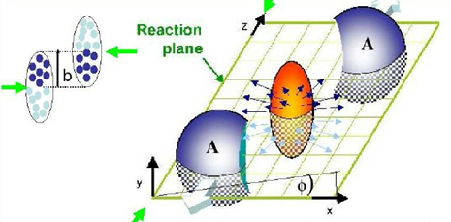
Collective anisotropic flow
The spatial asymmetry of the energy distribution at the initial moment of the collision of nuclei is transformed, through the strong interaction, into the momentum anisotropy of the produced particles
Fourier series expansion of particle distribution in azimuthal angle with respect to the reaction plane angle
The expansion coefficients:
In the experiment, we can get the event plane angle Φ_{n} , relative it:
R_{n} — Resolution of Φ_{n}
for the reaction plane angle Ψ_{RP}:

Slide 3
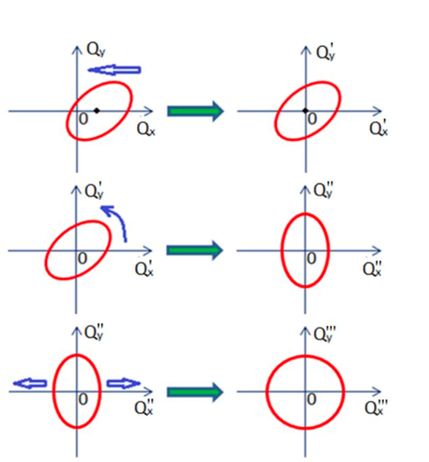
Scalar product method
Corrections for non-uniform acceptance
Each particle with an azimuthal angle ϕ is assigned a vector u:
recentering
The sum of these vectors determines the Q-vector of the event
twist
Event-averaged correlation of u-vectors with Q-vector depends on v_{n}
rescale
a,b - sub-events

Slide 4
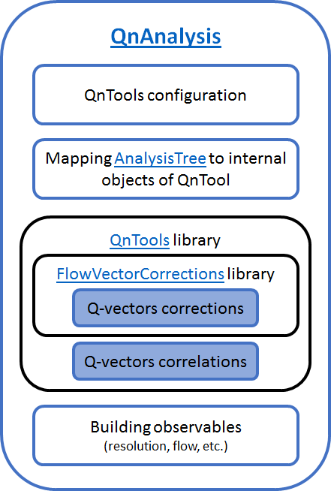
The QnAnalysis package
Motivation:
•Decoupling configuration from implementation
•Persistency of analysis setup
•Co-existence of different setups (easy systematics study)
•Unification of analysis methods
•Self-descriptiveness of the analysis results
QnAnalysis requirements:
•ROOT ver. ≧ 6.20 (with MathMore library)
•C++17 compatible compiler
•CMake ver. ≧ 3.13
Can be easily installed on NICA cluster using ROOT and CMake modules
Git repository: https://github.com/HeavyIonAnalysis/QnAnalysis

Slide 5
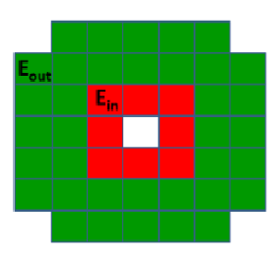
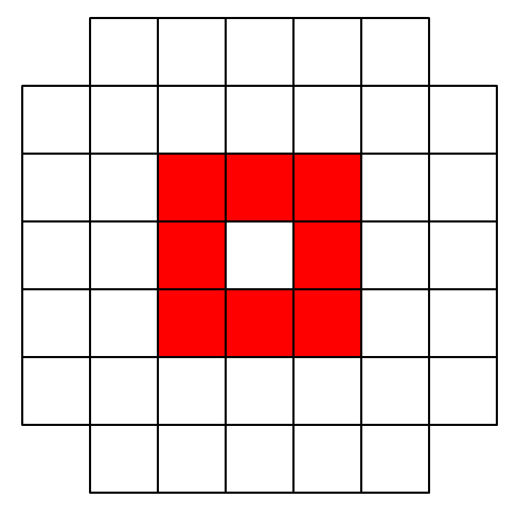
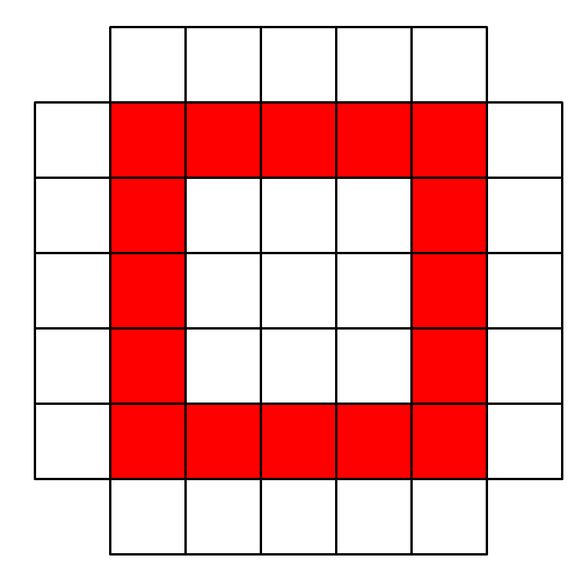
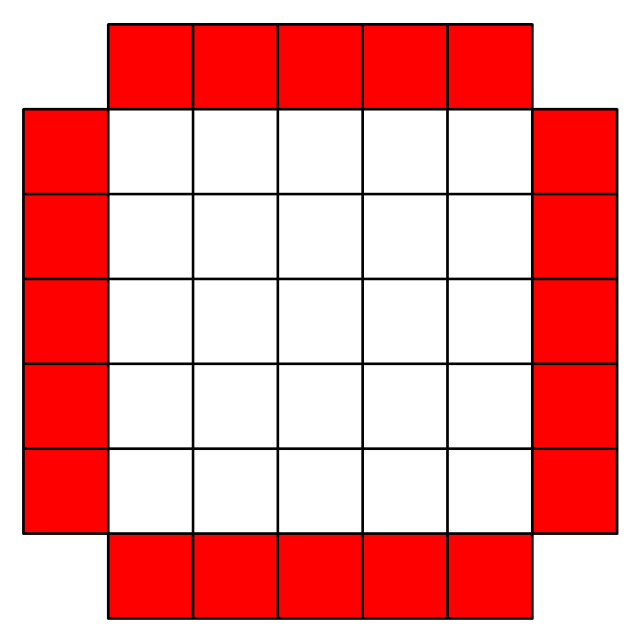
FHCal’s role in scalar product method
FHCal is used to form Q-vectors of sub-events according to the angular distribution of spectator energy in modules:
ϕ_{i} —azimuthal angle of modules № i in FHCal, w_{i} — energy in module
Sub-events can be formed by Right(South) and Left(North) FHCal and also by the rings of FHCal modules
Inner Middle Outer
When studying correlations, the following values is also considered:

Slide 6
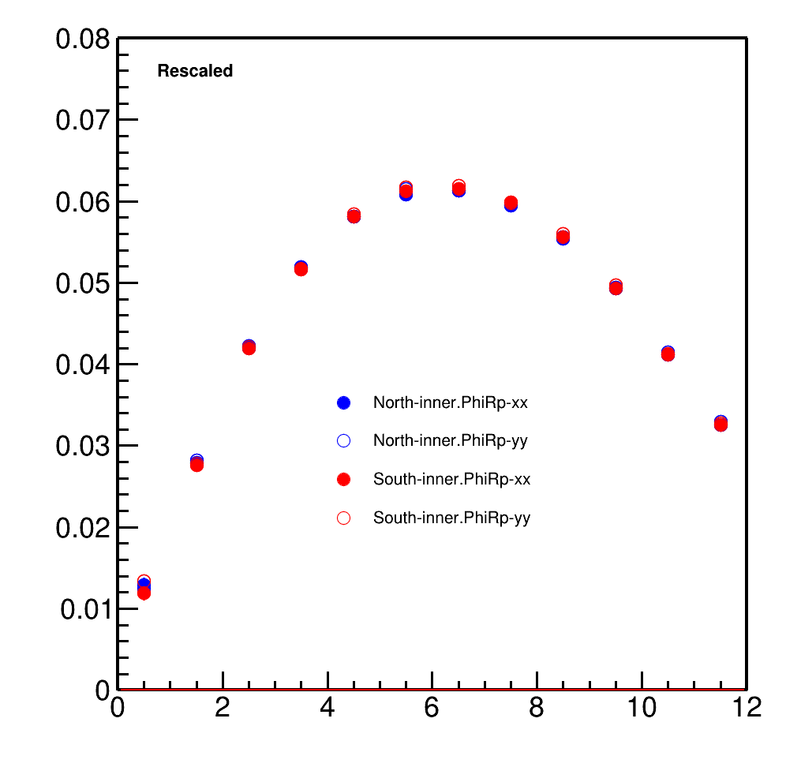
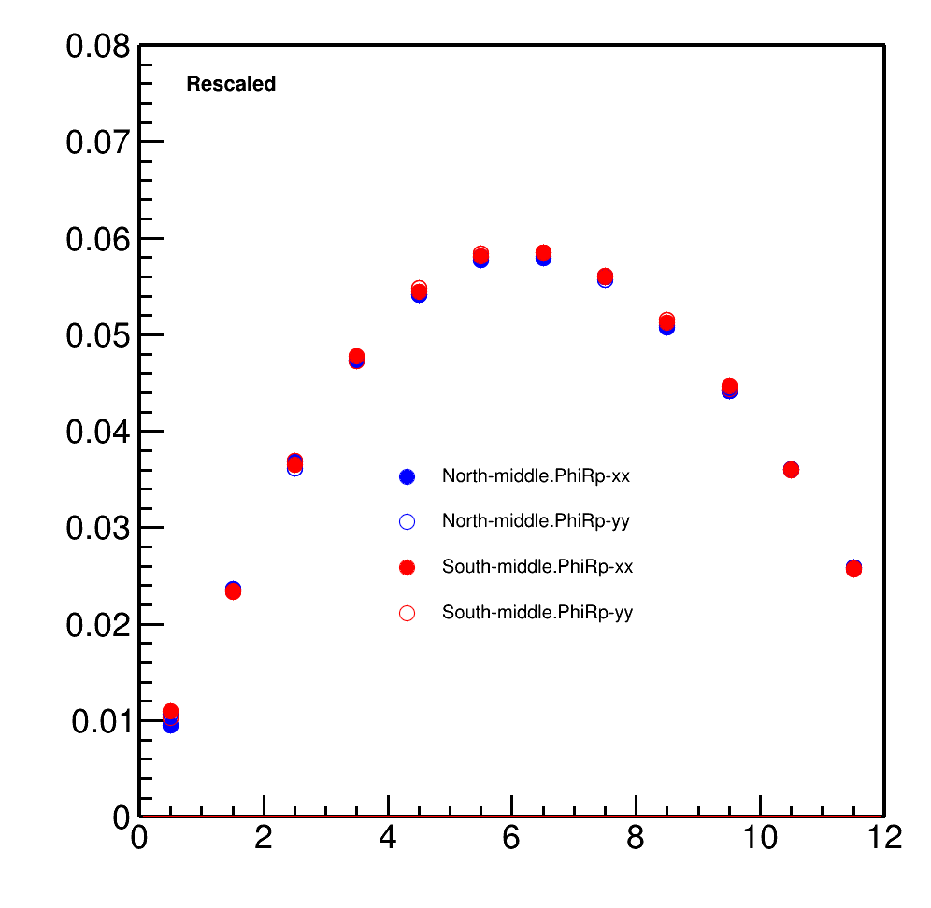
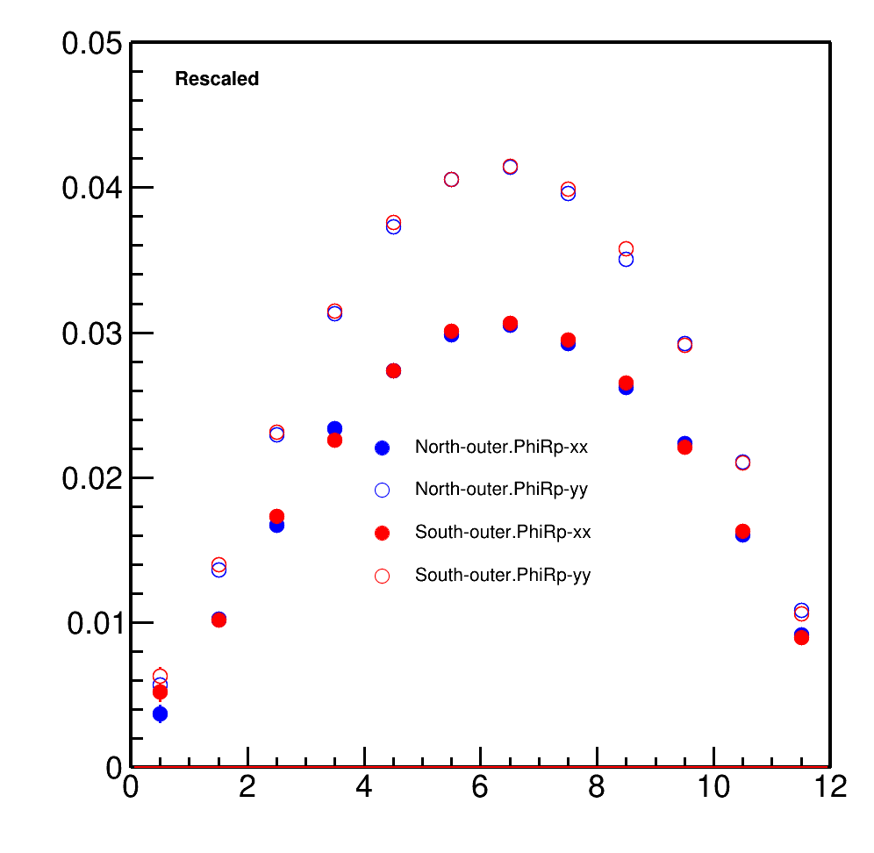
Correlation of Q-vectors in FHCal’s rings with reaction plane angle PhiRp
Inner ring
Middle ring
Outer ring
XX and YY components diverge for outer ring

Slide 7
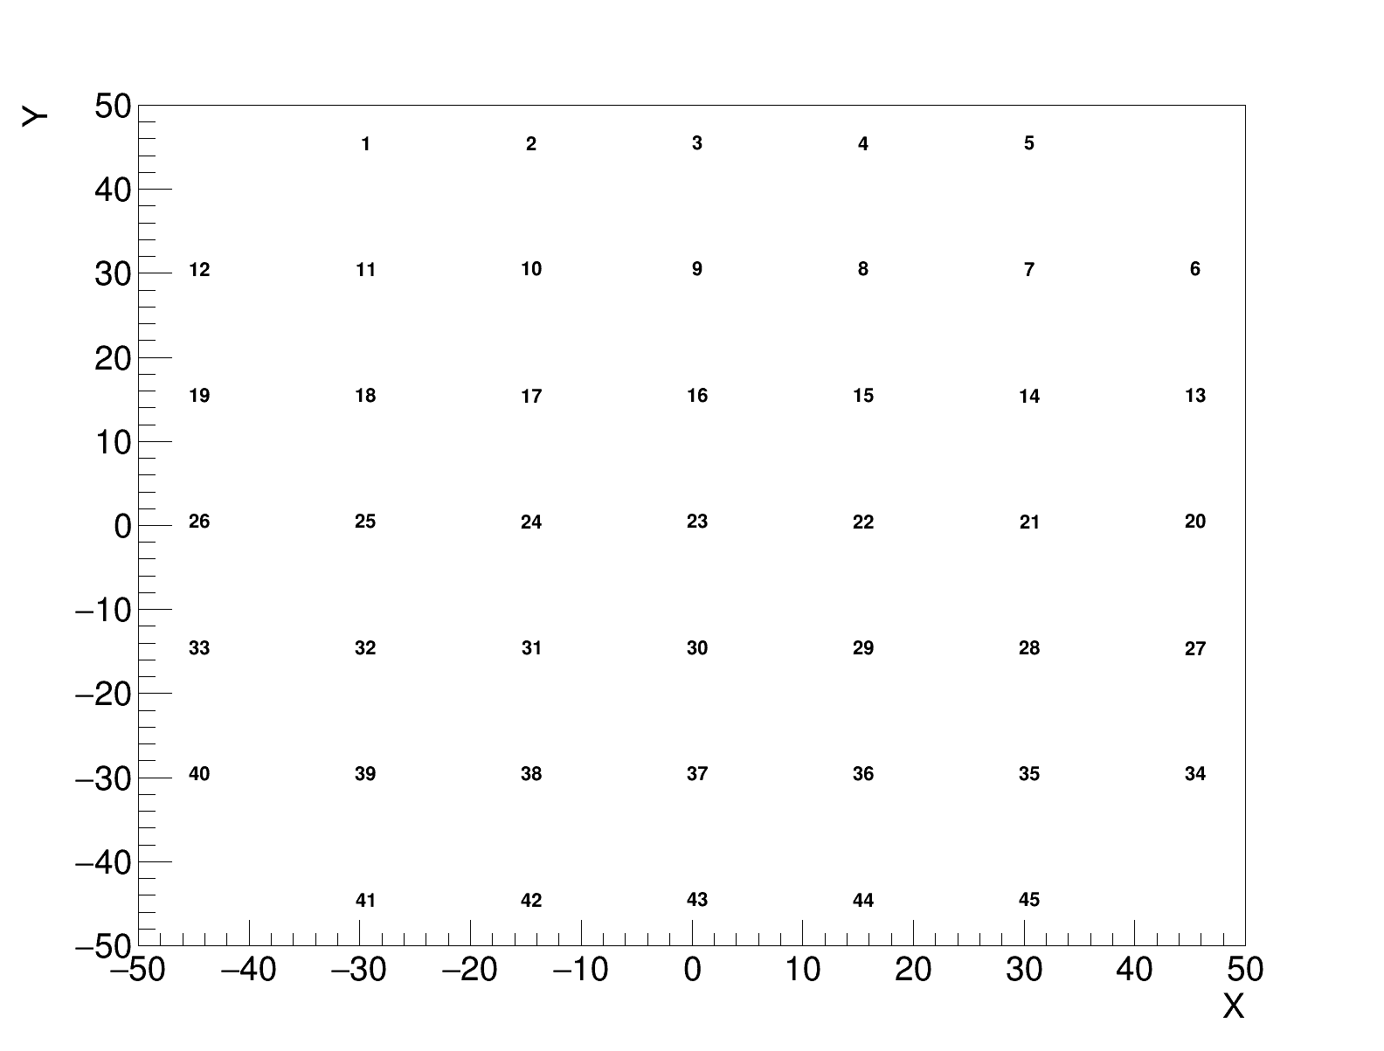
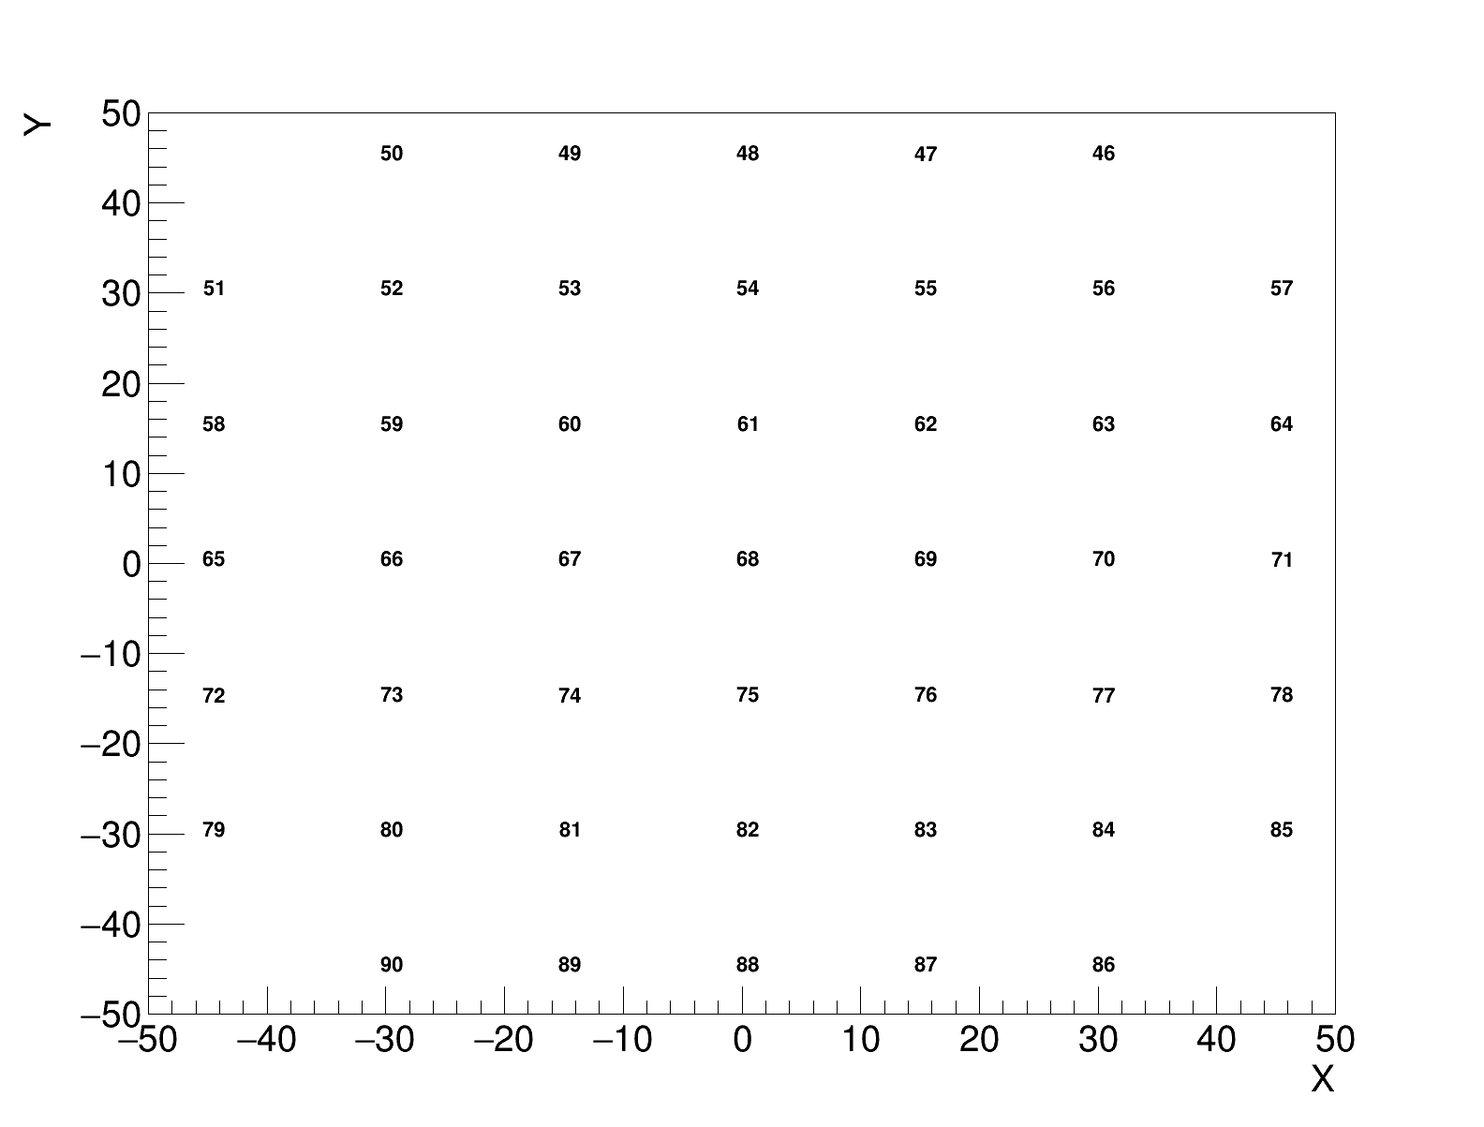
FHCal Module numbering
Left
Right
The first and last lines are numbered in the wrong direction. Can we obtain module coordinates from MPDROOT?

Slide 8
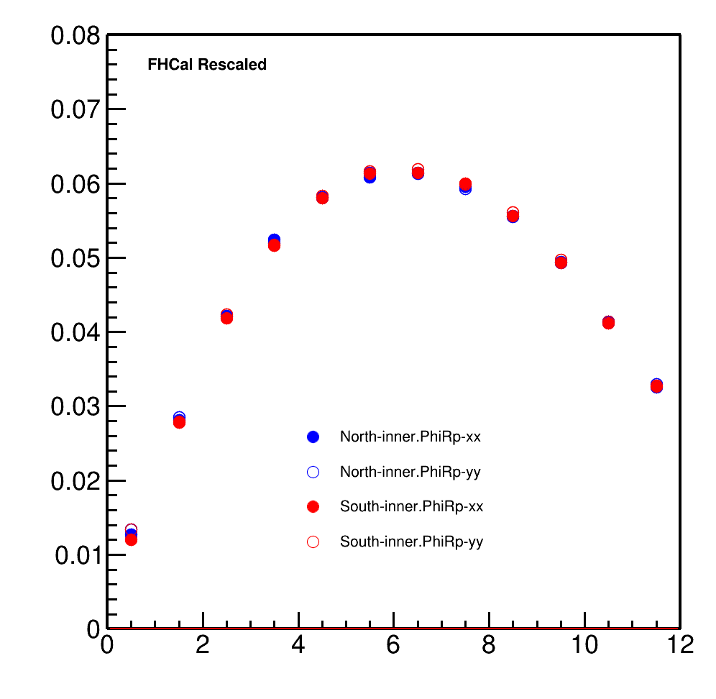
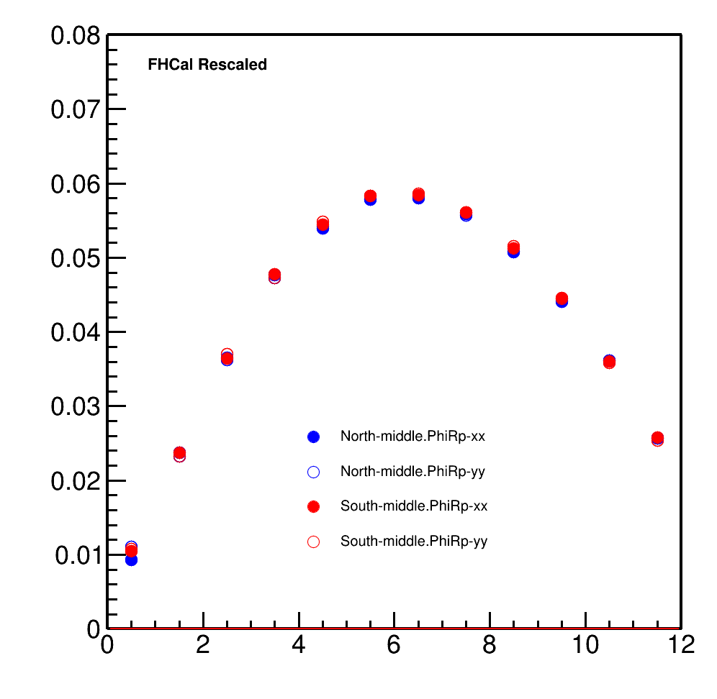
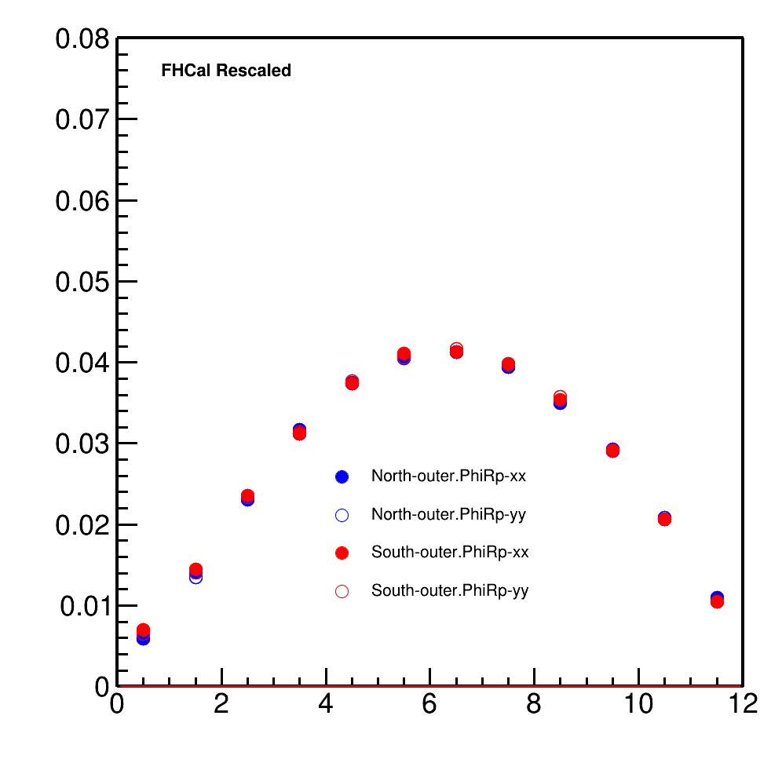
Correlation of Q-vectors in FHCal’s rings with reaction plane angle PhiRp
Inner ring
Middle ring
Outer ring

Slide 9
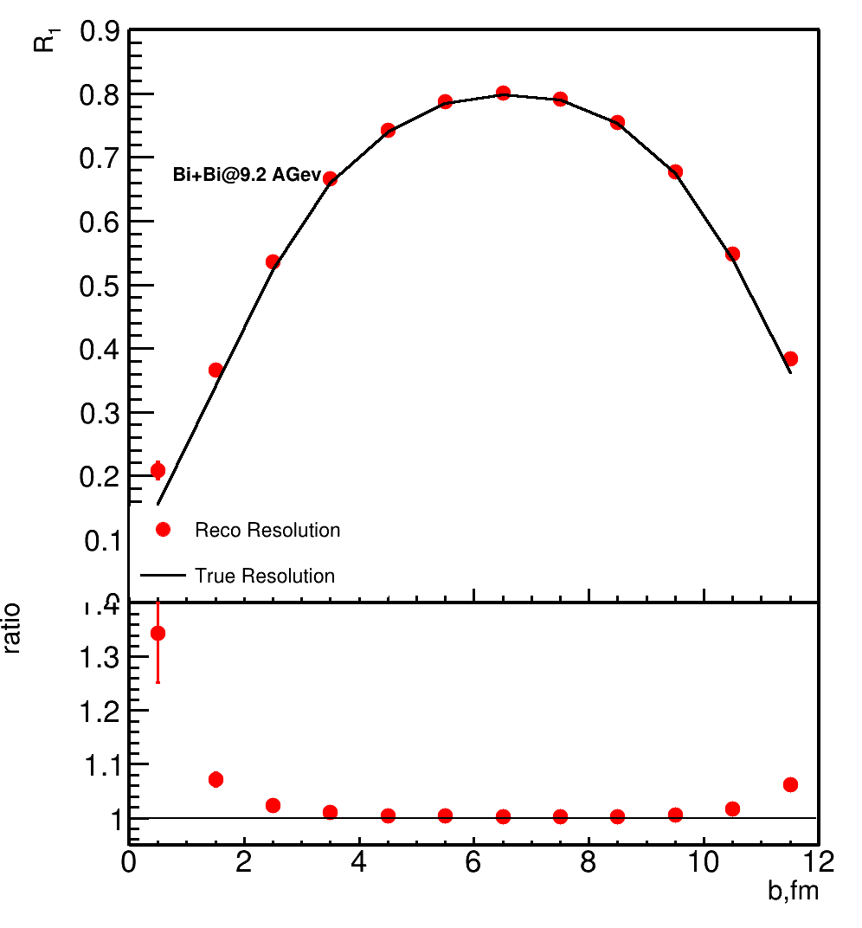
Ratio of True Resolution and Reco Resolution
good agreement for mid-central collisions
necessary to study difference for central collisions

Slide 10
Summary
An error was detected in the calculation of FHCal module coordinates
Two sub-events method is applicable to calculate first harmonic Resolution for mid-central collisions
It is necessary to study difference for central collisions
Three sub-events method is needed to study further

Slide 11
Thanks for your attention!

