Slide 1
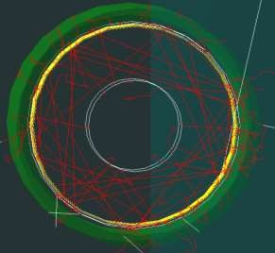
FCalPulse modeling progress report
M.Manashova 23/05/2022

Slide 2
Task
do the particles get into the LAr?
split LAr into phi-z (8x8)
generate N events and get the distribution of deposited energy in each cell (8x8).

Slide 3
Divide LAr into phi-z
LAr gap
split into 64 parts 8x8

Slide 4
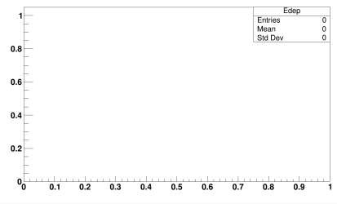
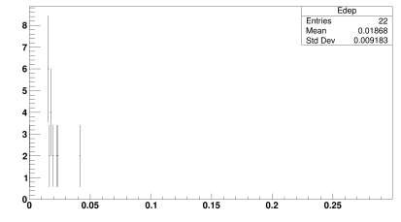
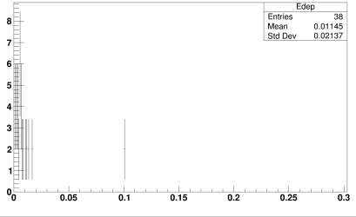
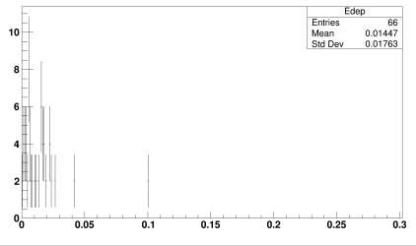
Deposited energy distribution
entries
entries
E, MeV
E,
MeV
entries
entries
E,
MeV
E,
MeV

Slide 5
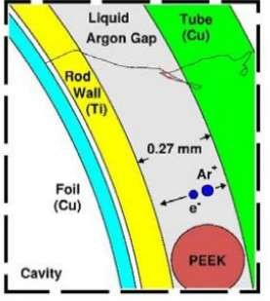
N event | Volume | Parent ID | E_dep(step) , MeV | E_dep_tot al, MeV
1 | Cavity_Logi cal | 0 | 9.50539e- 07 | 0.0010433 4
 | Wall_Logica l | 0 | 0.00104224
 | Cavity_Logi cal | 0 | 1.55968e- 07
2 | Cavity_Logi cal | 0 | 1.05857e- 07 | 0.0010434 5
33 | Gap_LAr | 0 | 0.00863106 | 1.38503 Why do p How to so
 | Cavity_Logi cal | 0 | 3.47767e- 07
 | Wall_Logica l | 0 | 0.0228112
 | Gap_Lar ... | 0 ... | 0.0101844 ...
34 | Gap_LAr | 0 | 0.0260677 | 1.4682
articles not enter the LAr?
lve it?

Slide 6
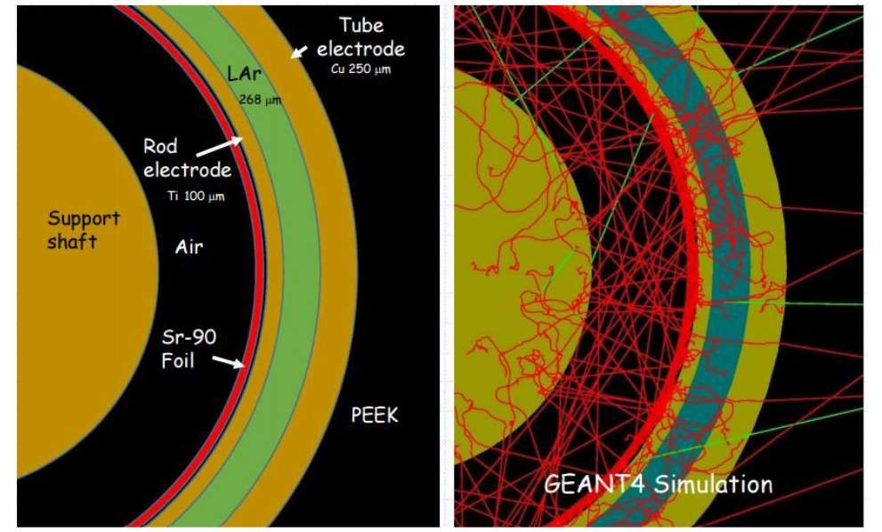
Radiation environment for beta source

Slide 7
The next meeting is scheduled for Friday 05/27/2022

Slide 8
Thank you for attention!

Slide 9
FCalPulse modeling progress report
M.Manashova 06/06/2022

Slide 10
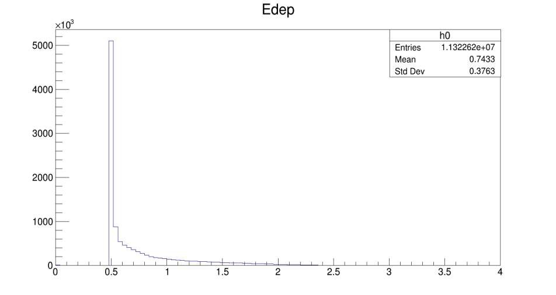
Deposited energy distribution (without split)
entries
E, MeV

Slide 11
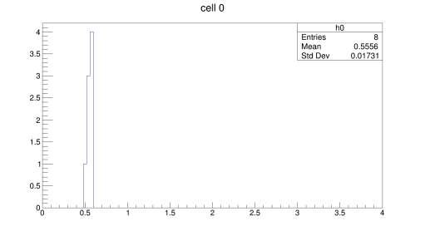
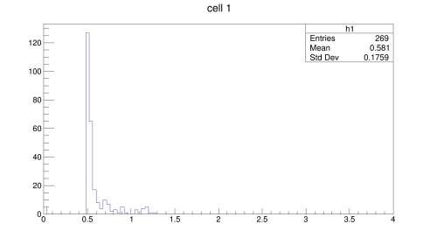
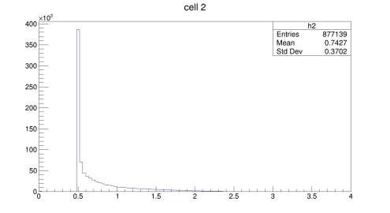
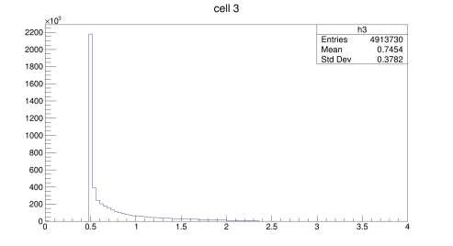
Deposited energy distribution in cell
entries
entries
E,
MeV
E,
MeV
entries
entries
E,
MeV
E,
MeV

Slide 12
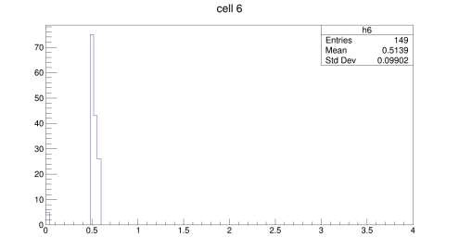
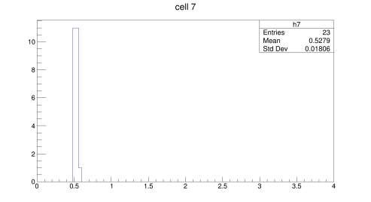
Deposited energy distribution in cell
entries
entries
E,
MeV
E,
MeV
entries
entries
E,
MeV
E,
MeV

Slide 13
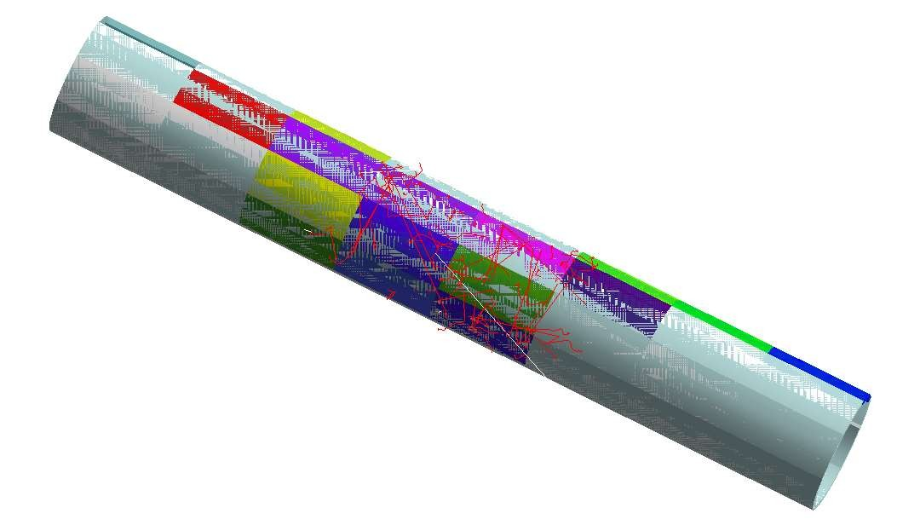
cell visualization

