Slide 1



Evolution of the phenomenologically determined collective potential along the chain of Zr isotopes
E. V. Mardyban,
E. A. Kolganova, T. M. Shneidman, R. V. Jolos

Slide 2
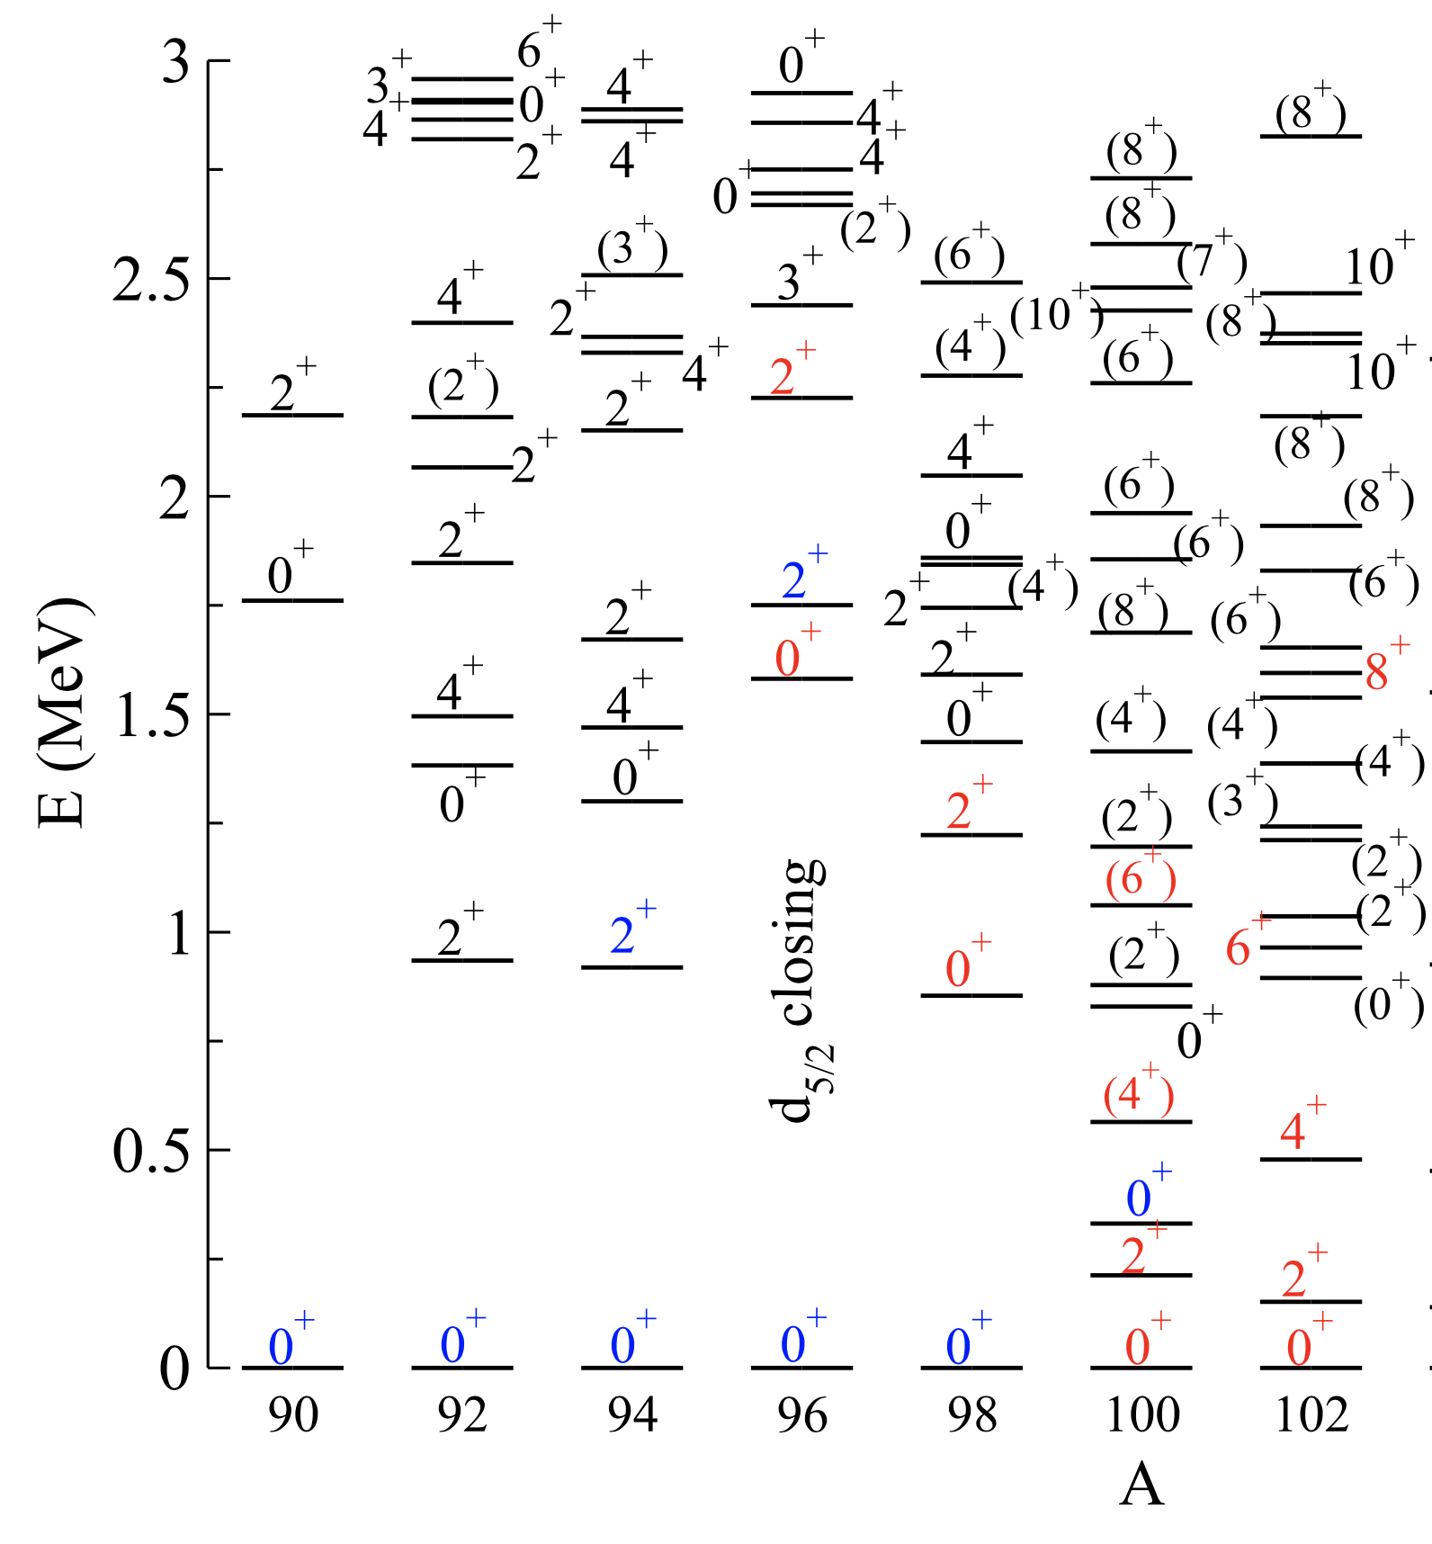
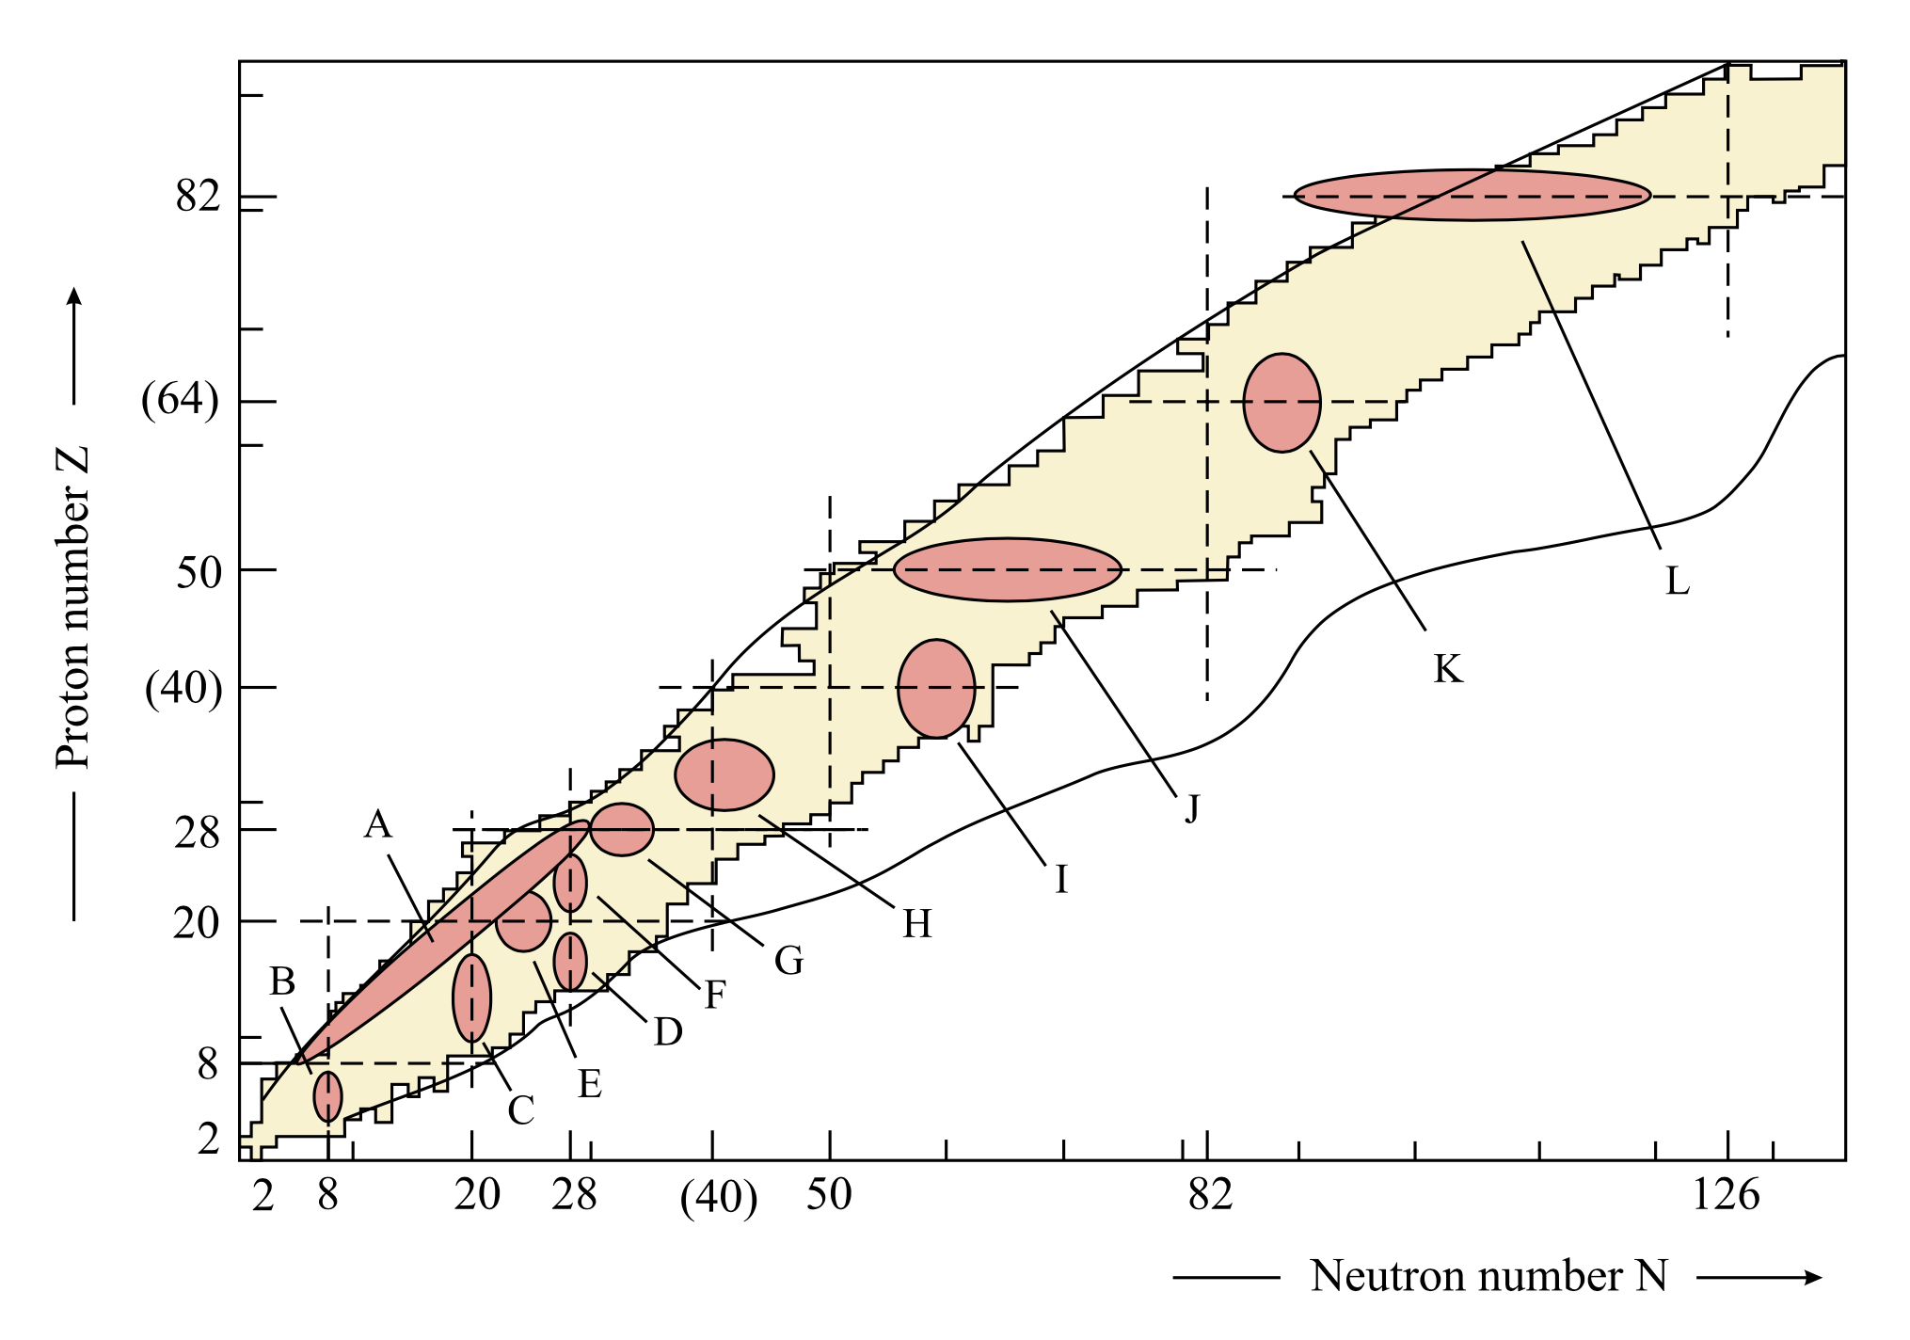
Introduction
The shape coexistence in nuclei is an interesting phenomenon that can occur in many nuclei with increasing excitation energy, angular momentum, and number of nucleons.
K. Heyde, J.L. Wood, Rev.Mod.Phys. 83, 1467 (2011).
J. E. Garc ́ıa-Ramos and K. Heyde, Phys. Rev. C 100, 044315 (2019).

Slide 3
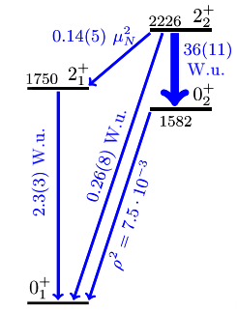
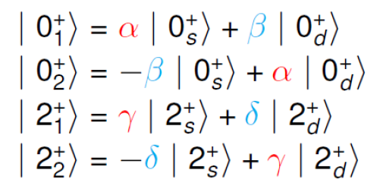
Introduction
The evolution of the shape can occur with a smooth or abrupt transition from a spherical to a deformed shape, and there can be a strong or weak mixing of configurations with different shapes. Such information is contained in the probabilities of electromagnetic transitions, and a high purity of coexisting forms was established in ⁹⁶Zr
C. Kremer et al. Phys. Rev. Lett. 117, 172503 (2016)

Slide 4
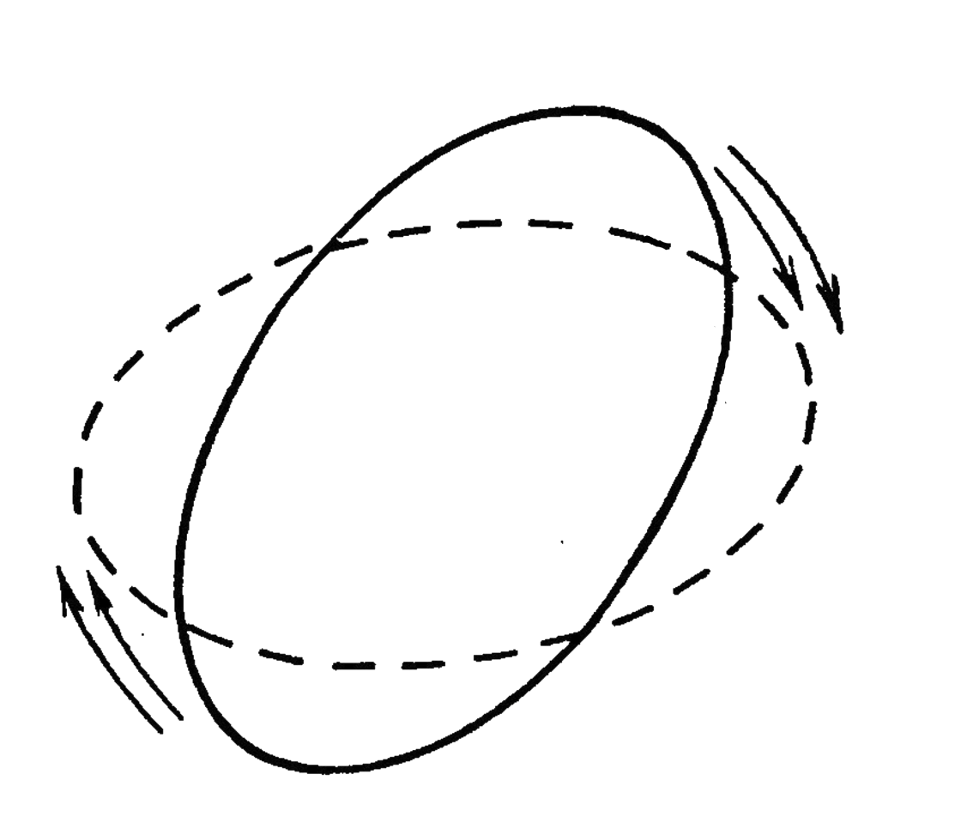
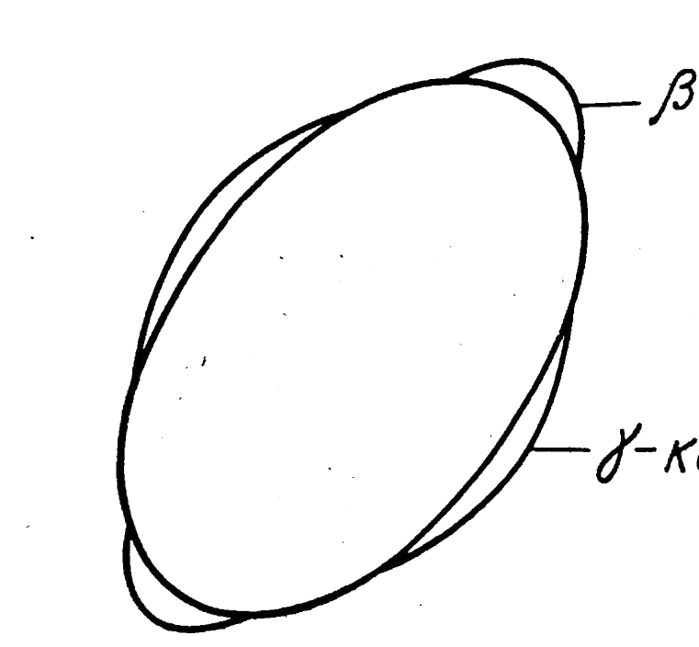
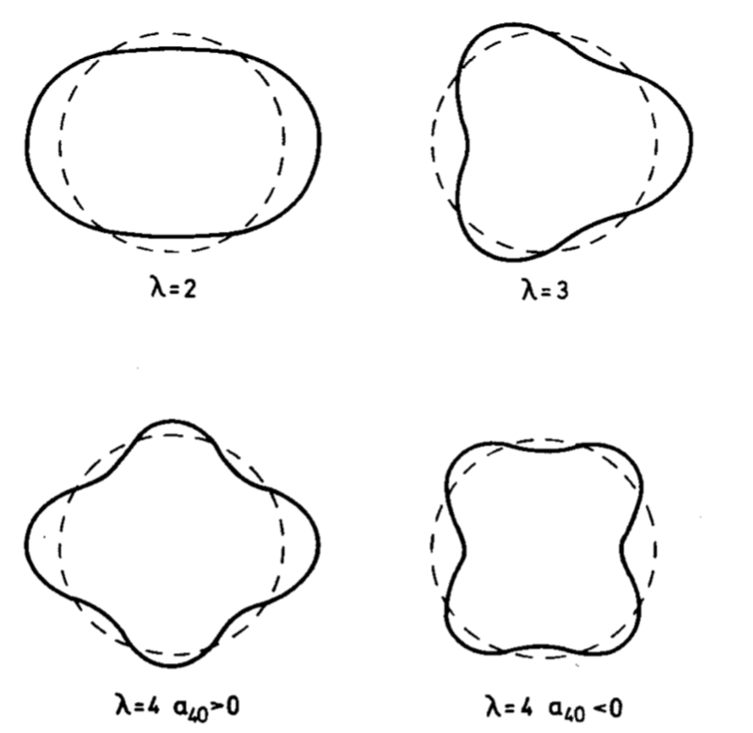
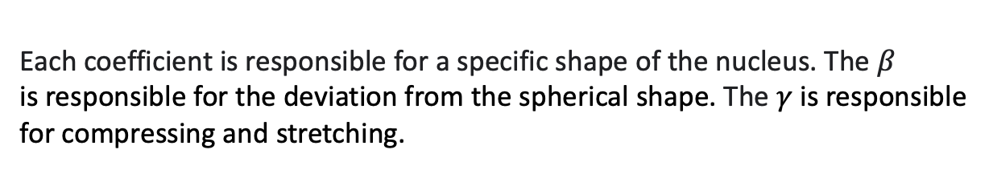
Model
The collective quadrupole Bohr Hamiltonian including axial degree of freedom can be written as :
Types of collective motion described by the Bohr Hamiltonian
It depends on two deformation parameters $β$and $γ$, which are the coefficients of the expansion of the radius of the nucleus
Each coefficient is responsible for a specific shape of the nucleus. The $β$
is responsible for the deviation from the spherical shape. The $γ$ is responsible for compressing and stretching.
Nucleus surface shapes of various types of deformations
T. Niksic, Z.P. Li, D. Vretenar, L. Prochniak, J. Meng, and P. Ring, Phys.Rev. C 79, 034303 (2009)
N. Gavrielov and A. Leviatan, Phys.Rev. C 99, 064324 (2019).

Slide 5
Model
Evolution of one dimensional potential energy without shape coexistence
Evolution of one dimensional potential energy with shape coexistence
A. Poves, J.Phys. G: Nucl. Part. Phys. 43, 024010 (2016).
K. Heyde, J.L. Wood, Rev.Mod.Phys. 83, 1467 (2011).
J.L. Wood, K. Heyde, W. Nazarewicz, M. Huyse, and P.V. Duppen, Phys. Rep. 215, 101 (1992).
K. Heyde, P. Van Isacker, M. Waroquier, J.L. Wood, and R.A.Meyer, Phys. Rep., 102, 291 (1983).

Slide 6
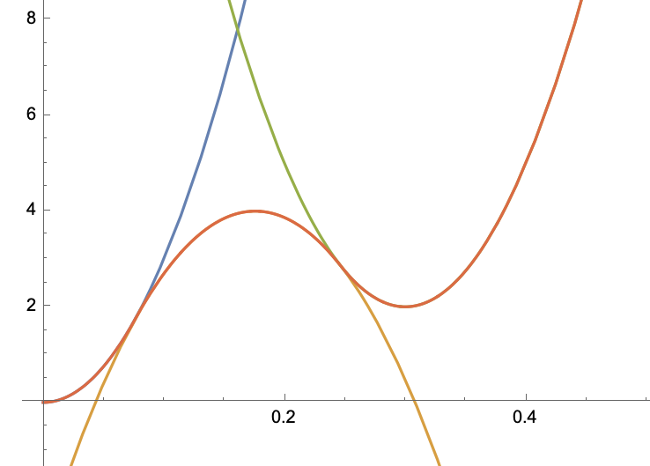
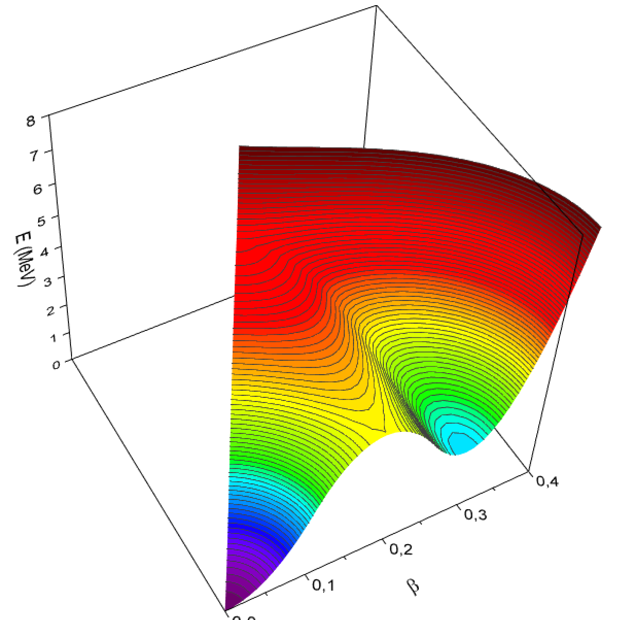


Model
We define a potential energy in the form
Construction of U($β$)
Influence of the $γ$ addiction

Slide 7
Model
To find the eigenvalues of the Hamiltonian, we expand the eigenfunctions in terms of the complete set of basis functions that depend on the deformation variables β and γ and the Euler angles.
Using the obtained wave functions, the matrix elements of an arbitrary operator can be calculated as
Of greatest interest is the calculation of the probabilities of E2 transitions. The collective quadrupole operator responsible for E2 transitions is taken in the form
where is the radius of the equivalent spherical nucleus, and is the charge number of the nucleus.
D. J. Rowe, P.S. Turner, and J. Repka, J. Math. Phys. 45, 2761 (2004).

Slide 8
Results
⁹²Zr
⁹⁴Zr
⁹⁶Zr
⁹⁸Zr
¹⁰⁰Zr
¹⁰²Zr
Calculated potential surfaces for Zr isotopes and cuts at $γ$ = 0.

Slide 9
Results
⁹⁶Zr

Slide 10
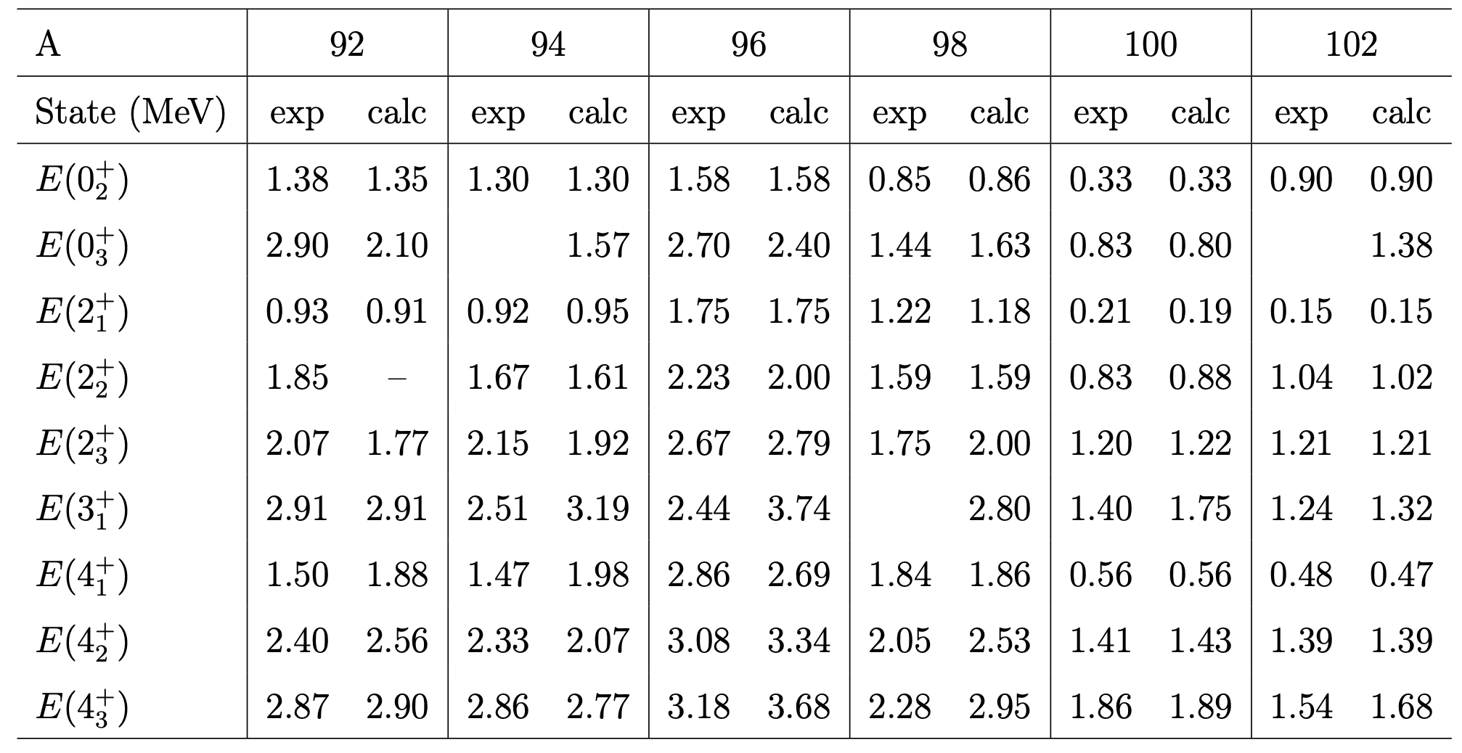
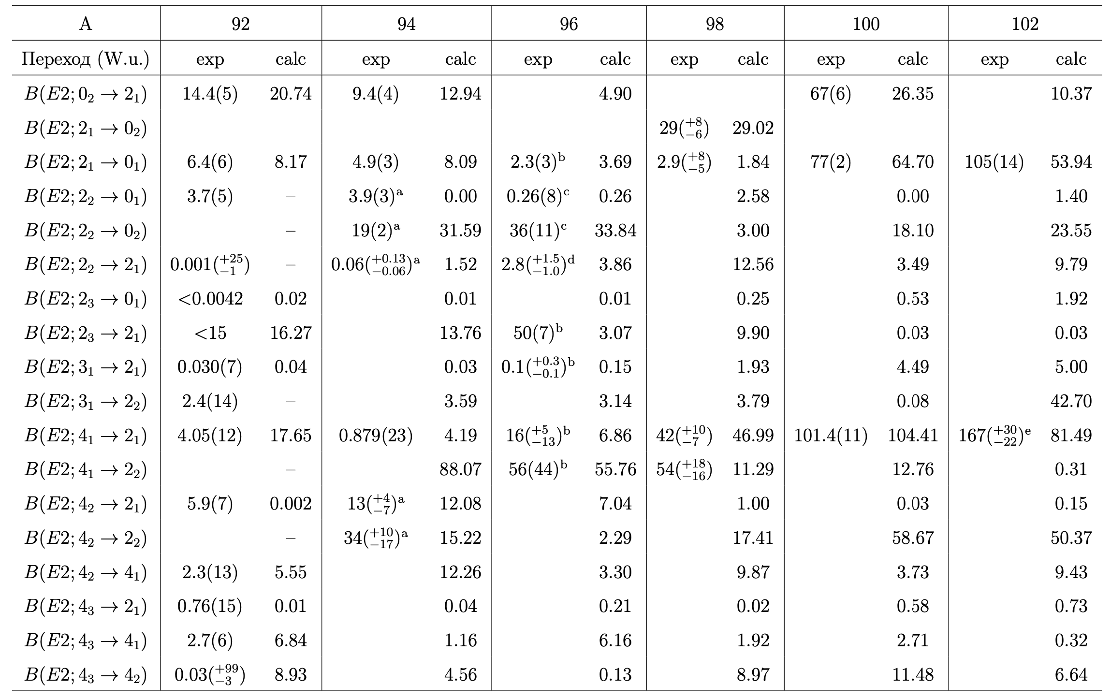
Results
Comparison of the experimental and calculated E2 reduced transition probabilities between the low-lying states of the even-even ⁹²⁻¹⁰²Zr isotopes.
Comparison of the experimental and calculated energies of the low-lying collective states of the even-even ⁹²⁻¹⁰²Zr isotopes.
Calculated (lines) and experimental (dots) values of the probabilities of quadrupole transitions between the lowest states of the ground band
Experimental data taken from https://www.nndc.bnl.gov/ensdf/

Slide 11
Results
Calculated (lines) and experimental (dots) energies of the ground and first two excited states with angular momentum 0, 2 and 4
Calculated (lines) and experimental (dots) values of the probabilities of quadrupole transitions between the lowest states of the ground band
Experimental data taken from https://www.nndc.bnl.gov/ensdf/

Slide 12
Conclusion
It is shown that the low-energy structure of ⁹²⁻¹⁰²Zr can be described in a satisfactory way within the Geometrical Collective Model with the Bohr Hamiltonian.
Good agreement with experimental data for excitation energies and E2 transition probabilities was obtained.
It was gated a distribution of the wave functions of the low-lying collective states in β − γ plane.
It was shown that in the evolution of potential energy there is a phenomenon of shape coexistence.
It is planned to carry out similar researching for the nearest neighboring nuclei Mo and Sr
Thank you for attention!
The main results are included in
E. V. Mardyban, E. A. Kolganova, T. M. Shneidman, R. V. Jolos, Phys. Rev. C 105, 024321 (2022).
E. V. Mardyban, E. A. Kolganova, T. M. Shneidman, R. V. Jolos, and N. Pietralla, Phys. Rev. C 102, 034308 (2020)
D.A. Sazonov, E.A. Kolganova, T.M. Shneidman, R.V. Jolos, N.Pietralla, and W. Witt, Phys. Rev. C 99, 031304(R) (2019)

