Slide 1
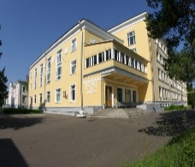
XXVI International Scientific Conference of Young Scientists and Specialists (AYSS 26-10-2022)
Manifestation of Devil’s staircase and Negative Differential Resistance in the IV- Characteristics of φ₀ Josephson Junction
M. Nashaat
BLTP – JINR (Russia)
In Collaboration with
Yu. M. Shukrinov & K. Kulikov (BLTP- Russia)
S. A. Abdelmoneim (Egypt)

Slide 2
Outline
Introduction to Josephson Junction
Ingredients to study magnetic moment dynamics
Φ₀-junction
Motivation
Model
Results
AYSS 26-10-2022

Slide 3
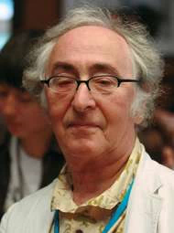
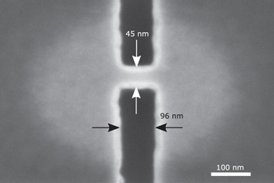
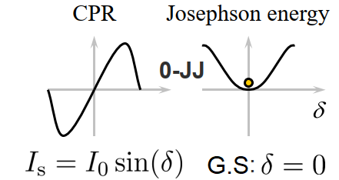
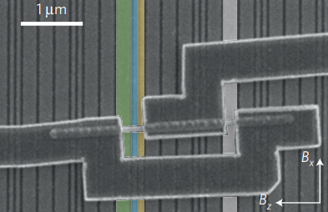
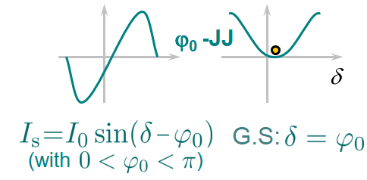
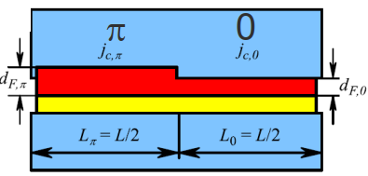
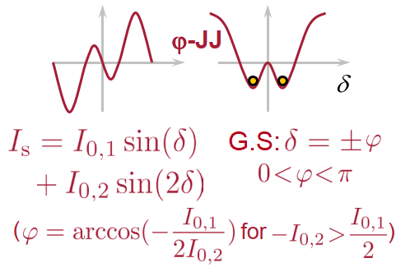
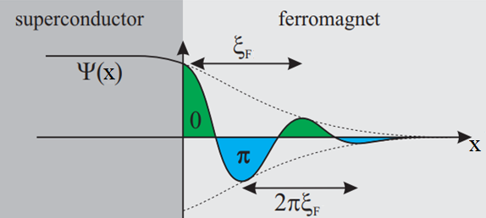
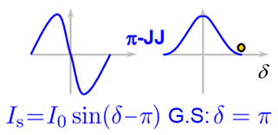
Josephson Effect
B. D. Josephson Phys. Lett. (1962).
AC current
$$I=I_{C}\sin\left[\frac{2π}{Φ_{0}}V t +δ_{0}\right]$$
DC supercurrent
$$I_{s}=I_{C}\sin\left[δ\right]$$
$$V=\frac{ħ}{2e}\frac{dδ}{dt}$$
$I_{C}:$critical current
(Nb-AlO_{x} -Nb) J$c$≈1–5000 A/cm²
1μV, ω_{J}=483.6 MHz
Josephson Energy
$E_{J}=\int_{0}^{t}{I_{s}V dt}$ $=\frac{ħI_{c}}{2e}(1−cos(δ))$
Potential
$$U=ε_{J}([1−cos\left(δ\right)]−Iδ)$$
ξ= 101-192 nm
C. D. Shelly et al., SUST, 30 095013 (2017)
D. B. Szombati et al., Nat. Phys. 12, 568 (2016)
H. Sickinger et al., PRL. 109, 107002 (2012)
V. V. Ryazanov et al., PRL. 86, 2427 (2001)
S. V. Mironov et al., PRB. 104, 134502 (2021) → no limit on ϕ
D. Koelle (2018)

Slide 4
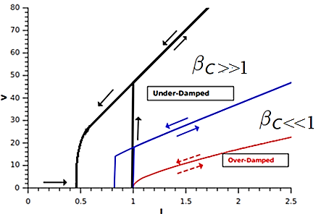
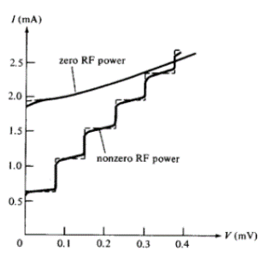
Resistively and capacitively shunted junction model (RCSJ)
$$i =I_{C} sin\left[δ(τ)\right] + \frac{ħ}{2eR}\frac{dδ(τ)}{dτ} + \frac{ħ C}{2e} \frac{d^{2}δ(τ)}{dτ^{2}} +I_{noise}$$
$$supercurrent$$
quasiparticle
displacement
$$I=\frac{i}{I_{c}} \& t=τ{ ω}_{c} \&{ ω}_{c}=\frac{2πI_{c}R}{Ф_{0}} \&{ β}_{c}=\frac{2e{CI}_{c}R^{2} }{ħ}$$
$$Dimensionless form$$
$β_{c} \ddot{δ}+\dot{δ}+\sin{δ}=I$
Stewart-McCumber
Under External Ac drive
$$V=V_{0}+V_{ac}\cos\left[ω t\right]$$
$ω_{1}$= $\frac{2e}{ħ}V_{0}$
$$I_{s}=I_{C}\sum_{n=−∞}^{∞}{{\left(−1\right)}^{n}J_{n}\left(\frac{2eV_{ac}}{ħ ω}\right)}sin\left[\left(ω_{1}−nω\right)t\right]$$
DC current at
$V_{0}=\frac{nħ}{2e }ω$, n=1,2,3
W.C.Stewart, Appl. Phys. Lett. 12, 277 (1968);
D.E.McCumber, J. Appl. Phys. 39, 3113 (1968)
S. Shapiro, PRL, 11(2):80, 1963.

Slide 5
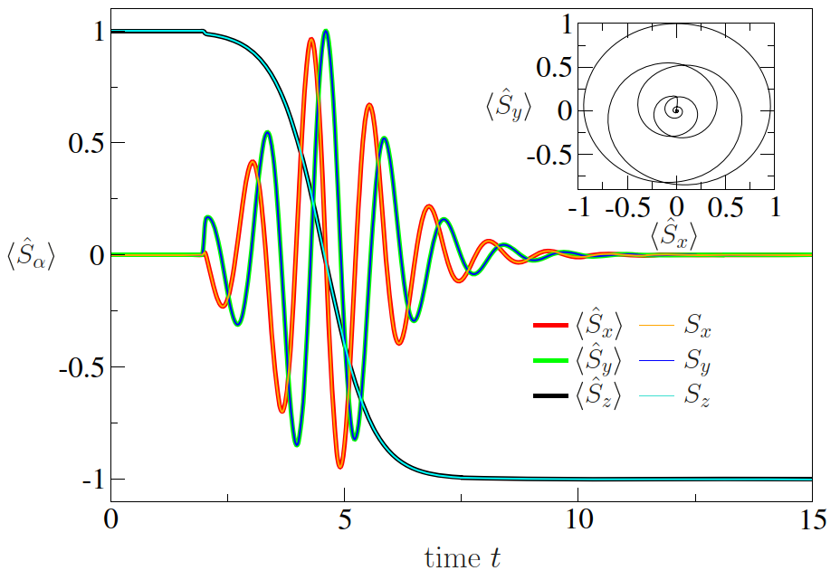
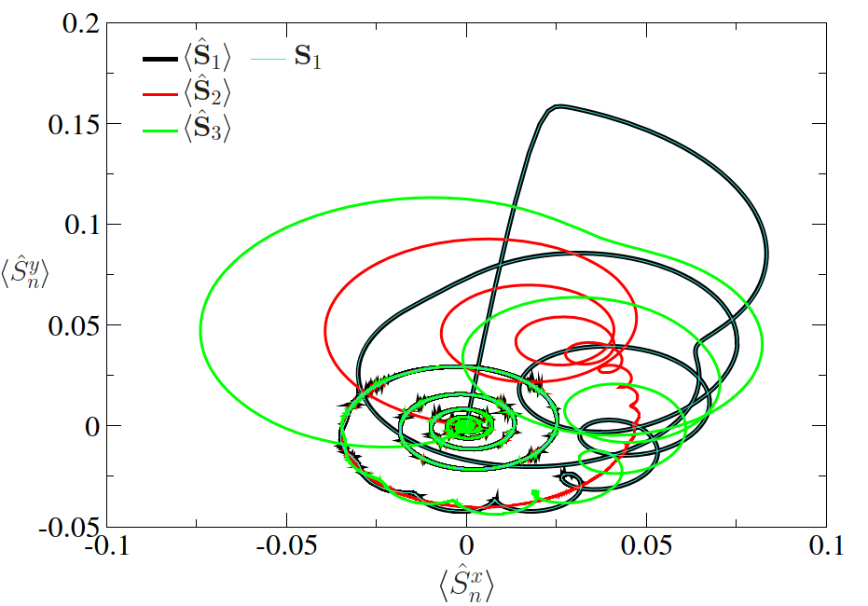
Nanomagnet
Landau-Lifshitz-Gilbert (LLG)
$$\left(1+α^{2}\right)\frac{dM}{dt}=−γ(M × H_{eff}+\frac{α}{\left|M\right|}[M×(M×H_{eff})])$$
𝛼: Gilbert damping & 𝛾: gyromagnetic ratio
Satu.
$$M_{o}^{2}=\sum_{i=x,y,z}{M_{i}^{2}}$$
Effective field
$$H_{eff}=−\frac{∇_{M}E_{M}}{v}$$
Nature 549, 169–170 (2017)
Coupling with JJ If
LLG can be derived from quantum mechanics
$$E_{J} α cos(δ−φ(M))$$
$$\left(1+α^{2}\right)\frac{d\left\langle \hat{S}\right\rangle }{dt}=−γ(\left\langle \hat{S}\right\rangle × H_{eff}+α [\left\langle \hat{S}\right\rangle ×(\left\langle \hat{S}\right\rangle ×H_{eff})])$$
The classical LLG: spin expectation value <S> → classical spin S.
Gaussian Pulse
3- coupled spin
$\left\langle \hat{S}\right\rangle =\left\langle \text{ψ} | \hat{S} | \text{ψ}\right\rangle$ which strongly depend on the wave functions $\left.|\text{ψ}\right\rangle$.
Absolute value |$\left\langle \hat{S}\right\rangle$| have not necessarily to be constant: |$\left\langle \hat{S}\right\rangle$| ≤ћS.
M. Fähnle et. al, J. Phys. D 41, 164014 (2008)
R. Wieser Phys. Rev. B 84, 054411 (2011)
R. Wieser Eur. Phys. J. B 88: 77 (2015)

Slide 6
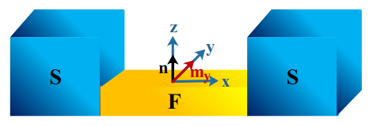
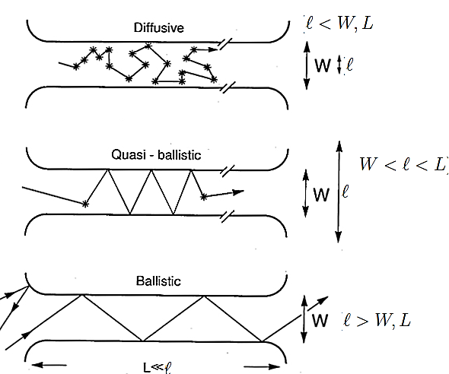
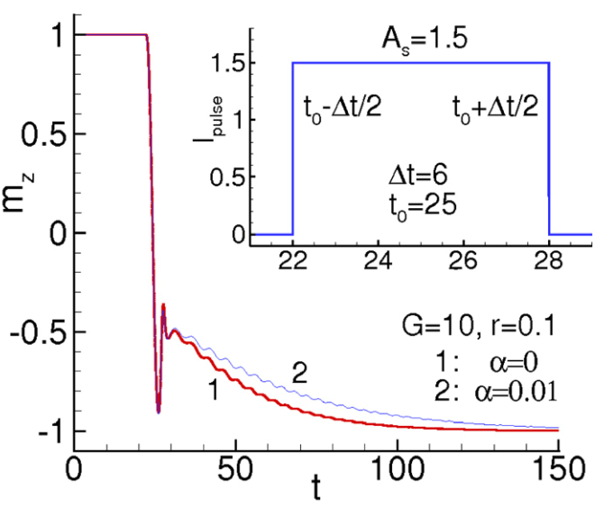
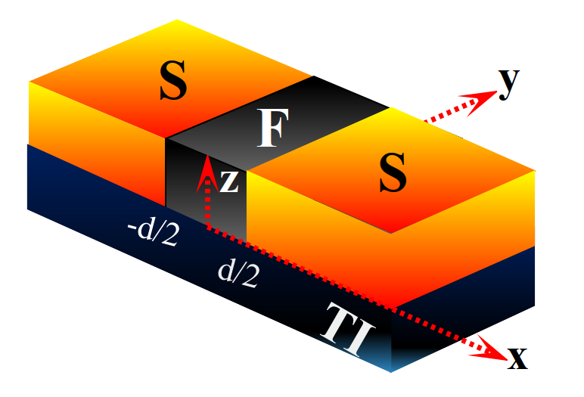
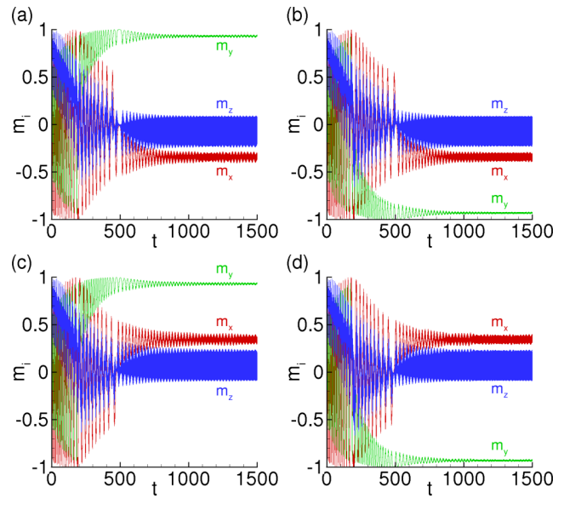
Anomalous JJ
$φ_{o}$ | = $\frac{Lv_{so}m_{y}}{v_{F}}$ ≈ 0.01π (Ballistic regime -SFS)
L | Barrier length (150 nm).
r_{so}=$\frac{v_{so}}{v_{F}}$ | Characterizes the relative strength of the spin-orbit interaction (≈0.1).
m_{y}=$\frac{M_{y}}{M_{o}}$ | Magnetic moment in y-direction, $M_{o}$ is Saturation value.
A. Buzdin, Rev. Lett. 101, 107005 (2008).
Yu. M. Shukrinov et.al.,
Appl. Phys. Lett. 110, 182407 (2017)
l:mean free path, W:width, L: length
$φ_{o}$ | = $\frac{τm^{∗2}E_{z}{(αL)}^{3}}{3ℏ^{6}D}$ ≈0.0028π (Diffusive regime -SNS)
τ | elastic scattering time (0.13 ps )
D=$\frac{1}{3}τv_{F}^{2}$ | diffusion constant (40 cm² /s)
m* | = 0.25 m_{e} effective electron mass
$$φ_{o}$$ | 2$h_{y}d$/$v_{F}$
$$I_{s}$$ | $I_{c}$($h_{x}$) sin ($φ$-$φ_{o}$)
Splitting of easy axis →
fourfold degenerate ferromagnetic state.
F. S. Bergeret, and I. V. Tokatly. EPL 110, 57005 (2015).
Yu M Shukrinov. Phys.-Usp. 65 317 (2022).
M. Nashaat, et al., PRB 100, 054506 (2019)

Slide 7
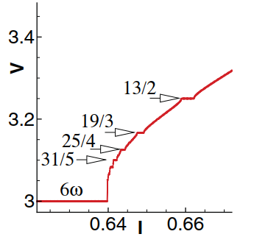
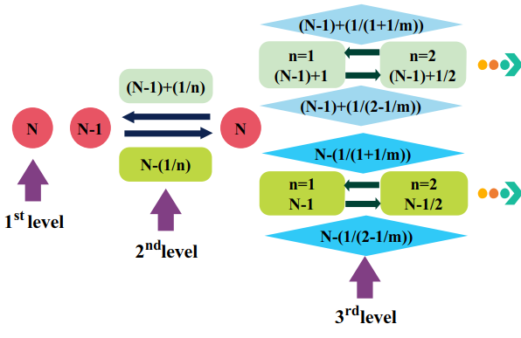
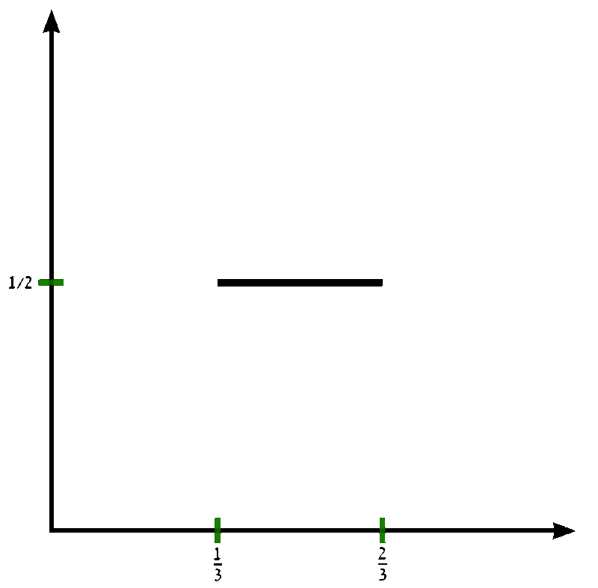
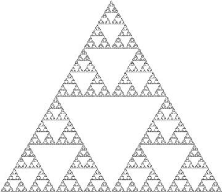
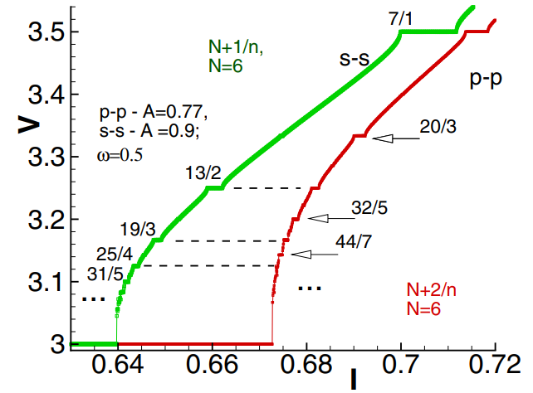
Devil’s staircase and its importance
$β_{c}$<<1
$β_{c} \ddot{θ}+\dot{θ}+\sin\left[θ\right]=I+A\sin\left[ω t\right]$
$\dot{θ}=V$
J.R. Waldram et.al., . J. Low Temp. Phys., 47(3-4): 1982.
M.J. Renne et.al., Revue de physique appliquée, 9(1) 1974.
$β_{c}$>>1
Yu. M. Shukrinov, et al, PRB 88, 214515 (2013)
Only harmonics appears
Is it the same for SFS ?!
The position of the steps follow:
$V=\left(N±\frac{1}{n±\frac{1}{m±\frac{1}{p±…}}}\right)$ $ω$
N,n,m,p,... are positive integers.
M. Maiti et al., PRB 92, 224501 (2015)
D=0.87
M. H. Jensen, et.al., PRL. 50, 1637 (1983)

Slide 8
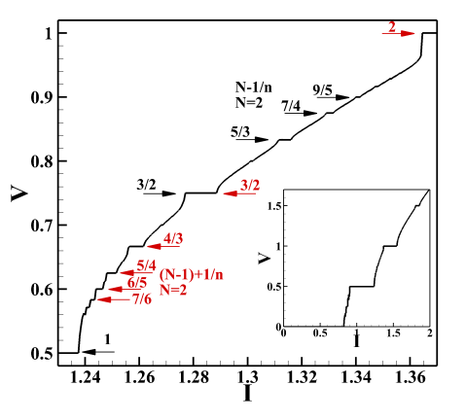
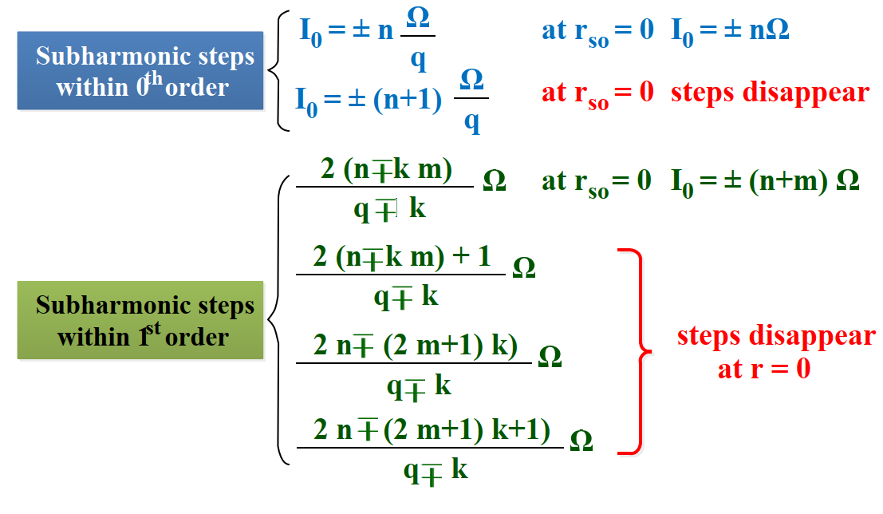
Devil’s staircase
RSJ equation
φ₀ = r_{so} m_{y}
Total energy
Perturbative method
where E_{J} = Φ₀I_{c}/2π, is the Josephson energy, E_{M} is the anisotropic energy and K = Ω_{F}M₀/γ is the anisotropic constant. G = E_{J}/Kv.
$V=\left(N±\frac{1}{n±\frac{1}{m±\frac{1}{p±…}}}\right)$ $ω$
Effective field
AYSS 26-10-2022
M. Nashaat et al arXiv:1905.09672

Slide 9
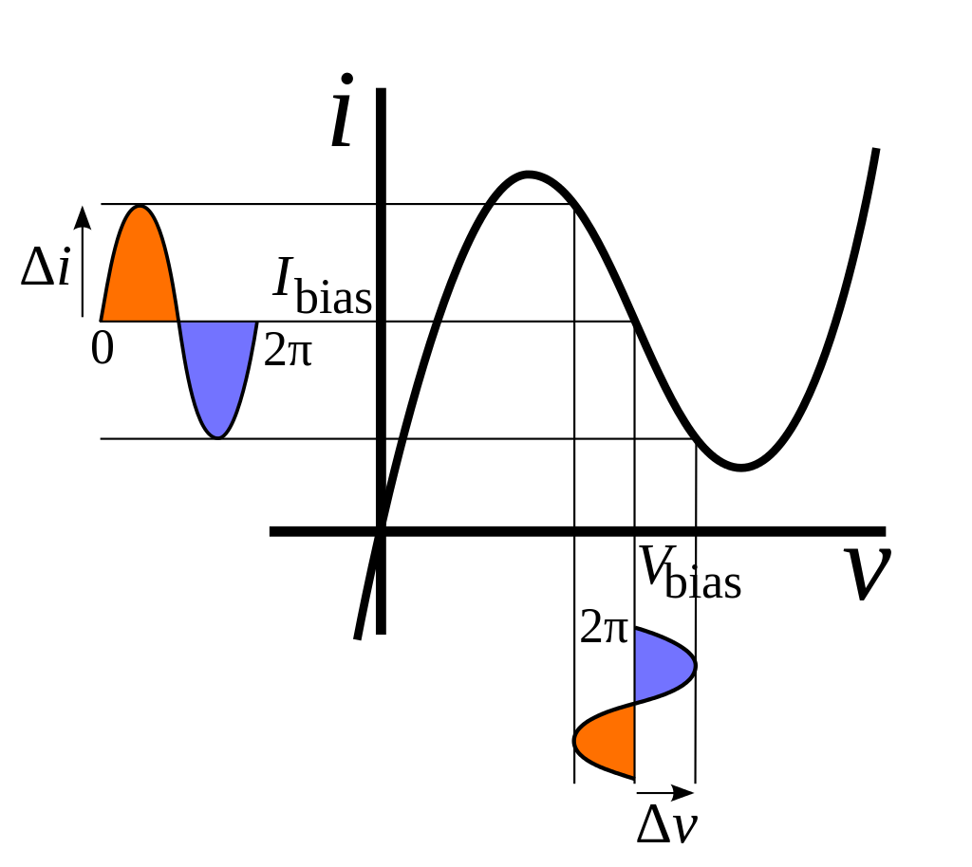
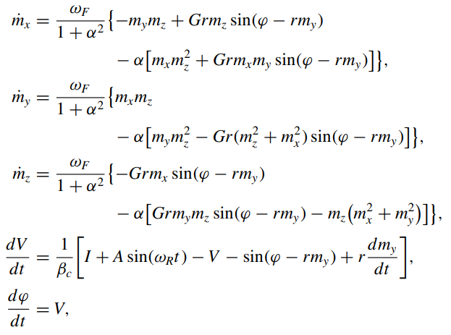
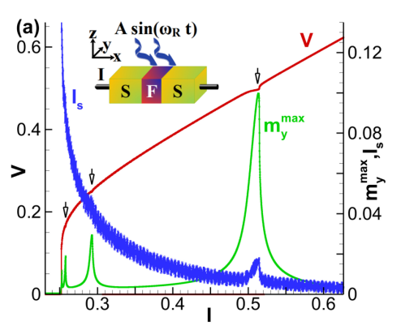
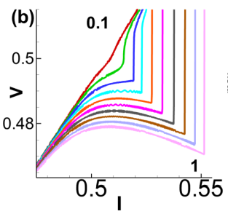
$$φ_{o}$$ | r | $$l$$ | G | α | $$𝔀_{c}$$ | I | V | $M_{o}$ (sat.Mag) | $$𝔀_{F}$$ | β_{c}
$r$m_{y} | $$lv_{so}/v_{F}$$ | $$4h_{ex}L/(ℏv_{F})$$ | E_{J}/(K V) | 0.01- 0.1 | $2eRI_{c}$/$ℏ$ ~ GHz | ~mA | ~ μV | 8 x 10⁵ A/m | 0.5 | 25
Yu. M. Shukrinov, et al. Phys. Rev. B 99, 224513 (2019).

Slide 10
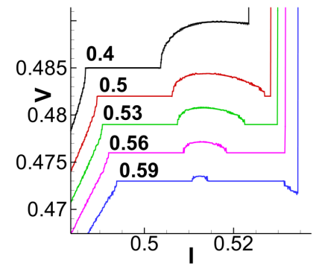
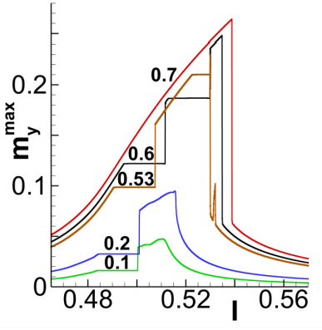
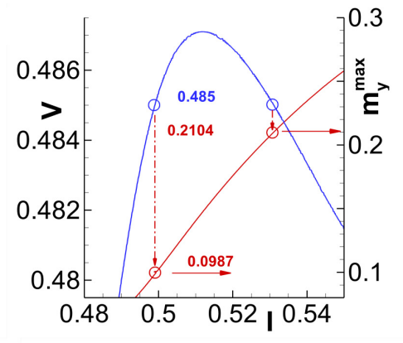
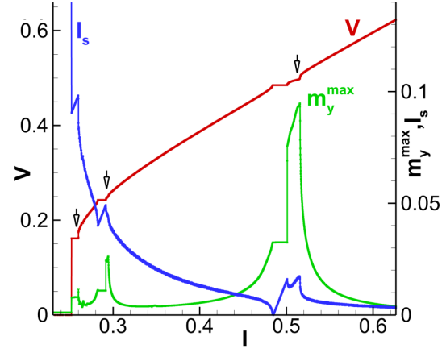
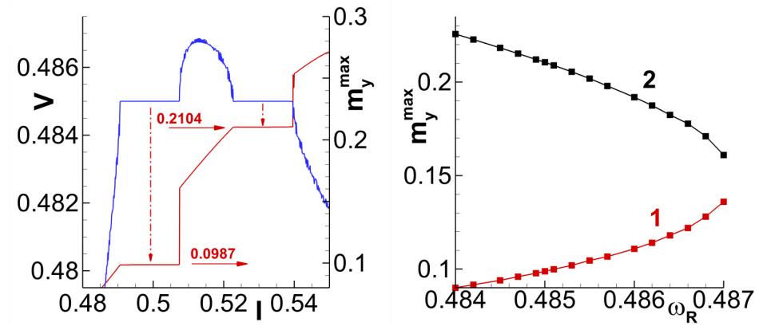
Tunning the Locking step and Negative Differential Resistance
r: SOC
r: SOC

Slide 11
Conclusions
In junctions with a strong spin-orbit coupling induces region of negative deferential resistance and Devil’s staircase structure on the IV-curves.
An additional locking step of magnetic precession due to negative deferential resistance appear. We show that it is possible to control not only the frequency but also the amplitude of the magnetic precession in the locking region.

