Slide 1
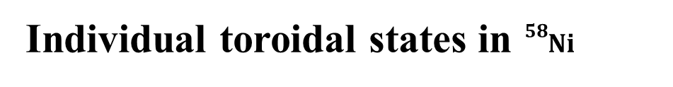
Individual toroidal states in ${}_{}^{58}{Ni}$
P. I. Vishnevskiy
Joint Institute for Nuclear Research, Dubna, Moscow region, Russia
V. O. Nesterenko,
Joint Institute for Nuclear Research, Dubna, Moscow region, Russia
J. Kvasil,
Inst. of Particle and Nuclear Physics, Charles University, Praha, Czech Rep.
Repko
Inst. of Physics, Slovak Academy of Sciences, Bratislava, Slovakia
P. von Neumann-Cosel
Inst. of Nuclear Physics, Technical University of Darmstadt, Germany

Slide 2
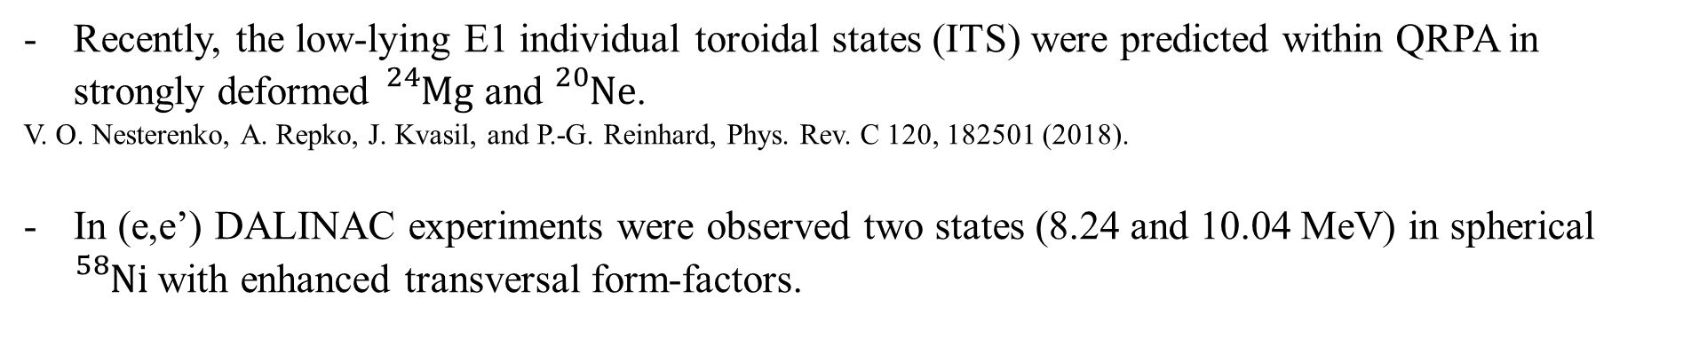
Introduction
Recently, the low-lying E1 individual toroidal states (ITS) were predicted within QRPA in strongly deformed ${}_{}^{24}{Mg}$ and ${}_{}^{20}{Ne}$.
V. O. Nesterenko, A. Repko, J. Kvasil, and P.-G. Reinhard, Phys. Rev. C 120, 182501 (2018).
In (e,e’) DALINAC experiments were observed two states (8.24 and 10.04 MeV) in spherical ${}_{}^{58}{Ni}$ with enhanced transversal form-factors.
W. Mettner, A. Richter, W. Stock, B.C. Metsch, and A.G.M. Van Hees, Nucl. Phys. A 473, 160 (1987).
- These states were initially treated as $1^{+}$ and $2^{−}$ magnetic ones.
It was later shown (in $γ,γ′$) that these states are $1^{−}$.
F. Bauwens et al, PRC 62, 024302 (2000)
Jaqueline Sinclair, PhD thesis, TU Darmstadt
The main goal is analyze low-energy states in a spherical ${}_{}^{58}{Ni}$.

Slide 3
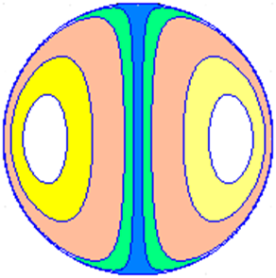
toroidal currents
Hill rings
Hill showed that the incompressible Euler equations have as a steady solution spherical vortex ring.
The spherical vortex ring propagates without change of either velocity or shape.
V.M. Dubovik and A.A. Cheshkov, SJPN 5, 318 (1975).
S.F. Semenko, SJNP 34 356 (1981).
vortical
M. J. M. Hill, PTRS 185, 213 (1894).
PhD thesis, M. M. Scase (2003)

Slide 4
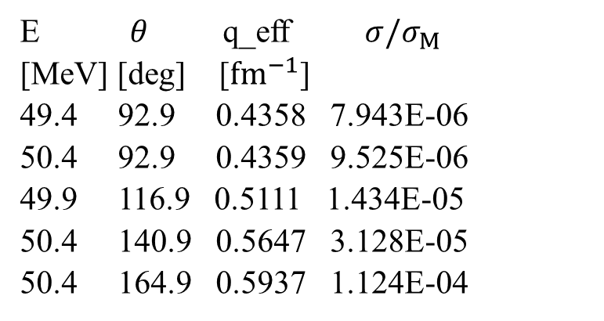
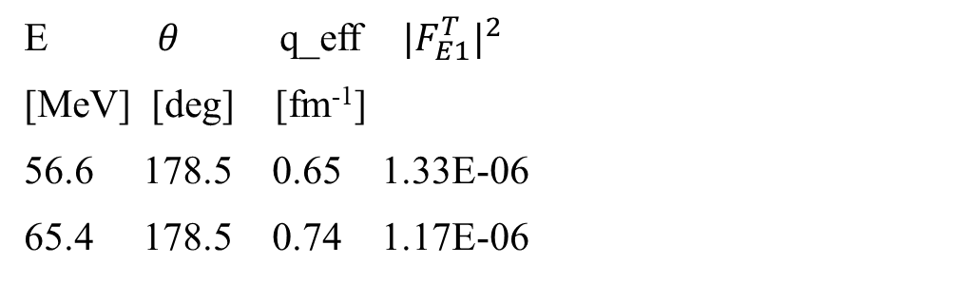
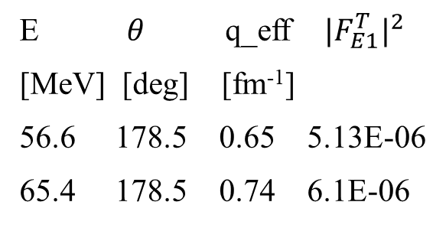
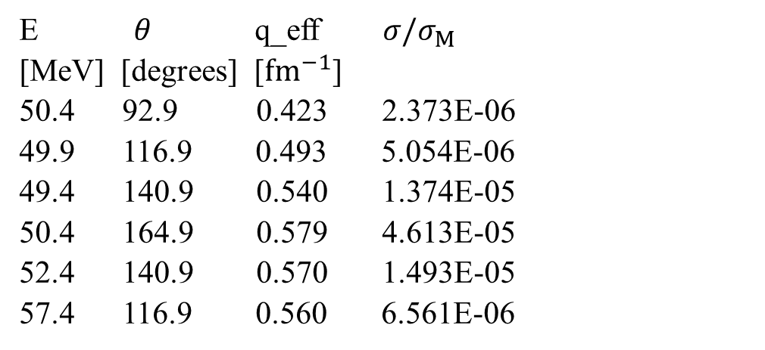

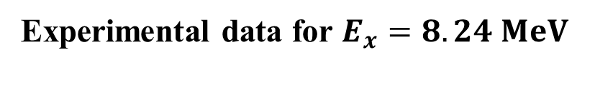
Experimental data for $E_{x}=8.24 MeV$
Exp. data for $E_{x}=10.04 MeV$
E $θ$ q_eff $σ/σ_{M}$
[MeV] [deg] [${fm}^{−1}$]
49.4 92.9 0.4358 7.943E-06
50.4 92.9 0.4359 9.525E-06
49.9 116.9 0.5111 1.434E-05
50.4 140.9 0.5647 3.128E-05
50.4 164.9 0.5937 1.124E-04
E $θ$ q_eff $σ/σ_{M}$
[MeV] [degrees] [${fm}^{−1}$]
50.4 92.9 0.423 2.373E-06
49.9 116.9 0.493 5.054E-06
49.4 140.9 0.540 1.374E-05
50.4 164.9 0.579 4.613E-05
52.4 140.9 0.570 1.493E-05
57.4 116.9 0.560 6.561E-06
W. Mettner, A. Richter et al, NPA 473, 160 (1987).
W. Mettner, A. Richter et al, NPA 473, 160 (1987).
E $θ$ q_eff ${|F_{E1}^{T}|}^{2}$
[MeV] [deg] [fm⁻¹]
56.6 178.5 0.65 5.13E-06
65.4 178.5 0.74 6.1E-06
E $θ$ q_eff ${|F_{E1}^{T}|}^{2}$
[MeV] [deg] [fm⁻¹]
56.6 178.5 0.65 1.33E-06
65.4 178.5 0.74 1.17E-06
B. Reitz, private communication
B. Reitz, private communication

Slide 5
Model
The Skyrme QRPA code (Repko) for spherical nuclei.
A. Repko, J. Kvasil, V. O. Nesterenko, and P.-G. Reinhard, arXiv:1510.01248[nucl-th].
Fully self-consistent QRPA (mean field and residual interaction are derived from the initial Skyrme functional, p-p and p-h channels, residual interaction takes into account all terms from the initial functional).
Single-particle basis includes 190 proton and 226 neutron levels.
For example, 2qp basis includes 143 proton and 249 neutron pairs for SVbas.
Spurious admixture are removed.
A. Repko, J. Kvasil, and V. O. Nesterenko, PRC 99, 044307 (2019).
3 Skyrme forces (SkM*, SVbas, SLy6)
Volume (SkM* and SLy6) and surface (SVbas) pairings.
A. Repko, J. Kvasil, V. O. Nesterenko, and P.-G. Reinhard, EPJA 53, 221 (2017).

Slide 6
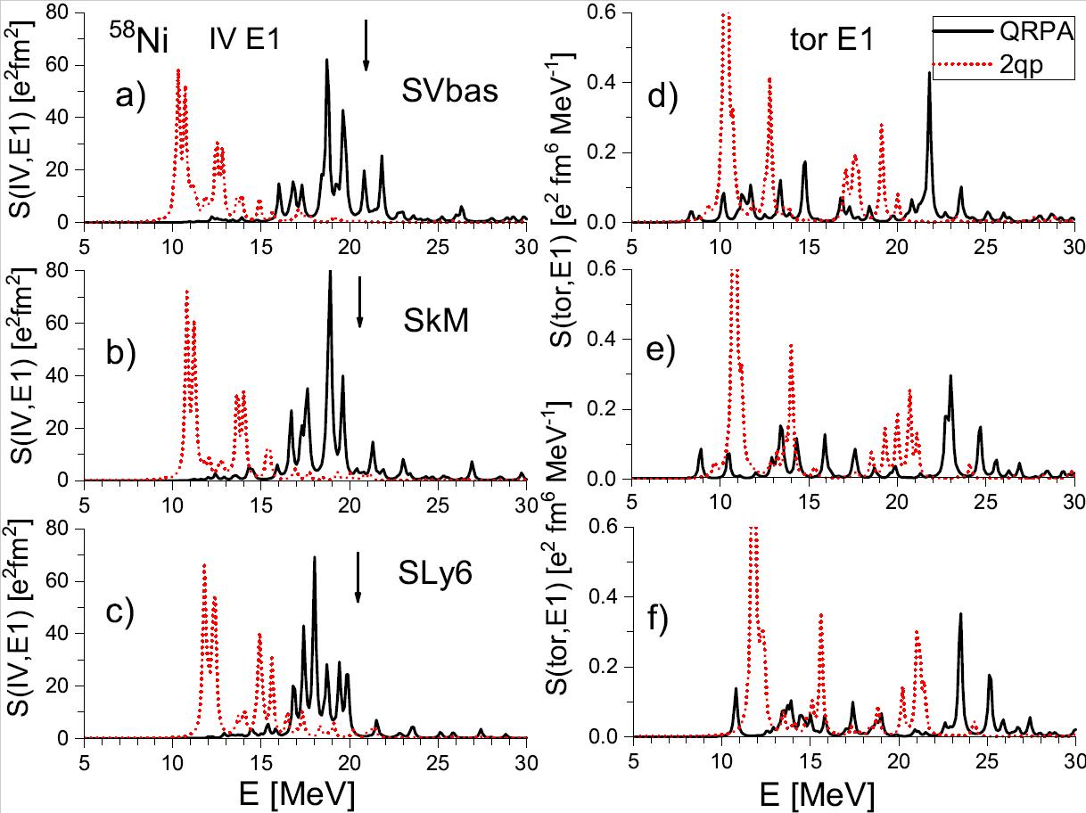

IV and tor E1 strength functions
for IV:
2qp strength is located at 10-15 MeV;
QRPA calculations correspond to IV GDR (16-22 MeV)
for tor E1:
two 2qp energy range;
QRPA states at 8-11 MeV (our energy range!)
$E_{GDR}≈81A^{−\frac{1}{3}} MeV$

Slide 7
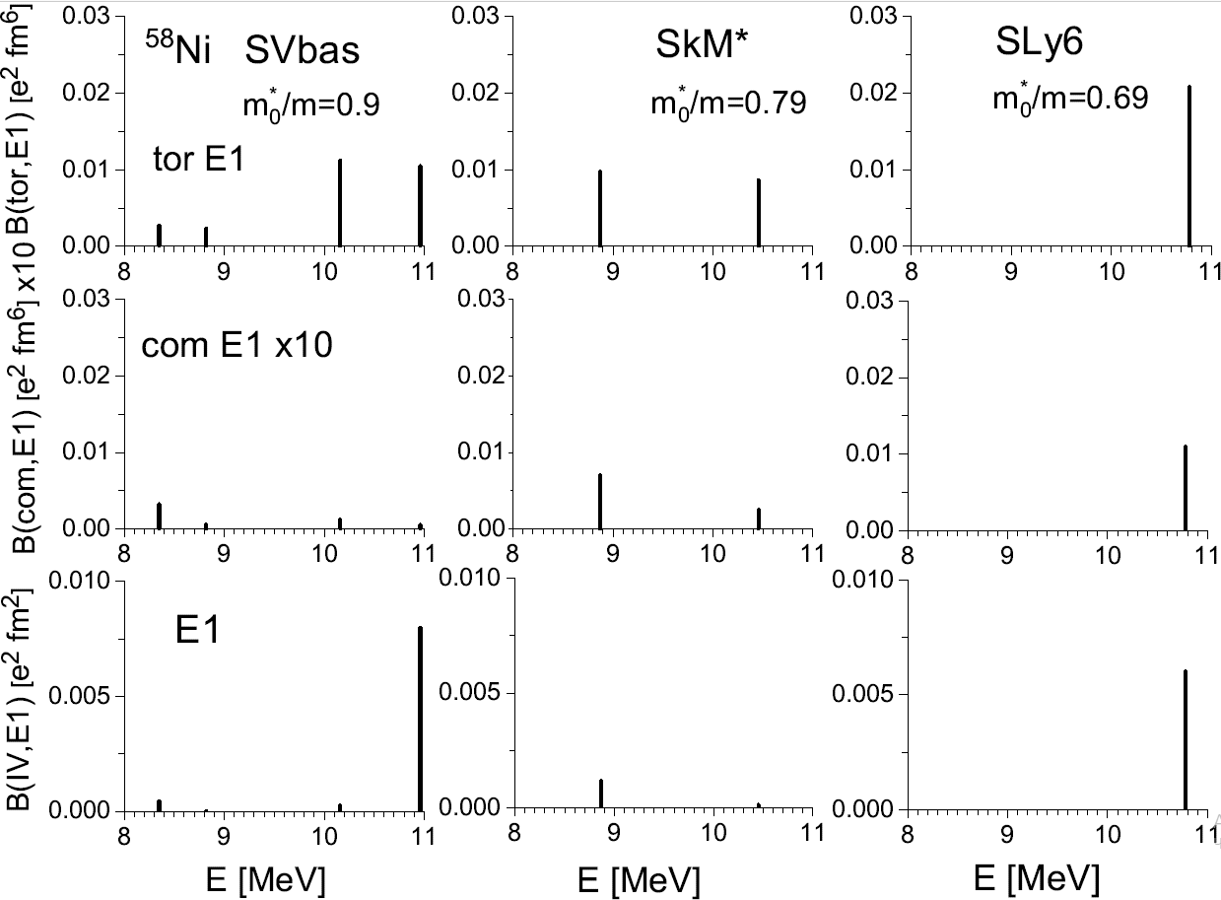
B(E1) strength
The IS QRPA states have a toroidal character;
Strength depends on the effective mass.
Best agreement for SVbas

Slide 8
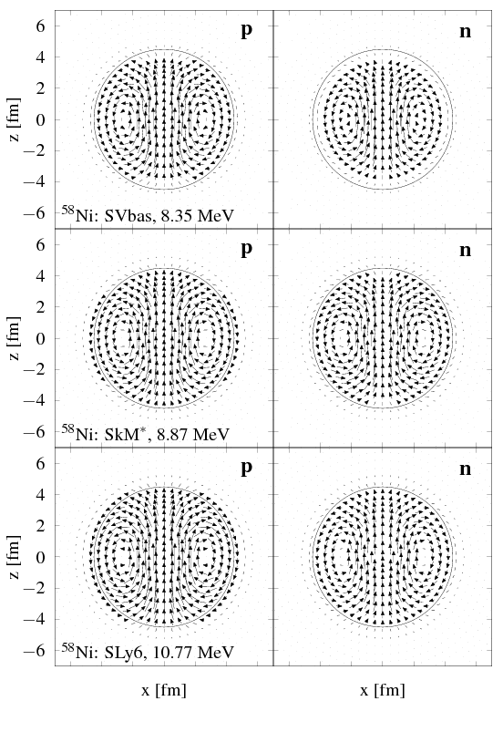
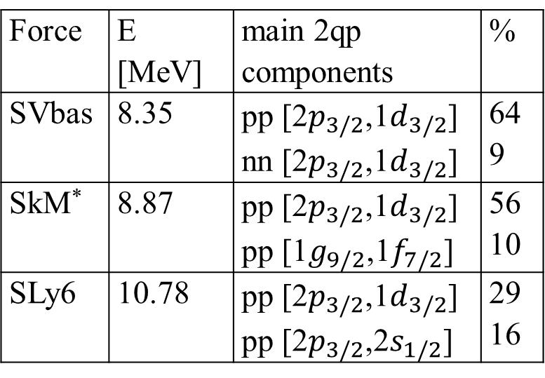
Currents: lowest dipole states
Force | E [MeV] | main 2qp components | %
SVbas | 8.35 | pp [2$p_{3/2}$,1$d_{3/2}$] nn [2$p_{3/2}$,1$d_{3/2}$] | 64 9
SkM* | 8.87 | pp [2$p_{3/2}$,1$d_{3/2}$] pp [1$g_{9/2}$,1$f_{7/2}$] | 56 10
SLy6 | 10.78 | pp [2$p_{3/2}$,1$d_{3/2}$] pp [2$p_{3/2}$,2$s_{1/2}$] | 29 16
the lowest E1 IS states have a toroidal character;
the same basic 2qp states for all QRPA states

Slide 9
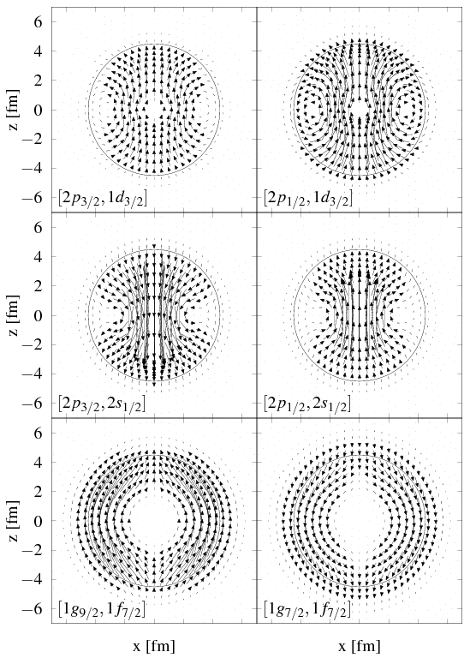
Currents: 2qp configurations
The currents of these 2qp configurations very remind the typical toroidal flow
the vorticity of the 2qp states leads to the vorticity of the QRPA states.
vortical flow has a mean-field origin

Slide 10
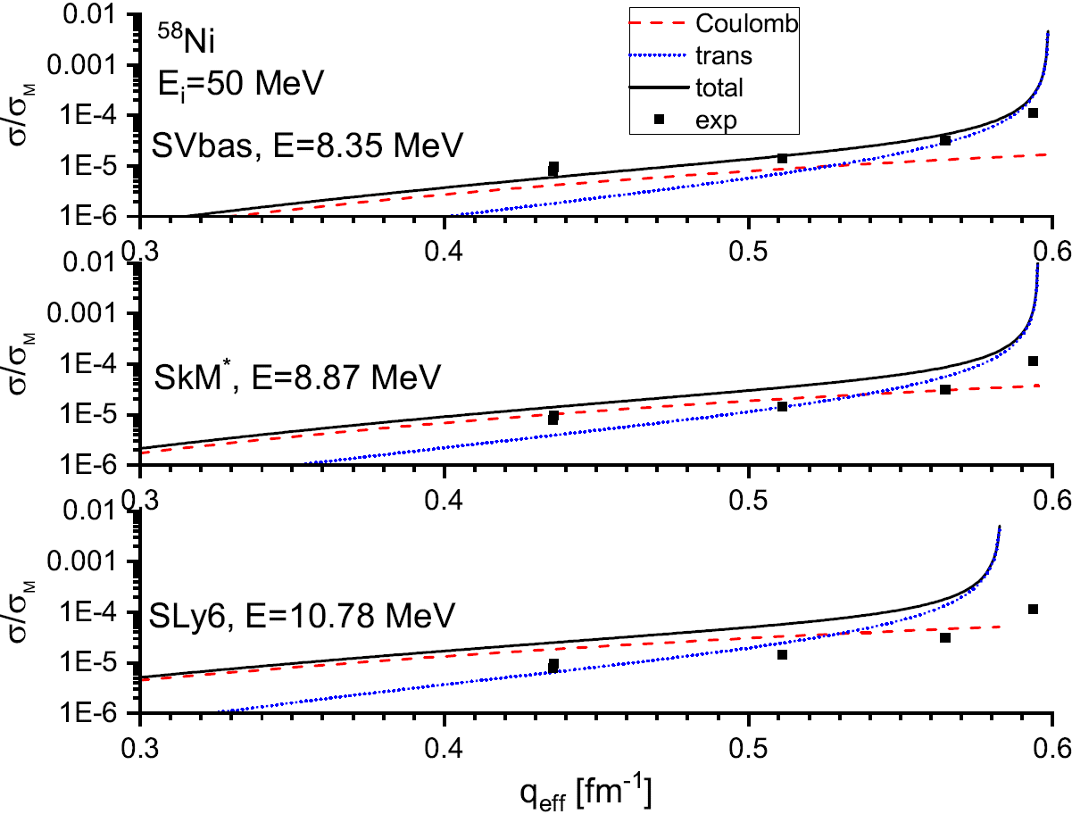
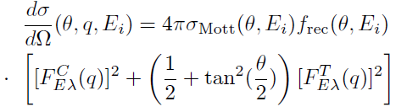
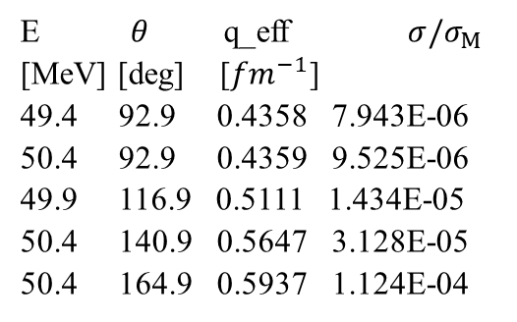
Cross-sections
E $θ$ q_eff $σ/σ_{M}$
[MeV] [deg] [${fm}^{−1}$]
49.4 92.9 0.4358 7.943E-06
50.4 92.9 0.4359 9.525E-06
49.9 116.9 0.5111 1.434E-05
50.4 140.9 0.5647 3.128E-05
50.4 164.9 0.5937 1.124E-04
8.24 MeV
QRPA well describes the experimental data on the cross-section.
The best agreement demonstrates the lowest state for the SVbas forces.

Slide 11
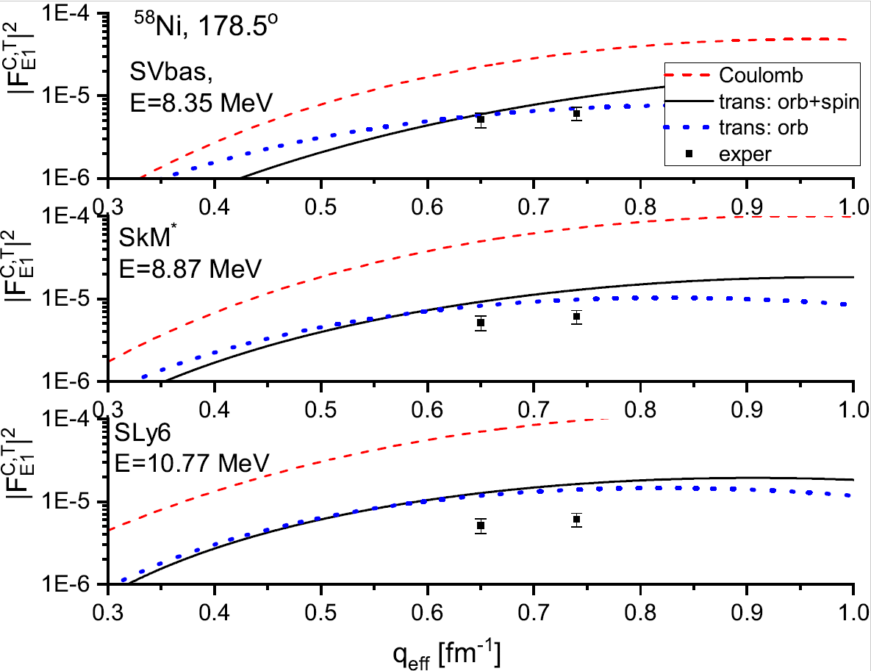

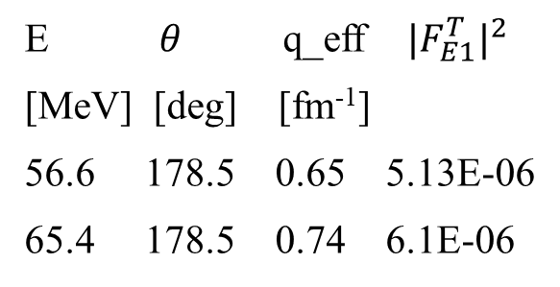
$$θ={178.5 }^{o}$$
E $θ$ q_eff ${|F_{E1}^{T}|}^{2}$
[MeV] [deg] [fm⁻¹]
56.6 178.5 0.65 5.13E-06
65.4 178.5 0.74 6.1E-06
8.24 MeV
QRPA well describes the experimental data of square form factors.
The best agreement demonstrates the lowest state for the SVbas forces.

Slide 12
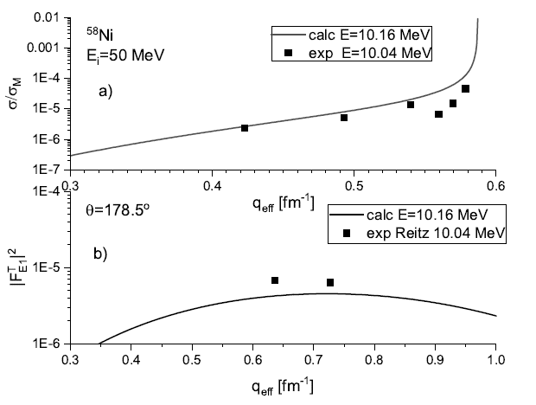
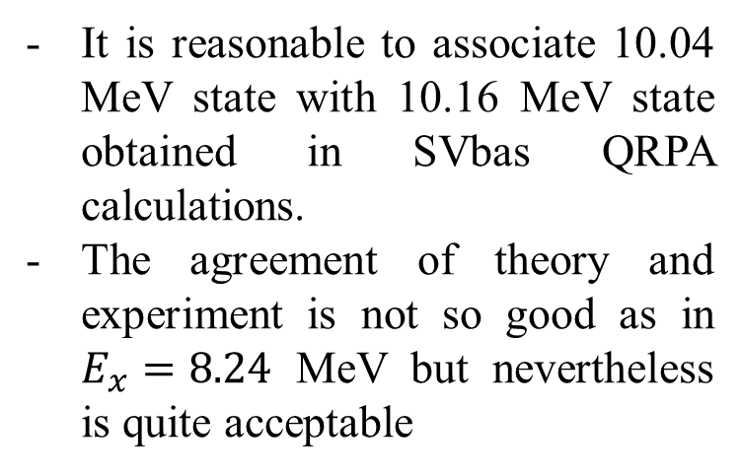
$E_{x}=10.04$ MeV
It is reasonable to associate 10.04 MeV state with 10.16 MeV state obtained in SVbas QRPA calculations.
The agreement of theory and experiment is not so good as in $E_{x}=8.24$ MeV but nevertheless is quite acceptable

Slide 13
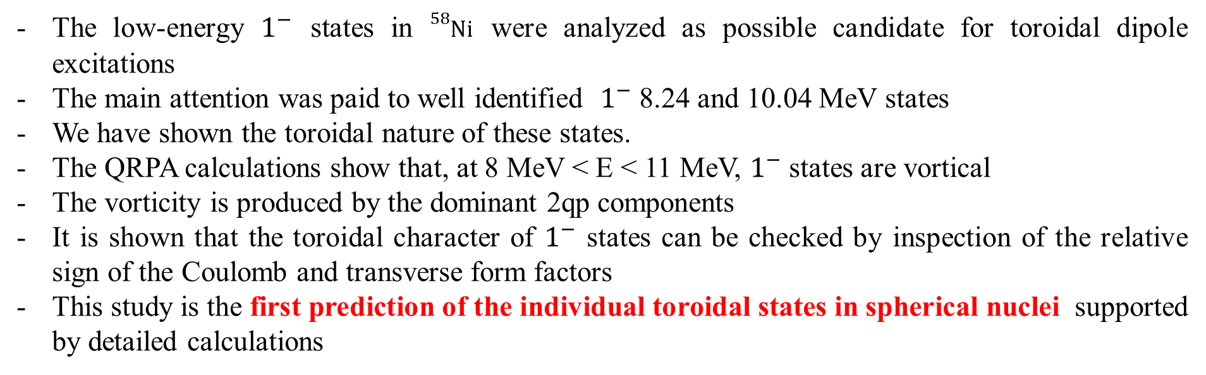
Conclusions
The low-energy $1^{−}$ states in ${}_{}^{58}{Ni}$ were analyzed as possible candidate for toroidal dipole excitations
The main attention was paid to well identified $1^{−}$ 8.24 and 10.04 MeV states
We have shown the toroidal nature of these states.
The QRPA calculations show that, at 8 MeV < E < 11 MeV, $1^{−}$ states are vortical
The vorticity is produced by the dominant 2qp components
It is shown that the toroidal character of $1^{−}$ states can be checked by inspection of the relative sign of the Coulomb and transverse form factors
This study is the first prediction of the individual toroidal states in spherical nuclei supported by detailed calculations

Slide 14
Thanks for your attention!

Slide 15
