Slide 1
photoluminescence of swift heavy ion
irradiated Magnesium aluminate spinel
single crystals
XXVI International Conference of Young Scientists and Specialists (AYSS-2022)
24 – 28 October 2022, Dubna, Russia
M. Mamatova*, V.A. Skuratov, A. Olejniczak, N.S. Kirilkin
Flerov Laboratory of Nuclear Reactions, JINR
Sector №8. Ion-implantation nanotechnology and radiation materials science

Slide 2
introduction
$${MgAl}_{2}O_{4}$$
Potential applications:
Important properties:
Wide band-gap (~9 eV);
High hardness (16 GPa);
Thermal stability (T_{melt} = 2135 ˚C);
Low density ~ 3.58 g·cm⁻³;
High transparent in the visible and infrared wavelength regions;
Excellent radiation resistance.
host for inert matrix fuels in light water reactors
transmutation target for minor actinides and long life fission products
diagnostic/optical windows of fusion devices (ITER, DEMO..)
aerospace engineering
laser technology
A$close−packed$
$face−centred cubic structure$of space group $O_{h}^{7}$ (Fd3m).
The cations occupy
1/8 (${Mg}^{2+}$) of the tetrahedral sites (Td point symmetry) and
1/2 ( ${Al}^{3+}$) of the octahedral sites (D3d local symmetry), and
there are 32 oxygen ions in the unit cell.
Schematic illustrations of MgAl₂O₄ structure :
$${−Al}^{3+}; {−Mg}^{2+}; {−O}^{2−}.$$

Slide 3
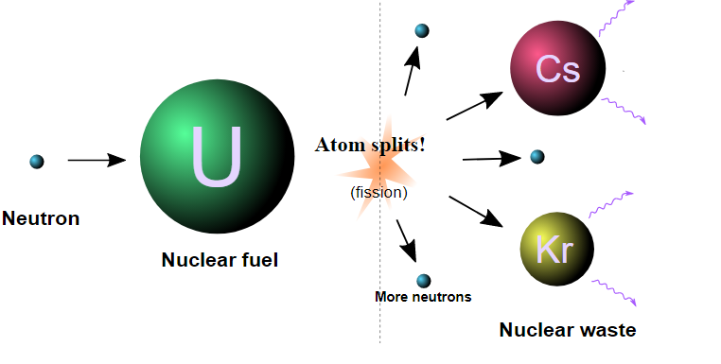
MOTIVATION
Modelling of the actinide fission fragments impact
E~ 70 – 100 MeV
Information about radiation defects induced by swift heavy ions in spinel has been lacking, especially in the range of high ionization energy losses.
to study a swift heavy ions-induced defects in ${MgAl}_{2}O_{4}$single crystals using optical spectroscopy methods.
The aim of the present work is

Slide 4
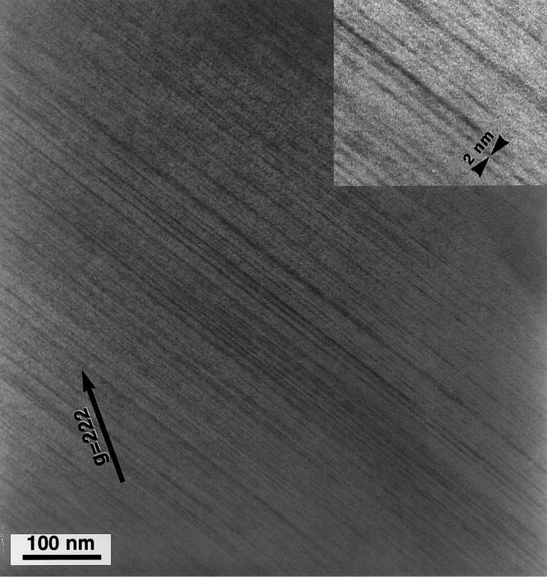
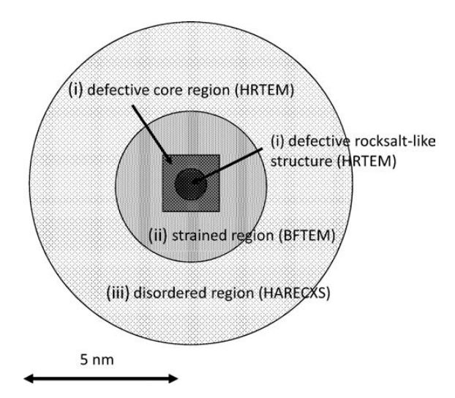
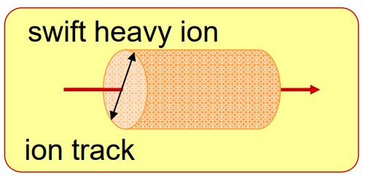
Highly resistant to radiation damage
Swift heavy ion irradiation:
High-density electronic excitation
Ion tracks
Amorphization
The phase transformation from spinel to defective rock-salt structure at the core region through the movements of cations from IV-site to VI-site under a condition of high electronic excitation
$$S_{e} \sim 20 keV/nm$$
$${threshold S}_{e} for discontinuous track formation \sim 8 keV/nm$$
>100 dpa, ${F\sim 10}^{13} {сm}^{−2}$
Ion tracks in spinel irradiated with 430 MeV Kr ions to
a fluence of 1.1· 10¹² cm⁻² at RT
$${ (\frac{dE}{dx})}_{e}=35\frac{keV}{nm}$$
[*] S.J. Zinkle, V.A. Skuratov, NIMB, B 141, 1998.
[**] K. Yasuda and et.al., NIMB, B 250, 2006.
Schematic diagram of the radiation-induced microstructure induced by a single ion of 200 MeV Xe or 350 MeV Au

Slide 5
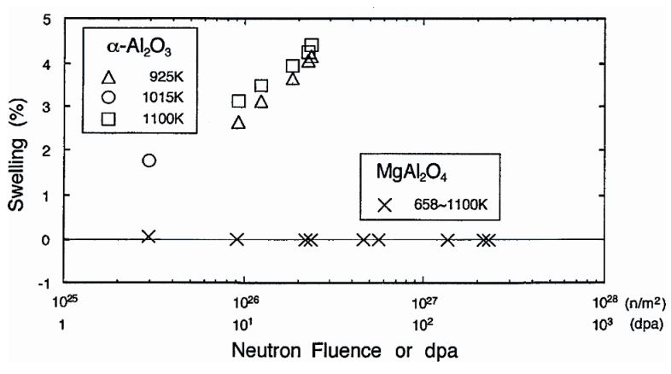
Strong resistance to void or cavity formation in ${MgAl}_{2}O_{4}$
C. Kinoshita. Microstructural evolution of
Irradiated ceramics. In: Radiation effects in
Solids. Eds. K.Sickafus, E.Kotomin and
B.Uberaga. Nato Science series. V.232, p.193.
Spinel is not amorphized by electron, neutron and low-energy ion irradiation at T>300 K.

Slide 6
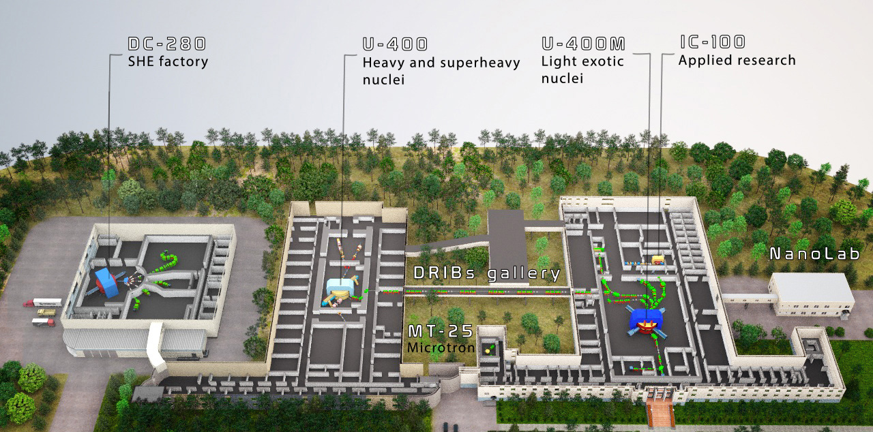
SWIFT HEAVY ION IRRADIATION PARAMETERS
Samples were irradiated at IC-100 and U-400 cyclotrons at room temperature in FLNR JINR (Dubna).
Ion type & Energy, MeV | Fluence, cm⁻² | R_{p}, μm | S_{e}, keV/nm
⁴⁰Ar, 46 | 10¹⁰ – 10¹³ | 8.47 | 7.3
¹⁰⁰Kr, 107 | 10¹⁰ – 10¹⁴ | 10.9 | 14.87
¹³²Xe, 150 | 10¹⁰ – 10¹³ | 11.37 | 21.97
²⁰⁸Bi, 670 | 10¹⁰ – 10¹³ | 26.1 | 36.6

Slide 7
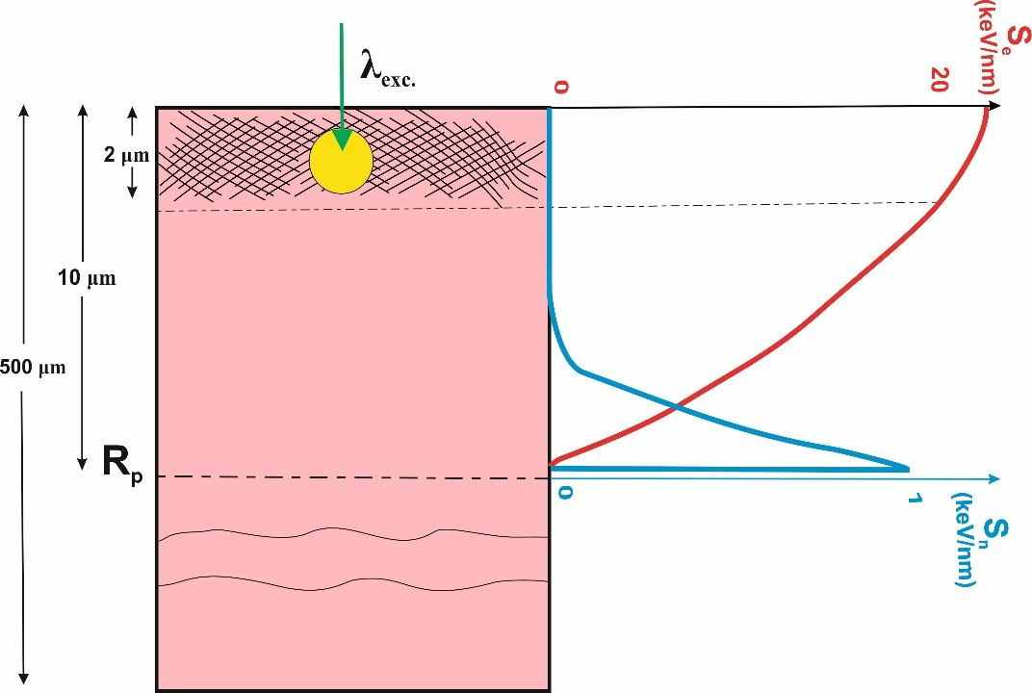
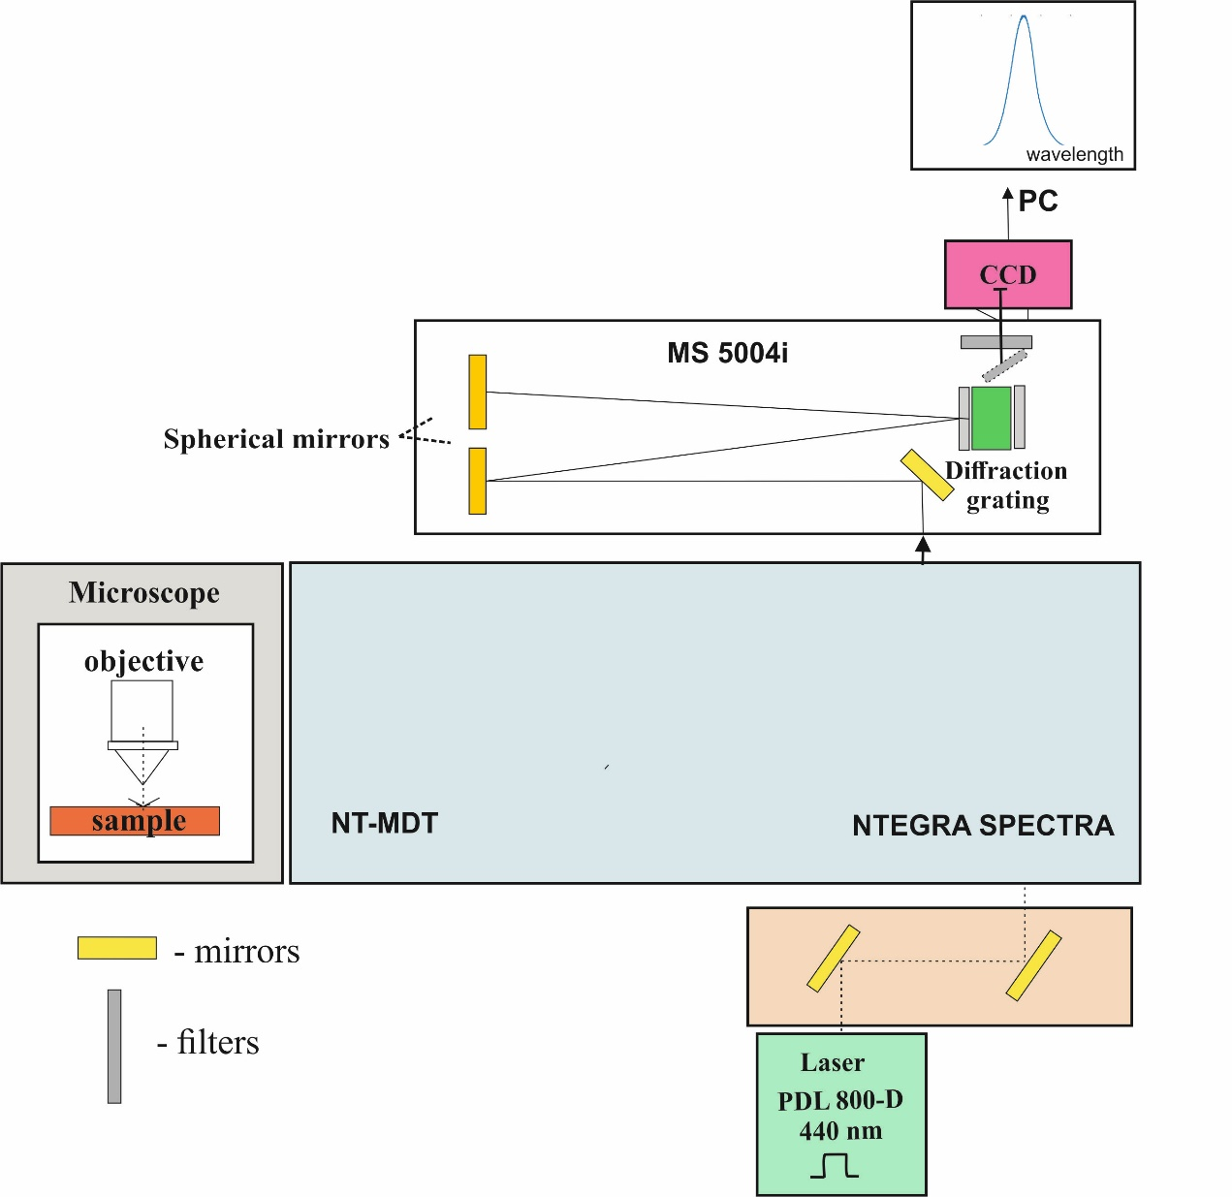
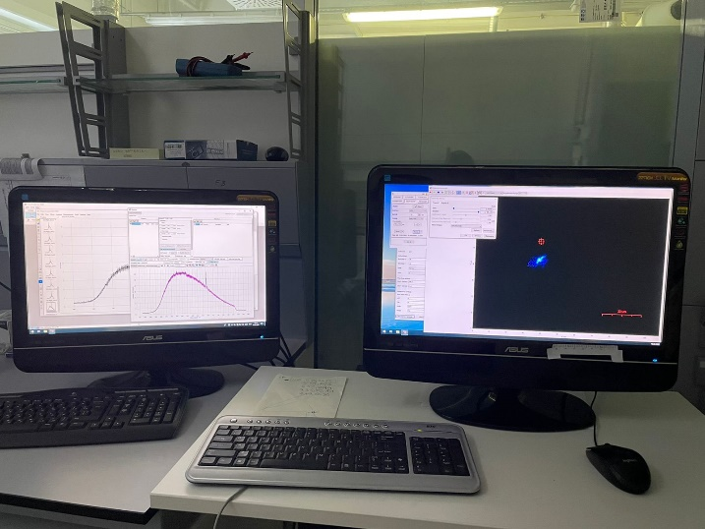
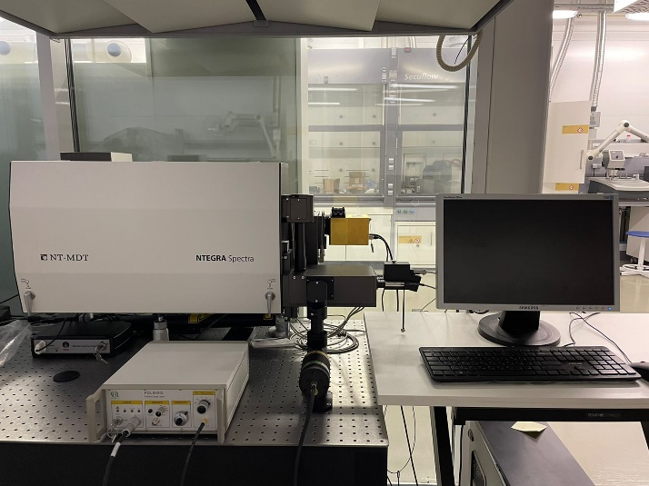
I. Photoluminescence measurement setup
Scheme of laser light focusing in the near-surface layer of the sample and electronic ($S_{e}$) and nuclear ($S_{n}$) stopping power
Scheme and photo of the experimental setup for PL measurements using confocal scanning microscope NTEGRA Spectra NT-MDT

Slide 8
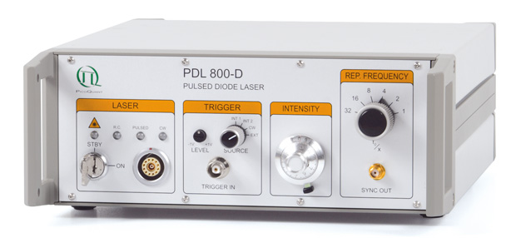
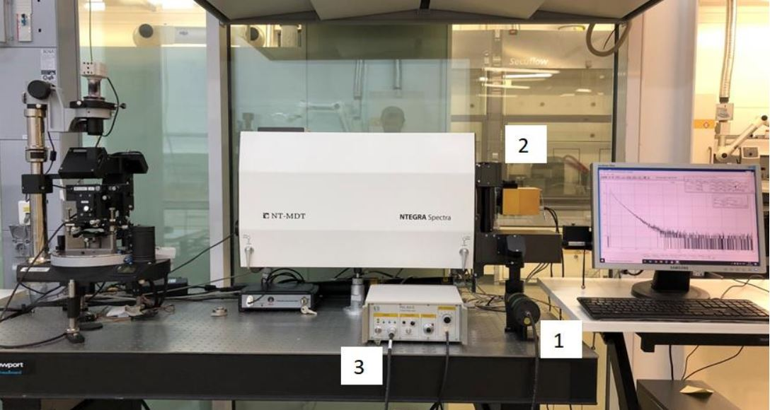
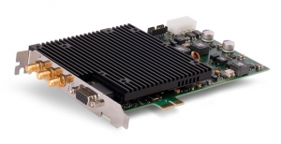
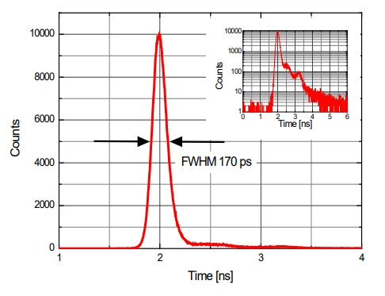
II. Time-resolved Photoluminescence measurement setup
$$λ_{exc.}=445 nm \left(FWHM=80 ps \right)$$
Frequency ~ 1 MHz
$$\text{TDC} \text{TimeHarp}\text{ 260}$$
Setup for measurement of the photoluminescence kinetics.
1 – Head of the pulse laser,
2 – Photomultiplier Detector Assembly (PMA 175),
3 – Picosecond Diode Laser driver (PDL800-D).

Slide 9
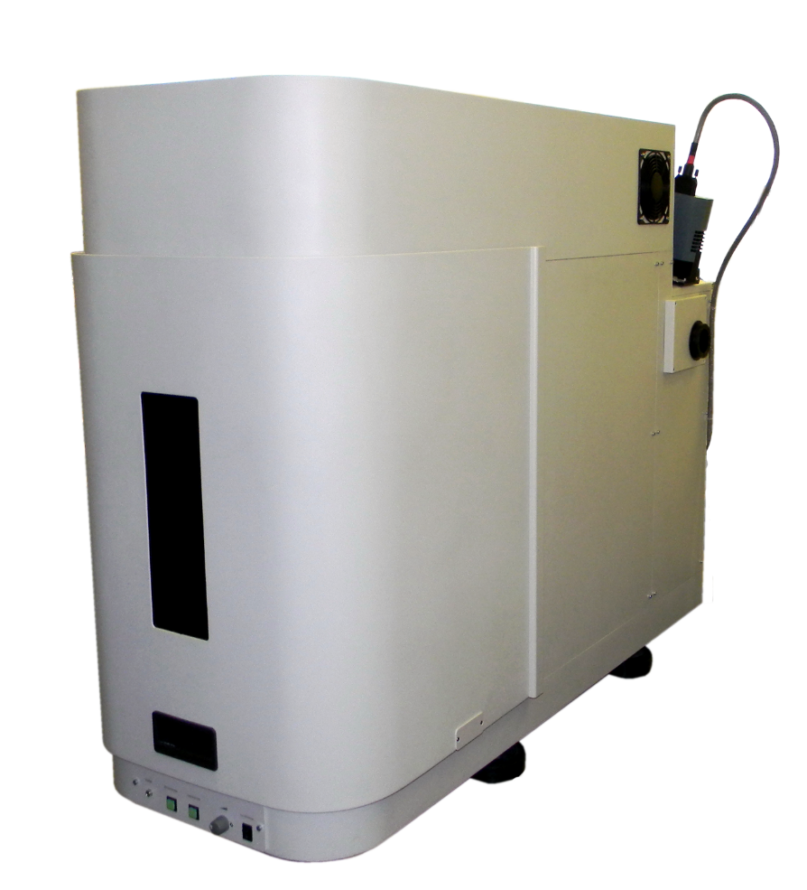
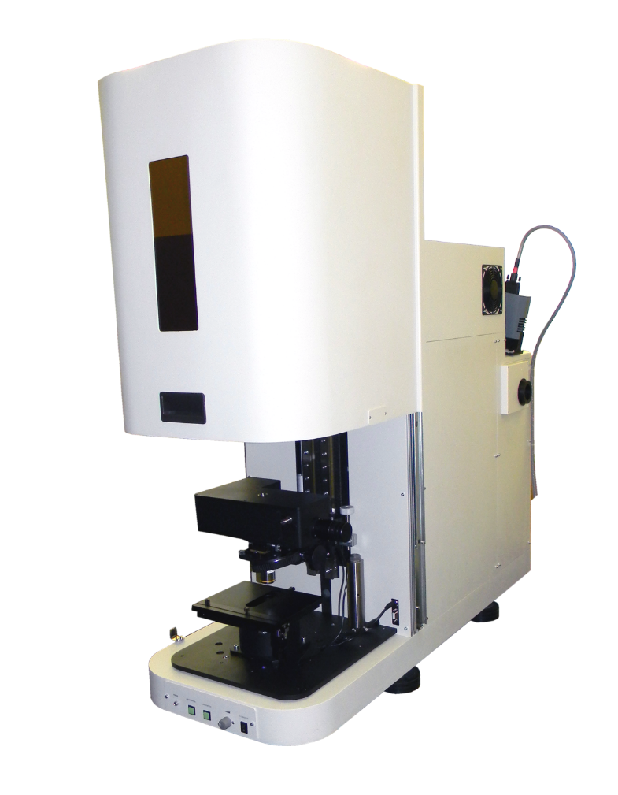
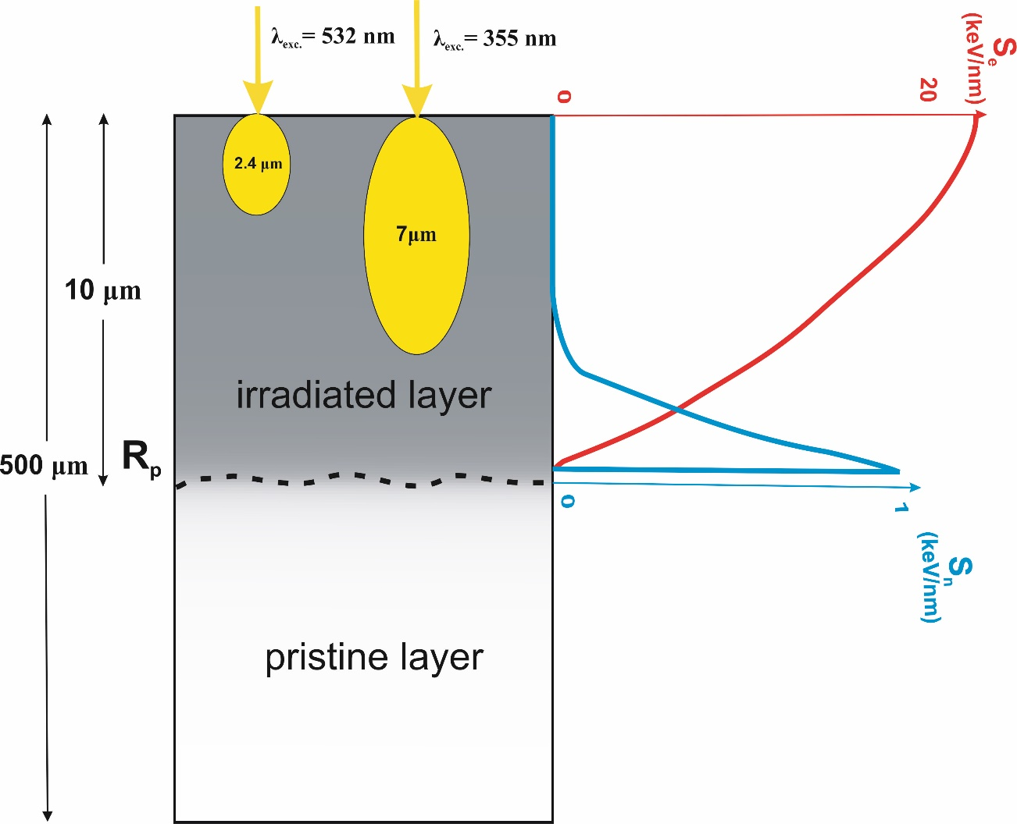
III. Photoluminescence measurement setup
Excitation was provided by
UV (355 nm)
Blue (473 nm)
Green (532 nm)
stationary laser sources
Registration of the
emission by Peltier-cooled CCD-matrix Andor Technology DU401A-BV
*Belarusian State University (Minsk, Belarus)
Micro Raman spectrometer Nanofinder High End (LOTIS TII Japan-Belarus)
combined with a 3D scanning confocal microscope

Slide 10
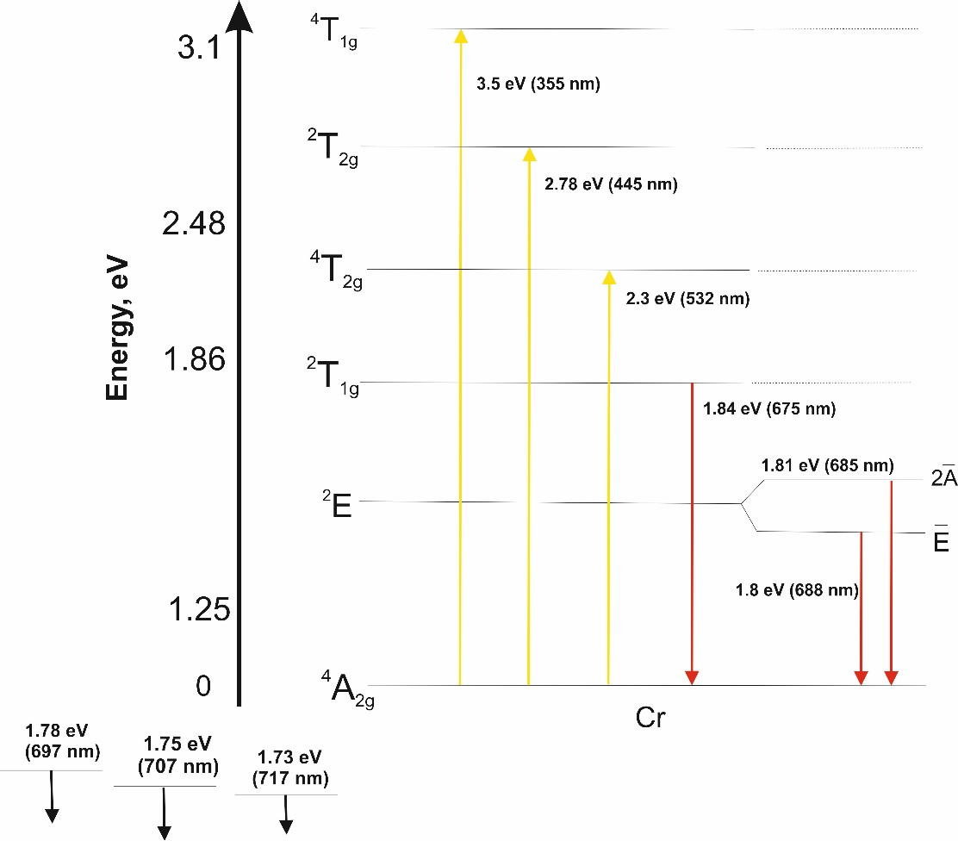
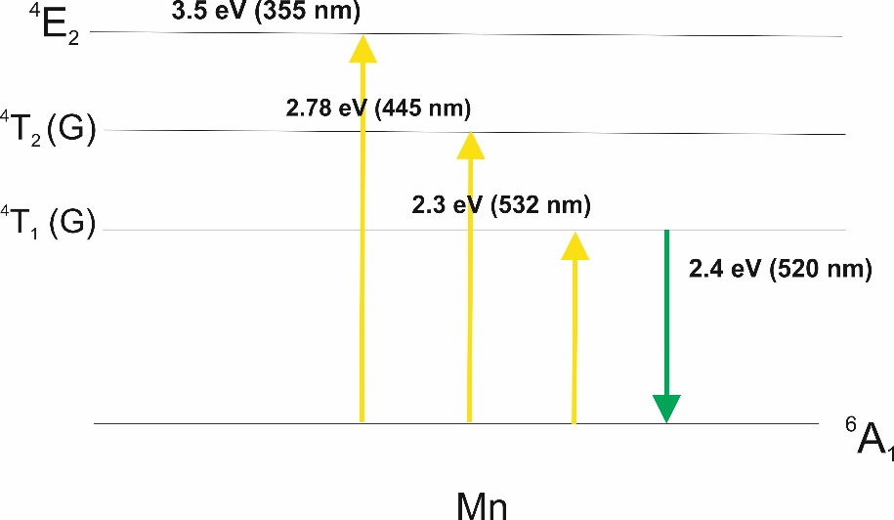
RESULTS
Dependence of the photoluminescence spectra of MgAl₂O₄ on the excitation wavelength

Slide 11
RESULTS
$$λ_{exc.}=355 nm$$
$$Confocal geometry$$
$$λ_{exc.}=532 nm$$
$$λ_{exc.}=473 nm$$

Slide 12
RESULTS
$$λ_{exc.}=445 nm (confocal geometry)$$
Photoluminescence spectra of spinel irradiated by Xe ions
in the fluence range of 10¹⁰-5·10¹³ cm⁻²
Photoluminescence decay curves of spinel irradiated by Xe ions.
Ion fluence is 1.2×10¹² cm⁻².

Slide 13
Photoluminescence intensity profiles
$$R_{p}=27.19 μm$$

Slide 14
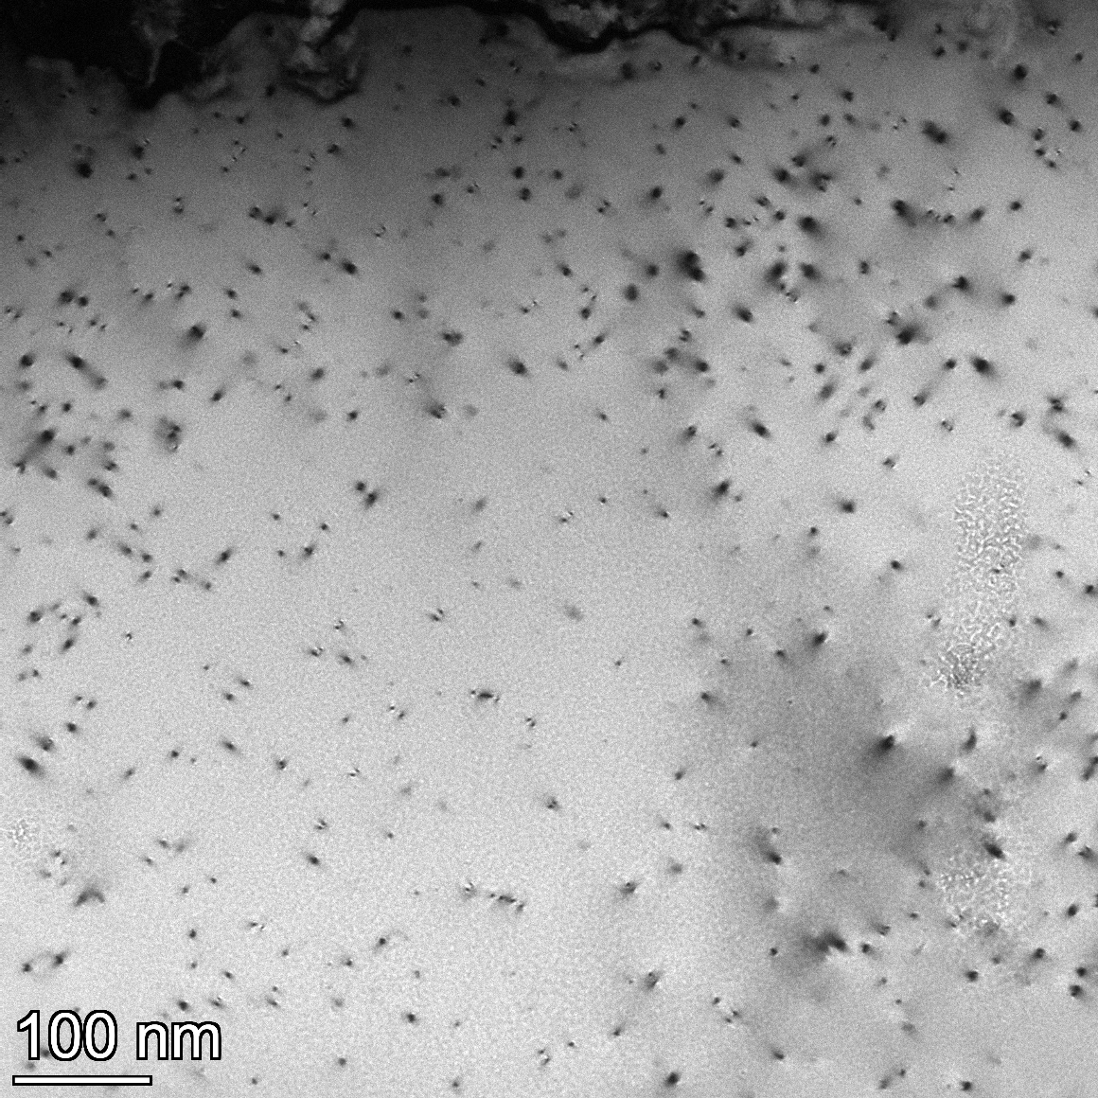
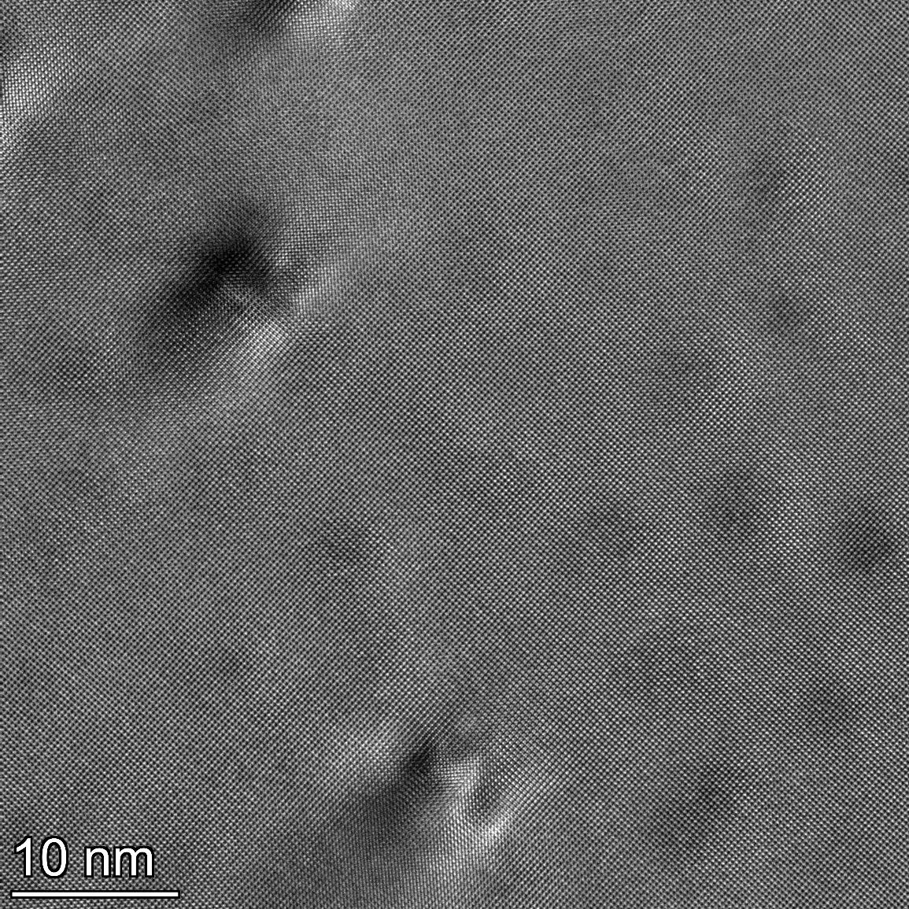
RESULTS
a)
b)
The plan view microstructure of MgAl₂O₄ irradiated with 670 MeV Bi ions to a fluence of 10¹¹ cm⁻²:
a) TEM image;
b) HR TEM image

Slide 15
summary
Photoluminescence spectra of intact spinel crystals excited by 355, 445, 473 and 532 nm laser light are composed of emission bands/lines attributed to Mn²⁺ and Cr³⁺ impurities.
Irradiation of MgAl₂O₄ crystals with high-energy Kr and Bi ions results in appearance of intense non-elementary bands in 1.55 - 3.1 eV spectral range. Intensity of these bands increases with the ion fluence up to 10¹³ cm⁻² (till ion track overlapping).
The emission decay times in 1.9 – 2.5 eV bands are ranged from 8 ns (500 nm, 2.5 eV) to 13.7 ns (650 nm, 1.9 eV).
Thank you for attention!

Slide 16
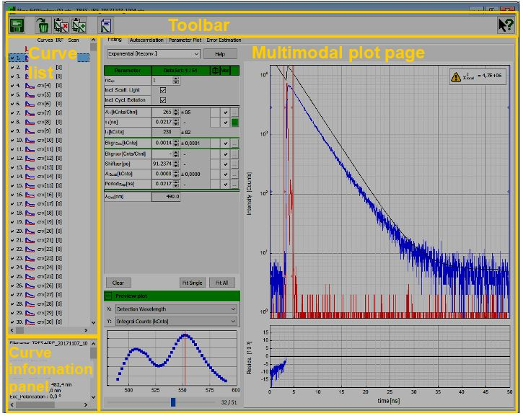
$$I \left(t\right)= \sum_{i=1}^{n_{exp}}{A_{i}e^{−\frac{t}{τ_{i}}}−{Bkgr}_{dec}}$$

Slide 17
Photoluminescence intensity profiles
$$R_{p}=27.19 μm$$

