Slide 1
A structural phase transition in La₂Ti₂O₇ at high pressure
Lab: Frank Laboratory for nuclear Research (JINR, Dubna, Russia).
Speaker: Asif Asadov.
Authors : A.G. Asadov^{1,2}, D.P. Kozlenko², A. Mammadov¹, R. Mehdiyeva¹,
S.E. Kichanov², E.V. Lukin², O.N. Lis², A.V. Rutkauskas².
Collaborations: ¹ Institute of Physics, Azerbaijan National Academy of Sciences, Baku AZ-1143, Azerbaijan.
² Frank Laboratory of Neutron Physics, JINR, 141980 Dubna, Russia.

Slide 2
Usage areas
High pressure sensors
Actuator
Fuel cells technology
Energy conversion technology
Solid State memory
Asif Asadov AYSS-2022 Condense Matter Physics

Slide 3
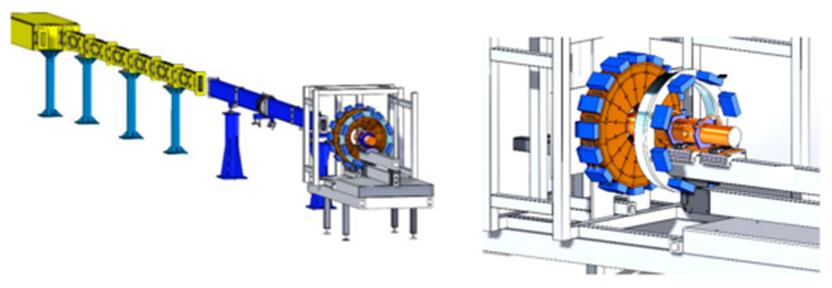
Measurments
Neutron diffraction at ambient condition (DN-6):
a) DN-6 diffractometer beam line b) Detectors
The crystal structure of La₂Ti₂O₇ was tested by neutron diffraction method, which allows determination of light oxygen atoms coordinates with much better accuracy. The neutron powder diffraction measurement at ambient conditions was performed with the DN-6 diffractometer at the IBR-2 high-flux pulsed reactor (FLNP JINR, Dubna, Russia). Diffraction patterns were collected at scattering angles 2θ=90°. The spectrometer resolution at λ = 2 Å is Δd/d = 0.022 for this angle. The typical data collection time was 20 min. The sample volume was about 5 mm³.
Asif Asadov AYSS-2022 Condense Matter Physics

Slide 4
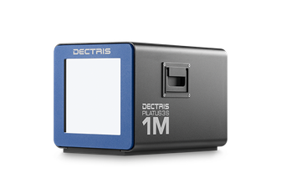
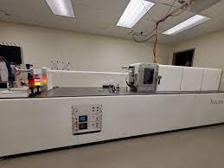
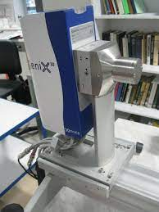
X-ray diffraction at pressure range 1 atm – 32 GPa:
c) DETRICS dedector
b) Genix3D source
a) Xenocs Xeuss 3.0
The X-ray diffraction experiments were carried out with the Xenocs Xeuss 3.0 specialized diffractometer (Xenocs SAS, France). The used Mo Kα X-ray radiation with the wavelength
λ= 0.71078 Å was generated by the GeniX3D source. X-ray diffraction patterns were collected using the DETRICS detector at sample-detector distances of 0.5 m.
Asif Asadov AYSS-2022 Condense Matter Physics

Slide 5
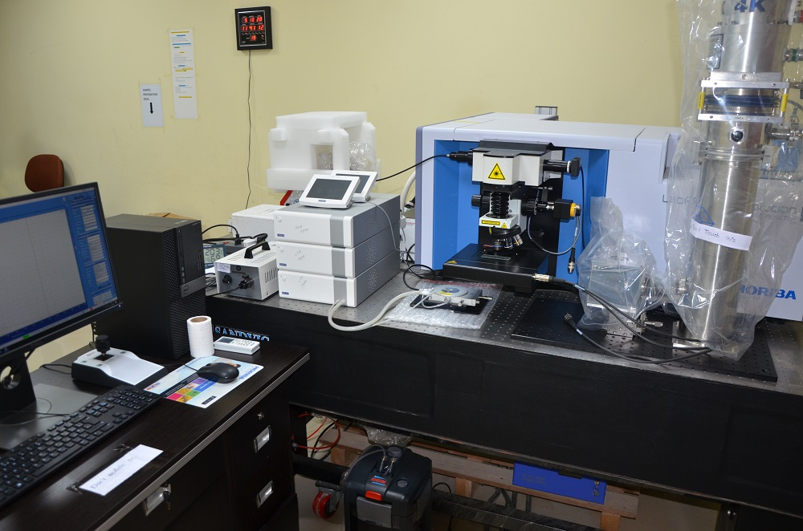
Raman Spectroscopy at pressure range 1atm-30 GPa
Raman spectra were collected using a LabRAM HR spectrometer (Horiba Gr, France) with a wavelength excitation of 633 nm emitted from He–Ne laser, 1800 grating, a confocal hole of 100 μm, and ×50 objective.
Asif Asadov AYSS-2022 Condense Matter Physics

Slide 6
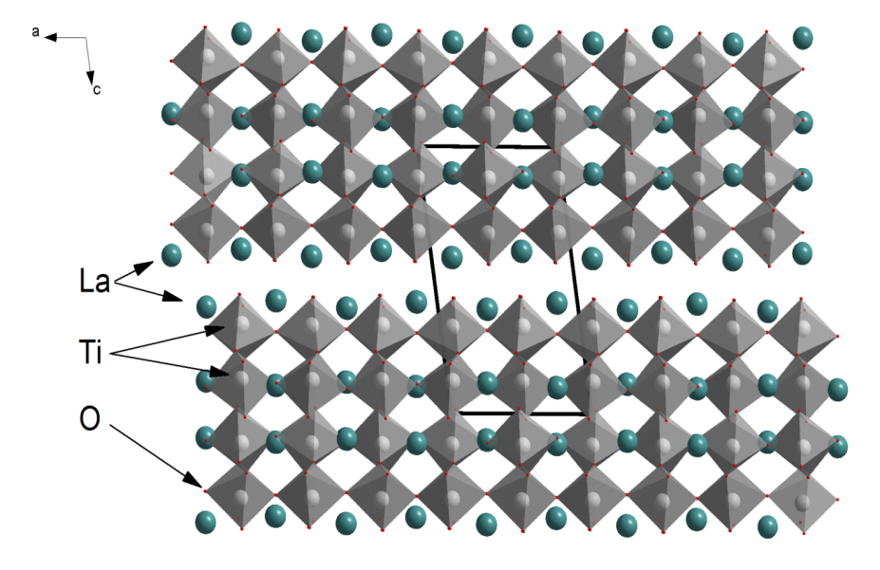
Results and Discussions.
Neutron diffraction.
Expected and modelled space groups:
P2₁, P2, P2/m – monoclinic
Pna2₁, Cmc2₁ - orthorhombic
Neutron diffraction pattern of La₂Ti₂O₇ at ambient temperature and pressure.
The schematic representation of modelled crystal structure of La₂Ti₂O₇ compound.
Neutron diffraction confirms that crystal structure at ambient condition is monoclinic P2₁!!!
Asif Asadov AYSS-2022 Condense Matter Physics

Slide 7
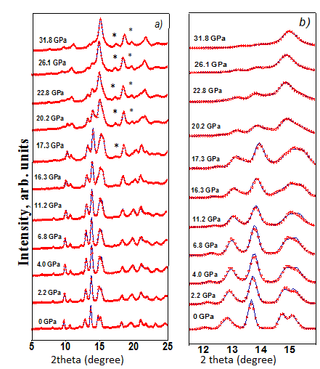
X-ray diffraction measurements.
At P>16.3 GPa, several new diffraction peaks located at 2θ ~ 6.4; 7.5; and 9.4°; were detected, at the same time, reflection at 2θ ~ 8.0; 9.7; 21.0° disappear. The significant changes in relative intensities of other diffraction peaks were detected. This kind of high pressure structure estimated as new P2 monoclinic phase .
Asif Asadov AYSS-2022 Condense Matter Physics

Slide 8
The compressibility of the lattice parameters :
k_{ai} = -(1/a_{i0})(da_{i}/dP)|_{T}, a_{i} = a, b, c
were calculated for low-pressure and high-pressure phase of La₂Ti₂O₇. The values
k_{a1} = 0.00022(1) GP⁻¹ k_{b1} =0.0010(1) GPa⁻¹ k_{c1} =0.0022(1) GPa⁻¹ - low pressure phase
k_{a2} =0.00017(1) GPa⁻¹, k_{b2} = 0.0008(1) GPa⁻¹, k_{c2} =0.0017(2) GPa⁻¹ - high pressure phase
Asif Asadov AYSS-2022 Condense Matter Physics

Slide 9
The volume compressibility data were fitted by the third-order Birch-Murnaghan equation of state:
$P=\frac{3}{2}B_{0}\left(x^{−\frac{7}{3}}−x^{−\frac{5}{3}}\right)\left[1+\frac{3}{4}\left(B^{′}−4\right)\left(x^{−\frac{2}{3}}−1\right)\right]$
Here x = V/V₀ is the relative volume change, V₀ is the unit cell volume at P = 0, and B₀, B' are the bulk modulus
B₀ = -V(dP/dV)_{T}
B' = (dB₀/dP)_{T}
The fitted values B₀ = 183(4) GPa at B' = 5(1) for the initial monoclinic P2₁ phase at low pressures (P< 16.3GPa).
B₀ = 201(1) GPa with fixed B' = 4(0) for the pressure induced phase P2 of La₂Ti₂O₇ were calculated for high pressures (P>16.3GPa).
The obtained values of bulk modulus are higher than the previous ones .
Asif Asadov AYSS-2022 Condense Matter Physics

Slide 10
Raman spectroscopy measurements.
The low frequency vibration modes in the wavelength range 50–490 cm⁻¹ can be attributed to the La–O vibrations; the modes in the range 490–575 cm⁻¹ associated with the vibrations of the distorted TiO₆ octahedra; the symmetric and asymmetric stretching modes of the of Ti–O vibrations are located in the range of 785-814 cm⁻¹ .
Asif Asadov AYSS-2022 Condense Matter Physics

Slide 11
a)
b)
The dependences of the relative displacement of La³⁺ ions relative to each other are shown in the Figure (a) . There are the changes in the relative distance Δ between lanthanum ions in different crystallographic positions. After the phase transition above 16.3 GPa, an increase in the magnitude of the displacement of rare-earth ions is observed, which indicates the grow of a disordering of the crystal structure of La₂Ti₂O₇ at high pressure.
The Raman spectra doublet at ~790 cm⁻¹ Figure (b) which is associated with a distortion of the TiO₆ octahedra, have similar behavior under pressure. Then the pressure increases, a slight symmetrization of the TiO₆ octahedra is observed, but after the phase transition, the octahedra distortions begin to increase.
Asif Asadov AYSS-2022 Condense Matter Physics

Slide 12
Conclusion.
Neutron diffraction confirms that, at ambient conditions La₂Ti₂O₇ structure is P2₁ monoclinic and unit cell parameters : a = 7.752(4) Å, b = 5.510(2) Å,
c = 12.962(3) Å, β = 98.7(2)°.
In X- ray diffraction spectrum of La₂Ti₂O₇ distinctive differences observed for low and high pressure region. The structure of high pressure spectrum allow us to model this phase as P2 monoclinic. This kind of phase transition happen at P≈17.3 Gpa.
Phase Transition related with displacement of La³⁺ ions in unit cell and distortion of TiO₆ octahedrons.
Raman spectrum confirms phase transition at high pressure region which is happen at exactly in vibration of distorted TiO₆ octahedrons modes and Ti-O stretch modes region.
Asif Asadov AYSS-2022 Condense Matter Physics

Slide 13
Thank for your attention!!!

