Slide 1

Resistive plate chamber (RPC) detector with B-10 for thermal neutrons
The XXVI International Scientific Conference
of Young Scientists and Specialists
24–28 Oct 2022
Dubna, JINR
Petrova M.O.*
Bogdzel A.A., Milkov V.M., Bodnarchuk V.I., Daulbaev O., Bulatov K. V., A.A. Kurilkin
mbelova@jinr.ru

Slide 2
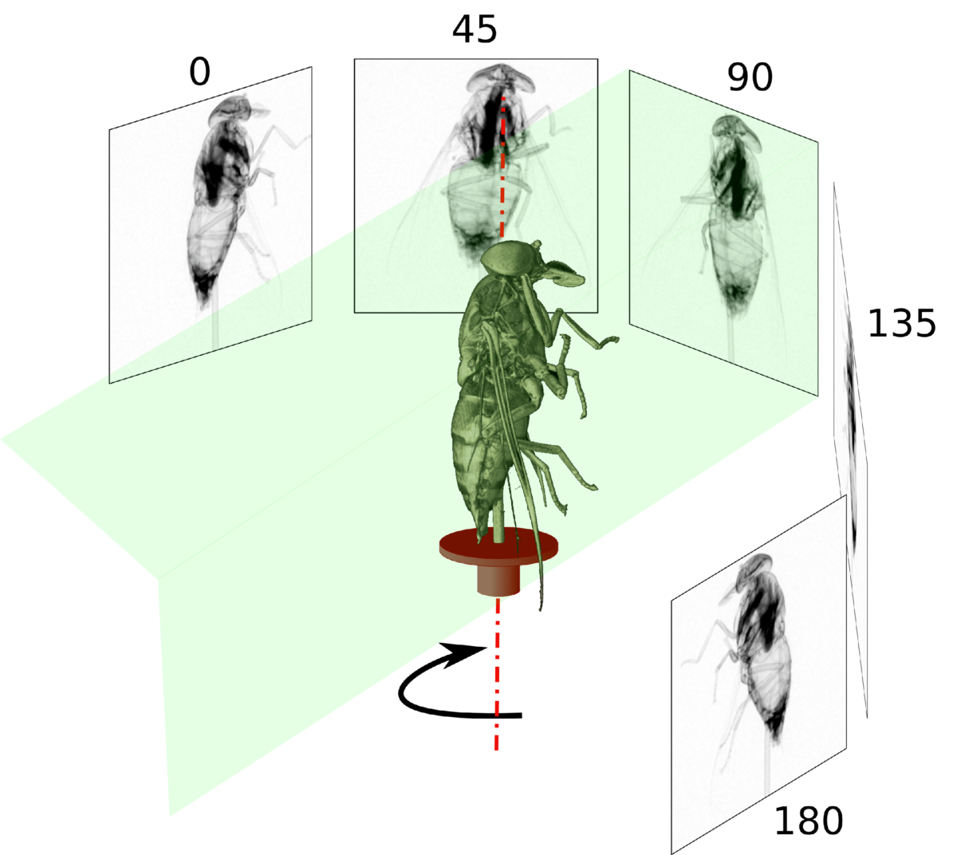
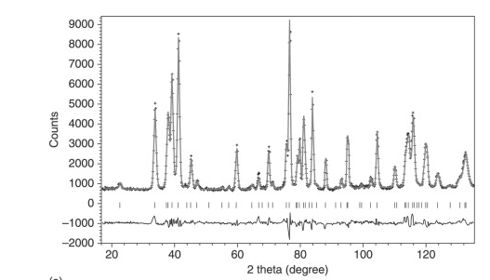
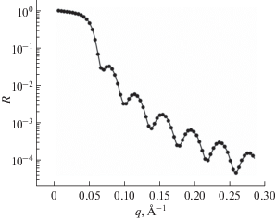
Most commonly used
neutronographic methods
Tomography
Reflectometry
Diffraction

Slide 3

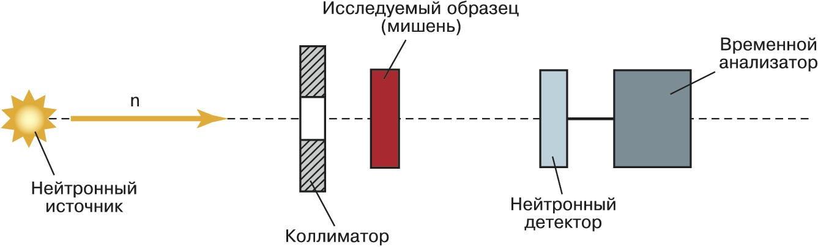
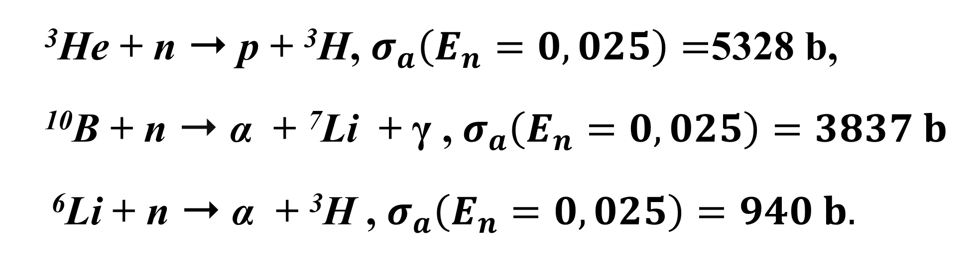
Neutron registration
³He + n ➝ p + ³H, $σ_{a}\left(E_{n}=0,025\right)=$5328 b,
¹⁰B + n ➝ α + ⁷Li + γ , $σ_{a}\left(E_{n}=0,025\right)=3837 b$
⁶Li + n ➝ α + ³H , $σ_{a}\left(E_{n}=0,025\right)=940 b.$

Slide 4
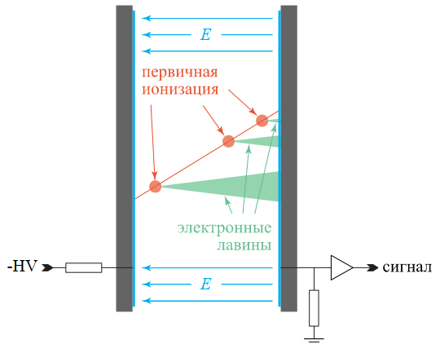

Resistive plate chamber

Slide 5
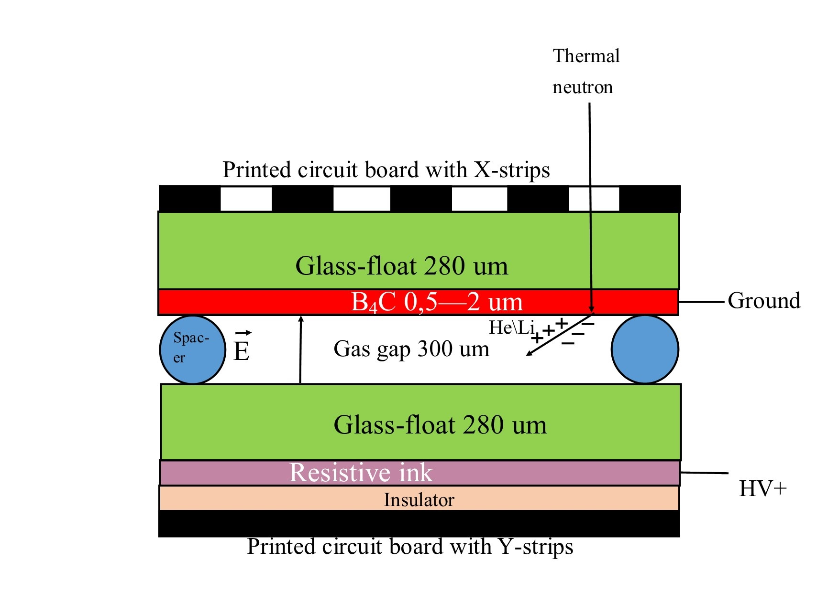
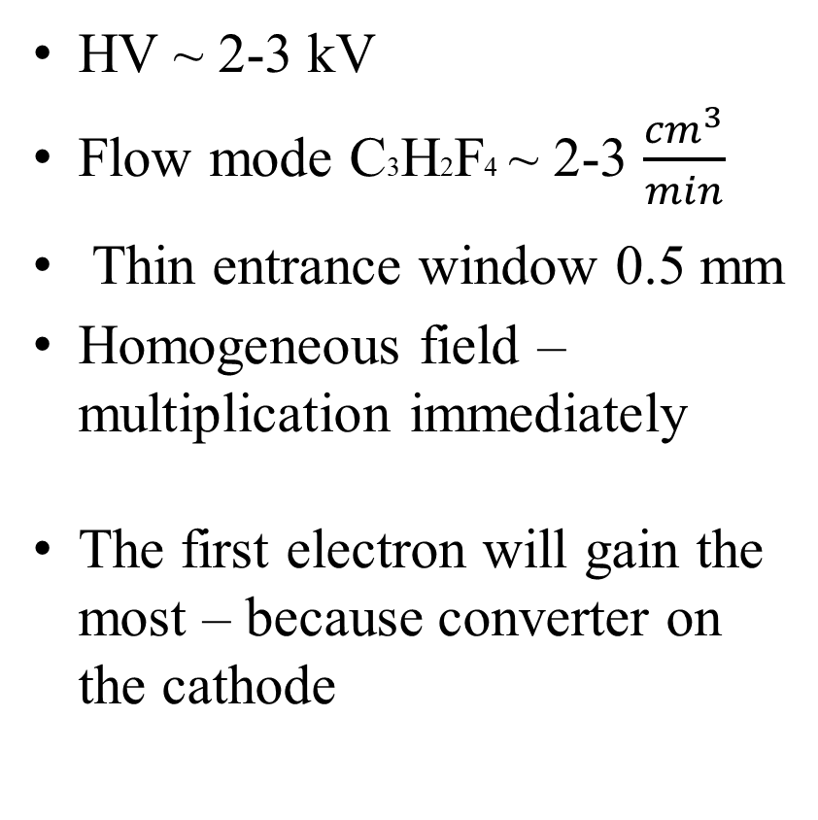
First topology
HV ~ 2-3 kV
Flow mode C3H2F4 ~ 2-3 $\frac{{cm}^{3}}{min}$
Thin entrance window 0.5 mm
Homogeneous field – multiplication immediately
The first electron will gain the most – because converter on the cathode

Slide 6
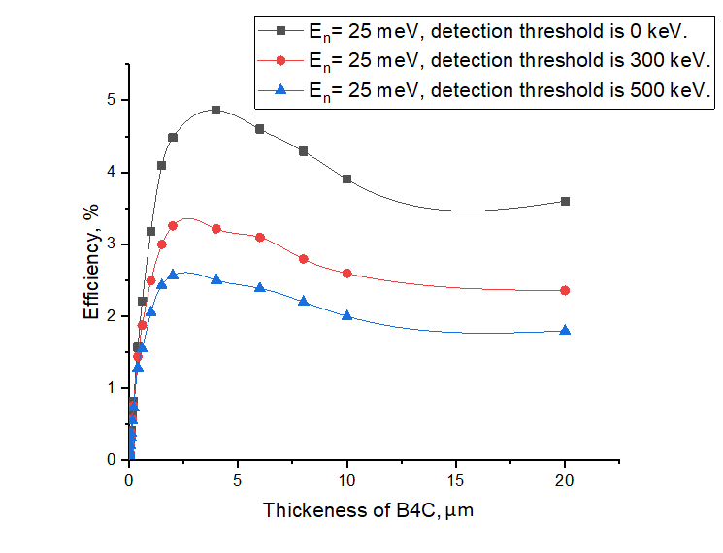
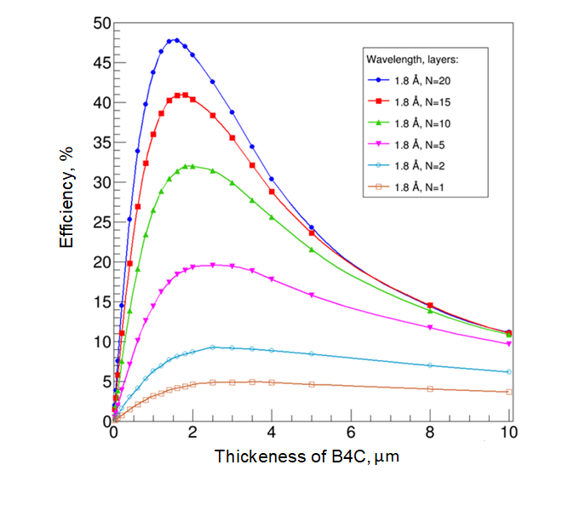
Calculated conversion efficiency by Geant4

Slide 7
Magnetron sputtering of thin films B4C
Dubna University
590±50 nm of B4C for 280 and 400 μm of glass-float
ESS Linkoping
0.5, 1 and 2 μm of B4C with ±10%
of deviation for 280 and 400 μm
of glass-float

Slide 8

X-Ray (1,54A) reflectivity curves

Slide 9
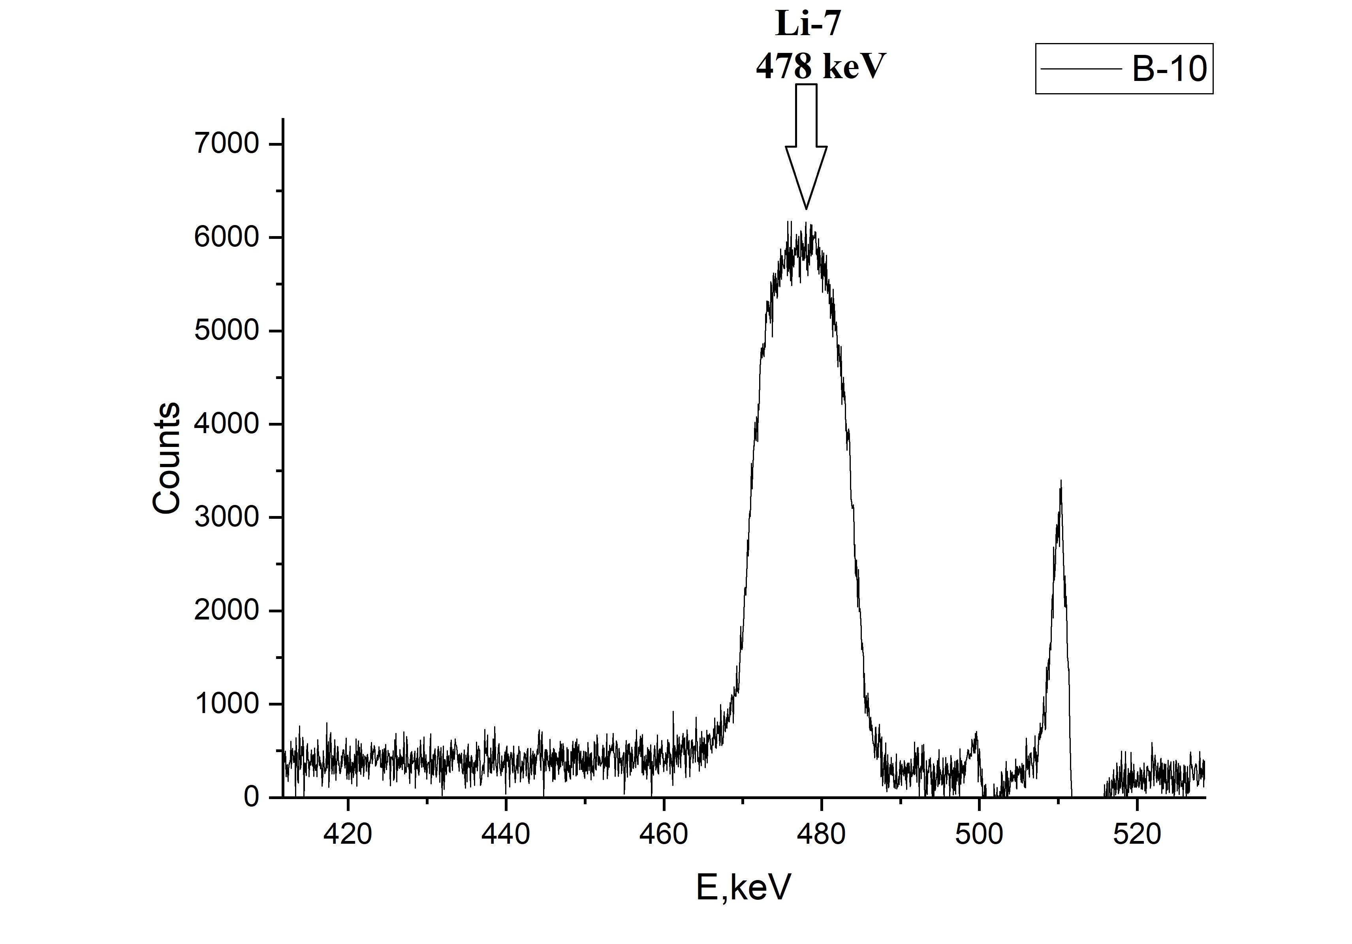
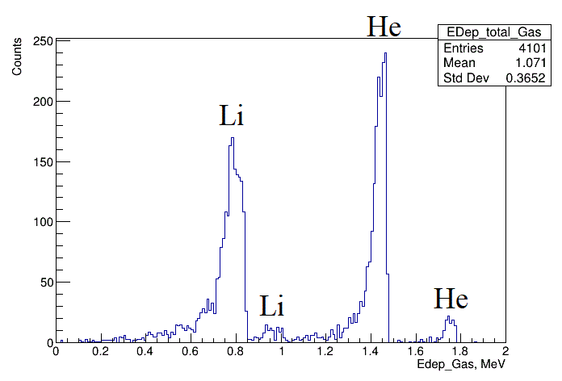
Energy spectrums
Gamma-quanta
Charged particles
Measured by HPGe Canberra GC10021
Calculated by Geant4

Slide 10
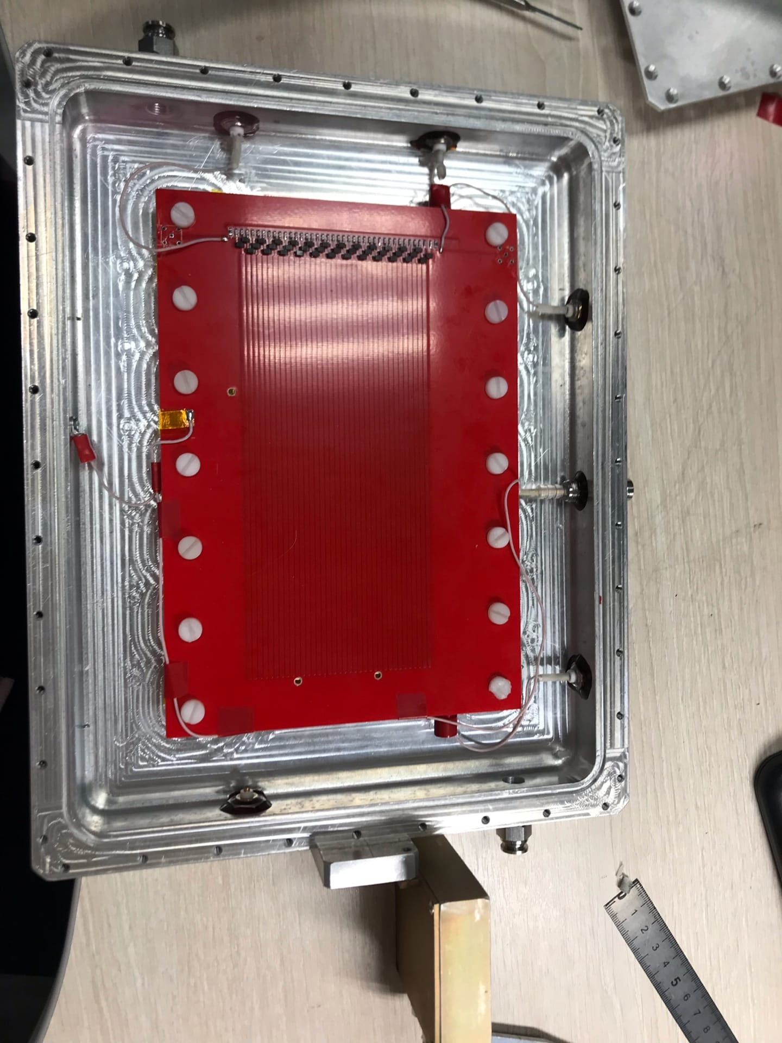
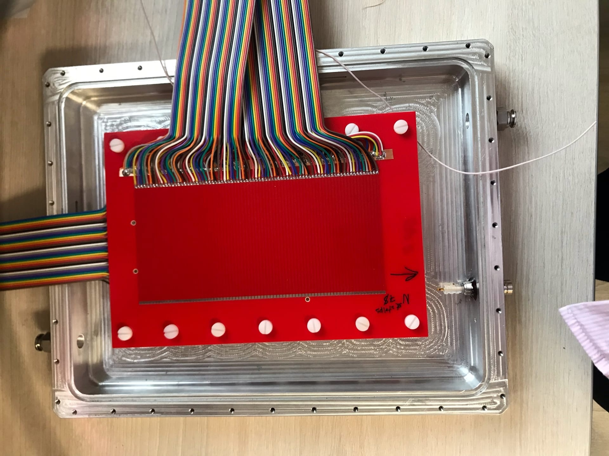
Current status – close to first measuring

Slide 11

mbelova@jinr.ru

