Slide 1
Risk factors of hypertension among sohag university students
Presented by
Ayat khalaf Ahmed

Slide 2
Background
Non-communicable diseases (NCDs) known as chronic diseases are non-infectious diseases of long duration, the patient is on lifelong treatment.
The importance of NCDs for global health stemmed from increased prevalence of NCDs. infectious diseases were the main cause of mortality around different regions of world but subsequent shifts in the worldwide morbidity and mortality trends have placed the issue of NCDs at the top of the research agenda.

Slide 3
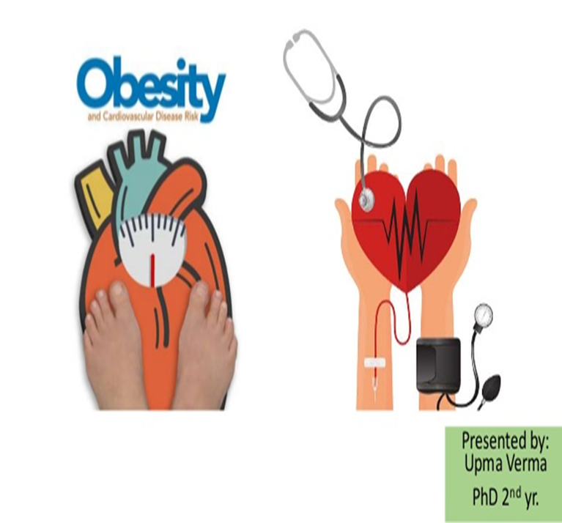
The greatest global NCDs burden arises due to cardiovascular diseases (CVDs). Hypertension (HTN) is often termed the silent killer many people with high blood pressure don't know they have the disease until it has progressed.

Slide 4
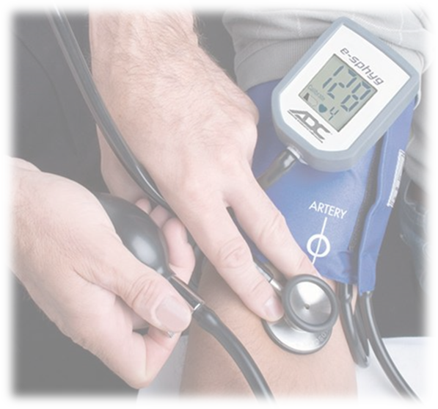
There is preponderance of hypertension as the most important risk factor of CVDs., Continuous presence of uncontrolled elevated blood pressure has an adverse effect on the risk of developing future cardiovascular events, Early screening and follow up will prevent the further health issues, Hypertension is present in the etiology of ischemic cardiomyopathy, renal diseases, and it is the most frequent factor in stroke cases Thus, immediate and intensive treatment of hypertension reduces the mortality risk associated with its complications.

Slide 5
Prevention of hypertension is the most effective in lowering the burden of this disease , Thus in terms of primary prevention, it is necessary to investigate the risk factors for hypertension .The recognition of the causes of hypertension is still challenging but it is widely assumed that its etiology is multifactorial with an intricate set of endogenous and environmental factors contributing to its onset and progression.

Slide 6
College is a critical period in which students face a variety of challenges such as changes in the social environment, developing new social networks, having more behavioral autonomy, and adjusting to new schedules, During this period, factors such as being away from family, having a new roommate, a lack of welfare, social and economic pressures, and educational problems all contribute to unhealthy behavior which consequently potentiate various diseases.
Hypertension, has modifiable and nonmodifiable risk
factors.

Slide 7
Non Modifiable Risk Factors
Several factors put people at risk of developing hypertension Gender, age, and family history (heredity ) are risk factors that cannot be modified
Modifiable risk factors
include excessive dietary salt, low dietary potassium, overweight and obesity, physical inactivity, excessive alcohol, smoking, socioeconomic status, psychosocial stressors.

Slide 8
Unhealthy Dietary habits
Excessive salt (sodium chloride) intake contributes to increased risk of non_communicable diseases like hypertension and associated cardiovascular complications .
Worldwide, ≈70 million disability adjusted life years and 30% of the cases of hypertension and related diseases, as well as 1.65 million annual deaths from cardiovascular events were attributed to high salt intake making it one of the top 3 dietary riskfactors.

Slide 9
In contrast to sodium, evidence from epidemiologic studies and randomized trials indicates that dietary potassium has a positive effect on blood pressure and cardiovascular health .
The recommended potassium intake for an average adult is 4,700 milligrams (mg) per day.
Many of the elements of the DASH diet fruits, vegetables, are good natural sources of potassium.

Slide 10
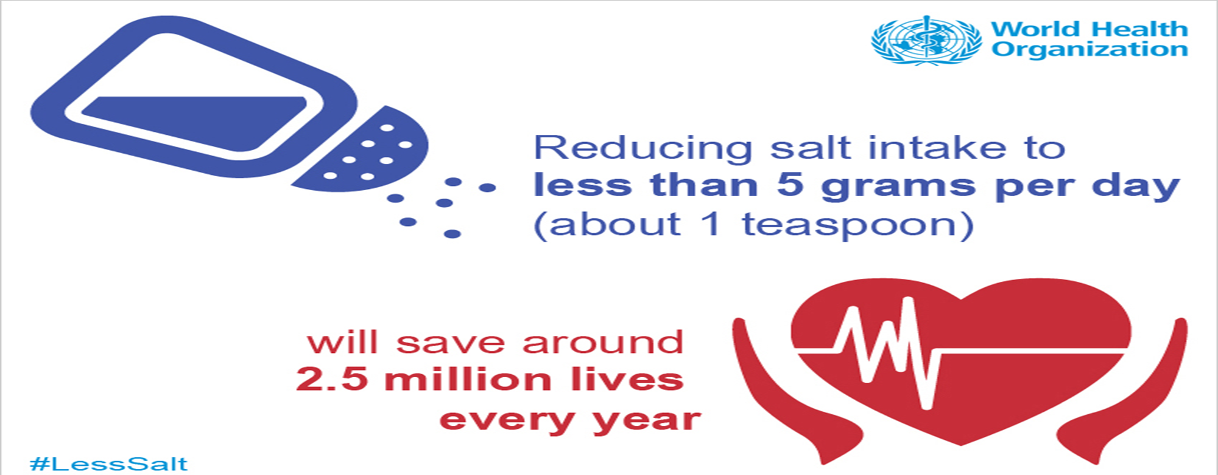
World Health Organization (WHO) has called for a reduction in dietary sodium intake to <2000 mg/day (5 g/day of salt in adults), as a cost-effective public health intervention that could potentially reduce the burden of NCDs, including hypertension and CVDs

Slide 12
Adequate diet: Diet including consumption of 5 servings of fruits and vegetables per day.
Inadequate diet: Diet including consumption of less than 5 servings of fruits and vegetables per day.

Slide 13
Physical inactivity
Regular physical activity can counteract and reduce negative outcomes while also promoting healthy living; it is an important factor in the prevention of chronic noncommunicable diseases.
Physical advantages include weight maintenance and blood pressure reduction .The concept that regular physical exercise induces stable physiological and metabolic adaptations for cells, tissues, and organs, including the cardiovascular system, is well established .

Slide 14
Smoking
smoking was found to be associated with an increased risk of hypertension by acting on multiple pathways. Tobacco smoking increases inflammation, stimulates sympathetic activity in the central nervous system and causes metabolic changes, all of which are important in the pathophysiology of hypertension.
Acting on these multiple pathways leads to the development of mitochondrial oxidase oxidative stress, which contributes to the development of hypertension.

Slide 15
Stress
Stress is an unavoidable experience that results from the complex interactions between a person and his or her environment When an individual's resources are insufficient to deal with situational demands and pressures, stress occurs .
Stress is a subjective experience that occurs more
frequently in certain situations than others. some individuals can be more prone to stress than others

Slide 16
University students are especially vulnerable to the problems associated with academic stress because they are a special group of people who are going through a critical period at an individual and social level in which they are transitioning from adolescence to adulthood, which can be one of the stressful times in a person's life .
When compared to previous generations, today's students are far more stressed and anxious.

Slide 18
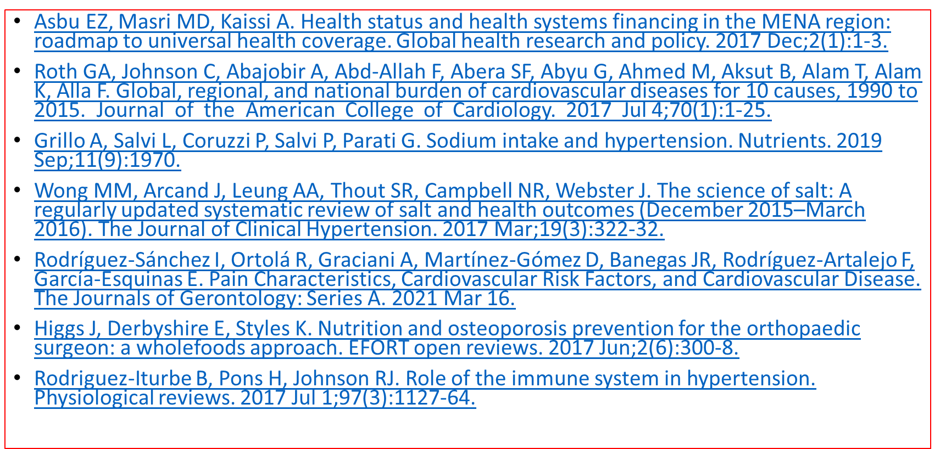
Key References

