Slide 1
Simulation of magnetization reversal in Phi-0 junction by the pulse of magnetic field
Joint Institute for Nuclear Research
XXVI International Scientific Conference of Young Scientists and Specialists (AYSS-2022)
Rahmonova Adiba Rahmonkulovna
Meshcheryakov Laboratory of Information Technologies, Dubna, Russia
24 – 28 October 2022
Dubna

Slide 2
Outline
Introduction
Josephson effect
Anomalous Josephson effect
Magnetization reversal in Phi-0 junction
II. Model and numerical method
Results
Conclusions

Slide 3
Introduction

Slide 4
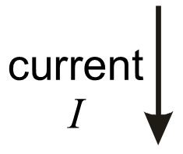

Josephson Effect
Josephson junction
Stationary Josephson effect
Nonstationary Josephson effect

Slide 5
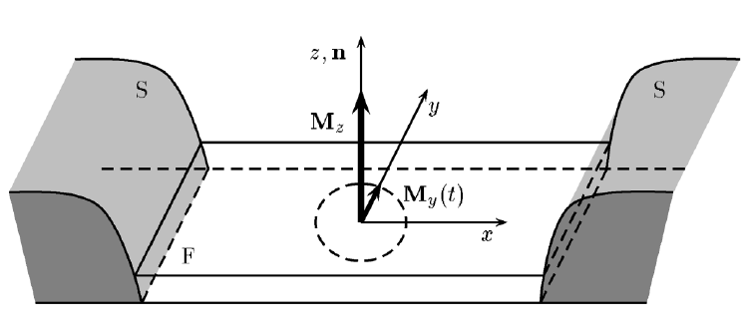
Anomalous Josephson Effect
► In SFS Josephson junction the spin orbit coupling in Ferromagnetic layer, leads to the direct coupling of magnetization dynamics and superconducting current.
► In the current phase relation of such junctions appears the phase shifting Phi-0, and they called Phi-0 junction and observed effect called Anomalous Josephson effect.
A. Buzdin, Phys. Rev. Lett. 101, 107005 (2008).
F. Konschelle and A. Buzdin, Phys. Rev. Lett. 102, 017001 (2009)

Slide 6
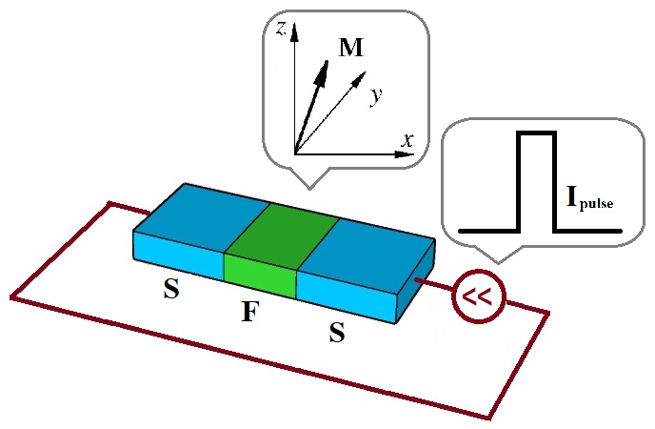
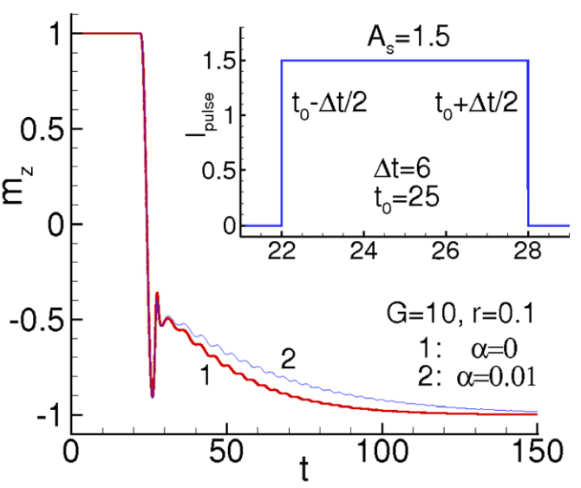
Magnetization reversal in Phi-0 junction
Yu. M. Shukrinov, I. R. Rahmonov, K. Sengupta, and A. Buzdin, Magnetization reversal by superconducting current in u 0 Josephson
Junctions, Appl. Phys. Lett. 110, 182407 (2017)
C. Guarcello and F.S. Bergeret, Cryogenic Memory Element Based on an Anomalous Josephson Junction, Phys. Rev. Appl. 13, 034012 (2020)

Slide 7
Motivation
Does it exist the another way to realize magnetization reversal?
Is it possible to realize it by pulse of magnetic field?
The answer is YES and we will consider this case next.

Slide 8
Model and numerical method

Slide 9
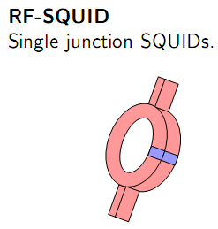
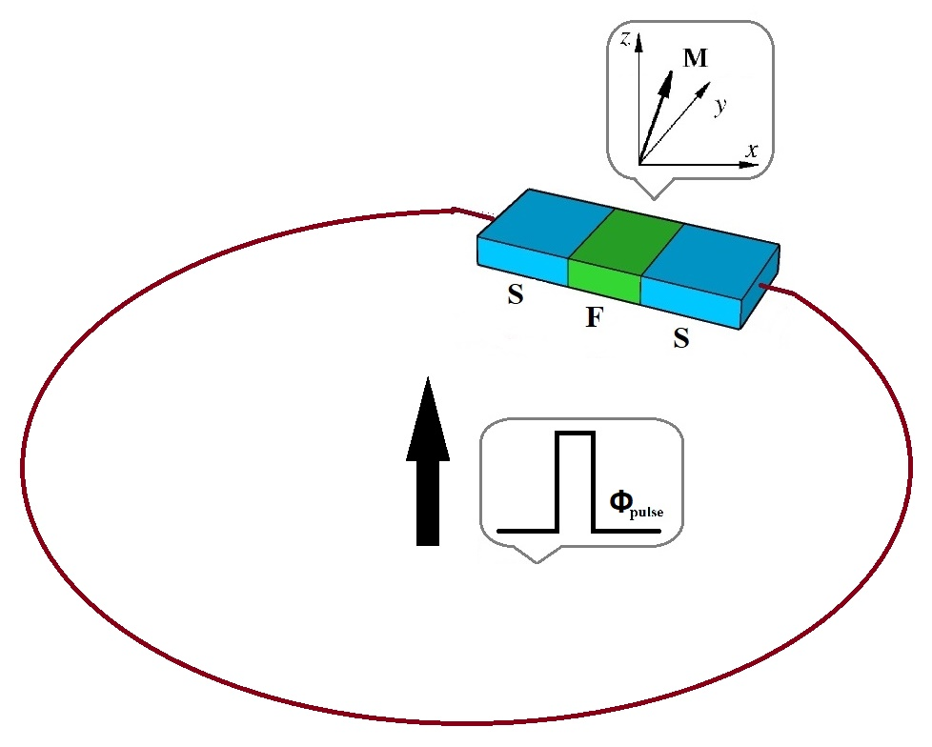
Single junction SQUID (Superconducting quantum interference device)
► The SQUIDs are superconducting devices which are ultra-sensitive to magnetic flux.
► So we consider dynamics of single junction SQUID with Phi-0 junction under the pulse of external magnetic field.

Slide 10
Model equations
► Total magnetic flux trough the SQUIDs has form
(1)
is magnetic flux created by external field, is inductance of
SQUID and is current trough the SQUID, which is determined as
(2)
- is characteristic Josephson frequency
- Magnetic flux quantum
Expression for phase difference has form
(3)
Combining (1) and (3) we can rewrite
(4)

Slide 11
Model equations
► Finally combining (2) and (4) we obtain in normalized variables
(5)
Time is normalized to
and inductance normalized to
The magnetization dynamics can be described by the Landau_lifshitz Gilbert equation
is frequency of ferromagnetic resonance
is magnetization vector
is effective field

Slide 12
Model equations
► Finally in normalized variables we can write coupled system of equations
This system of equations is solved numerically with the 4th order Runge Kutta method

Slide 13
Results

Slide 14
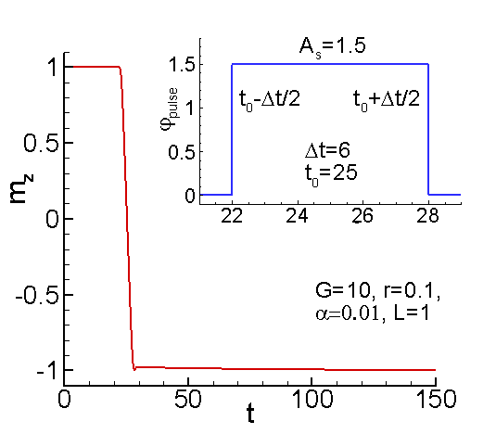
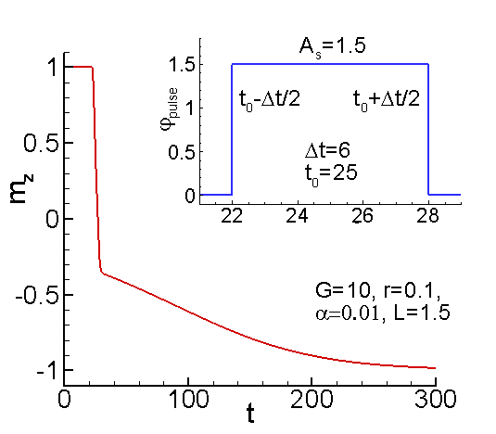
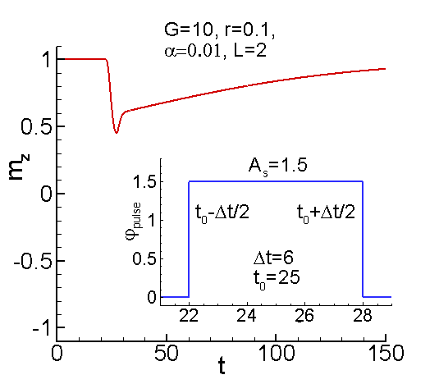
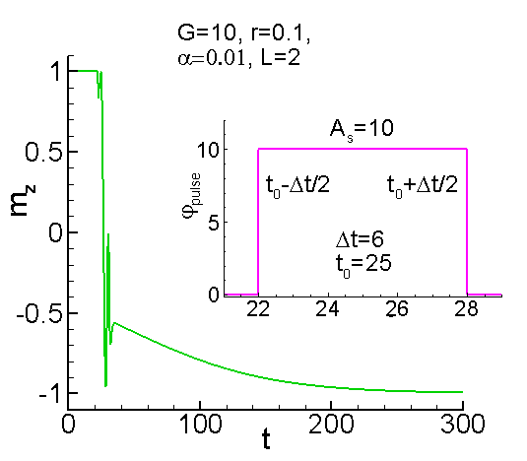
Influence of model parameters

Slide 15
Conclusions
We simulate dynamics of single junction SQUID (superconducting quantum interference device) with the Phi-0 junction.
We demonstrate that under the pulse of external magnetic field can be realized magnetization reversal in the ferromagnetic layer.
The influence of the model parameters of the systems on magnetization reversal is investigated in detail.
The detail analysis of system is planed in the nearest feature

Slide 16
Thank you for attention

