Slide 1
Comprehensive Elemental Analysis of Nanodiamonds for Simulating the Properties of Cold and Very Cold Neutron Reflectors
Borzakov S.^{1,2}, Dubois M.³, Gundorin N.^{1,2}, Hramco C.^{1,4},Korneeva E.¹, Lychagin E.^{1,2}, Muzychka A.¹, Nekhaev G.¹, Nesvizhevsky V.⁵, Nezvanov A.¹, Pavlov S.¹, Strelkov A.¹, Turlybekuly K.^{1,6}
¹Joint Institute for Nuclear Research, 141980, Dubna, Russia
²Dubna State University, 141980, Dubna, Moscow Region, Russia
³Université Clermont Auvergne, 63178, Auvergne, France
⁴Institute of Chemistry of Moldova (ICh), MD-2028, Chisinau, Republic of Moldova
⁵Institut Max von Laue – Paul Langevin, 38042, Grenoble, France
⁶Institute of Nuclear Physics of the Republic of Kazakhstan, 050032, Almaty, Kazakhstan
 | XXVI International Scientific Conference of Young Scientists and Specialists 24 – 28 October, 2022 Dubna, Russia

Slide 2
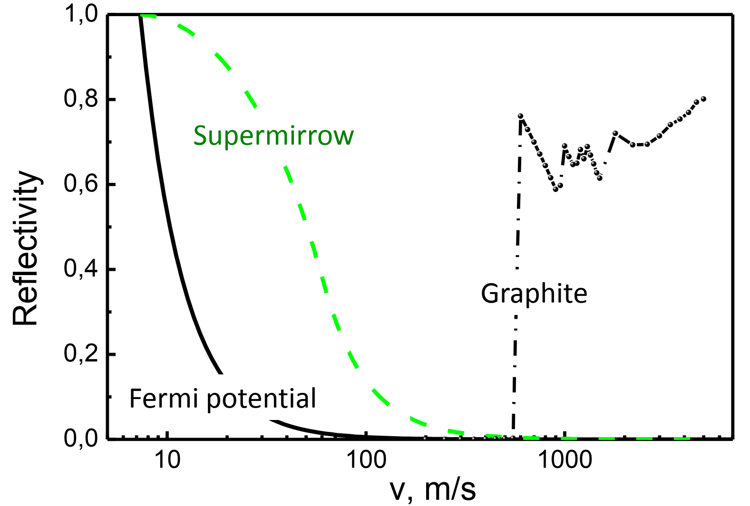
Very Cold Neutrons (VCN)
Ultracold Neutrons
Cold Neutrons
the typical wavelengths are 2.5–60 nm;
the velocities are 20–160 m/s;
the energies are 0.25–130 μeV;
the temperatures are 3×10⁻³–1.55 K.
Fig. 1. The reflection probability for isotropic neutrons with different velocities.

Slide 3
VCN Applications
The VCN advantages are: • long time of observation; • large angles of reflections from mirrors; • larger phase shift and as result more sensitive to contrast variation; • large coherent length; • large capture cross-section and big contrast at transmission; • structure analysis of large molecular complexes; etc.
The main disadvantage is a low flux intensity!
Neutron techniques:
SANS;
spin-echo;
TOF spectroscopy, in particular, high-resolution inelastic scattering;
reflectometry, diffraction, microscopy, holography, tomography, etc.
Fundamental Physics:
a search of extra-short-range interactions at neutron scattering;
experiments with neutrons in a whispering gallery;
beam experiment to measure of the neutron decay, etc.

Slide 4
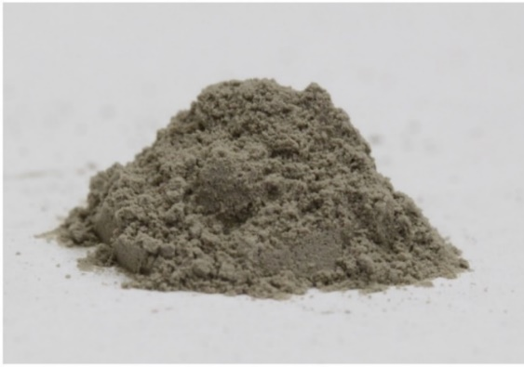
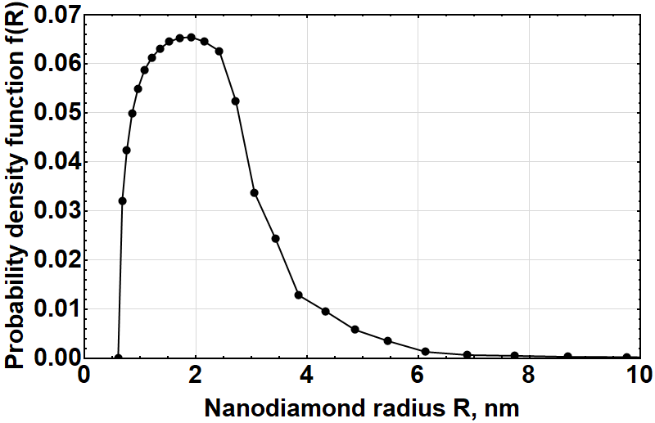
Nanodiamonds – the Main Material for VCN Reflectors
Criteria for the VCN reflector are minimum losses and maximum reflection.
Detonation nanodiamonds (DND) are the ideal candidate!
$$P_{REF}^{max}: R_{opt}≈0.27λ$$
$$R_{opt}\left(λ\right)≈0.7−4.3 nm,$$
$$λ∈\left[26, 160\right] Å$$
or $v∈\left[25, 150\right] m/s$
Positive Factors:
size distribution;
$b_{c.sc.}^{C}=6.65 fm$;
$σ_{c.sc.}^{C}=5.55 b$;
$σ_{abs}^{C}=3.5 mb$;
$σ_{in.sc.}^{C}→0 \left(T→0\right)$;
$ρ^{Diamond}≈3.5 g/{cm}^{3}$.
$$P_{REF} \sim 95\%$$
Negative Factors:
~10 at. % of hydrogen,
$σ_{abs}^{H}=0.33 b$;
$σ_{in.sc.}^{H}=108±2 b$;
other impurities
< 0.15 at. %
Implemented solutions:
the fluorination of DND
$C/H=7.4±0.2$ (before)
$C/H=430±30$ (after)
the additional purification of DND
$$Σ_{abs}^{after}/Σ_{abs}^{before}≈0.58$$
$$Σ_{abs}^{H}≈0.2Σ_{abs}^{after}$$
But still significant activation!
neutron
capture
neutron
activation
Fig. 2. The possible scheme of the VCN source.

Slide 5
Comprehensive Elemental Analysis
Fluorinated Detonation Nanodiamonds |  |  |  | Neutron capture, b
Element | XPS, ppm | PGAA, ppm | INAA, ppm
C |  |  |  | 0.0035
N |  |  |  | 1.9
O |  |  |  | 0.00019
F |  |  |  | 0.0096
H |  |  |  | 0.3326
B |  |  |  | 767
Na |  |  |  | 0,53
Cl |  |  |  | 35,5
K |  |  |  | 2,1
Cr |  |  |  | 3,05
Mn |  |  |  | 13,3
Fe |  |  |  | 2,56
Cu |  |  |  | 3,78
Zn |  |  |  | 1,11
Br |  |  |  | 6,9
In |  |  |  | 1,28
Ba |  |  |  | 1,1
Eu |  |  |  | 4530
Sm |  |  |  | 5922
Gd |  |  |  | 49700
Table 1. Sensitivity of methods to different elements.
XPS is a relative method.
PGAA can be both an absolute or relative method.
INAA is an absolute method.
What is the elemental composition for?
Control over the technologies of modification and purification of nanodiamond powders.
Consideration of realistic neutron capture by impurity nuclei during the simulation of the very cold neutron transport in nanodiamond powders.

Slide 6
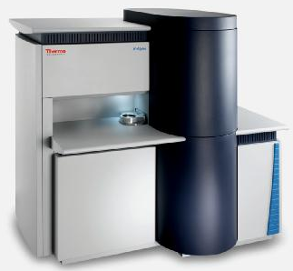
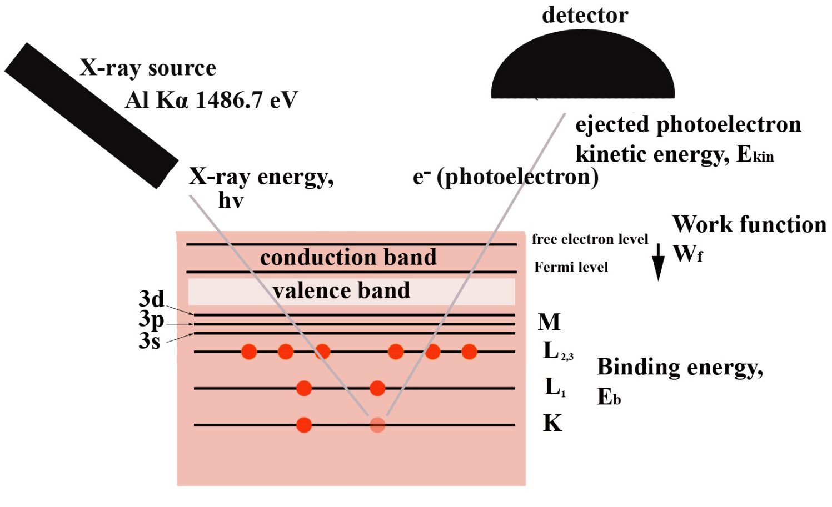
X-ray Photoelectron Spectroscopy (XPS)
Principle of XPS
$$E_{b}=hν−E_{kin}−W_{f}$$
K-alpha XPS (Thermo Fisher Scientific)
Possibilities:
Quantitative element analysis.
Chemical state by analysis of peak-shift or peak-shape changes.
Fig. 3. The schematic XPS principal.

Slide 7
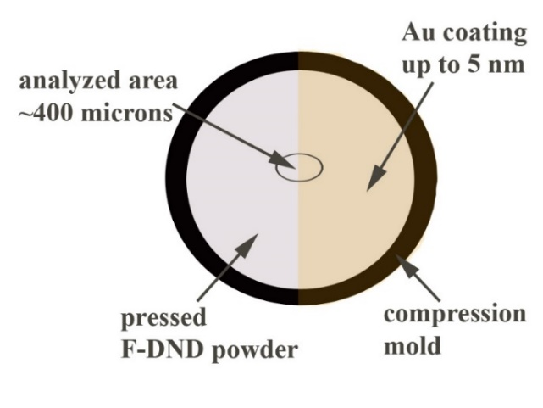
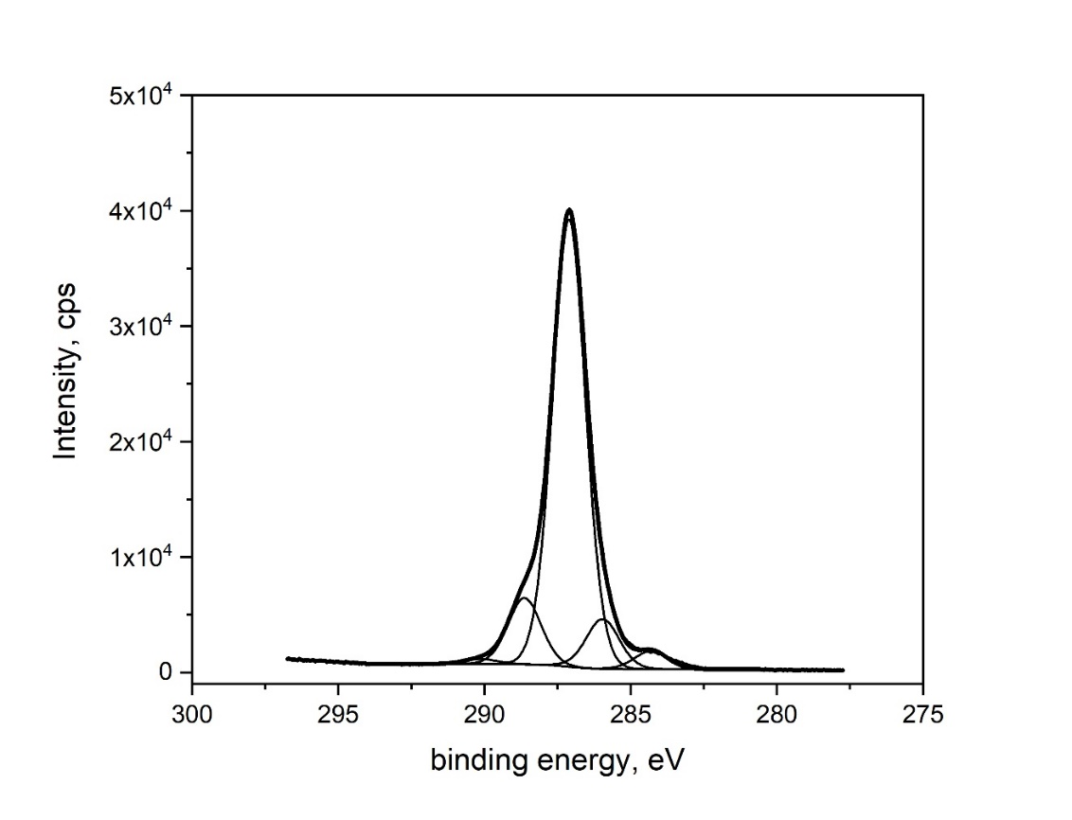
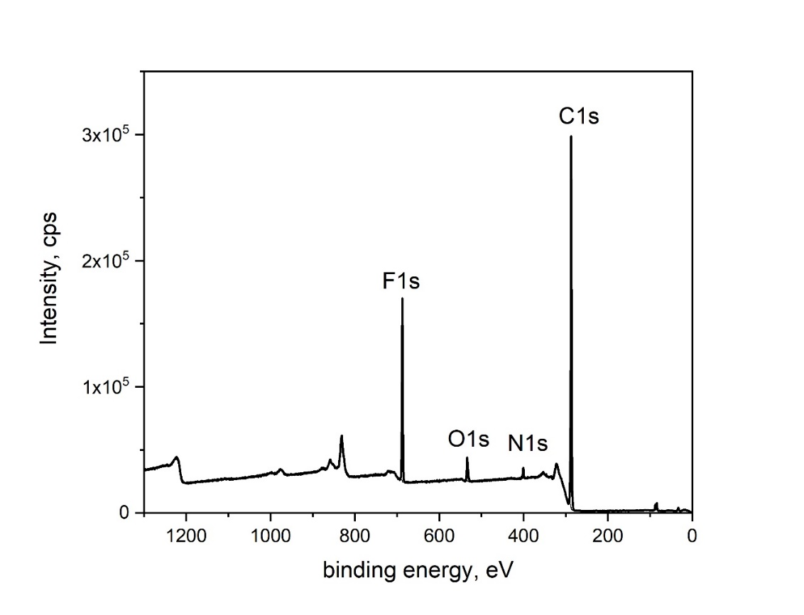
X-ray Photoelectron Spectroscopy (XPS)
Parameters:
Analyzed area is 400 µm.
Flood gun for charge neutralization
Step sizes are 0.05 and 0.5 eV for region and survey spectra.
Pass energies are 20 and 100 eV for region and survey spectra.
Au4f calibration.
Peaks analysis via the CasaXPS 2.3.18 software.
C1s region
survey
spectrum

Slide 8
Methods of Neutron Activation Analysis
Prompt
gamma
rays
PGAA
B_{n}
Beta decay
INAA
Fig. 4. Diagram of the neutron capture by the nucleus ¹⁹⁷Au.
198-Au
411.8 keV
Neutron
capture
Induced
gamma
radiation
198-Hg
Target
197-Au

Slide 9
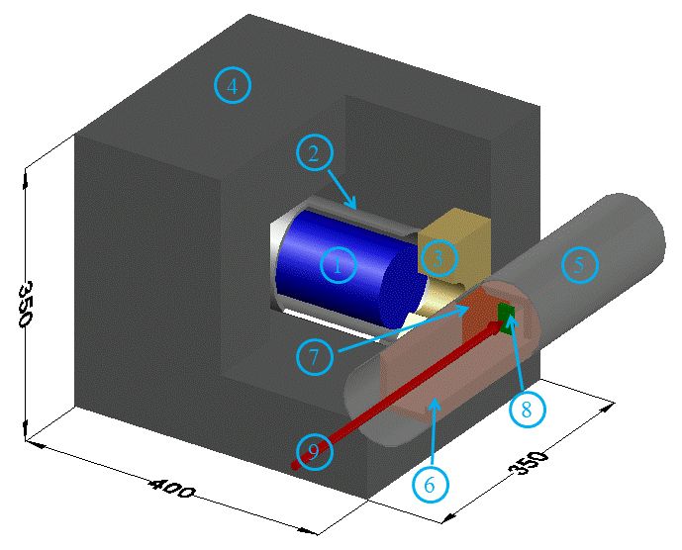
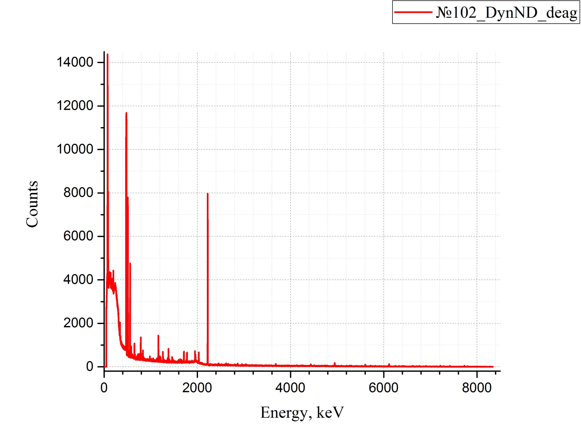
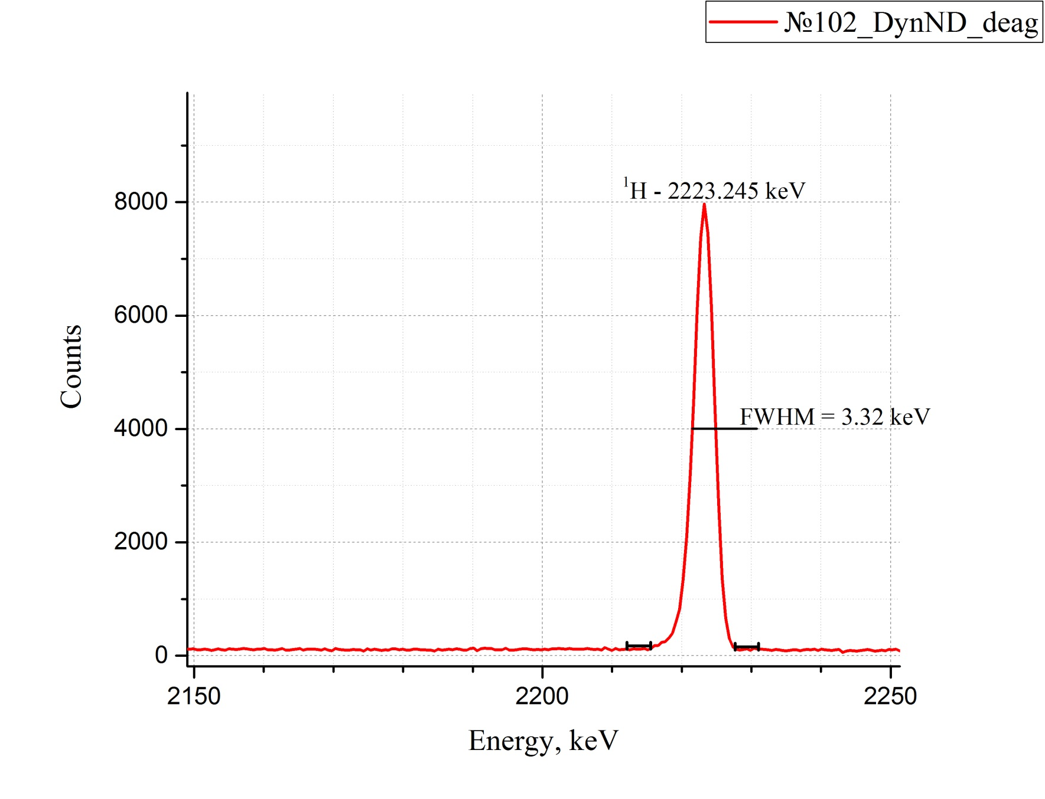
Prompt Gamma-ray Activation Analysis (PGAA)
Package – 20 µm PTFE bag
m(sample) = 0.2 g
t_{meas} = 43 h
m(H) = 1.5 E-3 g
Fig. 5. 3D model of the detector environment: 1 - HPGe detector, 2 - Cd layer, 3 - Bi window, 4 - Cd covered lead shielding, 5 - vacuum pipe, 6 - LiF tunnel, 7 - enriched ⁶LiF window, 8 - sample, 9 - neutron beam.
m_{min(H)} = 3.6 µg

Slide 10
Summing Up the Results
Table 2. Final concentrations of impurities.
Element | XPS, ppm | PGAA, ppm | INAA, ppm | Neutron capture, b | Capture cross section for 1E6 carbon atoms | Fraction, at. %
C | 1E+06 | 1E+06 |  | 0,0035 | 3500 | 82,41
N | 17176 | 21582 |  | 1,9 | 41006,23 | 1,78
O | 32700 |  |  | 0,00019 | 6,21 | 2,69
F | 129786 |  |  | 0,0096 | 1245,95 | 10,70
H |  | 27871 |  | 0,3326 | 9269,81 | 2,30
B |  | 65 |  | 767 | 50167,88 | 5,4E-03
Na |  |  | 100 | 0,53 | 53 | 8,2E-03
Cl |  | 68 | 60 | 35,5 | 2325,25 | 5,4E-03
K |  |  | 13 | 2,1 | 27,30 | 1,1E-03
Cr |  | 1063 | 990 | 3,05 | 3167,13 | 8,6E-02
Mn |  |  | 2 | 13,3 | 26,60 | 1,6E-04
Fe |  |  | 185 | 2,56 | 473,60 | 1,5E-02
Cu |  |  | 23 | 3,78 | 86,94 | 1,9E-03
Zn |  |  | 47 | 1,11 | 52,17 | 3,9E-03
Br |  |  | 0,23 | 6,9 | 1,59 | 1,9E-05
In |  |  | < 0,51 | 1,28 | 0,65 | 4,2E-05
Ba |  |  | 18 | 1,1 | 19,80 | 1,5E-03
Eu |  |  | 0,00025 | 4530 | 1,13 | 2,1E-08
Sm |  |  | 0,0008 | 5922 | 4,74 | 6,6E-08
Gd |  |  | < 0,013 | 49700 | 646,10 | 1,1E-06
Impurities not only capture neutrons, but are also strongly activated in high-intensity neutron fields!
Calculation of fractions
XPS: C, O, F → C + O + F = 1
NAA: H, N, Metals
$${(H+N+Metals)}_{COFHNM}=C_{XPS}{{10}^{6}}/{{\left(H+N+M\right)}_{NAA}}$$
$$total=C_{XPS}+O_{XPS}+F_{XPS}+{(H+N+Metals)}_{COFHNM}$$
$$C^{′}={C_{XPS}}/{total};$$
$$O^{′}={O_{XPS}}/{total};$$
$$F^{′}={F_{XPS}}/{total};$$
$$H^{′}={C_{XPS}H_{NAA}{10}^{−6}}/{total};$$
$$N^{′}={C_{XPS}N_{NAA}{10}^{−6}}/{total};$$
$${Metals}^{′}={C_{XPS}{Metals}_{NAA}{10}^{−6}}/{total}$$

Slide 11
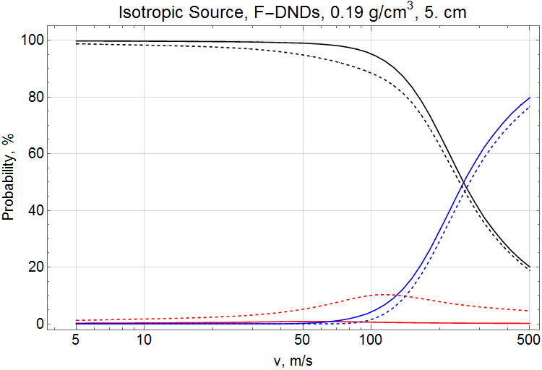
Impurities Impact on Simulation of Neutron Transport
Z
Fig 6. The scheme of a simulated geometry.
Fig. 7. The probabilities of neutron reflection (black lines), transmission (blue), and absorption (red) versus neutron velocity for isotropic incidence on a layer of nanodiamond powder of 5 cm (left) and semi-infinite (right) thickness with (dotted line) and without (solid line) neutron capture by non-carbon impurities.

Slide 12
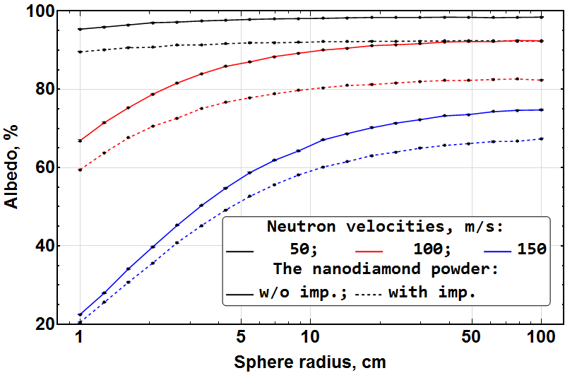
VCN Storage in a Nanodiamond Trap
Fig. 8. The visualisation of the neutron storing in a physical trap.
Fig. 9. The probability of neutron reflection versus the cavity radius for the velocities of 50 m/s (black lines), 100 m/s (red lines), and 150 m/s (blue lines) with (dotted line) and without (solid line) neutron capture by non-carbon impurities. The thickness of a cavity wall is 5 cm.

Slide 13
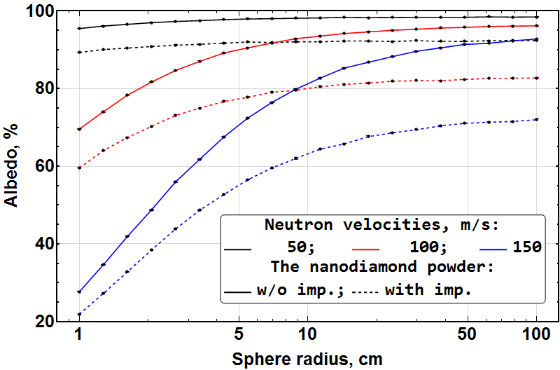
VCN Storage in a Nanodiamond Trap
Fig. 8. The visualisation of the neutron storing in a physical trap.
Fig. 10. The probability of neutron reflection versus the cavity radius for the velocities of 50 m/s (black lines), 100 m/s (red lines), and 150 m/s (blue lines) with (dotted line) and without (solid line) neutron capture by non-carbon impurities. The sphere wall has a semi-infinite thickness.

Slide 14
Conclusions
The combination of XPS, PGAA, and INAA methods is sufficient for a full elemental analysis of nanodiamond powders for neutron physics problems.
The use of these methods makes it possible to develop new technologies for the synthesis and purification of detonation nanodiamonds with an optimal elemental composition for neutron reflectors.
Taking into account the full elemental composition of nanodiamond powders makes it possible to simulate the full-scale VCN reflectors based on specific nanopowders existing in small quantities.
Elemental analysis using XPS, PGNAA, INAA can be completely conducted at the JINR.

Slide 15
Thank you all for your kind attention!
Alexander NEZVANOV, Ph.D.
nezvanov@jinr.ru
Frank Laboratory of Neutron Physics
Joint Institute for Nuclear Research, Dubna.
This research is funded by grants ERC INFRASUP P-2019-1/871072, ANR-20-CE08-0034, and the JINR grant for young scientists № 22-402-09.

