Slide 1
JI Accounting system for the JINR Laboratories’ experiments
Kashunin I., Mitsyn V., Strizh T.
October 2022

Slide 2
Goals
Load old WLCG Tier2 batch statistical data to the accounting system database
Load old CMS Tier1 batch statistical data to the accounting system
database
Load the old batch statistics of the JINR Laboratories’ experiments to the accounting system database
Create an accounting script for the JINR Laboratories’ experiments
Visualize data
2

Slide 3
Accounting system base parameters
Litmon-01
Number of jobs
HS06 CPUclock in hours
HS06 Wallclock in hours
Number of cores per job
Computing cluster efficiency
General view
of the complex
3

Slide 4
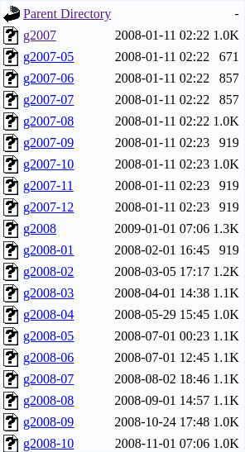
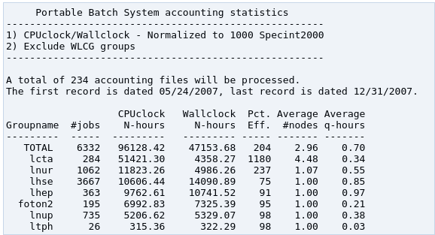
Accounting system history
The control, computing
and disk servers
HS06 = SPECINT2000 * 4
4

Slide 5
Data acquisition and processing algorithm
Batch system database
Crontab
Data acquisition
script
Console
output
Linux user
Grafana
The control, computing
and disk servers
5

Slide 6
Torque/Maui statistical data load to the accounting system database
Batch system (Torque/Maui)
Web server
Data acquisition
script
Crontab
The control, computing
and disk servers
Grafana
6

Slide 7
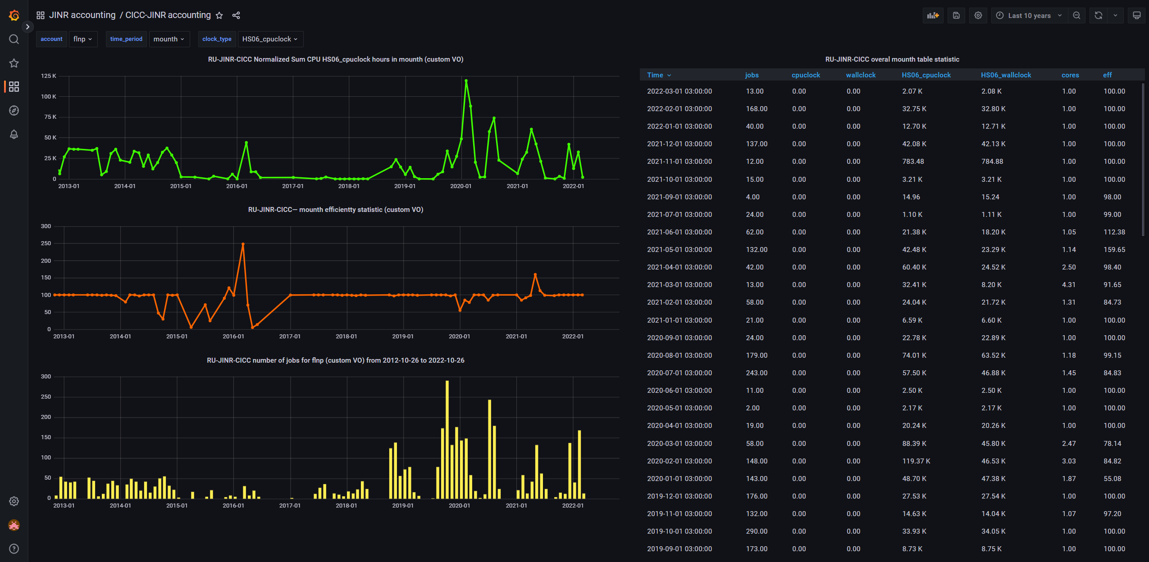
JINR Laboratories’ experiments accounting system dashboard
7

Slide 8
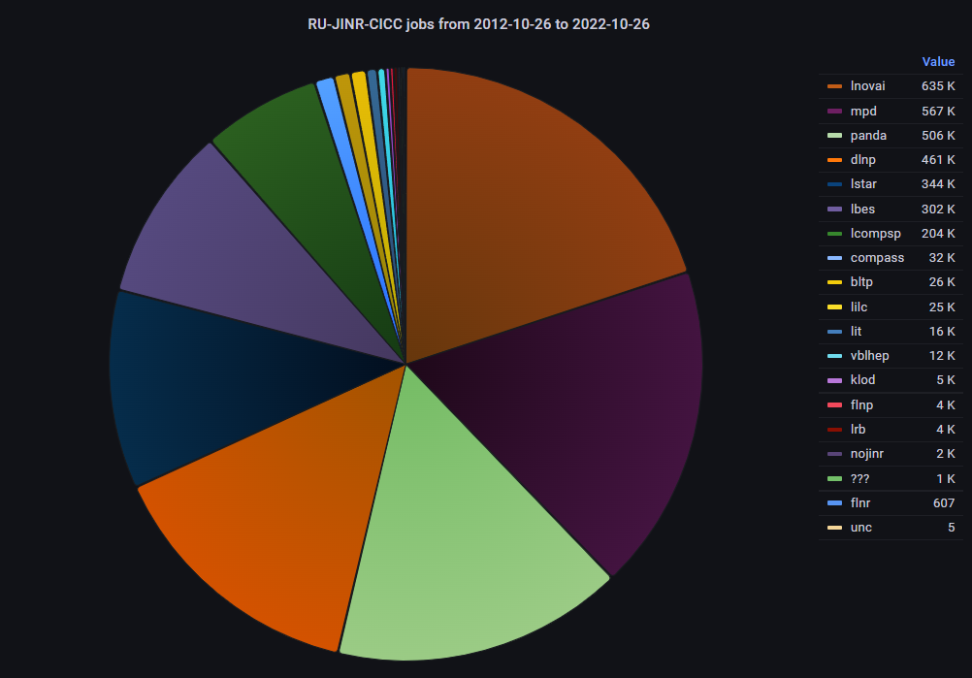
JINR Laboratories’ experiments CPU statistics
8

Slide 9
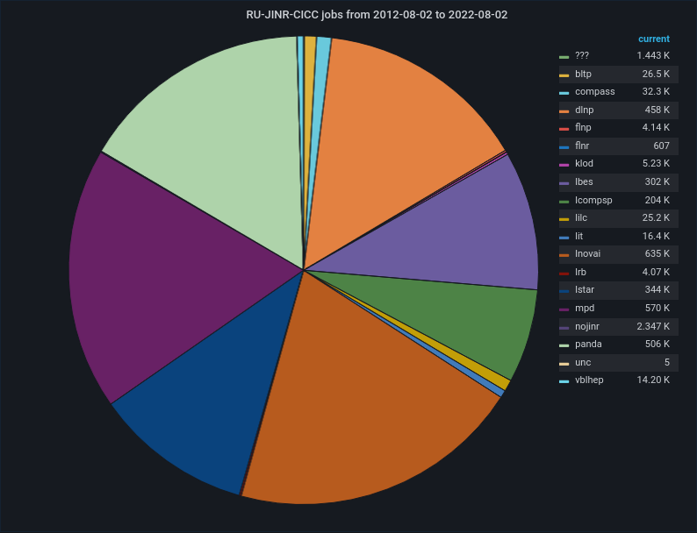
JINR Laboratories’ experiments job statistics
9

Slide 10
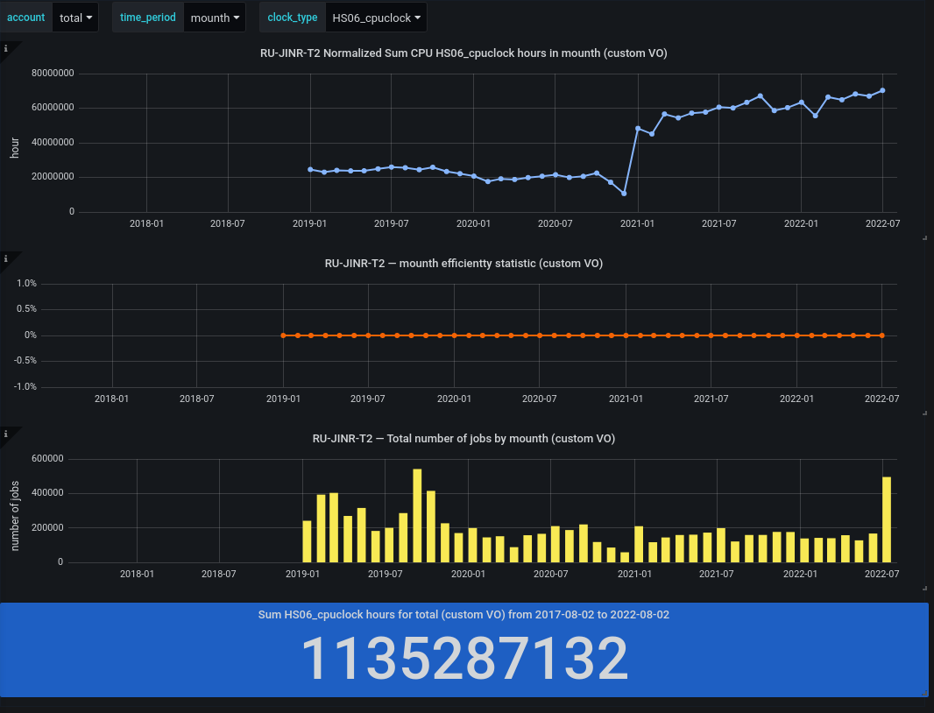
WLCG JINR Tier2 CPU statistics
10

Slide 11
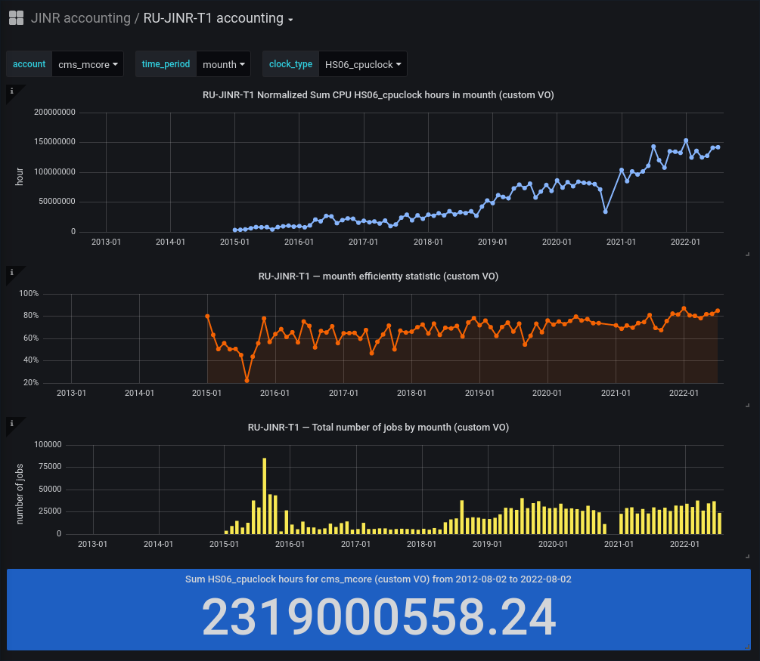
CMS JINR Tier1 CPU statistics
11

Slide 12
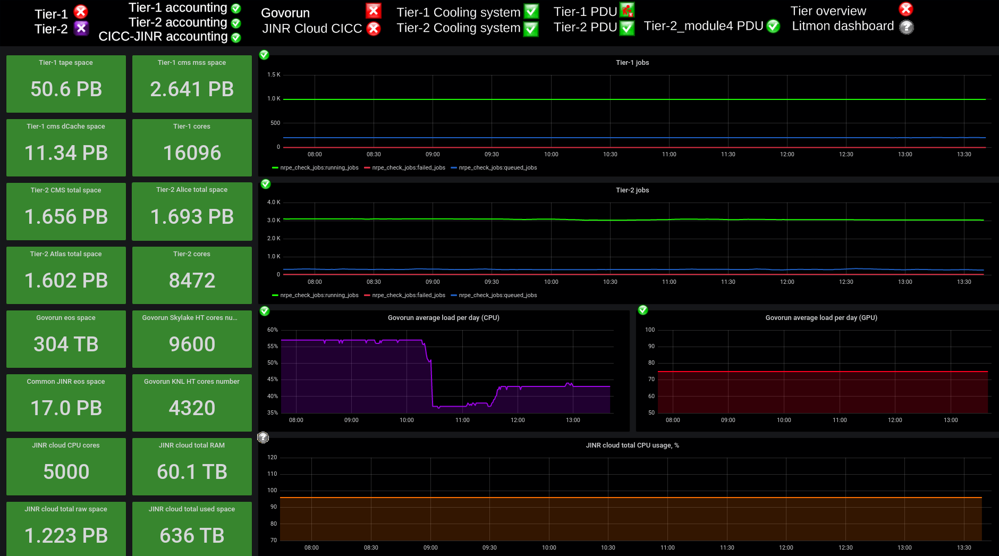
Integration into the monitoring system
https://litmon.jinr.ru https://litmon-01.jinr.ru
http://litmon-display.jinr.ru
12

Slide 13
Conclusions
The JINR Laboratories got a new tool for statistical data processing
The JINR Laboratories got a new monitoring tool
Old and new statistics can be compared
The database as a backend can be used by other monitoring systems
The accounting system for the JINR Laboratories’ experiments was put into operation.
13

Slide 14
Thank you for your attention!

Slide 15
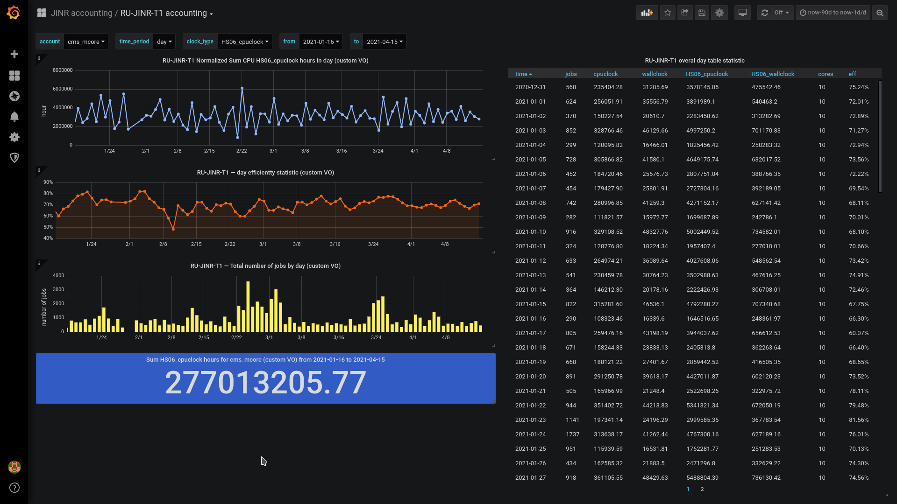
New Tier1 accounting system (visualization)
Litmon-01
General view
of the complex
9

Slide 16
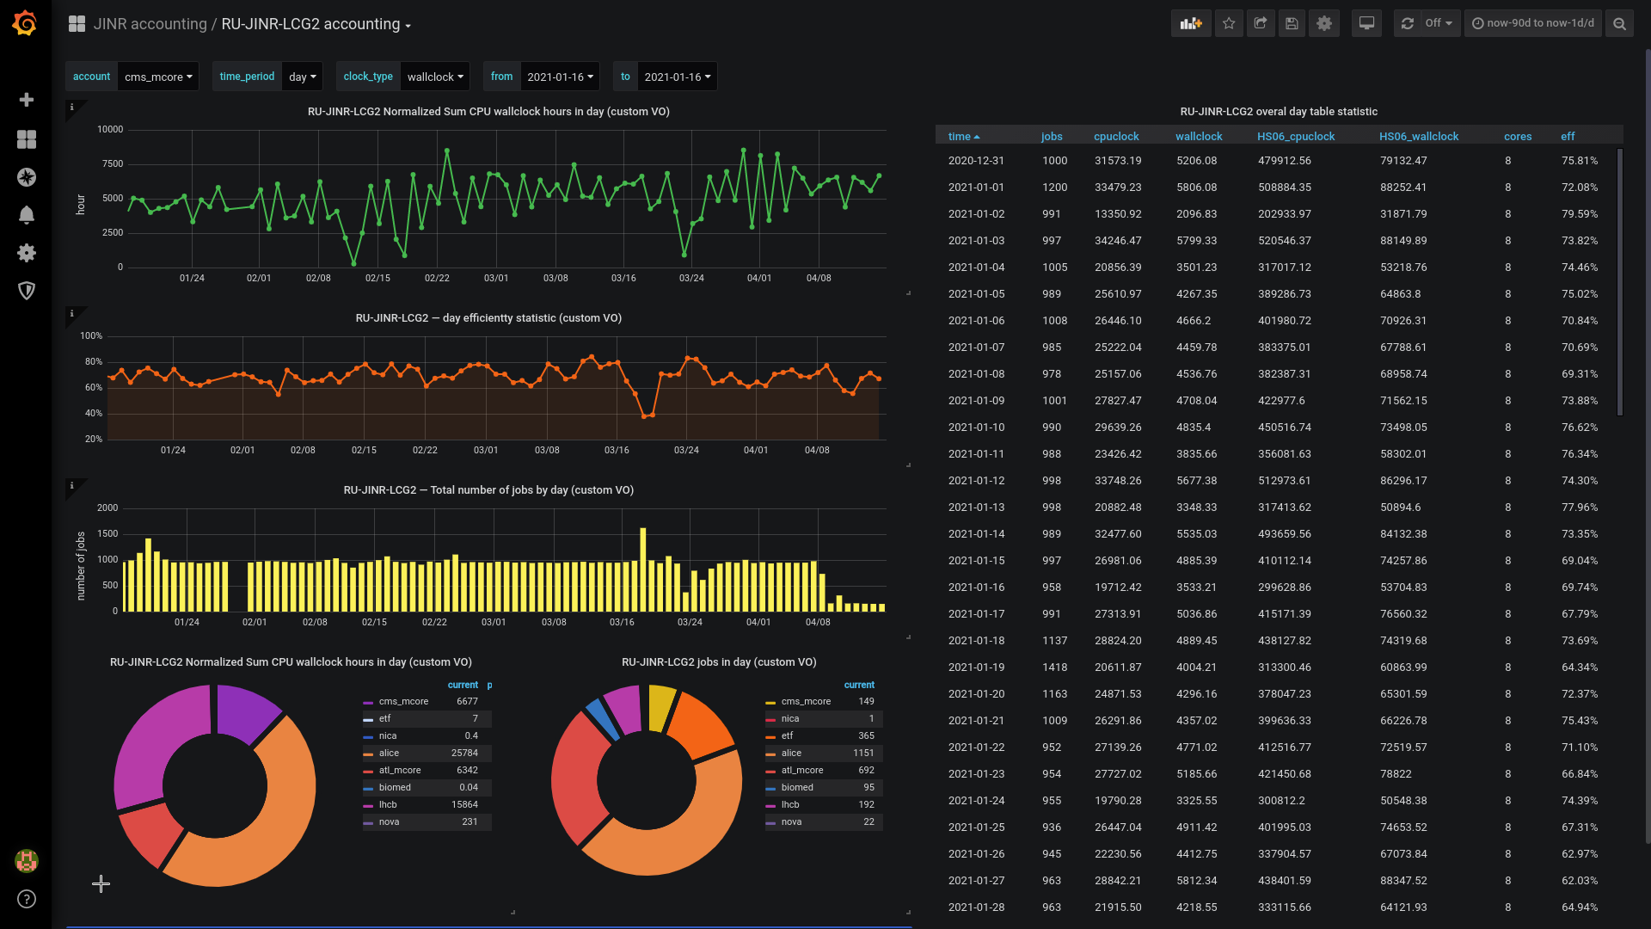
New Tier2/CICC accounting system (visualization)
Litmon-01
General view
of the complex
10

