Slide 1
The XXVI International Scientific Conference of Young Scientists and Specialists
Information Systems for the BM@N experiment and Common Deployment Service
A. Chebotov on behalf of the BM@N experiment Veksler and Baldin Laboratory of High Energy Physics, JINR
27.10.2022

Slide 2
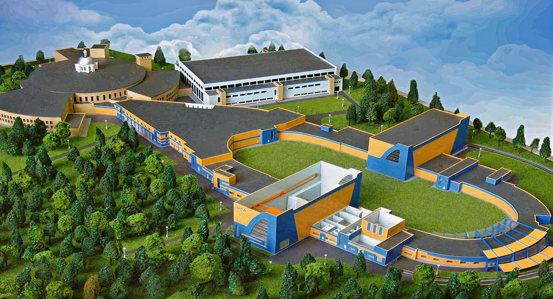
Nuclotron-based Ion Collider fAcility
Nuclotron
BM@N
SPD
MPD
Baryonic Matter at Nuclotron (BM@N)
Official site: bmn.jinr.ru
Multi-Purpose Detector (MPD)
Official site: mpd.jinr.ru
Spin Physics Detector (SPD)
Official site: spd.jinr.ru

Slide 3
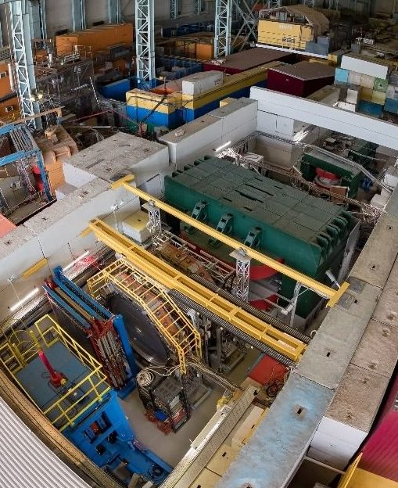
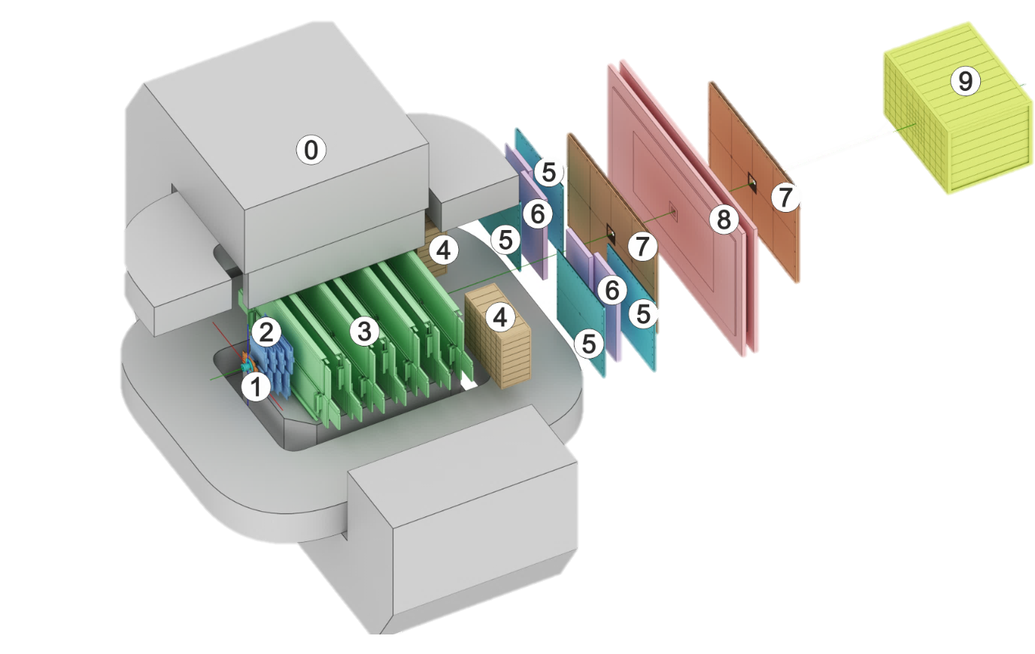
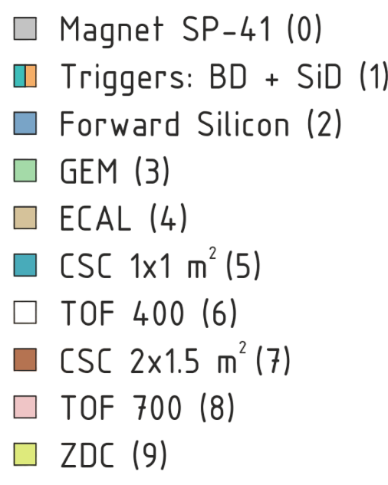
Baryonic Matter @ Nuclotron
BM@N Sessions(2015 – 2022)
Session №51 (d,C)
Feb. 22 – Mar. 15, 2015
Session №52 (d)
June 29 – June 30, 2016
Session №53 (d, $d^{↑}$)
Dec. 9 – Dec. 23, 2016
Session №54 (C)
Mar. 7 – Mar. 18, 2017
Session №55 (C,Ar,Kr)
Mar. 3 – Apr. 05, 2018
Session №57 (Xe)
Nov – Dec, 2022

Slide 4
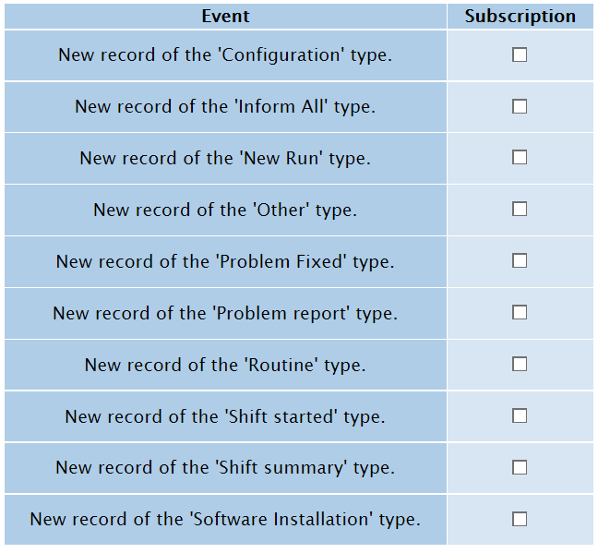
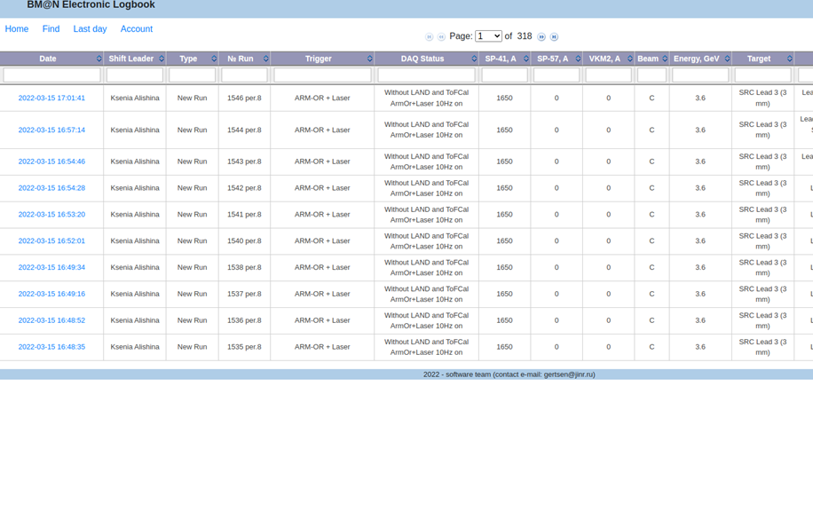
e-Log platform
What is an e-Log and why is it needed?
The online electronic logbook allows shift members to record information on current events, states of various systems, operation conditions of detectors., which are further used in processing and physics analysis of the particle collision events.
The system provides collaboration members with tools for convenient viewing, managing and searching for the required information in the logbook.
https://bmn-elog.jinr.ru

Slide 5
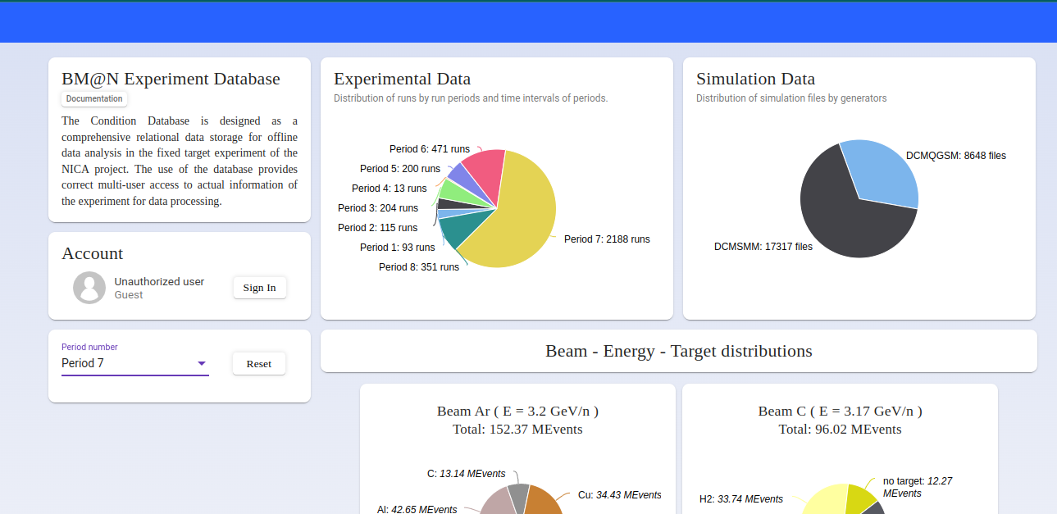
Condition Database
What is a Condition Database?
This system is intended for storage, control, as well as search, selection and use of the necessary parameters and operating modes of detectors and experimental systems in processing experimental and simulated particle collision events.
The main property of stored parametric data is that it changes over time and is used to process data collected only during the validity period of the corresponding parameter.
https://bmn-unidb.jinr.ru
5

Slide 6
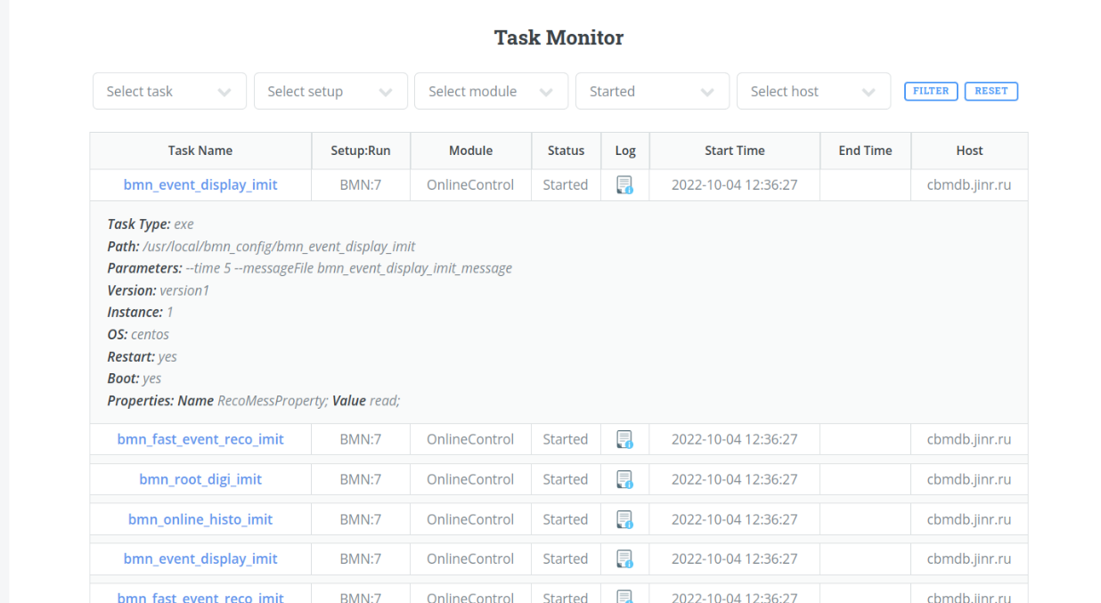
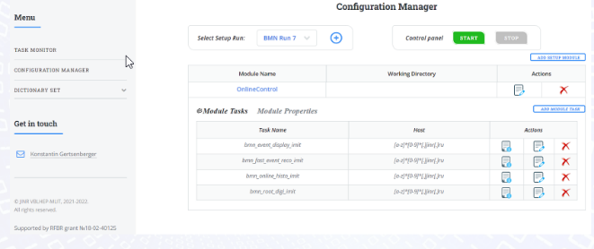
Configuration information system
What is a Configuration system?
The Configuration Information System stories a set of various configuration parameters, such as those required for setting the detectors into operation modes, for instance, working voltage, and descriptions of a sequence of software tasks to be started.
System starts the described software tasks in the a required sequence and allows managing them during sessions, including the transmission of messages between tasks and the update of some properties.
6

Slide 7
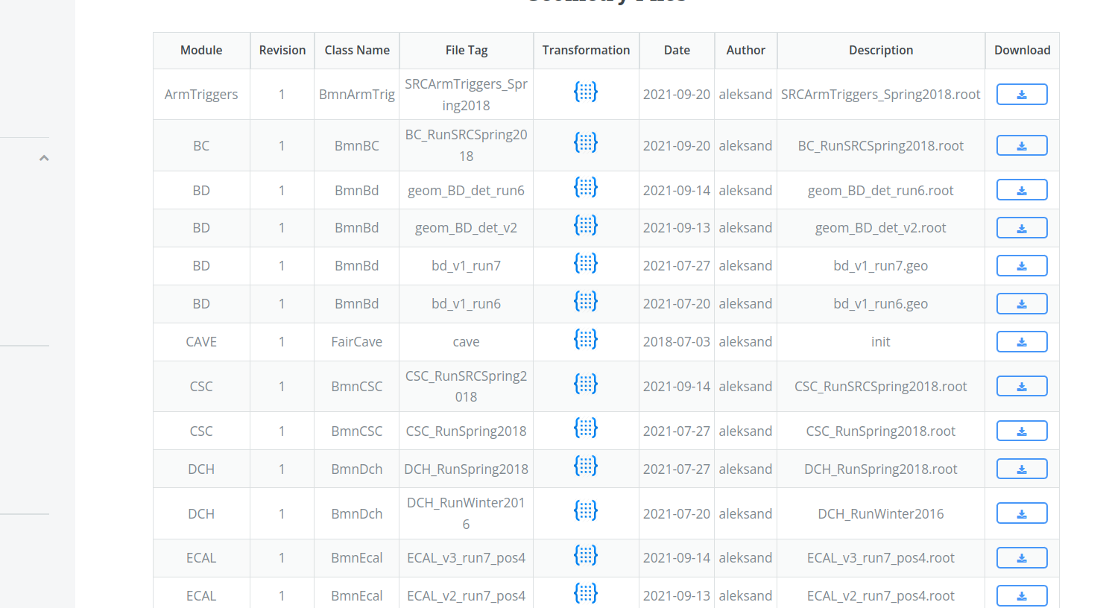
Geometry information system
What is a Geometry system?
The developed geometry information system provides a centralized repository of experimental setup geometries and a set of convenient tools for managing individual components and assemblies of various versions.
Different versions of setup geometries and constituent components are used to process obtained particle collision events in simulation and physics data analysis
https://bmn-geodb.jinr.ru
7

Slide 8
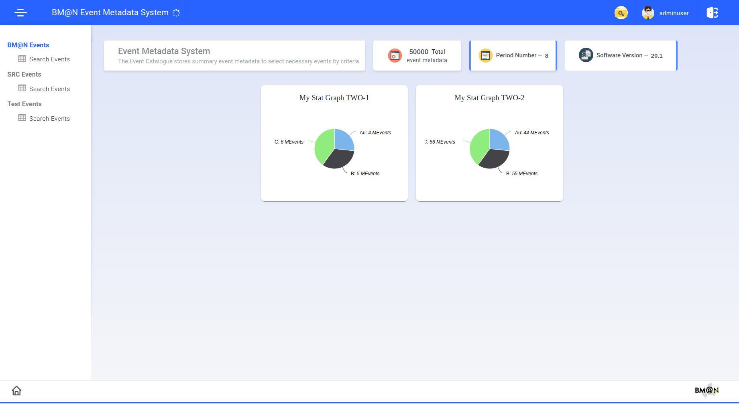
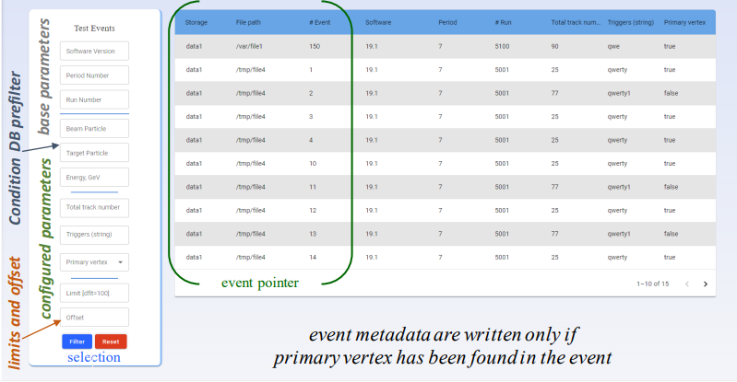
Event metadata system
What is Event metadata?
The implemented information system is based on an event database called the Event Catalogue, which contains summary information about on particle collision events, allowing the user to quickly search for a set of events required for a particular physics analysis according to given criteria.

Slide 9
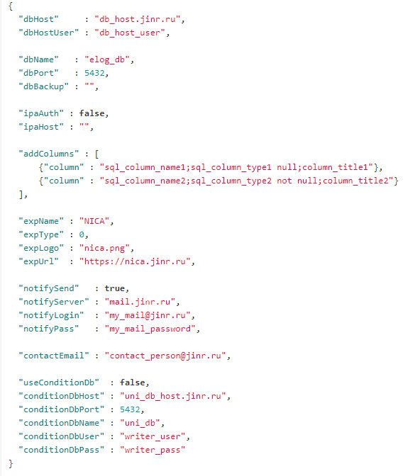
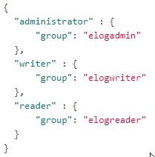
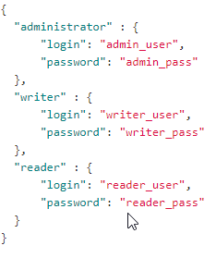
Common deployment services for e-Log platform
Web Server
Custom column for BM@N
Server for Database
// host user for deployment of the Logbook database (remote or locally)
// e-Log database name
// e-Log database port
// regular e-Log database backup, if needed (several storages are separated by semicolon)
// authentication/authorization type: false - as database roles; true - IPA/LDAP authentication/authorization
// custom (additional, specific to an experiment) columns defined in SQL-simular format, e.g. {"column" : "sp_41;int null;SP-41, A"}
// experiment type: 0 - fixed target experiment, 1 - collider experiment
// whether activate notification system for various types of events (adding new run, editing run data, dictionary changes)
Accounts for IPA authorization
// transfer run information to the Condition Database of the NICA experiments
Accounts for database authorization
https://git.jinr.ru/nica_db/elog_platform
Configuration file for deployment

Slide 10
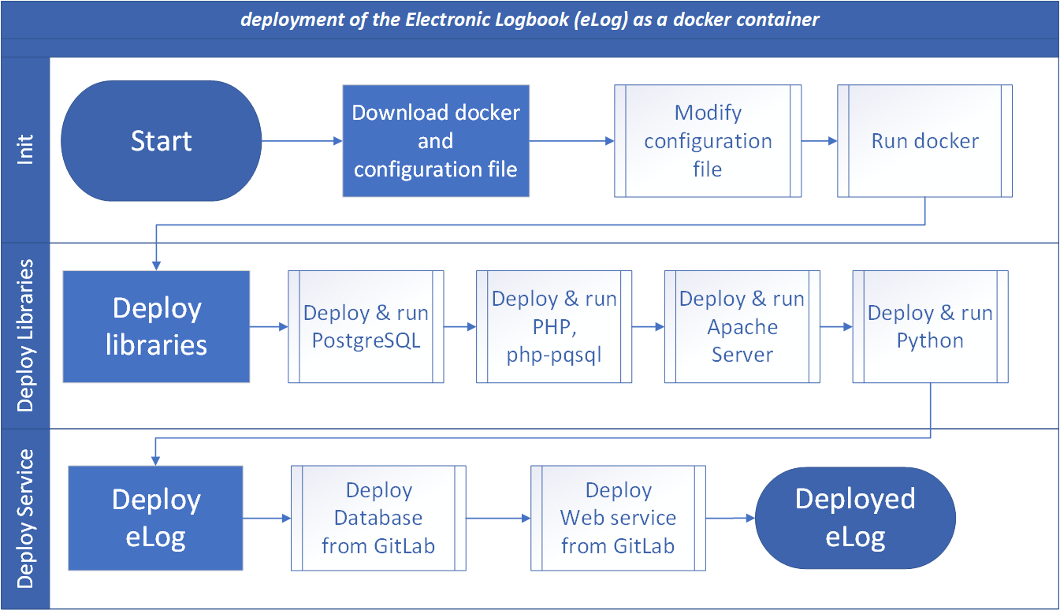
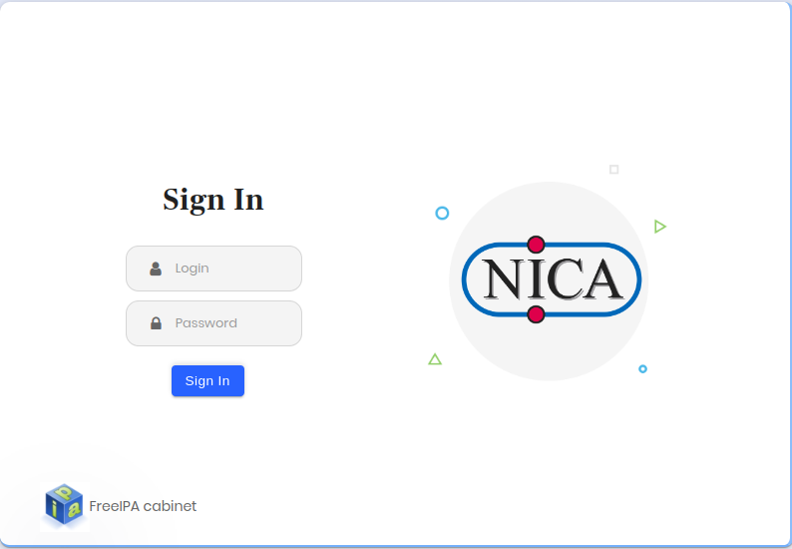
Common deployment services for e-Log platform
Base server (Web)
Run deploy script
Server for Web
Base server (Web)
Copy SQL files
Server for Database
https://git.jinr.ru/nica_db/elog_platform

Slide 11
Common deployment services for e-Log platform
"dbBackup" : "~/backup; backup_user@backup_server.jinr.ru:~/backup"
// host user for deployment of the Logbook database (remote or locally)
Server for Database
// e-Log database name
// e-Log database port
// regular e-Log database backup, if needed (several storages are separated by semicolon)
// authentication/authorization type: false - as database roles; true - IPA/LDAP authentication/authorization
// custom (additional, specific to an experiment) columns defined in SQL-simular format, e.g. {"column" : "sp_41;int null;SP-41, A"}
Server for Web
Other servers
// experiment type: 0 - fixed target experiment, 1 - collider experiment
// whether activate notification system for various types of events (adding new run, editing run data, dictionary changes)
// transfer run information to the Condition Database of the NICA experiments
Configuration file for deployment
https://git.jinr.ru/nica_db/elog_platform
Tracking updates

Slide 12
Conclusions
The complex of information systems have been developed that provides the collection, storage, organization of convenient, management of information necessary for processing and analyzing the data obtained throughout scientific research of the NICA megaproject.
The e-Log platform is an information system for viewing, modifying and visualizing the information on the experiment sessions for shift crews.
The Condition database system has been developed with an adaptive design, functional data selector and convenient tools for viewing and managing information.
The Configuration system interface, which provides a set of necessary functions for monitoring active tasks, as well as for viewing, searching and managing information about the configuration of the experiment.
The Geometry system for working with the geometry of experiment detectors has been implemented, designed to store, process and manage information about the geometric model of detectors.
The Metadata system for particle collision events has been developed to automate the search and selection of only those events that are required to process the received data.
A common installation system has been implemented for convenient deployment of the Electronic Logbook.
12

Slide 13
Thank you
for your attention!

