Slide 1
Food Recognition for Smart Restaurants and Self-service cafes
Executor: Gerasimchuk Mikhail
1st year of Master's degree at ITMO University
Scientific supervisor: Uzhinskiy Alexander
LIT JINR, Lead Programmer
The XXVI International Scientific Conference of Young Scientists and Specialists (AYSS-2022)

Slide 2
The relevance of the problem
2
01
Sanitary and epidemiological safety
02
Reduction of order processing time
03
Automation of the payment process
04
Reduction in staff costs
The XXVI International Scientific Conference of Young Scientists and Specialists (AYSS-2022)

Slide 3
Examples of existing solutions
3
The field is actively developing.
Since 2012, several open databases have been collected:
➤
Food-101
➤
UEC Food-256
MAFood–121
Literature:
➤
UEC Food-100
➤
Y. Matsuda, H. Hoashi, and K. Yanai, “Recognition of multiple-food images by detecting candidate regions,” in 2012 IEEE International Conference on Multimedia and Expo. IEEE, 2012, pp. 25–30.
Y. Kawano and K. Yanai, “Food image recognition with deep convolutional features,” in Proceedings of the 2014 ACM International Joint Conference on Pervasive and Ubiquitous Computing: Adjunct Publication, 2014, pp. 589–593.
C. Liu, Y. Cao, Y. Luo, G. Chen, V. Vokkarane, and Y. Ma, “Deepfood: Deep learning-based food image recognition for computer-aided dietary assessment,” in International Conference on Smart Homes and Health Telematics. Springer, 2016, pp. 37–48.
Fakhrou, A., Kunhoth, J. & Al Maadeed, S. Smartphone-based food recognition system using multiple deep CNN models. Multimed Tools Appl 80, 33011–33032 (2021). https://doi.org/10.1007/s11042-021-11329-6
Deepanshu Pandey, Purva Parmar, Gauri Toshniwal, Mansi Goel, Vishesh Agrawal, Shivangi Dhiman, Lavanya Gupta, Ganesh Bagler, Object Detection in Indian Food Platters using Transfer Learning with YOLOv4, 2022, arXiv:2205.04841
Year
2012
2014
2016
2020
Architectures
Two-step method for recognition
Deep convolutional neural network
Convolutional
neural network
Yolov4
Dataset
UECFood-100
UECFood-100
Food-101, UEC-256
Food-101, UEC-256, UEC Food-100
Accuracy (%)
55,8
72,26
77,4
92
The training takes place on a very large base without complicated cases of combining and crossing dishes.
The XXVI International Scientific Conference of Young Scientists and Specialists (AYSS-2022)
+
-

Slide 4
Methodology and purpose
4
Train different architectures on data
3.
Mark up the collected images
4.
2.
3
Get metrics results
2
4
Collecting a set of images
1
5
5.
1.
Use a custom classifier
Evaluate the possibility of optimizing or automating the order calculation process.
The XXVI International Scientific Conference of Young Scientists and Specialists (AYSS-2022)

Slide 5
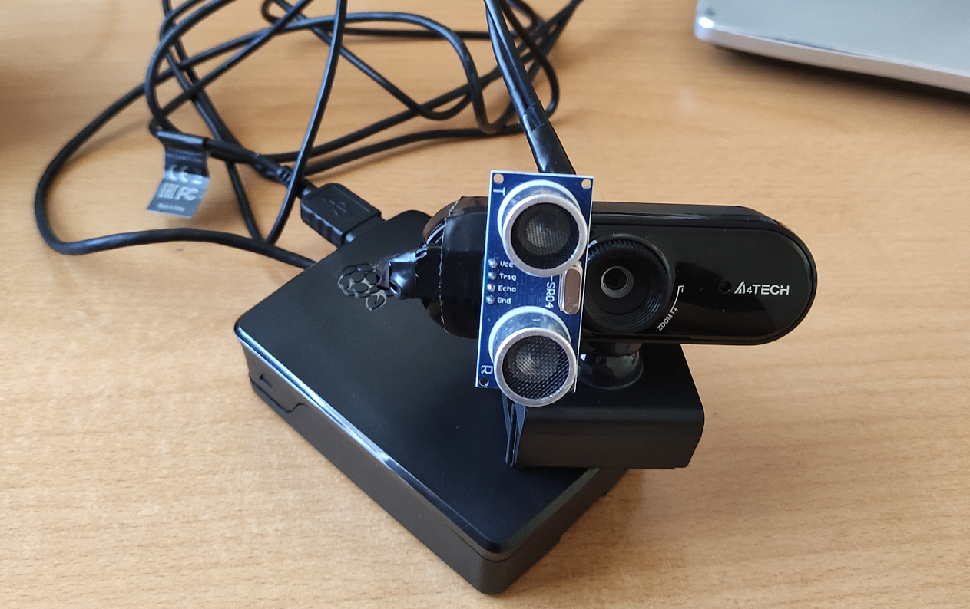
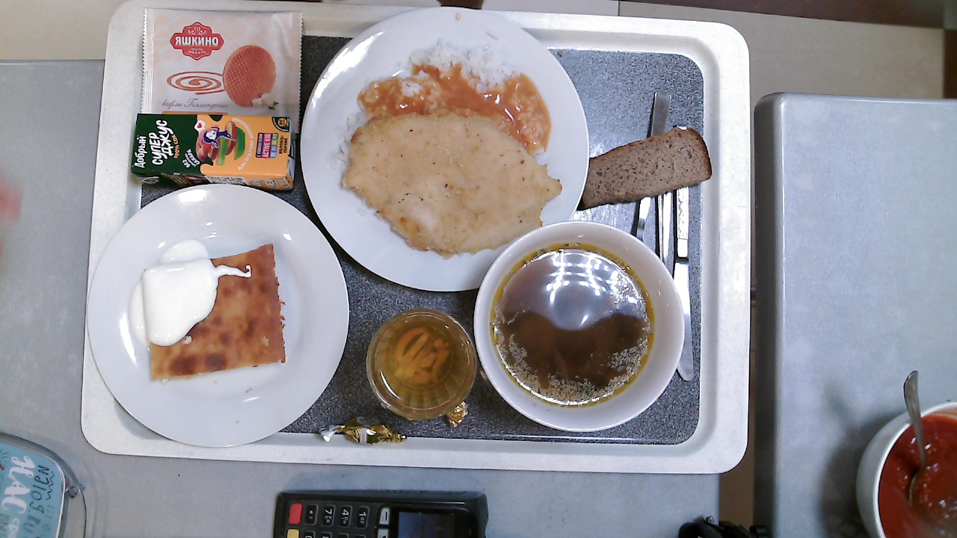
Set of images
5
Data collection was carried out in automatic mode using raspberry pi 4, a digital camera with manual focus, and sonar.
A set of images in 5 days:
➤
446 images
JINR cantine
More than 150 different classes of objects
➤
The XXVI International Scientific Conference of Young Scientists and Specialists (AYSS-2022)

Slide 6
Markup
6
The roboflow service was used as a data markup tool. This service provides convenient tools for working with images.
We have created 7 different datasets to achieve maximum metrics for yolo networks.
The XXVI International Scientific Conference of Young Scientists and Specialists (AYSS-2022)

Slide 7
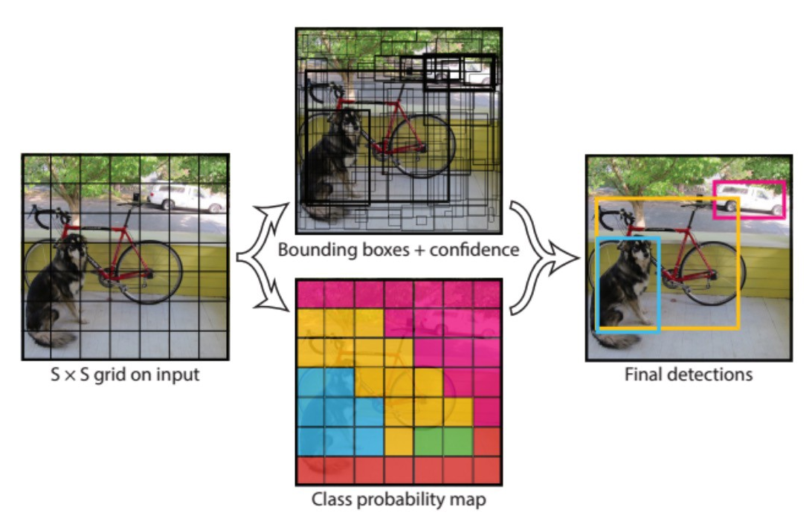
Yolo
7
YOLO (You Only Look Once) – this is a neural network architecture designed to detect objects in an image.
YOLO networks family seem to be one of the best solutions for object detection. According to [1] in an identical testing environment, YOLO-v3 outperforms SSD and Faster R-CNN. In [2] the authors evaluate Faster R-CNN and YOLO on UEC FOOD-100 dataset and report YOLO superiority in the food detection domain.
We used the lightest model versions, because they look the most adapted for use in real conditions
Literature:
Srivastava, S., Divekar, A.V., Anilkumar, C. et al. Comparative analysis of deep learning image detection algorithms. J Big Data 8, 66 (2021). https://doi.org/10.1186/s40537-021-00434-w
M. Chopra, A. Purwar, Food Image Recognition Using CNN, Faster R-CNN and YOLO, Applications of Artificial Intelligence, Big Data and Internet of Things in Sustainable Development, 1st Edition, 9, 2022
The XXVI International Scientific Conference of Young Scientists and Specialists (AYSS-2022)

Slide 8
8
Metrics
01
For each class , separate metrics were considered , after which the average value was found.
Recall =$\frac{\sum{TP}}{\sum{TP+FN}}$
02
Real label
Precision =$\frac{\sum{TP}}{\sum{TP+FP}}$
Positive
Negative
TP
FP
03
Positive
Predict label
mAP =$\frac{1}{N}$*$\frac{\sum{TP}}{\sum{TP+FP}}$
Negative
FN
TN
The XXVI International Scientific Conference of Young Scientists and Specialists (AYSS-2022)

Slide 9
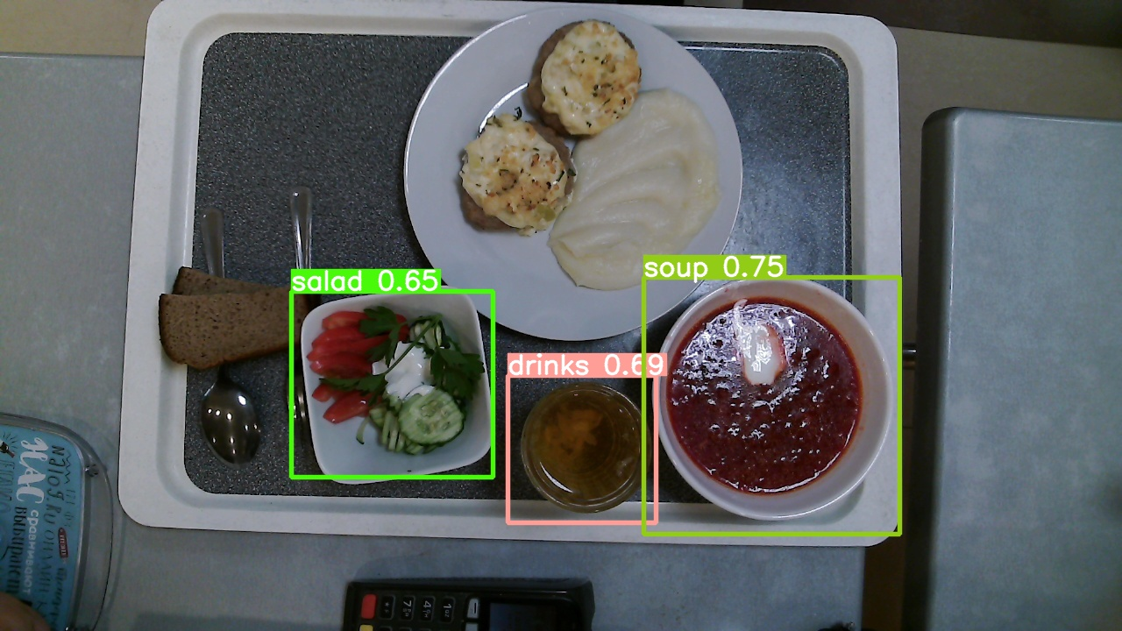
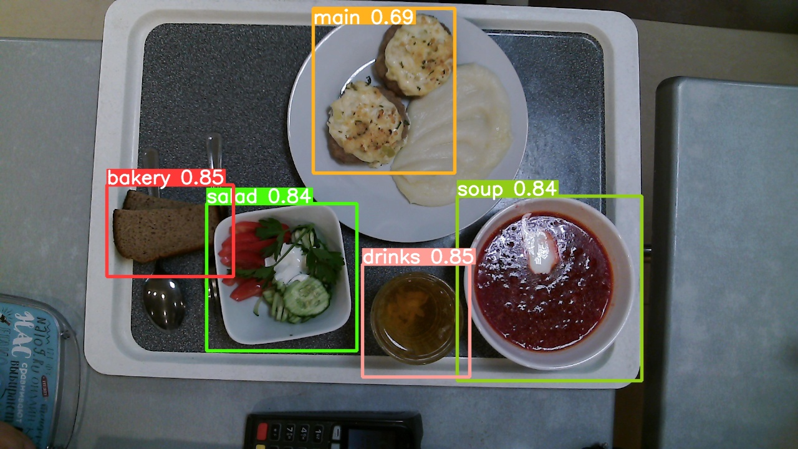
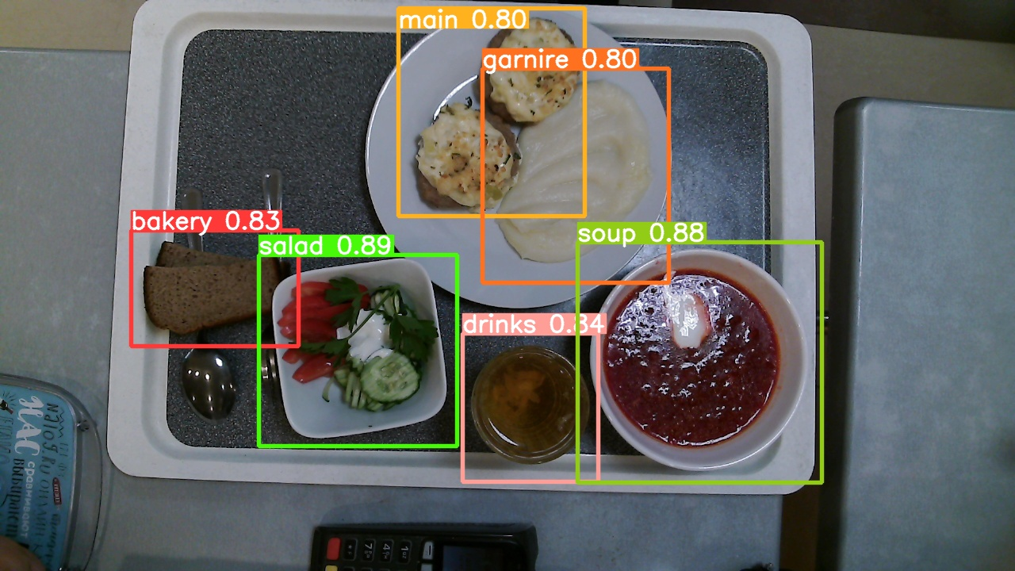
Experiment №1
9
If there are not many classes (in our case 7), then yolo allows you to get good results, already with a training sample of 200 marked up images, and if there are more than 250 of them, then everything is fine in general.
Information:
Architectures: YOLOv5S
Batch size: 16
Epochs: 50
Number of classes: 7
Classes: 'bakery', 'drinks', 'garnire', 'main', 'other', 'salad','soup’
Step #1
Step #2
Step #3
Recall: 0.666
Precision: 0.785
Map: 0.728
Count of images: 100
Recall: 0.807
Precision: 0.924
Map: 0.904
Count of images: 200
Recall: 0.926
Precision: 0.938
Map: 0.954
Count of images: 270
The XXVI International Scientific Conference of Young Scientists and Specialists (AYSS-2022)

Slide 10
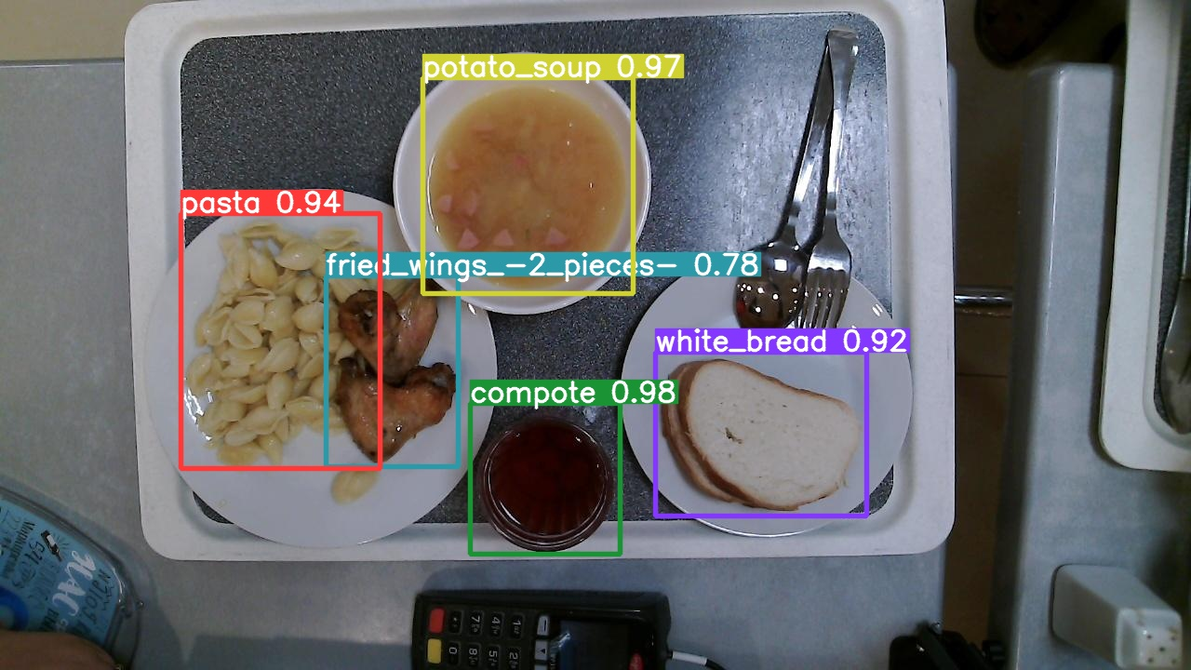
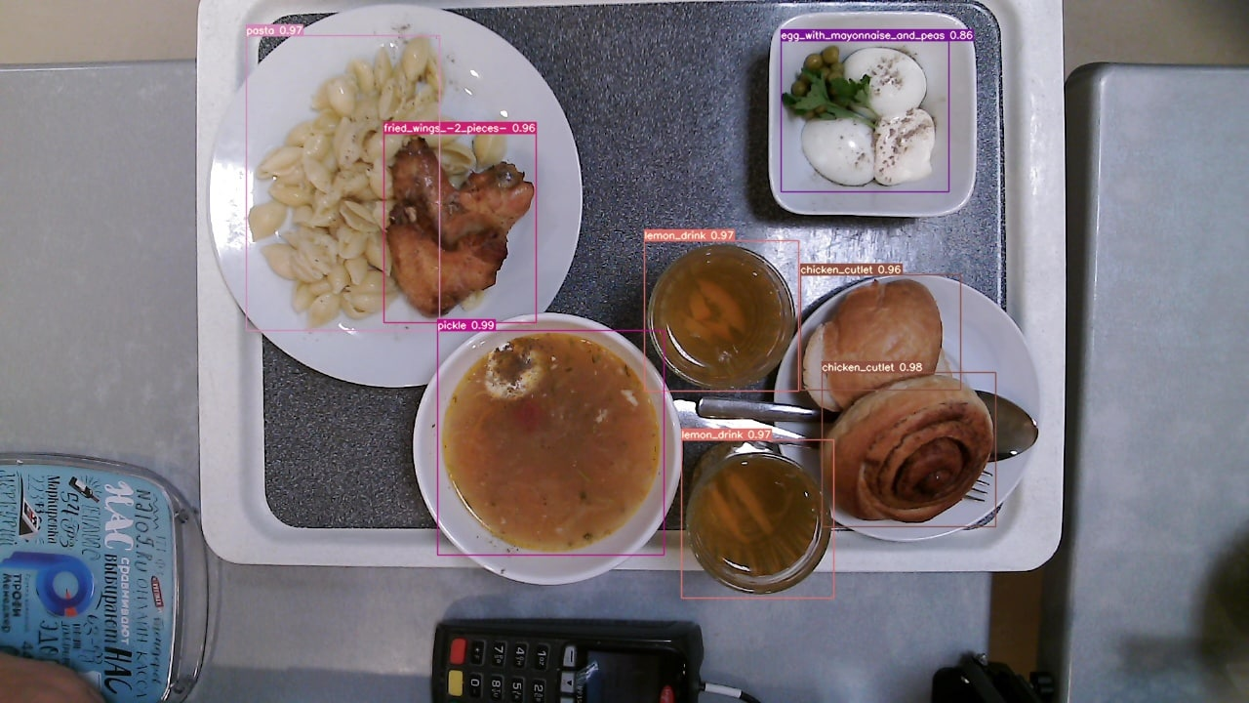
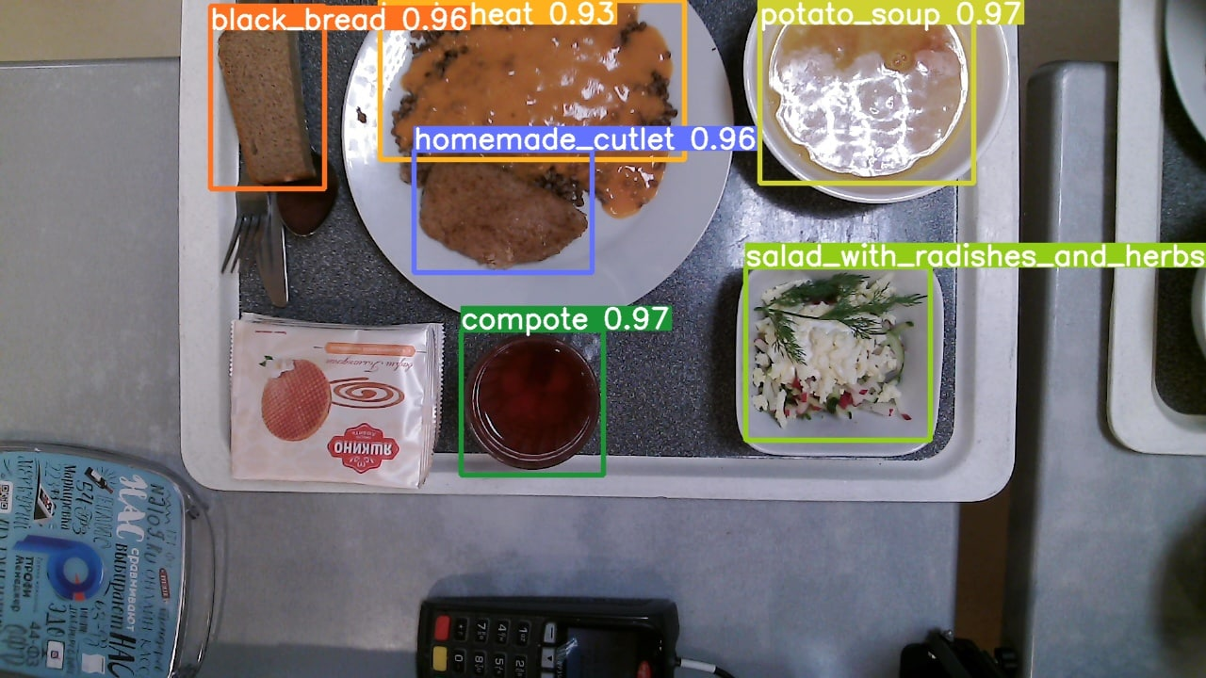
Experiment №2
10
Information:
Architectures: YOLOv5S, YOLOv6S, YOLOv7
Count of images: 126
Batch size: 16
Epochs: 400
Number of classes: 36 ('beetroot', 'black_and_white_salad_with_parsley', 'black_bread', 'buckwheat', 'bun', 'cabbage_c', 'cabbage_salad', 'chicken_cutlet', 'compote', 'egg_with_mayonnaise_and_peas', 'fried_wings_-2_pieces-', 'halibut_with_lemon', 'herring', 'homemade_cutlet', 'jelly', 'lemon_drink', 'liver_in_an_omelet', 'mashed_potatoes', 'olivier_salad', 'orange_juice', 'pasta', 'pickle', 'pork_schnitzel', 'pork_with_mayonnaise', 'potato_soup', 'potatoes_with_meat', 'salad_with_radishes_and_herbs', 'salad_with_salmon_and_crackers', 'sausage_in_the_dough', 'steam_meatballs-2_pieces-', 'tea', 'tomato_and_cucumber_salad', 'tomato_juice', 'tomato_salad_with_cheese', 'vinaigrette', 'white_bread’)
If there are a lot of object classes, and there is not enough data for training, then no architecture can cope. Need to use a custom classifier.
Yolo v5s
Yolo v6s
Yolo v7
Recall: 0.856
Precision: 0.723
Map: 0.906
Recall: 0.805
Precision: 0.687
Map: 0.854
Recall: 0.901
Precision: 0.845
Map: 0.925
The XXVI International Scientific Conference of Young Scientists and Specialists (AYSS-2022)

Slide 11
Custom classifier (Siamese network)
11
Architecture: Triplet + MLP
Number of classes: 36
Minimal class size: 5
Maximal class size: 15
Batch: 8
Epoch: 20
Anchor
CNN
…
Same weights
Positive
image
Triplet loss
Accuracy: 0.97
CNN
…
Same weights
Anchor – original image
Negative
image
➤
CNN
…
Positive image – image of the same class as Anchor
➤
Negative image – image from another class
➤
CNN – convolutional neural network
➤
The XXVI International Scientific Conference of Young Scientists and Specialists (AYSS-2022)

Slide 12
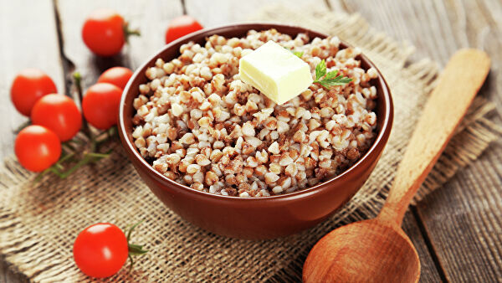
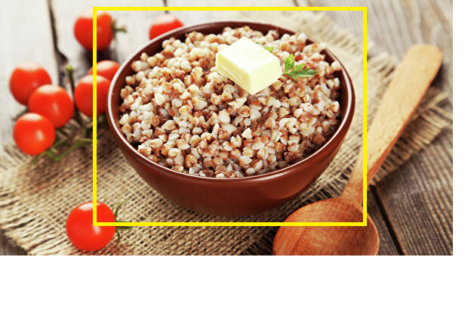
The principle of operation
12
Input image
Result
Detect.py
Detect.py
Yolov5
Triplet
image
object coordinates
object class and coordinates
The XXVI International Scientific Conference of Young Scientists and Specialists (AYSS-2022)

Slide 13
Подходы к разработке
13
Final results
Yolo v5s
Yolo v6s
Yolo v7
Yolo + Triplet
Metrics results
Metrics results
Metrics results
Metrics results
Recall
0.856
Recall
0.805
Recall
0.901
Recall
0.995
Precision
0.723
Precision
0.687
Precision
0.845
Precision
0.994
mAP
0.906
mAP
0.854
mAP
0.925
The XXVI International Scientific Conference of Young Scientists and Specialists (AYSS-2022)

Slide 14
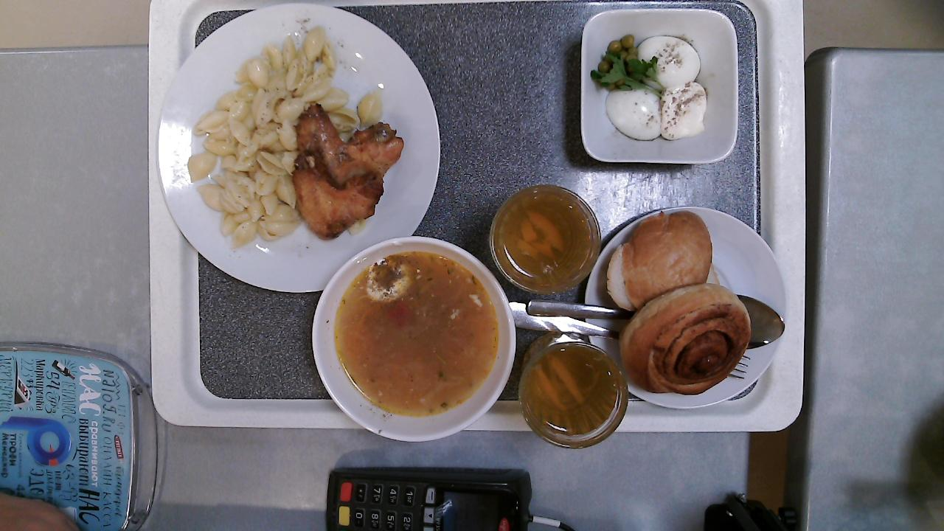
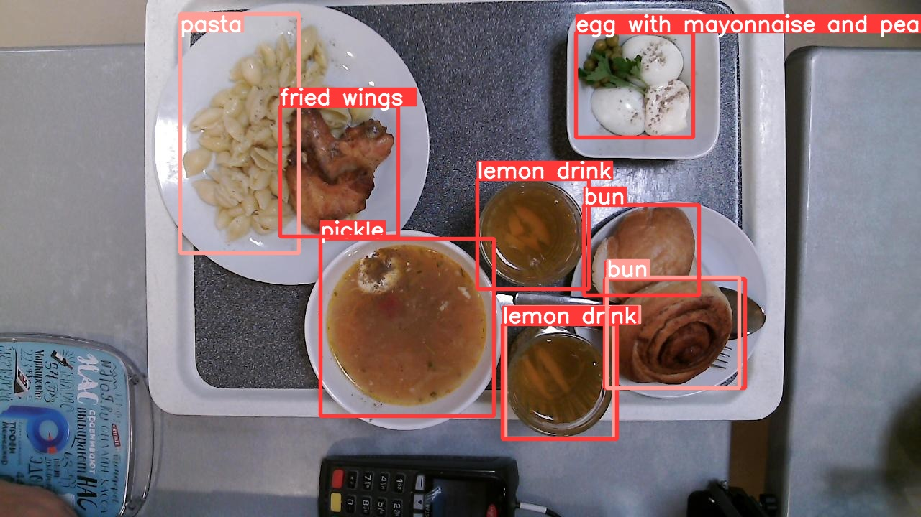
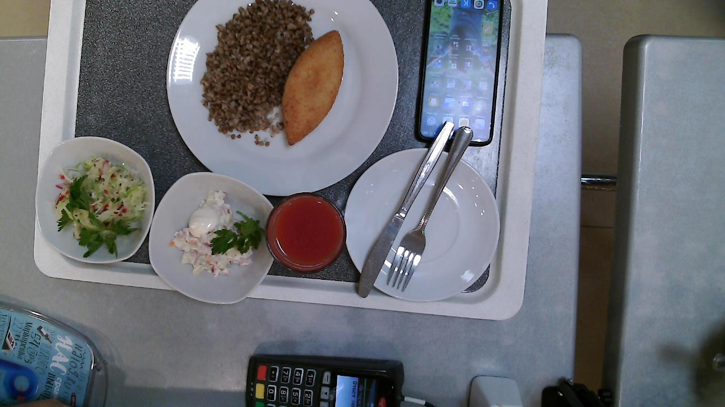
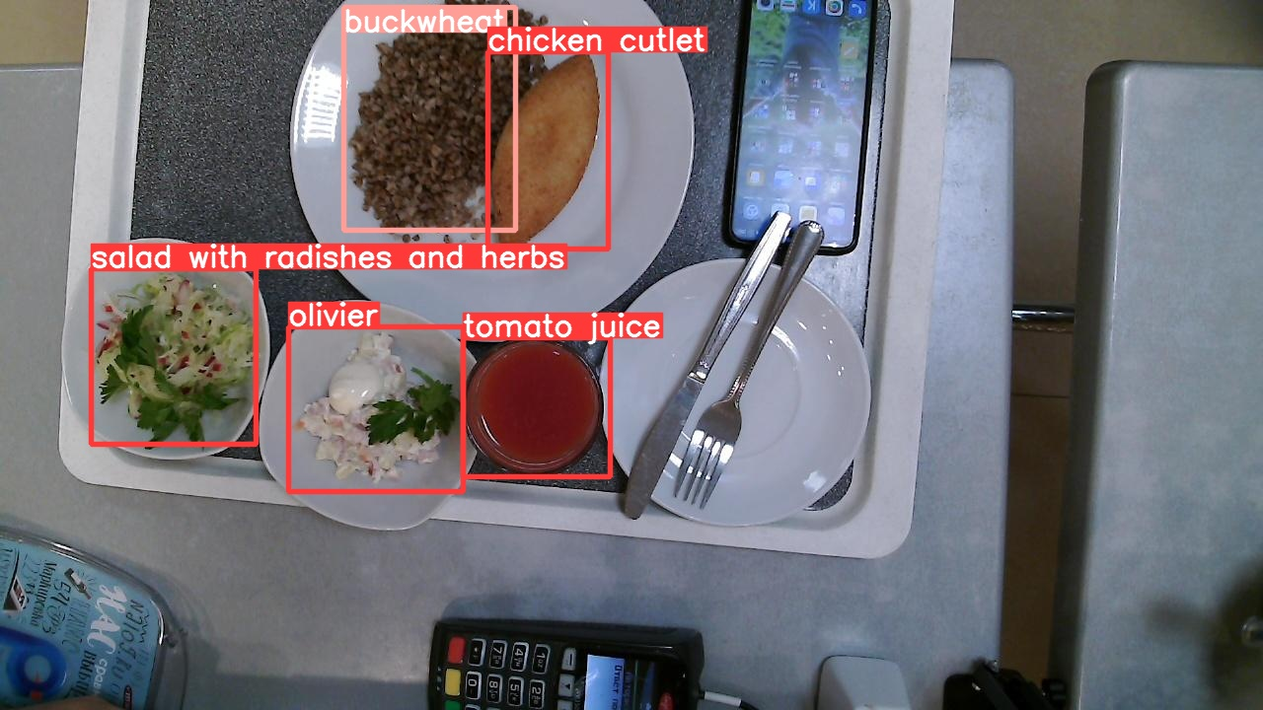
Examples
14
Input images
Output images
Processing
The XXVI International Scientific Conference of Young Scientists and Specialists (AYSS-2022)

Slide 15
Results
15
Conclusion :
It is impossible to solve the problem using standard methods "out of the box".
A custom classifier is required when there are a lot of dishes, but a lack of training data (by the way, this is the most common scenario in the real life)
Development prospects :
1
Сhange the classifier directly in the YOLO architecture and develop a training scheme.
2
If the solution turns out to be effective and convenient, then we can use it in other domains.
The XXVI International Scientific Conference of Young Scientists and Specialists (AYSS-2022)

