Slide 1
Deep tracking for the SPD experiment
Rusov D., Goncharov P., Ososkov G., Zhemchugov A.

Slide 2
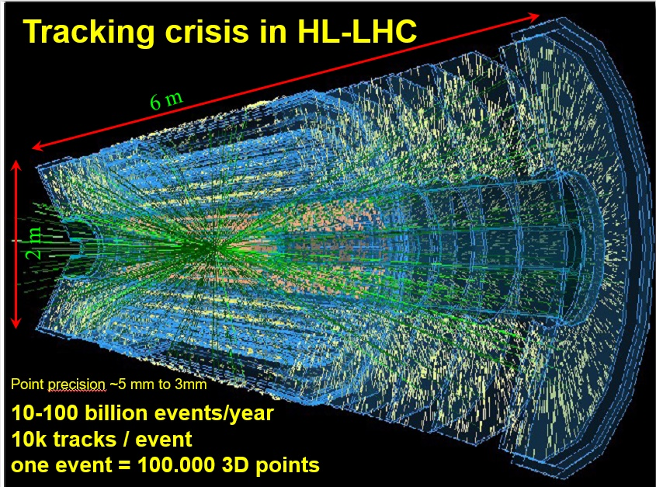
Problem Statement
Particle track reconstruction in dense environments such as the Run-4 detectors of the CERN High Luminosity Large Hadron Collider (HL-LHC) as well as MPD NICA is a challenging pattern recognition problem.
To achieve such high luminosity, the particles are not accelerated individually, but in bunches, so that the moments of collisions occur so close to each other that the event tracks overlap strongly.
For the SPD experiment, in which events are expected to arrive with a frequency of 3 MHz, the data acquisition is supposed to be performed in time slices, during one time slice up to 40 events with overlapping tracks may appear.
Of the entire stream of events, only a few percent are of interest to physicists.
Therefore, it is necessary to develop an intelligent online filter to sift out uninteresting events.

Slide 3
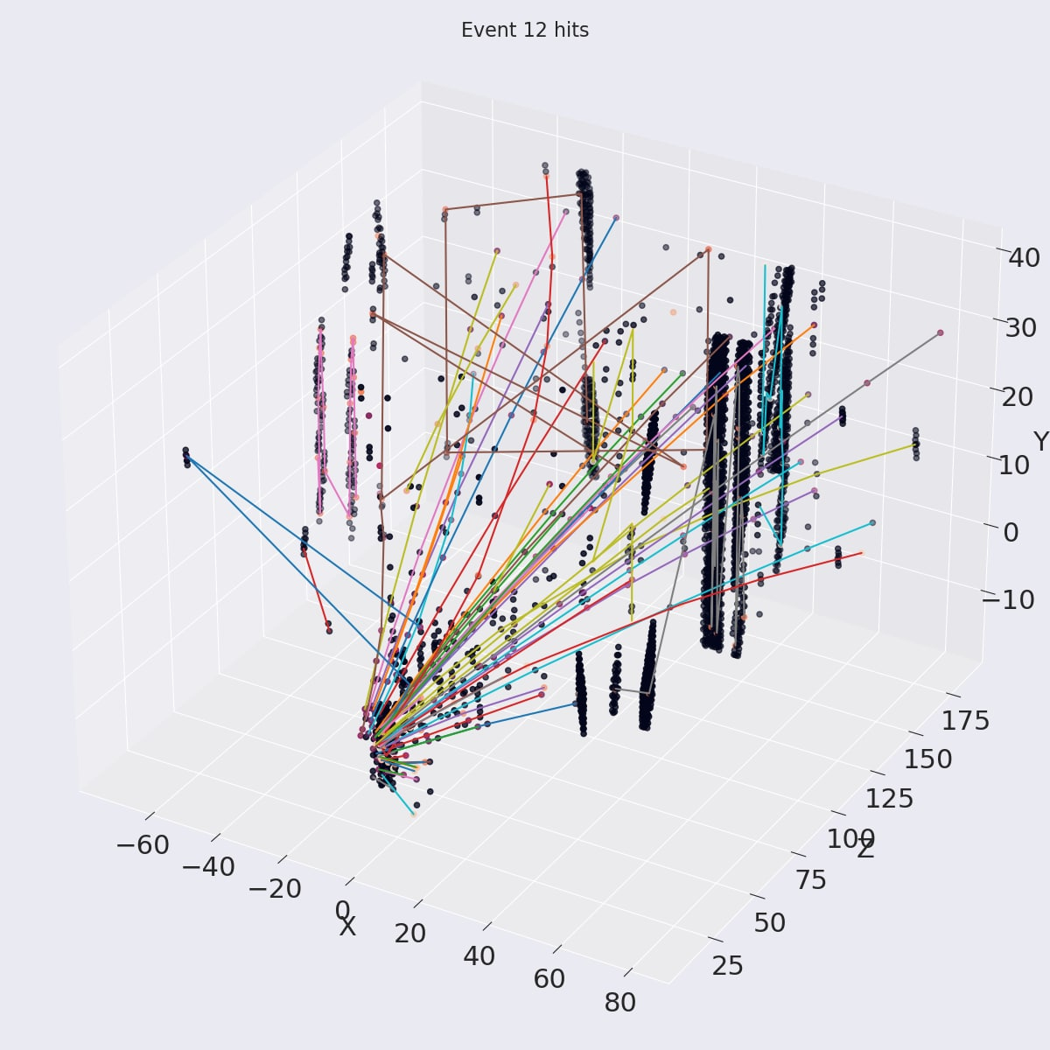
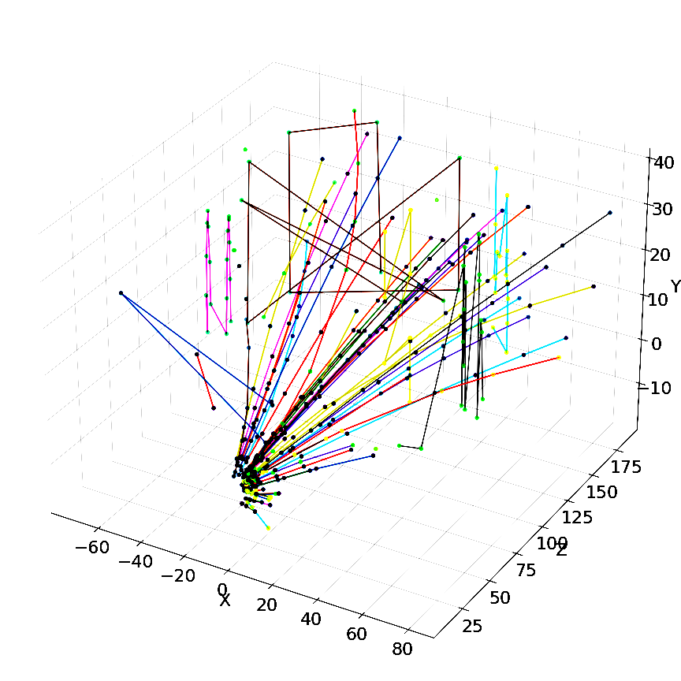
Deep Learning Comes to the Rescue
Deep learning algorithms bring a lot of potential to the tracking problem, due to
their capability to model complex non-linear data dependencies,
learn effective representations of high-dimensional data through training
parallelize easily on high-throughput architectures such as GPUs
What we propose for tracking?
Reconstructed event
Neural network
(online)
Kalman filter (offline)
High recall, low precision
Very fast
High recall, high precision
Too slow

Slide 4
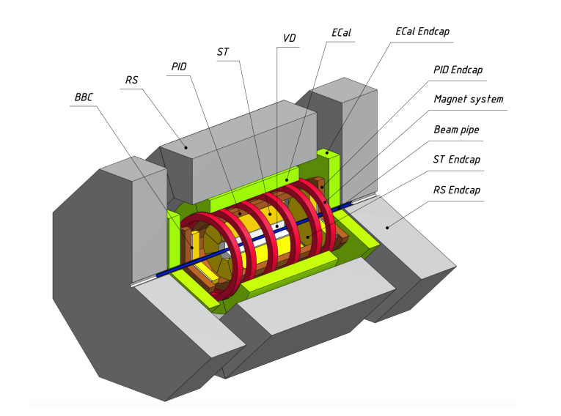
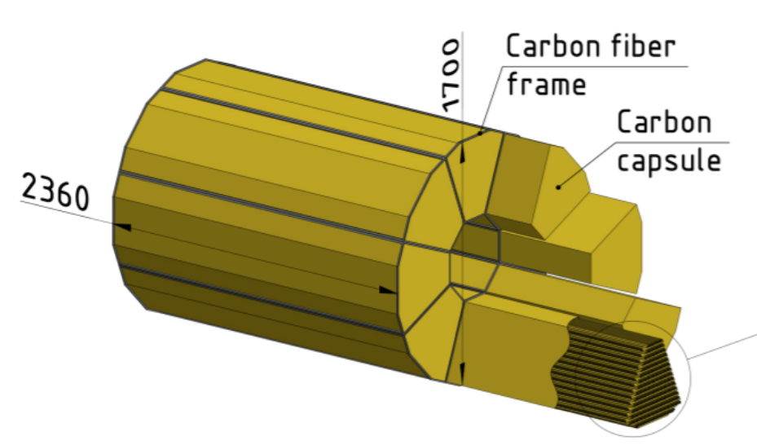
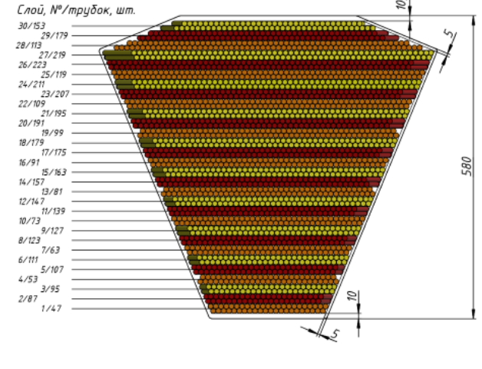
SPD Experiment
SPD (Spin Physics Detector) – is a future experiment of NICA facility in Dubna. The main goal of the experiment is to test the foundations of quantum chromodynamics (QCD).
Event data from SPD comes in the form of time slices with a length of 10 ms and about 40 events in time slice will be produced.
On average there are 200 tracks per time slice and 1100 hits (real and fake) per station.
As an online filter, the algorithm must allow processing over 100 time slices per second.
(x2 zoom)
Without cover
Layer, № / tubes, pcs
General layout of the SPD setup
External view of the SPD straw detector (left) and its module in section (right)

Slide 5
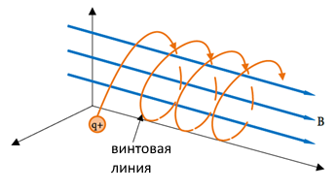
Events Data Generator
Generator is a simple Python program.
Multiplicity in each event is given by a random number from 1 to 10 tracks per event.
The transverse momentum of a particle is a random number with a uniform distribution in the range of values from 100 to 1000 MeV/s.
Vertex coordinates are also random.
The particle trajectory is represented by a selection of points on a segment of a helix with a helix pitch $h= \frac{2π}{B}|\frac{m}{q}|vcosα$ and radius $R=\frac{1}{B}|\frac{m}{q}|vsinα$.
Detector configuration with 35 stations is considered.
Helix

Slide 6
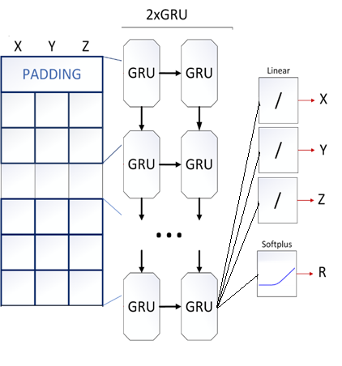
Local Tracking with TrackNETv3. Model overview
How the model works?
TrackNETv3 is a model for local track reconstruction.
Locality – one particular track-candidate during the prediction phase.
The model predicts the center and radius of the sphere where to search for the next hit.
All hits are placed in the spatial search index (Faiss).
Only K nearest to the center of sphere hits are checked (setting K=1 leads to linear computational complexity).
Candidate tracks are extended by hits that fall into sphere.
Extended track-candidates are fed back to the model input.
Pros:
Fast
Lightweight
No problems with memory consumption
Each track can be processed separately in parallel
Cons:
lot of false positives or so-called ghosts, because of its local nature of prediction
TrackNETv3 model

Slide 7
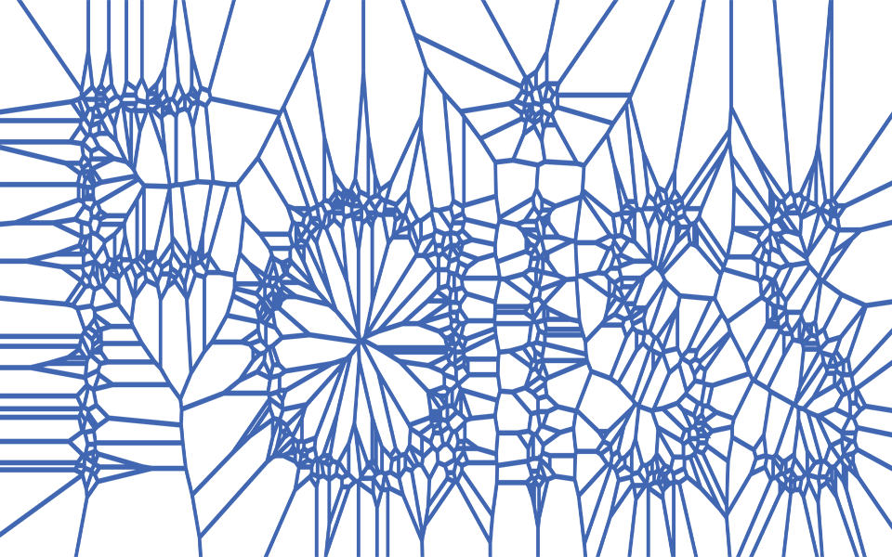
Local Tracking with TrackNETv3. Inference
1
2
Store all event hits in the index
4
As a result
$O\left(n\right)$ complexity depends on number of stations
Start predictions from the 1st hit – much less ghosts
Sphere centers (x, y, z)
Sphere predictions
(x, y, z, r)
3
1 nearest hits for each sphere center
6
Prolong candidates and pass them to the model
Check sphere attendance
5

Slide 8
Testing Results. Metrics
Used metrics:
$recall= \frac{N_{true}^{rec}}{N_{in}}$
$precision= \frac{N_{true}^{rec}}{N^{rec}}$
- $N_{true}^{rec}$ - no. real tracks that the network found
- $N_{in}$ - no. all real tracks known from Monte-Carlo
- $N^{rec}$ - no. all reconstructed tracks
Testing setup:
25 000 generated events
Xeon(R) Gold 6148 CPU @ 2.40GHz
NVIDIA Tesla V100 32GB
No tracks with less than 4 hits and tracks with missing hits
 | TrackNETv3 (single event) | TrackNETv3 (40 events in timeslice)
Track efficiency (recall) (%) | 99,62 | 96,78
Track purity (precision) (%) | 99,52 | 88,02
Timeslice/sec | 34,58 | 18,46

Slide 9
Testing Results. Time measurement
Brute force algorithm for spatial search was used
As the number of points in events increases, the time needed to perform a spatial search increases drastically
Some other algorithms, like Inverted File Index, may improve search speed but require preparation time, so can’t bring any speed-up.

Slide 10
Conclusion and outlook
Applying the TrackNETv3 model to SPD simulation data showed promising results in terms of track efficiency and purity.
Research on handling the tracks with missing hits is needed for SPD data (the TrackNETv3 model shown good results for processing such tracks for the BM@N experiment).
Inference optimization is needed to bring processing speed closer to required level. It can be done by translation the program to C++ or changing the inference algorithm, for example, skipping some stations.
More complex simulation of SPD events is required.

Slide 11
Deep tracking for the SPD experiment
Rusov D., Goncharov P., Ososkov G., Zhemchugov A.

