Slide 1
Breeding of a drought-resistant rice variety as an application of mutagenesis induced by the neutron irradiation on the EG-5 installation in the FLNP, JINR
The XXVI International Scientific Conference of Young Scientists and Specialists (AYSS-2022)
A.I. Kruglyak¹, Yu. Aleksiayenak ¹,
A.S. Doroshkevich ¹, N.O. Appazov ², K.B. Bakiruly ³
¹Joint Institute for Nuclear Research, Frank Laboratory of Neutron Physics, Dubna, Russia,
²Korkyt Ata Kyzylorda University, Kyzylorda, Kazakhstan,
³Kazakh Research Institute of Rice named after I. Zhakhaev, Kyzylorda, Kazakhstan,
Dubna, JINR, October 2022

Slide 2
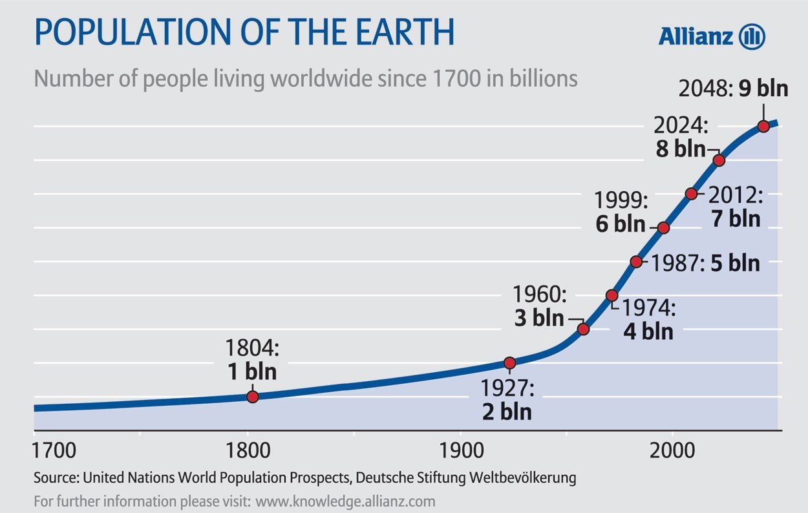
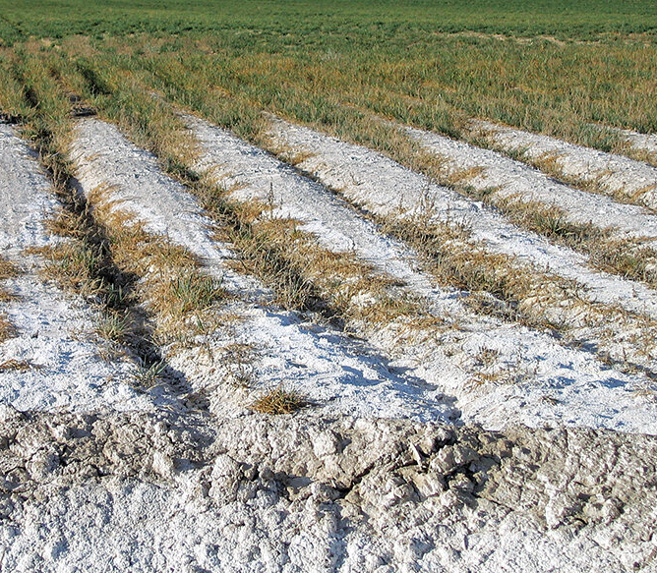
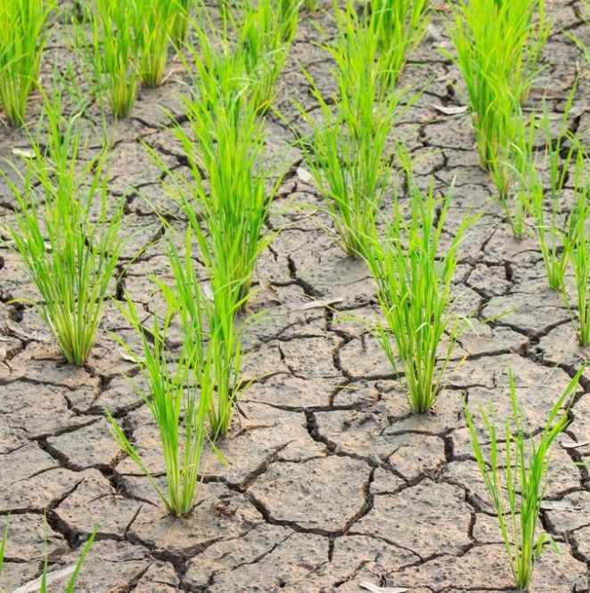
Purpose research
Ionizing radiation
Wing R.A. et. al. The rice genome revolution: from an ancient grain to Green Super Rice // Nat Rev Genet. 2018.

Slide 3
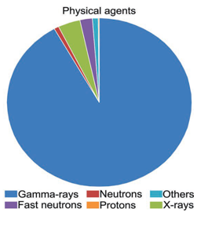
Using neutrons
The density of the background neutron flux
near the Earth's surface 4×10⁻³ neutron/cm²×s [1]
near sea surface - 13×10⁻³ neutron/cm²×s [2]
Fig. 1. Physical mutagens applied in rice
mutagenesis according to FAO/IAEA-MVD 2019 [3]
[1] N.A.Vlasov (1982), Atomic Energy, 52(2), 87-91.
[2] European Commission, Joint Research Centre – Cinelli, G., De Cort, M. & Tollefsen, T. (Eds.) (2019), European Atlas of Natural Radiation, Publication Office of the European Union, Luxembourg.
[3] V.E. Viana, C. Pegoraro, C. Busanello and A. Costa de Oliveira (2019). Mutagenesis in Rice: The Basis for Breeding a New Super Plant.
Front. Plant Sci. 10:1326. doi: 10.3389/fpls.2019.01326

Slide 4
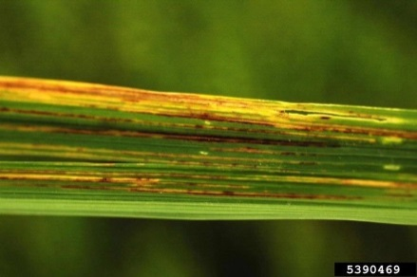
Fast neutrons as a type of radiation mutagenesis
Increase the frequency of chlorophyll mutations
Changes in amylose content not alter the amylopectin structure
Changes in the FRO1 gene tolerance to iron toxicity
Deletions, inversions, translocations, tandem duplications
NPR1 homologue immune responses against bacterial infection by Xanthomonas oryzae

Slide 5
Beginning of neutron irradiation of rice crops
Ajkerim
Lider
Kazakh Research Institute of Rice named after I. Zhakhaev, Kyzylorda, Kazakhstan
Syr-Suluy
The study performs in the scope of the Ministry of Agriculture of the Republic of Kazakhstan project
number BR10765056

Slide 6
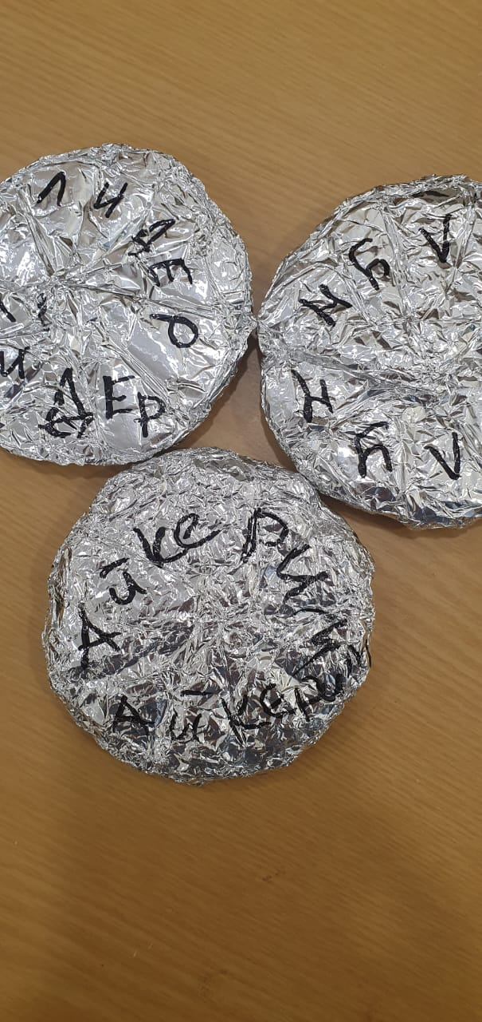
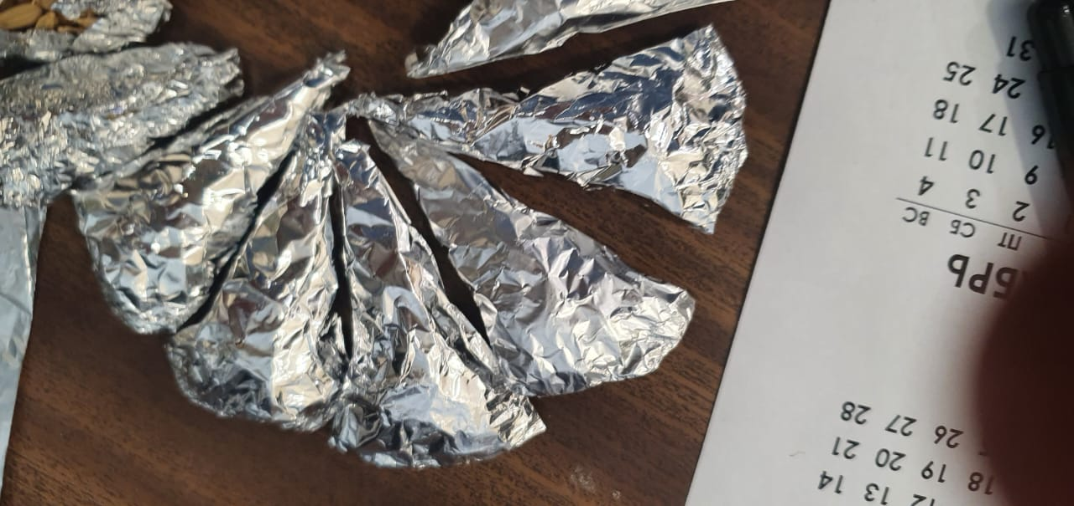
Sample preparation
Fig.2. Seed samples Rice grains were packed by 100 in the aluminum foil in triangles
Fig.3. Cylinders contains 1000 seeds of the rice breeds Ajkerim, Lider, Syr-Suluy prepared for irradiation.

Slide 7
Location of rice samples ready for neutron irradiation on channel 5 of the EG-5 accelerator
Irradiation characteristics:
Seed samples
$D(d,n){}_{}^{3}{He}$
$E_{n}$ = 4.1 MeV
I$\sim 1,7−2μA$
$E_{D}$ = 2.5 MeV
neutron monitor of the PIXE-4 type
204 hours
35 - 40 million particles / hour
Neutron–producing gas target
Output of the accelerator ion conductor

Slide 8
Planting rice
Experimental site LLP "Kazakh Research Institute of Rice named after. I. Zhakhaev” in the Republic of Kazakhstan.

Slide 9
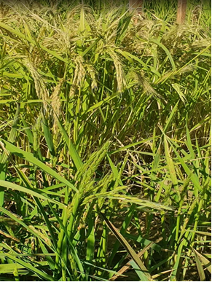
Results and discussion
Fig.4. Mutant samples where green
rice grains do not contain rice seeds
Fig.5. Mutant samples that shows lag the maturation period (top is the Syr-Syluy control variety, bottom is irradiated samples).

Slide 10
Conclusion
It was found out that the reported dose of 50 Gy is sufficient to carry out mutagenesis in rice crops.
Second generation received from the irradiated seeds will be studied next year.
It is additionally planned to study rice mutagenesis in vitro, which, according to study [4], reduces the number of chimeras and reduces the time for selecting the desired traits.
The next stage of the study is to irradiate mushroom samples and to compare irradiation effects on the two different biological objects. Expected results will play important role in the new varieties selection with the necessary properties for a particular area.
[4] A. J. Hernandez Soto Perez et al. (2022). Temporary Immersion System Improves Regeneration of In Vitro Irradiated Recalcitrant Indica Rice (Oryza Sativa L.) Embryogenic Calli. Plants.

Slide 11
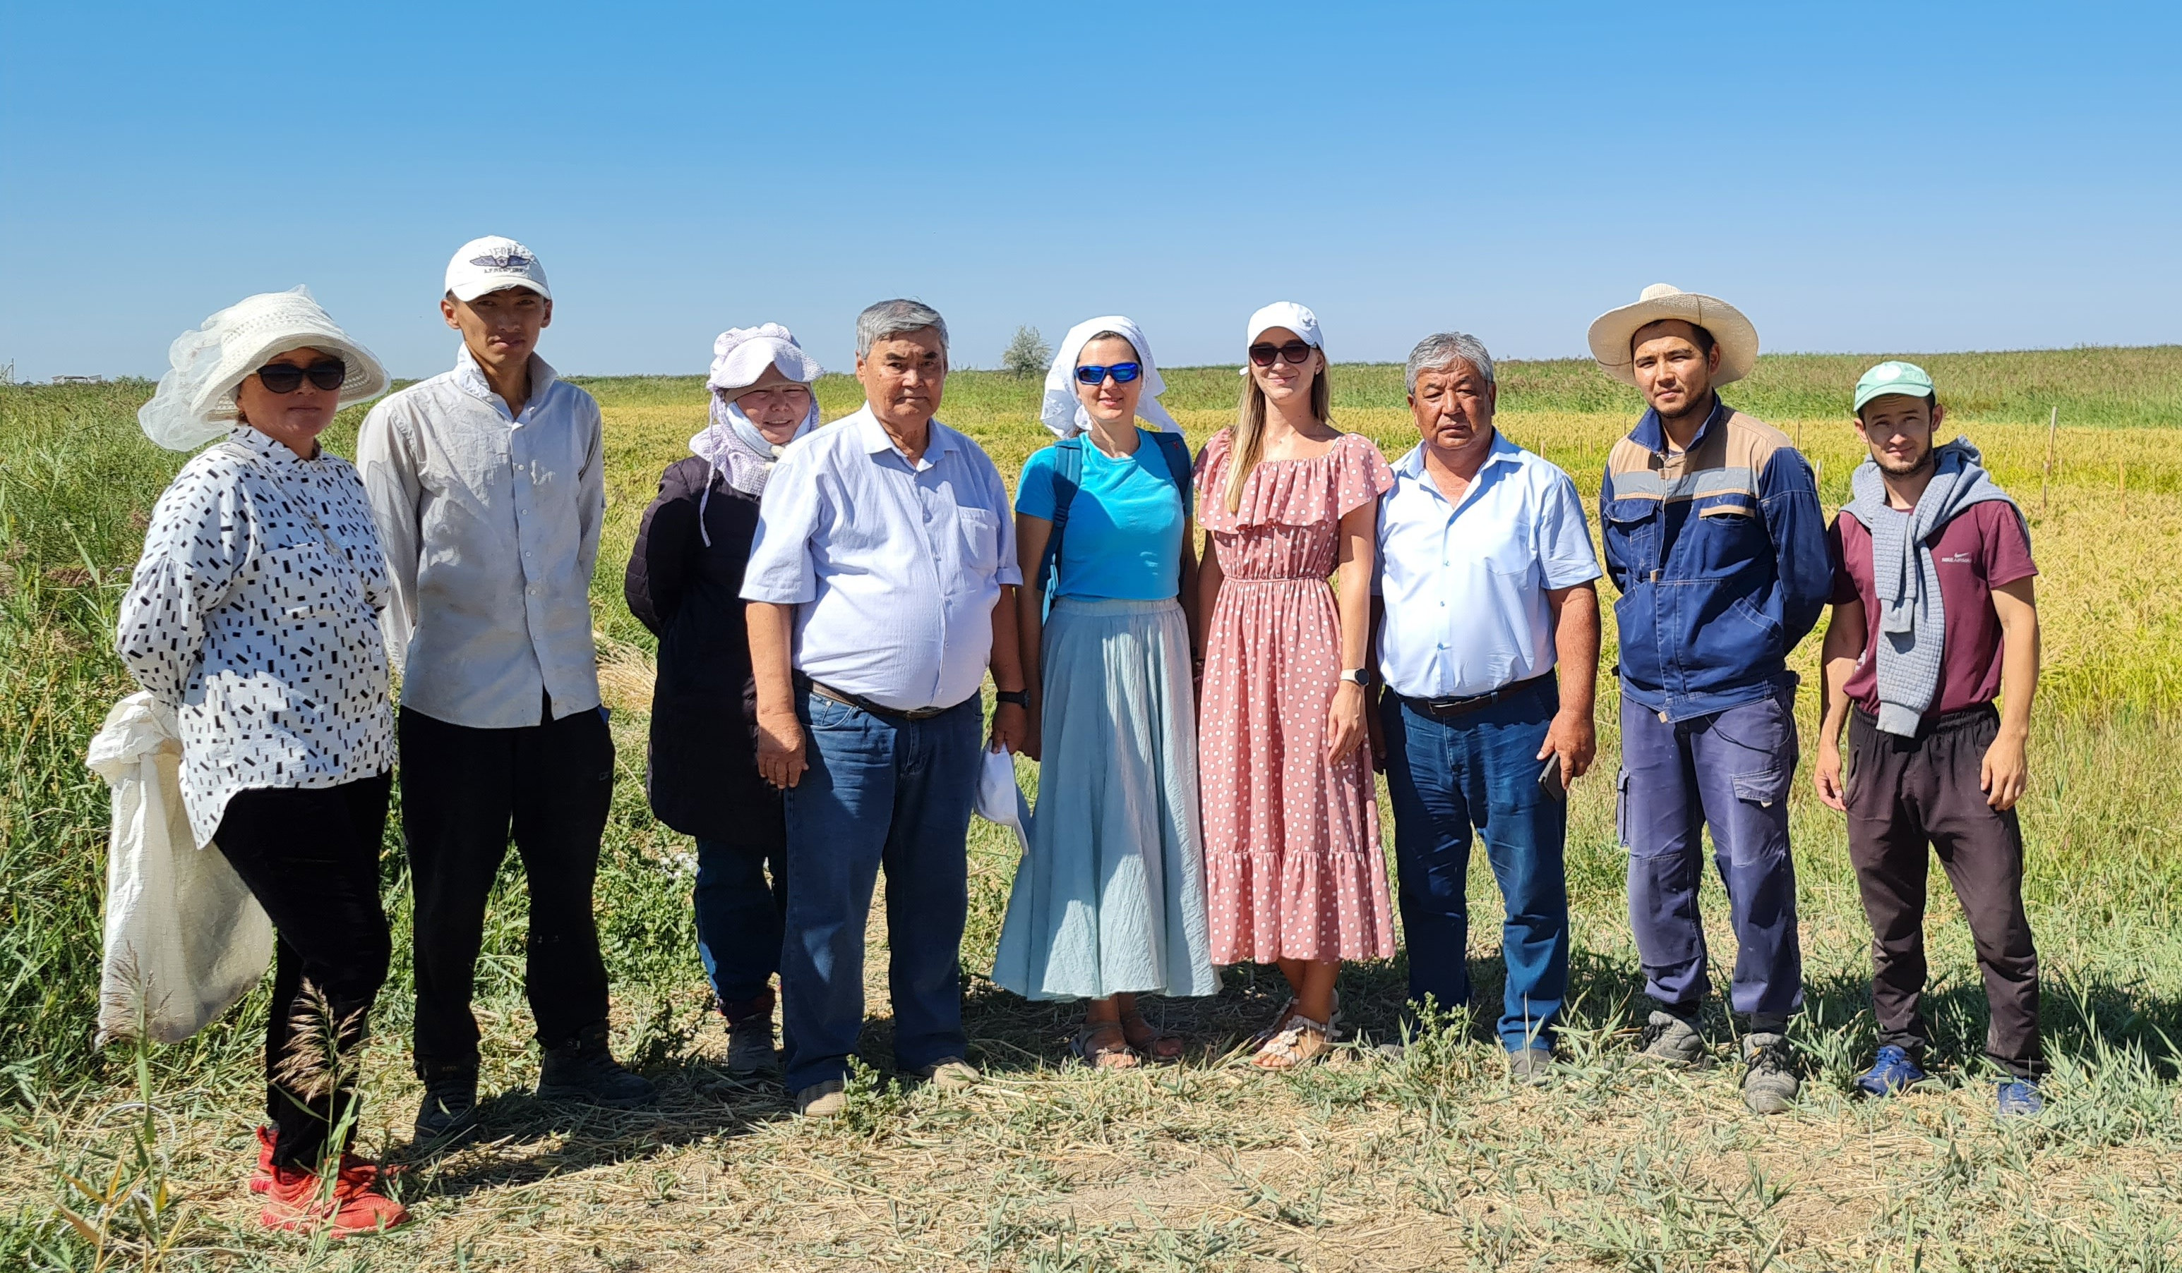
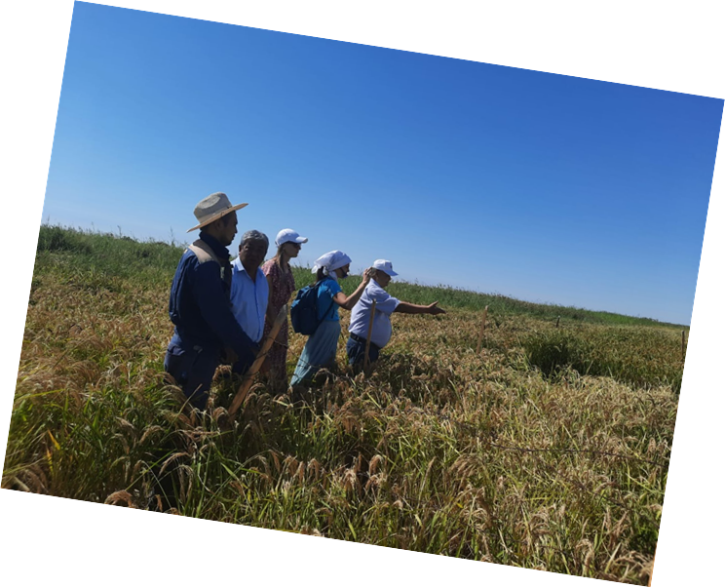
Thank you for attention!

