Slide 1



EFFECT OF CARBON ADDITIVES ON THE STRUCTURE OF ELECTRODES FOR HIGH ENERGY DENSITY Li-ION BATTERIES
Meir Yerdauletov^{[2,3,4]}, Philipp Napolsky^{[1,2]}, Mikhail Avdeev^{[1,2]}, Victor Krivchenko^{[1]}
^{[1]}Dubna University, Dubna, Moscow Region, 141980 Russia
^{[2]}Frank Laboratory of Neutron Physics, Joint Institute for Nuclear Research, Dubna, Moscow region, 141980 Russia
^{[3]}Institute of Nuclear Physics, Ministry of Energy of the Republic of Kazakhstan, Almaty, 050032 Kazakhstan
^{[ 4]}L.N. Gumilev Eurasian National University, Astana, 010000 Kazakhstan

Slide 2
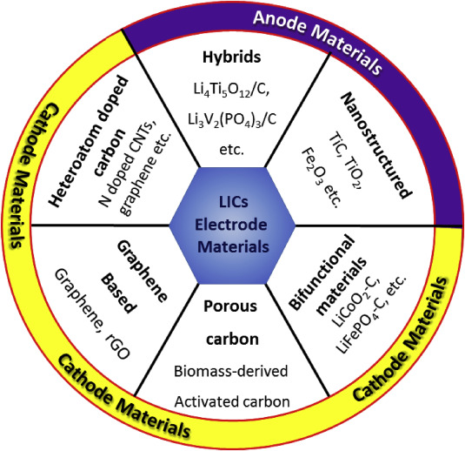
Energy storage systems
Comparison of specific energy and specific power of various energy storage systems. From the diagram, it can be seen that LICs bridge the gap between lithium-ion batteries and double-layer capacitors, making them promising for high power applications where long run times between recharges are important.

Slide 3
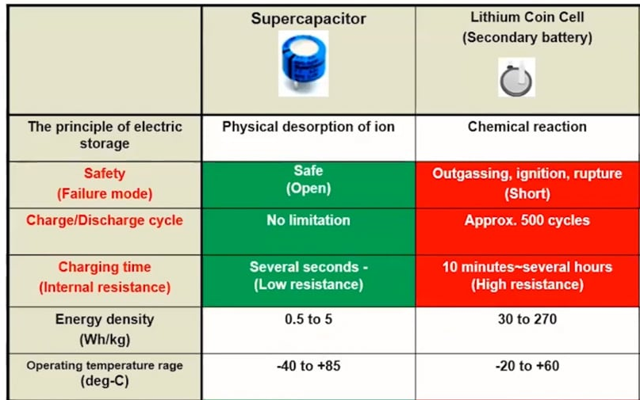
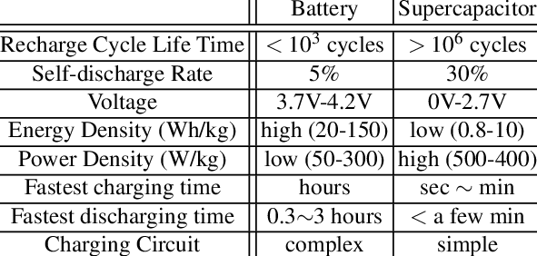
Li ion batteries vs Supercapacitors

Slide 4
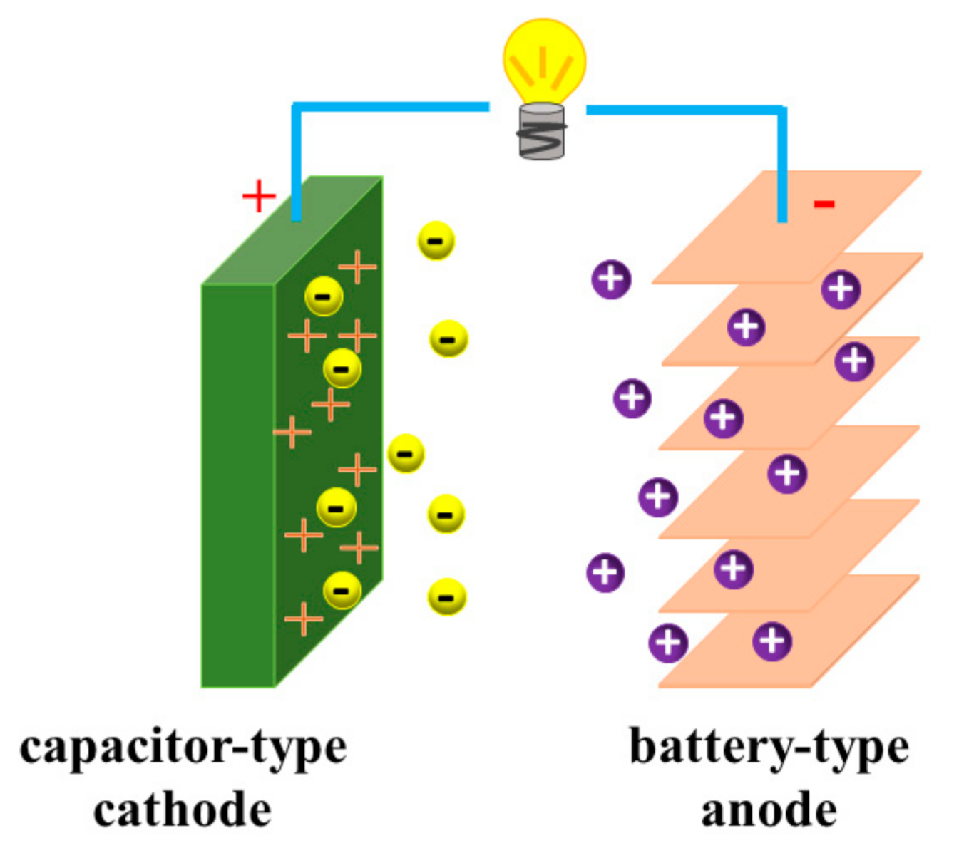
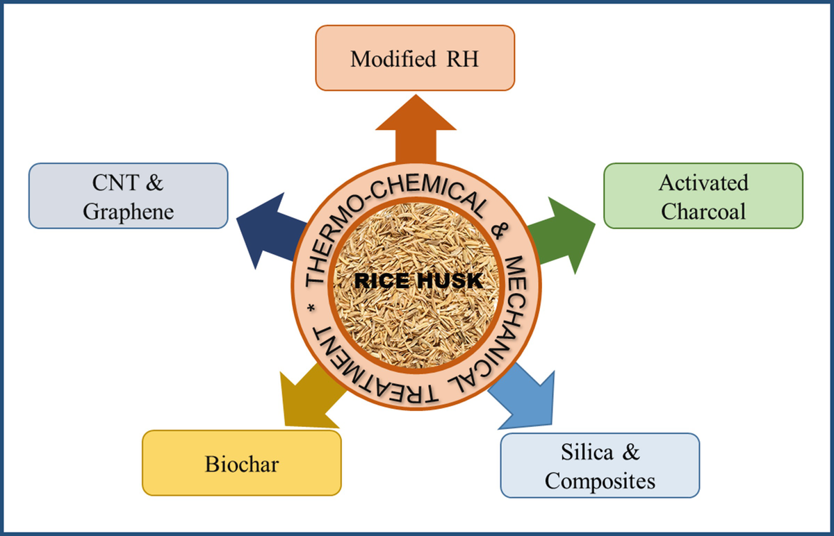
Hybrid Li ion capacitors

Slide 5
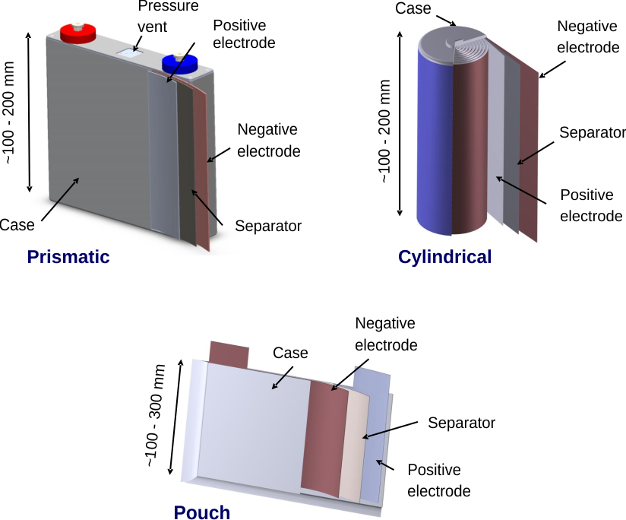
The aim of the work: Development of lithium-metal capacitors with increased specific energy and power
.
Tasks to be solved as part of the work:
Study of the electrochemical characteristics of positive electrodes based on activated carbons, obtained from various biowaste.
Prototyping a Lithium Metal Capacitor with Increased Energy Density prismatic form factor.
Investigate Lithium deposition with neutron radiography and tomography

Slide 6
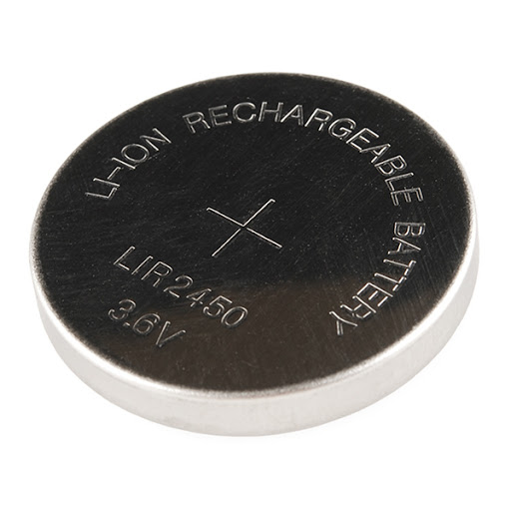
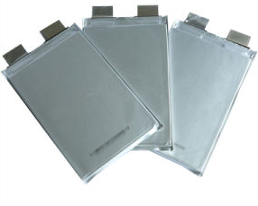
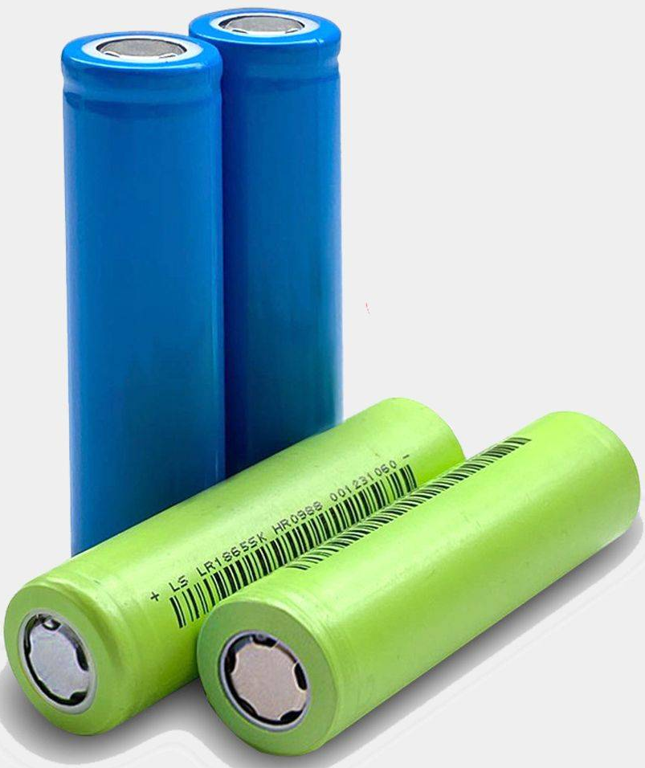
EXPERIMENTAL PARAMETERS
Electrolytes
1M LiClO4 in FEC-DME_3-7
1M LiDFOB in EC-DMC-DEC-1-1-1
1M LiDFOB in FEC-DME_3-7
1M LiDFOB in FEC-DME_3-7_LiNO3-3wt
1M LiDFOB in VC-DME_3-7
1M LiPF6 in EC-DMC-DEC-1_1_1(Sigma)
CATHODE COATING
Active material - activated carbon from rice hulls [90%]
Conductive additive - carbon nanotubes [5%]
Polymer binder - PVDF [5%]
Mass loading of the electrode coating - 2.5 mg/cm2
Elements
Coin cell 2032
Anode
Lithium metal 150 µm thick
Separator
Celgard 2500

Slide 7
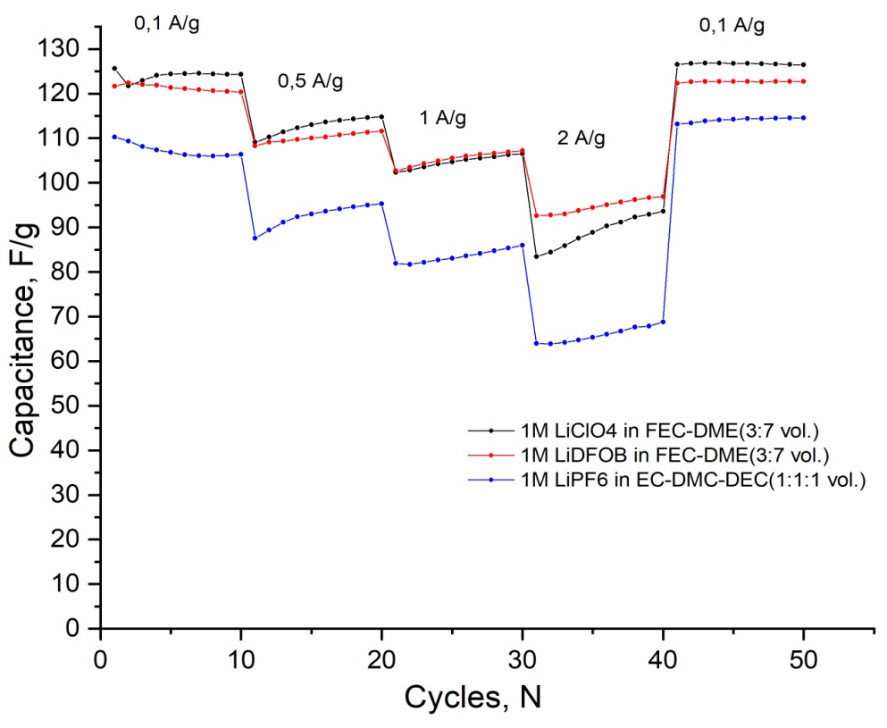
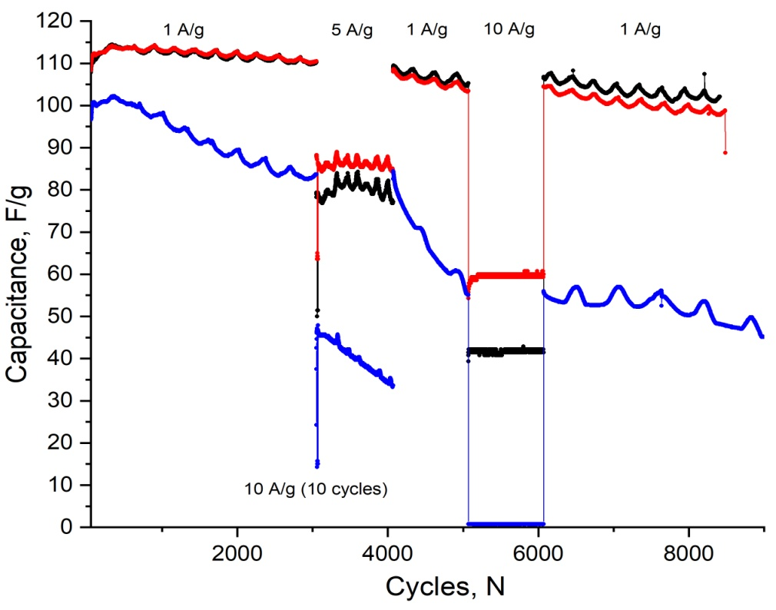
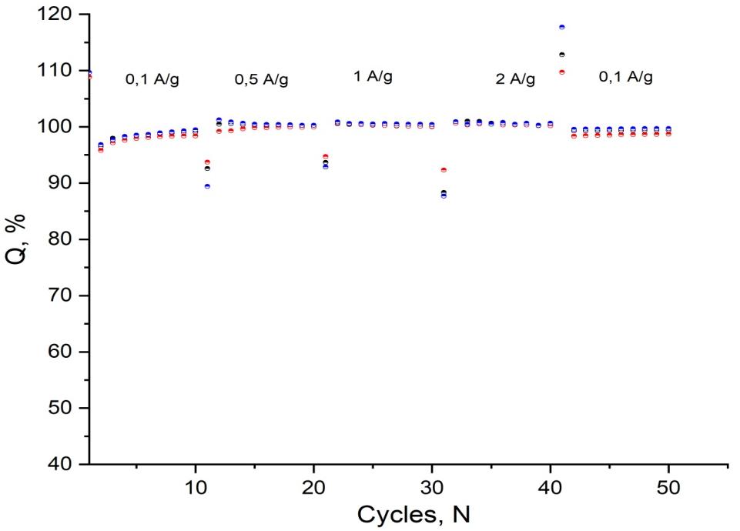
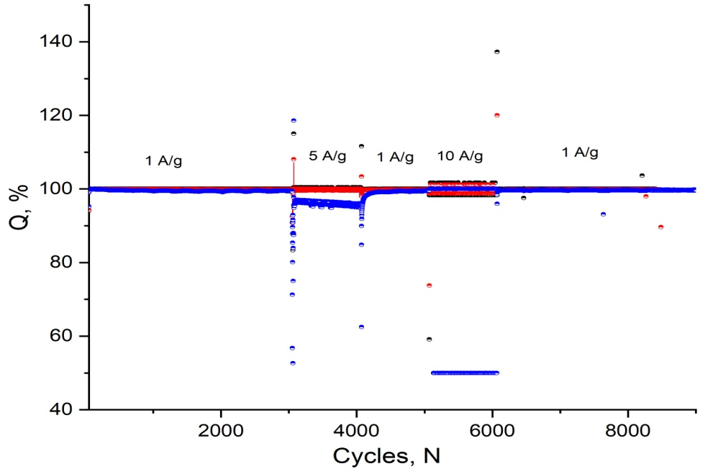
Galvanostatic curves

Slide 8
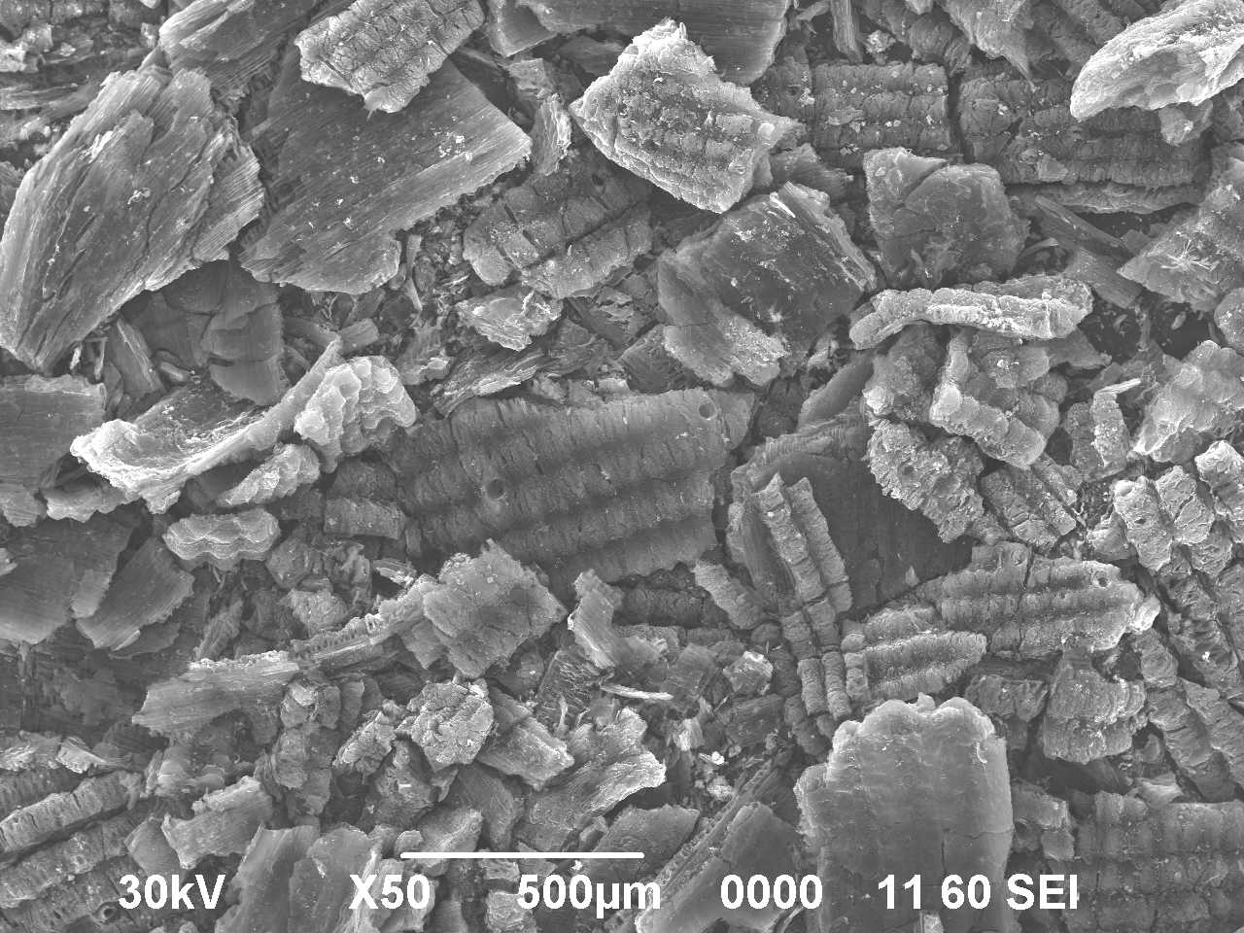
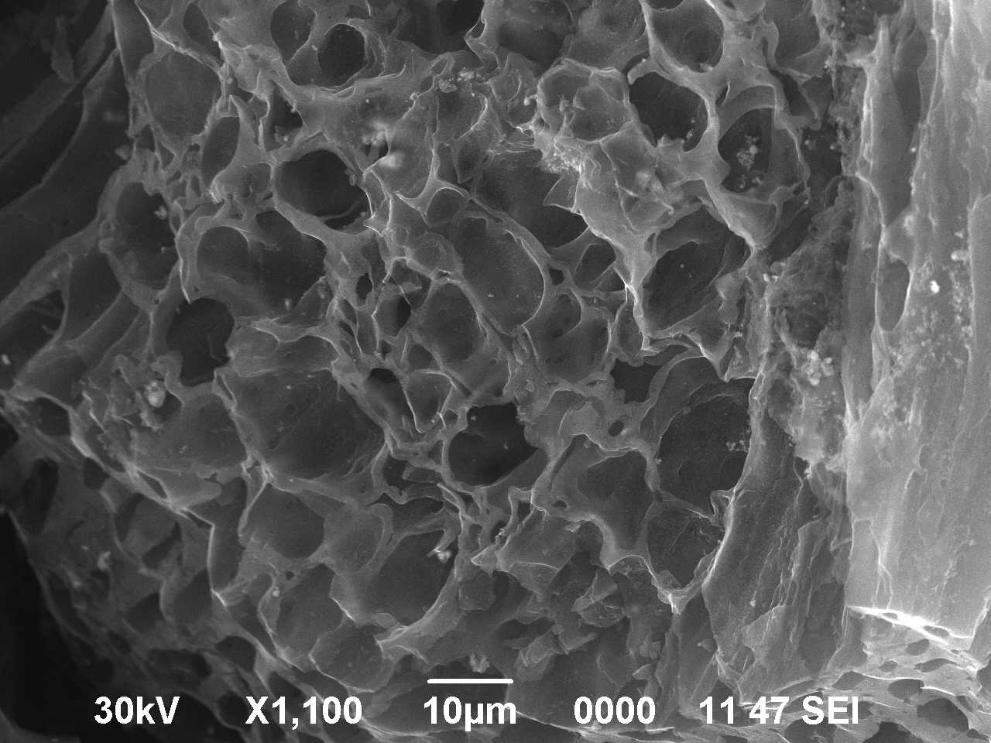
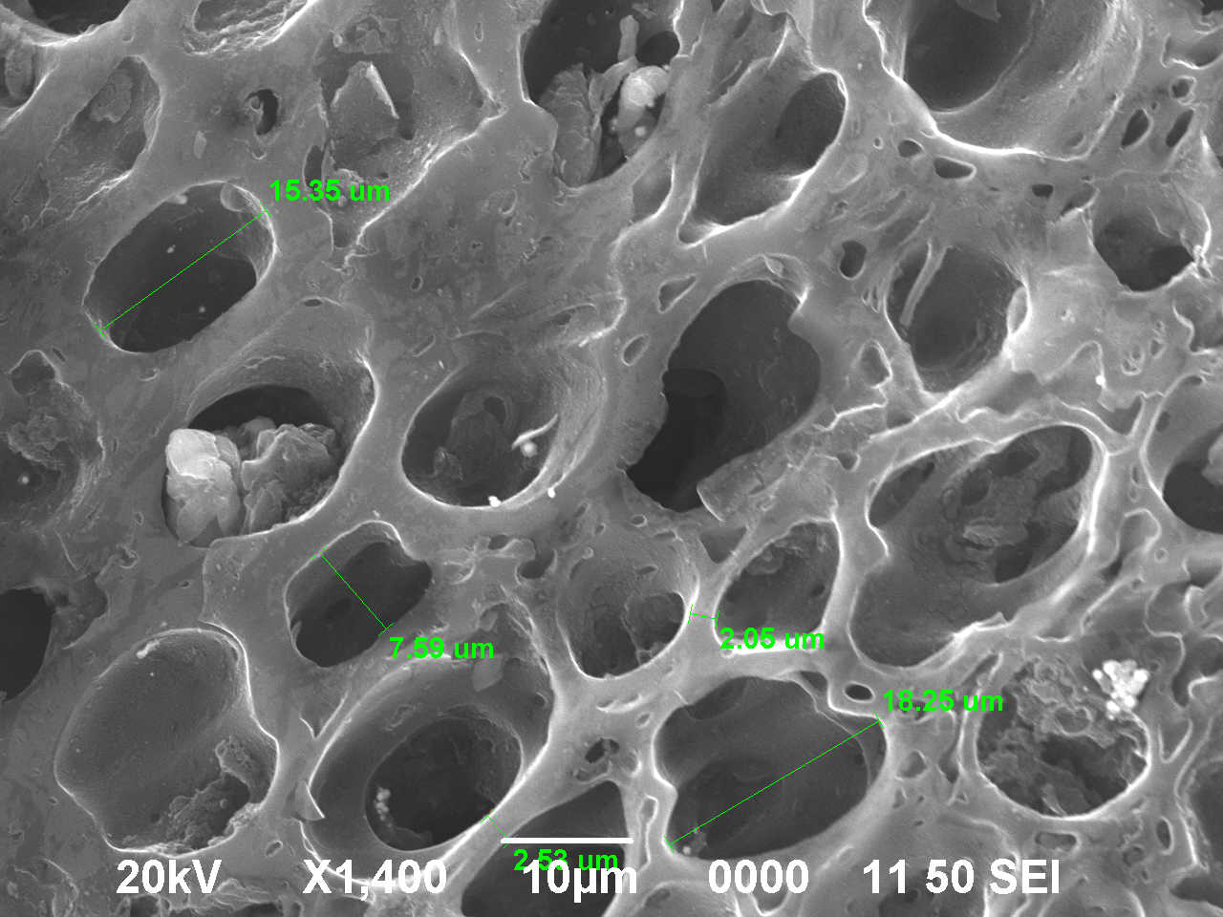
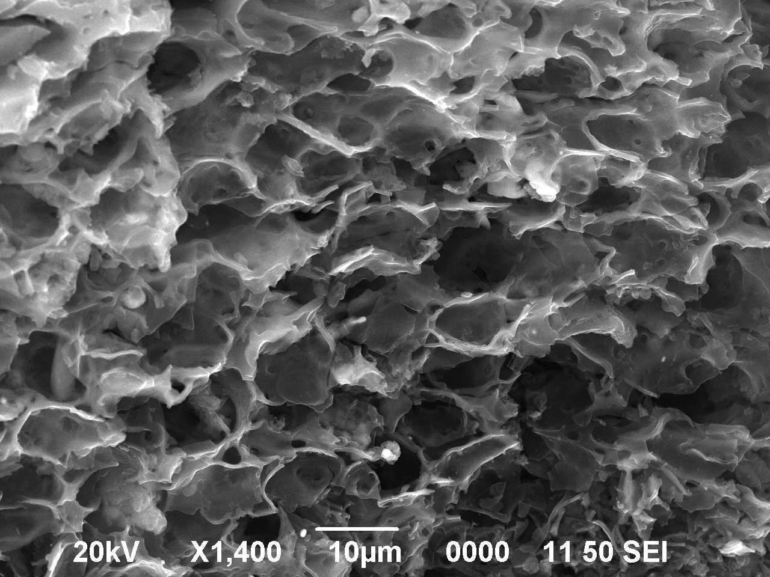
Results
Scanning electron microscopy (SEM, Jeol JSM-6490LA)
Transmission electron microscopy (TEM, JEM-2100analysis)
SEM micrographs of
carbonized Rice Husk
SEM micrographs of
activated Rice Husk
TEM micrographs of
activated Rice Husk

Slide 9

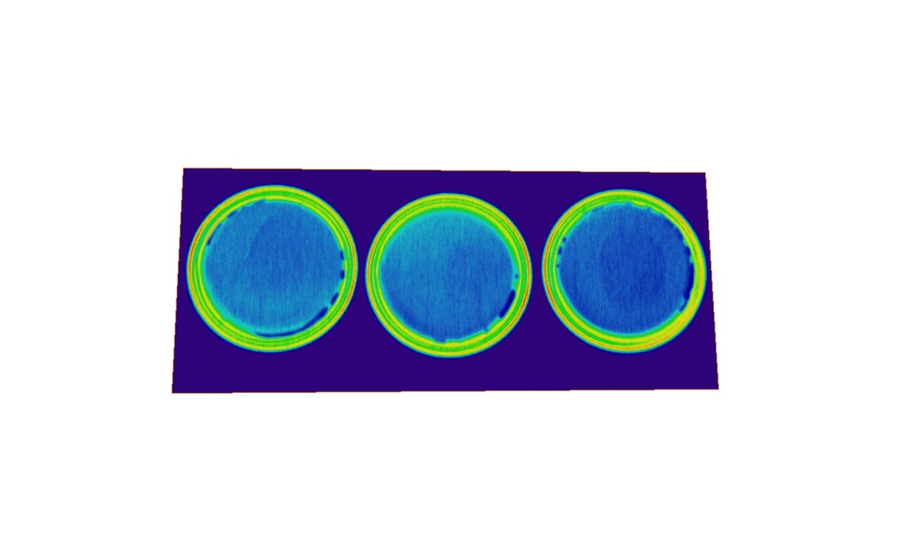
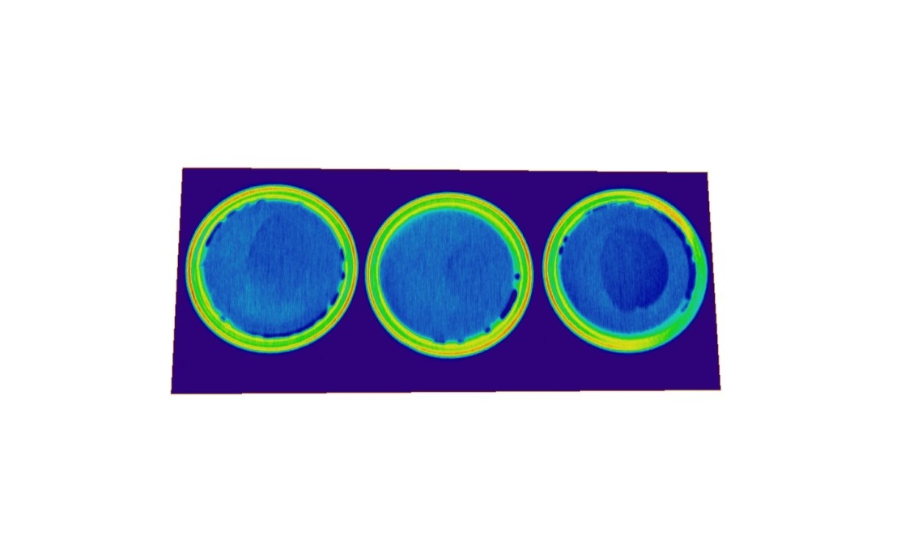
Neutron tomography
The neutron tomography method was used to visualize the lithium and electrolyte distribution regions flowing inside the cell in the initial and final states of lithium-ion batteries.
Capacity 100 %
Capacity 50 %
Capacity 0 %
Tomography experiments were done at TITAN beamline of WWR-K reactor Almaty INP. As convertor used 6LiF/ZnS scintillators with thicknesses of 100 μm, Hamamats CCD -chip based camera, and L/D was typically set at 350. Pixel resolution was 45 μm.

Slide 10

Conclusions
F uture Plans
1)
All the carbon structure s use d in the
e xpe rime nts provide s kine tic transport of
lithium ions into the crystals of active
mate rial
1.
2.
3.
Mak ing prototy pe s of Li ion batte ries /capacitors in cylindrical form
De ve lopme nt of scie nt ific and te chno log ical
criteria for the creation of e le ctrolyte s,
e le ctrode coatings and de sign of lithium-ion
batte rie s, allowing to work in t he are a
of e xtre me ly low te mpe rature s (be low -40C).
2)
3)
4)
Cathode materials obtained from biowaste
Prototype of Li ion capacitors were made
De ve lopme nt of te chno logica l solut io ns for
cre ating new ge ne ratio n lit hium-io n batte rie s at
the level prototypes wit h the ir s ubse que nt
introductio n into pilot and se rial productio n
Ne utron radiography showe d electrolyte deposition in Coin 2032 cells

