Slide 1


Timing resolution of fast gamma detectors
Authors
Cosmina Viorela NEDELCU
CS II Dr. Habil. Nikolay DJOURELOV

Slide 2
Table of contents
1. Introduction
2. Basics of PALS
2.1. Analog PALS
2.2. Digital PALS
2.3. Application of ⁶⁰Co for determination of the timing resolution of PALS
2.4. PALS Modes
2.4.1. Photo-multiplier tube signal waveforms (wave mode)
2.4.2. PALS spectrometry (lifetime mode)
2.5. BaF₂ scintillator detectors
3. Basics of magnetic field
4. Experimental results
4.1. Timing resolution without magnetic field
4.1.1. Experimental set-up configuration
4.1.2. Results and discussion
4.2. Influence of magnetic field
4.2.1 Influence of longitudinal magnetic field over timing resolution of detectors
4.2.2. Influence of transversal magnetic field over timing resolution of detectors
5. Conclusions
Notes:
The thesis is structured into two sections:
the theoretical part contains Chapters 2 and 3 and describes the PALS technique for both analog and digital hardware realization. It continues with the features of the used software for the experiments Positron Annihilation System 6.2.6 and points out the working principle of the scintillator detectors. In the last part of this theoretical section, an overview of how fast gamma detectors behave being placed both in longitudinal and transverse magnetic field is given
the experimental section is represented by Chapter 4 and refers to the used materials, experimental set-up configuration, the results and the discussion.
the last part of the thesis, Chapter 5, includes the conclusions and the future perspectives

Slide 3
Purposes of the experiments
to study the timing resolution of fast gamma detectors, consisting of BaF₂ scintillators coupled to photo-multiplier tubes (PMTs)
to investigate the performance of the fast detectors subjected to magnetic field for future experiments at ELI-NP using a PALS system guided by a magnetic field

Slide 4
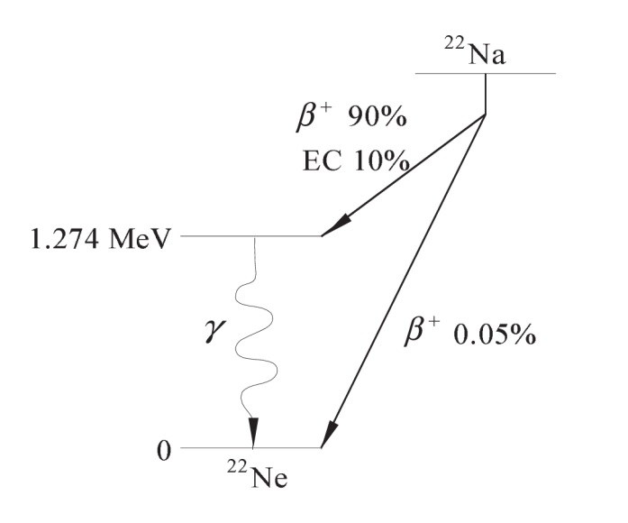
Theoretical section
2. Basics of Positron Annihilation Lifetime Spectroscopy (PALS)
PALS principle is based on the measurement of the lifetime of individual positrons as the time between the implantation of a positron into the sample and its annihilation with an electron
the measurement is usually carried out using a radioactive positron source (most often ²²Na is used) sandwiched between two identical samples using two scintillator detectors, whose signals are processed by a set of analog electronic modules
start signal: 1.274 MeV
stop signal: 0.511 MeV
Decay scheme of ²²Na

Slide 5
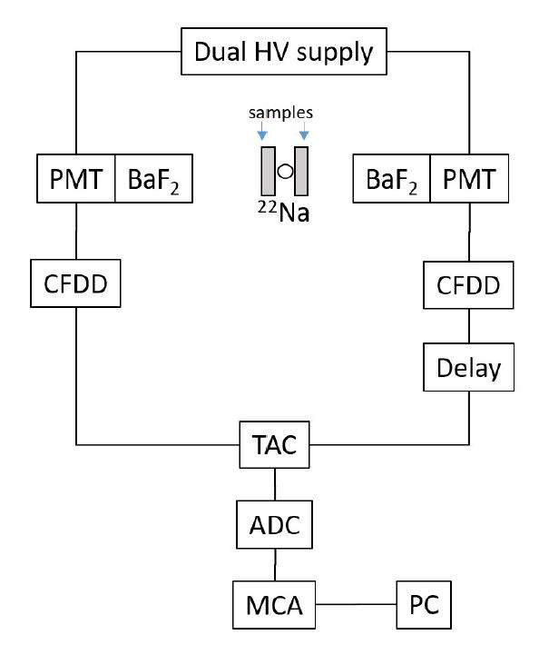
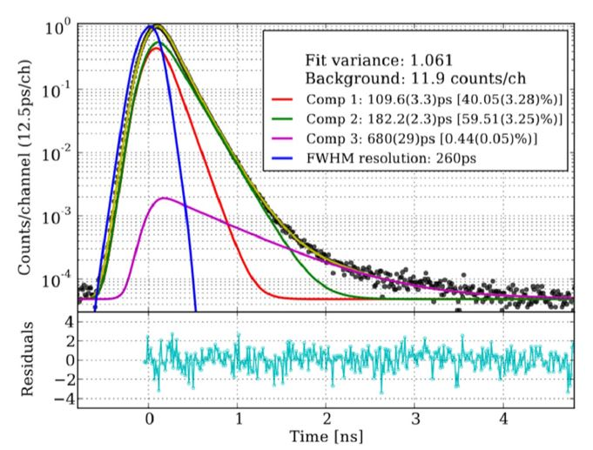
Theoretical section
2.1. Analog Positron Annihilation Lifetime Spectroscopy
Block diagram of analog PALS spectrometer. Legend: HV - high voltage, PMT- photo-multiplier tube, BaF₂ - barium fluoride scintillator, CFDD - constant fraction differential discriminator, TAC - time to amplitude convertor, ADC - analog to digital convertor, MCA - multi channel analyzer, PC - computer
Example of a PALS spectrum (histogram) with deconvoluted spectrometer timing resolution function (a Gaussian, in blue) and positron lifetime components

Slide 6
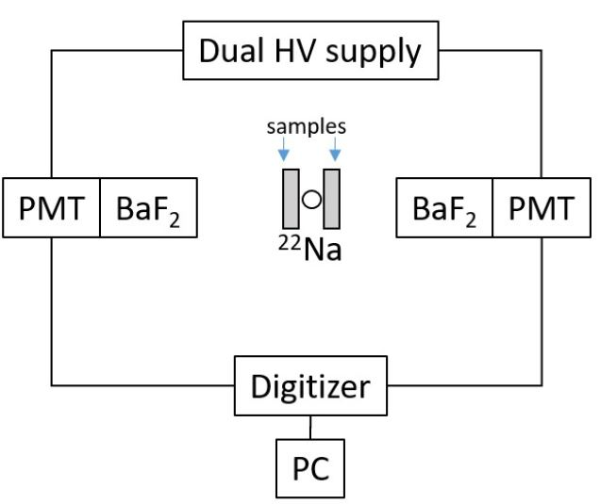
Theoretical section
2.2. Digital Positron Annihilation Lifetime Spectroscopy
Advantages:
a single device is used to detect pulse analysis, timing and energy
better adjustments for baseline fluctuation effects, ballistic deficit and pileup
cabling, size, cost and power consumption are all reduced
calibration and tuning can be done quicker and automatically
filtering is extremely flexible
Drawbacks:
the resolution and the sampling rate can‘t be enhanced without completely replacing the device
it may take longer to learn how to construct the experimental setup, by the reason of that ones should have knowledge about hardware, interfacing software and computer programming
Block diagram of a digital PALS spectrometer

Slide 7
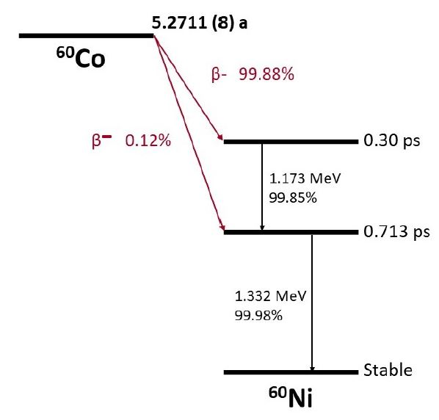
Theoretical section
2.3. Application of ⁶⁰Co for determination of the timing resolution of PALS
by setting the CFDD’s LLD and ULD parameters, a PALS spectrometer can be tuned to work as a gamma-gamma coincidence spectrometer. In this case, the spectrum consists only of the spectrometer timing resolution function
in contrast to ²²Na, no positrons are emitted, so, no positron lifetime components are observed
Simplified decay scheme of ⁶⁰Co

Slide 8
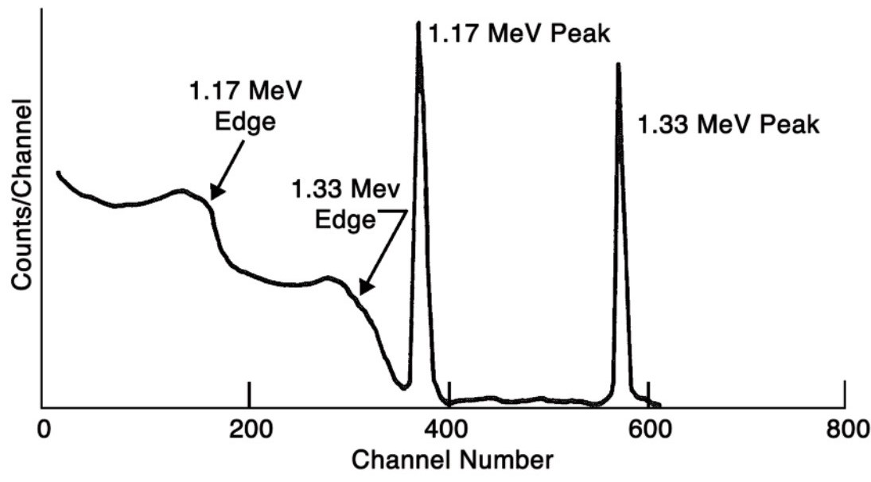
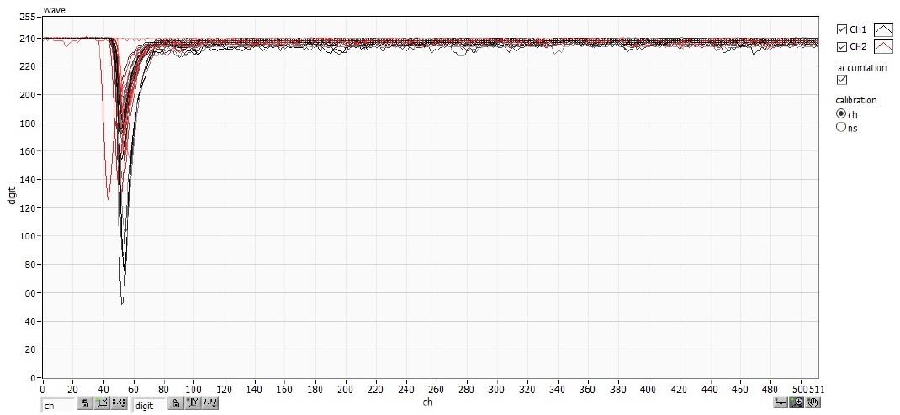
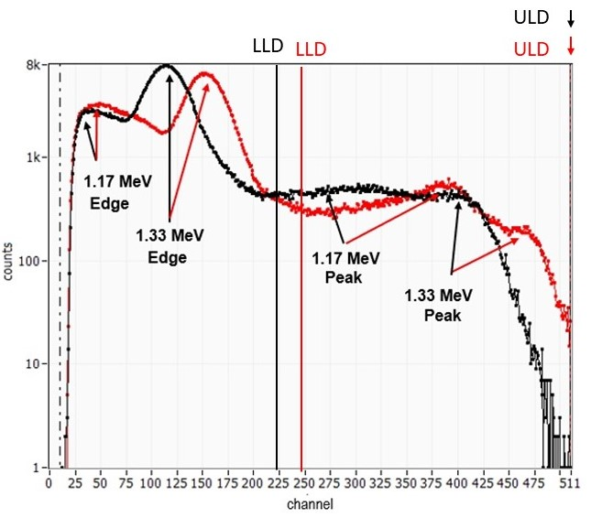
Theoretical section
2.4.1. Photo-multiplier tube signal waveforms (wave mode)
Full energy spectrum of ⁶⁰Co obtained using a HPGe gamma rays spectrometer
used to check the output signal from the scintillators
the signals are negative, because the electrons travel from the negative polarity of the cathode to the grounded anode
Wave mode graph with PMT anode signals from two detectors
Energy spectra of ⁶⁰Co obtained with the two scintillator detectors using PALS equipment at ELI-NP

Slide 9
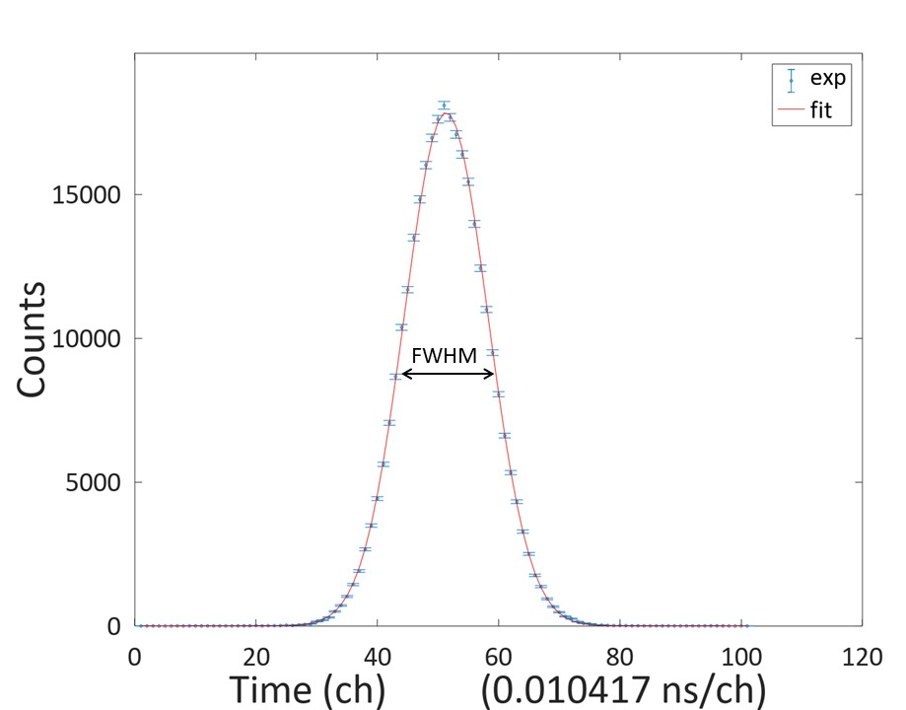
Theoretical section
2.4.2. PALS spectrometry (lifetime mode)
the lifetime mode of the positron annihilation system offers the possibility to obtain the timing resolution of the detectors
the spectrum:
is arranged in the form of a Gaussian
represents a histogram of the time difference between the start timing of CH1 and the stop timing of CH2
timing resolution:
defined as full width at half maximum (FWHM)
indicates the width of a Gaussian measured between two points from the OY axis which are located at the half of the maximum amplitude of this curve
Spectrum obtained by PALS using ⁶⁰Co fitted by a Gaussian

Slide 10
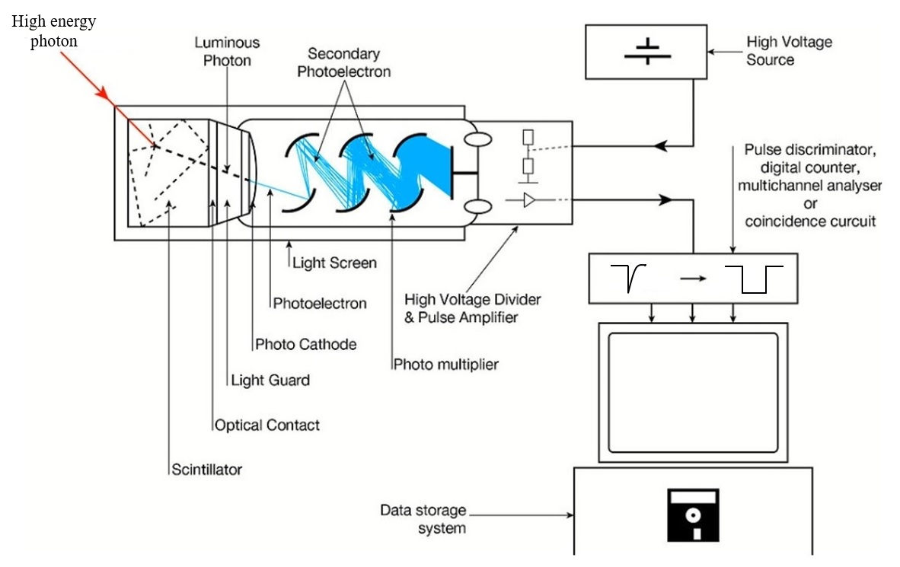
Theoretical section
2.5. BaF₂ scintillator detectors
PMTs are vacuum tubes with extraordinarily high sensitivity, reduced noise and a fast time response
BaF₂ crystals provide crucial characteristics for performing PALS measurements:
high density
short radiation wavelength
short decay time of 600 - 800 ps
the timing resolution of BaF₂ detectors is governed by several variables such as:
surface characteristics and the size of the crystal
coupling between the crystal and the PMT
decay time of the scintillator
light yield
rise time
Scheme of the scintillation process of the PMT

Slide 11
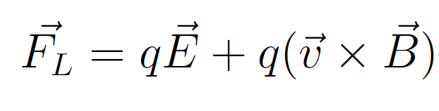
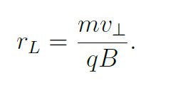
Theoretical section
3. Basics of magnetic field influence on PMT performance
when a charge is passing through the field, the Lorenz force acts on it; the force depends on the particle charge and velocity, and also on the electric and magnetic fields. The expression of the Lorenz force is:
Larmor radius (gyroradius) represents the radius of a helical motion of a particle in magnetic field and has the following expression:
a transversal magnetic field has a significant influence on particle motion
the parallel component of the velocity remains unchanged under the action of the magnetic field
Helical motion of a charged particle within magnetic field

Slide 12
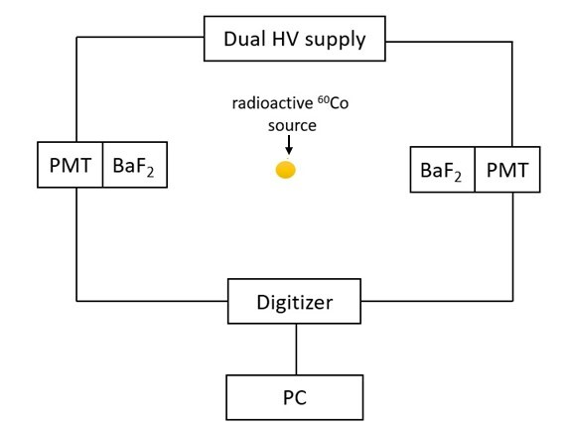
Experimental results
4.1. Timing resolution of scintillators without magnetic field
Experimental set-up configuration
two fast BaF₂ scintillation detectors (Hamamatsu H3378-50 PMT + + transparent BaF₂ crystals) in face-to-face geometry (start – stop signal)
BaF₂ crystals were wrapped with seven layers of teflon tapes
UV transparent silicon oil is utilized to couple the crystal to the PMT
source: ⁶⁰Co (activity = 92.27 kBq; half-life = 5.3 years)
electronics
    high voltage supply: between -1500 and -2200 V
    digitizer
    PC
distance between detectors: 3 - 4 cm
time of the measurement: 1 hour
Block diagram of the digital PALS experimental set-up

Slide 13
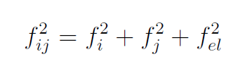
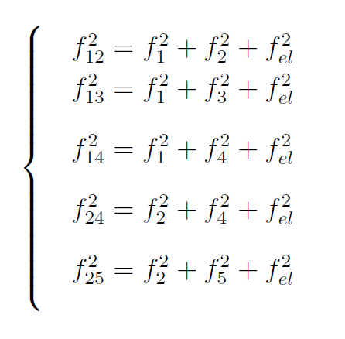
Experimental results
4.1. Timing resolution of scintillators without magnetic field
Experimental set-up configuration
the resulting spectrum has a Gaussian shape and the timing resolution is extracted as the FWHM
f_{ij} = timing resolution of the spectrometer (detector 1, f_{i}, detector 2, f_{j} ,electronics, f_{el})
three unknowns: f_{i}, f_{j} and f_{el}
solution
different combinations with other 3 detectors:
detector 1 - detector 2
detector 1 - detector 3
detector 1 - detector 4
detector 2 - detector 4
detector 2 - detector 5
five equations and six unknowns

Slide 14
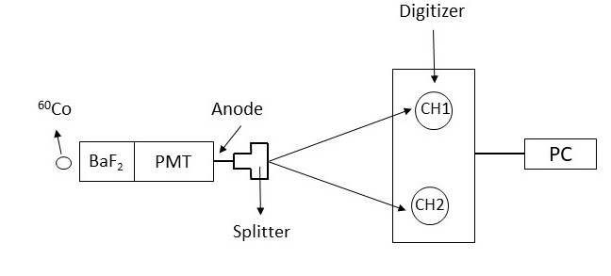
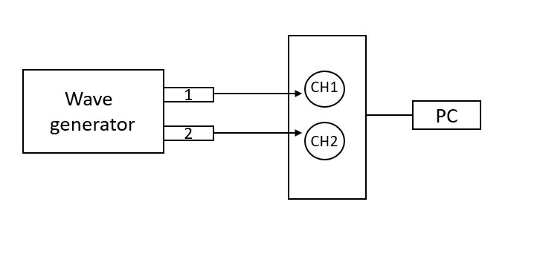
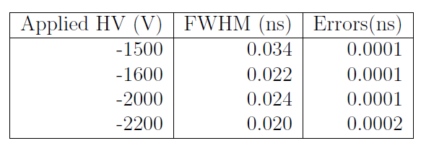
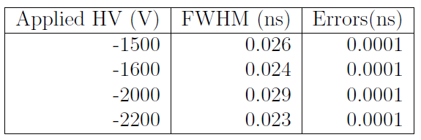
Experimental results
4.1. Timing resolution of scintillators without magnetic field
Results and discussion
to find the values of f_{i} electronics timing resolution, f_{el}, by two methods:
Block diagram of the experimental system, where a PMT anode signal is split into two identical signals
Block diagram of the set-up that generates two synchronized signals, using a pulse generator
a single detector and a passive splitter that divides the anode signal of one PMT into two identical signals used as start and stop
a pulsing function of a wave generator: two artificial and synchronized signals from channel 1 (CH1) and channel 2 (CH2)
Timing resolution values of the electronics and corresponding errors
Timing resolution values of the electronics and corresponding errors
average value: 0.025 ns
average value: 0.0255 ns

Slide 15
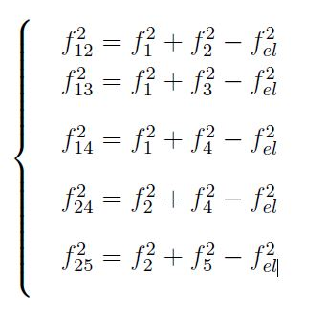
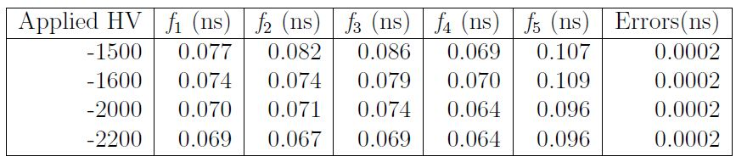
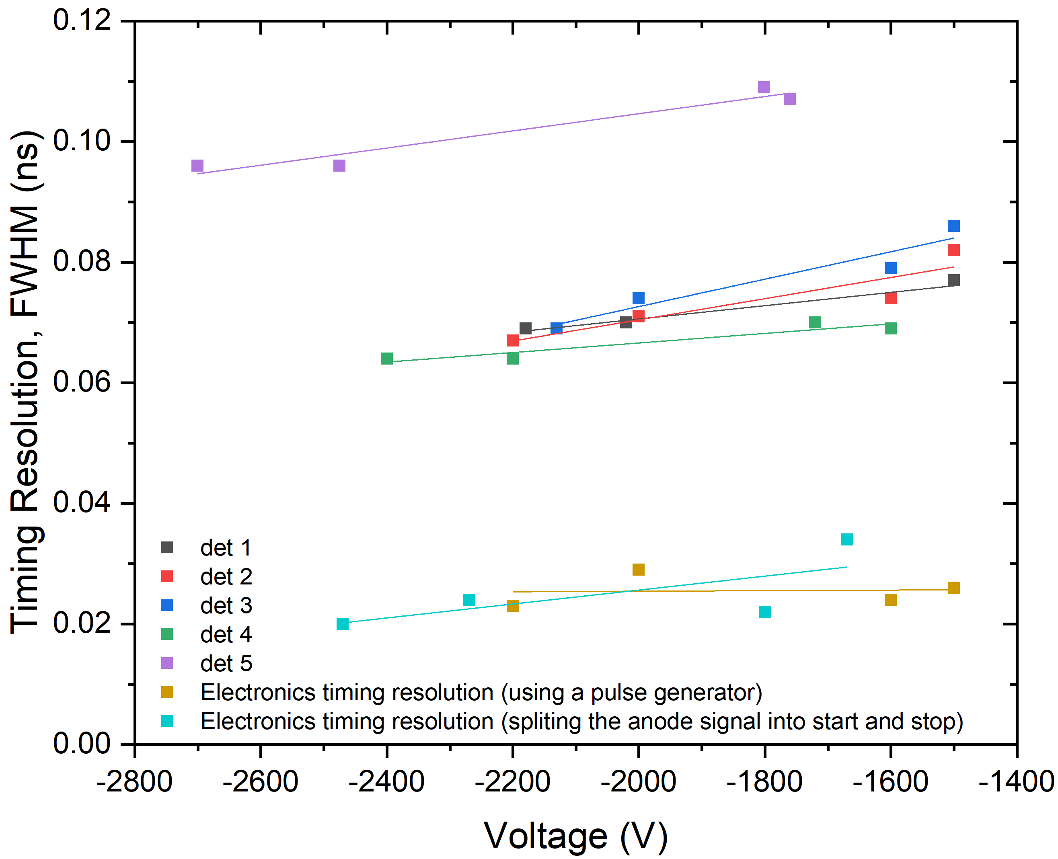
Experimental results
4.1. Timing resolution of scintillators without magnetic field
Results and discussion
|
Individual timing resolution values of gamma detectors and their related errors when high voltage is applied to each PMT
|
f_{i} is obtained using a Matlab code
|
|
f_{el} = 0.025 ns
|
Timing resolution
weak dependence on HV
improves as the magnitude of the applied HV increases
inverse proportional to the dimensions of the crystal
the four identical scintillators: 0.064 - 0.086 ns (good consistency)
the fifth scintillator: 0.096 - 0.107 ns
Timing resolution of detectors and electronics as a function of the HV applied on them; errors < 0.001 ns

Slide 16
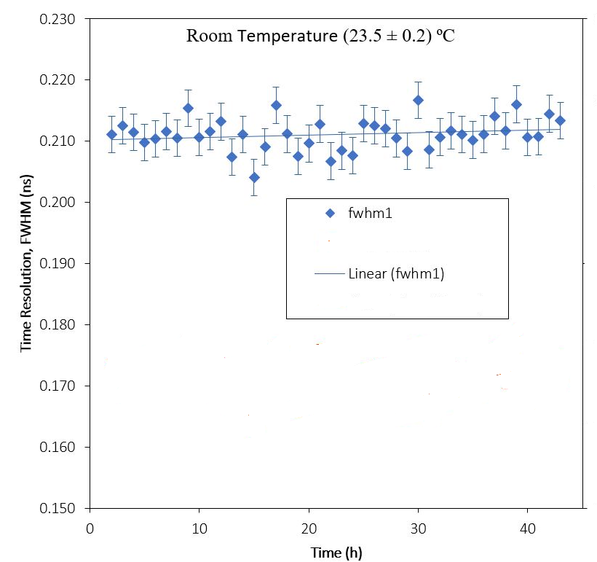
Experimental results
4.1. Timing resolution of scintillators without magnetic field
Results and discussion
Evaluation of the performance of the detector over long periods of time
stability test: 45 hours
experimental room’s temperature: monitored for 2.5 days
the temperature remains approximately constant: 23.5 ± 0.2 ºC
The system is extremely stable over longer periods of time
Advantage: can be used for measurements that require a longer period of time for data accumulation
Example of the system stability of over time

Slide 17
Experimental results
4.2. Influence of magnetic field over timing resolution of detectors
Experimental set-up configuration
two BaF₂ detectors (in yellow):
aligned longitudinally / transversely to the beam axis
used in two different positions, under the influence of longitudinal or transversal magnetic field
source: ⁶⁰Co inside the chamber at half distance between the detectors
Helmholtz coils
identical circular magnetic coils
transversely arranged around the equipment
distance between them = radius of the coil
consequence: the solenoids create a magnetic field that is not uniform
3D model and photo of the PALS set-up at ELI-NP with detectors placed in magnetic field.

Slide 18
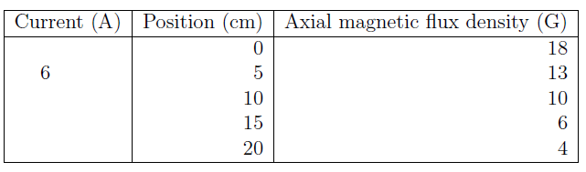
Experimental results
4.2. Influence of magnetic field over timing resolution of detectors
Experimental set-up configuration
Results
Field strength measurements with the Gauss-meter:
different distances from the center of the interaction chamber wall
the position of 0 cm represents the wall of the chamber
the point of measurement increased with an increment of 5 cm up to 20 cm
current: 6 A
Field strength gradient values measured with the Gauss-meter at different distances from the center of interaction chamber wall, with current at 6 A
the field gradient is inverse proportional to the distance from the center of the interaction chamber wall
Helmholtz coils generate a field up to 37 G in the center of the PALS chamber
3D model and photo of the PALS set-up at ELI-NP with detectors placed in magnetic field

Slide 19
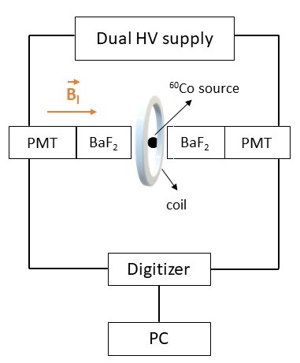
Experimental results
4.2.1. Influence of longitudinal magnetic field over timing resolution of detectors
Experimental set-up
two fast BaF₂ scintillation detectors (Hamamatsu H3378-50 PMT + transparent BaF₂ crystals) in face-to-face geometry (start – stop signal)
electronics
    high voltage supply: between -1500 and -2670 V
    digitizer
    PC
source: ⁶⁰Co (activity = 92.27 kBq; half-life = 5.3 years)
distance between detectors: 3 - 4 cm
coil (uniform magnetic field) parallel to the axis of the detectors
longitudinal magnetic field (B_{l}) propagates along the axis of the detectors
Gauss-meter (accuracy ≈0.1 G) to determine the strength of the magnetic field
time of the measurement: 1 hour
Block diagram and photo of the experimental set-up in longitudinal magnetic field

Slide 20
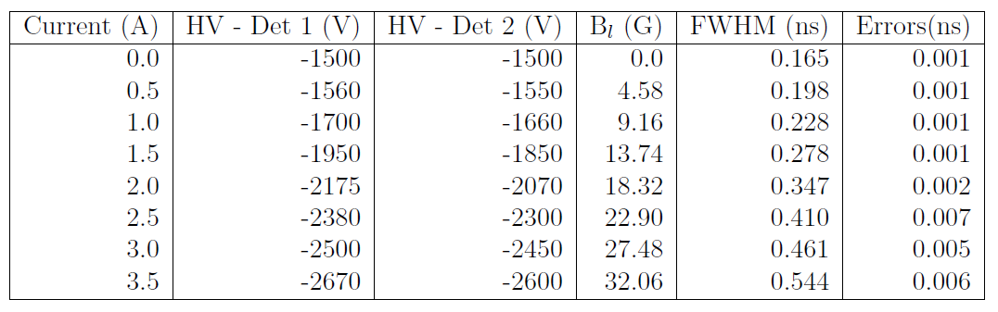
Experimental results
4.2.1. Influence of longitudinal magnetic field over timing resolution of detectors
Results and discussion
Timing resolution values of the spectrometer and characteristic errors determined by applying different currents to solenoids and different high voltage to PMTs
The timing resolution value increases when the magnetic flux density is increased
Timing resolution of the spectrometer with detectors placed in longitudinal magnetic field as a function of the magnetic flux density

Slide 21
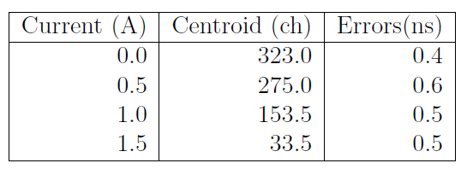
Experimental results
4.2.1. Influence of longitudinal magnetic field over timing resolution of detectors
Results and discussion
Energy spectra:
to determine the strongest and the weakest signals of the detectors
HV applied on PMTs: -1500 V
current: increased with an increment of 0.5 A
time of the measurement: 1.5 hours.
The centroid where the strongest signal of PMT is registered at different values of the current applied to the solenoids
The full energy spectra are obtained at different current values applied to the solenoids
The strongest signal of the detectors corresponds to 0 A and the weakest to 1.5 A

Slide 22
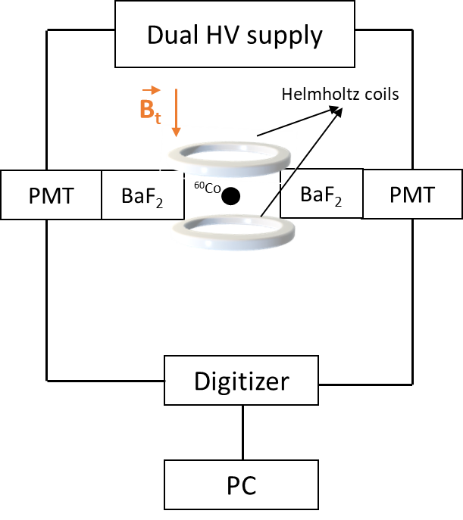
Experimental results
4.2.2. Influence of transversal magnetic field over timing resolution of detectors
Experimental set-up
two fast BaF₂ scintillation detectors (Hamamatsu H3378-50 PMT + transparent BaF₂ crystals) in face-to-face geometry (start – stop signal)
electronics
    high voltage supply: between -1500 and -1900 V
    digitizer
    PC
source: ⁶⁰Co (activity = 92.27 kBq; half-life = 5.3 years)
distance between detectors: 3 - 4 cm
2 Helmholtz coils:
one on top of each other
no longer uniform magnetic field
perpendicular to the axis of the detectors
transversal magnetic field (B_{t}) propagates perpendicular the axis of the detectors
Gauss-meter (accuracy ≈0.1 G) to determine the strength of the magnetic field
time of the measurement: 1 hour
Block diagram and photo of the experimental set-up in transversal magnetic field

Slide 23
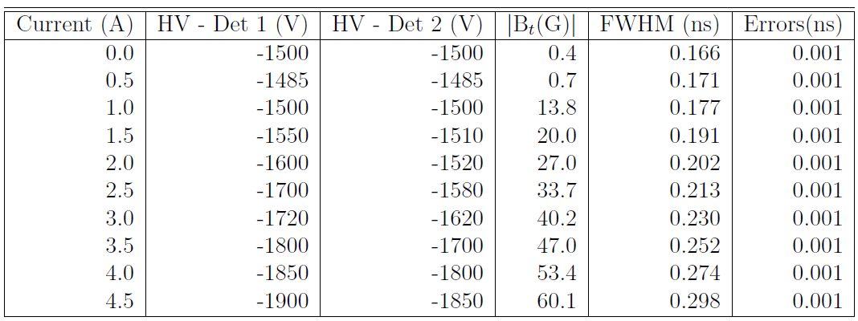
Experimental results
4.2.2. Influence of transversal magnetic field over timing resolution of detectors
Results and discussion
Timing resolution values of the spectrometer and characteristic errors determined by applying different currents to solenoids and different high voltage to PMTs
The timing resolution value increases when the magnetic flux density is increased
Explanation: the helical motion of the charged particles inside the PMTs deteriorates their performance and their timing resolution values
Timing resolution of the spectrometer with detectors placed in transversal magnetic field as a function of the magnetic flux density

Slide 24
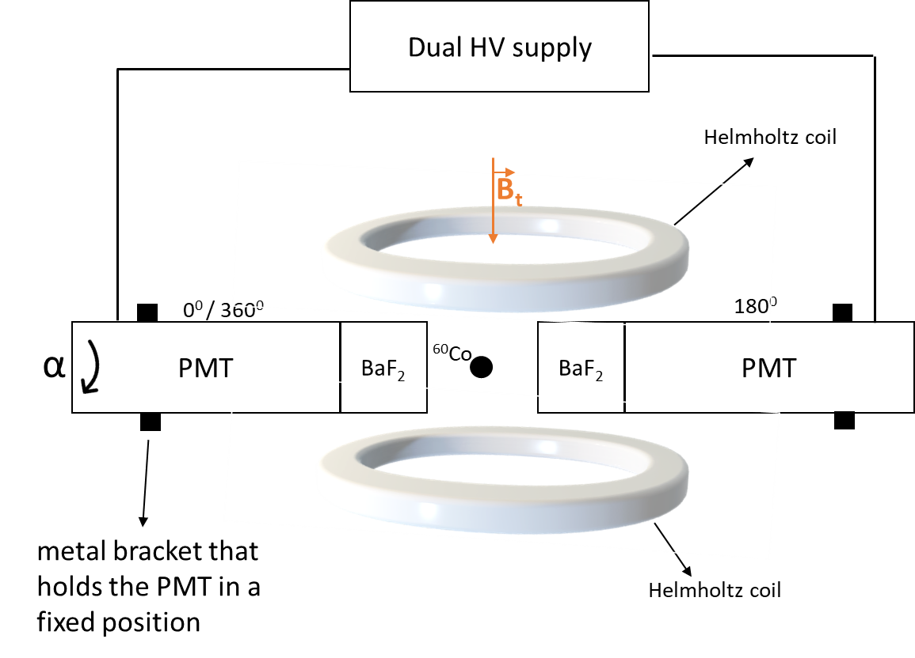
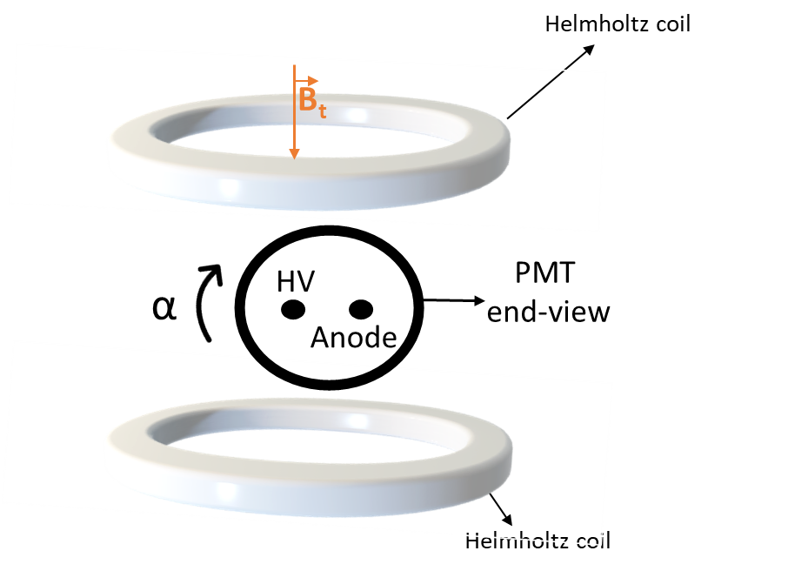
Experimental results
4.2.2. Influence of transversal magnetic field over timing resolution of detectors
Results and discussion
two fast BaF₂ scintillation detectors in face-to-face geometry (start – stop signal)
electronics
high voltage supply: between -1850 (detector 1); -1900 V (detector 2)
    digitizer
    PC
source: ⁶⁰Co (activity = 92.27 kBq; half-life = 5.3 years)
distance between detectors: 3 - 4 cm
2 Helmholtz coils:
one on top of each other
no longer uniform magnetic field
perpendicular to the axis of the detectors
transversal magnetic field (B_{t}) propagates perpendicular to the axis of the detectors
PMTs:
held in a fixed position by metal brackets
individually rotated with an α angles along their axis: one detector is fixed at 0⁰ angle; the other detector is rotated ( 0⁰, 45⁰, 90⁰, 180⁰, 270⁰ and 315⁰), until it gets back in the initial position (0⁰ or equivalently 360⁰)
time of the measurement: 1.5 hours
(a) diagram of the experimental set-up when the PMT is rotated with different α angles along its axis (b) PMT back-side view

Slide 25
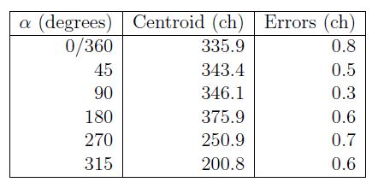
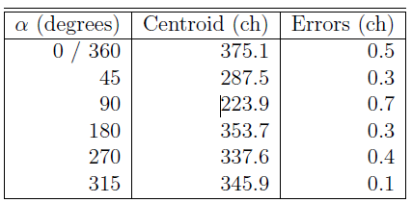
Experimental results
4.2.2. Influence of transversal magnetic field over timing resolution of detectors
Results and discussion
Energy spectra:
The centroid of the peaks obtained from the energy spectra and corresponding errors when the α rotation angles of the detector 1 varied and detector 2 is fixed
the configuration at which the strongest signal of detector 1 is obtained corresponds to 180⁰ and the weakest signal to 315⁰
configuration at which the strongest signal is registered by detector 2 corresponds 0⁰ and the weakest signal to 90⁰
The strongest and the weakest signals correspond to different rotation angles
The spectrometer timing resolution is obtained for the best and worse orientations, showing a FWHM value of 0.293 ns and 0.384 ns
The PMTs need individual optimization of the axial angle in order to make use of their best performances
The centroid of the peaks obtained from the energy spectra and corresponding errors when the α rotation angles of the detector 2 varied and detector 1 is fixed

Slide 26
5. Conclusions
the experiments present an attempt to reproduce how the timing resolution of the detectors performs within and without magnetic fields to have preliminary data about how the PALS system at ELI-NP will perform in magnetic field
Without magnetic field
the detectors timing resolution, FWHM, as a function of the voltage applied on PMTs, showed a linear improvement. The timing resolutions of the four detectors with identical scintillators fall between 0.064 and 0.086 ns. Their similar timing resolution indicates a good consistency among them. The fifth detector with the BaF₂ scintillator has a worse timing resolution that corresponds to 0.096 - 0.107 ns
the system presents an excellent stability over longer periods of time
Within magnetic field
timing resolution values increase with the magnetic flux density when the detectors are placed in longitudinal magnetic field. The results showed that at axial magnetic flux density of 37 G, the timing resolution of the spectrometer is worsen to 0.544 ns, which is not applicable for practical PALS measurements
the strongest signal of the detectors placed in longitudinal magnetic field corresponds to 0 A and the weakest to 1.5 A
introducing the detectors in transversal magnetic field, it is observed a worsening of the timing resolution with the magnetic flux density, but at a lower extend. The helical motion of the charged particles within magnetic field deteriorates the PMTs performance and, by default, their timing resolution values
in transversal magnetic field, the configuration at which the strongest signal of detector 1 is obtained corresponds to 180⁰ and the weakest signal to 315⁰ and for detector 2 corresponds to 0⁰ and the weakest signal to 90⁰
the spectrometer timing resolution is obtained for the best and worse orientations, showing FWHM at 0.293 ns and 0.384 ns correspondingly

Slide 27
Thank you!

