Slide 1
Spontaneous fission prompt neutron multiplicity distributions. Restoring techniques, its advantages and limitations.
Roman Mukhin
JINR FLNR, Dubna, Russia
AYSS-2022

Slide 2
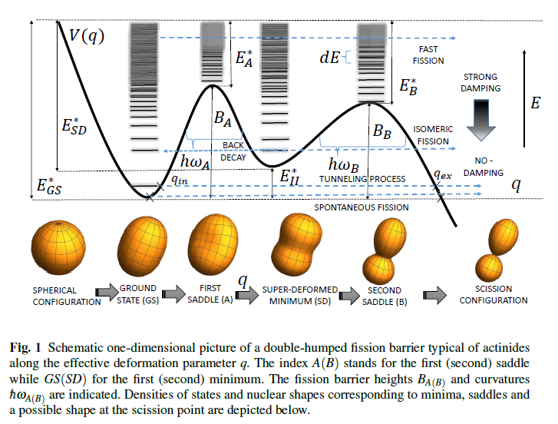
Spontaneous Fission process
Main characteristics of SF:
• Fragment mass distribution
• TKE spectrums of fragments
• Prompt neutrons multiplicity distribution
• Prompt gamma energy spectra and multiplicity distribution
Illustration from: Kowal, M. and Skalski, J. The Fission Barrier of Heaviest Nuclei From a Macroscopic-Microscopic Perspective

Slide 3
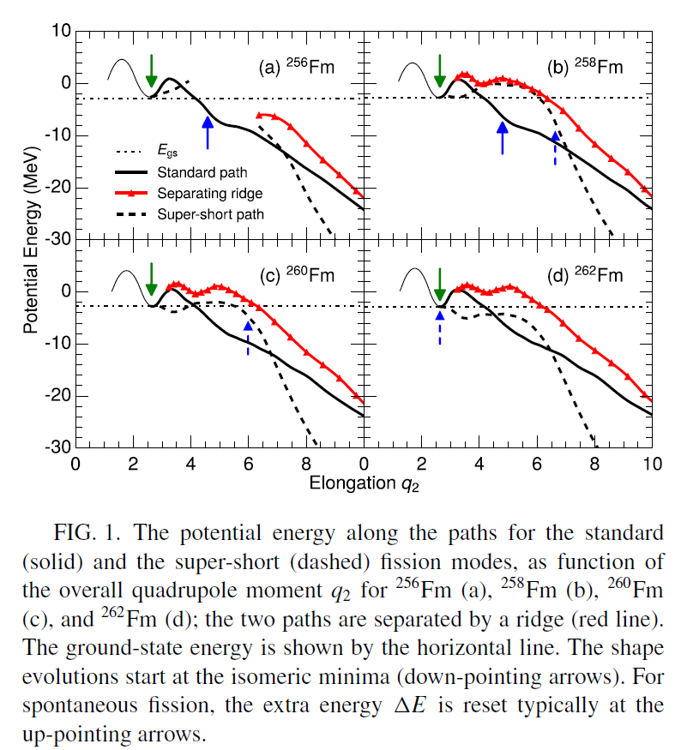
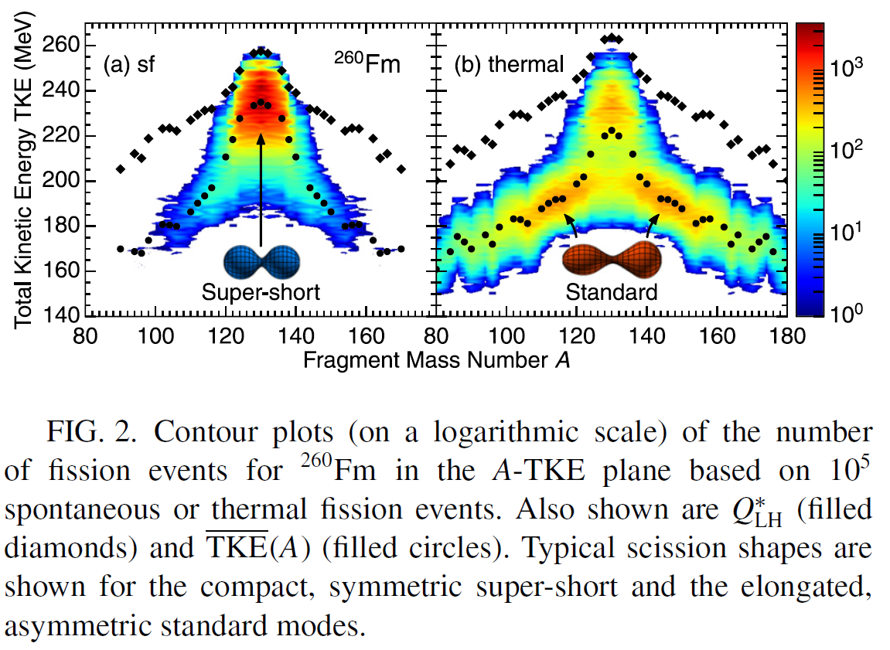
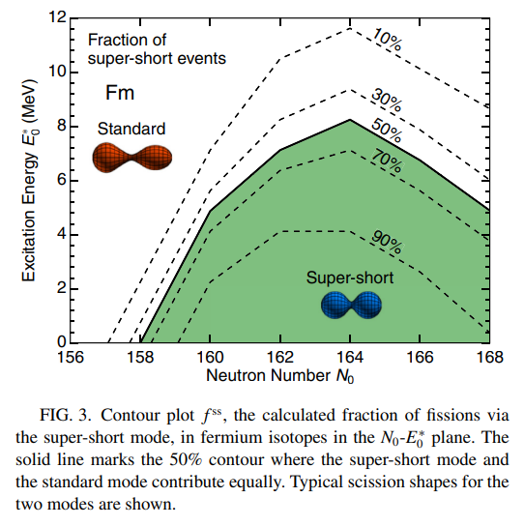
Neutrons multiplicity as an information about fission process
• Average number of emitted neutrons helps to restore energy balance equation of the spontaneous fission process
• Variance of the emitted neutrons multiplicity distribution can be used to estimate variance of fragments excitation energy
• Neutron multiplicity distribution shape is able to point at possible exotic modes of spontaneous fission.
M. ALBERTSSON et al., PHYSICAL REVIEW C 104, 064616 (2021)

Slide 4
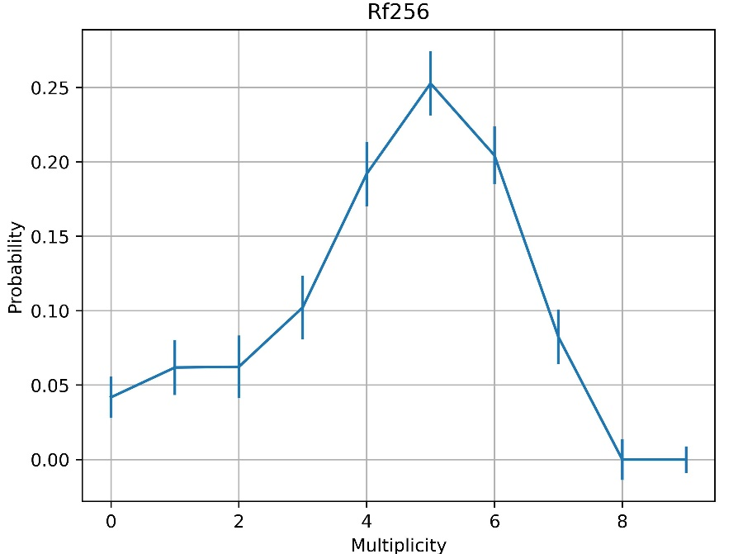
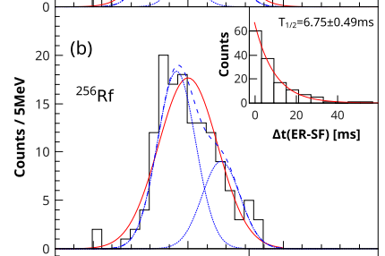
Evidences of exotic SF modes
Symmetrical distribution – nothing exotic
Asymmetrical distribution
P. Mosat, et al., PHYSICAL REVIEW C 101, 034310 (2020)

Slide 5
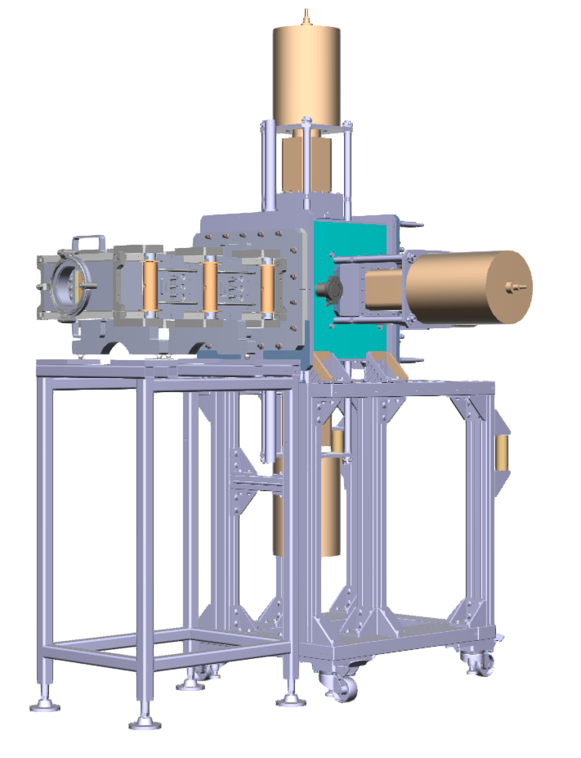
Experimental setup
• Velocity filter SHELS – electromagnetic separator
• Detecting systems:
GABRIELA for $α−, β−, γ−$spectroscopy
SFiNx for Spontaneous fission

Slide 6
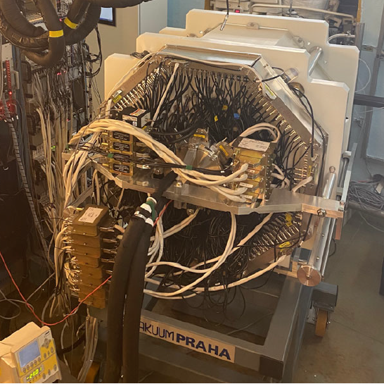
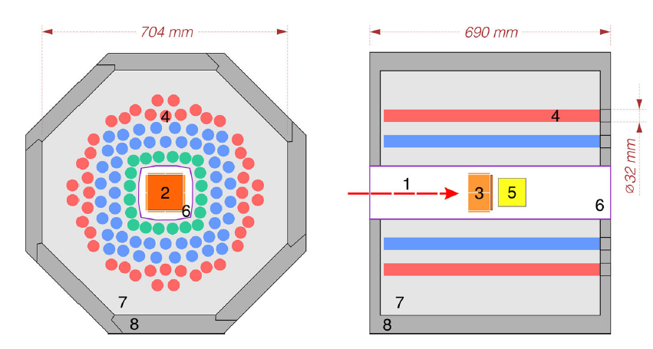
Neutrons ³He detector array
• To detect:
Neutrons
Prompt gamma-ray of spontaneous fission
• What is measured
Neutrons multiplicity
Two coordinates of counter that registered the neutron
• Spontaneous fission identification:
BGO detector to detect prompt gamma rays of spontaneous fission

Slide 7
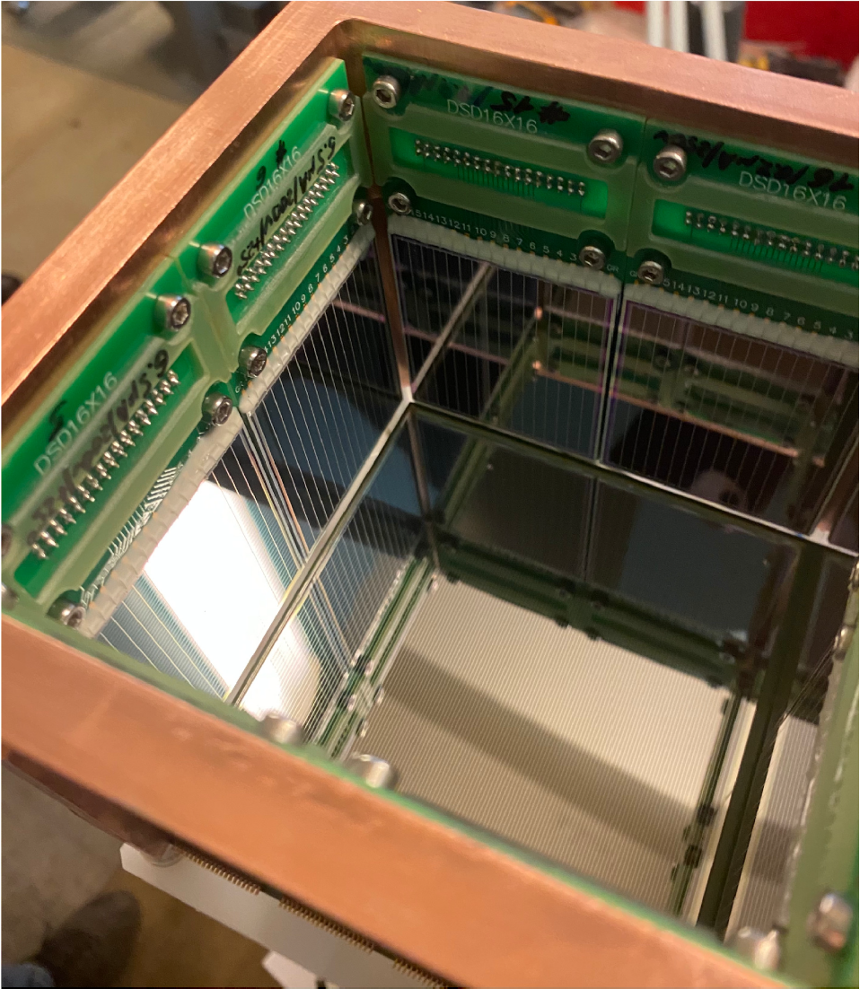
DSSD detectors box
• To detect particles emitted in decays or reactions of unstable nuclei:
Evaporation residue in complete fusion reactions
Alphas
Betas and conversion electrons
Protons
Fission fragments
• What is measured:
Energy
Emission time
Emission coordinates

Slide 8
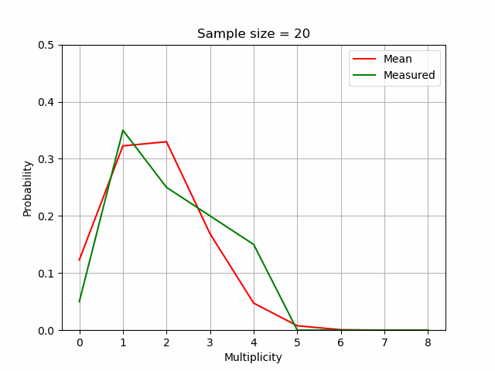
How detector affects the data
Dependence on the single neutron registration efficiency
Dependence on the data size

Slide 9
Restoring technique
• Due to detectors efficiency is far from 100% the measured distribution is heavily distorted.
• Let’s assume that registered number of neutrons is a random variable that follows the binominal distribution.
$n$ – maximum neutrons multiplicity
$x∈ℝ^{1, n}$ – real prompt neutrons multiplicity distribution vector
$K∈ℝ^{n,n}$ – detector response matrix
$ε$ – single neutron registration efficiency
$K_{i,j}=\frac{j!}{i!\left(j−i\right)!}ε^{i}{\left(1−ε\right)}^{j−i}$
$y∈ℝ^{1, n}$ – measured prompt neutrons multiplicity distribution vector
$y=Kx$
$x_{d}={\left(K^{T}K\right)}^{−1}Ky$ – direct solution of the problem
• Direct solution doesn’t make sense in most cases where the noise level (including statistical uncertainties) is quite high.

Slide 10
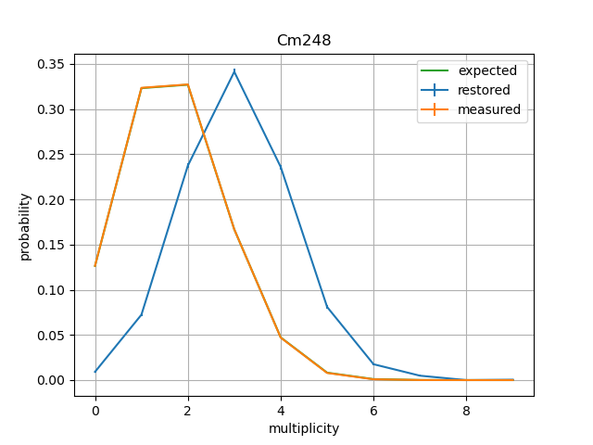
Direct solution examples
1 357 s.f. events
845 224 s.f. events
Single neutron registration efficiency $≈56\%$

Slide 11
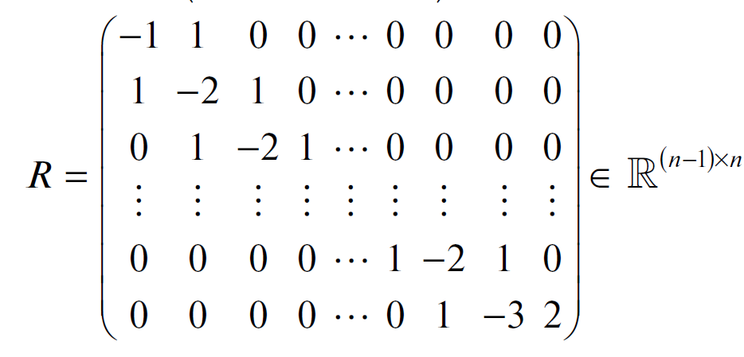
Regularization method
• The essence of the method is to use a priori information to find an approximate solution.
• Using a prior information:
Distribution is smooth
Distribution is flat at tails
• Regularization matrix:
• Regularized solution: $x_{r}={\left(L^{T}L+αs^{2}R^{T}R\right)}^{−1}L^{T}g$
$L\sim K;g\sim y$
$s=\sqrt[n]{\prod_{0}^{n}{s_{i}}};where s_{i} are uncertainties of the measured distribution$
$α$ – regularization parameter
$σ^{2}=s^{2}diag({\left(L^{T}L+αs^{2}R^{T}R\right)}^{−1})$ – uncertainties of regularized solution
R. Mukhin, et al., Physics of Particles and Nuclei Letters, 2021, V 18, 4, p 439

Slide 12
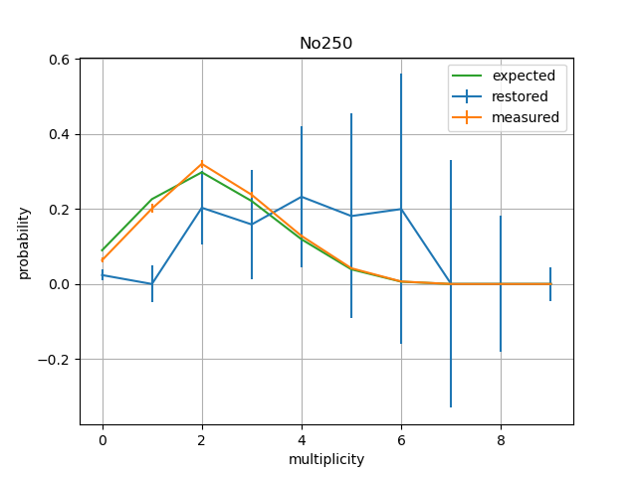
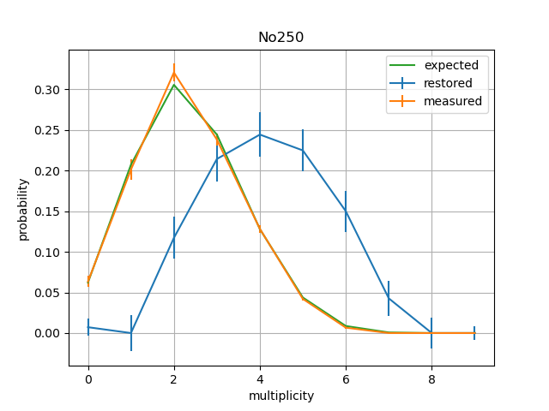
Restoring examples
$$α=89$$
$$α=89$$

Slide 13
Choice of regularization parameter
•Let’s define shape loss function as:
$loss\left(α\right)={\left\|<K,x_{r}\left(α\right)>−y\right\|}_{2}^{2}$
• We can choose regularization parameter as follow:
$α=argmin_{α}loss(α)$
• There is a risk to oversmooth the solution

Slide 14
Experimental results
•^{244, 248} Cm
• ²⁵²Cf
• ²⁴⁶Fm
• ^{250, 252, 254}No
• ²⁵⁶Rf

Slide 15
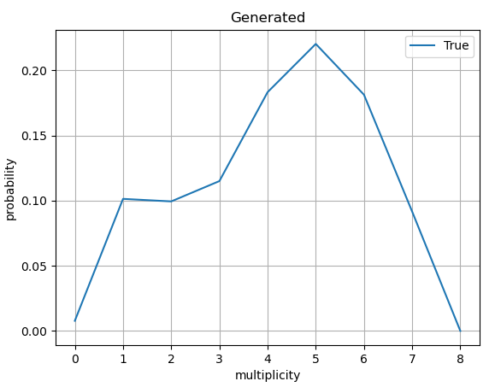
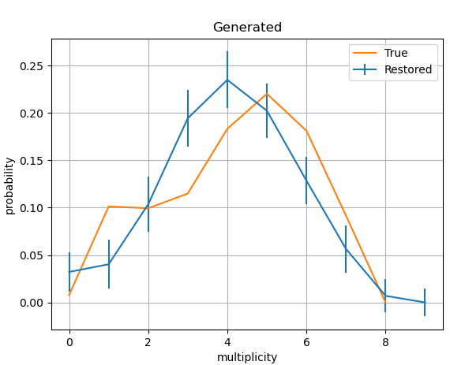
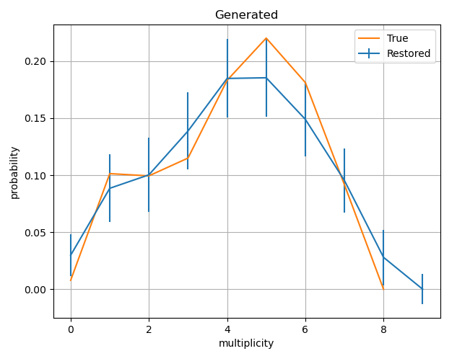
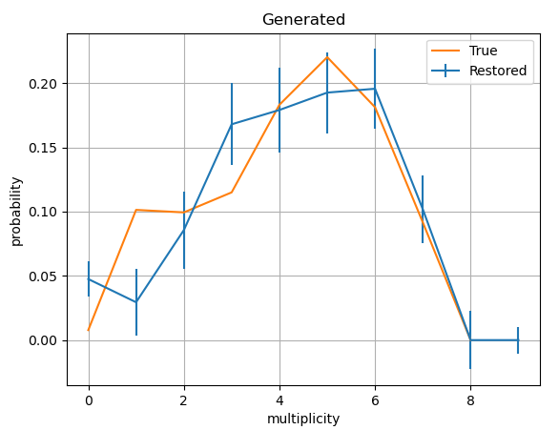
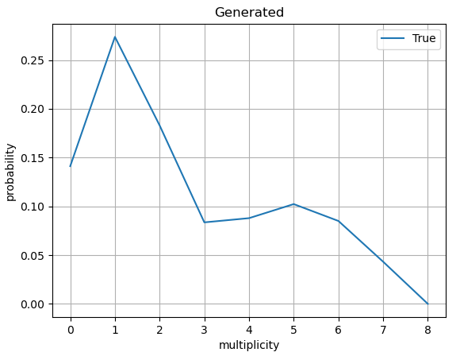
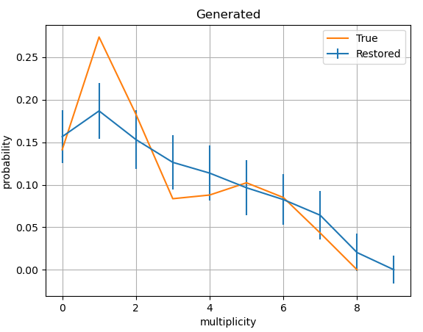
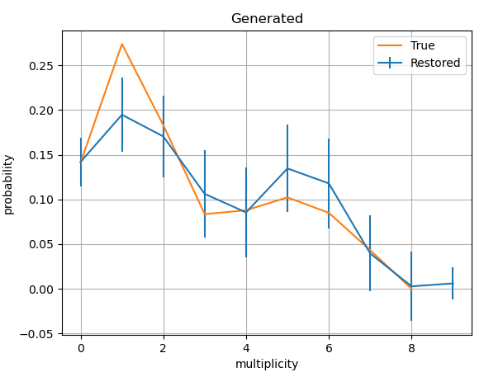
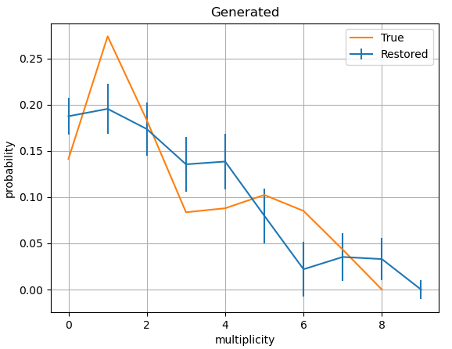
Why classic regularization is not enough?
True
Sample size = 250
Sample size = 500
Sample size = 1000

Slide 16
Possible improvements
Adding an equation describing mean value:
$\sum_{i}{y_{i}∗i}=ε$
$\sum_{i}{y_{i}}=1$
We will compare the next solution with a classic approach solution:
$x_{classic}={\left(K^{T}K\right)}^{−1}Ky$ ;
$x∈ℝ^{1, n}$, $K∈ℝ^{n, n}$,$y∈ℝ^{1, n+1}$
After adding an information about mean:
$x_{mean}={\left(K_{1}^{T}K_{1}\right)}^{−1}K_{1}^{T}y_{1}$ ;
$x∈ℝ^{1, n}$, $K_{1}∈ℝ^{n+1, n}$, $y_{1}∈ℝ^{1, n+1}$
Adding an equation describing the variance:
• Finding variance is a nonlinear problem.
• We can transpose that to linear problem by adding all possible monomials of power of 2 as an independent variables
• $\left[x_{1},x_{2},…,x_{n}\right]→$
$\left[x_{1},…,x_{n}, x_{1}^{2},…x_{n}^{2},x_{1}x_{2},…,x_{1}x_{n},…,x_{n−1}x_{n}\right]$
• After adding an information about mean and variance:
$x_{mean_var}={\left(K_{2}^{T}K_{2}\right)}^{−1}K_{2}^{T}y_{2}$ ;
$x∈ℝ^{1, n}$, $K_{2}∈ℝ^{m+2, n}$, $y_{2}∈ℝ^{1, m+2}$ , $m=\frac{n^{2}+3n}{2}$

Slide 17
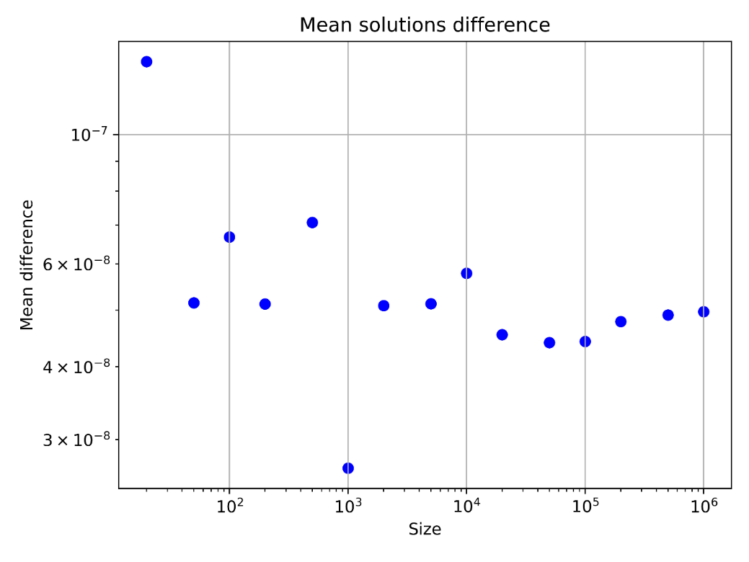
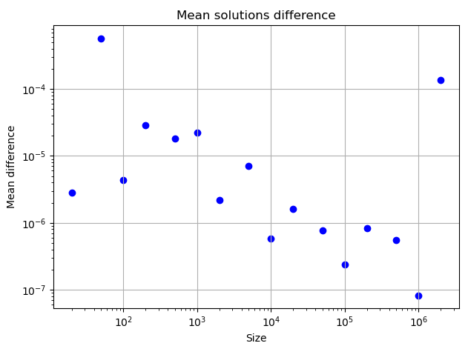
Possible improvements
Adding an equation describing mean value:
Adding an equation describing the variance:
There is no practically significant difference between methods results.

Slide 18
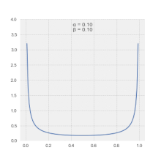
Bayesian approach
• Since we are looking for probabilities, why not use a probabilistic model?
• Bayesian models are often used in Data Science
• Practical examples show that Bayesian models work better than deterministic ones for small statistics
• It is possible to use more powerful prior information
• The Bayesian models are more complex than classical regularization technique
• We prefer to use beta-distribution prior (conjugated with binominal one)
• The technique still in progress.
Betta-distribution

Slide 19
Summary and outlook
• Using restoring technique it possible to analyze not just moments of distribution (mean and variance) but shapes too.
• Using the direct solution from Least Squares Problem doesn’t make sense in most of cases because of noisy data.
• The regularization technique allows to catch the exotic modes of spontaneous fission but it is difficult to analyze them in details.
• The next complication of the regularization technique (adding an information about the mean and variance) doesn’t significantly increase a power of the method.
• The probabilistic reconstruction technique that based on Bayesian approach is under development.

Slide 20
Thank you for your attention!
Contact: rmukhin@jinr.ru

