Slide 1
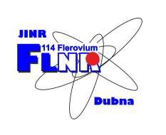
K. Berestov, S. Bogomolov, K. Kuzmenkov
Jinr, Dubna, Moscow Region, Russia
Investigation of characteristics of 2.45 GHz ECR ion source

Slide 2
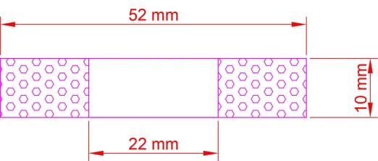
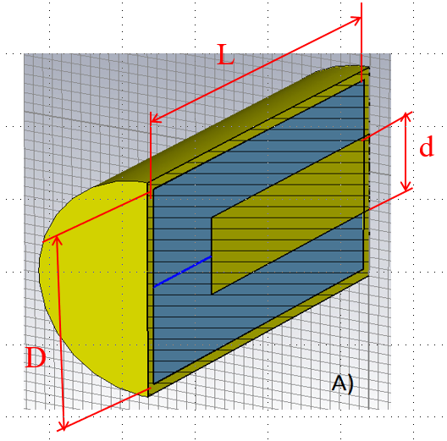
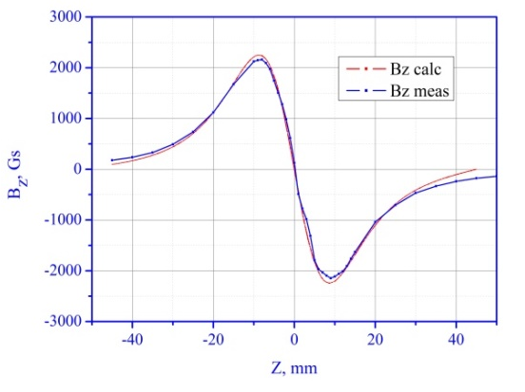
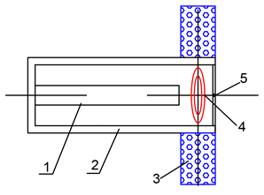
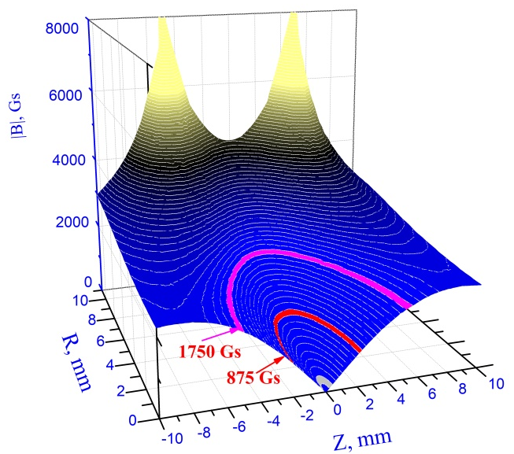
The concept of compact 2.45 GHz ECR ion source based on a coaxial resonator
Permanent magnet ring
Coaxial resonator
1 - central conductor of a coaxial resonator;
2 - resonator casing;
3 - magnetic ring;
4 - closed lines of the magnetic field;
5 - extraction hole.
L = λ/4 (~ 3 cm)
D/d = 2.3 (50 Ω)

Slide 3
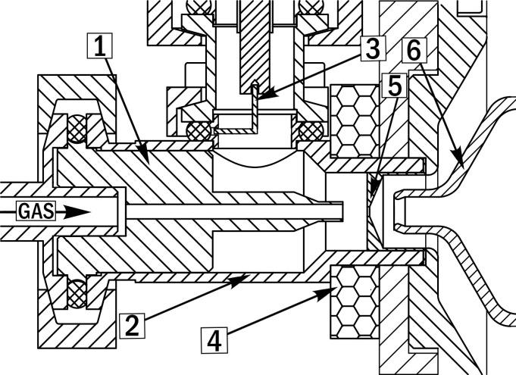
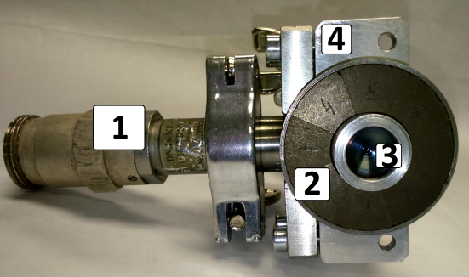
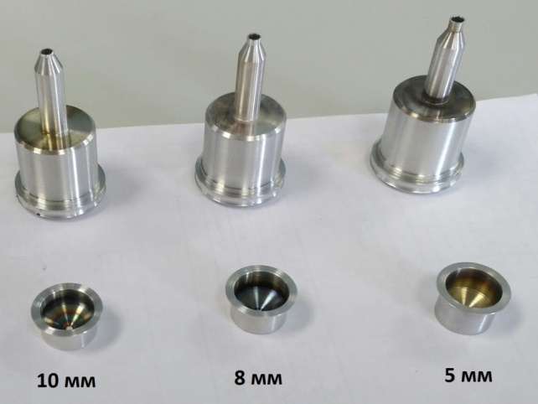
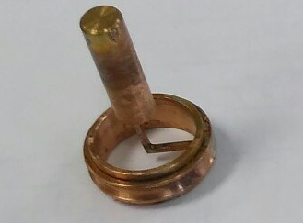
Compact 2.45 ECR development
Design of the source
1 - replaceable internal part of the resonator
2 – resonator casing
3 – coupling loop
4 – permanent magnet ring
5 - replaceable plasma electrode
6 - pulling electrode
Assembled ion source
Replaceable parts providing gap sizes of 5, 8 and 10 mm
View of coupling loop
1 – N-type coaxial feedtrough, 2 – permanent magnet ring,
3 – plasma electrode, 4 – resonator casing

Slide 4
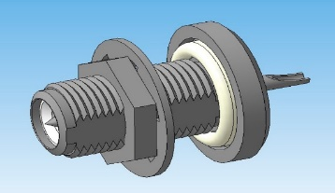
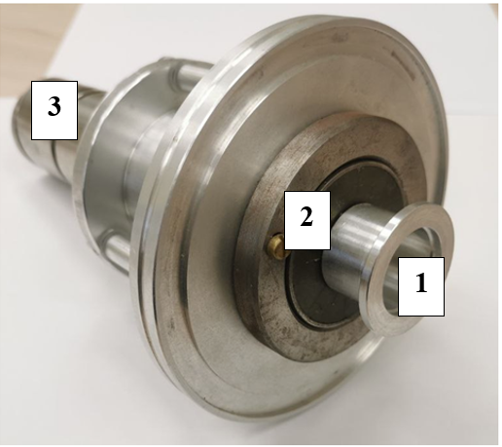
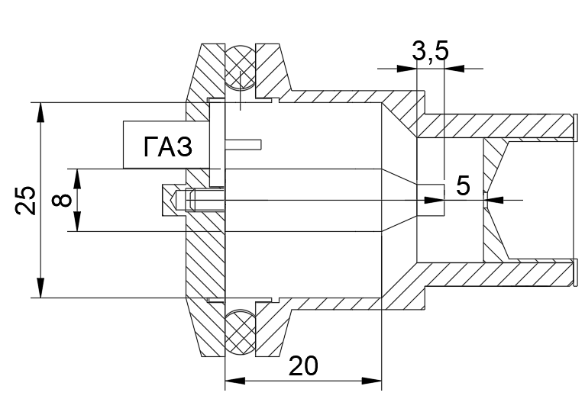
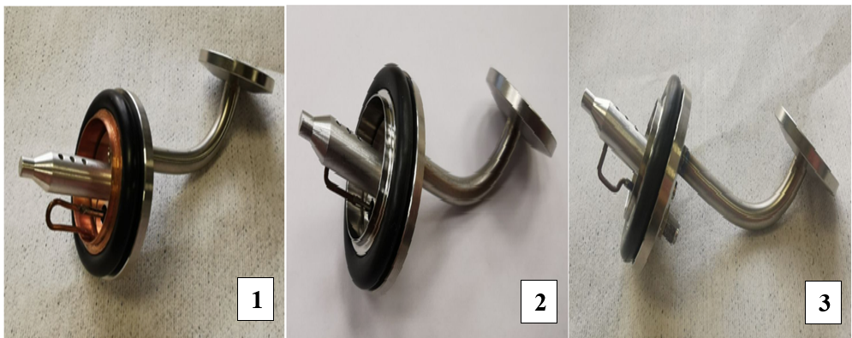

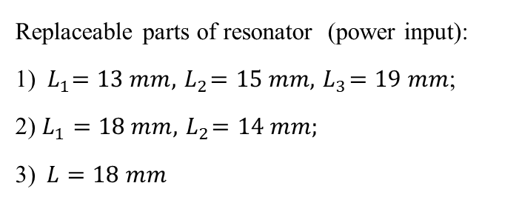

Compact 2.45 GHz ECR ion source
FLNR JINR (Dubna)
ECR-source
SMA-type coaxial feedthrough
1 – resonator casing (plasma cavity);
2 – permanent magnet ring;
3 – pulling electrode
Design of the source
Replaceable parts of resonator (power input):
1) ${ L}_{1}=13 mm, { L}_{2}=15 mm, { L}_{3}=19 mm$;
2) $L_{1}=18 mm, { L}_{2}=14 mm;$
3)$L=18 mm$
$$L$$
$$L$$
$$L$$
$L$ – length of the coupling loop

Slide 5
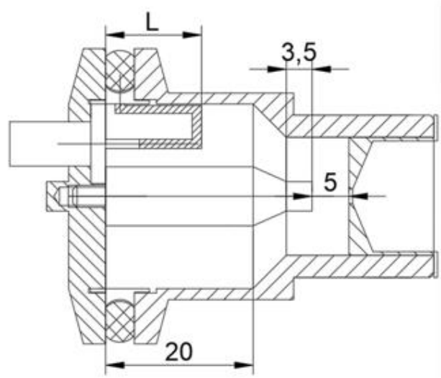
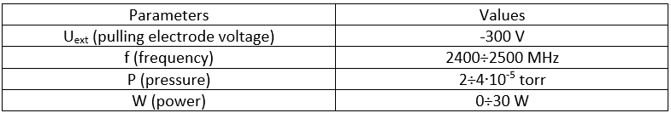
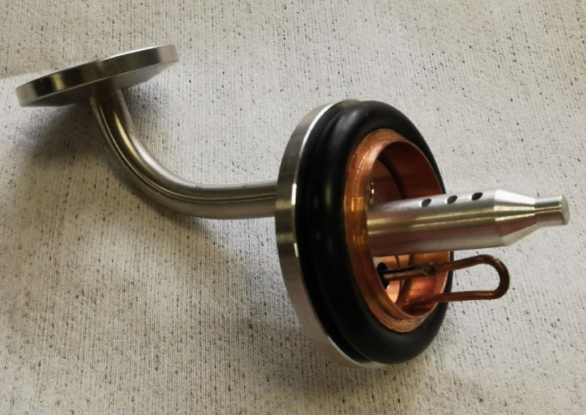
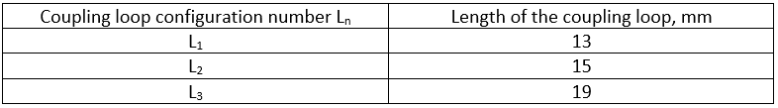
Ion source testing with power input configuration №1
Design of the source with configuration of UHF coupler №1 and photo of power input with coupling loop configuration №1

Slide 6
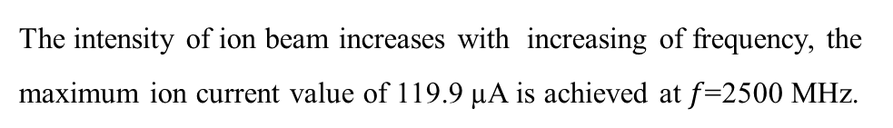
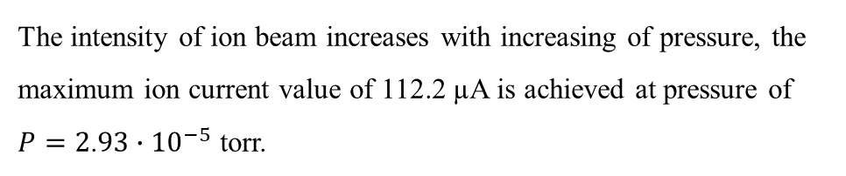
Ion source testing with power input configuration №1 $I\left(P\right)$ $I\left(f\right)$
He⁺ ion current $I$ as a function of pressure P
He⁺ ion current $I$ as a function of UHF $f$
The intensity of ion beam increases with increasing of pressure, the maximum ion current value of 112.2 µA is achieved at pressure of $P=2$.$93∙{10}^{−5}$ torr.
The intensity of ion beam increases with increasing of frequency, the maximum ion current value of 119.9 µA is achieved at $f\text{=2500}$ MHz.

Slide 7
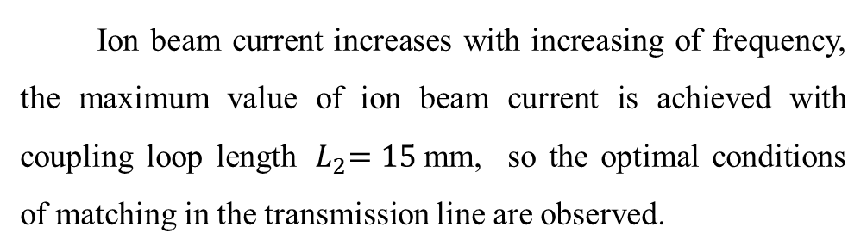
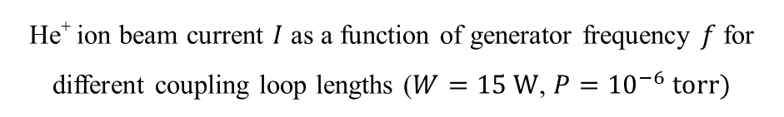
Ion source testing with power input configuration №1 $I\left(f\right)$
$$I_{max}=128.4 \text{µ}\text{A}$$
Ion beam current increases with increasing of frequency, the maximum value of ion beam current is achieved with coupling loop length ${ L}_{2}=15$mm, so the optimal conditions of matching in the transmission line are observed.
He⁺ ion beam current $I$ as a function of generator frequency $f$ for different coupling loop lengths ($W=15 W$, ${P=10}^{−6} torr)$

Slide 8
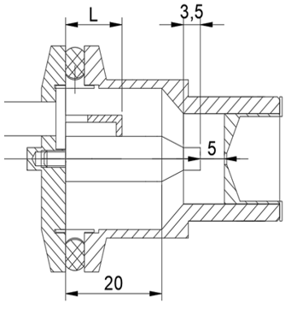
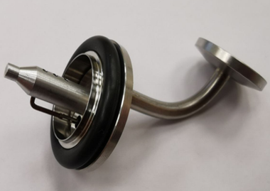

Ion source testing with power input configuration №2
Design of the source with configuration of UHF coupler №2 and photo of power input with coupling loop configuration №2

Slide 9
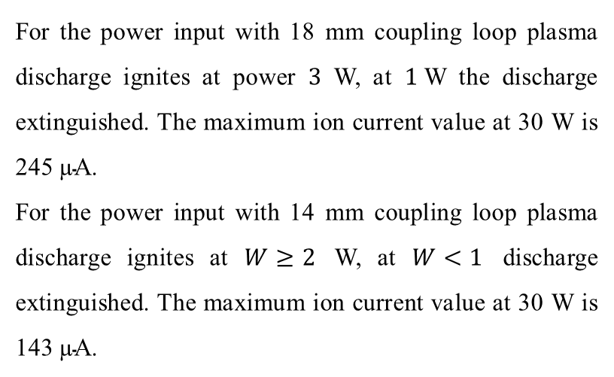
Ion source testing with power input configuration №2 $I\left(W\right)$
For the power input with 18 mm coupling loop plasma discharge ignites at power $3$ W, at $1$W the discharge extinguished. The maximum ion current value at 30 W is 245 $\text{µ}\text{A}$.
For the power input with 14 mm coupling loop plasma discharge ignites at $W≥2$ W, at $W<1$ discharge extinguished. The maximum ion current value at 30 W is 143 $\text{µ}\text{A}$.
He⁺ ion current $I$ as a function of power $W$

Slide 10
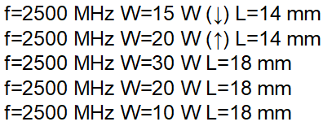


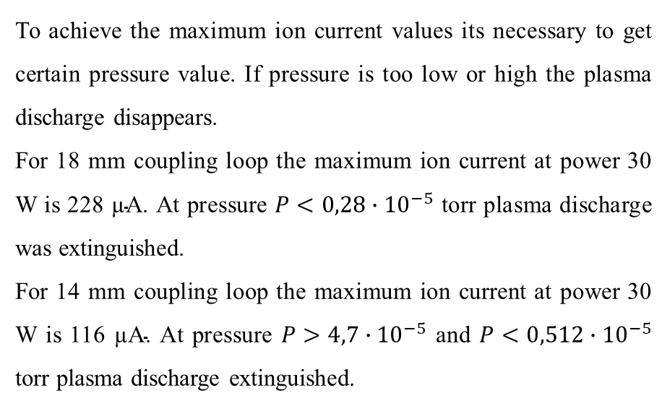
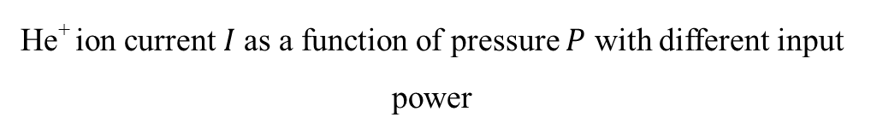
Ion source testing with power input configuration №2 $I\left(P\right)$
To achieve the maximum ion current values its necessary to get certain pressure value. If pressure is too low or high the plasma discharge disappears.
For 18 mm coupling loop the maximum ion current at power 30 W is 228 $\text{µ}\text{A}$. At pressure $P<0,28∙{10}^{−5}$ torr plasma discharge was extinguished.
For 14 mm coupling loop the maximum ion current at power 30 W is 116 $\text{µ}\text{A}\text{.}$ At pressure $P>4,7∙{10}^{−5}$ and $P<0,512∙{10}^{−5}$ torr plasma discharge extinguished.
He⁺ ion current $I$as a function of pressure $P$ with different input power

Slide 11
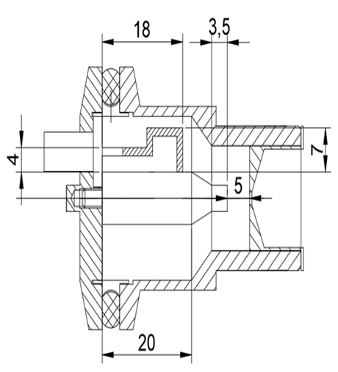
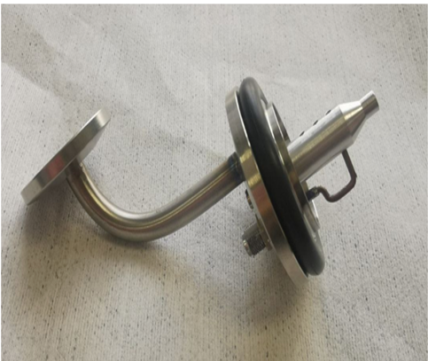
Ion source testing with power input configuration №3
Design of the source with configuration of UHF coupler №3 and photo of power input with coupling loop configuration №3

Slide 12

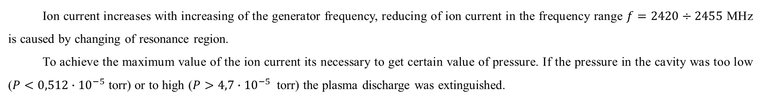
Ion source testing with power input configuration №3 $I\left(f\right)$, $I$(P)
$$I_{max}=103 \text{µ}\text{A}$$
$$I_{max}=118.5 \text{µ}\text{A}$$
He⁺ ion current $I$as a function of the UHF $f$
He⁺ ion current $I$as a function of the cavity pressure $P$
Ion current increases with increasing of the generator frequency, reducing of ion current in the frequency range $f=2420÷2455$ MHz is caused by changing of resonance region.
To achieve the maximum value of the ion current its necessary to get certain value of pressure. If the pressure in the cavity was too low ($P<0,512∙{10}^{−5}$ torr) or to high ($P>4,7∙{10}^{−5}$ torr) the plasma discharge was extinguished.

Slide 13
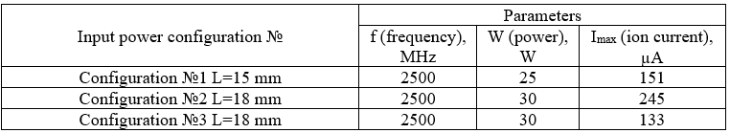
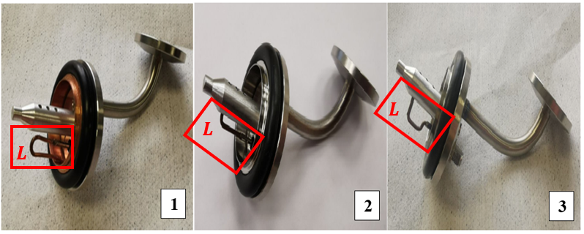
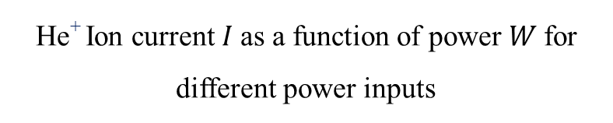
Comparision of different power inputs
He⁺ Ion current $I$as a function of power $W$for different power inputs

Slide 14
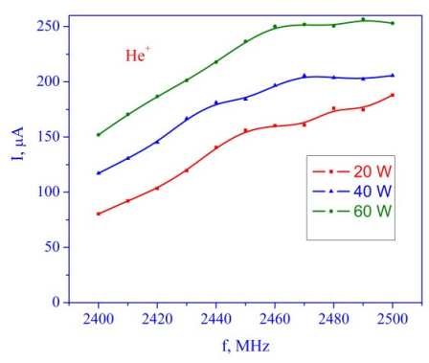

Comparisons with previous results
2019 y.
2022 y.
He⁺ ion current vs frequency at different power level
He⁺ ion current vs frequency
View of coupling loop
$L=13$ mm
View of coupling loop

Slide 15
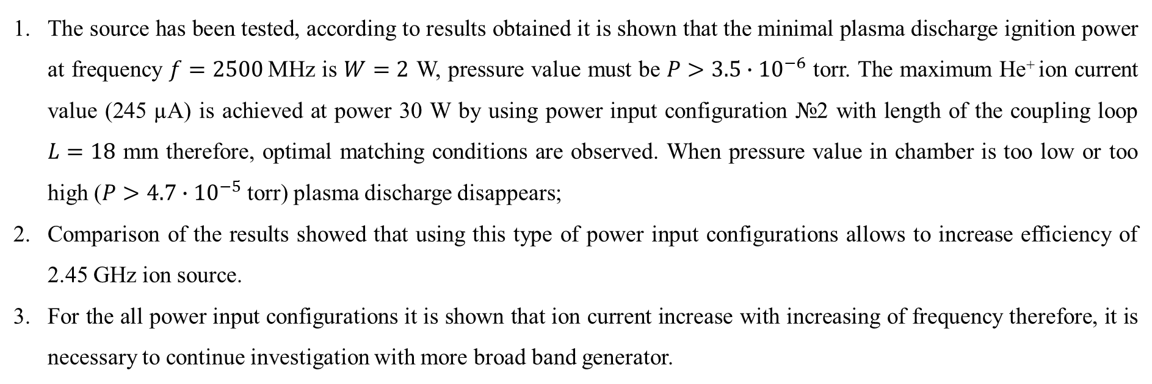
Conclusion
The source has been tested, according to results obtained it is shown that the minimal plasma discharge ignition power at frequency $f=2500$MHz is $W=2$ W, pressure value must be $P>3.5∙{10}^{−6}$ torr. The maximum He⁺ ion current value (245 $\text{µ}\text{A}$) is achieved at power 30 W by using power input configuration №2 with length of the coupling loop $L=18$ mm therefore, optimal matching conditions are observed. When pressure value in chamber is too low or too high ($P>4.7∙{10}^{−5}$ torr) plasma discharge disappears;
Comparison of the results showed that using this type of power input configurations allows to increase efficiency of 2.45 GHz ion source.
For the all power input configurations it is shown that ion current increase with increasing of frequency therefore, it is necessary to continue investigation with more broad band generator.

Slide 16
Thanks for your attention!

