Slide 1

MeV energy electron and proton irradiation effects in semiconductor materials for space applications
XXVI International Scientific Conference of Young Scientists and Specialists
(AYSS-2022), Dubna, Russia
Vika Arzumanyan
V. Harutyunyan, A. Sahakyan, N. Grigoryan, A. Martirosyan
Yerevan, Armenia
Email: vika.arzumanyan@yerphi.am

Slide 2
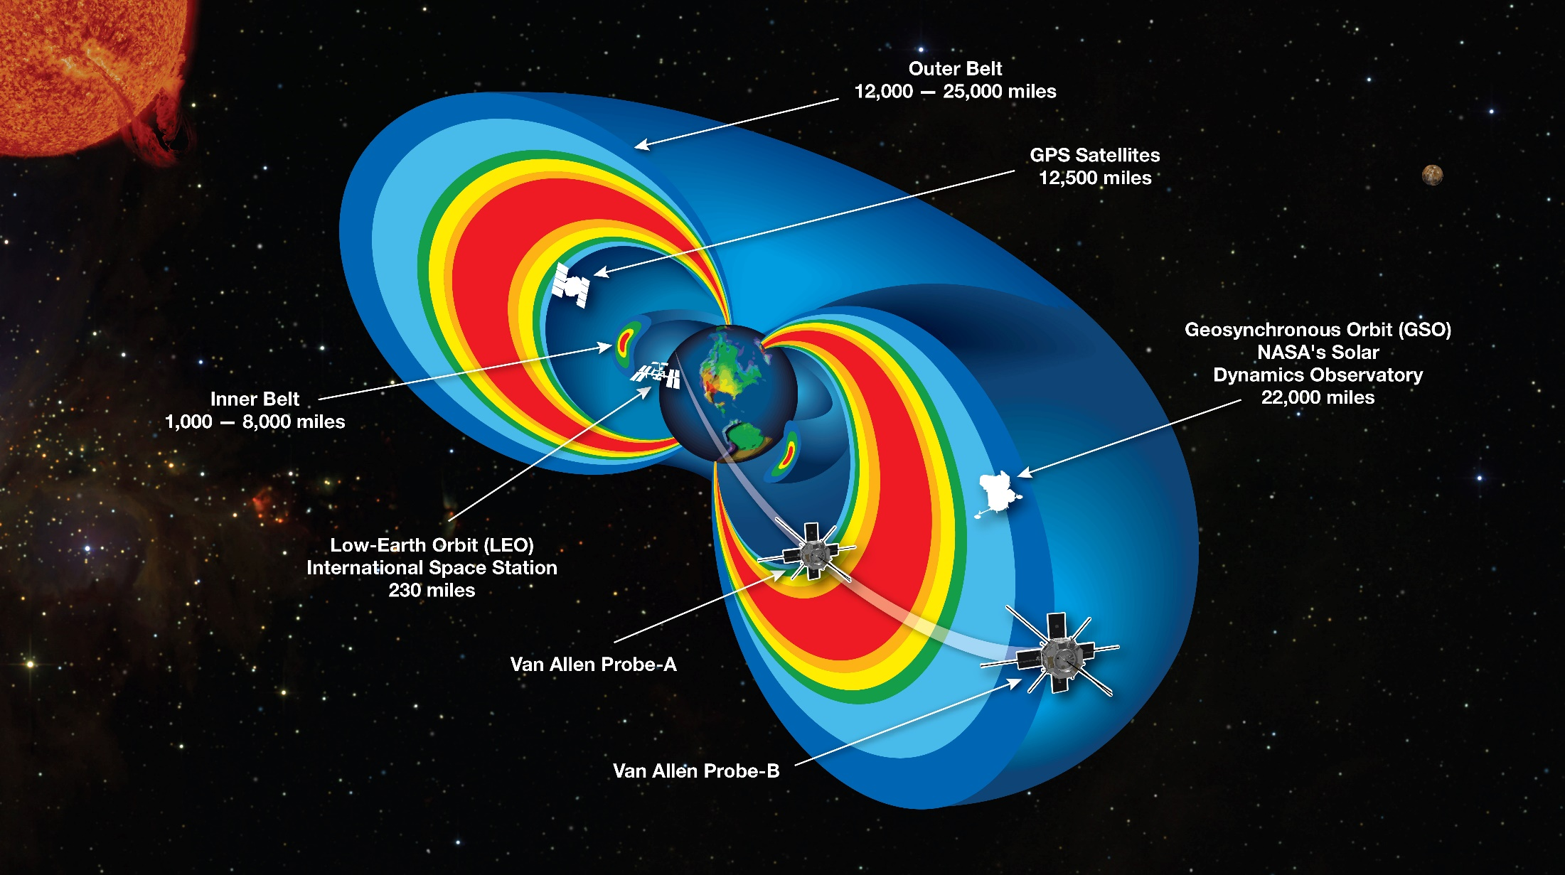
Earth’s Radiation Belts
Outer Radiation Belt:
Energetic protons ≥ 10MeV
Energetic electrons ≥ 2 MeV, ≤ 10MeV
Inner Radiation Belt:
Protons and electrons ≤ 1.5MeV

Slide 3
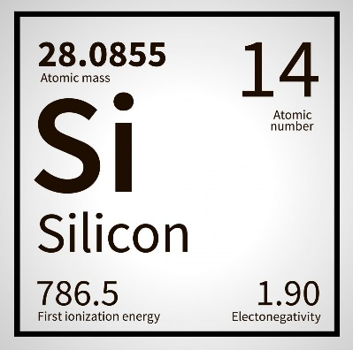
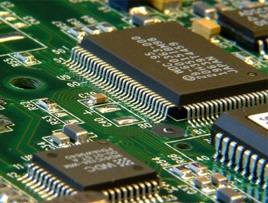
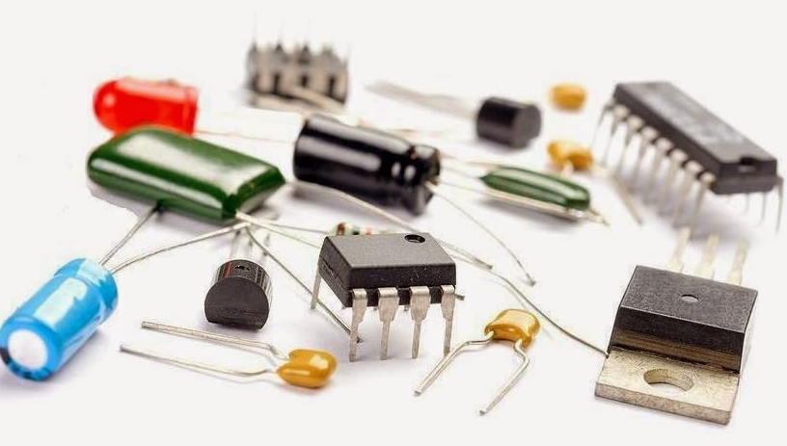
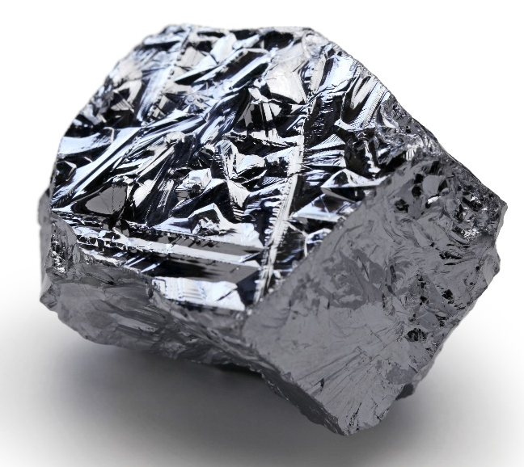
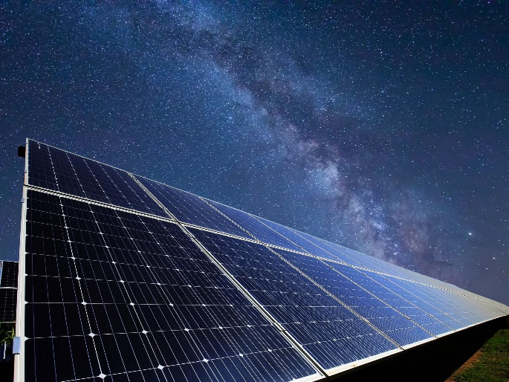
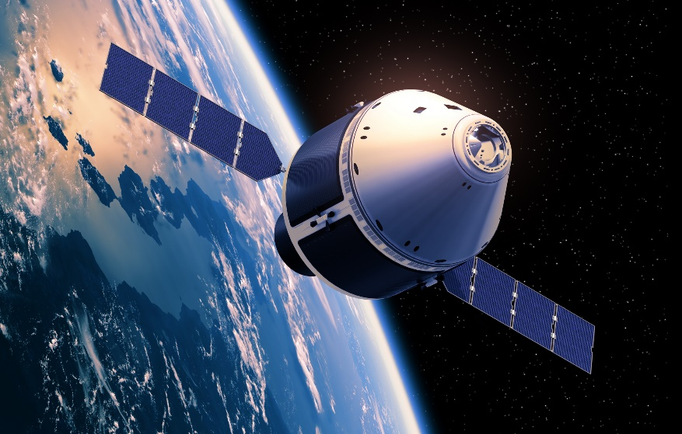
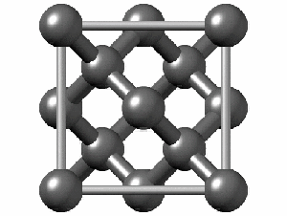

Slide 4
Aim
V. Arzumanyan. MeV energy electron and proton irradiation effects in …
The radiation defects’ concentration and the introduction rate of radiation defects depending on the electron irradiation dose in semiconductor crystals of n-Si and n-GaP and proton irradiation dose in n-type and p-type Si crystals were studied.
The aim is to identify an effective property of the irradiated sample in order to express changes in the structures and physical properties of semiconductors so that materials with specific predictable parameters can be created.

Slide 5
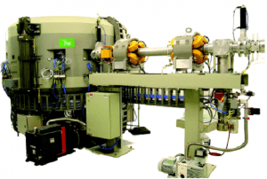
Experimental methods
V. Arzumanyan. MeV energy electron and proton irradiation effects in …
Electron irradiation
Energy – 3.5 MeV
Bunch charge – 60 pC
Bunch length – 0.4 ps
Repetition rate – 12 Hz
Intensity- 10⁹el/cm²·s
AREAL Facility at CANDLE, Armenia
Cyclotron C-18 at Radioisotope Production Center, Armenia
Proton irradiation
Energy -18MeV
Mean current -1μA
Intensity- 10¹²p/cm²·s

Slide 6
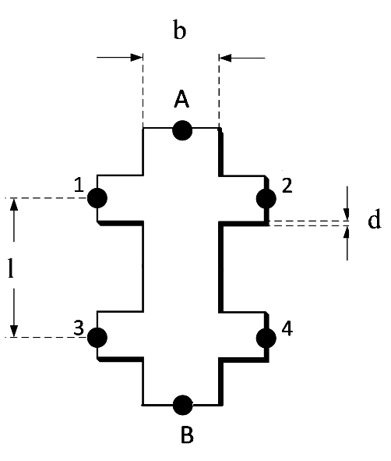
Experimental methods
V. Arzumanyan. MeV energy electron and proton irradiation effects in …
Parameters of each sample were measured using a direct current Hall effect method:
Magnetic flux - 0.5 Т
Electric current - 0.05—1 mA.
The mean experimental error for the measurements was determined to be no greater than ± 7%.
3mm
6mm
0.5mm

Slide 7
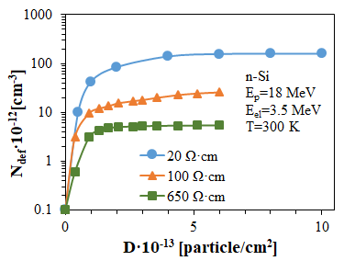
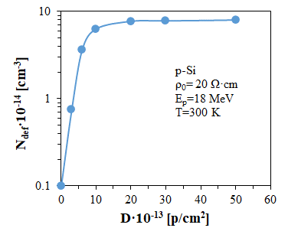
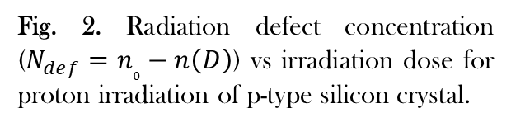
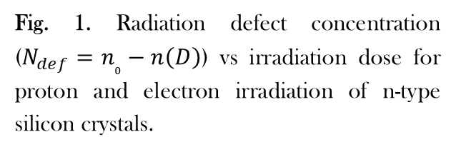
Experimental results
V. Arzumanyan. MeV energy electron and proton irradiation effects in …
Fig. 1. Radiation defect concentration ($N_{def}=n_{0}−n\left(D\right)$) vs irradiation dose for proton and electron irradiation of n-type silicon crystals.
Fig. 2. Radiation defect concentration ($N_{def}=n_{0}−n\left(D\right)$) vs irradiation dose for proton irradiation of p-type silicon crystal.

Slide 8
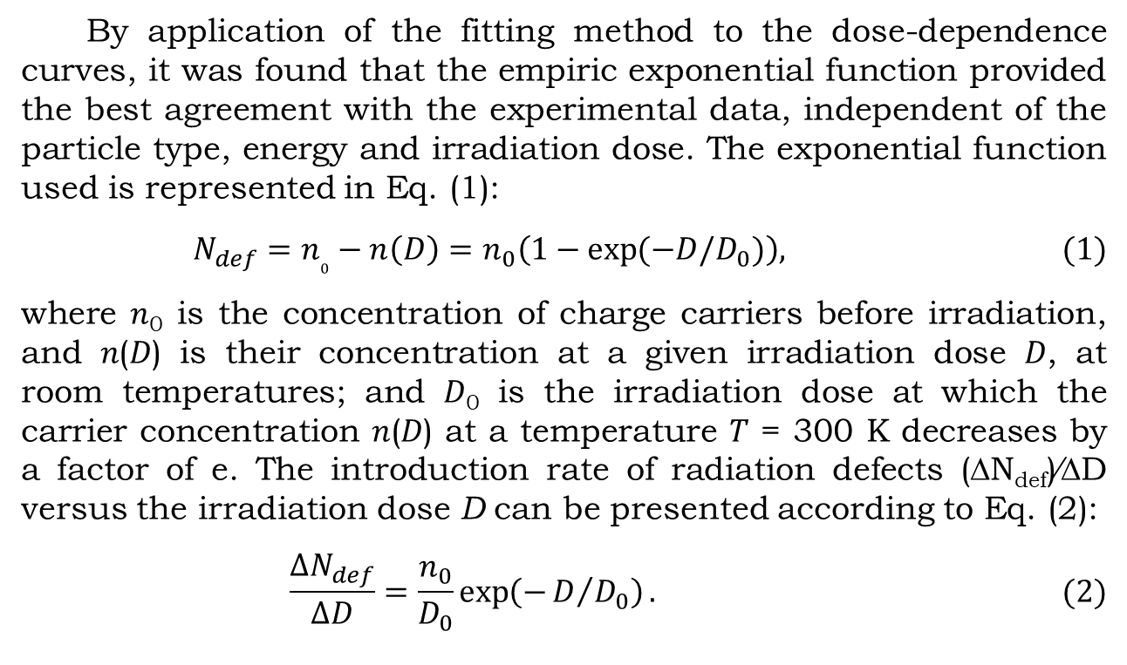
Experimental results
V. Arzumanyan. MeV energy electron and proton irradiation effects in …
By application of the fitting method to the dose-dependence curves, it was found that the empiric exponential function provided the best agreement with the experimental data, independent of the particle type, energy and irradiation dose. The exponential function used is represented in Eq. (1):
$$N_{def}={n_{0}−n\left(D\right)=n}_{0}\left(1−\exp{(−D/D_{0})}\right), (1)$$
where 𝑛₀ is the concentration of charge carriers before irradiation, and 𝑛(𝐷) is their concentration at a given irradiation dose 𝐷, at room temperatures; and 𝐷₀ is the irradiation dose at which the carrier concentration 𝑛(𝐷) at a temperature 𝑇 = 300 K decreases by a factor of e. The introduction rate of radiation defects (∆N_{def})⁄∆D versus the irradiation dose D can be presented according to Eq. (2):
$$\frac{{∆N}_{def}}{∆D}=\frac{n_{0}}{D_{0}}\exp\left(−D/{D_{0}}\right). (2)$$

Slide 9
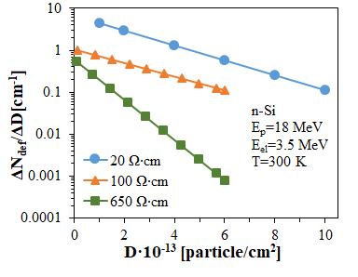
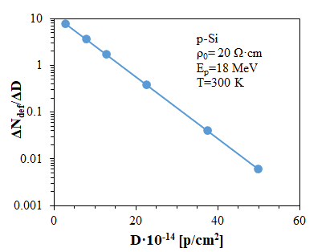
Experimental results
V. Arzumanyan. MeV energy electron and proton irradiation effects in …
Fig. 3. Introduction rate of radiation defects vs dose for proton and electron irradiation in n-type silicon crystals.
Fig. 4. Introduction rate of radiation defects vs dose for proton in p-type silicon crystal.

Slide 10
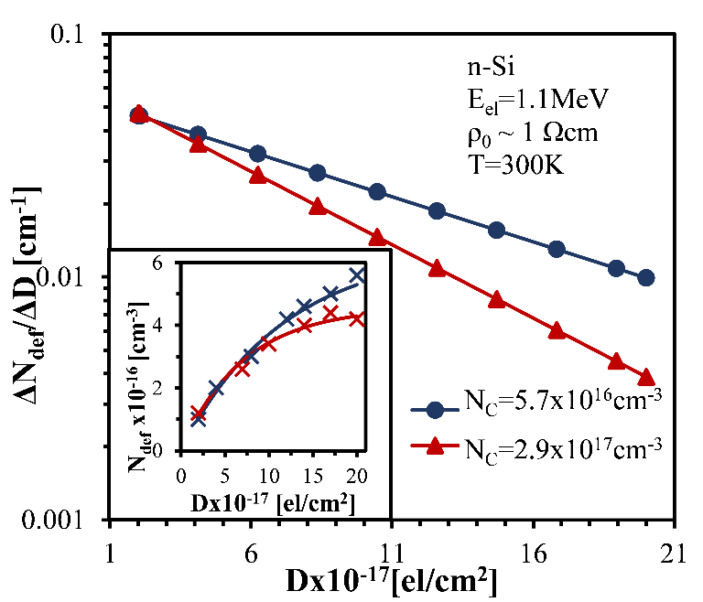
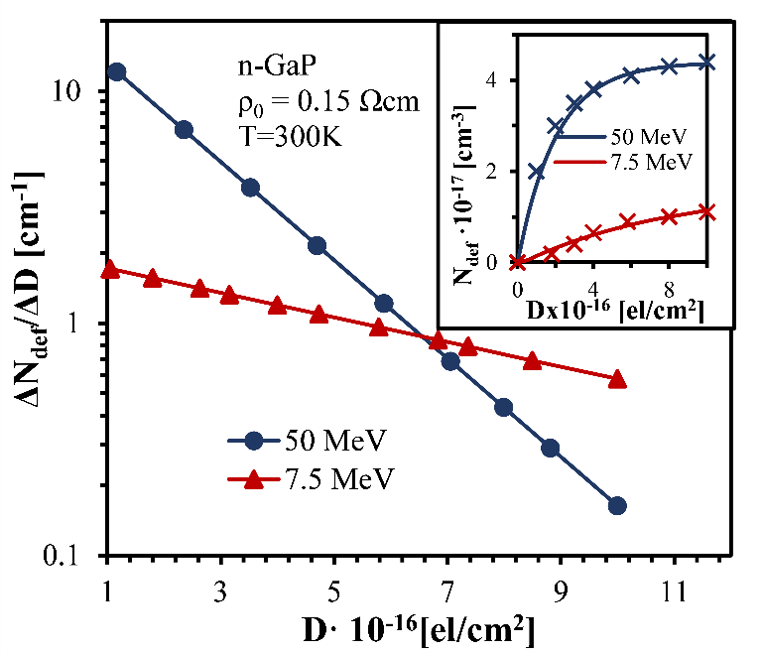
Experimental results
V. Arzumanyan. MeV energy electron and proton irradiation effects in …
Fig. 5. Introduction rate of radiation defects vs. irradiation dose for n -type silicon doped with different concentrations of carbon atoms. The induced radiation defects values for each applied dose are presented in the insert.
Fig. 6. Introduction rate of radiation defects vs. irradiation dose for n-GaP samples with an initial specific resistivity of 0.15 Ω·cm, irradiated by electrons with energies of 50 MeV and 7.5 MeV. In the insert is shown the induced radiation defects values for each applied dose.

Slide 11
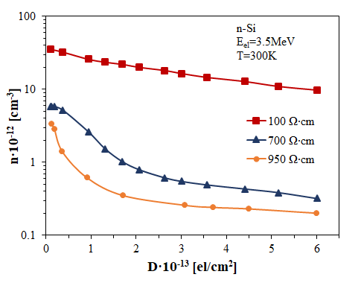
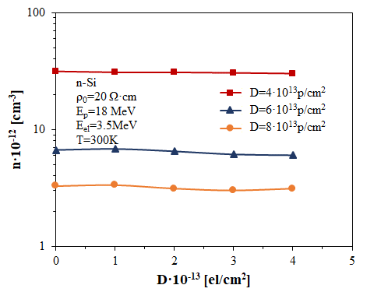
Effects of sequential proton-electron irradiation
V. Arzumanyan. MeV energy electron and proton irradiation effects in …
Fig.7. Charge carriers’ concentration depending on 3.5MeV energy electron irradiation dose.
Fig.8. Charge carriers’ concentration depending on electron irradiation dose, previously irradiated by different proton irradiation doses.

Slide 12
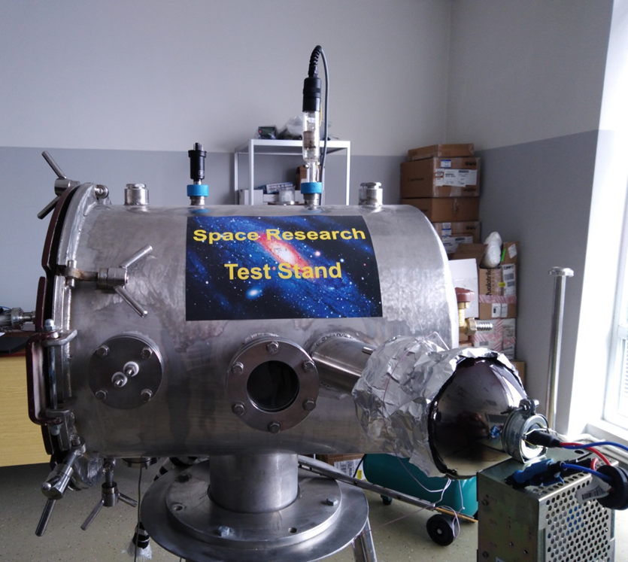
Space Environment Simulating Setup
V. Arzumanyan. MeV energy electron and proton irradiation effects in …
Parameters of Research Stand
Vacuum - 10⁻⁵ Torr (1.33x10⁻³ Pa )
3.5 MeV energy electron beam with energy
Measurement temperature range from -100 ℃ to +100℃,
Solar ultraviolet radiation.

Slide 13
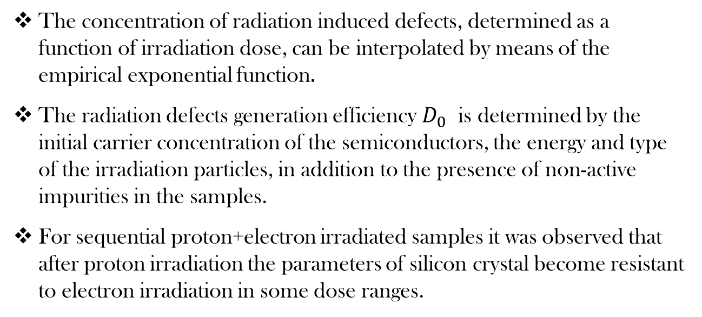
Conclusion
V. Arzumanyan. MeV energy electron and proton irradiation effects in …
The concentration of radiation induced defects, determined as a function of irradiation dose, can be interpolated by means of the empirical exponential function$.$
The radiation defects generation efficiency $D_{0}$ is determined by the initial carrier concentration of the semiconductors, the energy and type of the irradiation particles, in addition to the presence of non-active impurities in the samples.
For sequential proton+electron irradiated samples it was observed that after proton irradiation the parameters of silicon crystal become resistant to electron irradiation in some dose ranges.

Slide 14
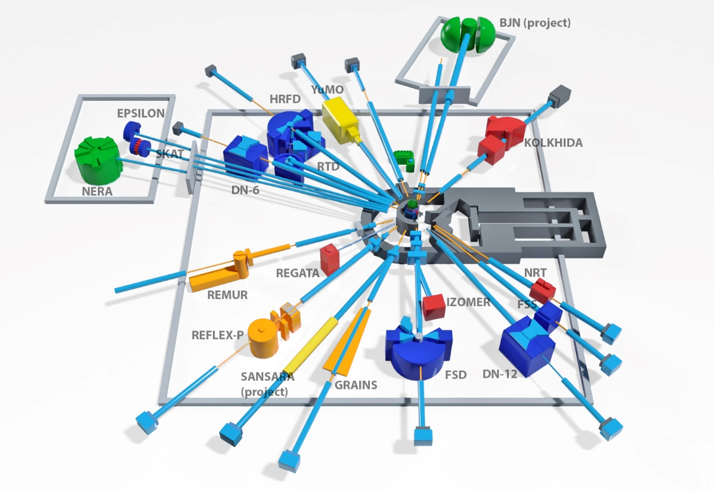
Future works
V. Arzumanyan. MeV energy electron and proton irradiation effects in …
IBR-2
It is planned to carry out neutron irradiation of semiconductor samples by IBR-2 reactor at JINR, Dubna.
It is planned to investigate the influences of different combinations of sequential irradiations on semiconductor materials.

Slide 15
Thank You for Your Attention!

