Slide 1
Prospects of catalytically-induced decomposition of methane to produce core-shell structured contrast agent for medical imaging
The XXVI International Scientific Conference of Young Scientists and Specialists (AYSS-2022)
24-28 October 2022,
MLIT, JINR
Aleksei P. Kozlov^{1,2}, Evgeniya V. Suslova¹, Vladislav A. Rozhkov^{1,3}
¹ Lomonosov Moscow State University, Faculty of Chemistry, Moscow, Russia
² Moscow Aviation Institute, Moscow, Russia
³ Joint Institute for Nuclear Research, Dubna, Russia
kozlov.aleksei.p@gmail.com

Slide 2
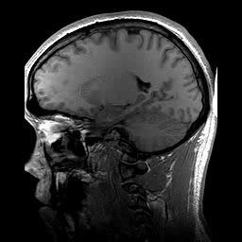
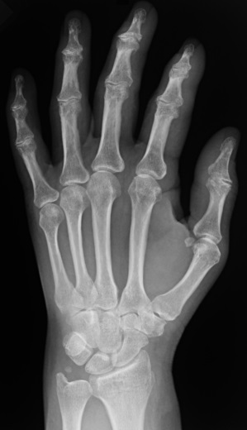
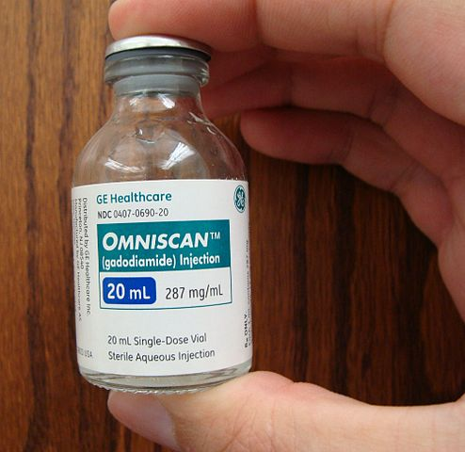
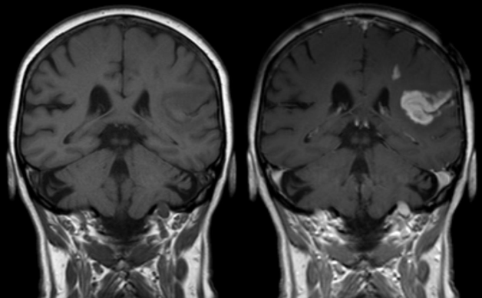
Introduction
The XXVI International Scientific Conference of Young Scientists and Specialists (AYSS-2022)
24-28 October 2022, MLIT, JINR
2
Medical Imaging
Applicable for everyone
Affordable
Non-invasive
Essential in clinical practice
Plays a key role in early disease detection
Contrast agents (CAs)
Ion-chelate CAs
Nanoparticles-based CAs
wikipedia.org

Slide 3
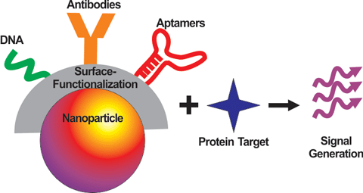
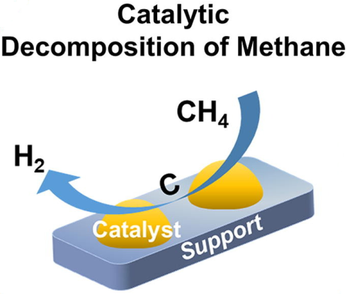
Nanoparticle CAs
The XXVI International Scientific Conference of Young Scientists and Specialists (AYSS-2022)
24-28 October 2022, MLIT, JINR
3
Have hierarchical architecture
Have signal-generating metal-containing particles
Have matrix to be loaded with such metal particles
The matrix have surface functionalization to enable targeting binding to specific biomolecules
The CA have core-shell structure to ensure integrity and safety
Catalytic Methane Decomposition (CMD)
Conversion of Methane to Hydrogen over metal particles with a side reaction of deposition of Carbon
Exploiting the deposition of Carbon to enclose metal-containing particles
The objective of the work: to test the reaction of catalytically-induced decomposition of Methane to produce core-shell structured contrast agent
10.1007/s13391-014-4383-0; 10.1016/j.jechem.2020.10.049

Slide 4
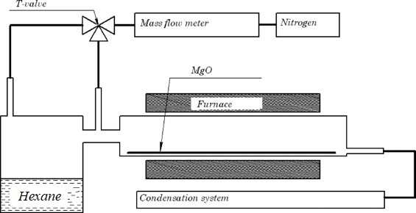
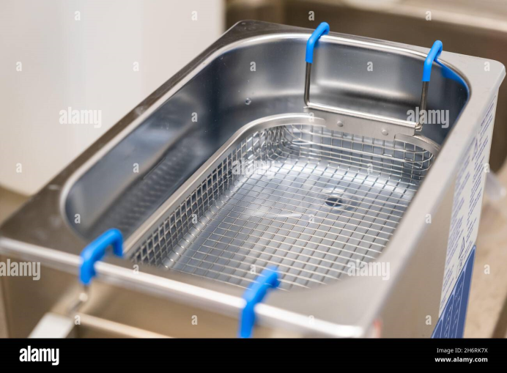
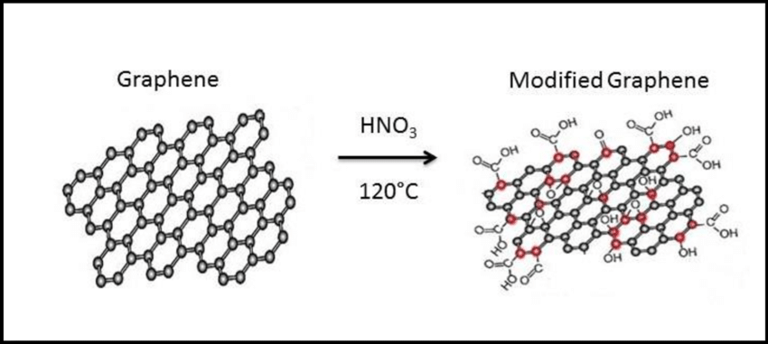
Experimental. Nanoparticle CA synthesis
The XXVI International Scientific Conference of Young Scientists and Specialists (AYSS-2022)
24-28 October 2022, MLIT, JINR
4
Step 1 – Graphene Nanoflakes (GNF) preparation
GNF treatment with boiling HNO3
Filtration of resulting GNFo
Step 3 – La-loaded GNFo (GNFo-La)
Chemical Vapor Deposition at 900 °C
MgO template
Flow of N2 through Hexane as the Carbon source
Boiling in HCl solution to remove the template
Step 2 – GNF oxidation (GNFo)
Addition of La(NO3)3 soluiton to the GNFo dispersion under sonication
Subsequent annealing under N2 flow at 400 °C, with or without of CMD

Slide 5
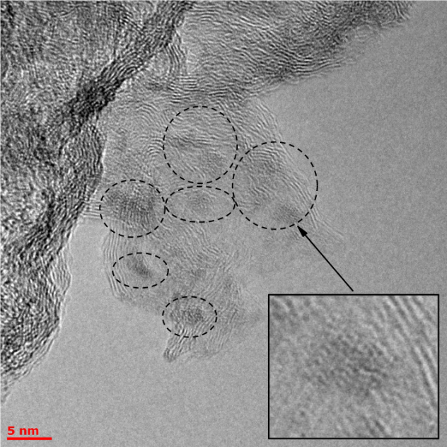
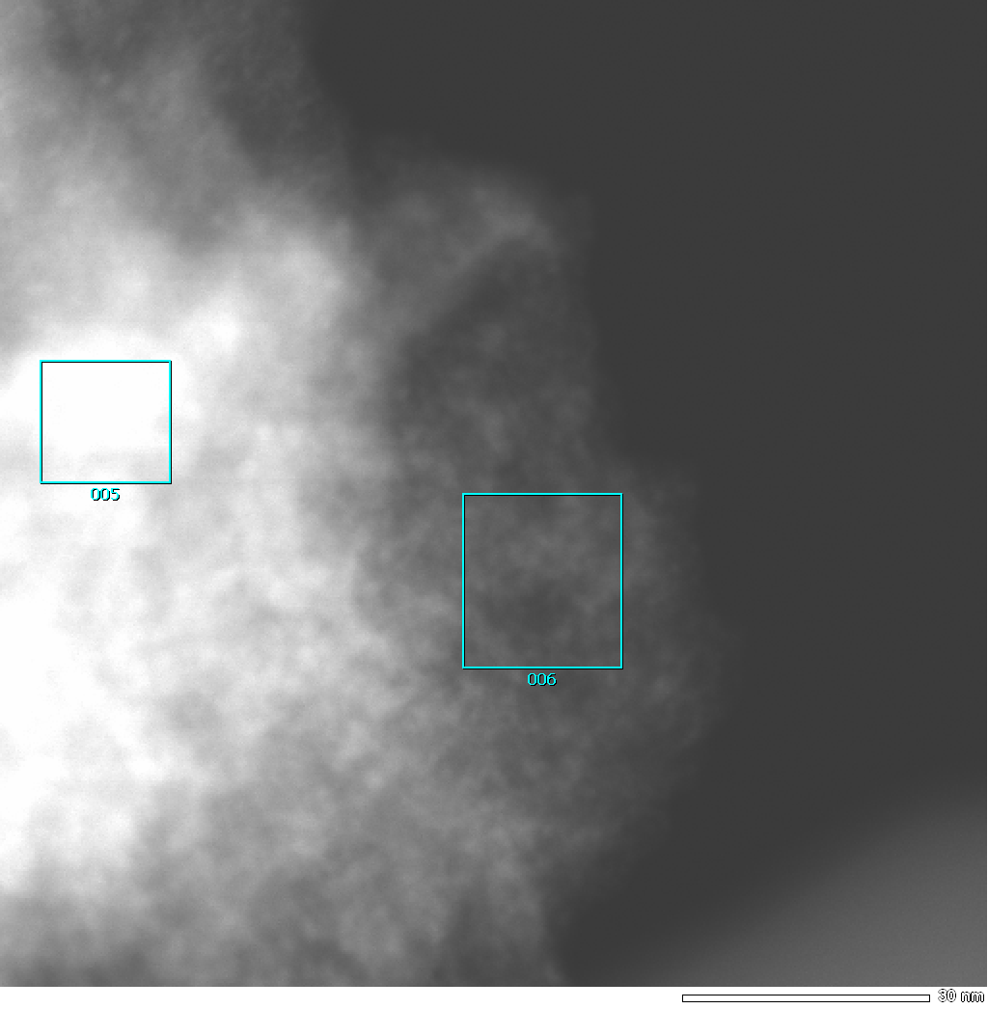
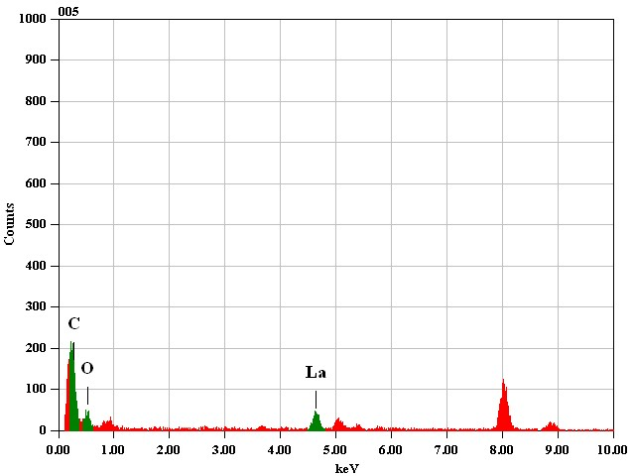
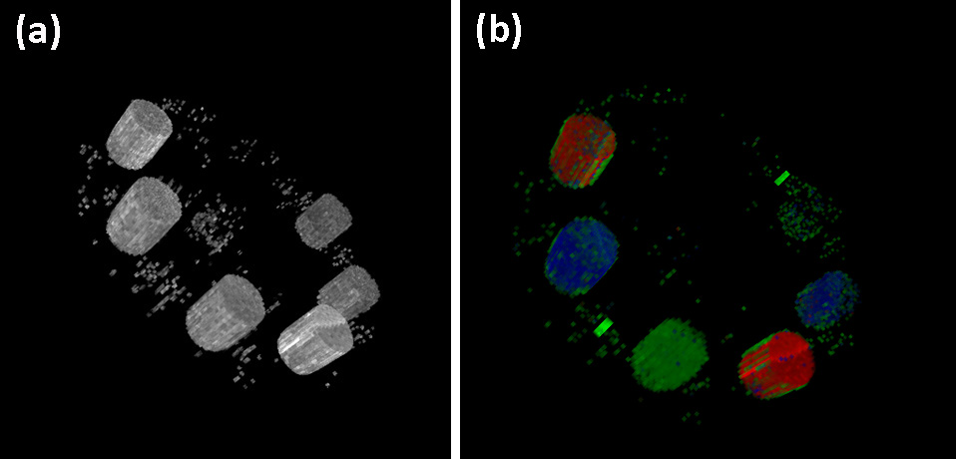
Results. Nanoparticle CA without CMD
The XXVI International Scientific Conference of Young Scientists and Specialists (AYSS-2022)
24-28 October 2022, MLIT, JINR
5
3D Spectral CT monochrome (a) and solution-calibrated, colored (b) images of phantom with test tubes filled with GNFo-La (red), GNFo-Nd (blue), and GNFo-Gd (green) nanoparticle CA

Slide 6
Results. Testing the CMD reaction
The XXVI International Scientific Conference of Young Scientists and Specialists (AYSS-2022)
24-28 October 2022, MLIT, JINR
6
Raman survey spectra
Band, cm-1 | Characteristic of
120 | La-O, lattice vibrations
190
330
440
730 | N-O vibrations
1050
1120
1350
1450
1630
1580 | G band of graphite
Conditions of CMD: preheating the sample up to 400 °C in N2 flow, switching to Methane for 10 minutes, cooling down

Slide 7
Results. Nanoparticle CA before and after CMD. Raman spectroscopy
The XXVI International Scientific Conference of Young Scientists and Specialists (AYSS-2022)
24-28 October 2022, MLIT, JINR
7
Survey spectra
1000-2000 cm-1 region
Band | D | G | 2D | D+D’ | 2D’
Position, cm -1 | 1350 | 1590 | 2700 | 2940 | 3180
D’’ | D | A | G
Gaussian | Gaussian | Gaussian | Pseudo-Voigt

Slide 8
Results. Nanoparticle CA before and after CMD. X-Ray photoelectron spectroscopy
The XXVI International Scientific Conference of Young Scientists and Specialists (AYSS-2022)
24-28 October 2022, MLIT, JINR
8
Survey spectra
C1s region

Slide 9
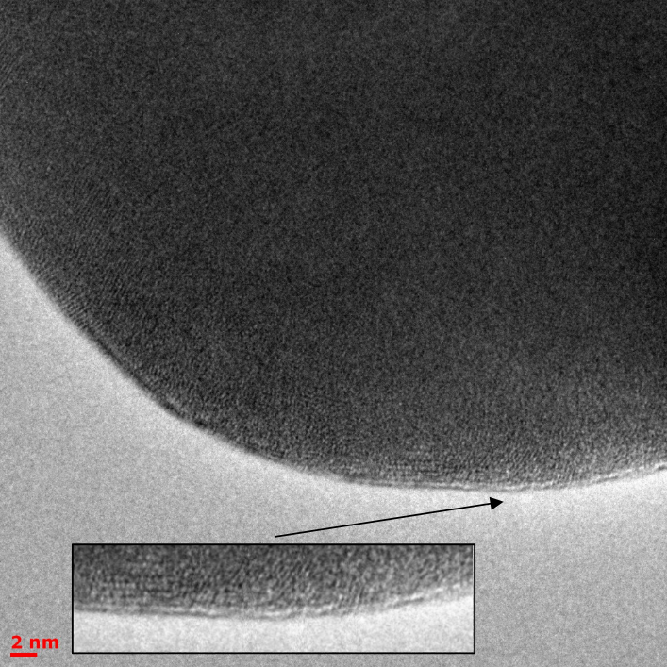
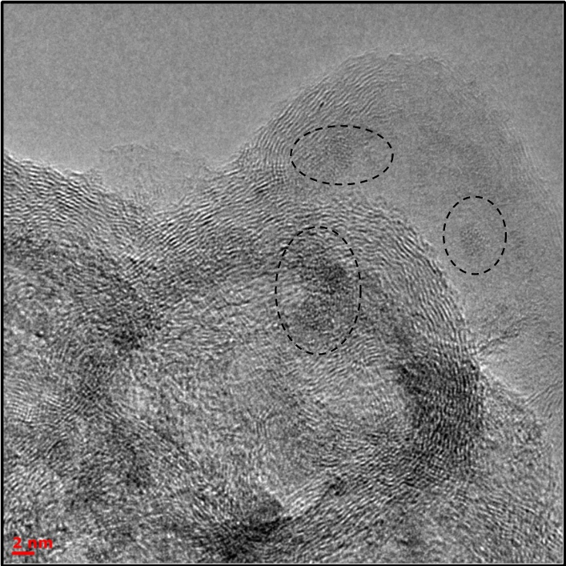
Results. Nanoparticle CA before and after CMD. Transmission electron microscopy
The XXVI International Scientific Conference of Young Scientists and Specialists (AYSS-2022)
24-28 October 2022, MLIT, JINR
9
La2O3 after CMD
GNFo-La after CMD

Slide 10
Conclusion
The XXVI International Scientific Conference of Young Scientists and Specialists (AYSS-2022)
24-28 October 2022, MLIT, JINR
10
The catalytically-induced reaction of decomposition of Methane over La-containing nanoparticles to produce core-shell structured contrast agent were tested;
Raman spectroscopy and X-Ray photoelectron spectroscopy data suggest that the reaction contributes to Carbon spectra. Transmission electron microscopy demonstrates thin layer over nanoparticles. All together, it indicates formation of Carbon layers over La-containing nanoparticles;
Further research is required to estimate kinetics and mechanisms of the reaction;
The method may be applicable for contrast agents for medical imaging.
Thanks for your attention!
This study was financially supported by the Russian Scientific Foundation (project no. 22-15-00072).

