Slide 1
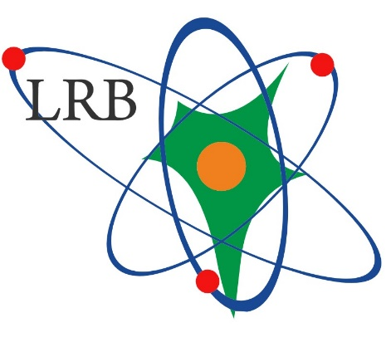
A new type of ground-based simulator of inner radiation field of a spacecraft in deep space
Gordeev I.S. and Timoshenko G.N.
LRB JINR
The XXVI International Scientific Conference of Young Scientists and Specialists (AYSS-2022)
Notes:
Good afternoon dear colleagues! My name is Ivan Gordeev and I’d like to make a presentation on topic of «a new type of ground-based simulator of inner radiation field of a spacecraft in deep space»

Slide 2
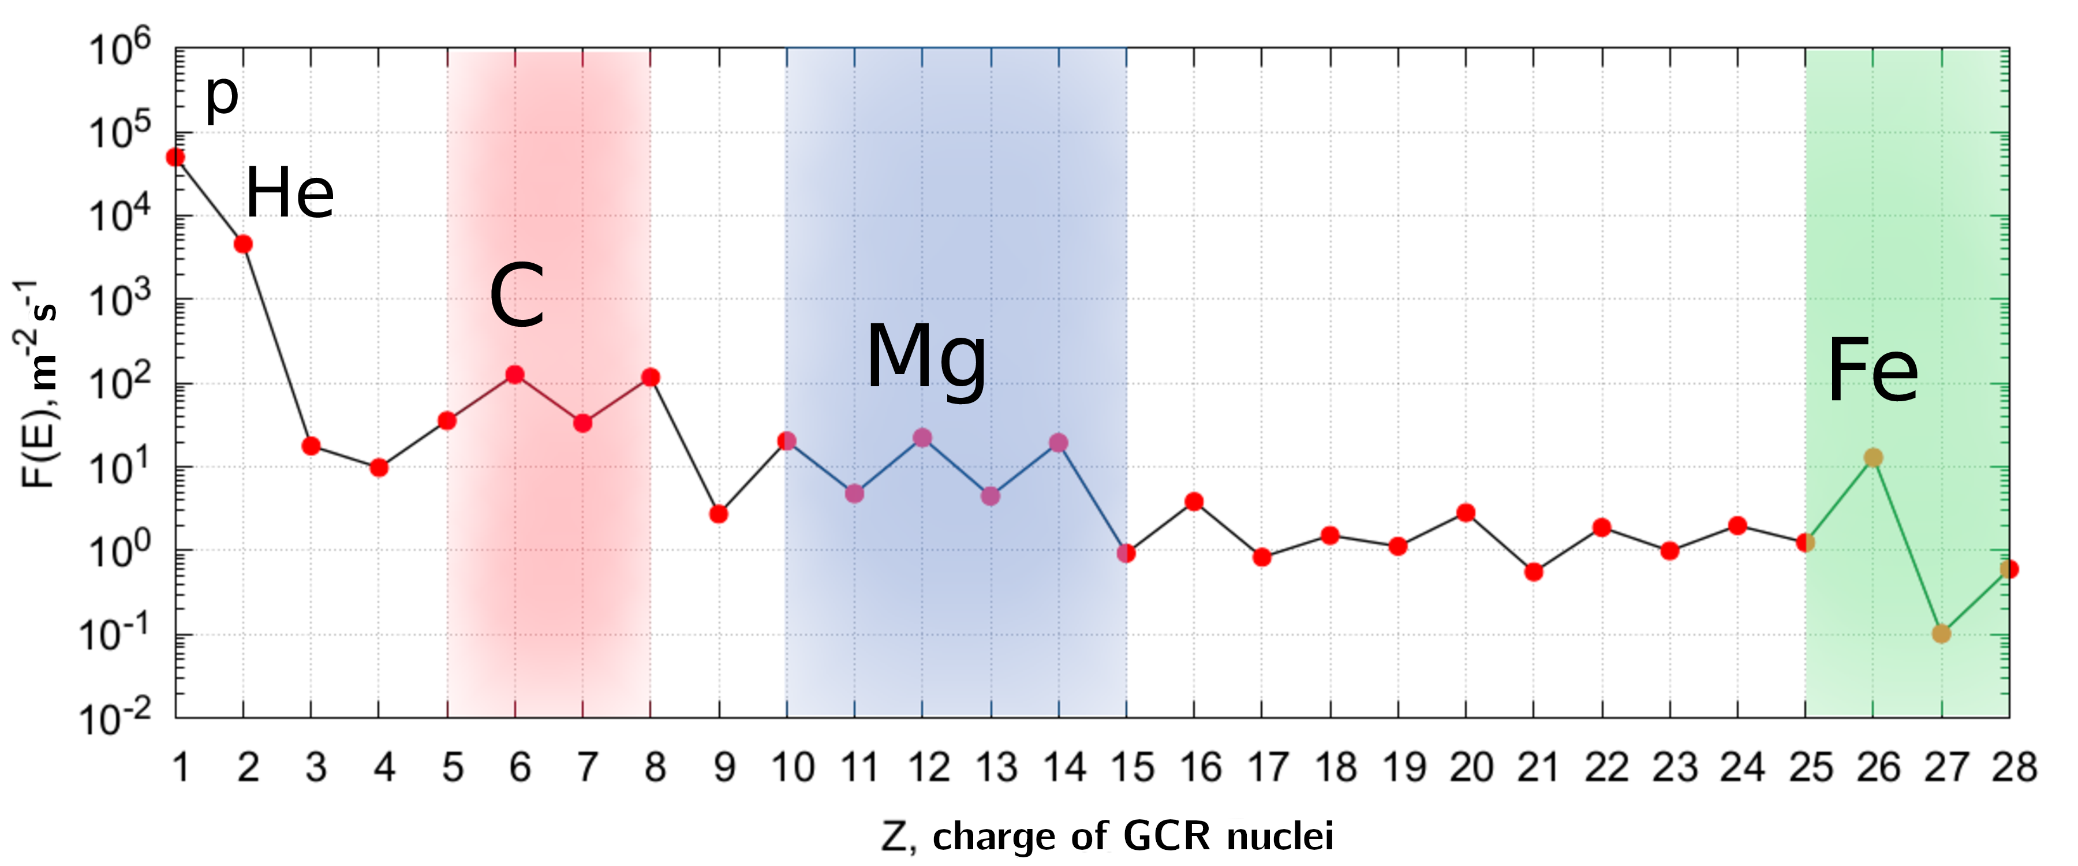
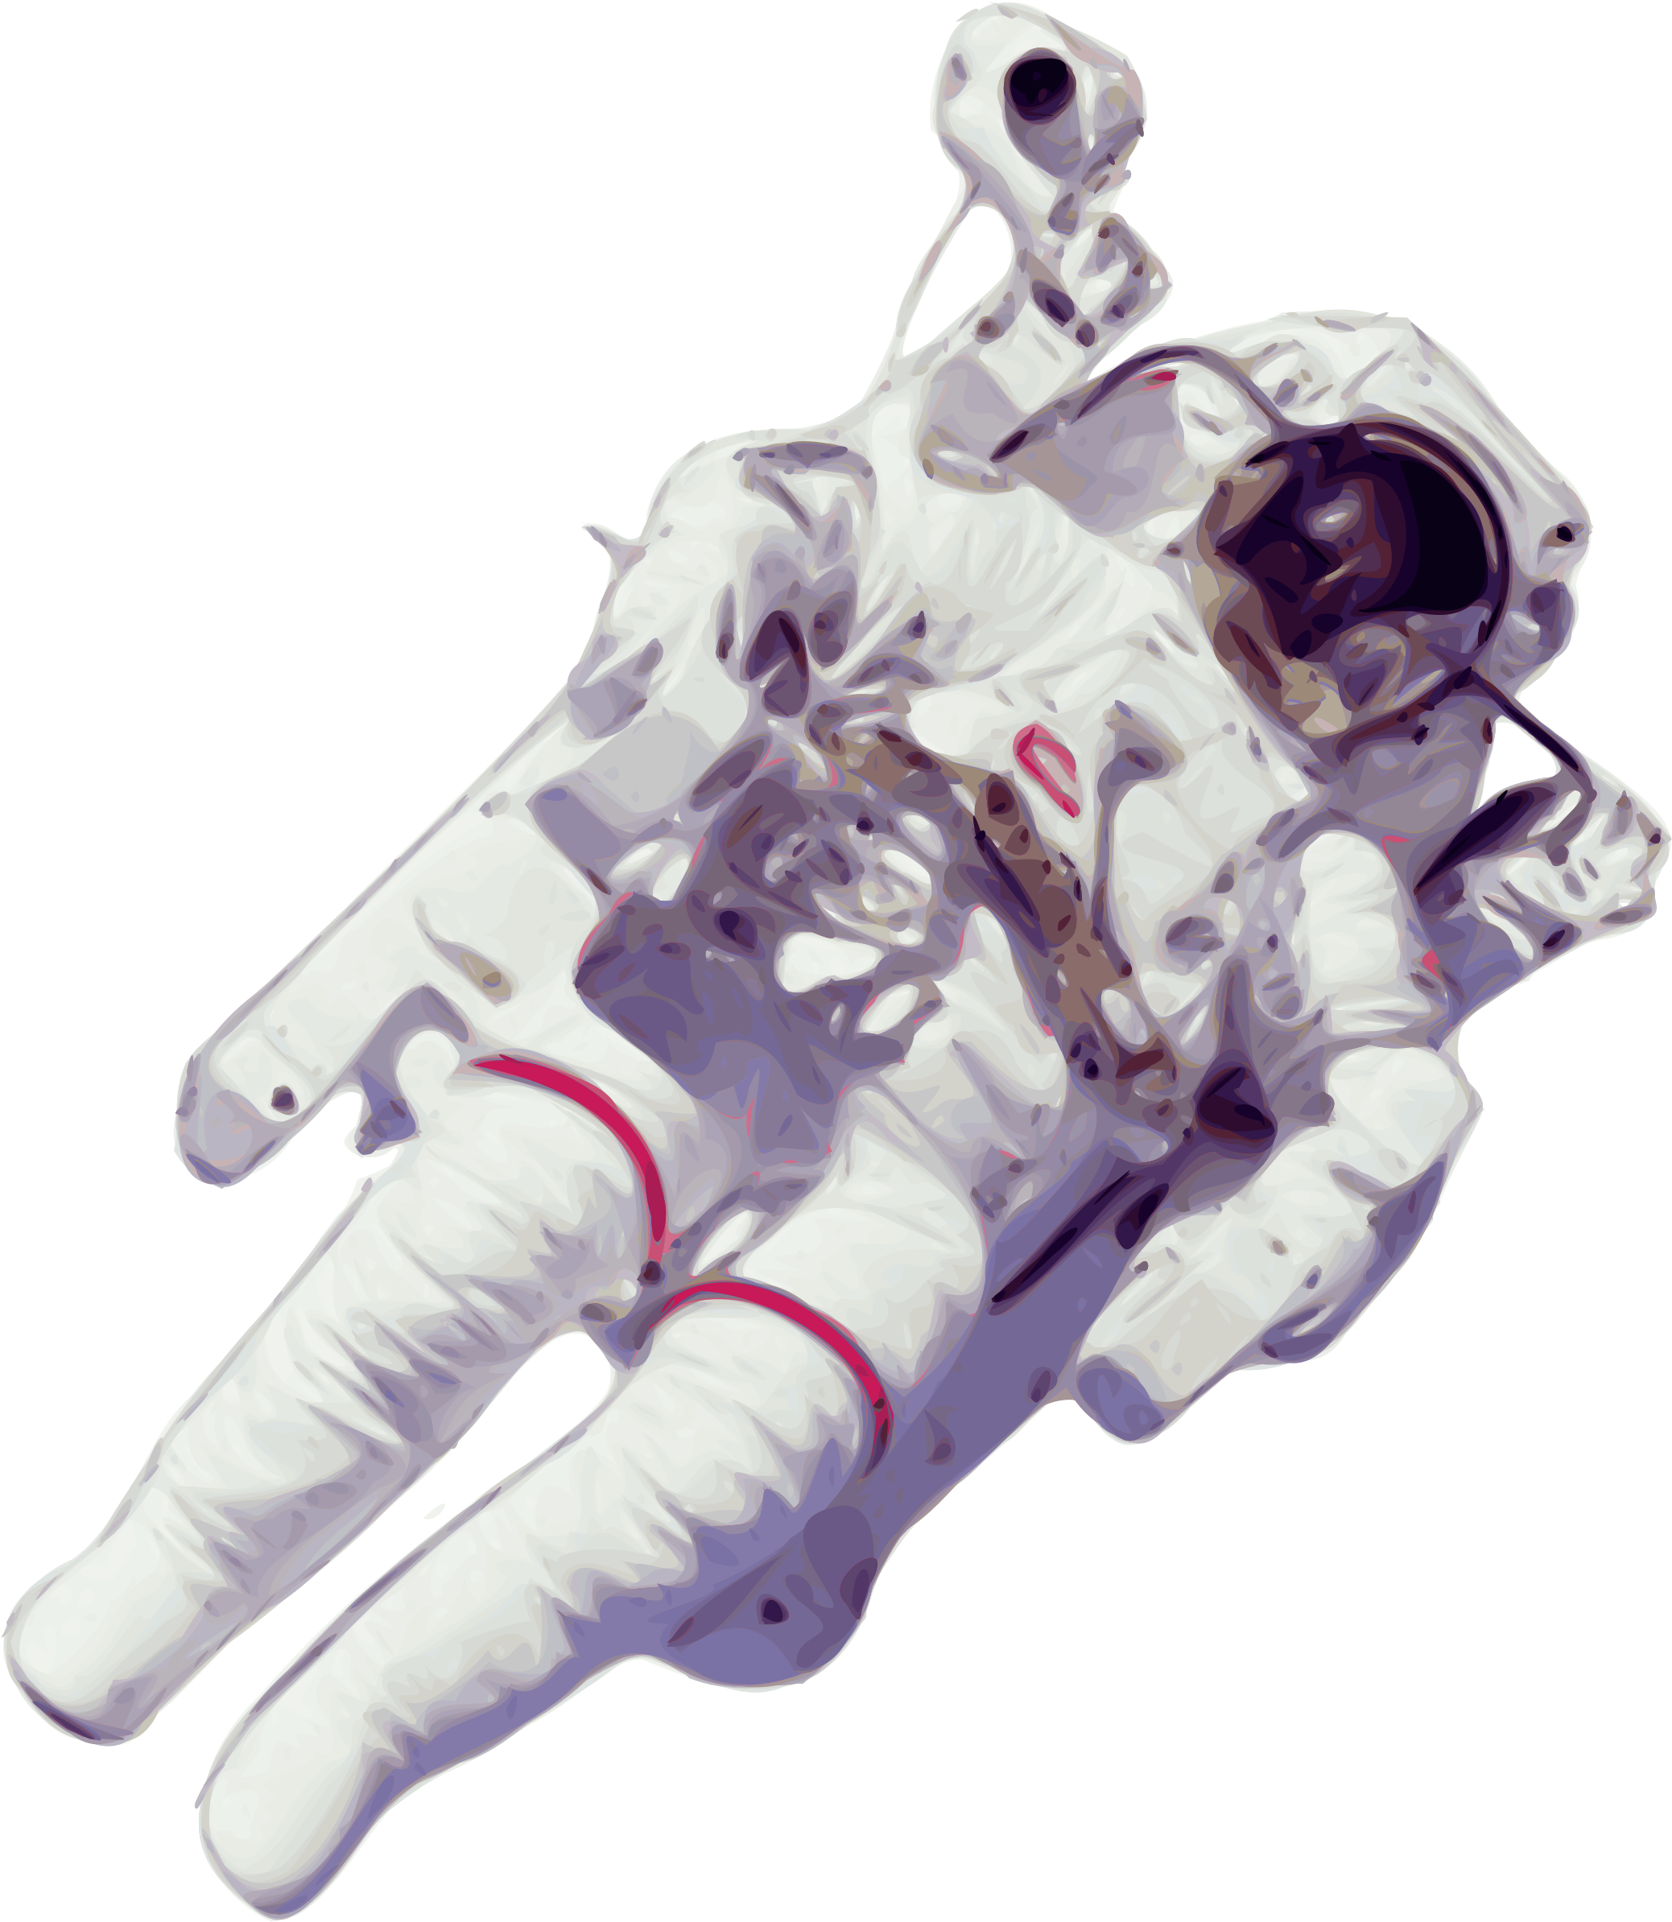
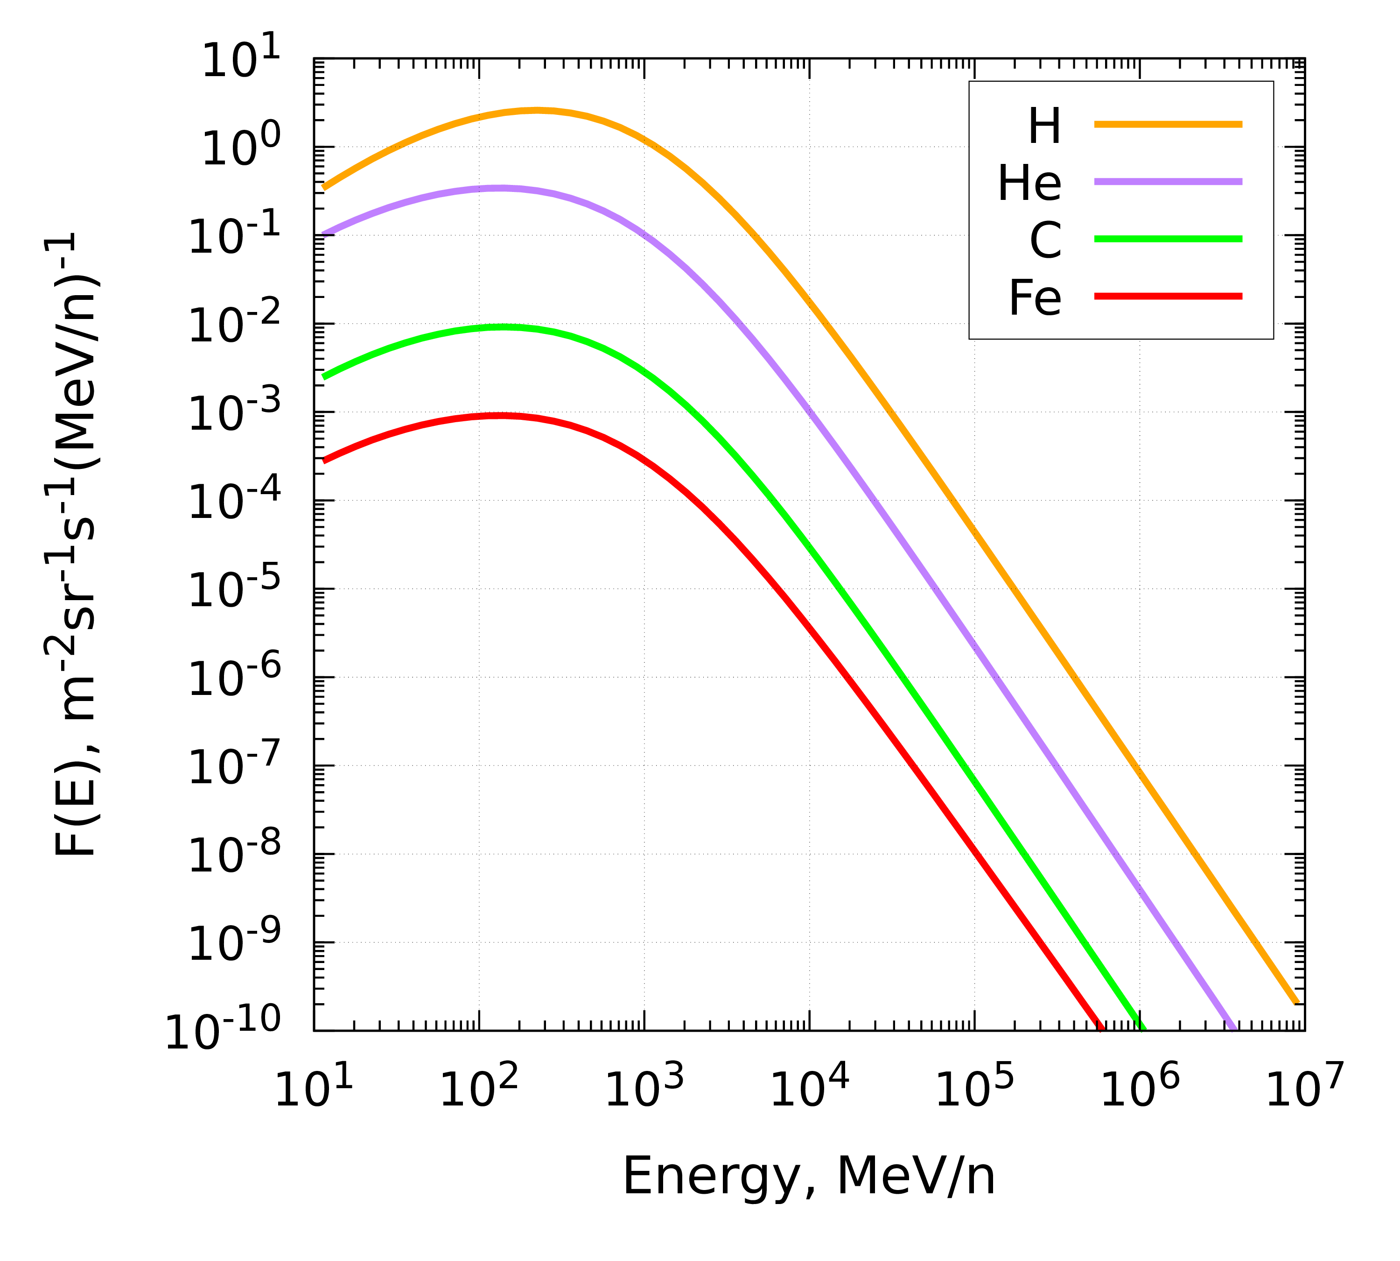
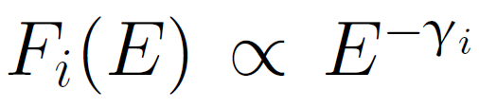
Relevance
protons and helium nuclei ~99%
GCR
galactic cosmic rays
GCR composition by charge
Assessment of the astronaut radiation risk due to GCR is the most important task of space radiobiology
High energy even up to TeV and higher!
The main part of the total fluence value (~99%)
GCR energy spectra
Notes:
Astronaut’s exposure to cosmic radiation on long-duration missions in deep space is a main limiting factor of space exploration and the most important and permanent source of space radiation is galactic cosmic rays (GCR) which is a multi-component and wide energy range radiation. The major charged components of the GCR are nuclei as you can see from the charge distribution on the slide. This ionizing radiation significantly increases cancer mortality risk to astronauts and the possibility of astronaut’s erroneous decisions during the mission, which can lead to its failure. Thus, assessment of the astronaut radiation risk is the most important task of space radiobiology.

Slide 3
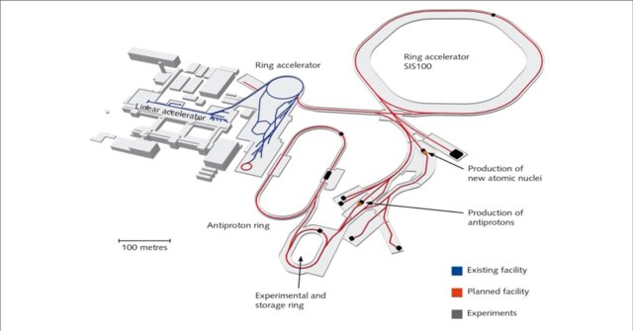
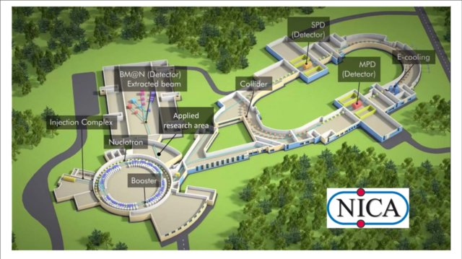
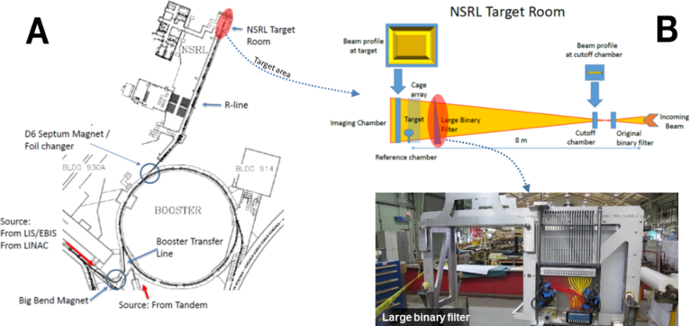
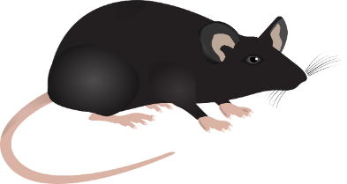
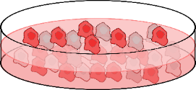
Ground-based experiments
NASA Space Radiation Laboratory (NSRL) at Brookhaven RHIC (USA)
GSI/FAIR in Darmstadt (Germany)
JINR NICA facility
p, He-4, C, Fe, …
Mixed field of p, He-4, Z=3...28 + secondaries (n, e-, gamma etc)
?
Beam
More accurate approach would be...
One type of particle in beam per irradiation with a fixed energy, short-term exposure, unidirectional
Beam
Biological objects
Multi-component field with a wide energy spectra, chronic exposure, isotropic
Biological objects
Setup for most current experiments
GCR Simulator
Notes:
Experimental research in the field of space radiobiology is carried out on charged particle accelerators (some of facilities are shown on the slide). Nevertheless, a number of problems are found in such experiments, from which it can be concluded that they are still cannot accurately reproduce the radiation conditions of space. As a rule, a biological object in terrestrial experiments is exposed to short-term exposure to monoenergetic and unidirectional particles of one type with relatively large dose rates, in the best case, to a set of particles with different, but still fixed energies. And in space, irradiation occurs simultaneously with all possible particles, isotropically and in the widest energy range, therefore, it is fundamentally possible to have a synergistic effects with the combined action of radiation with different physical characteristics. Therefore, the question of the discrepancy between experimental and real irradiation conditions in space remains open. To overcome these issues we could use the so-called GCR simulator, to recreate in experiments the necessary radiation field close to the cosmic one.

Slide 4

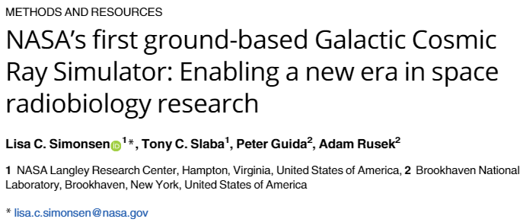
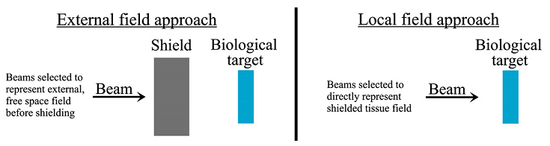

NASA GCR Simulator concept
Active approach - beam changes over the irradiation time
Key issues
Difficult to implement on other accelerators
The spectra are «quasi» continuous
Irradiation is sequential rather than simultaneous
The setup is complicated in general
The idea behind this approach is to reproduce the complex radiation field in space with the use of fast switching beams rapidly changing both the type and the energy of particles in beam
Notes:
NASA is the pioneer in this field. They have announced the creation of a GCR simulator which is based on a booster of collider RHIC and is capable of consistently delivering protons and nuclei to simulate the mixed GCR field in energy range up to 1 GeV/n.
Continuous particle spectra of GCR are reproduced with a set of discrete monoenergetic beams of various nuclei which rapidly changing over the irradiation time, that’s why this approach is also called “active”. However, it has many disadvantages, firstly, it was proposed only for the RHIC, and therefore it is difficult to implement on other accelerators. Secondly, the NASA simulator provides only a “quasi” continuous spectra as it is shown on the slide. Thirdly, there is a time gap in the impact of particles with different linear energy transfer (LET) on a biological object, so irradiation occurs sequentially rather than simultaneously, in that way, it is not possible to assess the synergistic effect. Finally, the proposed method is quite difficult to implement in general.

Slide 5
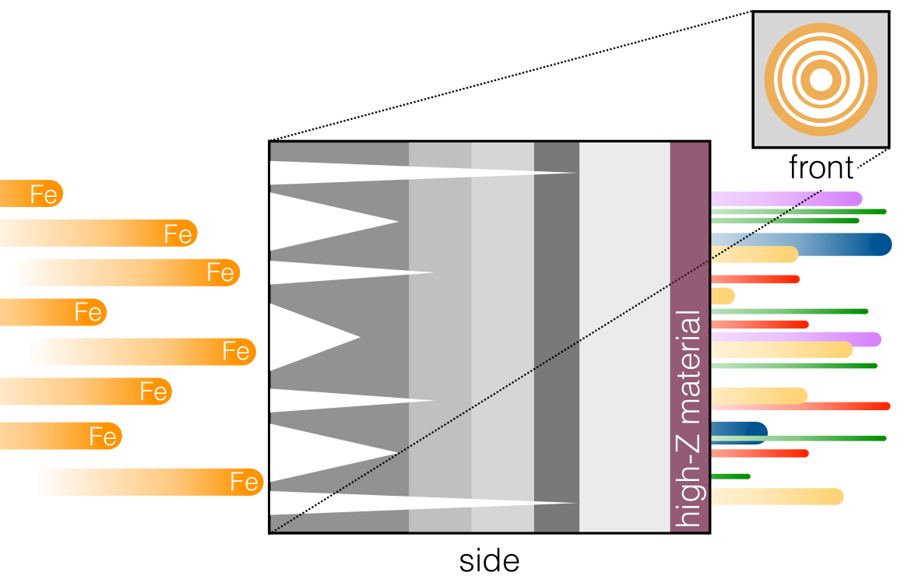
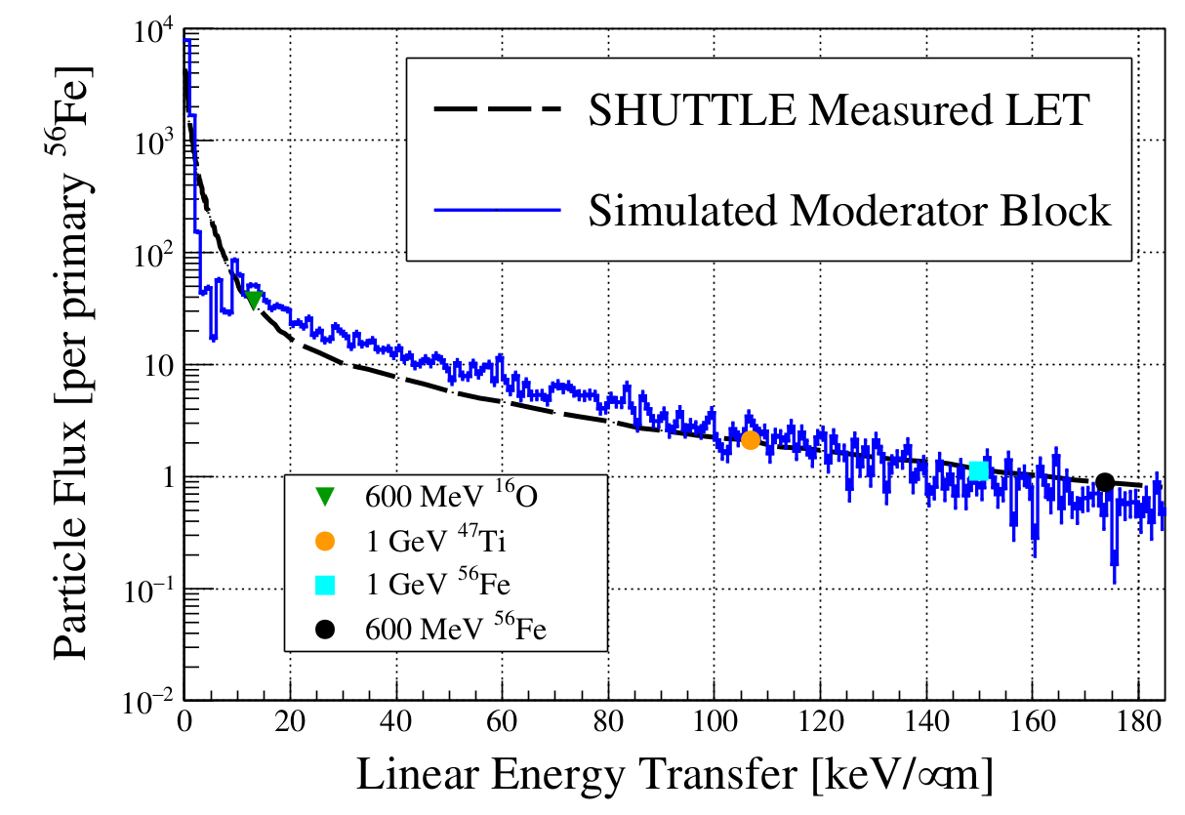
The passive GCR Simulator concept (J. Chancellor et al)
Passive approach - beam remains the same over the irradiation time
E = 1 GeV/n
n, γ, π, p, d, t, ³He,
α, nuclei with 2< Z≤ 26
Key issues
The specific design of the “moderator block” is not revealed (under patent)
The authors declare only the reproduction of the general LET spectrum
May lack of some GCR particles with some energies
The uniformity of the fields of secondary particles behind the moderator block may not be ensured
In general, this LET spectrum may be reproduced only by protons and helium ions with wide energy spectra
In this concept, the desired mixed radiation field simulating the radiation environment in space is created by a single monoenergetic Fe beam bombarding the special “moderator block”
Notes:
A fundamentally different approach of the simulator was proposed in the work by Jeff Chancellor and others, where the only one beam of iron nuclei with an energy of 1 GeV/n and a single complex polyethylene converter are used. This approach can be considered as a “passive”, meaning that the beam parameters remain the same during irradiation time and the special so-called moderator block ensures the continuity of the energy spectra of all secondary particles behind the block and irradiation is simultaneous.
However, the authors do not disclose specific details of the moderator block design and, to prove the effectiveness of the method, they only compare the final particle LET spectrum behind the simulator with the LET spectra measured in space. The important notice is that this total LET spectrum, in principle, could be reproduced only with the use of a few types of particles, for example: wide energy spectra of protons and helium nuclei, so this setup may lack of some heavy nuclei. Another problem of this method is the difficulty of ensuring the uniformity of the fields of secondary particles behind the moderator block.

Slide 6
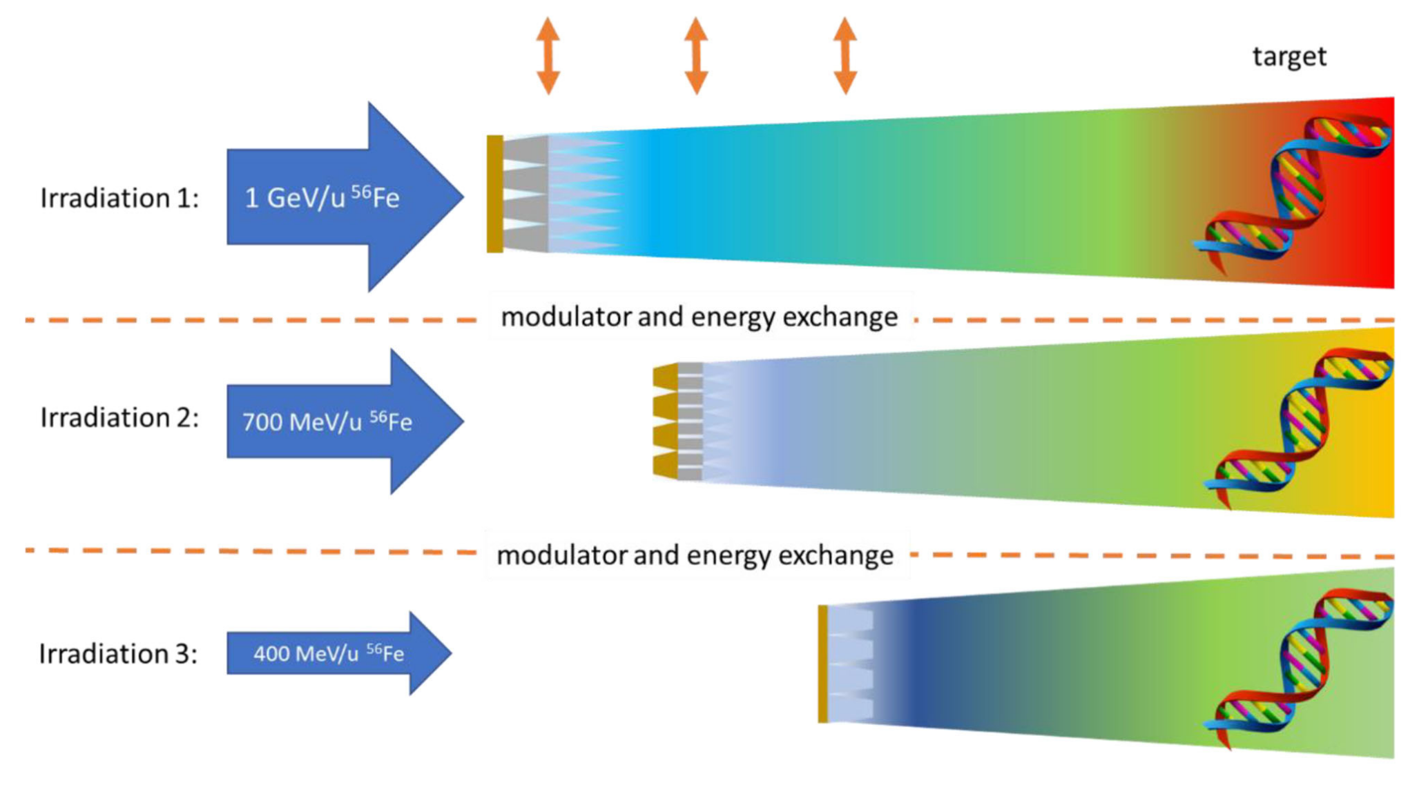
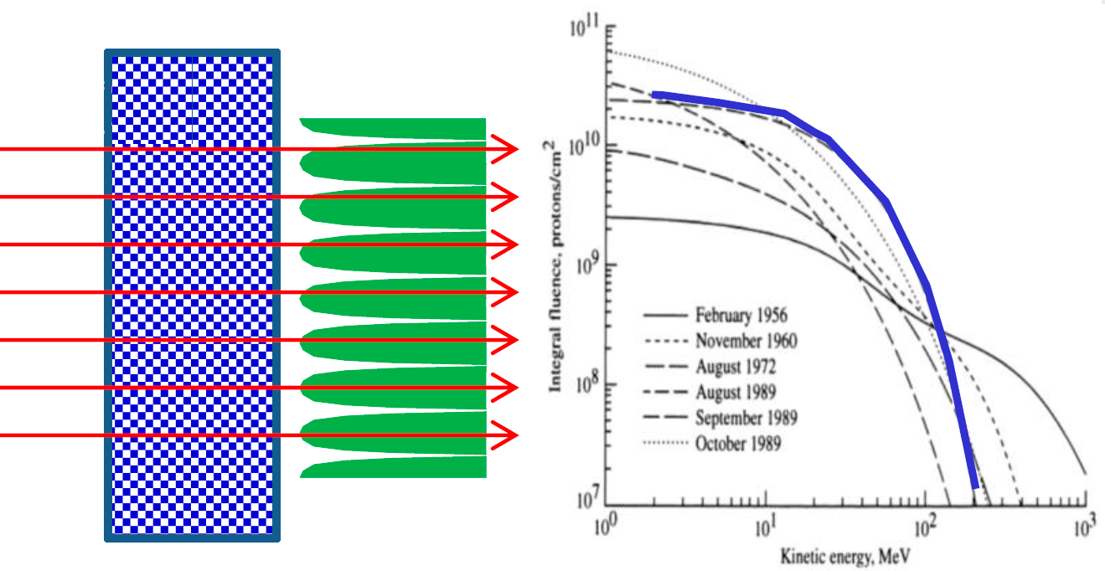
The hybrid active-passive GCR Simulator concept by ESA/GSI
Hybrid active-passive approach - parameters of beam change and the moderator changes over the irradiation time
Foam LN300
Foam is used for additional beam filtering
Key issues
The production of the modulators is difficult and requires high precision (a 3D printer is used)
Testing was carried out only for the proton spectrum during the SPE, so it is still unclear whether this approach is suitable for successful GCR simulation
Irradiation is sequential rather than simultaneous
The uniformity of the fields of secondary particles behind the modulators may not be ensured
4 cm
The first version of simulator reproduces only spectrum of protons from SPE
The concept employs a combination of geometrically complex, periodic, multi material, passive beam modulators and a number of actively varied energy of a single nuclei species to produce the desired field of radiation
Notes:
Another GCR simulator was recently proposed by European Space Agency (ESA). The so-called hybrid active-passive simulation approach designed for GSI and the future FAIR facility employs a combination of geometrically complex passive beam modulators and a number of actively varied energies of a single iron nuclei to produce the desired field of radiation from GCR. The main differences between this simulator and the one from the previous slide are the use of a set of three iron beam energies. However, the problem of uniformity of the radiation field behind the simulator remains not completely solved. This problem is related to the use of long and thin conical needles in the simulator design, this also means that such a simulator is difficult to produce. Currently, the authors tested this concept only on a proton beam to recreate spectrum from solar particle event, so, it is still unclear whether this approach is suitable for the successful GCR simulation.

Slide 7
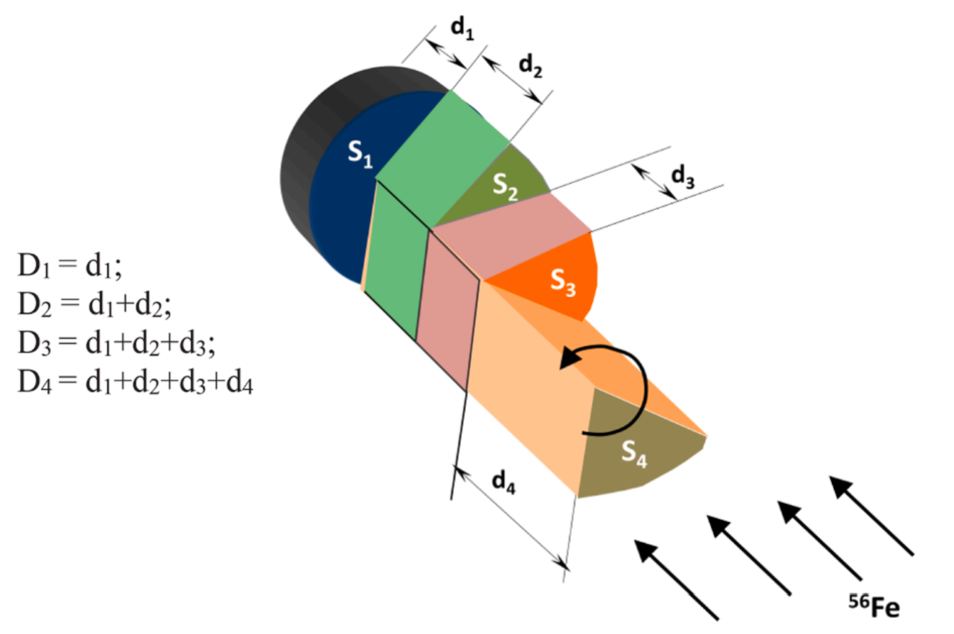
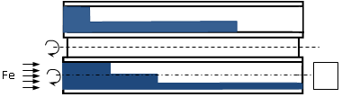
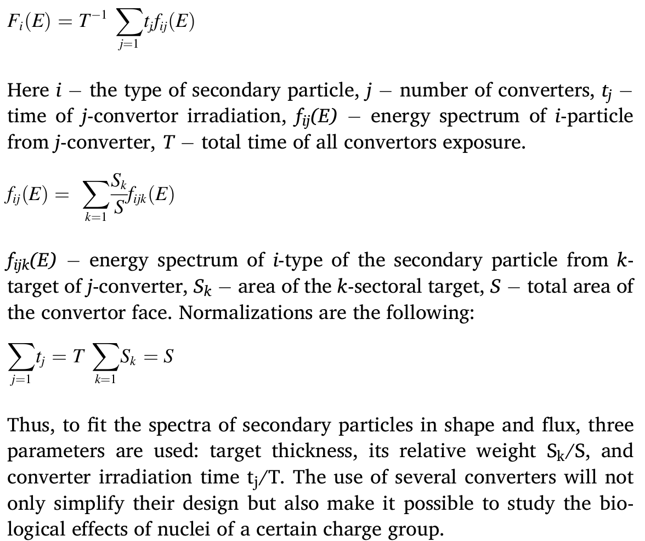
A new type of ground-based simulator by LRB JINR
Revolver drum type setup to change the converters on a beam
Max length is 50 cm
convertors
area of irradiaton of biological object
3D visualization
Convertor design
10 cm diameter
The Nuclotron will provide a beam of iron nuclei to the radiobiological channel at an intensity of 10⁸ ions per pulse at a repetition rate of 0.1 Hz
Key features
The proposed method makes it possible to reproduce all GCR nuclei with Z ranging from 1 to 27 with similar to space abundances
The simulator reproduces both LET and energy spectra of GCR particles
The uniformity of the fields of secondary particles behind the convertors is ensured by rotation
Irradiation is almost simultaneous with a mixed types of particles
The setup is simple in comparison to other simulators and could be done on accelerators capable of delivering uniform iron beam with 1 GeV/n energy
Notes:
In this regard, there is still exist a request to create a simpler and more accurate GCR simulator. That’s why we propose a new type of GCR simulator using another approach. The uniform field of iron nuclei with energy of 1 GeV/n will be formed by the pencil beam scanning technique at the radiobiological channel for applied researches on the Nuclotron. Our simulator uses a special set of cylindrical polyethylene converters consisting of sets of targets in form of a circular sector with different thicknesses as it is shown on the slide. Converter at the irradiation process is rapidly rotating around the beam axis. And this is a fundamental difference from the two previously discussed simulators. The initial projectile nuclei falling on a circular sector with a fixed thickness generates a uniform field of the required projectile fragments in the area behind this target. When the circular sector of the target rotates, a uniform field of projectile fragments fills the entire area of the converter circle. To fit the required spectra, three parameters are used: target thicknesses, its relative area weight Sk/S, and converter irradiation time tj /T as it is shown on the slide.
The fast change of converters on the beam can be carried out by a device such as a revolver drum as it is shown on this 3D visualization. The rest time between the beam pulses on the Nuclotron is enough to change the converter. Biological samples can be placed directly behind the simulator. This design ensures the uniformity of the fields of all secondary particles behind the simulator at the location of the irradiated samples.

Slide 8
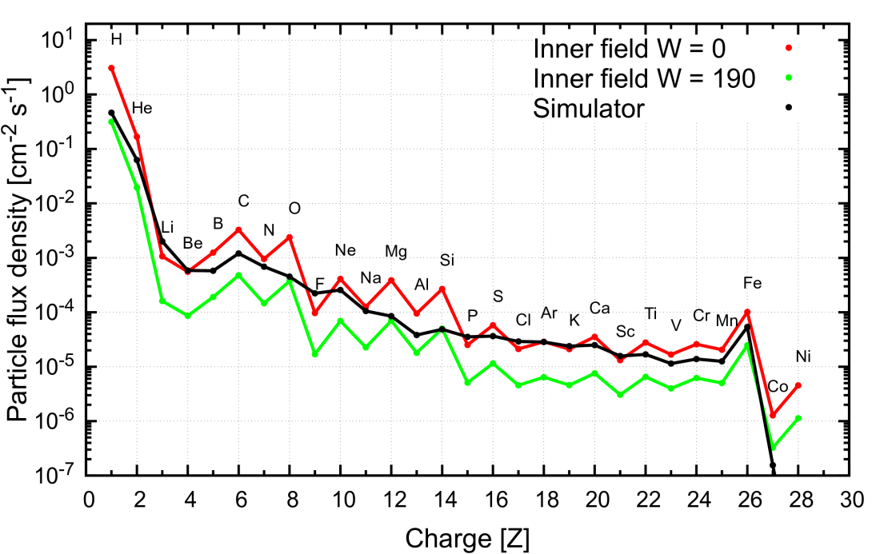
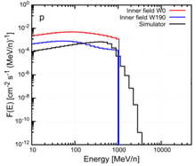
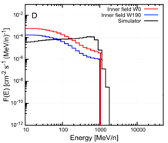
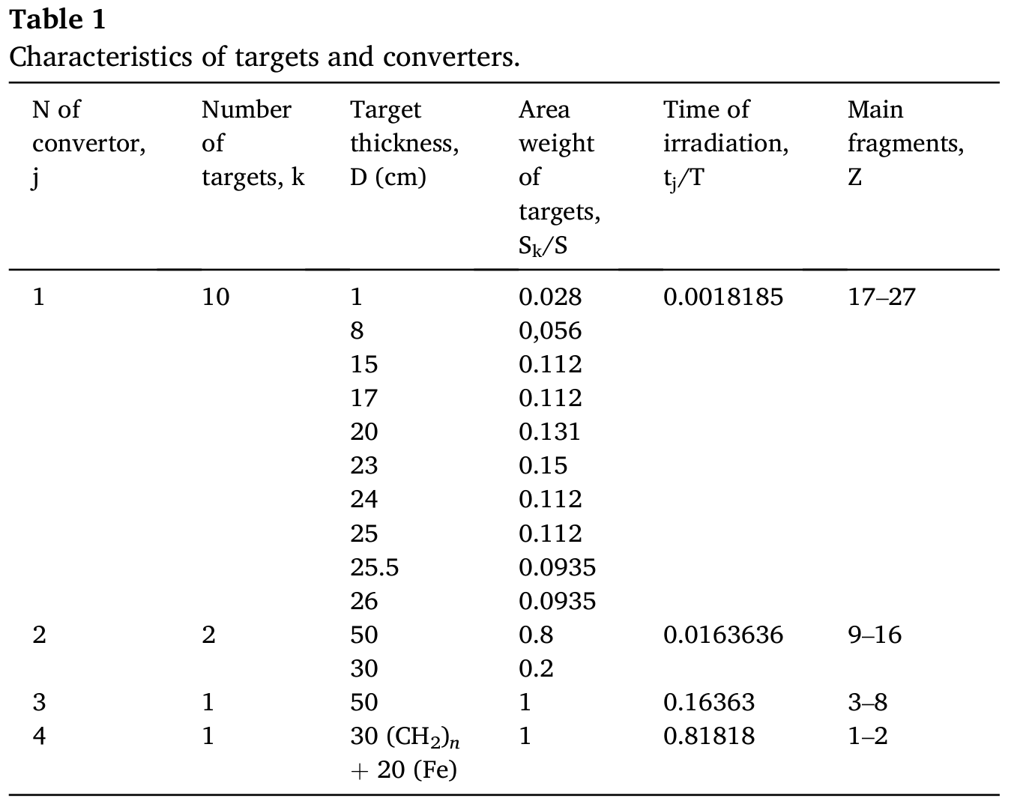
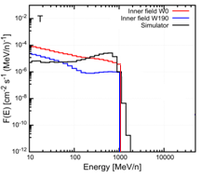
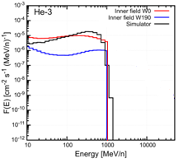
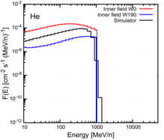
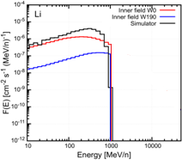

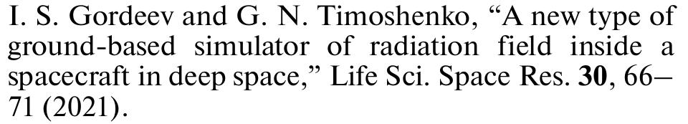
MC modeling and results
Parameters for the simulator to reproduce the data
Comparison of reproduced by simulator fluence abundance with the previous calculations inside a spacecraft ones
Reference data is from previous work:
Normalization: beam intensity = 20 iron nuclei per second
The calculation of the energy spectra of the secondary particles behind each target for the simulator was carried out by the PHITS code ver. 3.20 (physical models JQMD + GEM and JAMQMD + GEM).
Paper describing a new type of simulator:
Comparison of reproduced by simulator energy fluence spectra
Notes:
For the verification, calculations of the energy spectra of the secondary particles behind each target were performed using PHITS code. For the production of all fragments from a proton to iron nuclei 14 targets are applied that are responsible for various groups of nuclear fragments. These targets were grouped into four cylindrical converters. Table 1 shows characteristics of converters.
As a criteria of the simulator validity the comparison with the data of previous calculation were considered and used as a reference. It can be seen from figures that the charge distribution behind the simulator satisfactorily corresponds to the charge distribution of reference data in the minimum-maximum corridor of SA. This indicates that the proposed simulator design correctly reproduces the averaged component composition of reference data up to cobalt nuclei.

Slide 9
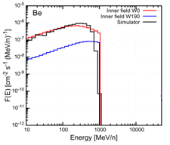
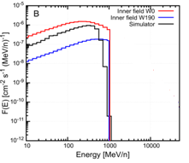
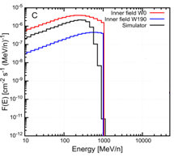
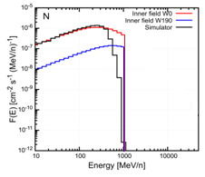
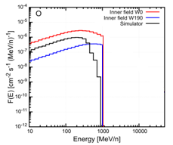
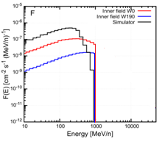
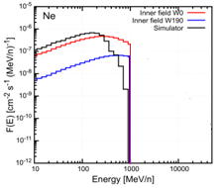
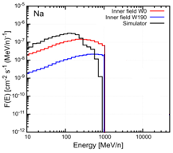
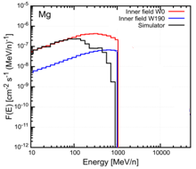
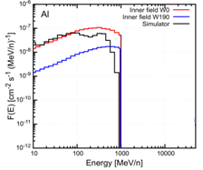
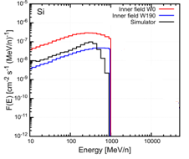
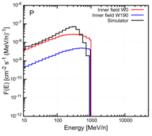
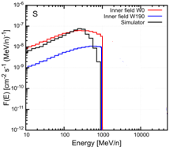
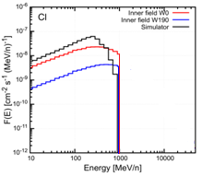
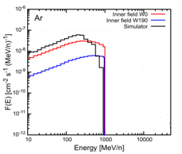
MC modeling and results
Notes:
The spectra of most secondary nuclei behind the simulator also fit into the corridor of reference spectra. As can be seen, satisfactory agreement is observed even for the cobalt nuclei and the largest difference is observed for light nuclei, gamma, neutrons and pions. This can be improved, considering another parameters and the design of converters.

Slide 10
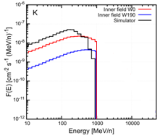
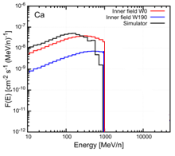
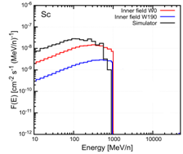
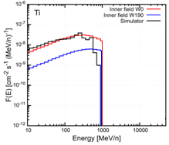
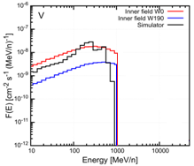
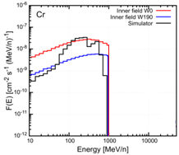

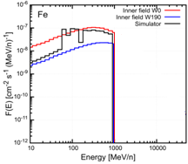




MC modeling and results
Notes:
The spectra of most secondary nuclei behind the simulator also fit into the corridor of reference spectra. As can be seen, satisfactory agreement is observed even for the cobalt nuclei and the largest difference is observed for light nuclei, gamma, neutrons and pions. This can be improved, considering another parameters and the design of converters.

Slide 11


MC modeling and results
Normalization: beam intensity = 140 iron nuclei per second
Comparisons of LET spectrum from previous MC calculations inside the spacecraft and available data from measurements (RAD, Liulin-MO) in space with the simulator result
A patent for a new method has been registered
Notes:
Confirmation that the simulator correctly reproduces the radiation doses to astronauts inside the spacecraft is the agreement of the total LET spectrum. The goodness of fit is shown on this slide, agreement is satisfactory.

Slide 12
Comparison of GCR simulator concepts
GCR Simulator | LET spectrum | Energy spectra of GCR | Irradiation is simultaneous | Ease of implementation | Possibility to create all the particles including secondaries | Uniformity of the fields | Experimental validation
NSRL | + | ? | - | - | - | + | +
J. Chancellor et al | + | ? | + | + | + | - | +
GSI | ? | ? | - | - | ? | - | +/-
LRB JINR | + | + | + | + | + | + | -
Thanks for your attention!
Notes:
Finally, we can sum up the discussed features of the simulators in the table. Calculations show that a new proposed method is freed from disadvantages of previously discussed simulators, however, the experimental validation must be considered to prove the calculated results.
Thanks for your attention!

