Slide 1


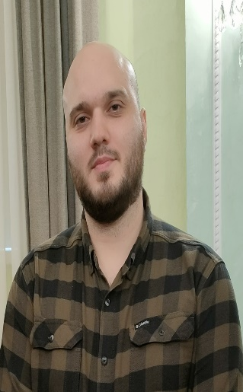

1
23
“Effects of Geometrical and Physical Properties of Cantor Structure for Gas Sensing Applications”
By
Zaky A. Zaky
Zaky.a.zaky@science.bsu.edu.eg
Ph.D. Student,
Assistant Lecturer at physics department, Beni-Suef University, Egypt.

Slide 2
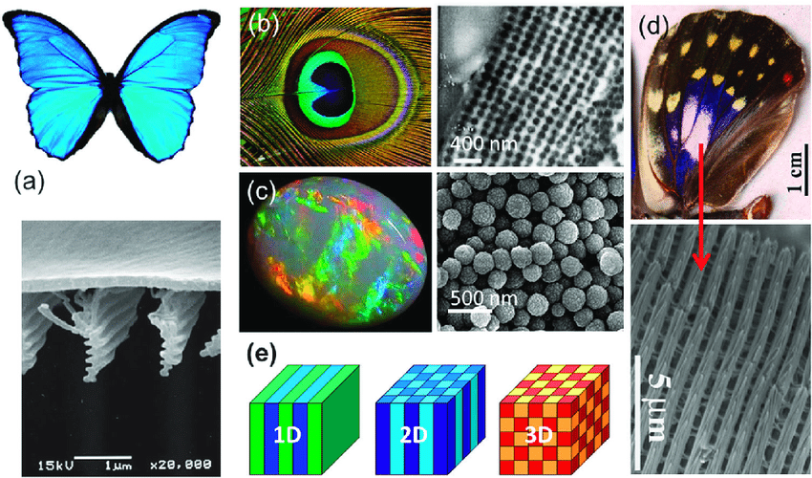
Introduction
2
23
Hui Wang et al. 2013
Notes:
Photonic crystal is a periodic structure in one, two or all three directions

Slide 3
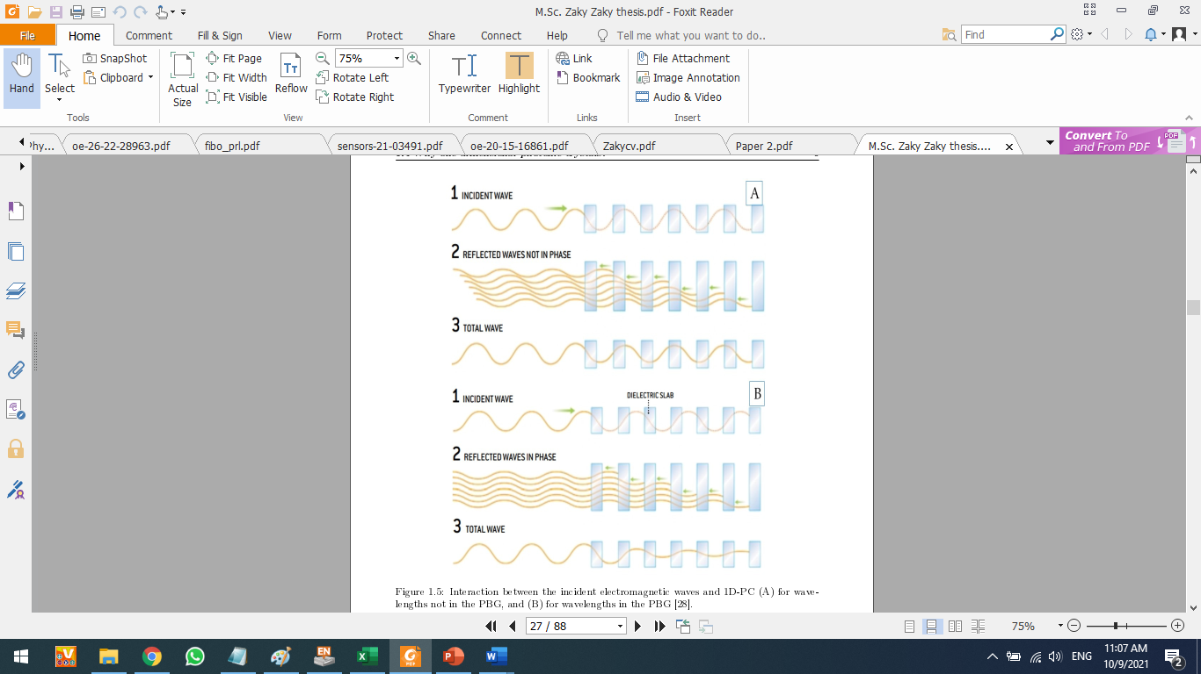
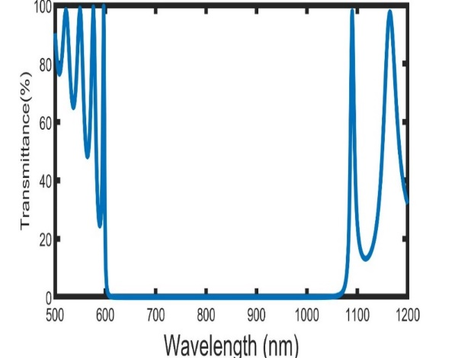
Introduction
3
23
Yablonovitch et al. 2001
Notes:
According to Yablonovitch explanation, When the light falls on the PC, some photons are allowed to propagate through the structure but others are forbidden due to multiple Bragg scattering
This range of forbidden wavelengths is called PBG.

Slide 4
4
23
Applications
Sensors
Smart Widows
Solar Cells
Filters
Notes:
PC can be used as….

Slide 5
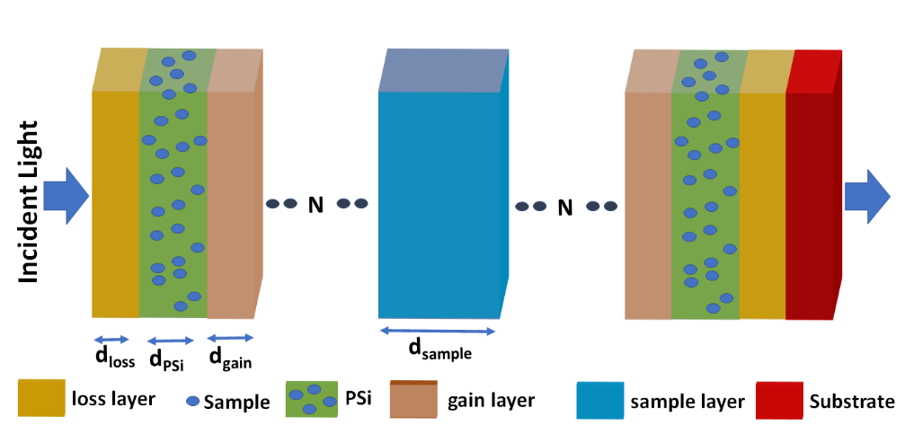
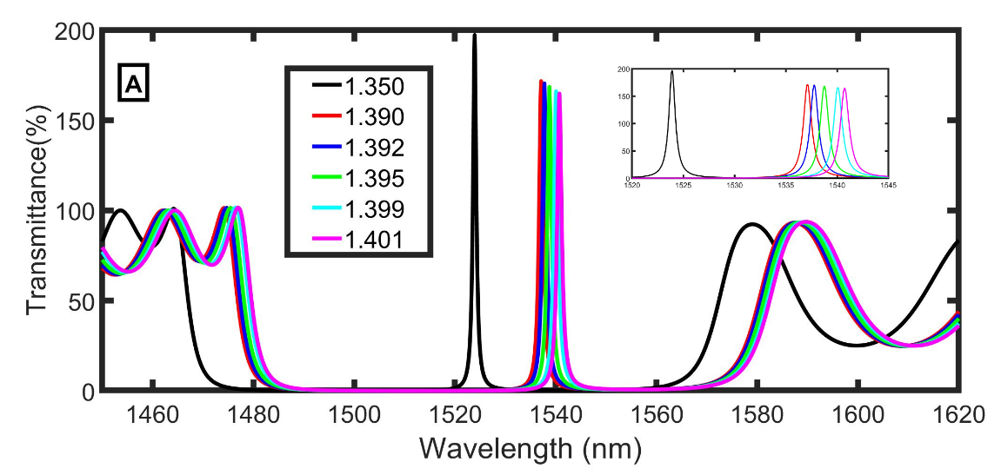
Sensor Applications
5
23
Different strategies to make PCs qualified:
1. Defect layer
Zaky, Z.A., Alamri, S., Zhaketov, V.D., Aly, A.H. Refractive index sensor with magnified resonant signal. Scientific Reports 12, 13777 (2022).
Notes:
I will talk about using PC in sensing applications.
There are different strategies to make PCs qualified to be used in sensing applications.

Slide 6
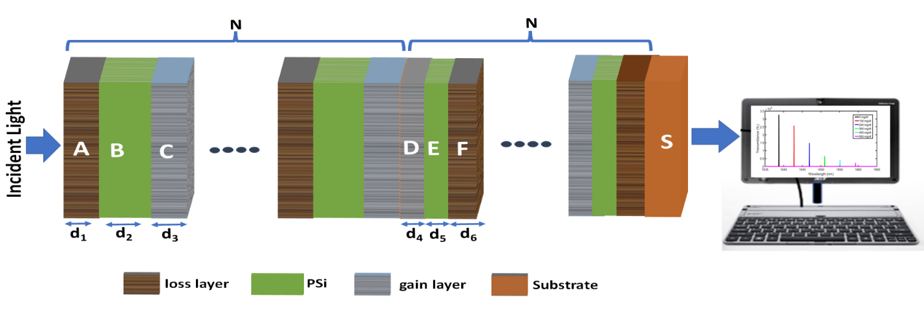
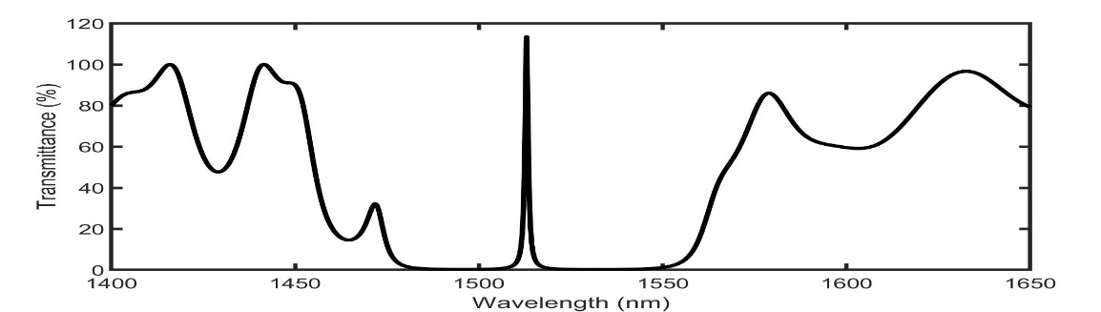
Sensor Applications
6
23
Different strategies to make PCs qualified:
2. Topological edge state
Under review paper
Notes:
I will talk about using PC in sensing applications.
There are different strategies to make PCs qualified to be used in sensing applications.

Slide 7
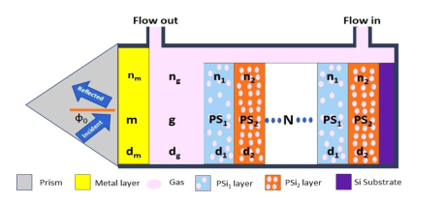
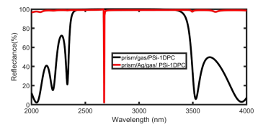
Sensor Applications
7
23
Different strategies to make PCs qualified:
3. Tamm Resonance with metals
Zaky, Z. A.,et al. Refractive index gas sensor based on the Tamm state in a one-dimensional photonic crystal: Theoretical optimization. Scientific Reports 10, 9736, (2020).
Notes:
Tamm resonance is a coupling of the collective charge oscillations with electromagnetic waves.
Unlike the resonance of surface plasmon resonance (SPR), Tamm resonance can be excited at any incident angle by both TE- and TM-polarized light without using diffraction gratings or prisms.

Slide 8
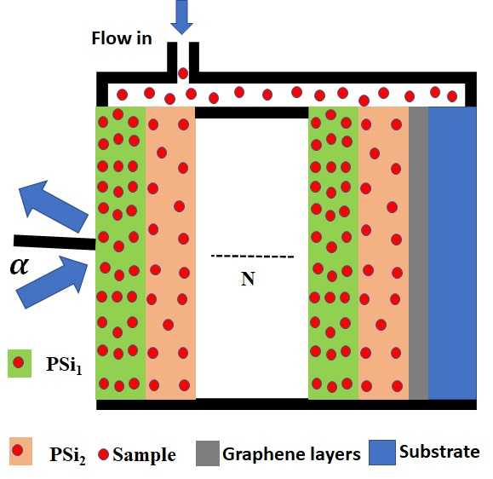
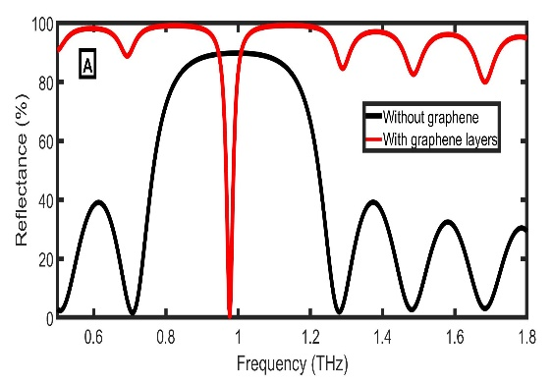
Sensor Applications
8
23
Different strategies to make PCs qualified:
3. Tamm Resonance with Graphene
Zaky, Z. A.,et al. Modeling of Novel Biosensor Using Tamm Resonance Excited by Graphene. Applied Optics, 60(5), 1411-1419, (2021).
Notes:
As the conductivity of graphene has a negative value at THz range and behaves as a “metal”, We used it to excite Tamm resonance

Slide 9
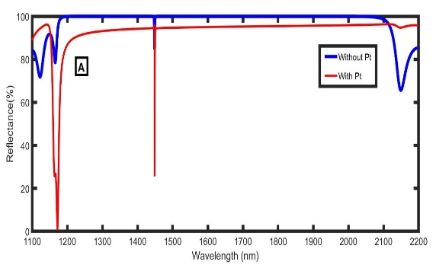
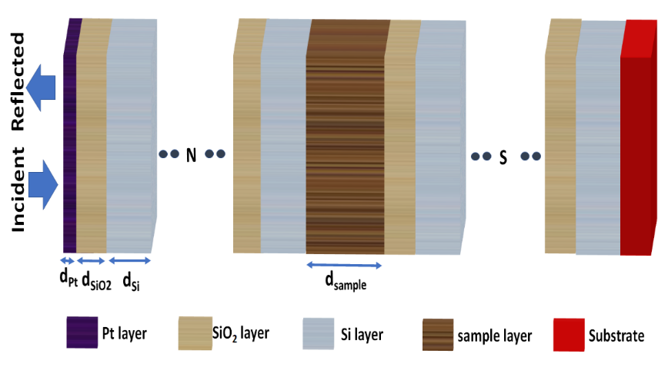
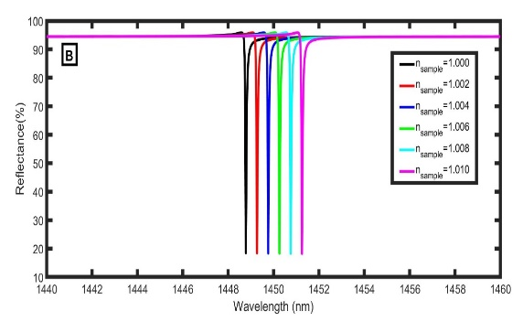
Sensor Applications
9
23
Different strategies to make PCs qualified:
4. Fano Resonance by Coupling Between Tamm and Defected Mode Resonance
Zaky, A. Z., et al., Design and Analysis of Gas Sensor Using Tailorable Fano Resonance by Coupling Between Tamm and Defected Mode Resonance. Accepted in Plasmonics (2022),
Notes:
Fano resonance is formed when a confined mode interacts with a continuum mode and has asymmetric edges.

Slide 10

10
23
Graphene or metals?
Notes:
The optical properties of graphene can be controlled with chemical doping or using an external gate voltage.
Also, graphene has higher stability than metals,
The main issue of using graphene is that

Slide 11
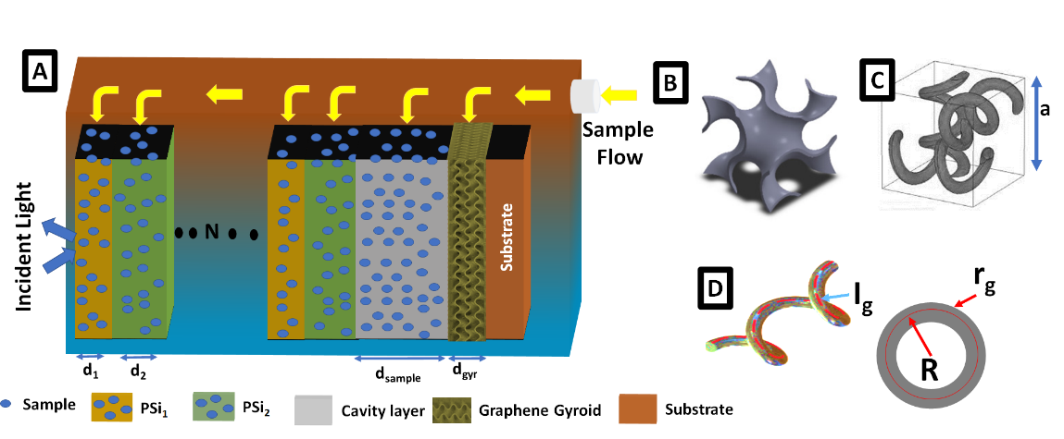
Sensor Applications
11
23
Graphene or metals?
Zaky, Z. A., Sharma A., Aly, A. H., Gyroidal Graphene for Exciting Tamm Plasmon Polariton as Refractive Index Sensor: Theoretical Study. Optical Materials, 122, 111684 (2021).

Slide 12
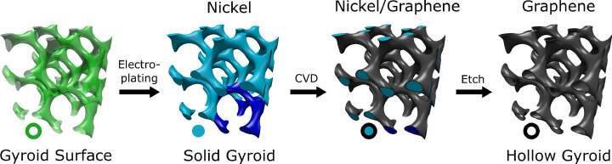
Sensor Applications
12
23
Nakanishi et al (2020)

Slide 13

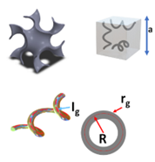
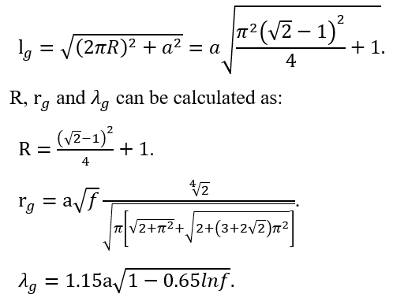

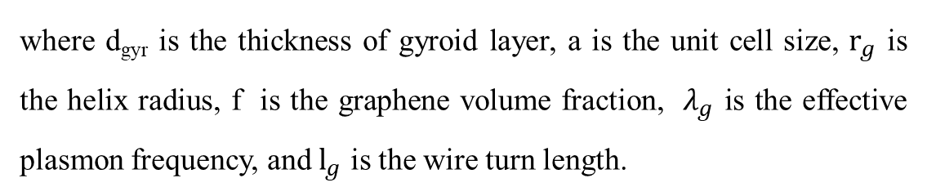
Materials and theoretical method
13
23
where d_{gyr} is the thickness of gyroid layer, a is the unit cell size, $r_{g}$ is the helix radius, f is the graphene volume fraction, $λ_{g}$ is the effective plasmon frequency, and $l_{g}$ is the wire turn length.
Bikbaev et al (2017)

Slide 14
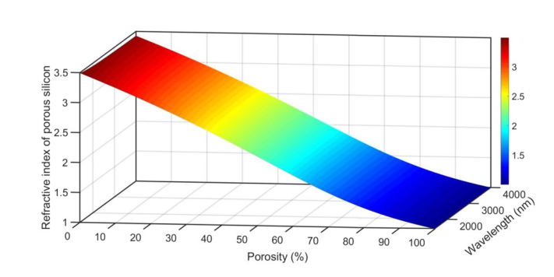
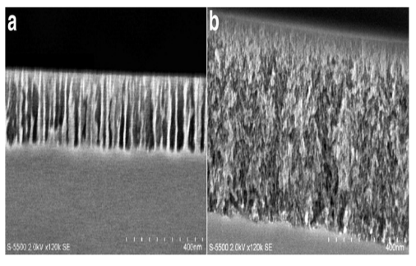
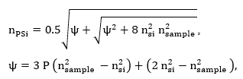
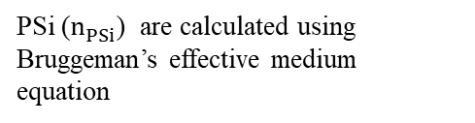
Materials and theoretical method
14
23
Refractive index of porous silicon
Loustau et al. 2013
PSi ($n_{PSi}^{ }$) are calculated using Bruggeman’s effective medium equation
Notes:
Why we use PSi?
PSi provides high surface area and low mass within small volumes
The optical properties of PSi can be controlled by changing the size of the pores and/or material that fills the pores.
Moreover, PSi is compatible with integrated circuits.
PSi multilayers can be experimentally prepared by electrochemical etching simple one-step.

Slide 15

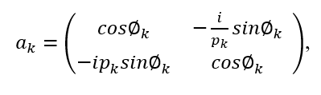

Materials and theoretical method
15
23

Slide 16
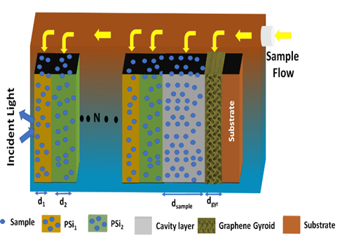
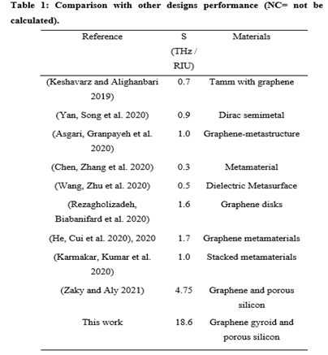
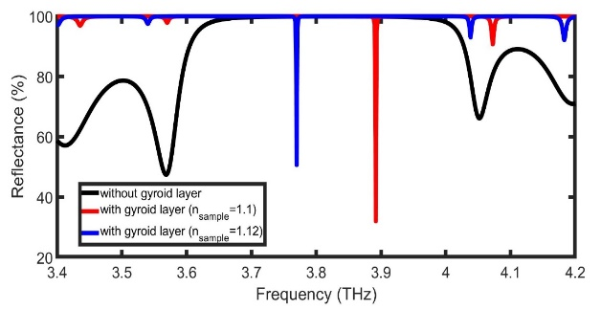
16
23

Slide 17
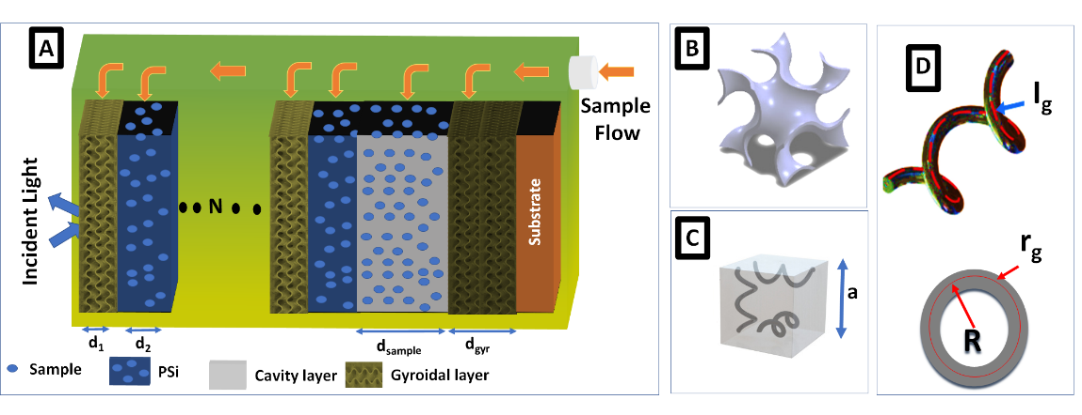
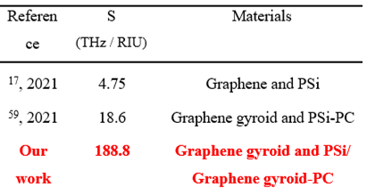
17
23
Zaky, Z. A., Aly, A. H., Gyroidal Graphene/Porous Silicon Array for Exciting Optical Tamm State as Optical Sensor. Scientific Reports, 11, 19389. (2021)

Slide 18
Current Study
18
23
“Effects of Geometrical and Physical Properties of Cantor Structure for Gas Sensing Applications”
Zaky, A. Z., Al-Dossari, M., Matar, Z. S., Aly, A. H., Effect of Geometrical and Physical Properties of Cantor Structure for Gas Sensing Applications. Synthetic Metals 291, 117167 (2022),

Slide 19
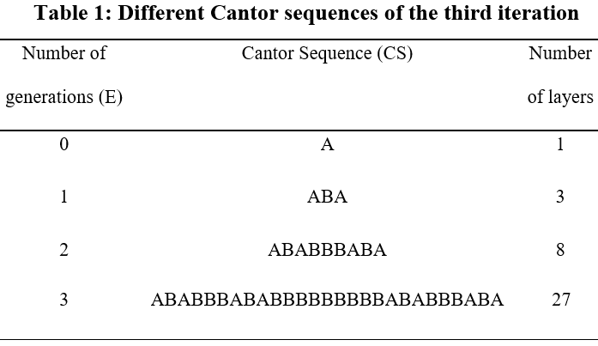
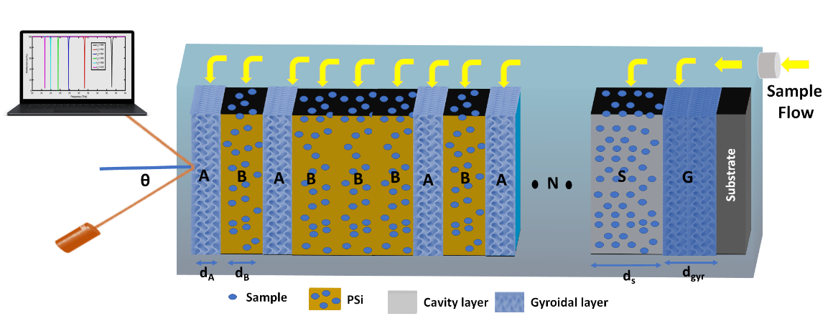
Current Study
19
23

Slide 20
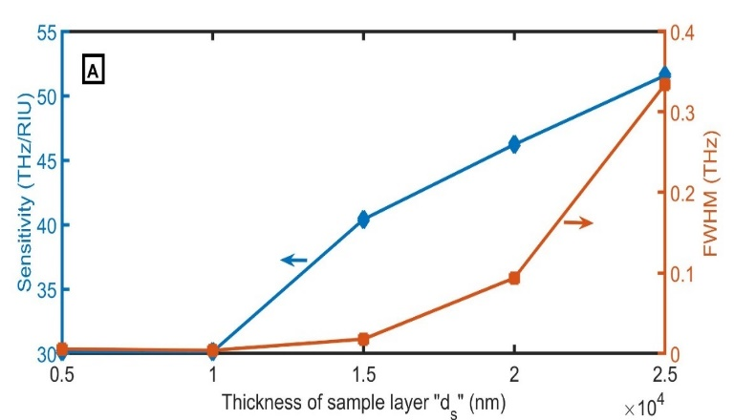
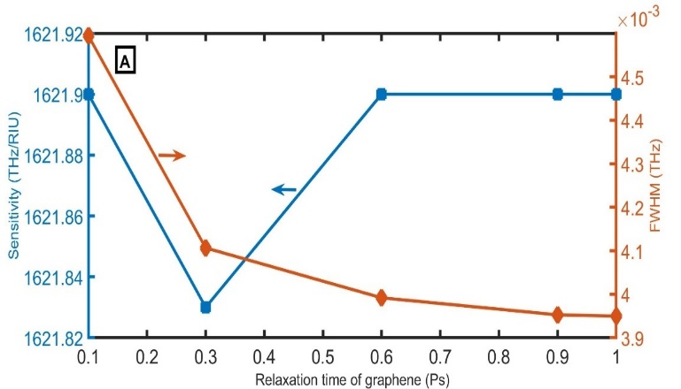
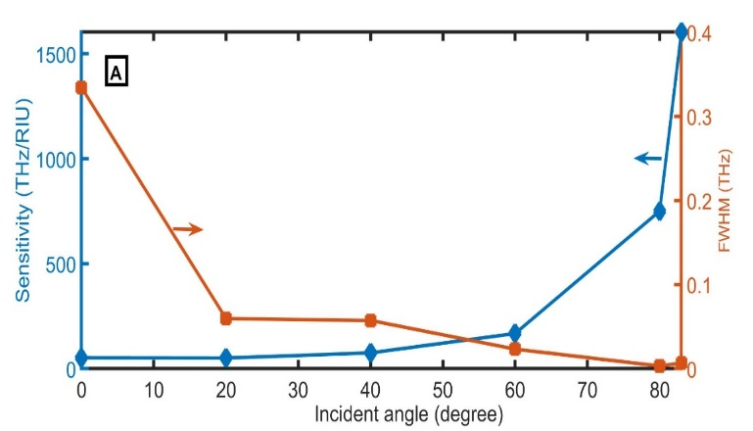
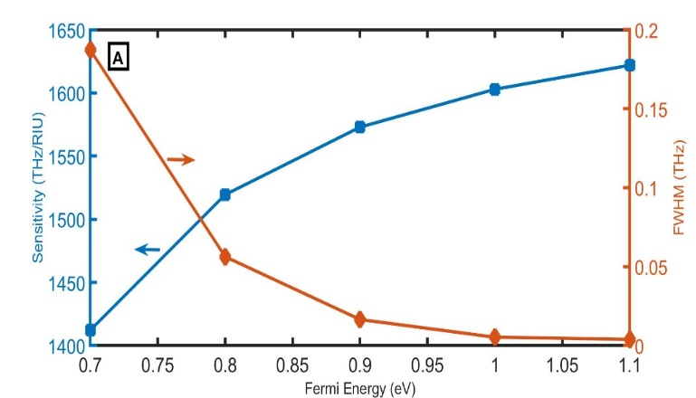
Current Study
20
23

Slide 21
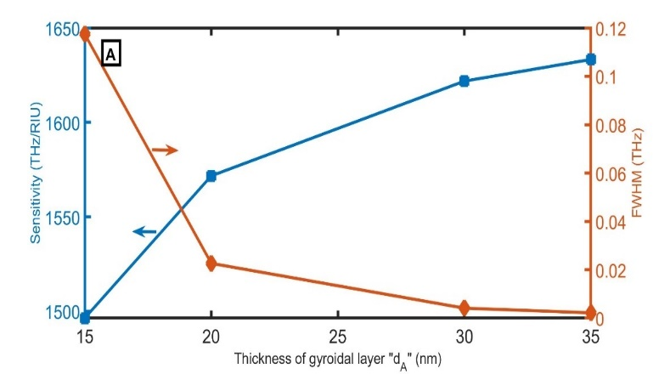
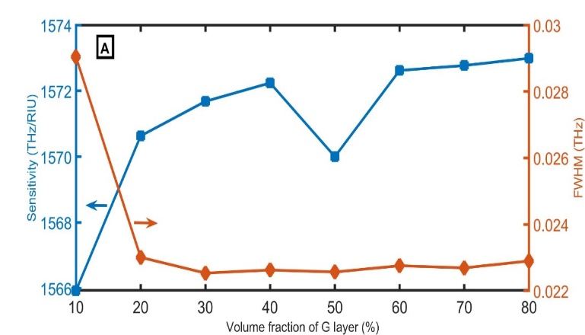
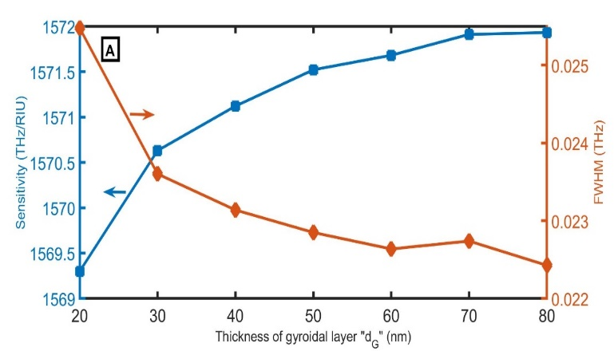
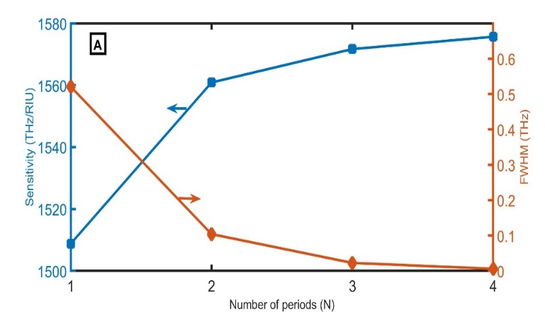
Current Study
21
23

Slide 22
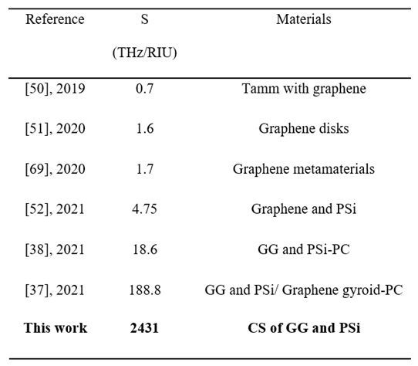
Current Study
22
23

Slide 23
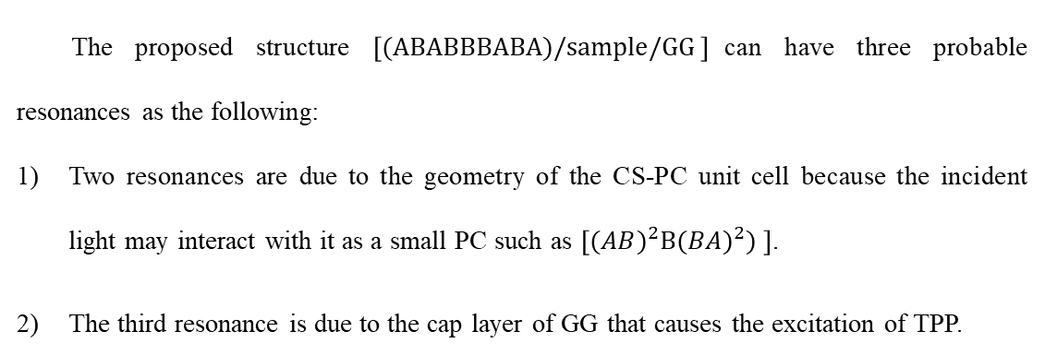
Current Study
23
23
The proposed structure $\left[(ABABBBABA)/sample/GG \right]$can have three probable resonances as the following:
Two resonances are due to the geometry of the CS-PC unit cell because the incident light may interact with it as a small PC such as $\left[({AB)}^{2}B({BA)}^{2}) \right]$.
The third resonance is due to the cap layer of GG that causes the excitation of TPP.

Slide 24
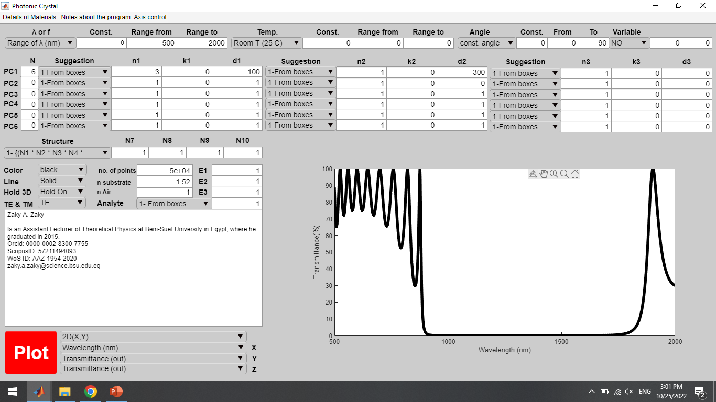
Tools

Slide 25
Thank you
Any Question?

Slide 26
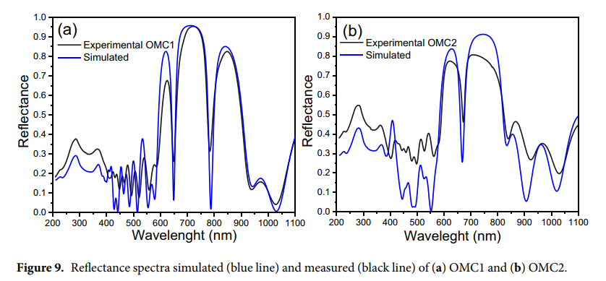
We used TMM in our study. Even though we believe that there will be some changes between the theoretical and experimental studies, the TMM method recorded results very close to experimental work (see Fig. 9 in Ref. ²³):
Ramirez-Gutierrez, C. F., Martinez-Hernandez, H. D., Lujan-Cabrera, I. A. & Rodriguez-García, M. E. Sci. Rep. 9, 1-15, doi:10.1038/s41598-019-51200-1 (2019).

