Slide 1
Scaling properties of anisotropic flow at Nuclotron-NICA energy range
Petr Parfenov^{1,2}, Arkadiy Taranenko²
INR RAS, Moscow, Russia
NRNU MEPhI, Moscow, Russia
The XXVI International Scientific Conference of Young Scientists and Specialists (AYSS-2022)
24 – 28 October 2022, JINR, Dubna
This work is supported by:
the RSF grant 22-12-00132, the Ministry of Science and Higher Education of the Russian Federation, Project "Fundamental properties of elementary particles and cosmology" No. 0723-2020-0041

Slide 2
Outline
Introduction
Scaling relations for anisotropic flow at RHIC
Scaling relations for anisotropic flow at SIS-AGS
Summary and outlook

Slide 3
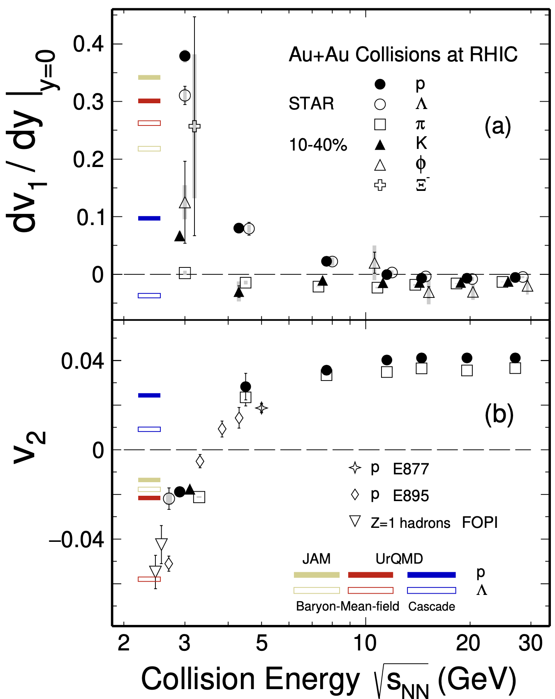
Anisotropic flow in Au+Au collisions at Nuclotron-NICA energies
M. Abdallah et al. [STAR Collaboration] 2108.00908 [nucl-ex]
$$\frac{dN}{dφ}∝1+2\sum_{n=1}{v_{n}\cos\left[n\left(φ−Ψ_{RP}\right)\right]}, v_{n}=\left\langle \cos\left[n\left(φ−Ψ_{RP}\right)\right]\right\rangle$$
Strong energy dependence of $dv_{1}/dy$ and $v_{2}$ at $\sqrt{s_{NN}}$=2-11 GeV
Makes it difficult to perform comparisons between different experiments for $v_{2}$ (change of sign with energy)
Anisotropic flow at FAIR/NICA energies is a delicate balance between:
The ability of pressure developed early in the reaction zone ($t_{exp}=R/{c_{s}}, c_{s}=c\sqrt{{dp}/{dε}}$) and
The passage time for removal of the shadowing by spectators ($t_{pass}={2R}/{γ_{CM}β_{CM}}$)
Goal of this work:
Perform scaling tests for anisotropic flow at Nuclotron-NICA energy range and make predictions what one can expect at BM@N ($\sqrt{s_{NN}}$=2.3-3.3 GeV) and MPD ($\sqrt{s_{NN}}$=4-11 GeV)
BM@N
CBM
MPD

Slide 4
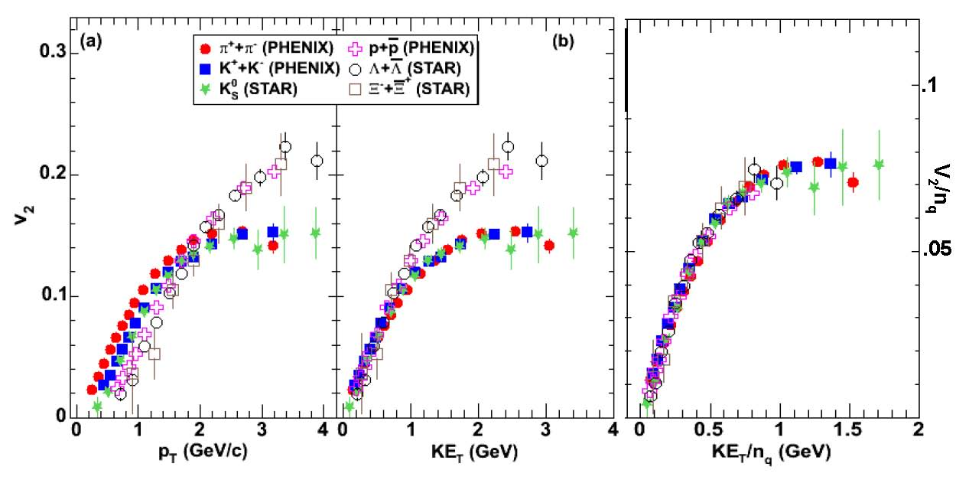
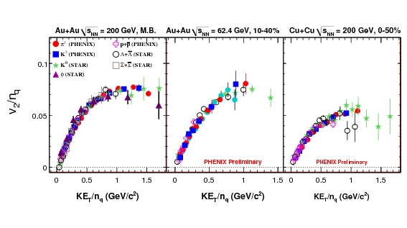
Scaling relations at RHIC/LHC – NCQ ($KE_{T}/n_{q}$) scaling
Phys. Rev. Lett. 98, 162301 (2007)
$\sqrt{s_{NN}}=200$ GeV
NCQ scaling: $v_{n}\left(p_{T}\right)→v_{n}/n_{q}^{n/2}\left(KE_{T}/n_{q}\right)$
$$n_{q}=\left\{\begin{aligned}2 for mesons \\ 3 for baryons\end{aligned}, KE_{T}=\sqrt{m^{2}+p_{T}^{2}}−m\right.$$
Baryons
Mesons
v₂ scaling
Significant part of flow at RHIC developed at partonic level
Scaling provides an additional constraint for the mechanism for hadronization at RHIC

Slide 5
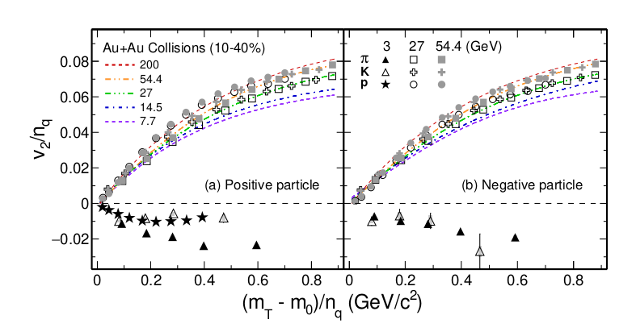
Dissapearence of partonic collectivity in $\sqrt{s_{NN}}=3$ GeV Au+Au collisions at RHIC
Phys. Lett. B 827, 137003 (2022)
Breaking of NCQ scaling at 3 GeV
“imply the vanishing of partonic collectivity and a new EOS, likely dominated by baryonic interactions in the high baryon density region”

Slide 6
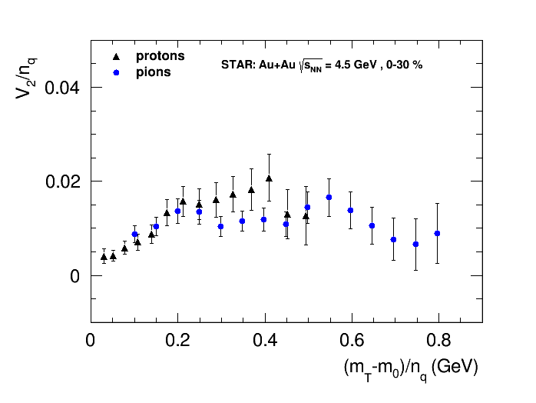
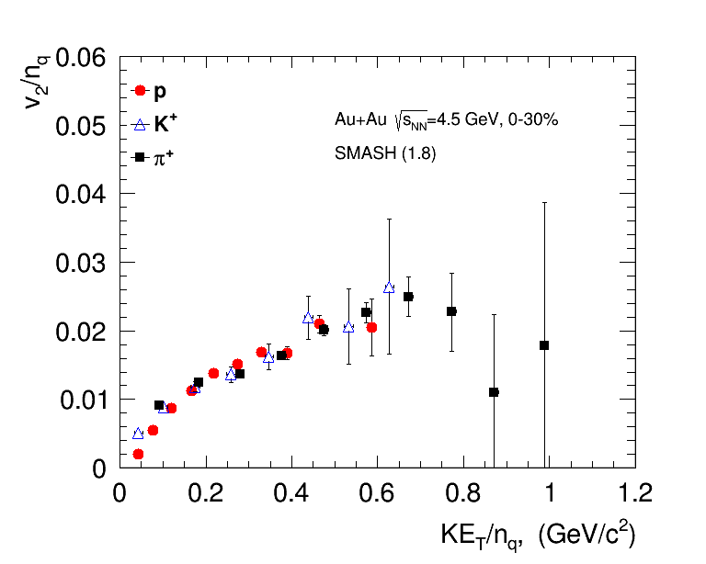
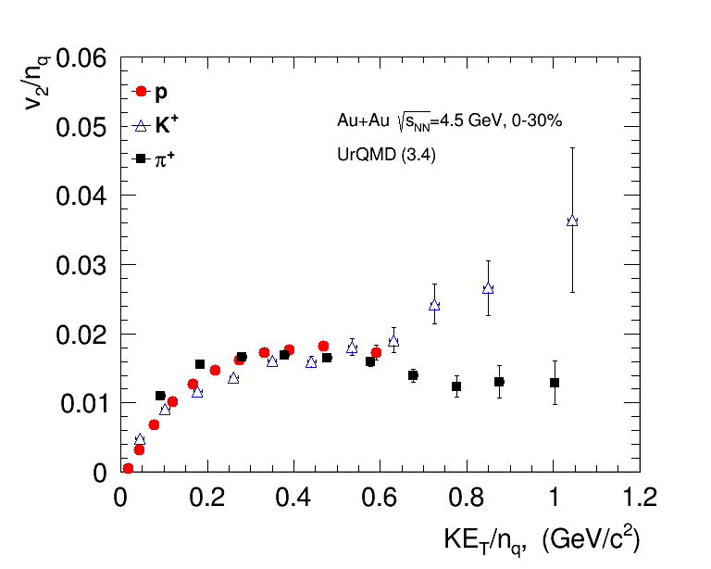
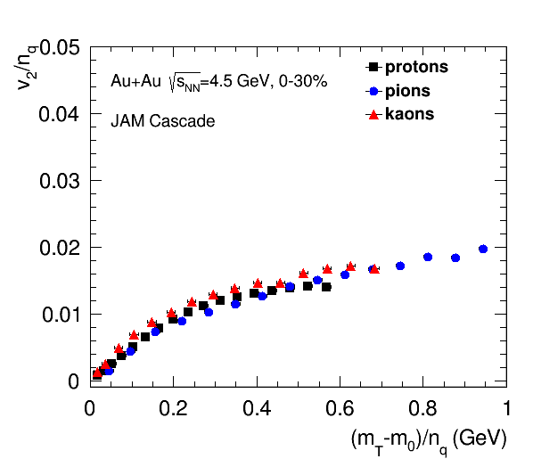
NCQ scaling: hybrid and cascade models
STAR Collaboration, arxiv.org/abs/2007.14005
Scaling holds up at 4.5 GeV in STAR data and pure string/hadronic cascade models (without partonic d.o.f.)
$KE_{T}/n_{q}$ scaling at 4.5 GeV might be accidental – more careful studies should be performed

Slide 7
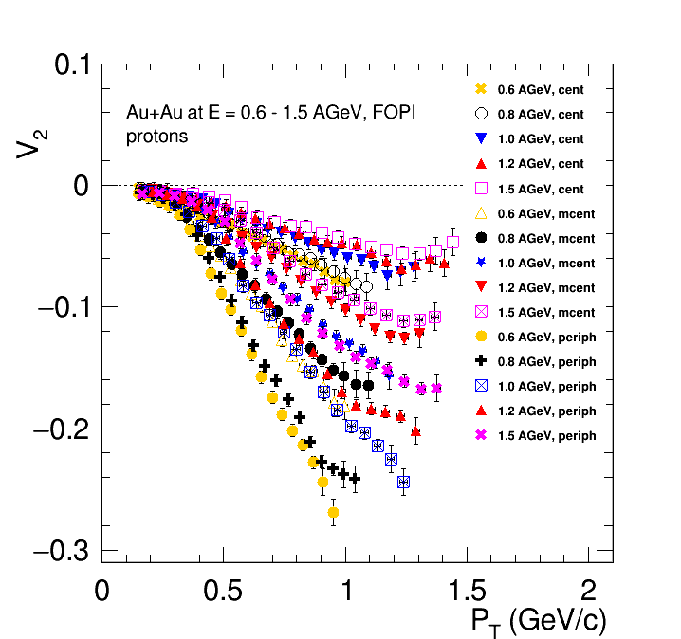
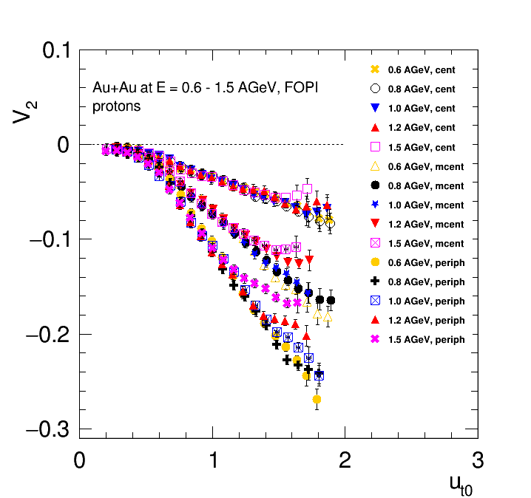
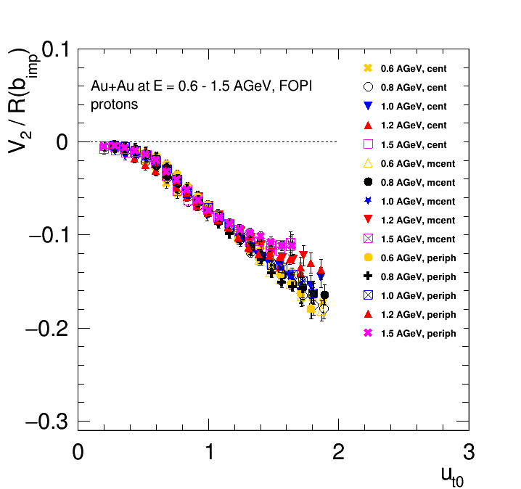
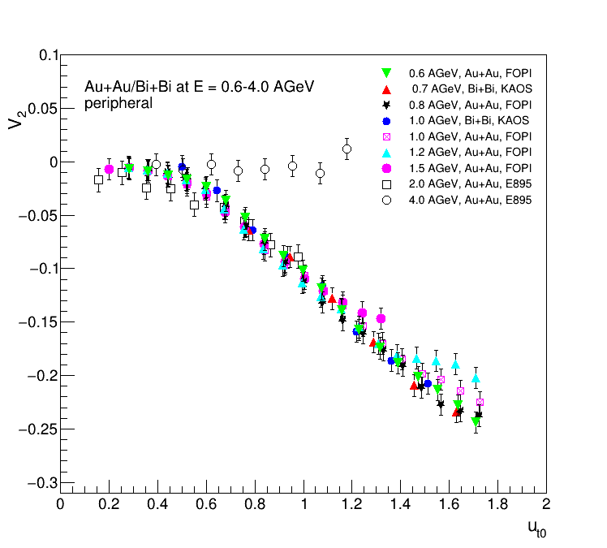
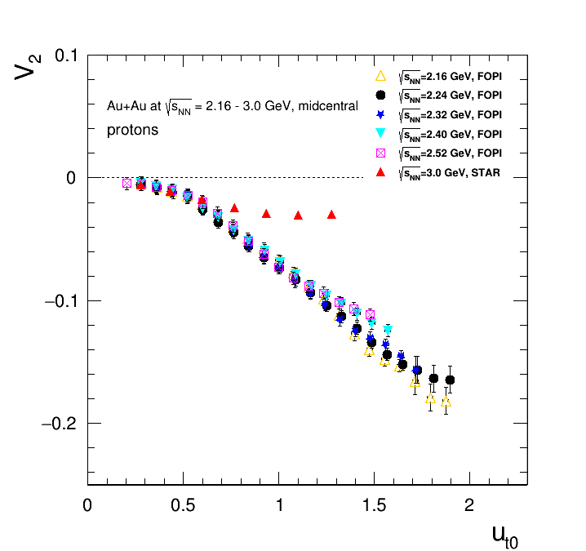
Scaling relations at SIS – scaling with passage time
Nucl. Phys A 876 (2012) 1-60
$u_{t0}=\frac{p_{T}}{m_{0}β_{CM}γ_{CM}}≡\frac{p_{T}t_{pass}}{2Rm_{0}}$
$t_{pass}=\frac{2R}{β_{CM}γ_{CM}}$
$$\left|y_{0}\right|<0.4$$
The rather good scaling observed suggests that $c_{s}$ does not change significantly over beam energy range $E_{kin}=0.4−2$ AGeV ($\sqrt{s_{NN}}=2−2.7$ GeV)
Scaling breaks at $E_{kin}=2.9$ AGeV ($\sqrt{s_{NN}}=3$ GeV)

Slide 8
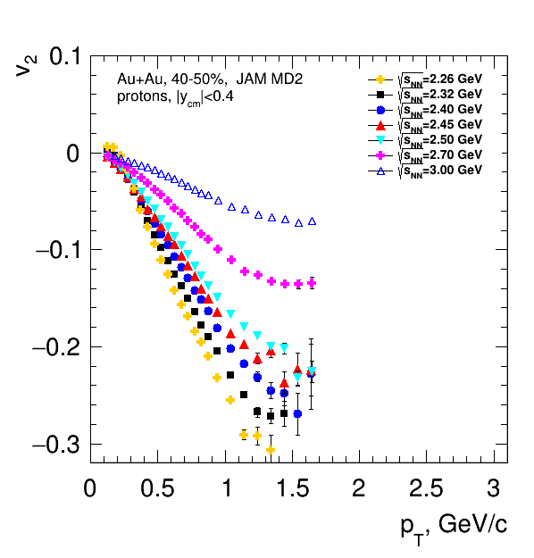
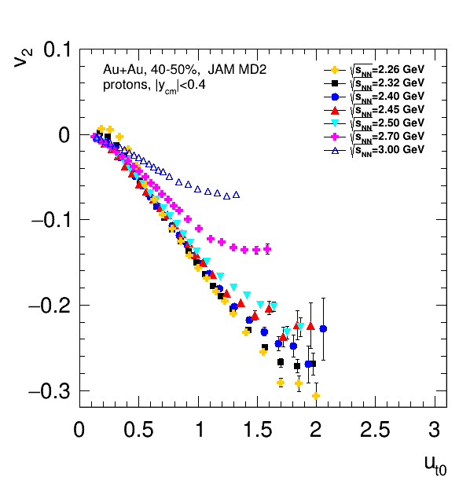
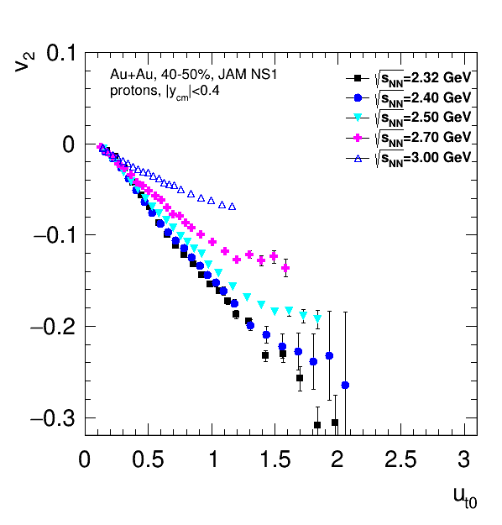
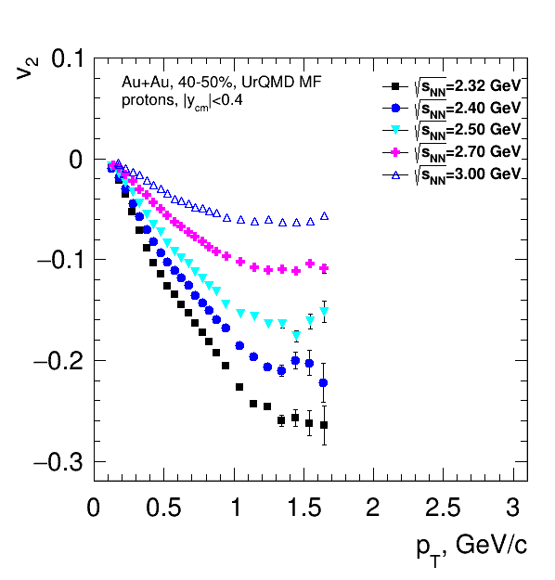
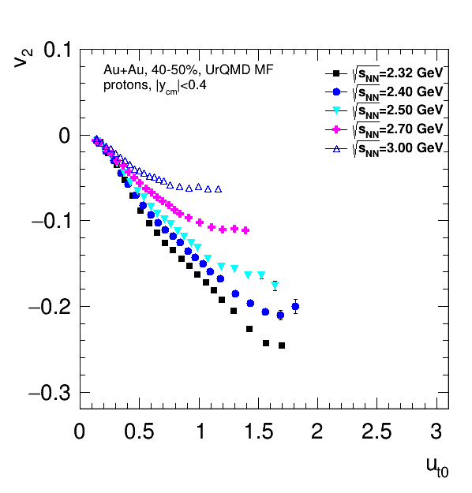
$u_{t0}$ scaling: mean-field models
Scaling holds for both JAM and UrQMD models with mean-field potentials for all EOS
Similar trend with experimental data: scaling breaks at around $\sqrt{s_{NN}}≥2.7$ GeV
Scaling can provide additional constraints for models

Slide 9
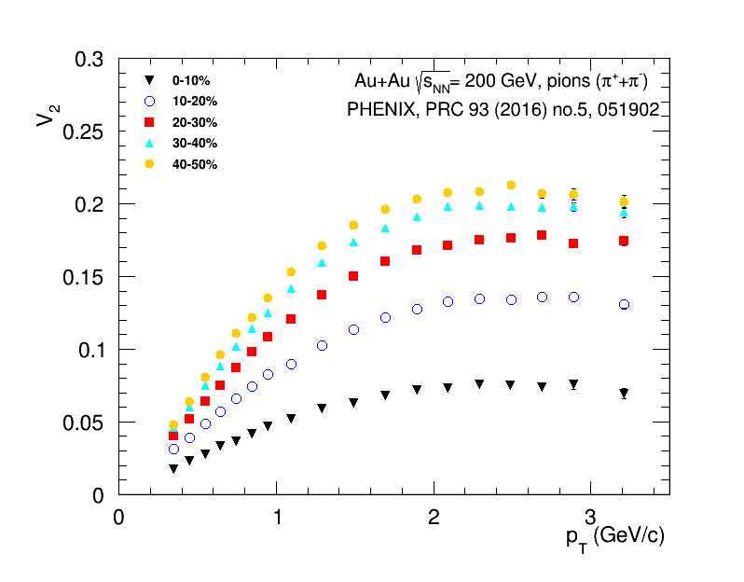
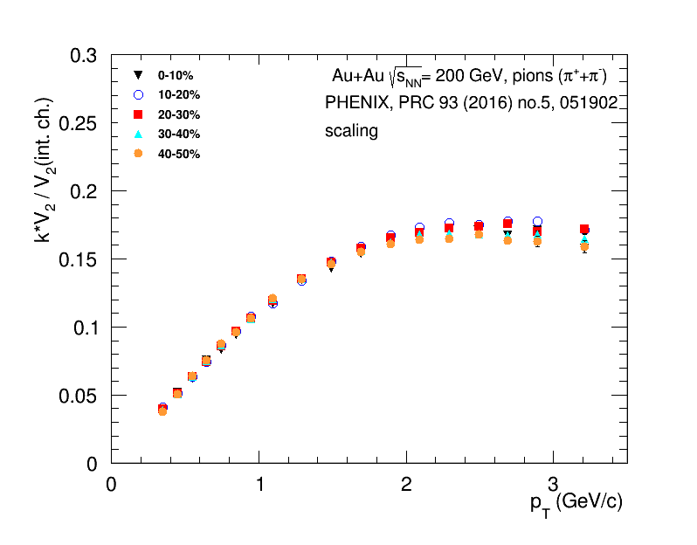
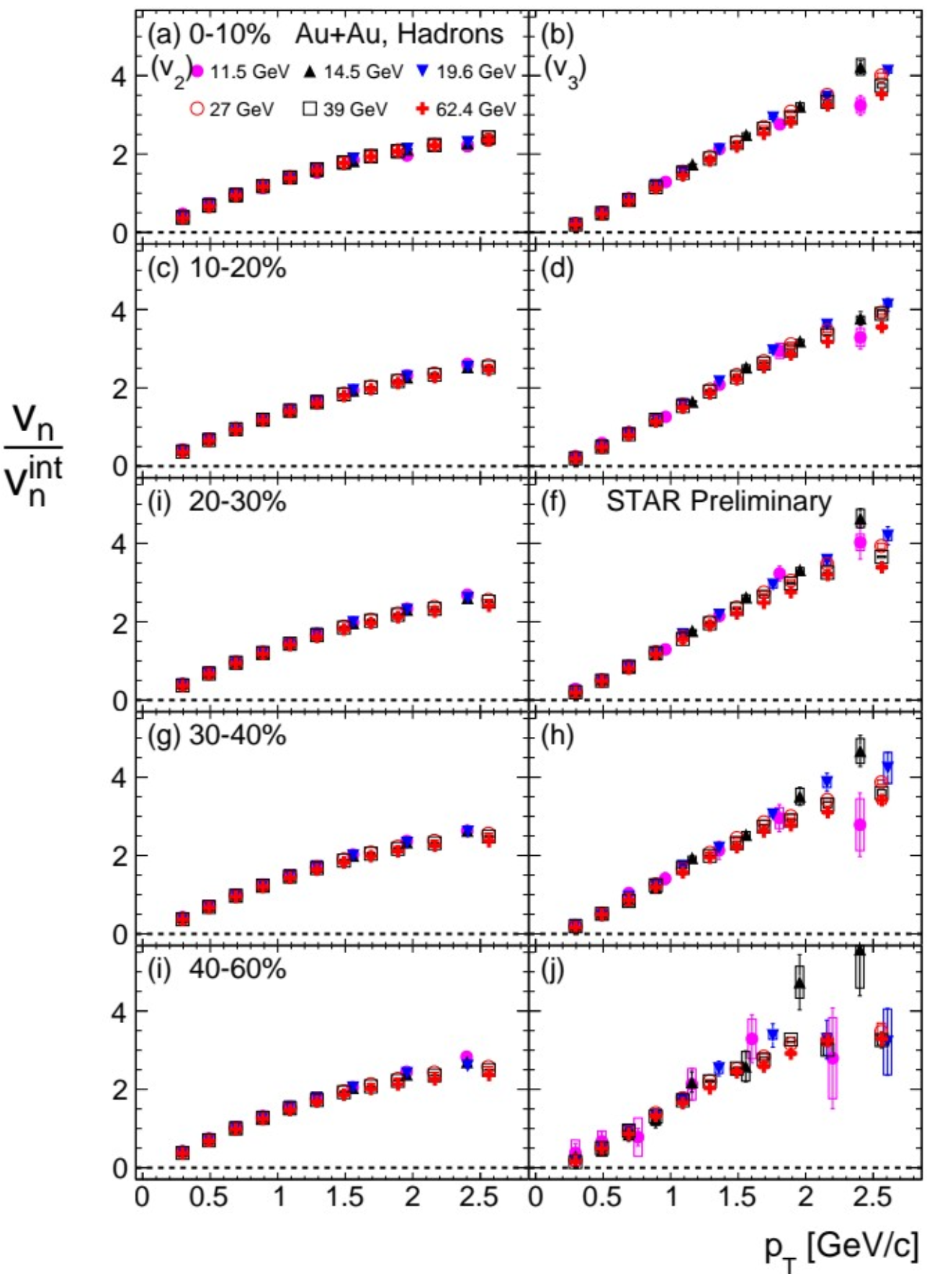
Scaling with integral anisotropic flow
J.Phys.Conf.Ser. 1690 (2020) 1, 012128
$$v_{n}\left(int.\right)≡\left|v_{n}^{int}\right|=\left|{\left\langle v_{n}\left(p_{T},y,centrality,PID\right)\right\rangle }_{p_{T},y}\right|$$
Scaling works at top RHIC and BES energy range
Similar trend for pions, kaons and protons

Slide 10
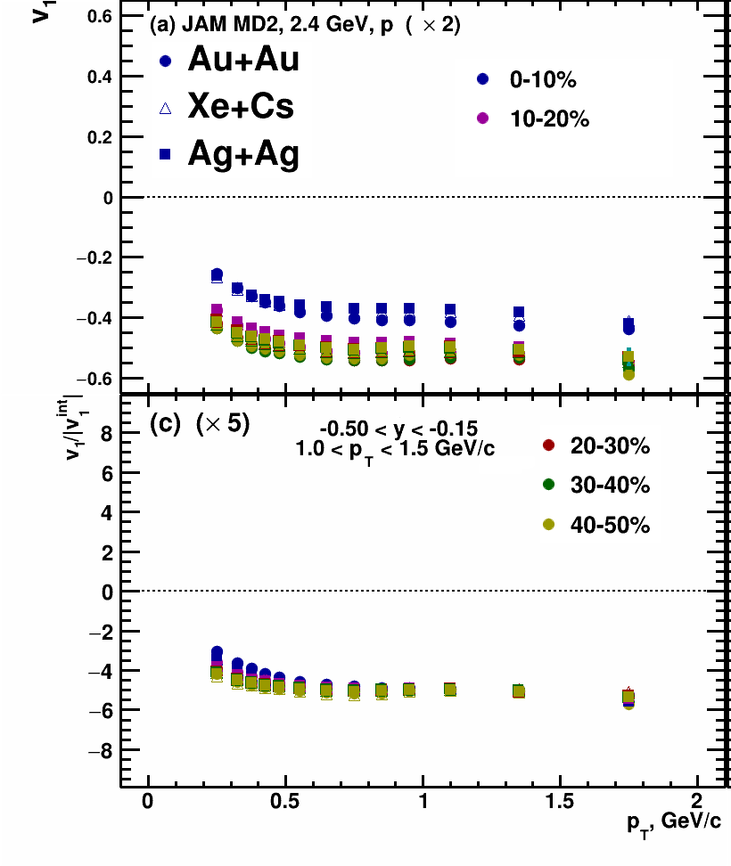
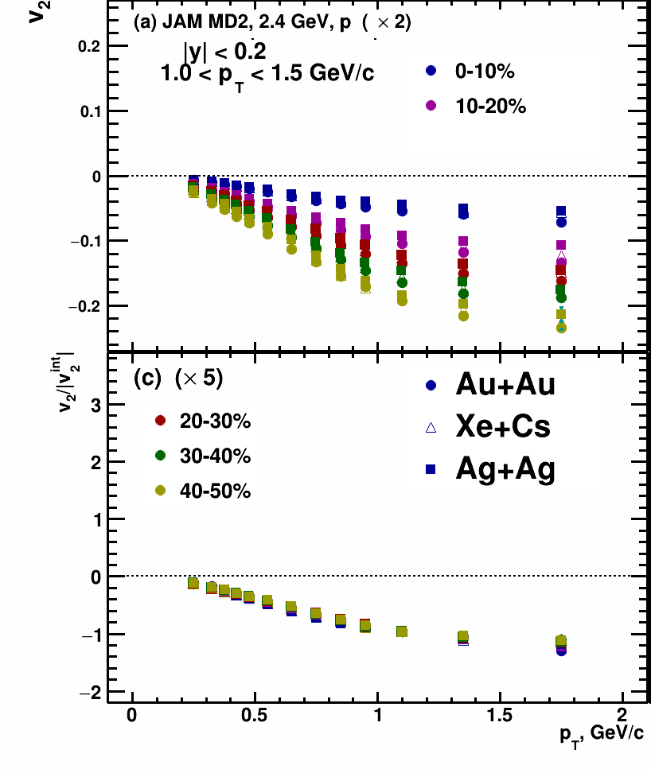
$\left|v_{n}^{int}\right|$ scaling: JAM MD2 model
Scaling works for JAM model at $\sqrt{s_{NN}}=2.4$ GeV for Au+Au, Xe+Cs and Ag+Ag collisions

Slide 11
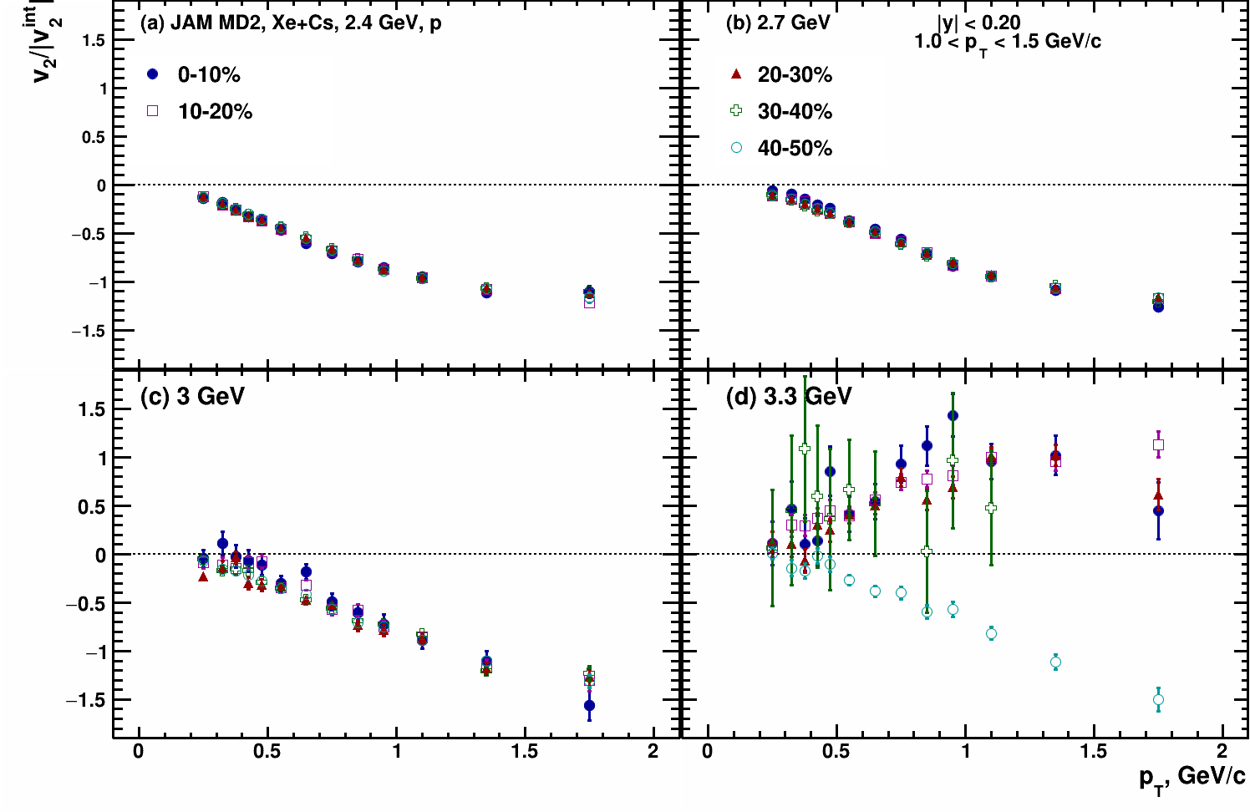
$\left|v_{2}^{int}\right|$ scaling: JAM MD2 model
Scaling works for energy range $\sqrt{s_{NN}}=2.4−3$ GeV and breaks at $\sqrt{s_{NN}}=3.3$ GeV where $v_{2}$ changes sign

Slide 12
Summary and outlook
NCQ scaling:
Holds up for energies $\sqrt{s_{NN}}>4$ GeV in both experimental data and models (hybrid and pure string/hadronic cascade models)
Scaling at $\sqrt{s_{NN}}=4.5$ GeV in the experimental data and pure string/hadronic cascade models can be accidental – more thorough study should be performed
Scaling with passage time:
Holds up for energies $\sqrt{s_{NN}}=2−2.7$ GeV and breaks at $\sqrt{s_{NN}}≥3$ GeV
Shows that at this energy range $v_{2}\left(\sqrt{s_{NN}}\right)$ changes due to the change of the passage time $t_{pass}$ of the spectators
Scaling with integral anisotropic flow:
Holds up for a wide energy range for different particle species, colliding systems and centrality classes
Breaks in the energy range where $v_{2}$ changes sign, transitioning from out-of-plane ($v_{2}<0$) to in-plane ($v_{2}>0$)
Scaling relations allow to separate different contributions to anisotropic flow originating from different energies, particle masses, initial conditions, etc. from general fluid-dynamical features
Scaling relations also provide a useful tool
to perform comparison between results from different experiments with different system size and beam energies
to constrain existing models

Slide 13
Thank you for your attention!

Slide 14
Backup slides

Slide 15
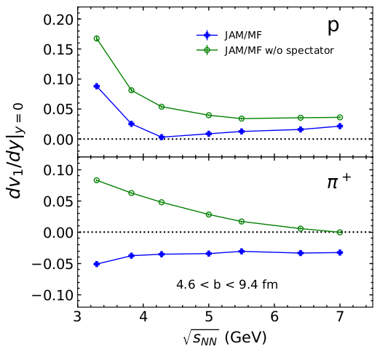
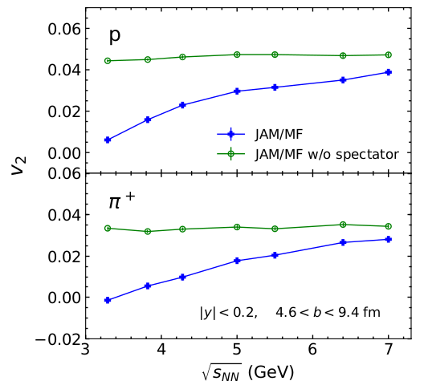
Anisotropic flow in Au+Au collisions at Nuclotron-NICA energies
M. Abdallah et al. [STAR Collaboration] 2108.00908 [nucl-ex]
BM@N
CBM
MPD
$$\frac{dN}{dφ}∝1+2\sum_{n=1}{v_{n}\cos\left[n\left(φ−Ψ_{RP}\right)\right]}, v_{n}=\left\langle \cos\left[n\left(φ−Ψ_{RP}\right)\right]\right\rangle$$
Anisotropic flow at FAIR/NICA energies is a delicate balance between:
The ability of pressure developed early in the reaction zone ($t_{exp}=R/{c_{s}}, c_{s}=c\sqrt{{dp}/{dε}}$) and
The passage time for removal of the shadowing by spectators ($t_{pass}={2R}/{γ_{CM}β_{CM}}$)

Slide 16
Scaling properties of collective flow
“Change of collective-flow mechanism indicated by scaling analysis of transverse flow “ A. Bonasera, L.P. Csernai , Phys. Rev. Lett. 59 (1987) 630
The general features of the collective flow could, in principle, be expressed in terms of scale-invariant quantities. In this way the particular differences arising from the different initial conditions, masses, energies, etc. , can be separated from the general fluid-dynamical features
“Collective flow in heavy-ion collisions”, W. Reisdorf, H.G. Ritter Ann.Rev. Nucl.Part.Sci. 47 (1997) 663-709 :
There is interest in using observables that are both coalescence and scale-invariant. …The evolution in non-viscous hydrodynamics does not depend on the size of the system nor on the incident energy, if distances are rescaled in terms of a typical size parameter, such as the nuclear radius. Momenta and energies are rescaled in terms of the beam velocities, momenta or energies.
The idea to look for scaling relations and use them was proposed a long time ago
$v_{n}\left(\sqrt{s_{NN}},R,centrality,PID,p_{T},y\right)=v_{n}\left(\sqrt{s_{NN}},R,centrality\right)×v_{n}\left(PID,p_{T},y\right)$ ?

Slide 17
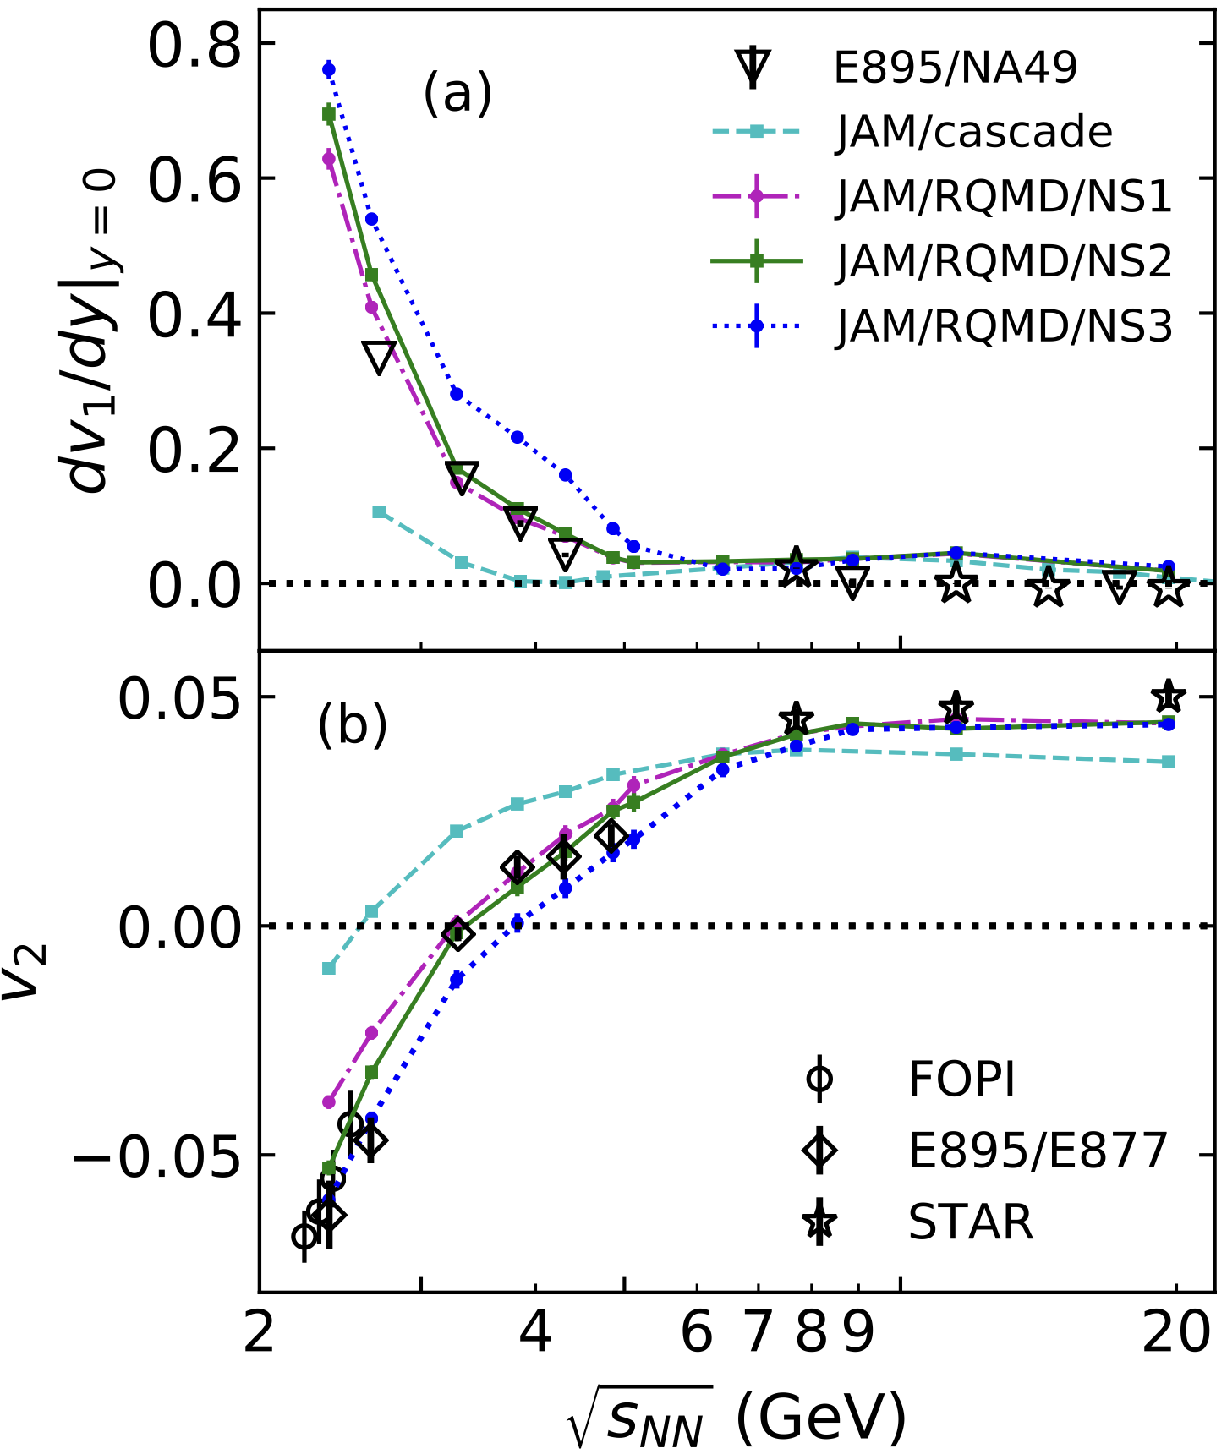
Anisotropic flow study at $\sqrt{s_{NN}}$=2-4 GeV with JAM model
Y.Nara, et al., Phys. Rev. C 100, 054902 (2019)
To study energy dependence of $v_{n}$, JAM microscopic model was selected (ver. 1.90597)
NN collisions are simulated by:
$\sqrt{s_{NN}}$<4 GeV: resonance production
4<$\sqrt{s_{NN}}$<50 GeV: soft string excitations
$\sqrt{s_{NN}}$>10 GeV: minijet production
We use RQMD with relativistic mean-field theory (non-linear $σ$-$ω$ model) implemented in JAM model
Different EOS were used:
MD2 (momentum-dependent potential): $K$=380 MeV, $m^{∗}/m$=0.65, $U_{opt}\left(∞\right)$=30
MD4 (momentum-dependent potential): $K$=210 MeV, $m^{∗}/m$=0.83, $U_{opt}\left(∞\right)$=67
NS1: $K$=380 MeV, $m^{∗}/m$=0.83, $U_{opt}\left(∞\right)$=95
NS2: $K$=210 MeV, $m^{∗}/m$=0.83, $U_{opt}\left(∞\right)$=98
Y.Nara, T.Maruyama, H.Stoecker Phys. Rev. C 102, 024913 (2020)
Y.Nara, H.Stoecker Phys. Rev. C 100, 054902 (2019)

Slide 18
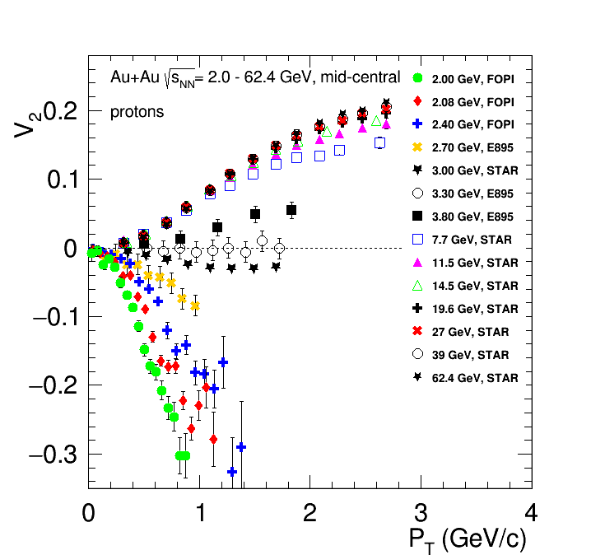
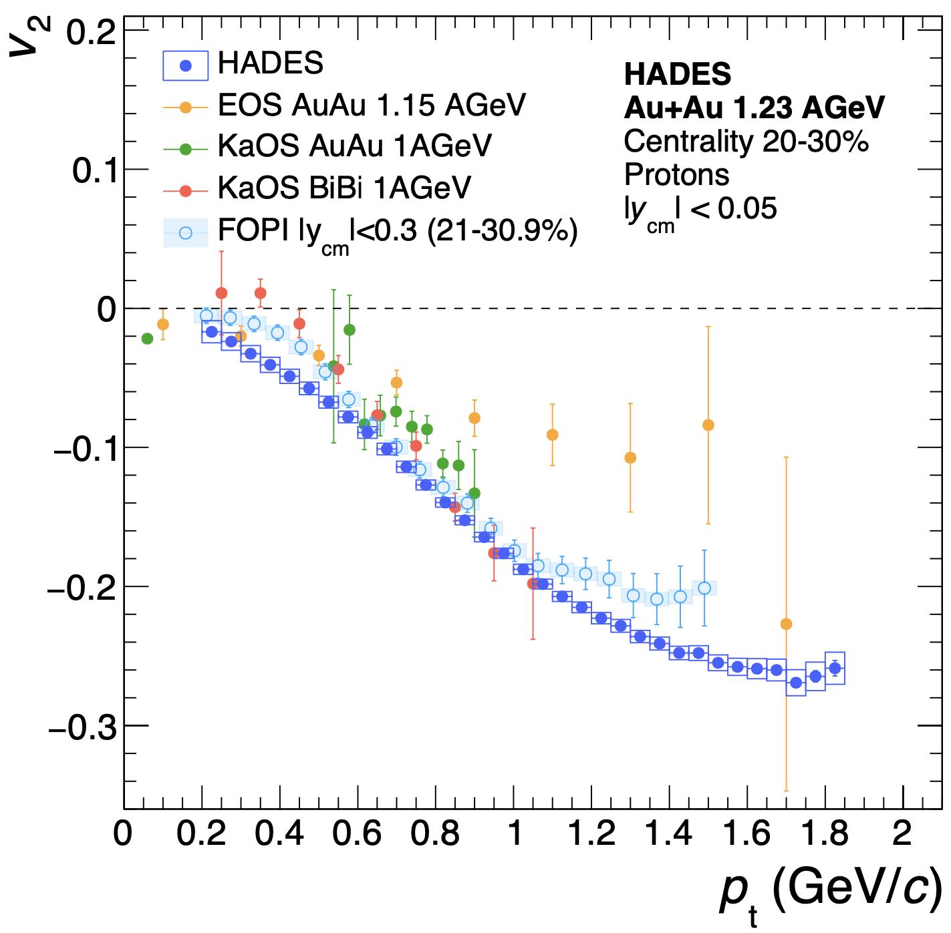
Why do we need new measurements at BM@N, CBM and MPD?
The main source of existing systematic errors in $v_{n}$ measurements is the difference between results from different experiments (for example, FOPI and HADES)
New data from the future BM@N ($\sqrt{s_{NN}}$=2.3-3.3 GeV), CBM ($\sqrt{s_{NN}}$=2.7-4.9 GeV) and MPD ($\sqrt{s_{NN}}$=4-11 GeV) experiments will provide more detailed and robust $v_{n}$ measurements

Slide 19
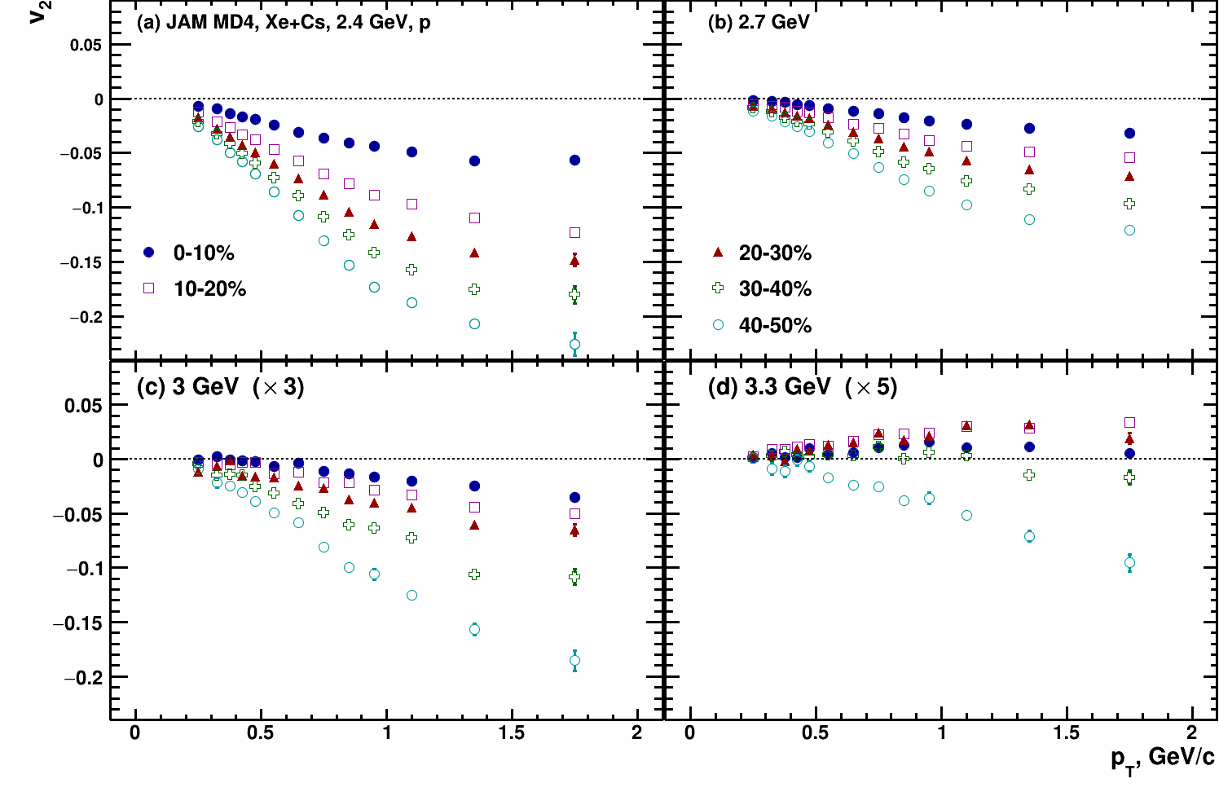
Scaling with integrated $v_{2}$
$$\left|v_{2}^{int}\right|=\left|{\left\langle v_{2}\left(p_{T},y,centrality,PID\right)\right\rangle }_{p_{T},y}\right|$$
Scaling with integrated flow coefficient allows to perform comparison results from different centralities, beam energies and colliding systems
Scaling breaks at $\sqrt{s_{NN}}=3.3$ GeV for $v_{2}$

Slide 20
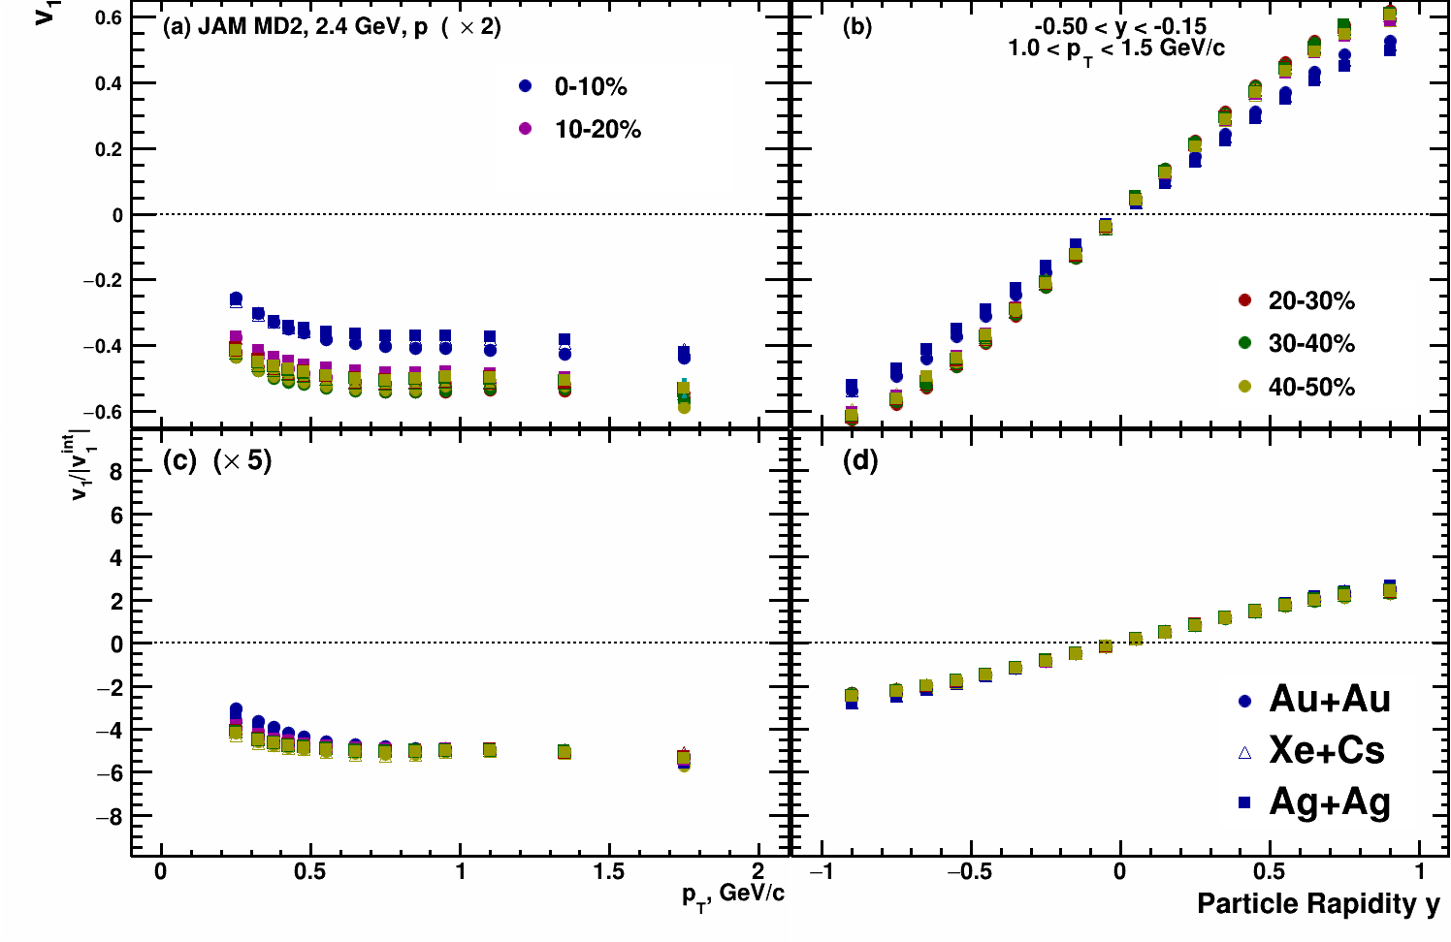
$v_{1}\left(y\right)$ protons at $\sqrt{s_{NN}}=2.4$ GeV
Kinematic cuts:
-0.2 < y < 0.2
1.0 < p_{T} < 1.5 GeV/c

Slide 21
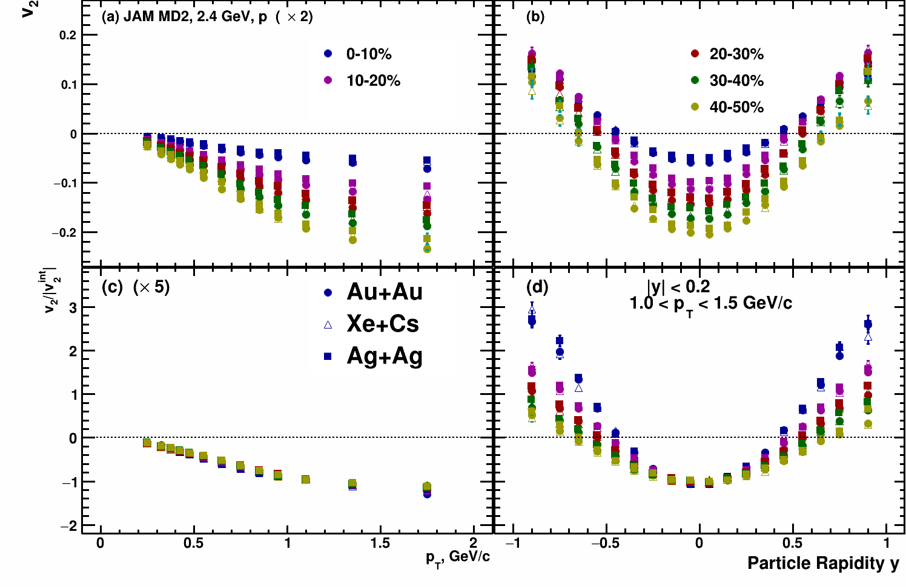
$v_{2}\left(y\right)$ protons at $\sqrt{s_{NN}}=2.4$ GeV
Kinematic cuts:
-0.2 < y < 0.2
1.0 < p_{T} < 1.5 GeV/c

Slide 22
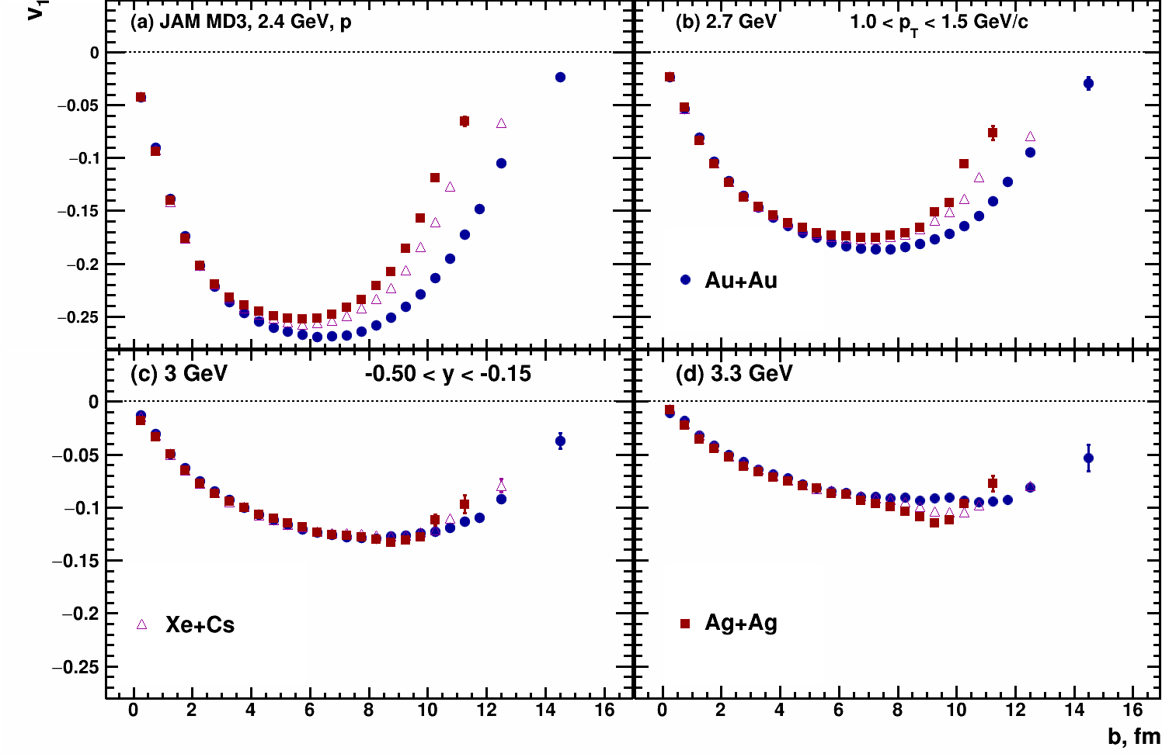
$v_{1}\left(b\right)$ Xe+Cs vs Au+Au - protons
Kinematic cuts:
-0.5 < y < -0.15
1.0 < p_{T} < 1.5 GeV/c

Slide 23
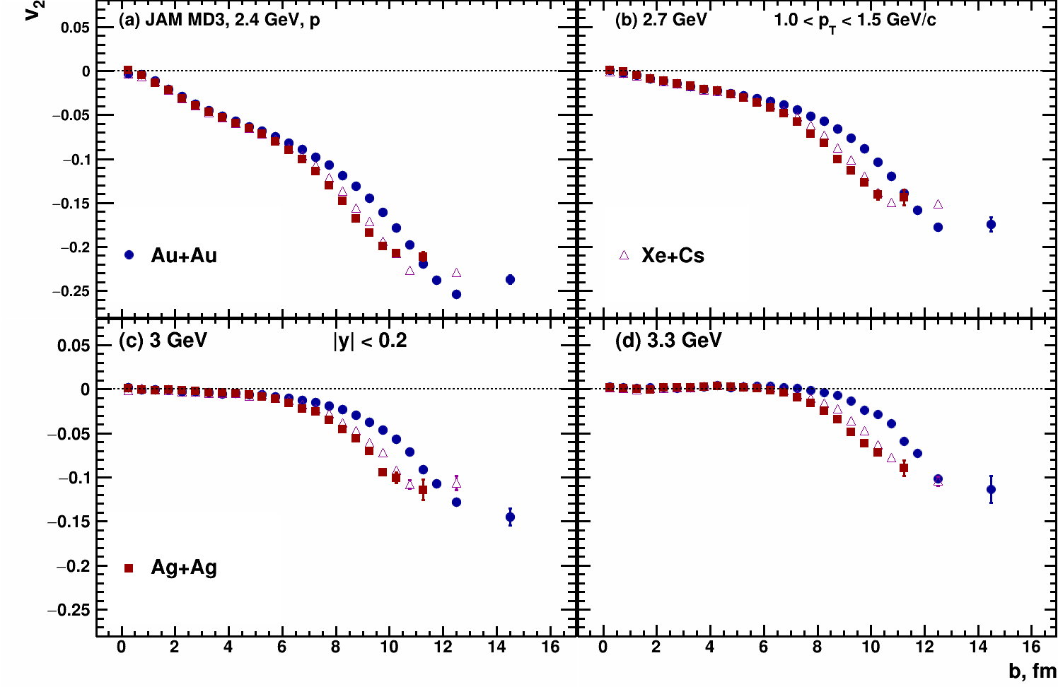
$v_{2}\left(b\right)$ Xe+Cs vs Au+Au - protons
Kinematic cuts:
-0.2 < y < 0.2
1.0 < p_{T} < 1.5 GeV/c

Slide 24
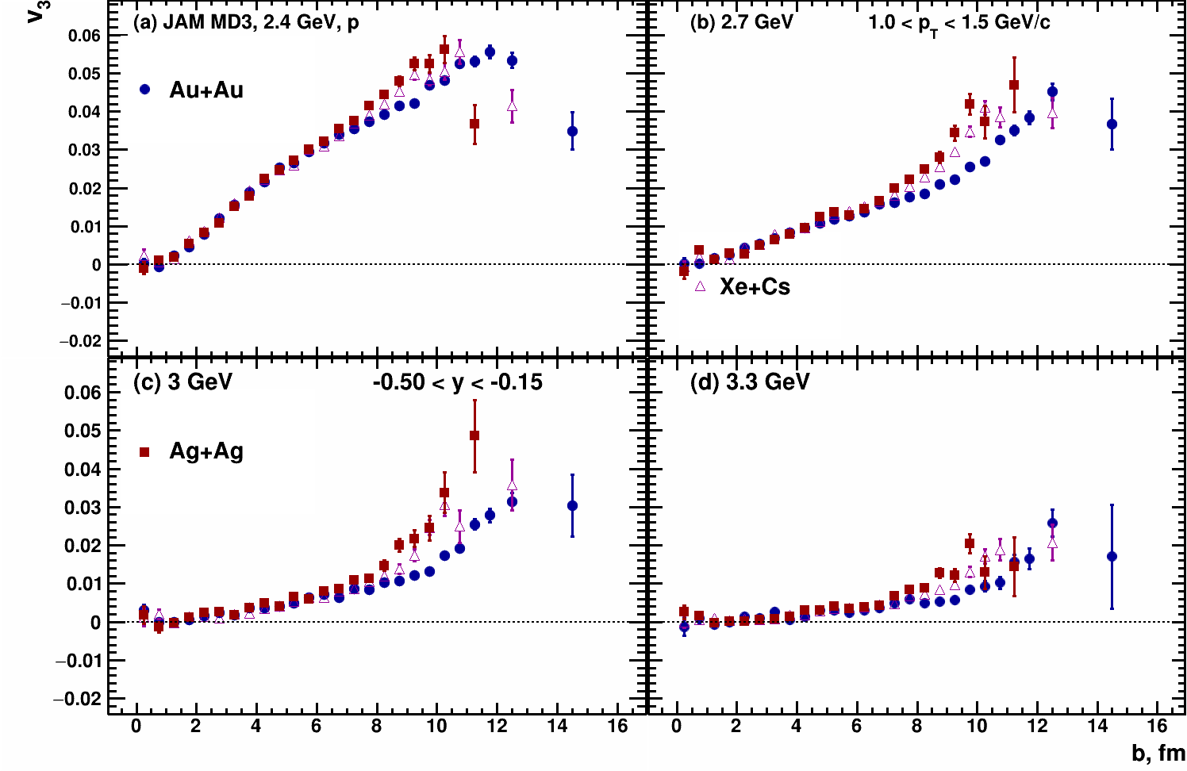
$v_{3}\left(b\right)$ Xe+Cs vs Au+Au - protons
Kinematic cuts:
-0.5 < y < -0.15
1.0 < p_{T} < 1.5 GeV/c

Slide 25
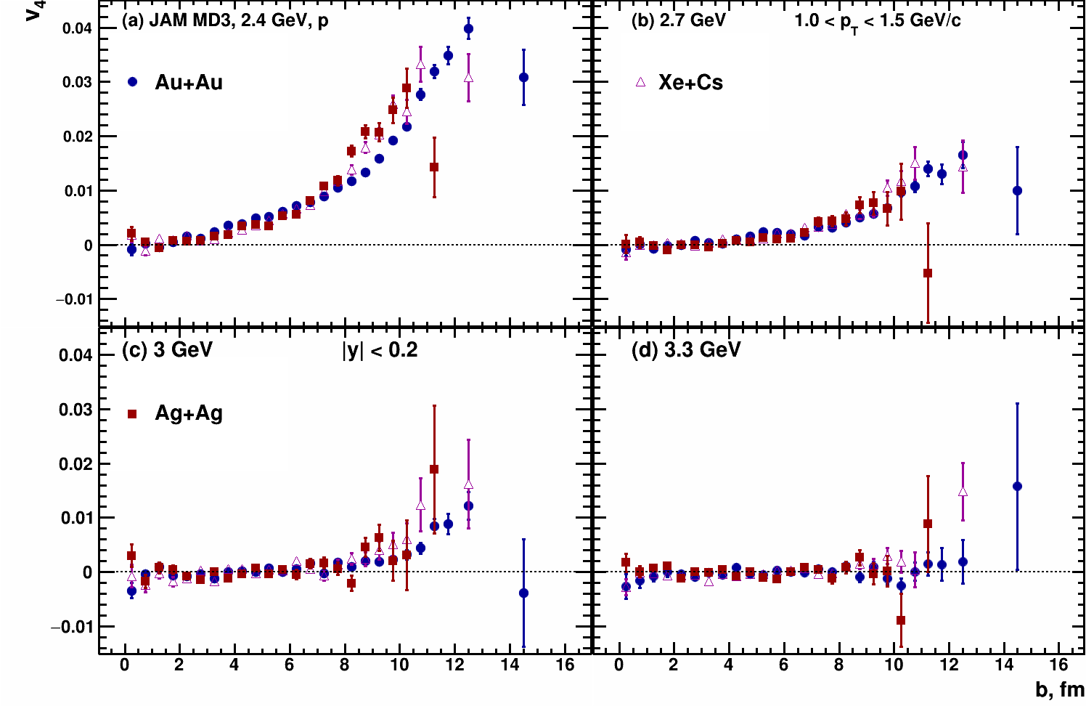
$v_{4}\left(b\right)$ Xe+Cs vs Au+Au - protons
Kinematic cuts:
-0.2 < y < 0.2
1.0 < p_{T} < 1.5 GeV/c

Slide 26
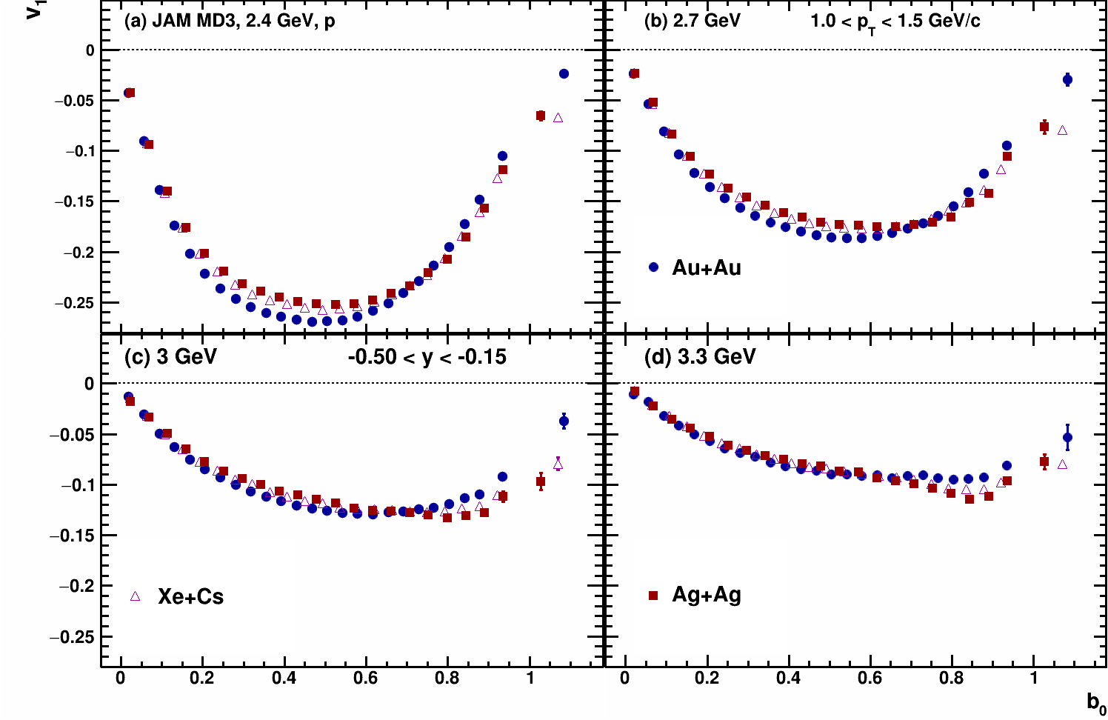
$v_{1}\left(b_{0}\right)$ Xe+Cs vs Au+Au - protons
Kinematic cuts:
-0.5 < y < -0.15
1.0 < p_{T} < 1.5 GeV/c
$$b_{0}=b/{b_{max}}$$
$$b_{max}=1.15\left(A_{targ}^{1/3}+A_{proj}^{1/3}\right)$$
$b_{max}\left(Xe+Cs\right)=11.68$ fm
$b_{max}\left(Au+Au\right)=13.38$ fm

Slide 27
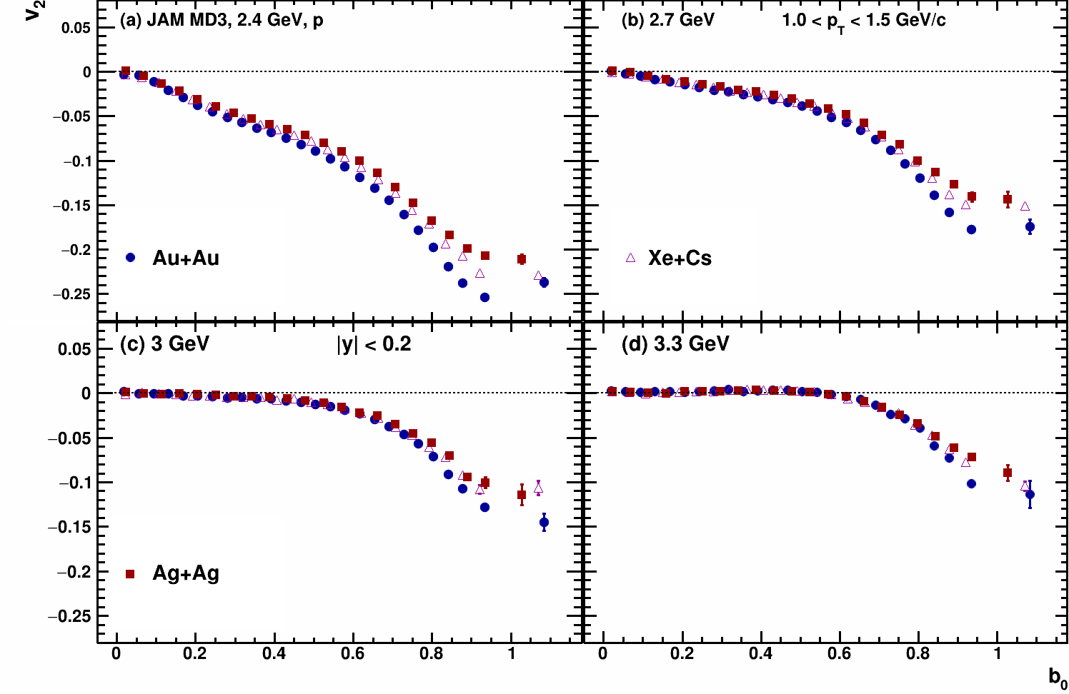
$v_{2}\left(b_{0}\right)$ Xe+Cs vs Au+Au - protons
Kinematic cuts:
-0.5 < y < -0.15
1.0 < p_{T} < 1.5 GeV/c
$$b_{0}=b/{b_{max}}$$
$$b_{max}=1.15\left(A_{targ}^{1/3}+A_{proj}^{1/3}\right)$$
$b_{max}\left(Xe+Cs\right)=11.68$ fm
$b_{max}\left(Au+Au\right)=13.38$ fm

Slide 28
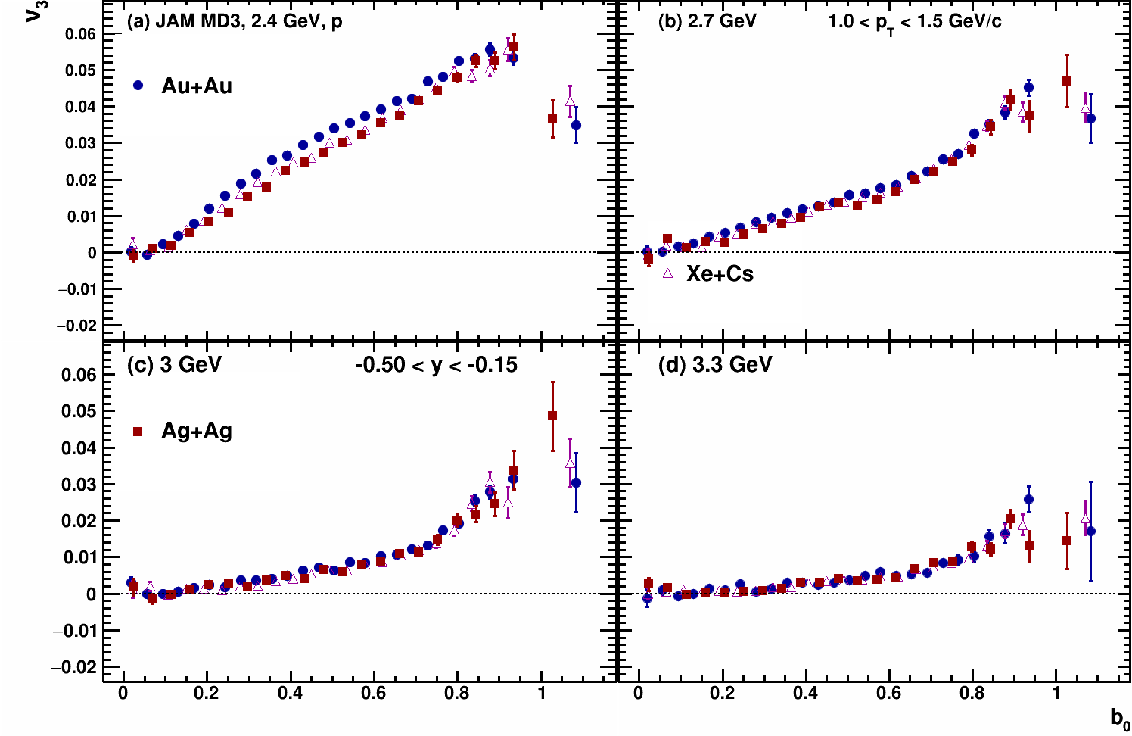
$v_{3}\left(b_{0}\right)$ Xe+Cs vs Au+Au - protons
Kinematic cuts:
-0.5 < y < -0.15
1.0 < p_{T} < 1.5 GeV/c
$$b_{0}=b/{b_{max}}$$
$$b_{max}=1.15\left(A_{targ}^{1/3}+A_{proj}^{1/3}\right)$$
$b_{max}\left(Xe+Cs\right)=11.68$ fm
$b_{max}\left(Au+Au\right)=13.38$ fm

Slide 29
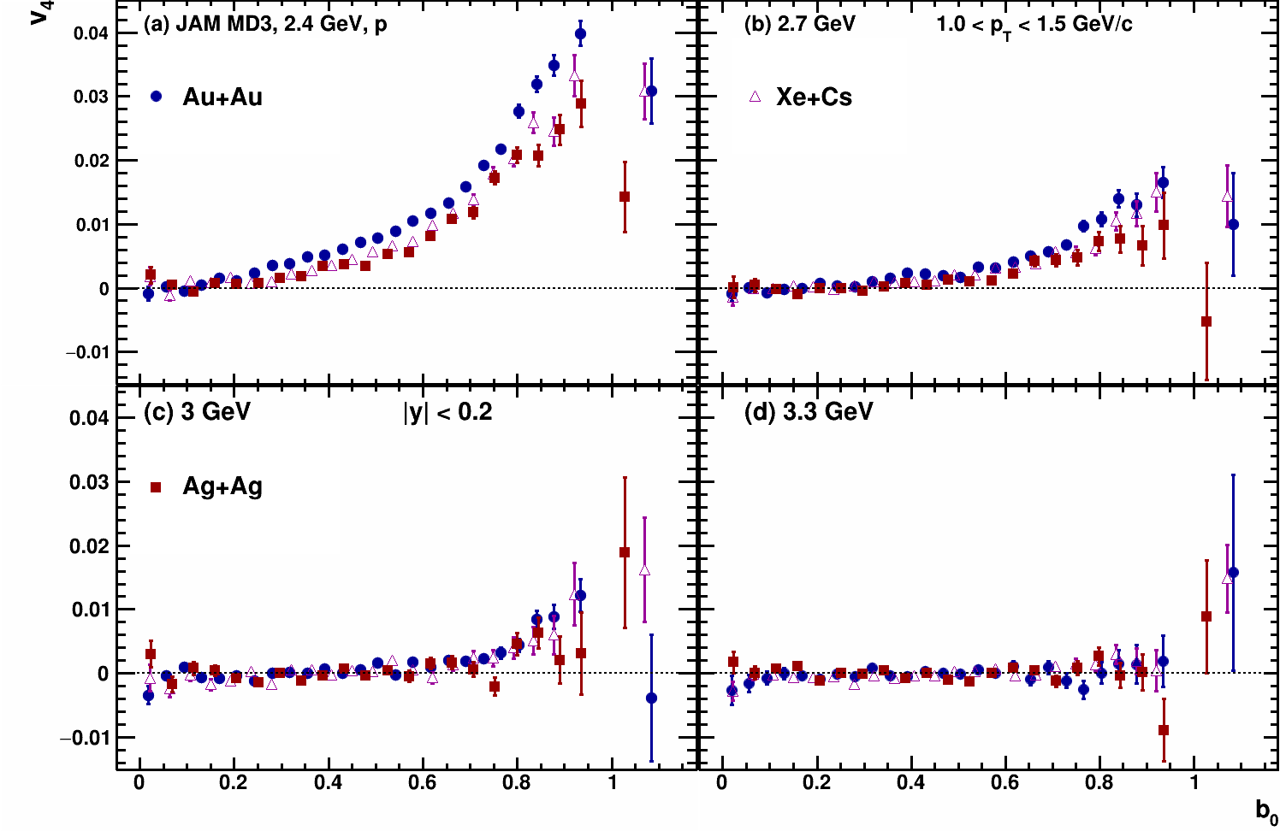
$v_{4}\left(b_{0}\right)$ Xe+Cs vs Au+Au - protons
Kinematic cuts:
-0.5 < y < -0.15
1.0 < p_{T} < 1.5 GeV/c
$$b_{0}=b/{b_{max}}$$
$$b_{max}=1.15\left(A_{targ}^{1/3}+A_{proj}^{1/3}\right)$$
$b_{max}\left(Xe+Cs\right)=11.68$ fm
$b_{max}\left(Au+Au\right)=13.38$ fm

