Slide 1
Physicochemical properties of hydrothermally synthesized nanocomposites of graphene-oxide and Zn/Ga-dopped cobalt ferrite
Marija Grujičić, Željko Mravik, Milica Pejčić, Danica Bajuk-Bogdanović, Ivana Stojković Simatović, Sonja Jovanović
The XXVI International Scientific Conference of Young Scientists and Specialists (AYSS-2022)
Notes:
Hello, my name is Marija and the title of my work is…..
Nanocomposites consist of two materials, and first of them is cobalt ferrite dopped with Zn and gallium….

Slide 2
Spinel ferrites
Metal oxides of general formula MFe₂O₄
Oxygen atoms are densely packed in a surface-centered cubic lattice
Depending on the cation distribution between tetrahedral (A) and octahedral (B) positions, the structure can be described by the formula:
(M²⁺_{1-δ}Fe³⁺_{δ})_{A}(M²⁺_{δ}Fe³⁺_{2-δ})_{B}O₄
Inverse spinel (δ = 1)
$→$ М²⁺ ions occupy B positions*
$→$ Fe³⁺ ions are distributed between the A and B positions
*M²⁺= Co²⁺, Zn²⁺, Ni²⁺, Mn²⁺ ,…

Slide 3
Graphene oxide
Two - dimensional material formed by covalent bonding of oxygen groups to a monolayer of graphene
Each layer can be considered a surface layer
Oxygen functional groups enable further binding of graphene oxide

Slide 4
Synthesis of composites
Solvothermal synthesis of cobalt ferrite nanoparticles (CoFe₂O₄, CFO), cobalt ferrite doped with zinc (Co_{0,5}Zn_{0,5}Fe₂O₄, CFO_Zn) and galium (CoFe_{1,5}Ga_{0,5}O₄, CFO_Ga) with oleic acid as the surfactant (180 °С, 8 h)
Exchange of ligands with dihydrocaffeic acid (DHCA)
Synthesis of graphene oxide by modified Hammer method
Hydrothermal synthesis of composites with 5% and 15% share of spinel ferrite nanoparticles on graphene oxide (120 °С, 3 h)

Slide 5
Characterization methods
X-ray diffraction (XRD)
Scanning electron microscopy (SEM)
Transmission electron microscopy (ТЕМ)
Fourier-transform infrared spectroscopy (FTIR)
Raman Spectroscopy
Cyclic voltammetry (CV)

Slide 6
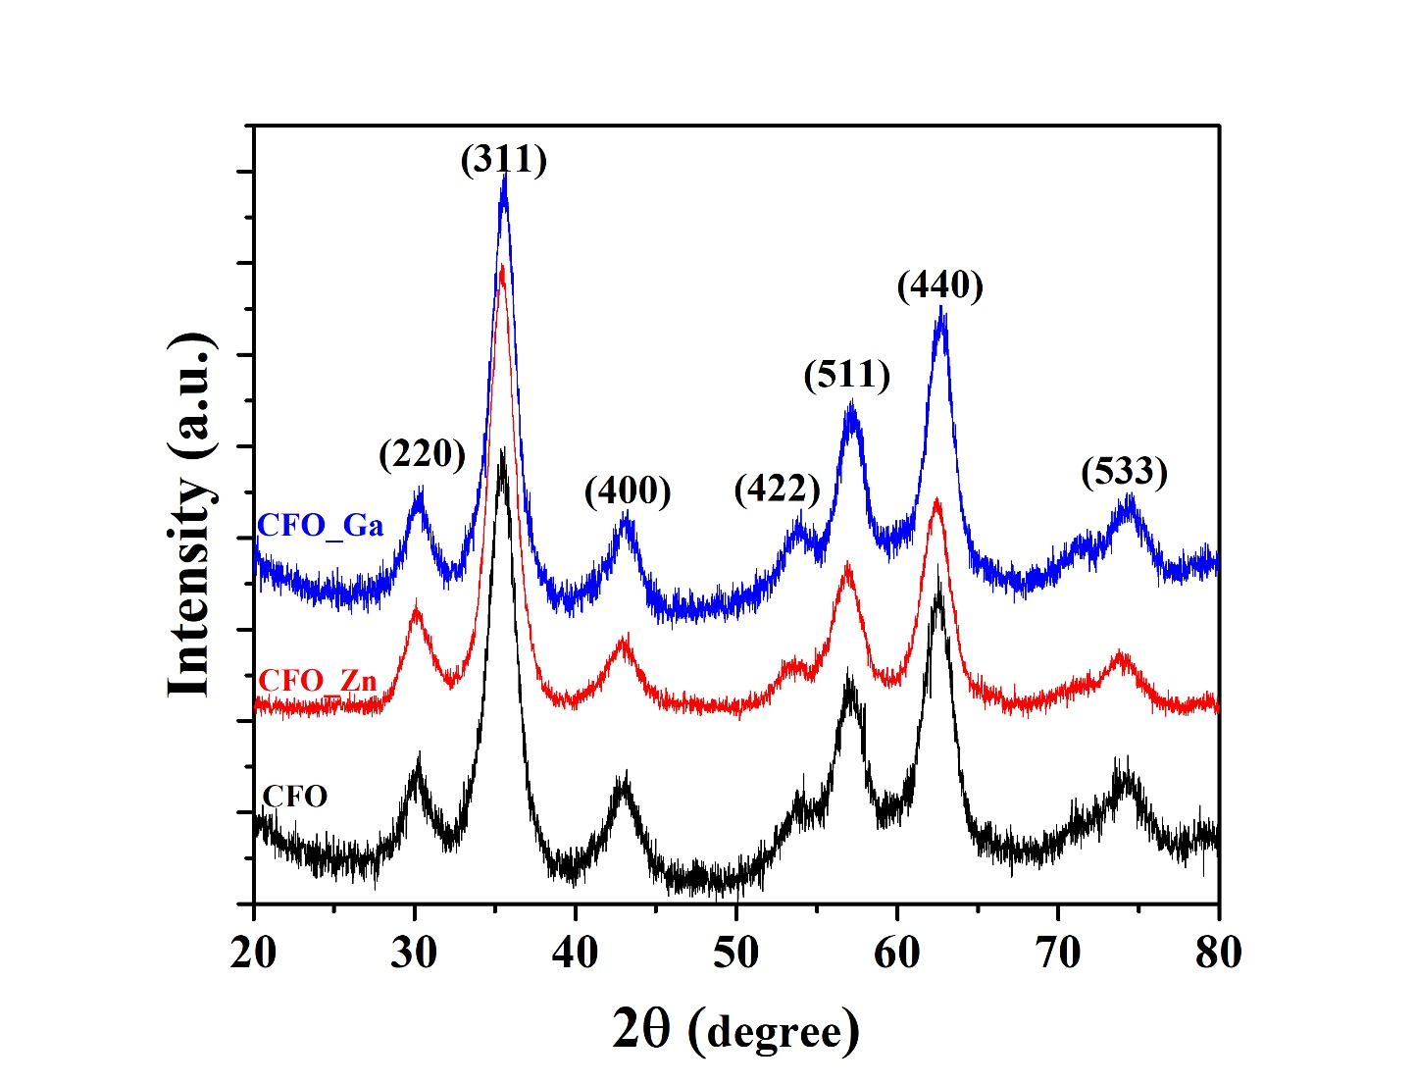
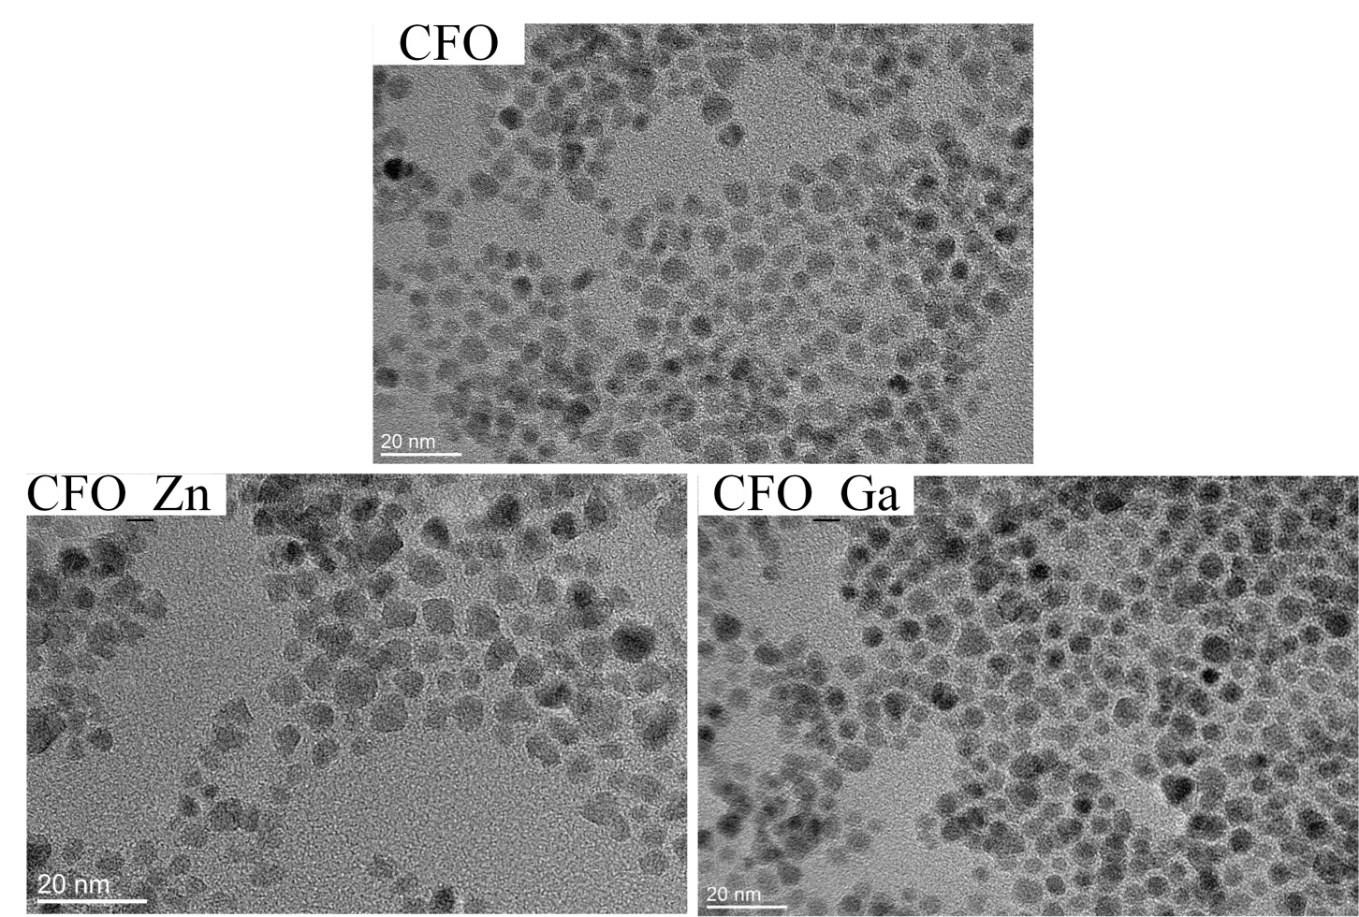
Spinel ferrite nanoparticles
XRD diffractogram
ТЕМ micrographes
Pure ferrite phase
Average size = 5 ± 1 nm

Slide 7
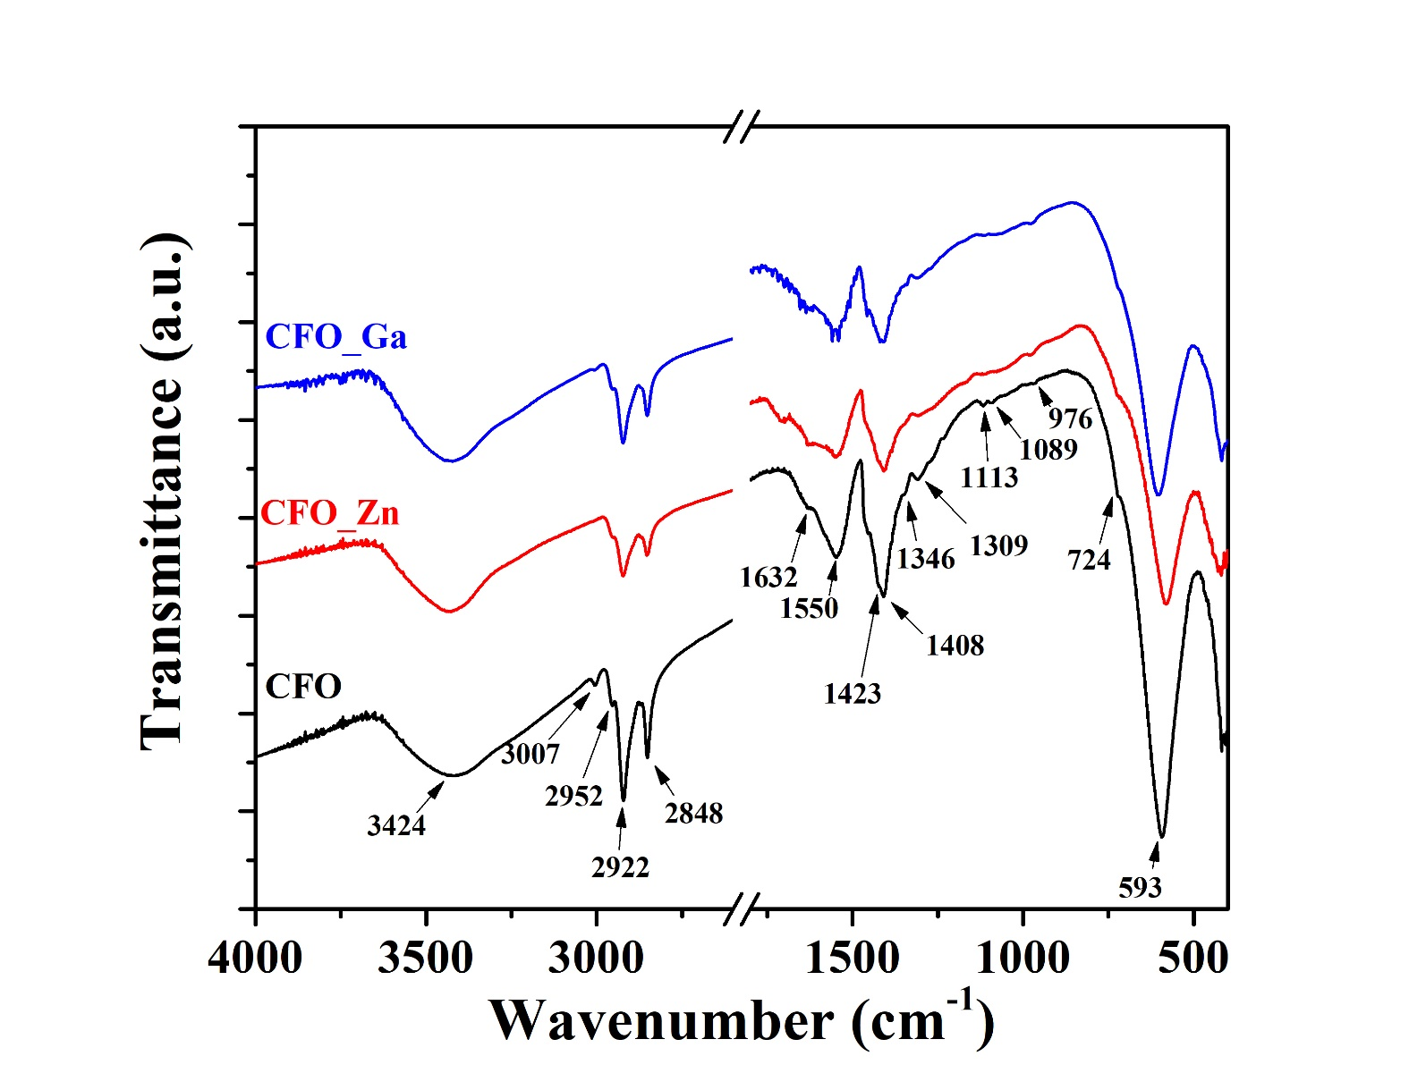
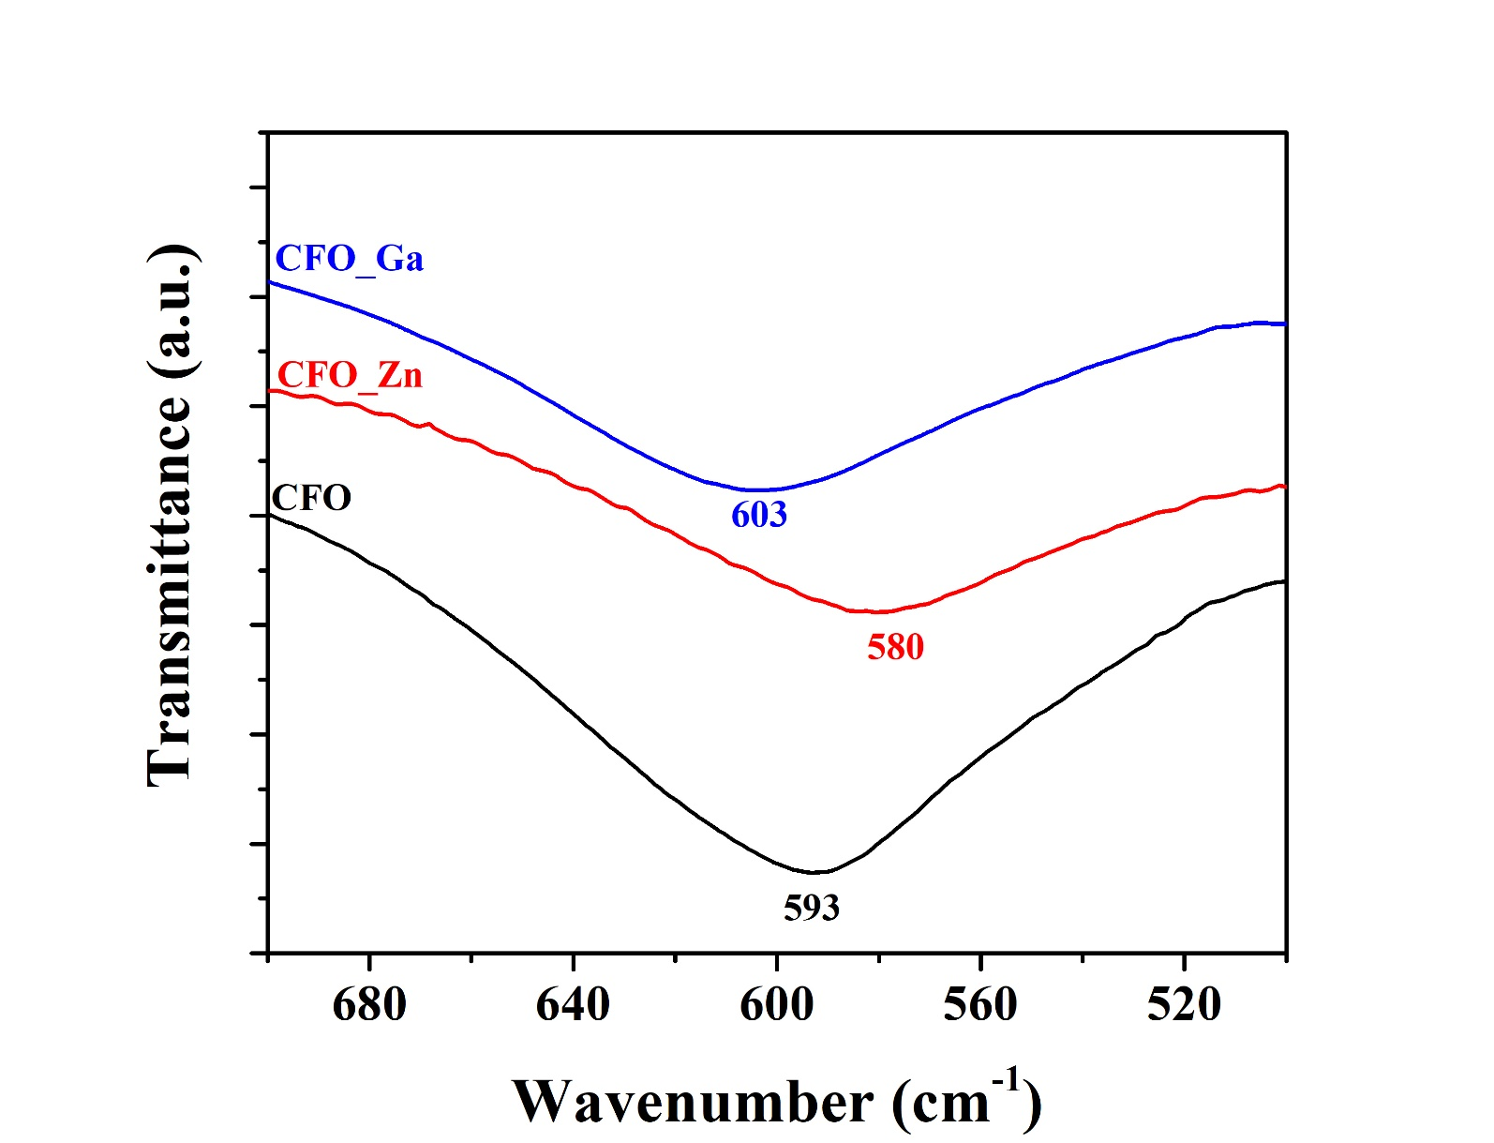
Spinel ferrite nanoparticles
FTIR analysis
Asymmetrically stretching vibration of the carboxyl group $\sim$ 1550 cm⁻¹
Symmetrically stretching vibration of the carboxyl group $\sim$ 1408 cm⁻¹
Δ = 142 cm⁻¹
Covalent bridging bidentate interaction
Stretching vibration of metal and oxygen atoms in the tetrahedral position $\sim$ 580-603 cm⁻¹

Slide 8
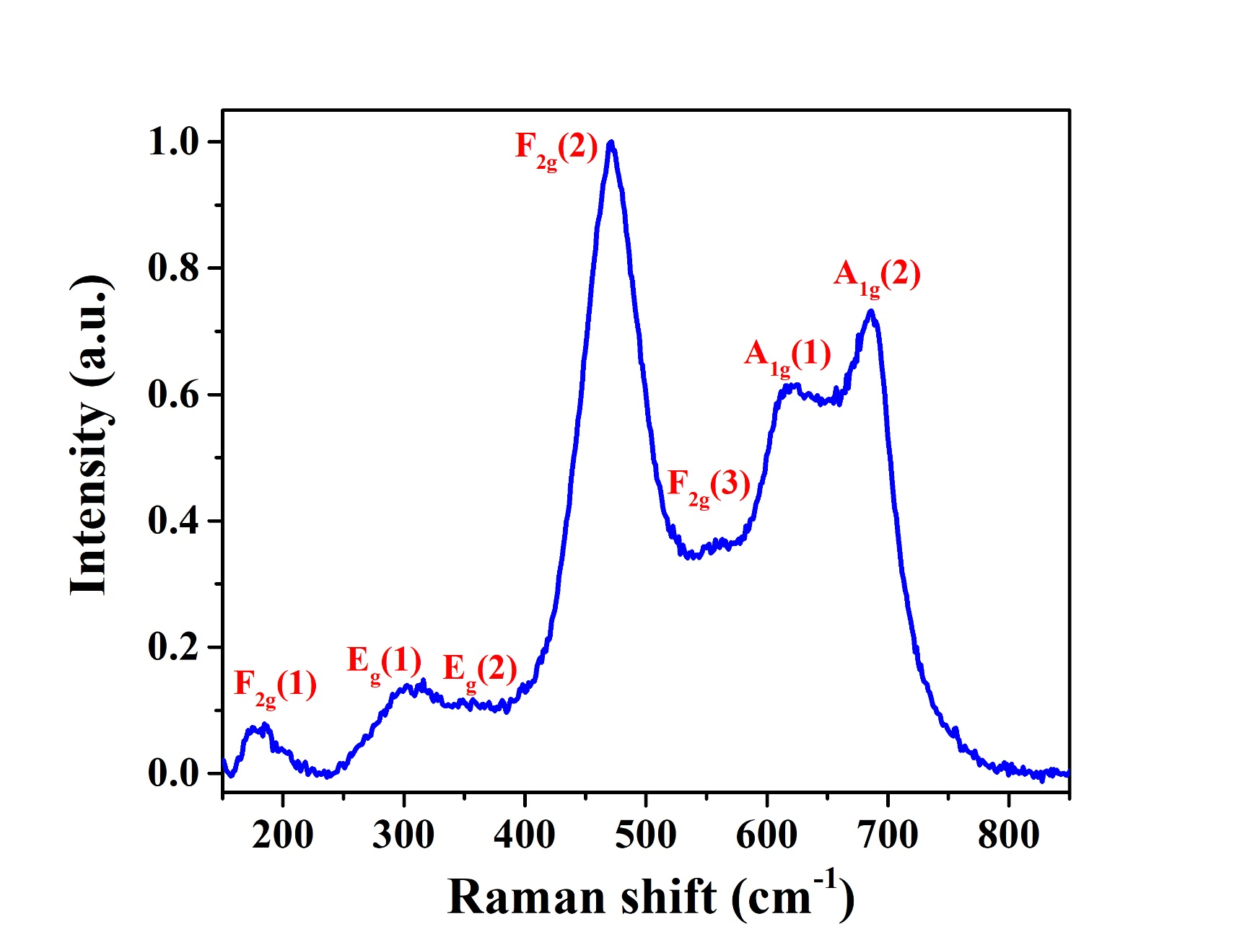
Spinel ferrite nanoparticles
Raman spectroscopy
Seven Raman active modes
А_{1g} mode - symmetrical stretching vibration (М_{А}-О)
Е_{g} mode - symmetrical bending vibration (М_{В}-О)
F_{2g}(3) mode – asymmetrical bending vibration (М_{В}-О)
F_{2g}(2) mode – symmetrical stretching vibration (М_{В}-О)
F_{2g}(1) mode - translation mode of the FeO₄ group

Slide 9
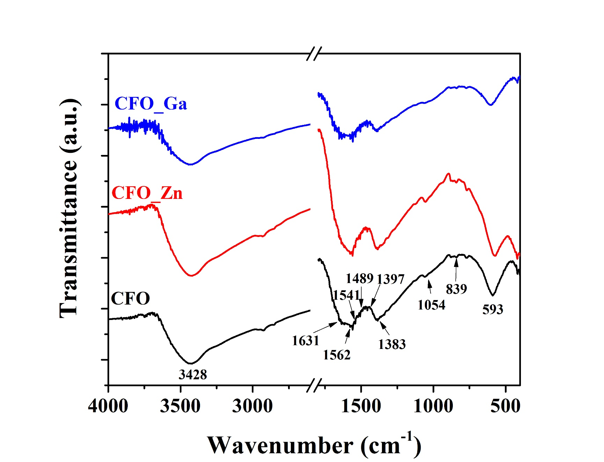
Spinel ferrite nanoparticles
FTIR analysis after ligand exchange
Asymmetrically stretching vibration of the carboxyl group $\sim$ 1562 cm⁻¹
Symmetrically stretching vibration of the carboxyl group $\sim$ 1383 cm⁻¹
Δ = 179 cm⁻¹
Covalent bridging bidentate interaction
Binding of DHCA to the surface of the nanoparticle $\sim$ 1631, 1541, 1489, 1397 cm⁻¹
$⇨$ binding through the carboxyl and catechol groups

Slide 10
Graphene oxide
SEM
ТЕМ
Layered structure
Transparent for electron beam

Slide 11
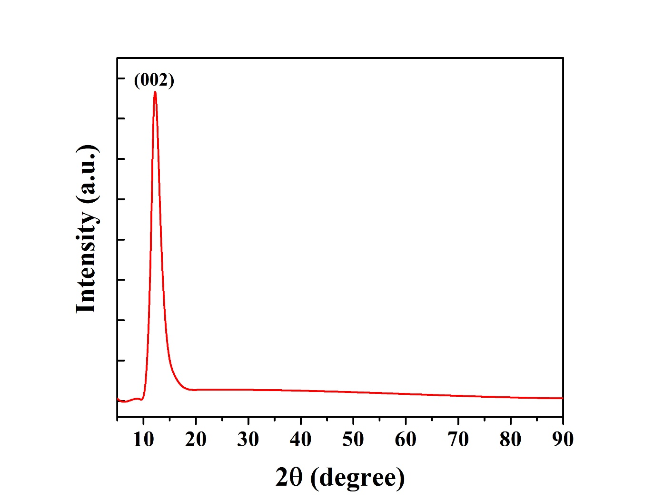
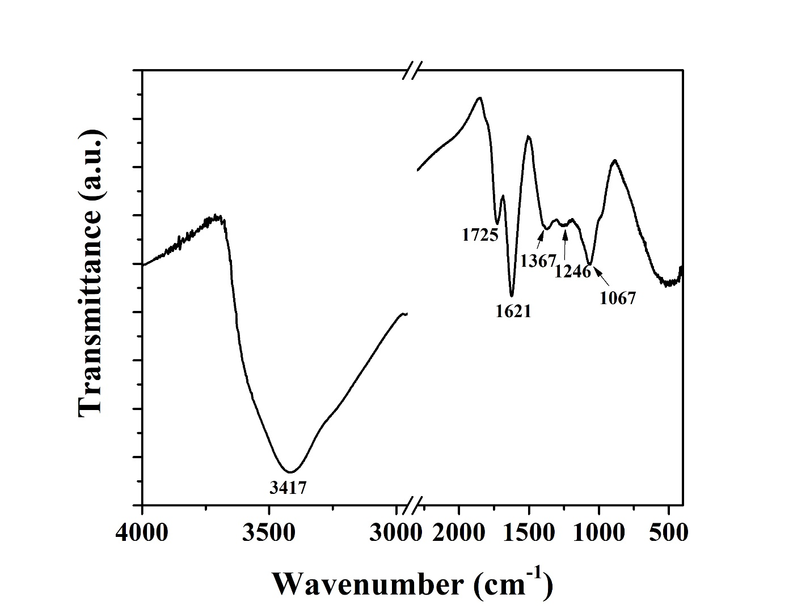
Graphene oxide
XRD diffractogram
FTIR analysis
Diffraction maximum at 12.3°
Oxidation increases the distance between two layers
С=О stretching vibration $\sim$ 1725 cm⁻¹
С=С и С=О stretching vibration $\sim$ 1621 cm⁻¹
С$−$О stretching vibration $\sim$ 1067 cm⁻¹

Slide 12
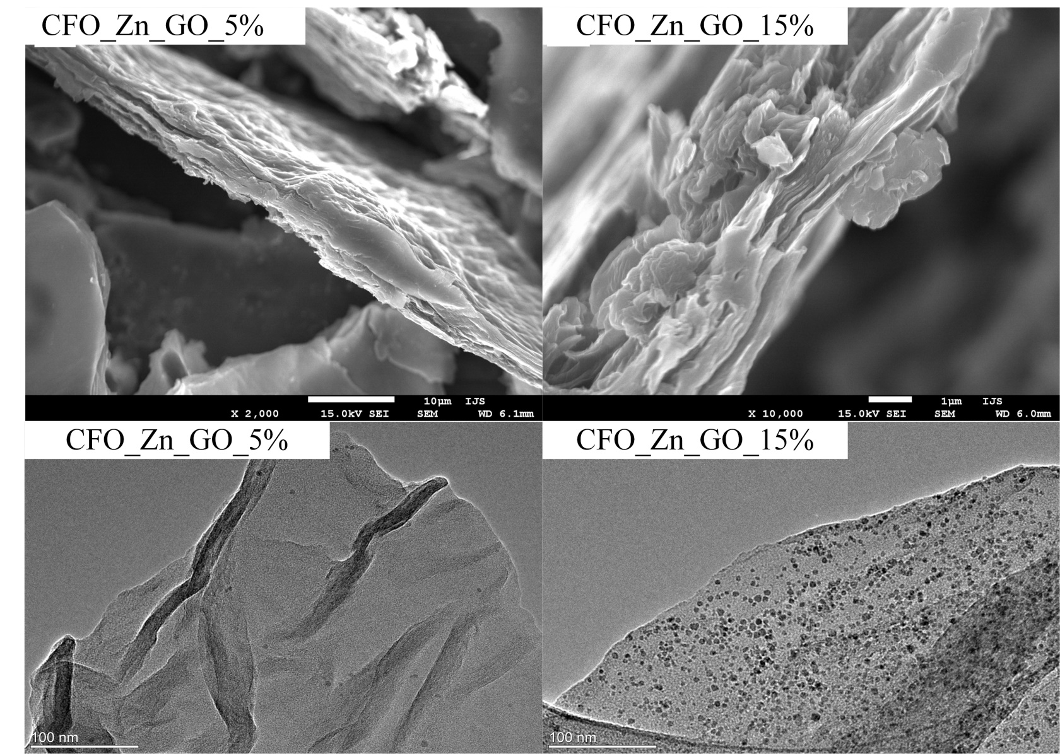
Composites
SEM
Agglomerated layers
There is no difference between compo-sites with different share of nanoparticles
ТЕМ
Large difference in distribution density
High dispersion of nanoparticles on the graphene oxide layer

Slide 13
Composites
FTIR analysis
The band at $\sim$1617 cm⁻¹ exhibit downshifts to lower wavenumber which is correlated to the presence of hydrogen bonding
The same characteristic vibrations as with graphene oxide

Slide 14
Cyclic voltammetry
Composites
Specific current (A/g)
Specific current (A/g)
Divalent cations (Co²⁺) act as active sites for charge adsorption
Trivalent iron ions (Fe³⁺) participate in Faraday reaction
Surface oxygen groups are responsible for the existence of pseudocapacity
A box-like shape is most noticable in the samples CFO_Ga_GO_5% и CFO_Ga_GO_15%
E vs. SCE (V)
E vs. SCE (V)
Specific current (A/g)
Specific current (A/g)
E vs. SCE (V)
E vs. SCE (V)
Specific current (A/g)
Specific current (A/g)
E vs. SCE (V)
E vs. SCE (V)

Slide 15
Cyclic voltammetry
Composites
The value of specific capacity is greatly influenced by the interaction between graphene oxide and spinel ferrite
Specific capacity (F/g)
Specific capacity (F/g)
Polarization rate (mV/s)
Polarization rate (mV/s)
The highest value of specific capacity is shown by the composite CFO_GO_15% of 36.86 F g⁻¹ at a polarization rate of 5 mV s⁻¹
Specific capacity (F/g)
Specific capacity (F/g)
Polarization rate (mV/s)
Polarization rate (mV/s)
Specific capacity (F/g)
Specific capacity (F/g)
Polarization rate (mV/s)
Polarization rate (mV/s)

Slide 16
Conclusion
TEM analysis of composites shows different distribution densities
The formation of a hydrogen bond between spinel nanoparticles and graphene oxide was confirmed by FTIR analysis
Co²⁺ contributes to the capacity of the electric double layer, while Fe³⁺ contributes to the pseudocapacity
The composite CFO_GO_15% has the highest value of specific capacity of 36.86 F g⁻¹ at a polarization rate of 5 mV s⁻¹

Slide 17
Acknowlegement
The present study was founded by the Ministry of Science, Education and Technological Development of the Republic of Serbia
The resuls are published in article:
ELECTROCHEMICAL PROPERTIES OF COMPOSITES OF GRAPHENE-OXIDE AND COBALT-FERRITE DOPED WITH ZINK AND GALLIUM
doi: 10.5937/tehnika2202155G

Slide 18
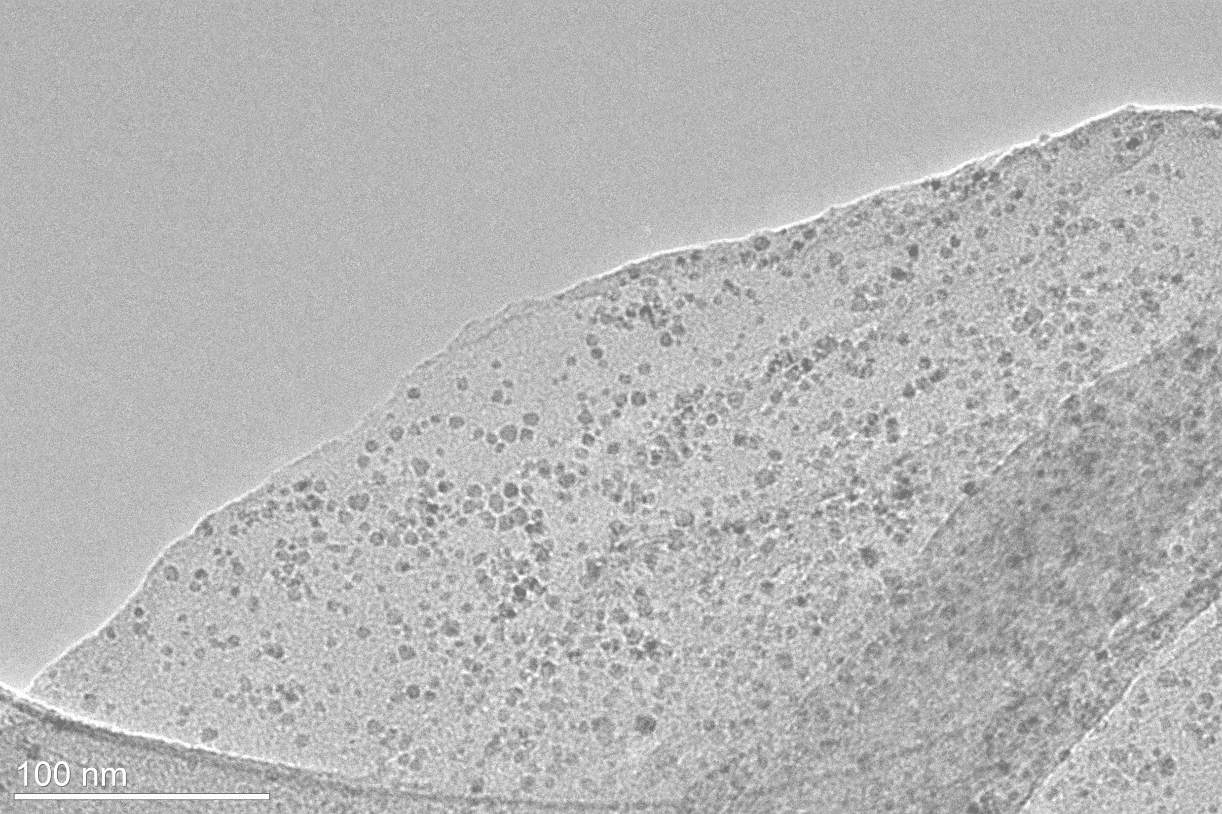
Thank you for your attention!

Slide 19
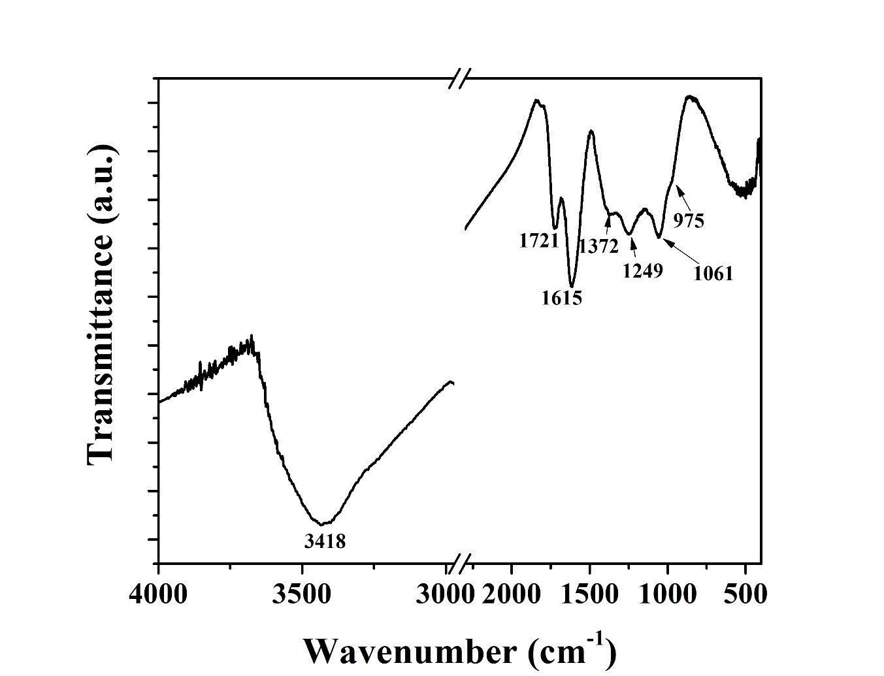
Hydrothermally treated graphene oxide
SEM
FTIR analysis
Agglomerated layers of graphene oxide
Partial reduction of С$−$О group

Slide 20
Cyclic voltammetry
Spinel ferrite nanoparticles
Divalent cations (Co²⁺) act as active sites for charge adsorption
Trivalent iron ions (Fe³⁺) participate in Faraday reactions
Specific capacities are 4.68; 5.78; and 3.75 F g⁻¹ for CFO_DHCA, CFO_Zn_DHCA and CFO_Ga_DHCA at a polarization rate of 5 mV s-1

Slide 21
Cyclic voltammetry
Graphene oxide
A box-like shape is observed
Surface oxygen groups are responsible for the existence of pseudocapacity
Specific capacity 9.17 F g⁻¹ at a polarization rate of 5 mV s⁻¹
Hydrothermally treated graphene oxide
A redox peak at 0.4 V contributes to pseudocapacity
Specific capacity 3,91 F g⁻¹ at a polarization rate of 5 mV s⁻¹

