Slide 1
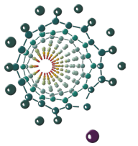
Oxygen moieties on GO and GO/WPA nanocomposites after thermal treatment and chemical titrations
Vinča Institute of Nuclear Sciences – National Institute of the Republic of Serbia, University of Belgrade
Faculty of Physical Chemistry, University of Belgrade
Milica Pejčić - Vinča Institute of Nuclear Sciences – National Institute of the Republic of Serbia, University of Belgrade – Laboratory of physics
The XXVI International Scientific Conference of Young Scientists and Specialists (AYSS-2022)

Slide 2
Outline
Introduction
Graphene oxide
Heteropoly acids
Aim
Synthesis and modifications of samples
Results
FTIR analysis
XPS analysis
TPD analysis
Titrations
Zeta potential
Adsorption of methylene-blue (MB)
Conclusion
The XXVI International Scientific Conference of Young Scientists and Specialists (AYSS-2022)

Slide 3
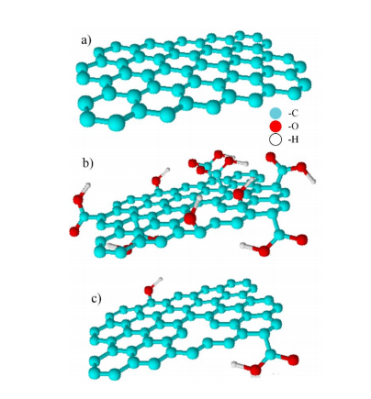
Graphene oxide (GO)
Graphene
Graphene oxide (GO)
Reduced GO (rGO)
Used in many applications:
supercapacitors
sensors
batteries
environmental protection
The XXVI International Scientific Conference of Young Scientists and Specialists (AYSS-2022)
Notes:
Graphene oxide is 2D material, which represents the oxidized form of graphene and as such has a large number of oxygen groups.
Reduced graphene oxide (rGO) represents treated graphene oxide (chemically, thermally, photochemically, etc.) where the oxygen content has been purposefully reduced.
GO is used in many applications like supercapacitors, sensors, batteries, environmental protection.

Slide 4
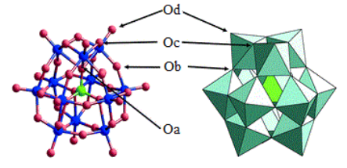
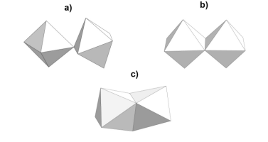
Heteropolyacids
Heteropolyacids belong to the group of polyoxometallates
The general formula is (X_{x}M_{m}O_{y})^{q-}, x<m
Basic building unit - octahedron
The most known structure is Keggin anion structure (H_{n}XM₁₂O₄₀)
They are easily synthesized, non-toxic and especially suitable for use as:
catalysts
supercapacitors
fuel cells
batteries
The XXVI International Scientific Conference of Young Scientists and Specialists (AYSS-2022)

Slide 5
Aim
Investigation of the nature of interactions between GO and WPA in aqueous suspensions.
The nature of the interaction was primarily observed from the aspect of surface chemistry of graphene oxide, which is based on the assumption that the interaction will be most pronounced on oxygen functional groups.
For this purpose, the experimental approach is based on chemical titrations, i.e. their possibility to detect differences in functional groups due to different reactivity of titrants.
The XXVI International Scientific Conference of Young Scientists and Specialists (AYSS-2022)

Slide 6
Synthesis and modification of samples
Nanocomposites of GO and WPA are synthesised, and weight percent of WPA is adjusted to be from 5 to 50 wt.% compared to GO.
Prepared composites were modified with:
titrations with NaOH, Na₂CO₃, NaHCO₃
thermal treatment
Surface chemistry of chemically modified samples was monitored using:
Fourier-transform infrared spectroscopy (FTIR)
X-ray photoelectron spectroscopy (XPS)
Temperature programmed desorption (TPD)
Chemical titrations (NaOH, Na₂CO₃, NaHCO₃)
Zeta-potential
Indication of interaction GO and WPA, in this work, is adsorption of methylene-blue (MB).
The XXVI International Scientific Conference of Young Scientists and Specialists (AYSS-2022)

Slide 7
Results
The XXVI International Scientific Conference of Young Scientists and Specialists (AYSS-2022)

Slide 8
FTIR analysis
Initial GO
GO/WPA 15%
GO/WPA 50%
Chemically treated – slightly shifted bands with lower intensity
Thermally treated – More visible changes
Initial – WPA bands
Chemically and thermally treated – WPA bands hardly visible, resembles initial GO
Chemically treated – lower intensity of WPA bands
Thermally treated – no structural changes of WPA
The XXVI International Scientific Conference of Young Scientists and Specialists (AYSS-2022)

Slide 9
XPS analysis
C 1s spectra of:
a) pure graphene oxide and
b) GO/WPA 15% composite,
c) GO titrated with Na₂CO₃ solution,
d) GO/WPA 15% titrated with Na₂CO₃
solution
The XXVI International Scientific Conference of Young Scientists and Specialists (AYSS-2022)

Slide 10
TPD analysis
a)
c)
e)
Initial GO
CO desorption of initial GO and GO/WPA 15% (a,b), titrated with NaOH solution (c, d) and thermaly treated (e,f).
b)
d)
f)
GO/WPA 15%
The XXVI International Scientific Conference of Young Scientists and Specialists (AYSS-2022)

Slide 11
Titration
NaOH: –COOR, Ar-OH i –COOH
Na₂CO₃:–COOR and –COOH
NaHCO₃:–COOH
Merging of peaks - the influence of a larger amount of WPA
The XXVI International Scientific Conference of Young Scientists and Specialists (AYSS-2022)

Slide 12
The amount of titrant required to reach the equivalent point in titration with solution
NaOH
Na₂CO₃
NaHCO₃
WPA titration is also affected by the amount of WPA - the amount of titrant required to reach the equivalence point.
A share of about 30% - the limit at which the shape of titration curve changes either due to pH-induced changes in WPA or due to an increase in the agglomeration of Keggin anions in the solution.
Comparing the amounts of titrants for the composites and for the sum of graphene oxide and WPA at the same proportions, similar values are observed.
The XXVI International Scientific Conference of Young Scientists and Specialists (AYSS-2022)

Slide 13
Zeta potential
NaOH
Na₂CO₃
NaHCO₃
Negative values of zeta potential - the presence of electronegative functional groups.
With increasing share WPA zeta potential is more negative.
When the pH value changes, deprotonation of groups occurs which results in the creation of more negative charge.
The negative charge can be attributed to the deprotonation of carboxylic and phenolic groups.
The XXVI International Scientific Conference of Young Scientists and Specialists (AYSS-2022)

Slide 14
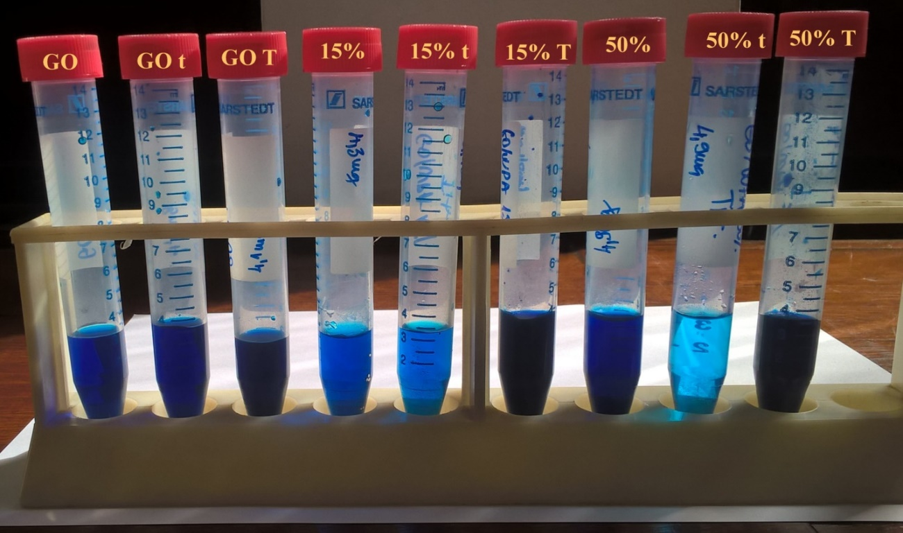
Adsorption of methylene-blue (MB)
Histogram of shown samples of adsorbed amounts of methylene-blue
The XXVI International Scientific Conference of Young Scientists and Specialists (AYSS-2022)

Slide 15
Conclusion
The chemical titrations revealed that the presence of WPA affects the ability of surface oxygen groups to transfer protons, which is manifested by widening and merging of the peaks in first derivative of titration curve. This behavior was observed in the case of composites with a higher WPA content (50 wt.%).
Adsorption of methylene blue has shown that in the case of pure graphene oxide, oxygen groups have a positive effect. In the case of composites, the presence of WPA is advantageous because the adsorption capacity is improved compared to the initial GO.
Also, it can be concluded that titration improves, while thermal treatment completely blocks the adsorption capacity of nanocomposite. This is an interesting observation and requires more detailed experimental analysis in the future.
The results of our study provide a new insight into the nature of the interaction of GO and WPA and that the selected methods have significant potential to contribute in the future to a better understanding of the interaction of this system in aqueous suspensions.
The XXVI International Scientific Conference of Young Scientists and Specialists (AYSS-2022)

Slide 16
Acknowledgement
Vinča Institute of Nuclear Sciences – National Institute of the Republic of Serbia, University of Belgrade
Faculty of Physical Chemistry, University of Belgrade
The present study was funded by the Ministry of Science, Education and Technological Development of the Republic of Serbia.
Željko Mravik, Marija Grujičić, Marko Jelić, Darija Petković, Sonja Jovanović, Zoran Jovanović
Thank you for your atention!
The XXVI International Scientific Conference of Young Scientists and Specialists (AYSS-2022)

